Slide 1
CTE Advisory Council
Strategic Planning Committee
April23, 2018
Day 1
Welcome!

Slide 2
Introductions
Dr. Mike Brown
Facilitator’s Role
Ask the right questions
Process your responses that create your strategic plan
Clarify and mediate when necessary
Challenge to be goal-oriented, think innovatively, work collaboratively, and always be mindful of who you serve
Other expectations for your facilitator?

Slide 3
Overview of the Day
Introductions
Creating Context for our Work
Norms and Expectations
Overview of the Work to Date
Vision, Mission, Values, and Stakeholders
Strategic Planning
SWOT Analysis
Brain Pop Activity
Measures for Success
Next Steps
Facilitator Feedback

Slide 4
Introductions
Name
Who do you represent?
Why are you here?
What does Career Ready Missourians mean to you?

Slide 5
Creating Context For Our Work
Quality Continuous Improvement Framework
Outcomes
Mission, Vision, Values that set our direction
Strategic Plan that guides your work
Goals, Champion, Objectives, Improvement Actions, Timelines, and Cost
Process for monitor, review, and revision

Slide 6
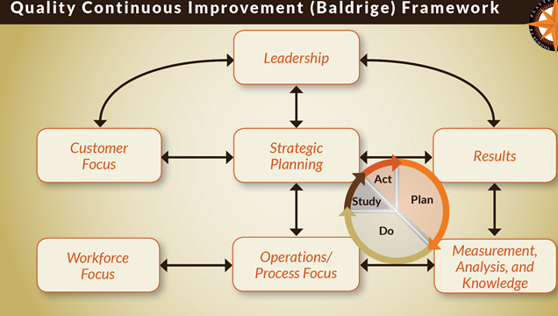

Slide 7
Norms and Expectations
Value our time
Be open to diverse thoughts and opinions
Be active and in the moment
Be ok with a “messy” process
Review, stakeholder feedback and communication 4/23-7/23
Others?

Slide 8
Overview of the CTE Advisory Council Work
Brian Noller – Chairman
Vision – Creating Career Ready Missourians
Four Strategic Focus Areas
Marketing
Business, Finance, and Partnership
Programming and Staffing
Student Achievement
Marketing Plan
Program Evaluation
Other information anyone wants to share that would be important…

Slide 9
Vision, Mission, Values, Stakeholders
Vision – Creating Career Ready Missourians
Mission
Why does Career and Technical Education exist?
Values
What does this council value in Career and Technical Education?
Stakeholders/Customers
Who cares that we exist?
Why do they care?

Slide 10
Strategic Planning
Definitions
Goals
Champion – RACI Model
Improvement Actions
Objectives – measures that support determining progress towards the goal
Timelines
Priorities
Budget Implications
Others?

Slide 11
Strategic Planning
Data Orientation
SWOT Analysis
Purpose of the Activity
Strategic Advantages
Strategic Disadvantages
Potential Blind Spots or Obstacles
Opportunities for Improvement (Possible Future Improvement Actions)

Slide 12
Strategic Planning
“Brain Pop” Activity
Purpose of the Activity
Definition of Innovation
Innovative and strategic improvement actions that would support progress in the four goal areas…

Slide 13
Measures for Success
How can we measure success in our four goal areas?

Slide 14
Next Steps
Facilitator will process and communicate our work
Council will review, seek stakeholder feedback, and communicate their personal feedback
Explore cost considerations to the possible improvement actions
Prioritize and create timelines for improvement actions
July 23rd Meeting
Review and begin to finalize our Strategic Plan
Identify any processes that need to be revised or developed in supporting improvement in our four goal areas

Slide 15
Facilitator Feedback
What did you find valuable about the facilitation?
What are some opportunities for improvement for the facilitator?

Slide 16
Day TWO:

