Slide 1
Curriculum and Assessment Updates
Chip Sharp
Office of College and Career Readiness
January 2019

Slide 2

Show-Me Success
The Department of Elementary and Secondary Education does not discriminate on the basis of race, color, religion, gender, gender identity, sexual orientation, national origin, age, veteran status, mental or physical disability, or any other basis prohibited by statute in its programs and activities. Inquiries related to department programs and to the location of services, activities, and facilities that are accessible by persons with disabilities may be directed to the Jefferson State Office Building, Director of Civil Rights Compliance and MOA Coordinator (Title VI/Title VII/Title IX/504/ADA/ADAAA/Age Act/GINA/USDA Title VI), 5th Floor, 205 Jefferson Street, P.O. Box 480, Jefferson City, MO 65102-0480; telephone number 573-526-4757 or TTY 800-735-2966; email civilrights@dese.mo.gov

Slide 3


Slide 4
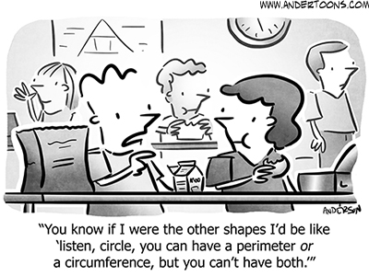
Math Humor?

Slide 5
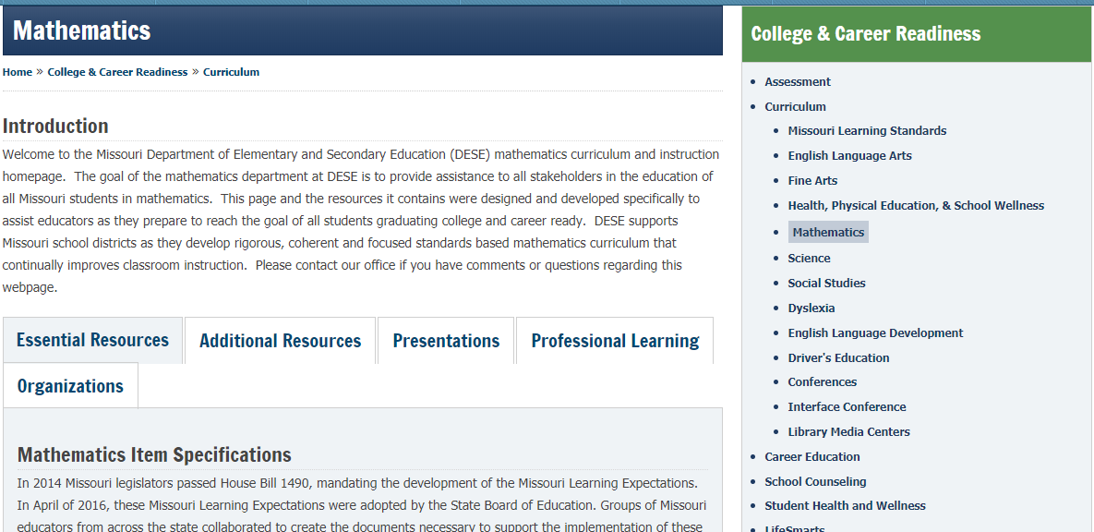
Updated Math Page

Slide 6
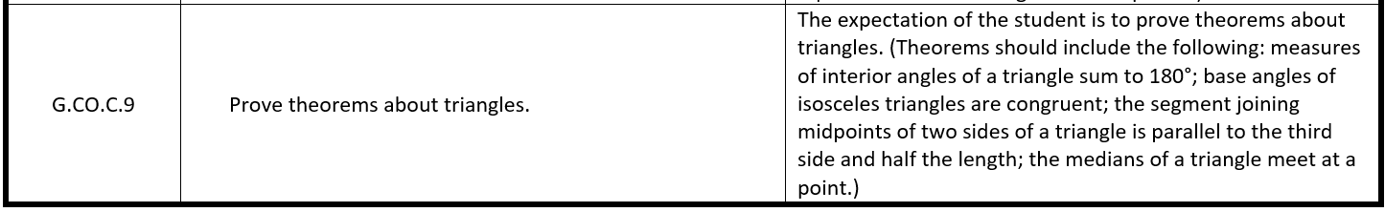
Expanded Expectations

Slide 7
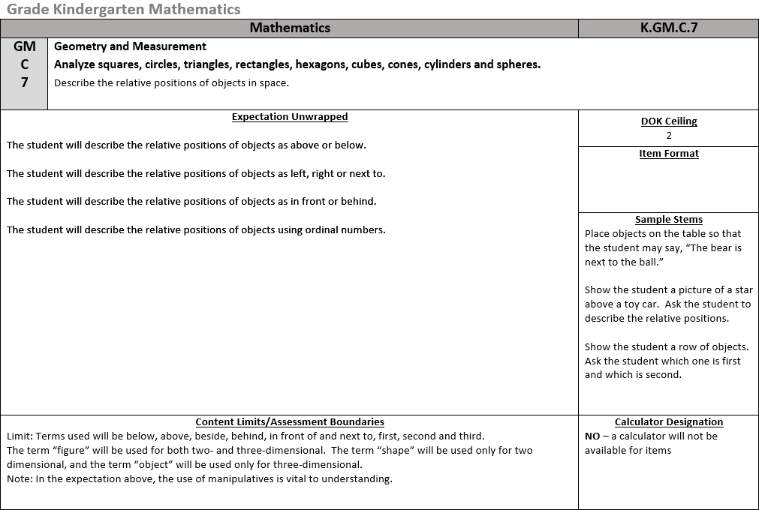
Item Specifications

Slide 8
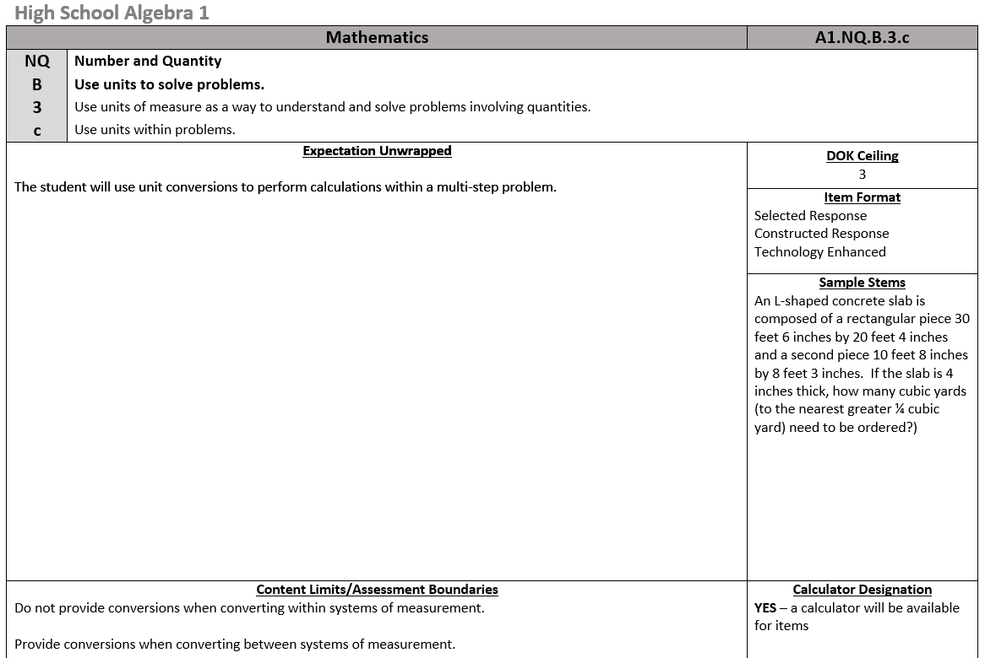
Item Specifications

Slide 9
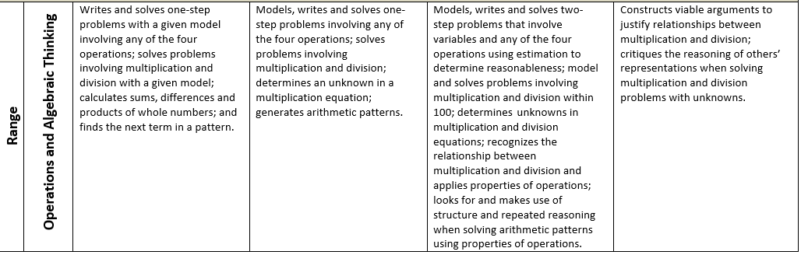
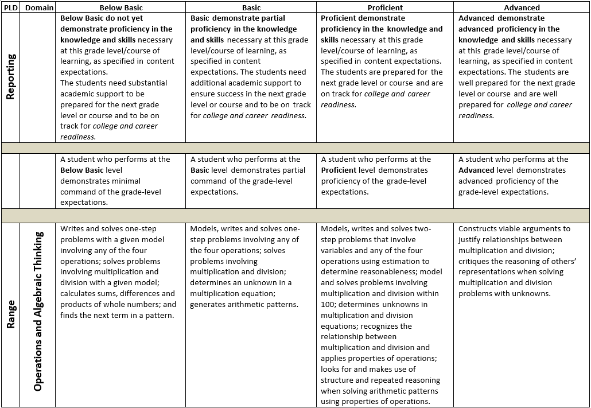
Performance Level Descriptors (PLDs)

Slide 10
Change in Performance Event
Shift in what is coming beginning next year (2019)
What will they look like and when will they be available?
Will this make the test harder?
NO!

Slide 11
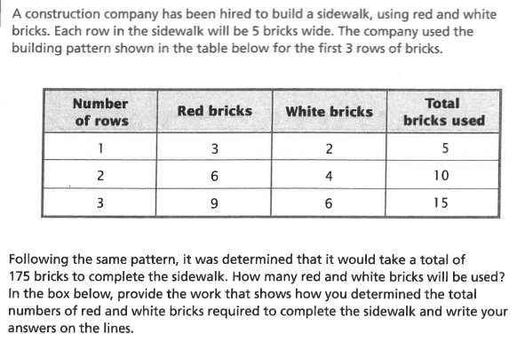
A problem to consider

Slide 12
One of My Favorite Quotes
We don’t have time for _____, we need to teach (cover) all of the standards before MAP test time.
Test prep, district pressure, federal requirements…
I wonder…

Slide 13
Maybe a better question
If you were going to focus on an area, what might you consider using to decide on areas of high importance?

Slide 14
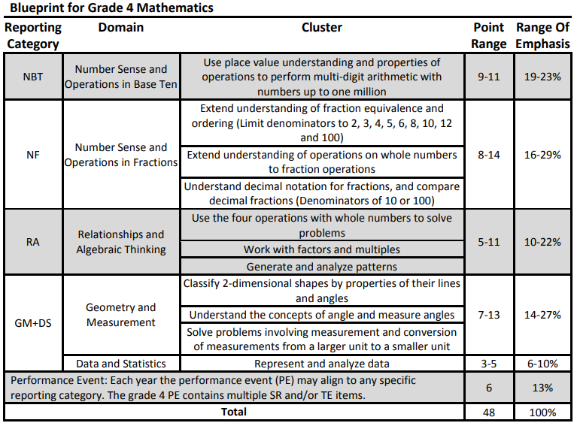
Blueprints

Slide 15
Ideas to consider
Notion of an item being “below basic”, “basic”, “proficient”, or “advanced” (caution with DOK)
Use of resources from DESE to inform practice

Slide 16
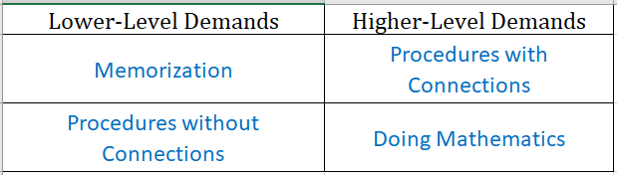
Levels of Cognitive Demand

Slide 17
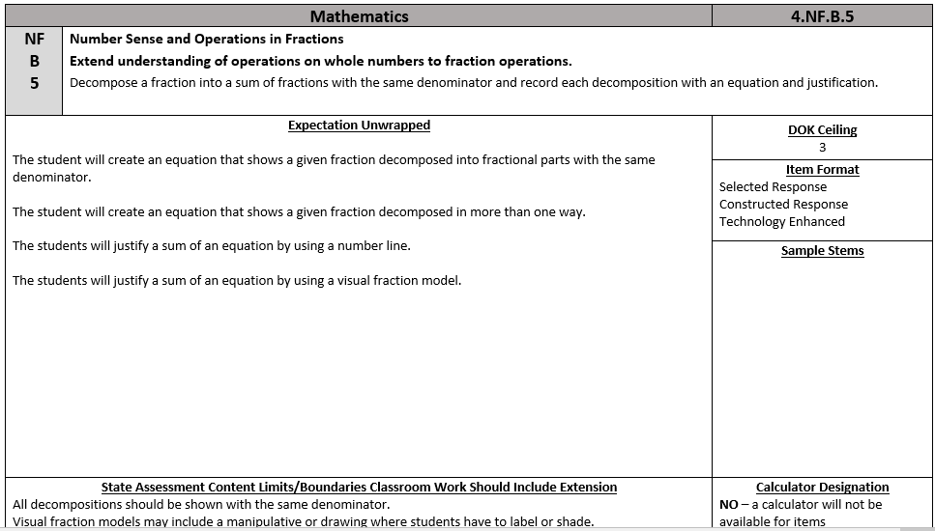
Activity - Item Specifications

Slide 18
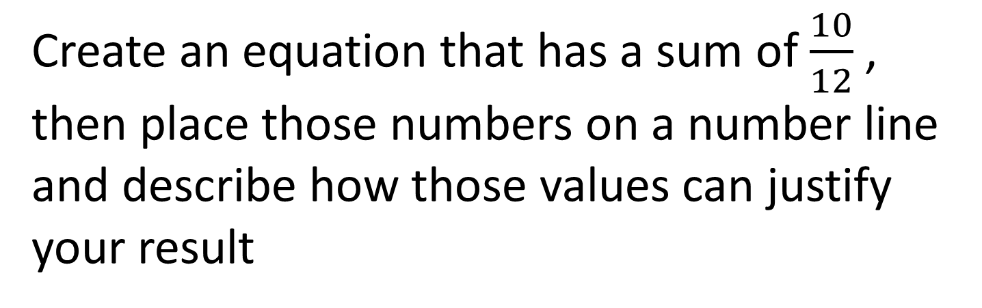
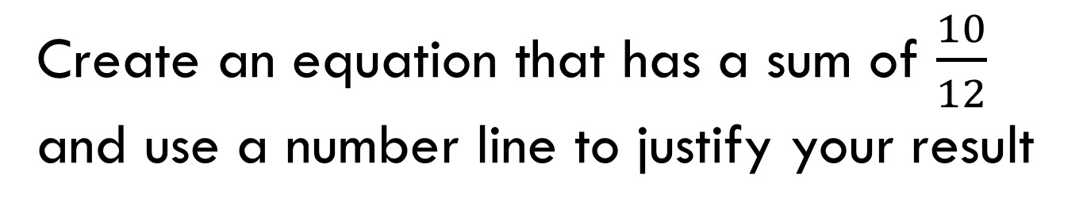
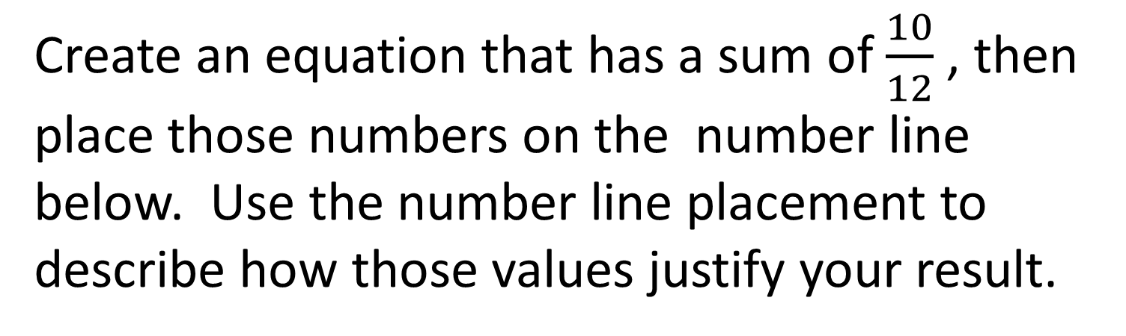
Activity - Item Specifications
Create an equation that has a sum of $\frac{10}{12}$ , then place those numbers on the number line below. Use the number line placement to describe how those values justify your result.
Create an equation that has a sum of $\frac{10}{12}$ , then place those numbers on a number line and describe how those values can justify your result
Create an equation that has a sum of $\frac{10}{12}$ and use a number line to justify your result
0
1

Slide 19
Performance Event – Coming Soon
Using the values below, for coefficients, constants, and variables, create systems of equations that would represent all possible ways that two linear equations can interact. Explain how each situation differs from the others and be sure to include the solution to each system.
Coefficients, constants, and variables (you do not need to use all of these values):
1, 2, 3, 4, 5, 6, 9, 10, 12, x, and y
8th EEI

Slide 20
Performance Event – Coming Soon
Given a rectangle with an area of 36 square feet, find its dimensions (length and width) so that you would have the smallest possible perimeter.
Explain how you know you have found the smallest perimeter.
4th Grade RA

Slide 21
Work Continuing to Happen
Item Writing both EOC and GL
CBR for both EOC and GL
Summer Professional Learning Series
Item Writing Project
chip.sharp@dese.mo.gov – for info and interest

Slide 22
Mathematics Assessments
Item Types for Math Assessments
  Selected Response
    Multiple Choice, Matching, Multi-Select
  Constructed Response
  Performance Event
  Technology Enhanced
    Drag and Drop, Matching, Graphing

Slide 23

Assessment Implementation Schedule
22
2016-17 2017-18 2018-19 2019-20
ELA & Math
English Language Arts & Mathematics
Science
Science Field Test
Science
Social Studies
Social Studies Field Test
Social Studies
Personal Finance
Personal Finance
Assessments Aligned to the Previous Expectations
Assessments Aligned to the New Expectations

Slide 24
Assessment Development
Item Writing (Winter 2018)
Rangefinding (Spring 2018)
Content and Bias Review (Summer 2018)
Field Testing (Spring 2019)
Operational (Spring 2018)
Achievement Level Setting (Summer 2018)
Reporting (Fall 2018) Grade 3 through Algebra 2
Item Writing, Content Bias Review and Rangefinding continue into 2018-2019

Slide 25
Building Mathematics Capacity
Promote Mathematics with your Students
Presidential Award for Excellence in Mathematics and Science Teaching (PAEMST)
Elementary Mathematics Specialist (EMS)
Interface
Regional Mathematics Groups
Missouri Council of Teachers of Mathematics (MCTM)
National Council of Teachers of Mathematics (NCTM)
  St Louis Annual Oct 21-24, 2020

Slide 26
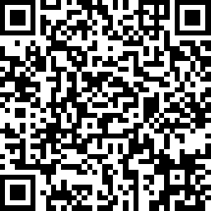
Workshop/Presentation Evaluation
https://www.surveymonkey.com/r/J33C969
Curriculum and Assessment Sections: FY19

Slide 27
Questions?
Chip Sharp
chip.sharp@dese.mo.gov
573-751-1395

Slide 28

Curriculum and Assessment Updates
Chip Sharp
chip.sharp@dese.mo.gov
573-751-1395
Missouri Department of Elementary
and Secondary Education
January 2019

Slide 29
OCR Non-Discrimination Statement
The Department of Elementary and Secondary Education does not discriminate on the basis of race, color, religion, gender, national origin, age, or disability in its programs and activities. Inquiries related to Department programs and to the location of services, activities, and facilities that are accessible by persons with disabilities may be directed to the Jefferson State Office Building, Office of the General Counsel, Coordinator – Civil Rights Compliance (Title VI/Title IX/504/ADA/Age Act), 6th Floor, 205 Jefferson Street, P.O. Box 480, Jefferson City, MO 65102-0480; telephone number 573-526-4757 or TTY 800-735-2966; fax number 573-522-4883; email civilrights@dese.mo.gov.

Slide 30
Lessons Learned during Summer
Number of Questions on the Summative Test
    Highlight number of points not number of questions (not the same)
Item Types to highlight
    Tech Enhanced

Slide 31
Lessons Learned during Summer
Standard Setting Process (Standard)
  Share Historical Issues and Concerns
  Describe the Process used
  Setting Cut Scores “How much is just enough?”
Basic
Proficient

Slide 32
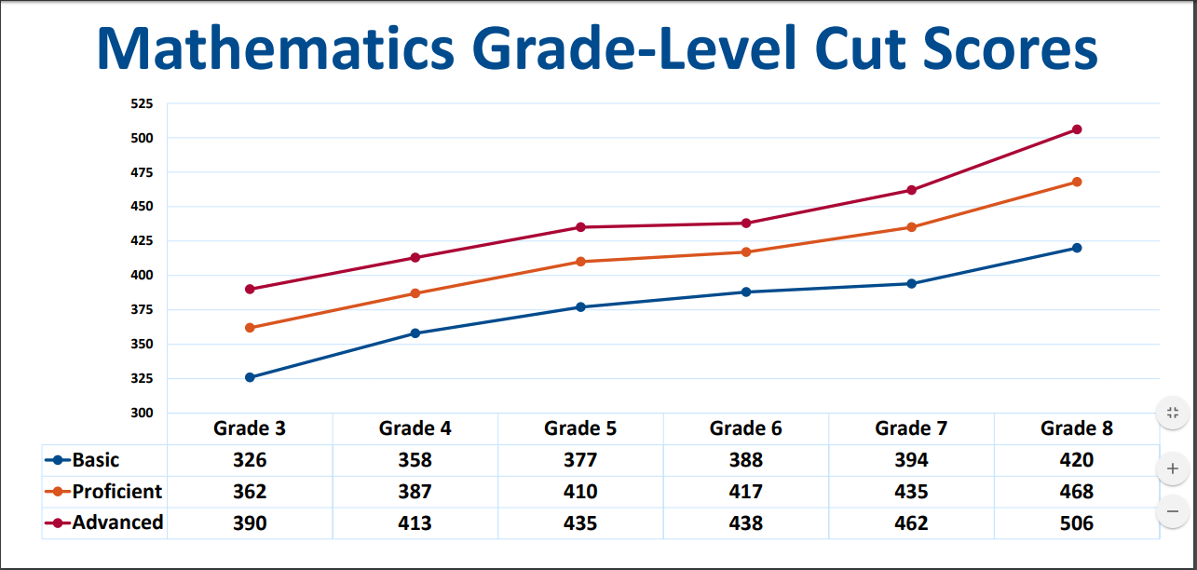
Cut Scores for Grade Level
These are the cut scores to be used until we redo the MLS per Legislature

Slide 33
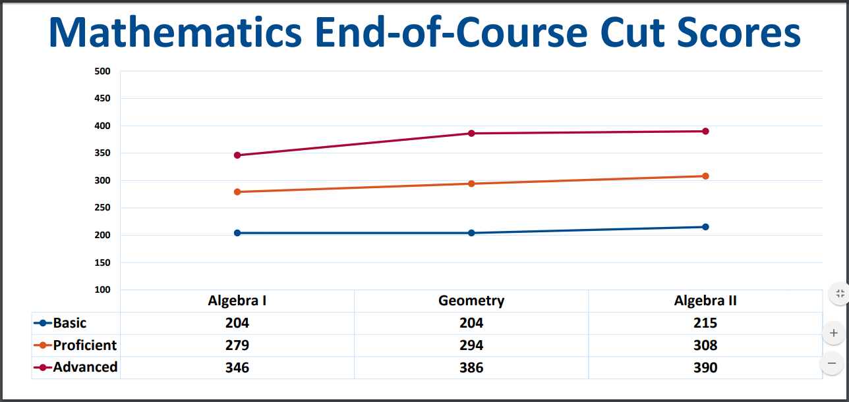
Cut Scores for End Of Course
These are the cut scores to be used until we redo the MLS per Legislature

Slide 34
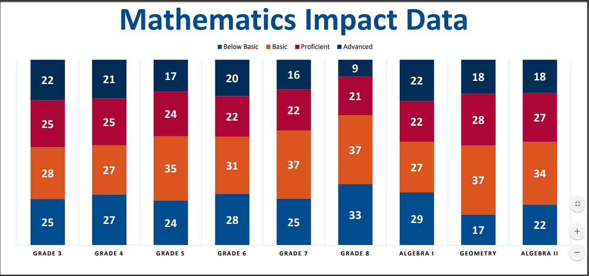
Impact Data of Cut Scores - 2018
These are the cut scores to be used until we redo the MLS per Legislature

Slide 35
Practice Form for Spring 2018

