Slide 1
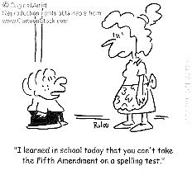
Social Studies Expectations: Challenges and Opportunities Dixie Grupe, Director, Social Studies
I “I learned today that you cannot take the Fifth Amendment on a spelling test.”

Slide 2
Social Studies DESE PAGE dese.mo.gov/college-career-readiness/curriculum/social-studies

Slide 3
Elementary teacher-friendly layout and resources

Slide 6
Significant Changes and Refinements in Elementary Social Studies Expectations
Grade-level first coding
Thinking like a social scientist
Organized around questions
Deeper illustrative examples
K: Self, Family and School
1: School and Community
2: Regions
3: Missouri Past and Present
4: Our Nation (c. 1799)
5: Our Nation (c.1800-2000)

Slide 7
Secondary Social Studies teacher-friendly layout

Slide 9
Significant Changes and Refinements in Secondary Social Studies Expectations
Organized by course, not grade level
Emphasis on social science thinking, not detail
Focus on themes within time periods
Strands are consistent across courses
Greater freedom and more responsibility

Slide 10
Professional Development Opportunities dese.mo.gov/sites/default/files/curr-prof-dev-professional-learning-series-workshops-2016.pdf

Slide 11
Hey, what do you think these New Expectations will mean?
180 new opportunities!

Slide 12
My background is all about ELA and Social Studies
Undergraduate degree in Journalism
Writing in the Content Area
31 years social studies teacher> 25 of those years working in an interdisciplinary, content- integrated classroom
Confession!

Slide 13
My POV
In great social studies lessons, there are five essential elements:
Meaningful content
Reading
Writing
Speaking
Listening

Slide 14
Teaching Historical Thinking Skills: Point of View
Analyzing Evidence: Content and Sources
A historical analysis of sources focuses on the interplay between content of a source and the authorship, point of view, purpose, audience and format of that sources, assessing the usefulness, reliability and limitations of the source as historical evidence.
Using a world history lens, describe how people’s perspectives shape the sources/artifacts they created.
Using a United States historical lens, describe how people’s perspectives shape the sources/artifacts they created.
Using a geographic lens, describe how people’s perspectives shape the sources/artifacts they created.
Using a governmental lens, describe how people’s perspectives shape the sources/artifacts they created.
…analyze point of view by citing relevant and thorough textual evidence to support analysis of what text says
Evaluate how an author’s work reflects his or her historical/cultural perspective.
Analyze a case in which recognizing point of view requires distinguishing what is directly stated in a text, to what is implied.
Analyze a text in which the author’s point of view is not obvious and requires distinguishing what is directly stated from what is implied.
Analyze how multiple texts reflect historical and cultural contexts.

Slide 15
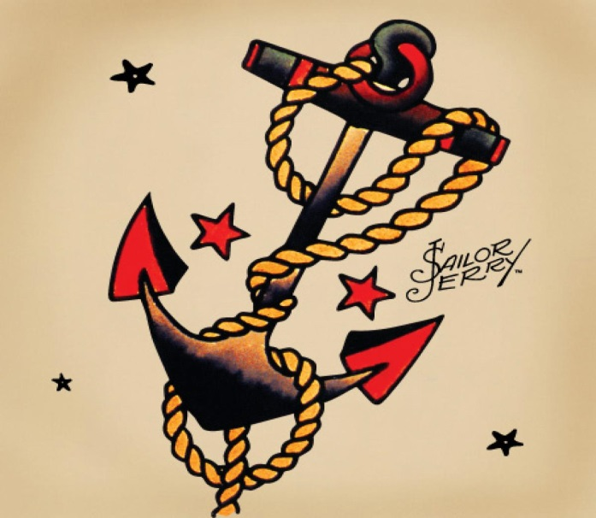
Use an anchor experience to teach an enduring idea or skill
What learning experiences can I create to anchor the learning that is to come?
Memorable
Relevant
Applicable
Will this experience serve as a shorthand or touchstone?

Slide 16
Using an anchor experience to teach POV
The Big Game:
What really happened ?

Slide 17
“Americanizing” the First Americans

Slide 18
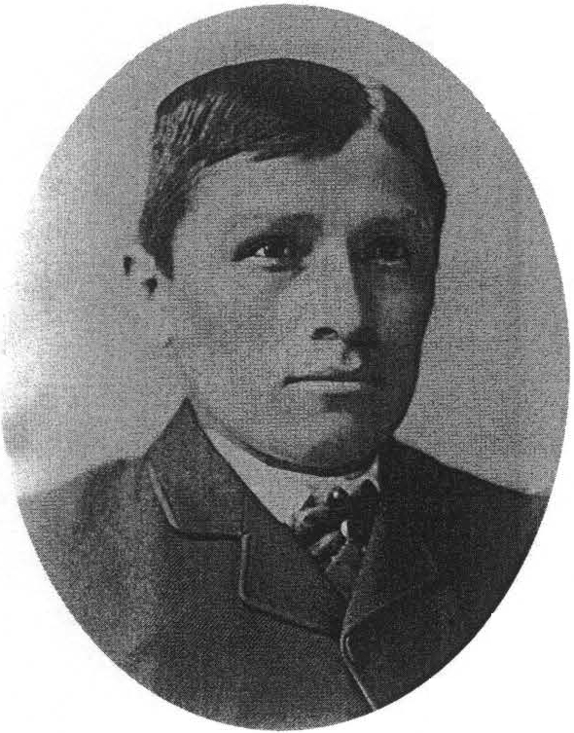
What we know about these images:
These are two images of the same young man. One was taken in 1882 and the second was taken in 1885.
We do not know his name in 1882. In 1885, he was named Tom Torlino.
He was a Navajo who attended Carlisle Indian School from 1882 to 1885.
He graduated from the school with a second grade education.

Slide 19
Working by yourself,
Describe the images from the perspective listed on your paper. This paragraph description should be thorough and reflective of your position. Without telling us “who” you are, we should be able to figure it out from your paragraph.
After you have written your description, write a point of view statement for that person/position.

Slide 20
Description:
When they took my picture in 1882, inside I was angry and sad, but I did not want to show those feelings. Instead, I tried to appear strong and proud, because I was strong and proud of myself and my family and my people, the Navajo. When they took my picture in 1885, while they had forced me to change my clothes and they had cut my hair and they told me to smile like a white man, I still wanted to show that I was proud. They thought I was proud because I had “become civilized.” Actually, I was proud because I had survived as a Navajo in my heart. They had not defeated me. Nothing that happened in that prison or anywhere else could ever cause me to lose that pride in my family and my people.
POV statement:
As a graduate of a tribal school in the late 19th century, this man had learned to resist the pressures of the white authorities by appearing to be “civilized” in his appearance, while retaining his Navajo identity in his heart. Because of this anger, he may have not recognized the adaptations that inevitably occur when one is forced to change one’s way of life against one’s will, like the barely visible forced smile on his lips. In both these pictures however, his steely eyes remain unchanged. His face clearly reflect this man’s determination and grit in 1882 and still in 1885. His time at Carlisle school did not alter that personal attribute: pride

Slide 22
POV Paragraph people
A Navaho childhood friend of this man who remained on the Navaho Reservation rather than being taken away to school.
This man’s son upon his father’s death in 1911.
A classmate of this man at a school reunion in 1900.
This man’s first white, missionary teacher at Carlisle school.
A Navaho tribal leader in 2017.
This man’s mother: her son was forcibly taken from his home in Arizona to attend Carlisle school in Pennsylvania in 1882.
This man’s eight year old sister, upon his return home in 1885. Her brother was forcibly taken from his home in Arizona to attend Carlisle school in 1882.

Slide 23
For discussion in your small groups:
Why do we have so many different interpretations of the same two photographs?
What specific reasons can you cite for the often-conflicting interpretations?
As a historian, what bigger meaning about research do you find in these images and their interpretations?
How do the ideas from our discussion apply to Americans today?

Slide 24
As you continue your curriculum work consider how together Social Studies and ELA
provide a deeper, richer context for student learning.
make learning more enduring and scalable.
allow students to see themselves in the curriculum.
promote an understanding of our shared human experience.

Slide 25
Please:
Contact me with questions or ideas any time: Dixie.Grupe@dese.mo.gov
Share the information from today with your peers.
Check the Social Studies DESE page for information and opportunities.
The Department of Elementary and Secondary Education does not discriminate on the basis of race, color, religion, gender, gender identity, sexual orientation, national origin, age, veteran status, mental or physical disability, or any other basis prohibited by statute in its programs and activities. Inquiries related to department programs and to the location of services, activities, and facilities that are accessible by persons with disabilities may be directed to the Jefferson State Office Building, Director of Civil Rights Compliance and MOA Coordinator (Title VI/Title VII/Title IX/504/ADA/ADAAA/Age Act/GINA/USDA Title VI), 5th Floor, 205 Jefferson Street, P.O. Box 480, Jefferson City, MO 65102-0480; telephone number 573-526-4757 or TTY 800-735-2966; email civilrights@dese.mo.gov

