Slide 1
Implementation and Integration: MLS Secondary Social Studies Expectations 2017 June 2017
Teaching and learning together:
deeper, richer, more meaningful, and maybe even fun.

Slide 2
Agenda June 2017
Welcome and DESE updates
Habits of Mind: Mutual and Distinct
Ideas, Resources and Ruminations
Lunch
Can a picture really be worth
a thousand words?
Wrap-up and future plans

Slide 3
Ice Breaker
Choose a historical person or literary figure from the envelope
Form a circle of chairs with ten people
I will ask you a series of Questions. If your character can answer yes, move one seat to the left. If your individual cannot answer yes, stay where you are. First person/ character who can answer yes and defend those answers in each group wins.

Slide 4
DESE Updates for Social Studies https://dese.mo.gov/college-career-readiness/curriculum/social-studies
Missouri Civics Initiative
Personal Finance update
EOC: 2017-2018 ….. 2018-2019
NEW EOC: 2019-2020
Progress on Social Studies assessment development for 2019-2020:
Blueprints
Performance Level Descriptors
Item Specs: They are UP! (bottom of the Assessment page)

Slide 5
K-12 Social Studies ELA, Math Science too ☺!

Slide 6
Assessment Development
Prior to Initial Operational Administration
Missouri educators participate:
Write performance level descriptors
Create test frameworks
Design test blueprints
Conduct alignment studies
Write test items
Conduct content and sensitivity reviews
Conduct field tests
It takes a village…a dedicated group of Missouri Social Studies Educators

Slide 7
Practice and Processes (PP) identify the ways students demonstrate knowledge through inquiry, research, experimentation and synthesis, when using modes of flexible thinking and by exploring multiple perspectives. (Note: working to have each test item linked to a PP)
PP1: Gather, analyze and/or apply information
Ask questions and/or define problems
Analyze the cause and consequences
Develop compelling questions
Obtain, synthesize, and report findings clearly and effectively in response to task and purpose
Create and use tools to analyze, communicate information and ideas
Understanding and supporting fact, opinion, bias and point of view in sources
Use technology & digital media strategically & capably
Build strong bases of knowledge through content rich texts
Come to understand other perspectives and cultures through reading, listening, and collaboration
Analyze the conditions that affect stability and change
PP2: Communicate effectively
Construct viable arguments and critique reasoning of others
Read, write and speak grounded in evidence
Exhibit independence in reading complex texts, and writing and speaking about them
Construct explanations & design solutions
Obtain, evaluate & communicate information
Create and use tools to analyze, communicate information and ideas
Explain and evaluate connections
Develop, identify, conduct and present research with appropriate resources
PP3: Recognize and solve problems
Analyze & interpret data
Model with mathematics
Analyze information in relationship to scale, proportion and quantity
Reason abstractly & quantitatively
Look for & make use of structure and function
Explain and evaluate patterns about relationships and causes underlying them
Use models to understand and predict behavior of systems
Track energy and matter in and out of and within systems
DRAFT

Slide 8
What does this image suggest to you about thinking, teaching, and learning Social Studies in our secondary Social Studies classrooms?

Slide 9
Content
Curriculum you develop based on the Missouri Learning Standard Expectations for Social Studies.
Teacher View of Expectations

Slide 10
Student Learning Behaviors

Slide 11
Elementary and beginning Middle School Social Science Thinking Skills

Slide 12
High School Social Science Thinking Skills

Slide 13
Content: What
Student Learning Behavior: Do
Social Science Thinking Skill: qualities of systematic reasoning
Habits of Mind:
The attributes sucessful people rely on when faced with new problems, difficult dilemmas and perplexing enigmas.

Slide 14
Habits of Mind
“These ―habits of mind,‖ or intellectual dispositions, do more than help students solve academic problems in school. In fact, they can arm students to face a wide variety of ethical, moral, and spiritual challenges throughout their lives. They encourage students to become active and inquisitive in the face of challenges, rather than passive and accepting.”
Boyes & Watts, 2009

Slide 15
Habits of Mind in Writing

Slide 16
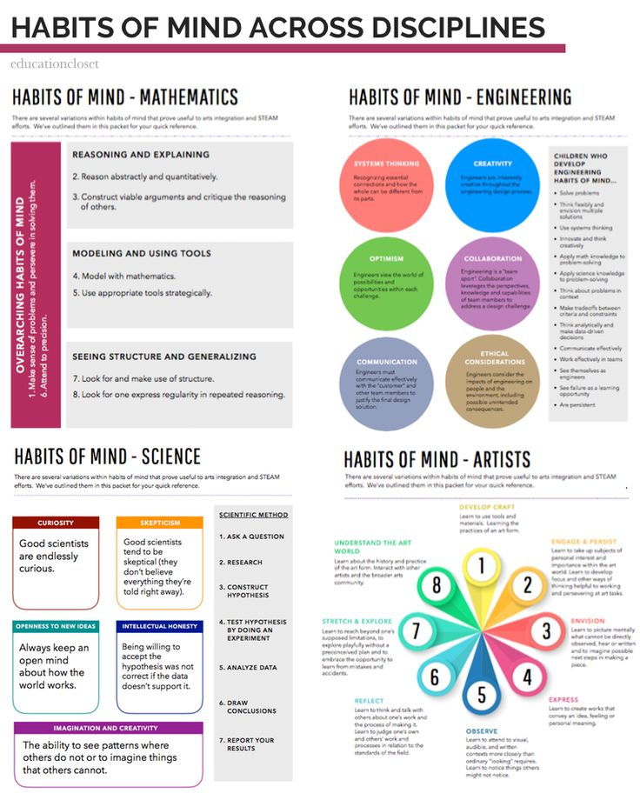

Slide 17
Ideas, Resources and Ruminations

Slide 18
Thinking through Metaphor
http://www.msn.com/en-us/video/other/youtuber-creates-musical-metaphor-to-explain-fact-interpretation/vp-AAmhfAs
What does this clip say about interdisciplinary teaching and learning?

Slide 19
Consider this idea as you plan your interdisciplinary instruction….
In any great lesson, there are SIX essential elements:
Meaningful content
Reading
Writing
Speaking
Listening
Thinking skill

Slide 20
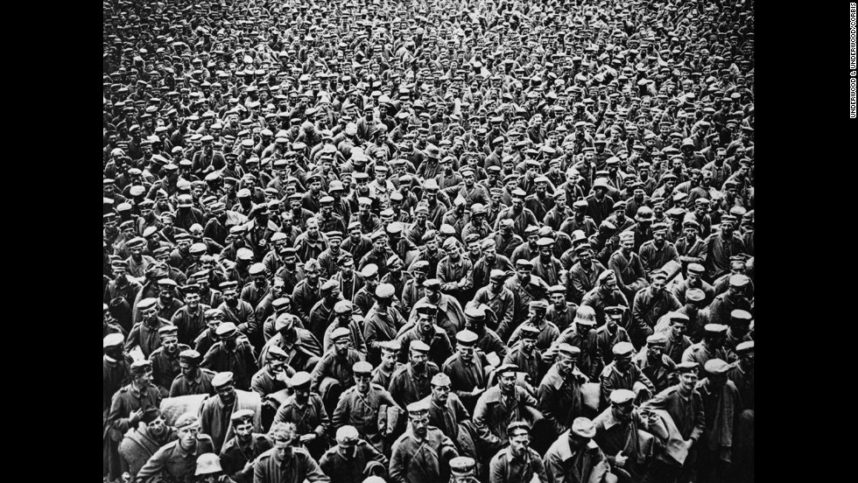
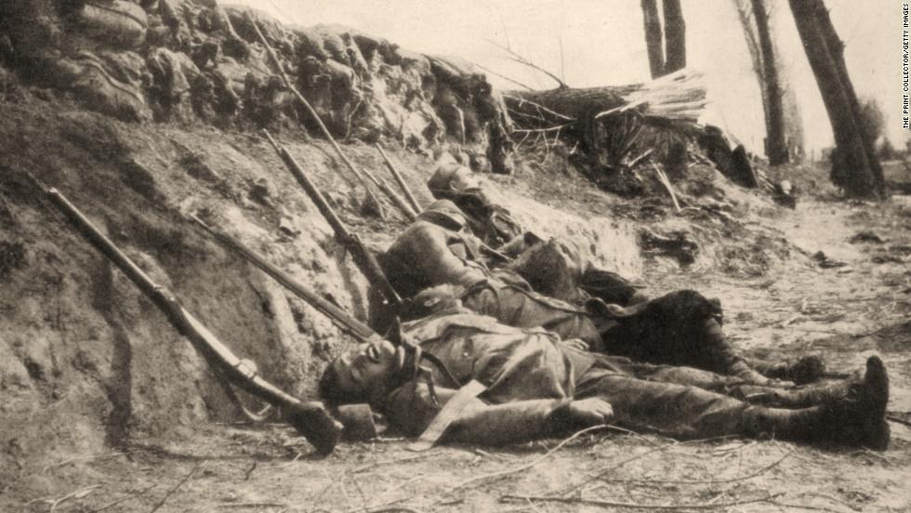
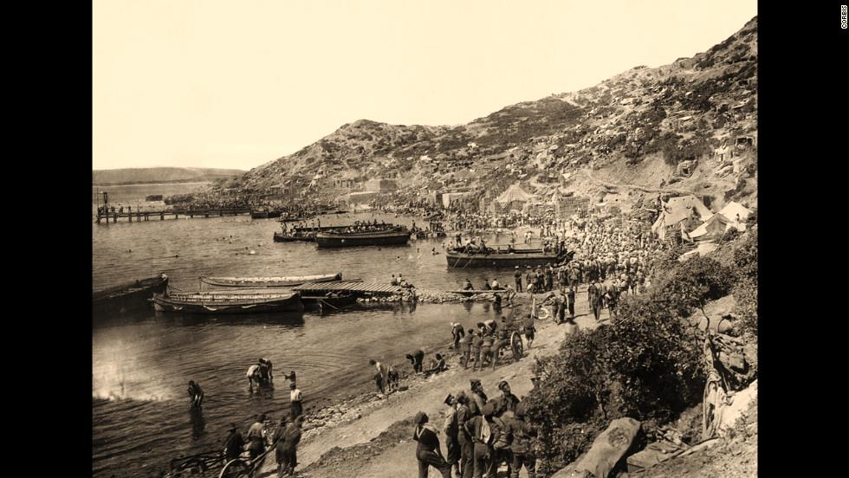
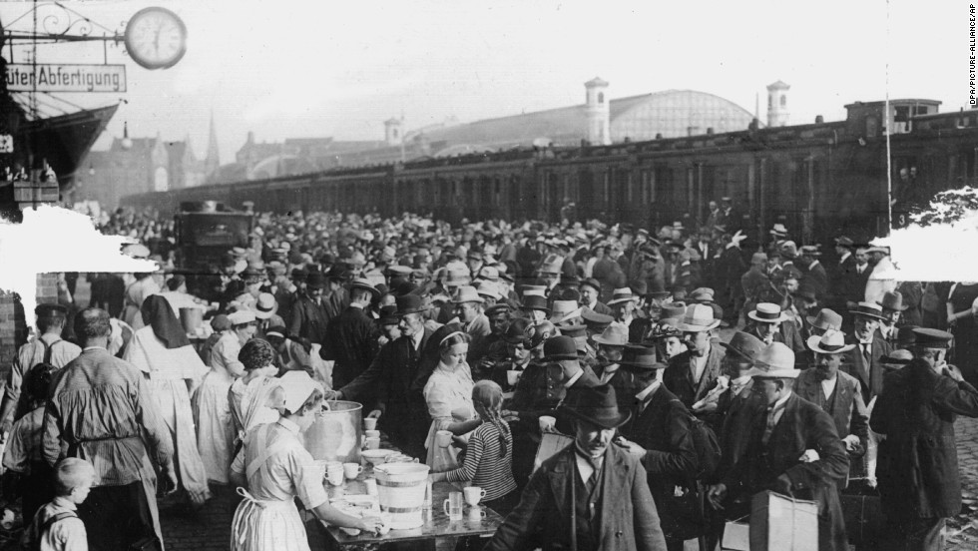
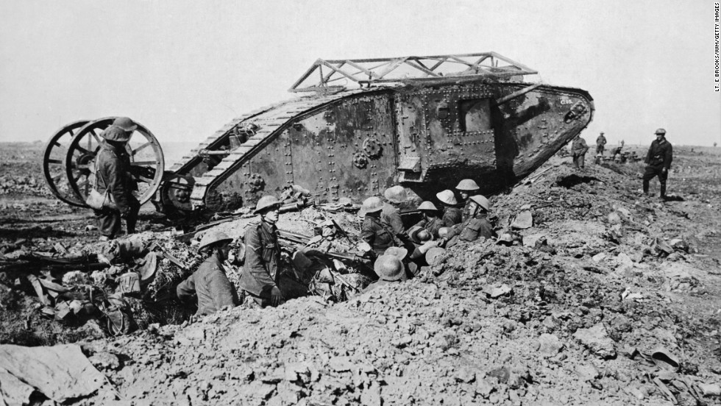
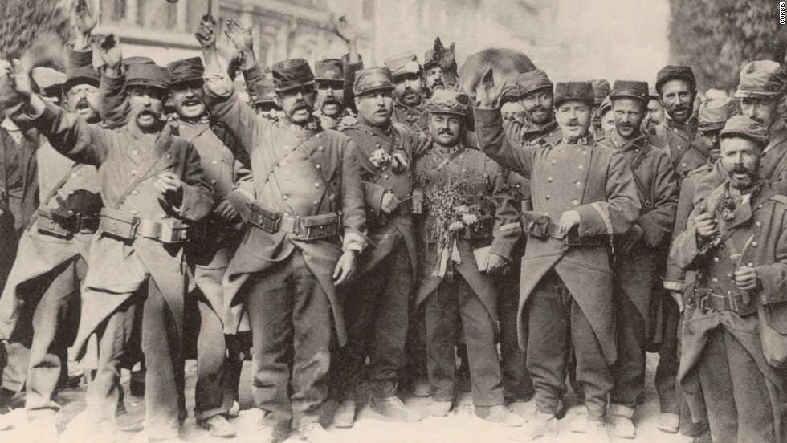
World War I : Dreams and Nightmares
https://www.youtube.com/watch?v=_pFCpKtwCkI

Slide 21
Congruent Social Studies/ELA Standards
Social Studies
ELA
Trace the origins and relationships among the world wars, revolutions, and global conflicts of the 20th century to determine their impacts on the world today. (9-12 WH.4.CC.C)
Describe and evaluate the motivations for United States entry into World War I.
(9-12.AH.C.CC.B)
Describe and evaluate the impact of US participation in World War I and resulting peace efforts.
(9-12.AH.C.CC.B)
Evaluate how effectively two or more texts develop similar ideas/topics (9-10.RI.3.B)
Synthesize information from two or more texts about similar ideas/topics to articulate the complexity of the issue. (11-12.RI.3.B)
Analyze how multiple texts reflect the historical and/or cultural contexts. (9-10.R.I.3.C)

Slide 22
WWI: Dreams and Nightmares
Objective: Describe and analyze how ideas about WWI changed during the era 1914-1919.
Students will trace changing ideas about WWI through poetry.
SSTS: Chronological Reasoning: Continuity and Change and Periodization
HOM: Analysis and Perspective
Interdisciplinary Connections: ELA and Visual Arts

Slide 23
1914
Rejoice
By Bruno Frank, 1914 Rejoice, friends! that we are alive And that we're young and vigorous. Never has there been a year like this, And never has youth been so blessed For we can stand and we can march Where the morning dawns and the evening sinks. The greatest of all epochs Puts its mark upon our young hearts. And no matter what may befall any one of us He shall have seen this proud year.

Slide 24
Directions: You will need to keep a few notes of your discussion to be able to share with the large group. Use the margins of your paper to record your thoughts
1. Read your poem once silently to yourself.
2. Underline the parts of the poem that “speak” to you.
3. Read your poem aloud to your partner.
4. Compare underlined elements with your partner: which ones were the same and which ones were different?
5. Read back through your poem together and circle those places where you find imagery used to communicate.
6. How would you describe the mood of your poem? Are there places where the mood shifts? Discuss with your partner and mark the places in the poem you agree on.
7. Now, look at the picture next to your poem; how does it reflect and/ or contrast with the your ideas from reading the poem? Discuss with your partner.
8. Discuss with the people at your table: How does your poem support or refute what you already know about WWI?
9. Be ready to share

Slide 25
1914
The Soldier
Rupert Brooke
If I should die, think only this of me:
That there's some corner of a foreign field
that is forever England. There shall be
in that rich earth a richer dust concealed;
a dust whom England bore, shaped, made aware,
gave, once, her flowers to love, her ways to roam,
a body of England's, breathing English air,
washed by the rivers, blest by suns of home.
And think, this heart, all evil shed away,
a pulse in the eternal mind, no less
gives somewhere back the thoughts by England given;
her sights and sounds; dreams happy as her day;
and laughter, learnt of friends; and gentleness,
in hearts at peace, under an English heaven.
1914

Slide 26
1915
In Flanders Fields
by John McCrae 1915
In Flanders fields the poppies blow
Between the crosses, row on row,
That mark our place; and in the sky
The larks, still bravely singing, fly
Scarce heard amid the guns below.
We are the Dead. Short days ago
We lived, felt dawn, saw sunset glow,
Loved and were loved, and now we lie,
In Flanders fields.
Take up our quarrel with the foe:
To you from failing hands we throw
The torch; be yours to hold it high.
If ye break faith with us who die
We shall not sleep, though poppies grow
In Flanders fields.

Slide 27
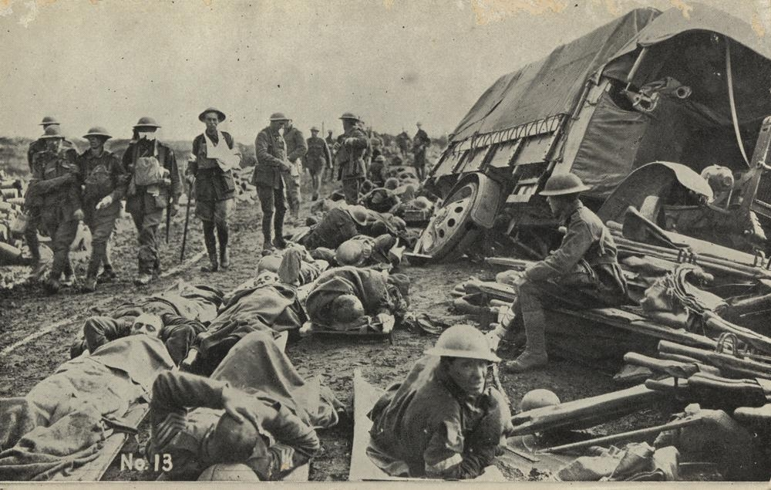
1916
The Death Bed
BY SIEGFRIED SASSOON
He drowsed and was aware of silence heaped
Round him, unshaken as the steadfast walls;
Aqueous like floating rays of amber light,
Soaring and quivering in the wings of sleep.
Silence and safety; and his mortal shore
Lipped by the inward, moonless waves of death.
Someone was holding water to his mouth.
He swallowed, unresisting; moaned and dropped
Through crimson gloom to darkness; and forgot
The opiate throb and ache that was his wound.
Water—calm, sliding green above the weir;
Water—a sky-lit alley for his boat,
Bird-voiced, and bordered with reflected flowers
And shaken hues of summer: drifting down,
He dipped contented oars, and sighed, and slept.
Night, with a gust of wind, was in the ward,
Blowing the curtain to a gummering curve.
Night. He was blind; he could not see the stars
Glinting among the wraiths of wandering cloud;
Queer blots of colour, purple, scarlet, green,
Flickered and faded in his drowning eyes.
Rain—he could hear it rustling through the dark;
Fragrance and passionless music woven as one;
Warm rain on drooping roses; pattering showers
That soak the woods; not the harsh rain that sweeps
Behind the thunder, but a trickling peace,
Gently and slowly washing life away.
He stirred, shifting his body; then the pain
Leaped like a prowling beast, and gripped and tore
His groping dreams with grinding claws and fangs.
But someone was beside him; soon he lay
Shuddering because that evil thing had passed.
And death, who'd stepped toward him, paused and stared.
Light many lamps and gather round his bed.
Lend him your eyes, warm blood, and will to live.
Speak to him; rouse him; you may save him yet.
He's young; he hated war; how should he die
When cruel old campaigners win safe through?
But death replied: “I choose him.” So he went,
And there was silence in the summer night;
Silence and safety; and the veils of sleep.
Then, far away, the thudding of the guns.

Slide 28
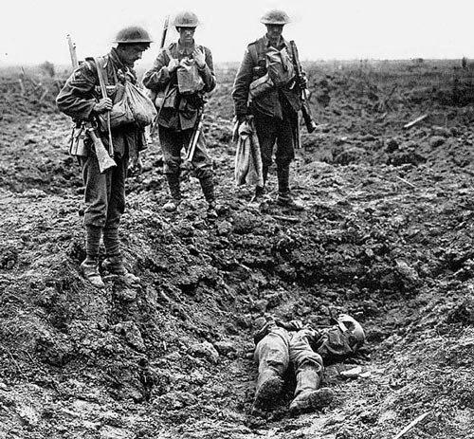
1917
Dulce Et Decorum Est
Wilfred Owen
Bent double, like old beggars under sacks, Knock-kneed, coughing like hags, we cursed through sludge, Till on the haunting flares we turned our backs And towards our distant rest began to trudge. Men marched asleep. Many had lost their boots But limped on, blood-shod. All went lame; all blind; Drunk with fatigue; deaf even to the hoots Of disappointed shells that dropped behind. GAS! Gas! Quick, boys!-- An ecstasy of fumbling, Fitting the clumsy helmets just in time; But someone still was yelling out and stumbling And floundering like a man in fire or lime.-- Dim, through the misty panes and thick green light As under a green sea, I saw him drowning. In all my dreams, before my helpless sight, He plunges at me, guttering, choking, drowning.
If in some smothering dreams you too could pace Behind the wagon that we flung him in, And watch the white eyes writhing in his face, His hanging face, like a devil's sick of sin; If you could hear, at every jolt, the blood Come gargling from the froth-corrupted lungs, Obscene as cancer, bitter as the cud Of vile, incurable sores on innocent tongues,-- My friend, you would not tell with such high zest To children ardent for some desperate glory, The old Lie: Dulce et decorum est Pro patria mori.

Slide 29
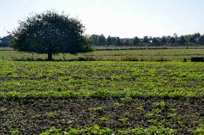
1918
Grass
by Carl Sandburg , 1918
Pile the bodies high at Austerlitz and Waterloo.
Shovel them under and let me work—
I am the grass; I cover all.
And pile them high at Gettysburg
And pile them high at Ypres and Verdun.
Shovel them under and let me work.
Two years, ten years, and passengers ask the conductor:
What place is this?
Where are we now?
I am the grass.
Let me work.

Slide 30
Now
Form a heterogeneous group
Discuss: What changes and continuities regarding ideas about WWI can you infer by analyzing these poems and images?
On the back of your original image, respond to that question in writing. Be prepared to share your response.

Slide 31
1919
Common Form
Rudyard Kipling
If any question why we died,
Tell them, because our fathers lied. (1919)
https://www.poetryfoundation.org/features/articles/detail/70139

Slide 32
Lunch
Relax, talk with your new friends
Working lunch question:
How might you apply our work this morning to your classroom or learning situation?

Slide 33
Please, when you return from lunch,
Take your belongings and move to the marked table which corresponds with your content area.
Say hi to your
new friends and
introduce yourself.

Slide 34
Ponder:
…the content becomes a vehicle for experiencing, practicing, and applying the processes needed to think creatively and critically: observing and collecting data, formulating and testing hypotheses, drawing conclusions, and posing questions.
-----Arthur L. Costa and Bena Kallick 2013
If you agreed with that idea, how might it affect the way you could conceive of interdisciplinary instruction in your teaching situation?
What concerns you about that idea?
How might you find a “middle way?”

Slide 36
This afternoon:
Brainstorm and plan with your partner how you might teach towards that standard. Be as detailed and specific as time will allow
You are encouraged to include other content areas as well in your work.
With 8 minutes remaining, you and your partner should plan an “elevator pitch” for your idea which you can share with the large group.
CALL ME OVER
Choose a Social Studies course you teach or focus on and find a partner who wants to focus on that same course.
Using the materials on your table and your partner, select a SS standard in that course to work on by developing an interdisciplinary lesson.
Using the materials on your table find an ELA standard(s) that is supports SS lesson parameters. Make note of the codes for SS and ELA.

Slide 37
Now:
Capture your pitch in words you can add to the chart paper around the room. (brief description)
On the chart papers, include:
the SS standard you are addressing
the ELA or other content standards
you are building on
your names

Slide 38
Consider:
Think of a person who you consider wise:
What intellectual habits does this person display that have allowed her/him to ask questions and pursue answers to a deeper degree than others may have dared?

Slide 39
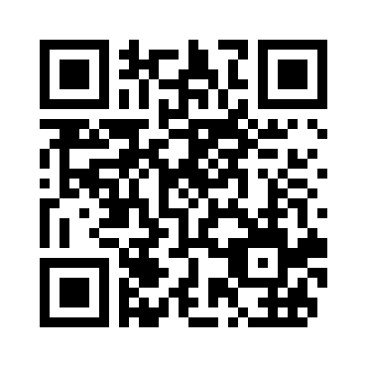
Tell us what you think!
https://www.surveymonkey.com/r/OCCREvaluation
Please indicate that you participated in the Secondary Social Studies session
The Department of Elementary and Secondary Education does not discriminate on the basis of race, color, religion, gender, gender identity, sexual orientation, national origin, age, veteran status, mental or physical disability, or any other basis prohibited by statute in its programs and activities. Inquiries related to department programs and to the location of services, activities, and facilities that are accessible by persons with disabilities may be directed to the Jefferson State Office Building, Director of Civil Rights Compliance and MOA Coordinator (Title VI/Title VII/Title IX/504/ADA/ADAAA/Age Act/GINA/USDA Title VI), 5th Floor, 205 Jefferson Street, P.O. Box 480, Jefferson City, MO 65102-0480; telephone number 573-526-4757 or TTY 800-735-2966; email civilrights@dese.mo.gov

