Slide 1
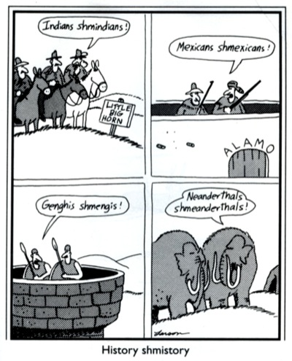
DESE Social Studies Professional Development Series
Exploring Instructional Practices in Social Studies
July 26, 2016

Slide 2
Introductions: Making Connections Be ready to share your chain once your small group introductions are completed.

Slide 3
Social Studies Professional Development Series: Day 2
Introductions
Social Studies: Giraffes and Elephants
Social Studies: Questions and Answers
Break
Debbie Jameson, ELA Director, and Lisa Scroggs, ELA Assistant Director
Nick Kremer, Missouri Writing Project
Reading and Writing through History:
World War II and the Bomb
Working Lunch
Tom Tobias, Arts Education Director-- Defining Arts Integration: Reading Portraits as Biography
SS Pedagogy

Slide 4
Anchor Experiences
What learning experiences can I create to anchor the learning that is to come?
Experiences should be:
memorable
relevant
applicable
Anchor experiences become your shorthand touchstones.

Slide 5
The Elephant and the Giraffe
Giraffe → Bend over, hands clasped in front of you
Elephant → Stand straight, hands clasped above head
Alone → Group together with other people
Group → Move away from others
Sit → Stand up where you are: Small jump in place
Stand → Sit where you are
Against wall → Move to center area
Center of area → Move near a wall

Slide 6
There once was an elephant who had a giraffe as his best friend. Often the elephant would lean against a wall alone and sit, waiting for the giraffe. The elephant’s friend liked to go to the center of an area of grass and stand with the giraffes. Meanwhile, the patient elephant would lean against the wall and sit until the giraffe left the center of the area of grass to come over and lean against the wall to stand by his friend.

Slide 7
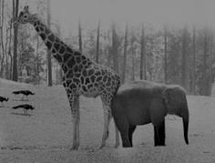
How might you adapt this lesson to use in your social studies classroom?
Learning something new
Stretching social studies pedagogy
Scary at first, but got easier with each successive effort
Didn’t get better until I tried it (couldn’t just observe)
Different people mastered at a different pace, but with time and practice everyone could master
Needed multiple opportunities to practice
Used examples from peers with each try to get better
Received feedback from teachers with each try to get better
Scary at first, but got easier with each successive effort
Didn’t get better until I tried it (couldn’t just observe)
Different people embraced at a different pace, but with time and practice everyone embraced
Needed multiple opportunities to practice
Received feedback with each try to get better
Used examples from peers with each try to get better

Slide 8
Social Studies: Questions and Answers Aaronson Model Activity
2 3 4
4 3 2 1
4 3 2 1
1 2 3 4
2 3 4
4 3 2 1
2 3 4
4 3 2 1

Slide 9
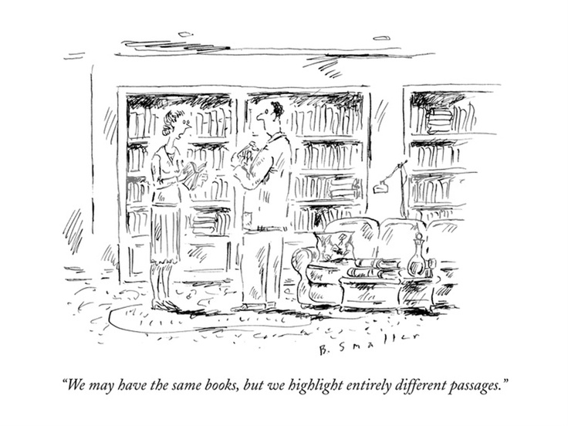
Debbie Jameson, ELA Director Lisa Scroggs, ELA Assistant Director Nick Kremer, Missouri Writing Project
Social Studies and ELA:
Challenges and Opportunities

Slide 10
Working Lunch:
Talk with someone you did not know until today, about how you might use Giraffe and Elephant or Aaronson model in your classroom or work.

Slide 11
Defining Arts Integration: Reading Portraits as Biography Tom Tobias, Arts Education Director, DESE
“Do I have to be creative?”

Slide 12
THE VOICE YOU HEAR WHEN YOU READ SILENTLY
is not silent, it is a speaking-
out-loud voice in your head: it is spoken,
a voice is saying it
as you read. It's the writer's words,
of course, in a literary sense
his or her "voice" but the sound
of that voice is the sound of *your* voice.
Not the sound your friends know
or the sound of a tape played back
but your voice
caught in the dark cathedral
of your skull, your voice heard
by an internal ear informed by internal abstracts
and what you know by feeling,
having felt. It is your voice
saying, for example, the word "barn"
that the writer wrote
but the "barn" you say
is a barn you know or knew. The voice
in your head, speaking as you read,
never says anything neutrally- some people
hated the barn they knew,
some people love the barn they know
so you hear the word loaded
and a sensory constellation
is lit: horse-gnawed stalls,
hayloft, black heat tape wrapping
a water pipe, a slippery
spilled *chirr* of oats from a split sack,
the bony, filthy haunches of cows...
And "barn" is only a noun- no verb
or subject has entered into the sentence yet!
the voice you hear when you read to yourself
is the clearest voice: you speak it
speaking to you.
- -----Thomas Lux, The New Yorker, July 14, 1997

Slide 13
Think, Pair, Share
What essential idea might you use this poem to teach?
How might you use this poem as the basis of an anchor experience? (memorable, relevant, applicable)

Slide 14
Contact me with questions or ideas any time: Dixie.Grupe@dese.mo.gov
Share the ideas you’ve gathered today with your
peers
Check the Social Studies DESE page for new information and opportunities
Send me your email to add to our informal
Wiggio group.
The Department of Elementary and Secondary Education does not discriminate on the basis of race, color, religion, gender, gender identity, sexual orientation, national origin, age, veteran status, mental or physical disability, or any other basis prohibited by statute in its programs and activities. Inquiries related to department programs and to the location of services, activities, and facilities that are accessible by persons with disabilities may be directed to the Jefferson State Office Building, Director of Civil Rights Compliance and MOA Coordinator (Title VI/Title VII/Title IX/504/ADA/ADAAA/Age Act/GINA/USDA Title VI), 5th Floor, 205 Jefferson Street, P.O. Box 480, Jefferson City, MO 65102-0480; telephone number 573-526-4757 or TTY 800-735-2966; email civilrights@dese.mo.gov

