Slide 1
Implementation and Integration: MLS Elementary Social Studies Expectations 2017 June 2017
Teaching and learning together:
deeper, richer, more meaningful, and maybe even fun.

Slide 2
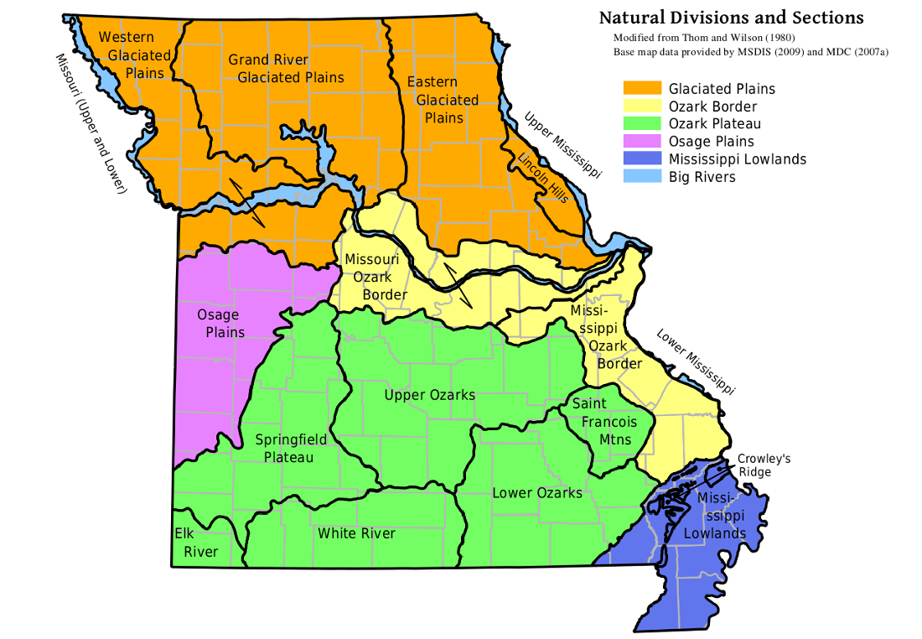
Agenda
Welcome and DESE updates
Habits of Mind: Mutual and Distinct
Shared Instructional Practices
Ideas and Resources
Lunch
Bigger and Even Better:
Missouri Geographic Alliance
Wrap-up and future plans

Slide 3
DESE Social Studies Updates https://dese.mo.gov/college-career-readiness/curriculum/social-studies
Standards and
curriculum work

Slide 6
DESE Social Studies Updates
Assessment
Support for local social studies curriculum, instruction and assessment
Item Specifications available for comment on 6/15

Slide 7
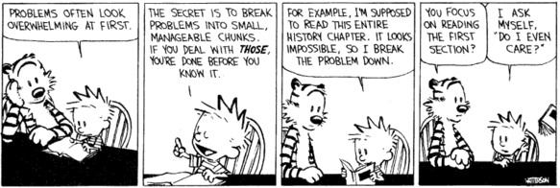
DESE Social Studies Updates: Assessment
No plans for a DESE-generated elementary Social Studies assessment at this time.
Changes coming in Government and American History EOC in 2019-2020 school year.
Practices and Processes can be tied to items in all content areas: potential to include in revised reporting format.

Slide 8
Practice and Processes (PP) identify the ways students demonstrate knowledge through inquiry, research, experimentation and synthesis, when using modes of flexible thinking and by exploring multiple perspectives.
PP1: Gather, analyze and/or apply information
Ask questions and/or define problems
Analyze the cause and consequences
Develop compelling questions
Obtain, synthesize, and report findings clearly and effectively in response to task and purpose
Create and use tools to analyze, communicate information and ideas
Understanding and supporting fact, opinion, bias and point of view in sources
Use technology & digital media strategically & capably
Build strong bases of knowledge through content rich texts
Come to understand other perspectives and cultures through reading, listening, and collaboration
Analyze the conditions that affect stability and change
PP2: Communicate effectively
Construct viable arguments and critique reasoning of others
Read, write and speak grounded in evidence
Exhibit independence in reading complex texts, and writing and speaking about them
Construct explanations & design solutions
Obtain, evaluate & communicate information
Create and use tools to analyze, communicate information and ideas
Explain and evaluate connections
Develop, identify, conduct and present research with appropriate resources
PP3: Recognize and solve problems
Analyze & interpret data
Model with mathematics
Analyze information in relationship to scale, proportion and quantity
Reason abstractly & quantitatively
Look for & make use of structure and function
Explain and evaluate patterns about relationships and causes underlying them
Use models to understand and predict behavior of systems
Track energy and matter in and out of and within systems
DRAFT

Slide 9
What does this image suggest to you about thinking, teaching, and learning Social Studies in our Missouri elementary classrooms?

Slide 10
CONTENT

Slide 11
Student Learning Behaviors

Slide 12
Habits of Mind:
The attributes successful people rely on when faced with new problems, difficult dilemmas and perplexing enigmas.
Content = What
Student Learning Behaviors = Do
Social Science Thinking Skills = quality of systematic reasoning (disciplinary tools)
Content

Slide 13
Habits of Mind in Writing

Slide 14
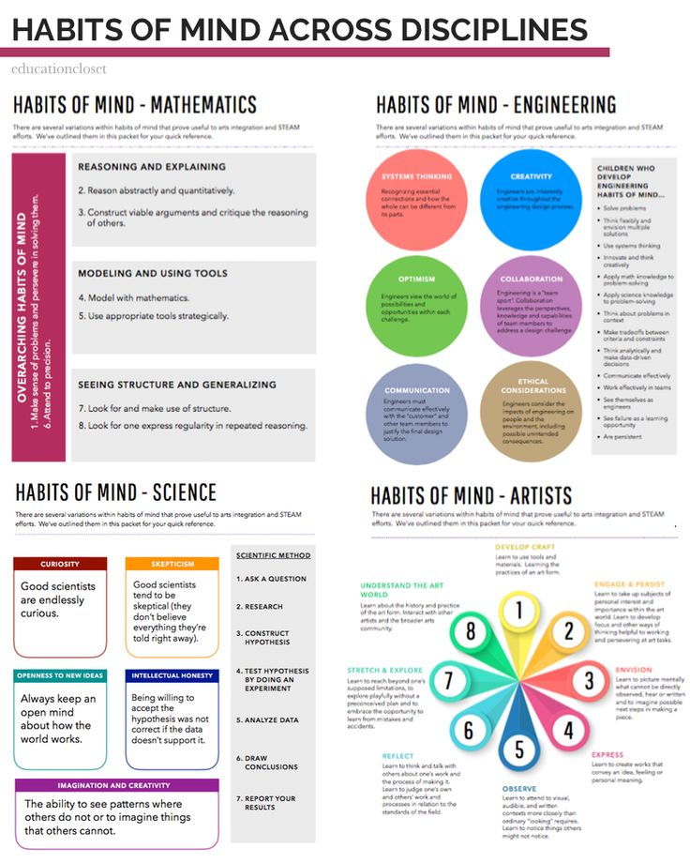

Slide 15
The Elephant and the Giraffe
Giraffe → Bend over, hands clasped in front of you
Elephant → Stand straight, hands clasped above head
Alone → Group together with other people
Group → Move away from others
Sit → Stand up where you are: Small jump in place
Stand → Sit where you are
Against wall → Move to center area
Center of area → Move near a wall

Slide 16
There once was an elephant who had a giraffe as his best friend. Often the elephant would lean against a wall alone and sit, waiting for the giraffe. The elephant’s friend liked to go to the center of an area of grass and stand with the giraffes. Meanwhile, the patient elephant would lean against the wall and sit until the giraffe left the center of the area of grass to come over and lean against the wall to stand by his friend.

Slide 17
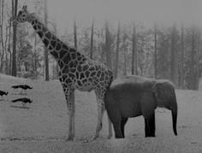
How is this lesson about interdisciplinary instruction?
Learning something new
Stretching disciplinary pedagogy
Scary at first, but got easier with each successive effort
Didn’t get better until I tried it (couldn’t just observe)
Different people mastered at a different pace, but with time and practice everyone could master
Needed multiple opportunities to practice
Used examples from peers with each try to get better
Received feedback from teachers with each try to get better
Scary at first, but got easier with each successive effort
Didn’t get better until I tried it (couldn’t just observe)
Different people mastered at a different pace, but with time and practice everyone could master
Needed multiple opportunities to practice
Used examples from peers with each try to get better
Received feedback from teachers with each try to get better

Slide 18
What does this fable say to you about interdisciplinary learning in an elementary classroom?
https://www.youtube.com/watch?v=qPlJWk8-b4E

Slide 19
Consider this idea as you plan your interdisciplinary instruction….
In any great lesson, there are SIX essential elements:
Meaningful content
Reading
Writing
Speaking
Listening
Thinking skill

Slide 20
Elementary Social Science Thinking Skills

Slide 21
Working with your grade-band group,
1. Share the primary or secondary resource you brought or describe one you use.
2. Discuss with your group how that resource might be used in a lesson designed with a deliberate interdisciplinary focus.
3. Discuss with your group which “Thinking Like a Historian” question (s) you could use in that lesson.
4. Be ready to share that idea with the large group.

Slide 22
Potential Resources: …just a beginning
Picturing American: NEH Images, essays and teaching strategies
https://picturingamerica.neh.gov/downloads/pdfs/Resource_Guide/English/English_PA_TeachersGuide.pdf
National Archives
https://www.archives.gov/education
Smithsonian
https://www.si.edu/Educators
National Park Service
https://www.nps.gov/index.htm
Gilder Lehrman Institute of American History
https://www.gilderlehrman.org/
National Council for the Social Studies
http://www.socialstudies.org/search/site/elementary%20Socal%20Studies

Slide 23
Missouri Resources: …just a beginning
Missouri Sec. of State Digital Resources
http://www.sos.mo.gov//mdh/
Missouri State Historical Society (organized by regions)
http://shsmo.org/
Missouri Historic Towns:
http://www.missourihistorictowns.com/index.htm#index
History Channel: Missouri
http://www.history.com/topics/us-states/missouri/videos
Wilson and Ditch: St. Louis Arch
https://www.youtube.com/watch?v=fqfY0vQm8Ro
Missouri-The Show-Me State 3.5 minutes
https://www.youtube.com/watch?v=vwB2T5vbgwE
Picture Tour of Arch: what questions do you have about this structure?
http://www.elcivics.com/el_civics_history_government_landmark_gateway_arch.html
NPR History of Arch: teacher background
http://www.npr.org/2013/05/25/185773695/gateway-arch-biography-reveals-complex-history-of-an-american-icon
Books related to a wide range of Missouri topics: Local publisher
https://www.reedypress.com/

Slide 24
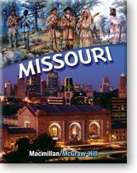
What about a Social Studies Textbook?
Cannibalize your existing textbook (s)
What other ways might you stretch your textbook budget?
What is already there you can re- apportion between grades 3,4,5? In the book and in the ancillaries?
What textbook recommended resources can you access and share?
What trade books are strong and available on topics in your grade level? Above and below proficient readers?
What great literature do you already use which is rooted in social studies topics?
What other type of texts do your students’ need?

Slide 25
Working with your grade band group,
5. Explore the ELA/ Social Studies Crosswalk
6. Add ideas to the central column
7. Be ready to share those ideas

Slide 26
Teaching and learning can become interdisciplinary through a conscious focus on
Content
Specific Skill
Systematic Thinking Skill
Instructional Strategy
Habits of Mind Focus

Slide 28
As you get started in consciously planning for interdisciplinary instruction, or as you continue to teach from that mindset, consider these (edited) words:
Nothing can stop the man thinker with the right mental attitude from achieving his her/his goal; nothing on earth can help the man thinker with the wrong mental attitude.
—Thomas Jefferson

Slide 29
Lunch:
Enjoy your lunch
Consider this question:
What idea from this morning would you like to explore further?

Slide 30
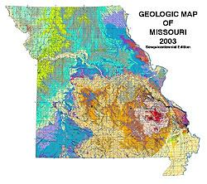
Missouri Geographic Alliance
Bigger and Even Better:
How Geography can be Everything!
Facilitators: Marta Payne and Shannon White

Slide 31
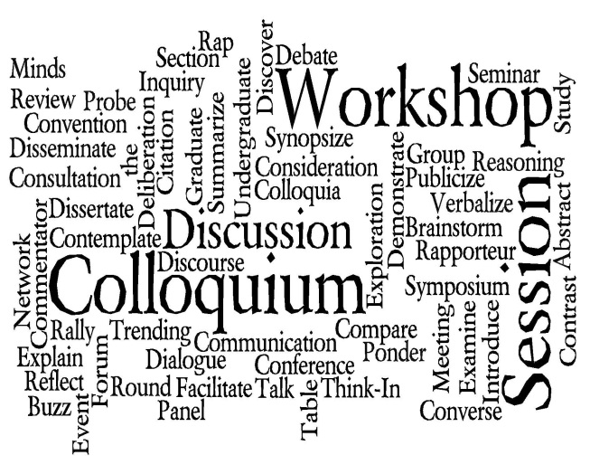
DESE Social Studies Professional Learning 2017-2018
Social Studies Colloquia:
Thinking like a Social Scientist
This four-part series brings together Missouri K-12 educators who have an interest in Social Studies content, pedagogy and instruction. In addition to providing updates on DESE curriculum and assessment developments, sessions will focus on the theme, Thinking like a Social Scientist, an idea central to the Missouri Social Studies K-12 Expectations.
Each colloquium will focus on a single Social Science skill related directly to improving students’ learning. It will identify that skill as highlighted in the Missouri Learning Expectations, demonstrate anchor experiences to introduce that thinking skill to students, suggest ways to teach that skill in K-12 classrooms throughout a variety of content areas and grade levels, and elicit ideas for implementation from teachers and other social studies practitioners.
Each session runs from 9:00-3:00 and is free to participants. See the DESE Social Studies page in July 2018 for details.
September 14, 2017
Contextualization
November 2, 2017
Patterns of
Continuity and Change
February 14, 2018
Analyzing Evidence I
May 10, 2018
Analyzing Evidence II

Slide 32
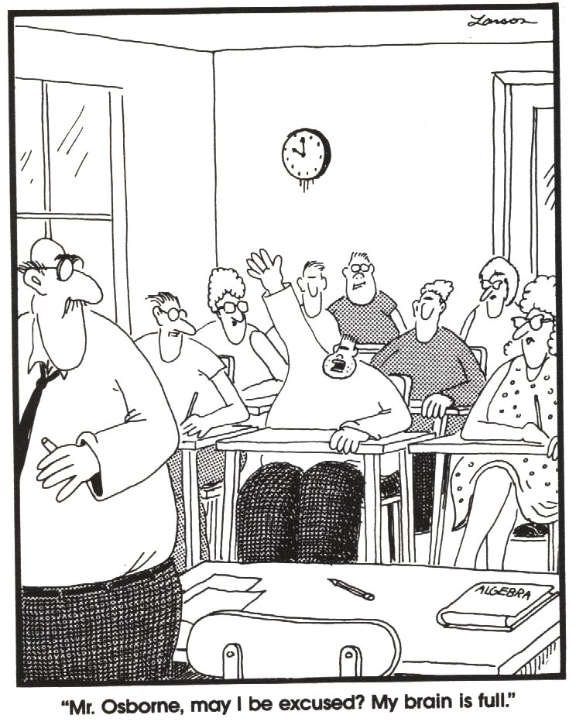
Thank you!
Our guiding question is always,
How can we better support our schools and teachers in the important work you do?
Please complete the evaluation and drive safely.
The Department of Elementary and Secondary Education does not discriminate on the basis of race, color, religion, gender, gender identity, sexual orientation, national origin, age, veteran status, mental or physical disability, or any other basis prohibited by statute in its programs and activities. Inquiries related to department programs and to the location of services, activities, and facilities that are accessible by persons with disabilities may be directed to the Jefferson State Office Building, Director of Civil Rights Compliance and MOA Coordinator (Title VI/Title VII/Title IX/504/ADA/ADAAA/Age Act/GINA/USDA Title VI), 5th Floor, 205 Jefferson Street, P.O. Box 480, Jefferson City, MO 65102-0480; telephone number 573-526-4757 or TTY 800-735-2966; email civilrights@dese.mo.gov

