Slide 1
Released Sample items Grade 3
Released Performance Event Item with Student work

Slide 2
Information about this PowerPoint
Performance Events in Mathematics will be either 3- or 4-point items. A student’s score for an item indicates the level of understanding they are demonstrating for the particular question. Each score point provides a range of possible papers, meaning there will be stronger or weaker papers within each point value.

Slide 3
Information about this PowerPoint
The sample in this presentation is a 3rd Grade item that is worth 3-points. Students must sort the quadrilaterals and describe the attributes they used to make that sort. For each sample of student work there is an annotation indicating both the score as well as the scoring rationale.

Slide 4
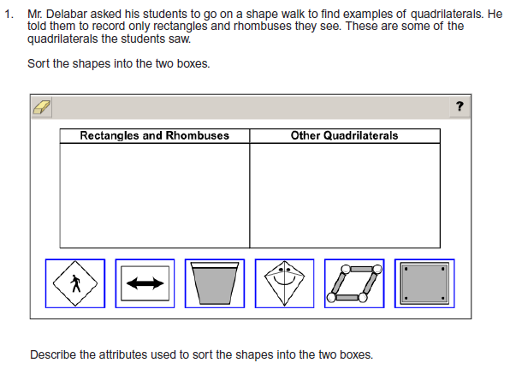
3rd Grade Item

Slide 5
Scoring Guide
3 Points
The student’s response demonstrates 3 out of 3 elements below:
The student accurately sorts the quadrilaterals into the appropriate categories.
The student accurately identifies and communicates the common attributes of rectangles and
rhombuses.
The student accurately identifies and communicates the common attributes of quadrilaterals
that are not rectangles and rhombuses.
2 Points
The student’s response demonstrates 2 out of 3 elements of the 3‐point response.
Note: For the first bullet point, the student may receive credit for an appropriate sorting of 5 out of 6 shapes.
1 Point
The student’s response demonstrates 1 out of 3 elements of the 3‐point response.
Note: For the first bullet point, the student may receive credit for an appropriate sorting of 4 out of 6 shapes, unless all shapes are put in the same box.

Slide 6
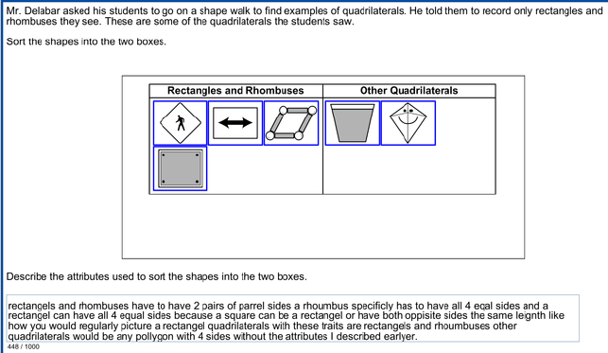
Score – 3 Points
Student correctly sorted the quadrilaterals as well as provided appropriate attributes for all sets. No deductions for spelling or grammatical errors

Slide 7
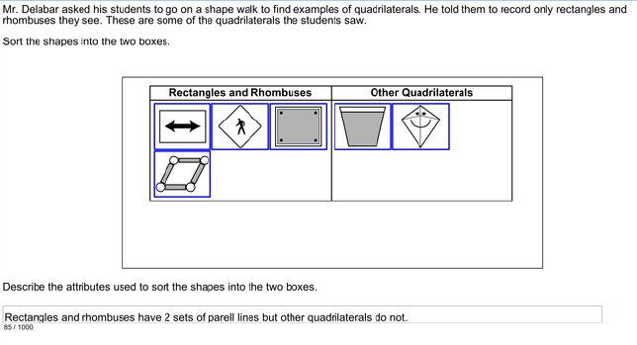
Score – 3 Points
Student correctly sorted the quadrilaterals as well as provided sufficient attributes for all sets. No deductions for spelling or grammatical errors

Slide 8
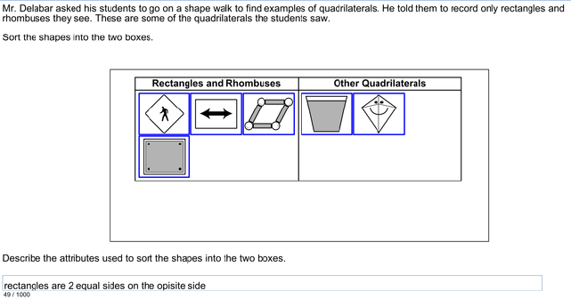
Score – 2 Points
Student correctly sorted the quadrilaterals as well as provided sufficient attributes for only Rectangles. No deductions for spelling or grammatical errors

Slide 9
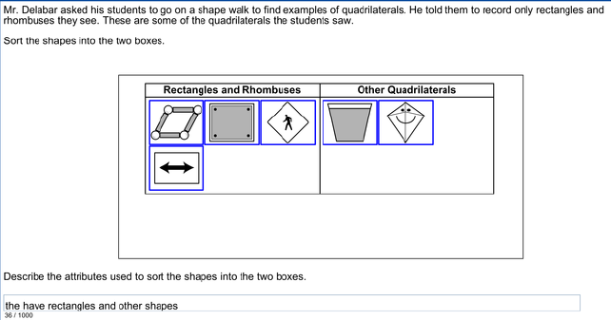
Score – 1 Point
Student correctly sorted the quadrilaterals but has not provided any of the attributes for Rectangles, Rhombuses, or other.

Slide 10
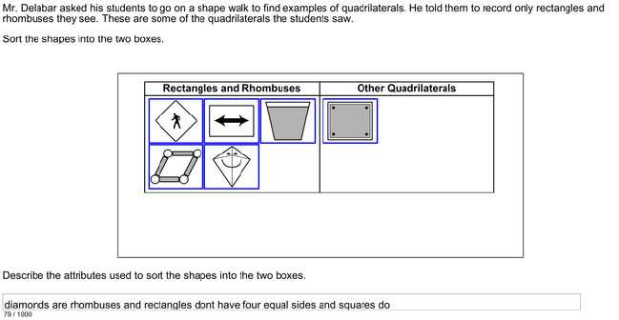
Score – 0 Points
Student incorrectly sorted the quadrilaterals and has not provided any of the attributes for Rectangles, Rhombuses, or other.

