Slide 1
Scoring Math Performance Event Items
Prepared by Chip Sharp
Director of Mathematics – DESE
chip.sharp@dese.mo.gov

Slide 2
Background
Performance Events in Mathematics will be either 3- or 4-point items. A student’s score for an item indicates the level of understanding they are demonstrating for the particular question. Each score point provides a range of possible papers, meaning there will be stronger or weaker papers within each point value.

Slide 3
Background
The sample in this presentation is a 4th Grade item that is worth 3-points. Students must evaluate Michael’s claim and support their response with mathematical work and demonstration of understanding. For each sample of student work there is an annotation indicating both the score as well as the scoring rationale.

Slide 4
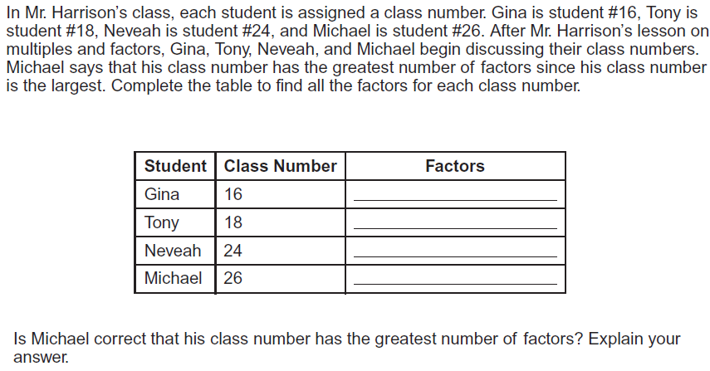
Sample Problem

Slide 5
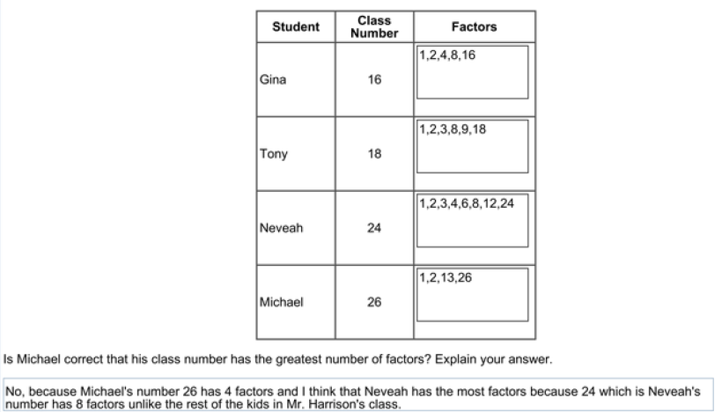
Student Sample 1
This student has correctly indicated that Michael is incorrect supported by mathematical work/explanation. In addition, the student has accurately completed all the factors of each number.
Score 3

Slide 6
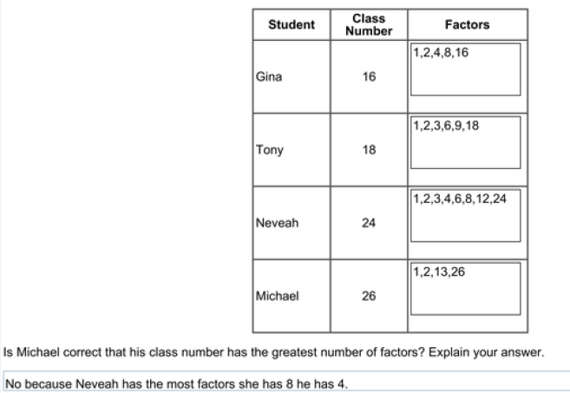
Student Sample 2
This student has correctly indicated that Michael is incorrect supported by mathematical work/explanation. In addition, the student has accurately completed all the factors of each number.
Score 3

Slide 7
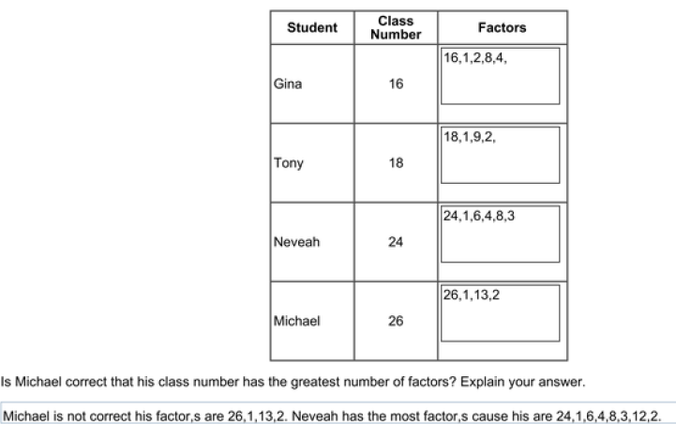
Student Sample 3
This student has correctly indicated that Michael is incorrect supported by mathematical work/explanation. While this student has some errors in the chart, they corrected those errors in the explanation, which allows for a recovery.
Score 3 (considered a low 3)

Slide 8
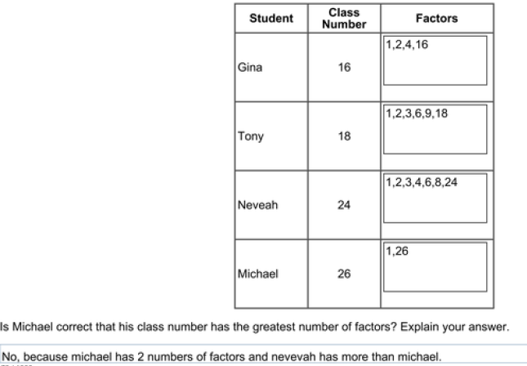
Student Sample 4
This student has correctly indicated that Michael is incorrect supported by mathematical work/explanation. There are multiple errors (e.g. missing factors) but student has demonstrated partial understanding.
Score 2

Slide 9
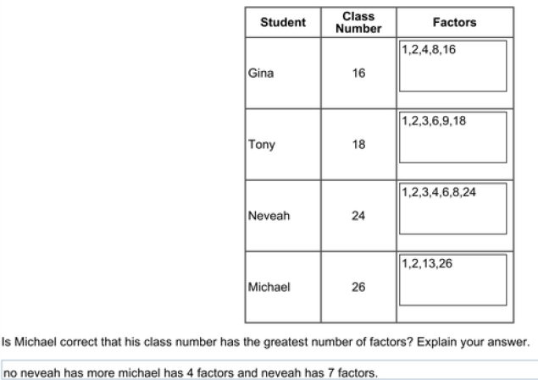
Student Sample 5
This student has correctly indicated that Michael is incorrect supported by mathematical work/explanation. While this student has one error in the chart, it was not detract from the explanation.
Score 3 (considered a low 3)

Slide 10
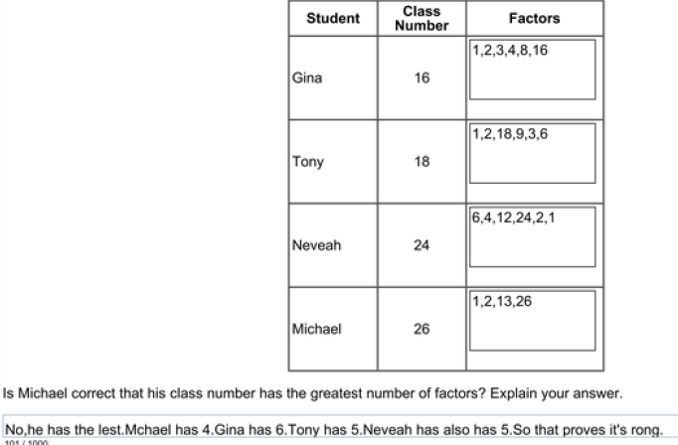
Student Sample 6
This student has correctly indicated that Michael is incorrect supported by mathematical work/explanation. There are multiple errors (e.g. missing factors) but student has demonstrated partial understanding. Note: spelling errors do not affect score as long as intent is clear.
Score 2

Slide 11
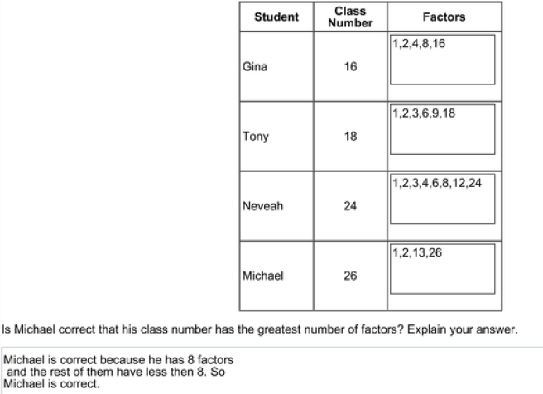
Student Sample 8
This student has incorrectly indicated that Michael is correct due to confusing two student names. The mathematical work/explanation is completely correct. The student has demonstrated understanding of math concept with conclusion error.
Score 2

Slide 12
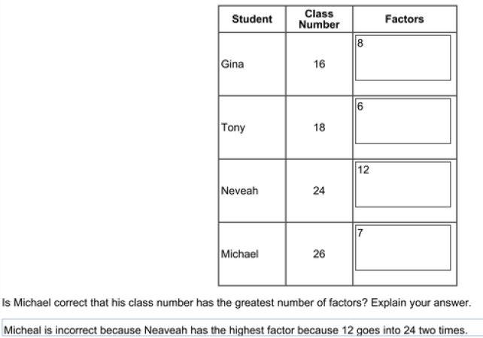
Student Sample 9
This student has correctly indicated that Michael is incorrect but has not supported this conclusion with mathematical work/explanation. Conclusions generating points must be supported by mathematics work or explanation. There are multiple errors (e.g. numbers in factor box do not indicate understanding of factors) and student has not demonstrated understanding.
Score 0

