Slide 1
Resources for Test Administrators
Access the Test Administration Manual (TAM)
Print or download the following manuals
Educator Portal User Guide
Guide to Dynamic Learning Maps (DLM) Required Test Administrator Training
Test Administration Manual
Guide to Practice Activities and Released Testlets
https://padlet.com/pstenger11/MAP_A_2021_2022
Notes:
THIS SLIDE SHOULD BE HIDDEN PRIOR TO PRESENTING

Slide 2
MAP-A for Experienced Test Administrators
2021-2022

Slide 3
Welcome and Introductions
Notes:
To Do: Give an opening icebreaker and how you can offer technical assistance. Add your own icebreaker or information.

Slide 4
Agenda For the Day
Part 1
Updates for the 2021-22 school year
Review Blueprints, Essential Elements, and Required DLM Testing
Become familiar with the following websites
DESE
Dynamic Learning Maps (New Layout)
DLM Professional Development
https://dynamiclearningmaps.org/professional-development
Notes:
To Say: Our agenda will have two sections:
Updates and Embedding Instruction
Engagement Strategies

Slide 5
Agenda For the Day
Part 2
Instructional and Engagement practices for English Language Learners (ELA), math and science
Individual Student Reports
Technical Assistance

Slide 6
Norms
Be present
Turn cell phone off or silence
Minimize sidebar conversations
Ask questions
Take care of personal needs with minimal distractions
Have open heart and open mind
Be patient
Notes:
To Do: Read the slide and ask if there are other norms the group would like to add.

Slide 7
Learning Objectives
Participants Will
Be familiar with the new DLM landing page and its content
Know the updates for the 2021-22 school year
Know how to embed instruction for daily use
Be able to create a lesson to encompass content areas for multiple students

Slide 8
DESE MAP-A Webpage
The place for resources
http://dese.mo.gov/college-career-readiness/assessment/map-a
How do I get to DESE’s MAP-A webpage
Go to dese.mo.gov
Scroll to Topics
Choose MAP
On the right, choose MAP-A
NOTE: When you open the MAP-A page, be sure to scroll the length of the entire MAP-A webpage since it contains links to almost all needed information and/or materials
Notes:
To Know: How to get to DESE’s MAP-A website.
To Do: The consultant will model and guide participants through the use of the DESE MAP-A website. You may want to show the preceding slides or just model on the screen. It is the consultant’s choice.
To Say: DESE’s MAP-A webpage is the page to go for resources and current information. It can be cumbersome to navigate so the process is written. We are now going to look the next few slides which will show you each step on how to access the DESE webpage for MAP-A. The following slides are screen shots of the webpages.

Slide 9
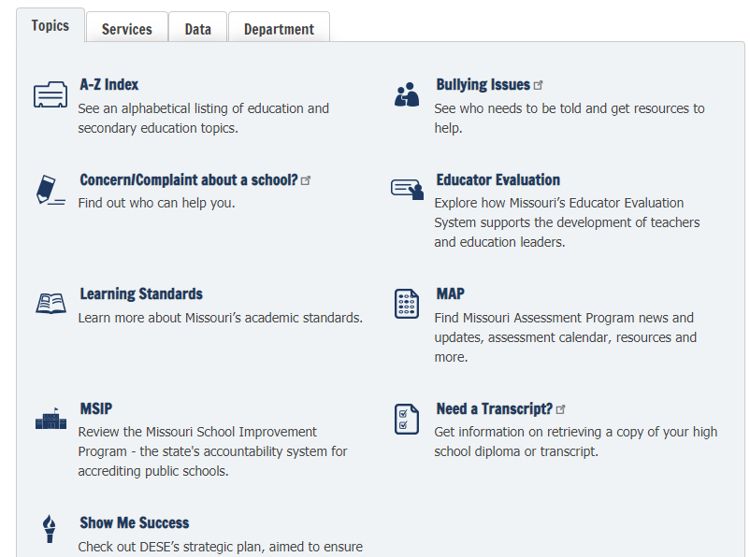
Notes:
To Say: You will go to the DESE Home Page and in the middle of the page where you see the blue arrow, you will see MAP. Once you select MAP, it will take you to MAP-A.

Slide 10
Important Dates for Testing Windows
Fall Window - Required
September 13, 2021-December 17, 2021
CLOSED FROM DECEMBER 17 at 5 PM AND OPENS FEBRUARY 7, 2022
Spring Window - Required
February 7, 2022-May 20, 2022

Slide 11
Fall Testing Window - ELA and Mathematics
Essential Elements
Selected in the Instruction and Assessment Planner at the linkage levels the teacher deems appropriate for each student
Required to be assessed
Have blueprint requirements
Contributes to a student’s final, end-of-year Individual Student Report (ISR)
Notes:
To Say: During the fall window, as described in the previous section, teachers use the Instruction and Assessment Planner to select Essential Elements and linkage levels for the English language arts and mathematics testlets students will take. Teachers make those choices based on their instructional priorities and their students’ academic needs throughout the fall window. The number of ELA and mathematics Essential Elements to be chosen depends on the test blueprint for each grade and subject. Ensure each student is assessed on enough Essential Elements to satisfy the blueprint requirements for ELA and mathematics and, more importantly, to give each student ample opportunities to show what they have learned and can do. The ELA and mathematics testlets taken during the fall window contribute to a student’s final, end-of-year Individual Student Report.

Slide 12
Fall Testing Window - Science
Essential Elements
Selected in the Instruction and Assessment Planner
Not required to be assessed
Does not have blueprint requirements
Does not contribute to a student’s final, end-of-year Individual Student Report (ISR)
Notes:
To Say: Assessing students in science during the fall window is recommended but optional. The Instruction and Assessment Planner is still used for science, but no blueprint requirements for science are provided. Science testlets taken during the fall window do not contribute to a student’s end-of-year report.

Slide 13
Spring Testing Window - ELA and Mathematics
Essential Elements
Selected in the Instruction and Assessment Planner
Required to be assessed
Involves the same blueprint requirements as were used for the fall window
Contributes to a student’s final, end-of-year Individual Student Report (ISR)
Notes:
To Say: The same set of ELA and mathematics Essential Elements taught and assessed during the fall window can be selected in the Instruction and Assessment Planner for the spring window, or the teacher can choose other Essential Elements from the blueprint based on the teacher’s professional judgment of the student’s academic needs. The blueprint requirements still apply for ELA and mathematics, and the ELA and mathematics testlets taken during the spring window are combined with the results from the ELA and mathematics testlets taken during the fall window to produce a student’s final, end-of-year report.

Slide 14
Spring Testing Window - Science
Essential Elements
Not selected in the Instruction and Assessment Planner but they are located in the MANAGE TESTS tab in Educator Portal
Required to be assessed
All assessed for a student’s grade band, therefore, there is no need for blueprint options
Contributes to a student’s final, end-of-year Individual Student Report (ISR)
Notes:
To Say: For science, during the spring window, the Instruction and Assessment Planner is not used. The Kite® System delivers each science testlet one at a time, and each student is assessed on all of the Essential Elements in the test blueprint for the applicable grade band. As mentioned previously, information from the student’s First Contact survey is used to determine the linkage level of the first testlet delivered, and the system is adaptive thereafter, using student performance on the prior testlet to determine the linkage level of the next testlet. Unlike science testlets taken during the fall window, science testlets during the spring window are not optional and contribute to a student’s final, end-of-year report.

Slide 15
Test Information Pages – Spring Science
Testlet Information Pages (TIP) for science during the spring window
Accessed via the Manage Tests tab in Educator Portal
Located in the Test Information column
Available one at a time due to the adaptive delivery
Notes:
To Say: For science during the spring window, Testlet Information Pages are not accessed via the Instruction and Assessment Planner. Instead, they are accessed via the Manage Tests tab in Educator Portal. They are located in the Test Information column and are available one at a time due to the adaptive delivery.

Slide 16
Updates for 2021-2022

Slide 17
Important to Note
Districts may choose to administer the optional MAP-A ELA and math assessments to students in grades 9, 10, and 12 and the science assessments in grades 3, 4, 6, 7, 9, 10, and 12 for local assessment use. Please refer to Forms D and E
Form D - State Assessments have been updated! It is now dated as July 30, 2021 https://dese.mo.gov/media/file/form-d-corrected
Form E has also been updated! It is now dated as July 30, 2021 https://dese.mo.gov/media/file/form-e-2021
Notes:
To Know: The grades MAP-A are required and voluntary.
To Do: Show slide and go over information.
To Say: Form D- #2- has been updated so you will need to have a copy that is dated July 29, 2020. Form D-Part 3 pertains to MAP-A along with the MAP-A Justification. Form D needs to reflect the type of assessment given (i.e., local assessment). Form E- #3- If a district chooses to administer the optional assessments, then they are considered district level as opposed to state level. If you have questions about Form D or Form E, please contact your Compliance Consultant. NOTE: Students who were juniors last year are considered seniors; therefore, they do NOT need to take 11th grade testlets.

Slide 18
Update of IEP Form
For children with the most significant cognitive disabilities, describe how the disability impacts the child’s access to the general education curriculum and how the alternate standards are appropriate will now be completed in the present level of academic achievement and functional performance (PLAAFP)
Notes:
To Say: Last sentence was added to prompt LEAs to include a description of how the education is impacted for children with the most significant cognitive disabilities and how this relates to participation in the regular curriculum.

Slide 19
Educator Identifier Case Sensitivity
Currently, the Educator Identifier field is case-sensitive
Example: MariLangas@ku.edu and marilangas@ku.edu are seen as two different educator identifiers
Issue: Risks in having one user with the same educator identifier tied to multiple accounts
An update will make the Educator Identifier field case-insensitive
Example: MariLangas@ku.edu and marilangas@ku.edu will be seen as the same educator identifier
Notes:
To Say: This year, your login is not case sensitive.

Slide 20
2021-22 Security Agreement Update
Requires the user to accept the security agreement in order to access Educator Portal
Users who do not accept the security agreement will not be allowed to access the application
The user can accept the terms to move on or stay stuck on the screen, very similar to how this is handled on other websites and applications
After the user accepts the security agreement, they will no longer receive the pop-up message after they log in
Notes:
To Do: Read the slide.

Slide 21
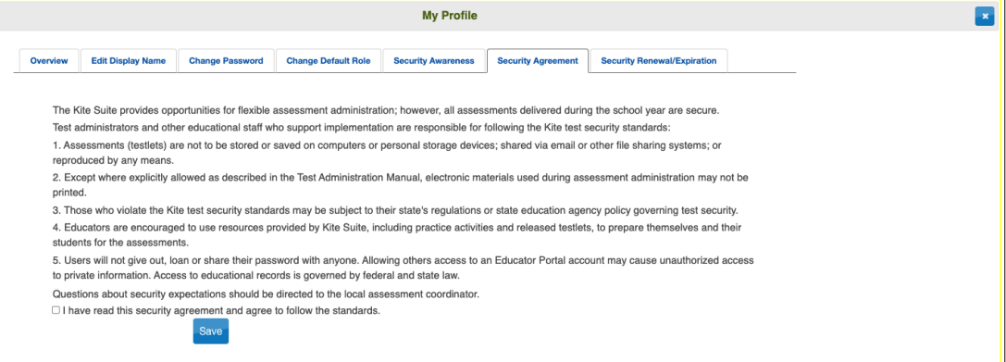
Security Agreement
Notes:
To Say: Last year there were two buttons. This year you MUST select AGREE or you will not be able to move forward with anything.

Slide 22
Kite® Client/Student Portal
Kite® Client must be installed on all student devices for the 2021-22 assessments
Mac and PC will require an uninstall of the old client
Chrome will auto-update if that feature is turned on
When launched, a pop-up message will inform the user if the most up-to-date client is not installed
Go to the Kite® Suite on the DLM website to get the installation instructions for supported platforms, screen requirements, and additional resources
Notes:
To Do: Read the slide.

Slide 23
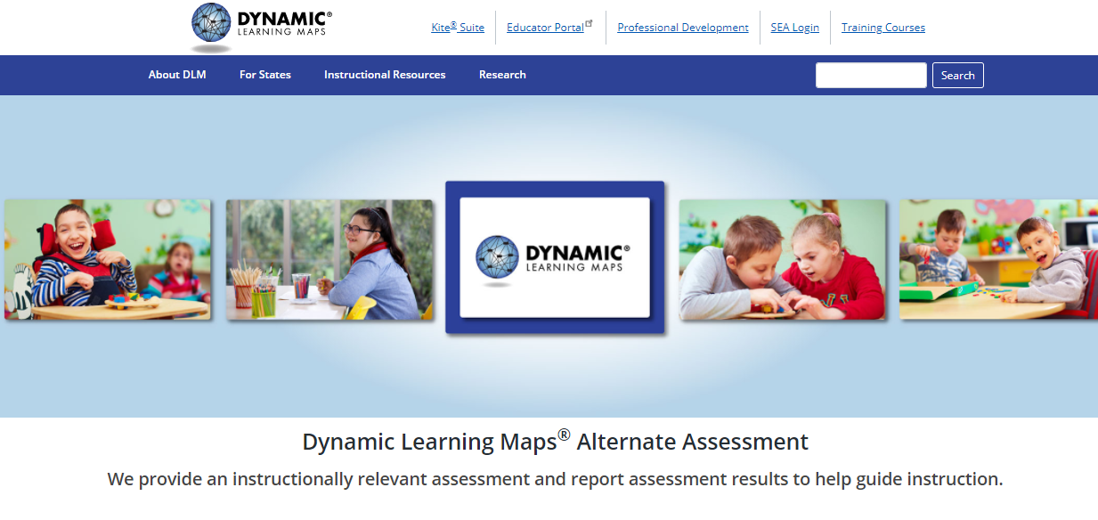
DLM Web Page
https://dynamiclearningmaps.org/
Notes:
To Do: Be sure to practice using the website so that you can take them through how to use it. Go to the DLM website.

Slide 24
Notes:
To Do: Select the ‘For States’ tab. You will see Year-End Model and Instructionally Embedded Model. Notice that Missouri is an IE state.

Slide 25
Notes:
To Do: At this point, you will select the Instructional Resources tab. A dropdown menu will appear for either YE Model States or IE Model States. Missouri is an IE Model state.

Slide 26
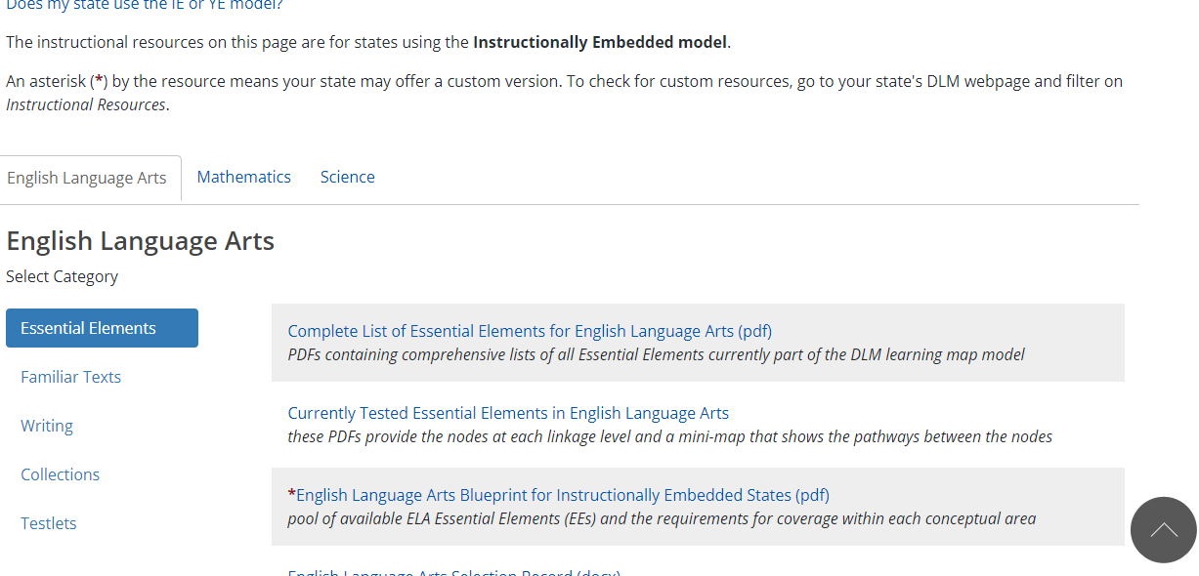
Notes:
To Do: Go through each category for all three content areas.
To Say: From the English Language Arts page, you can scroll to the bottom and go directly to the Mathematics and Science sections.

Slide 27
Mini-MAP Updates

Slide 28
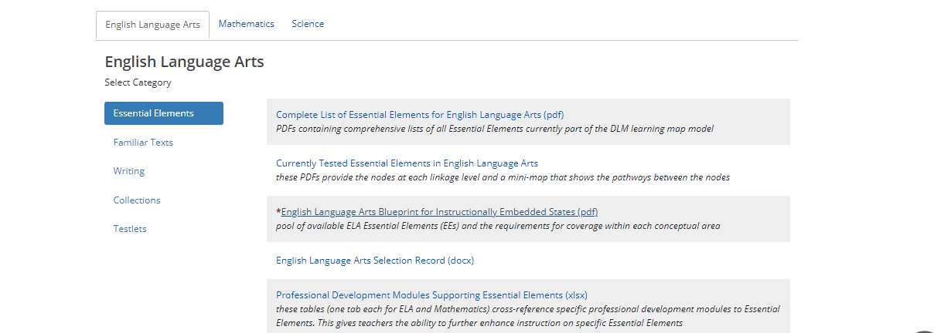
English Language Arts (ELA)
Notes:
To Say: Notice the arrow. This is where you will find the currently tested Essential Elements (EE) for English Language Arts (ELA).

Slide 29
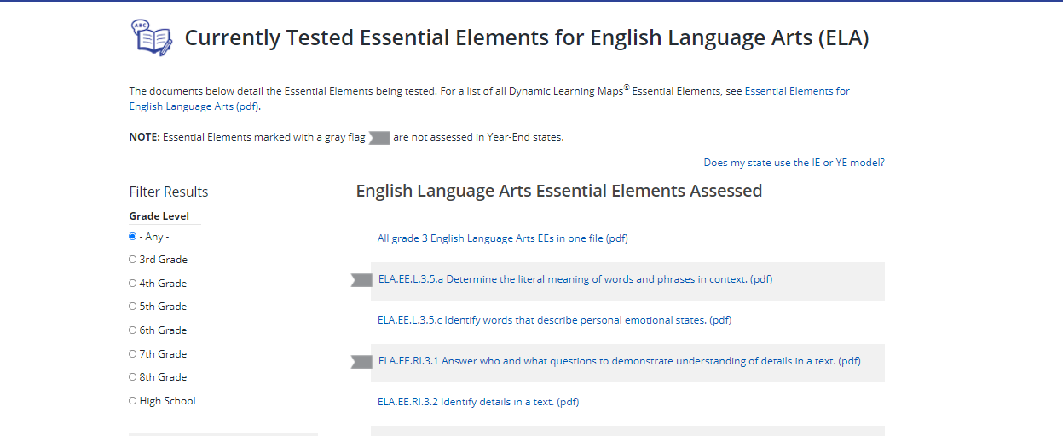
Notes:
To Say: The red box allows you to filter which grade level you will be testing and allows you to see the EEs.

Slide 30
ELA Mini-Map Page
Notes:
To Say: This is an example of a Mini-Map showing the five linkage levels.

Slide 31
ELA Mini-Map Page
Notes:
To Say: Once on the Mini-Maps, select the stories that are aligned to the linkage levels.

Slide 32
ELA Mini-Map Page
Notes:
To Say: Circles mean untested. Squares mean tested.

Slide 33
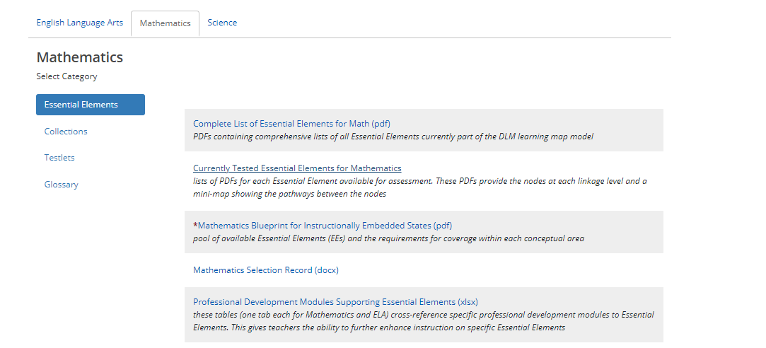
Notes:
To Say: This screenshot shows you the Currently Tested Essential Elements for Mathematics.

Slide 34
Notes:
To Say: Again, the red box is to help you filter through the grade level.

Slide 35
Math Mini-Map Page
Notes:
To Say: Here is the MIni-Map for Math showing the five linkage levels.

Slide 36
Math Mini-Map Page
Notes:
To Say: This screenshot illustrates the link between Initial and Distal Precursors, as well as other Instructional Resources available.

Slide 37
Math Mini-Map Page
Notes:
To Say: This screenshot illustrates the Math Mini-Map.

Slide 38
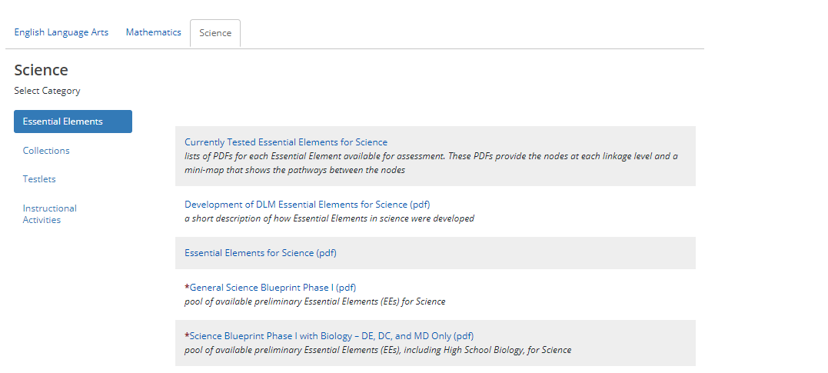
Science
Notes:
To Say: The arrow indicates where you will find the Currently Tested EEs for Science.

Slide 39
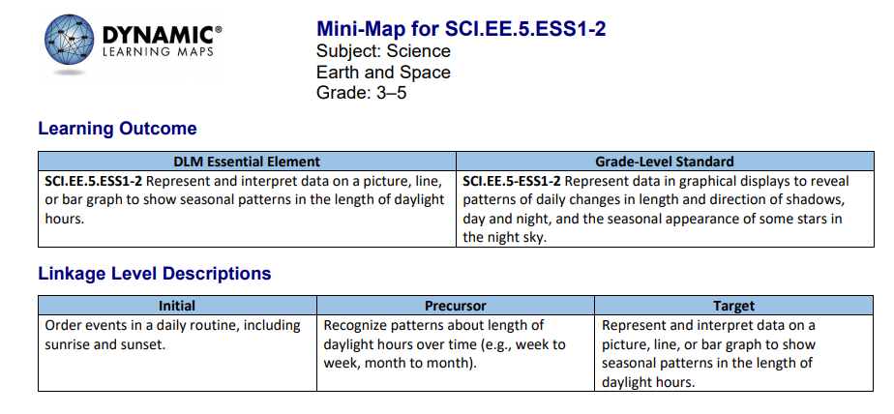
Notes:
To Say: This is an example of a Mini-Map for Science showing the three linkage levels.

Slide 40
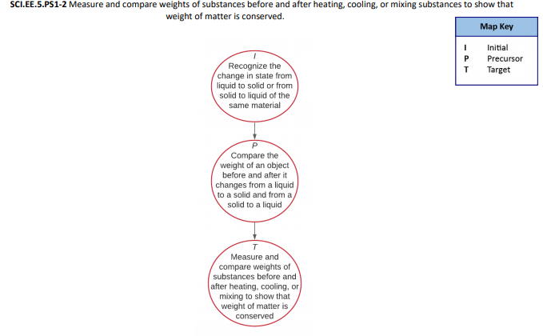
Science
Notes:
To Say: Here is an example of Science.

Slide 41
Science-Connected Content
Notes:
To Say: This screenshot illustrates how you can embed ELA and math into the science EE chosen.

Slide 42
Manuals and Training Updates
Notes:
To Say: In the next few slides, we go over several of the updates to the manuals and DLM website.

Slide 43
Required Test Administrator Training
All versions now ADA compliant
Minor changes to reflect updates
Brief description of new website
Focus on resources and their uses
Revised Mini-Map screenshots
Training for returning test administrators now begins with a brief explanation of changes 2021-22

Slide 44
Revisions to Resource Videos
Getting started in Educator Portal – shorter with demo
Personal Learning Profile – shorter with demo
a.k.a. Completing the First Contact Survey and PNP Profile
Instructionally Embedded Assessments – shorter
Testlet overviews – all new
Overview of English Language Arts Testlets
Two testlet demos, same Essential Element, different linkage levels, including the TIP and mini-map
Overview of Mathematics Testlets
Two testlet demos, same Essential Element, different linkage levels, including the TIP and mini-map

Slide 45
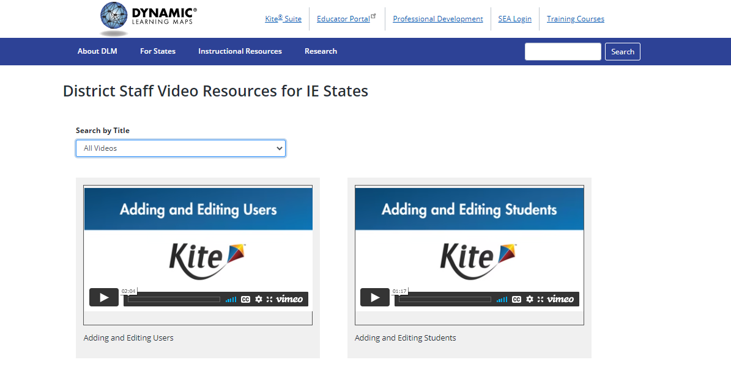
Educator Video Resources
https://dynamiclearningmaps.org/educator-resource-videos-ie
Notes:
To Know: Remember these videos.
To Do: Make sure participants have these resources. Take them to the website. It is hotlinked.
To Say: These resources can be a lifesaver for you. The videos shown are a small sampling of what is provided. These are Educator Resource Videos. The next slide has the liink for the District Resource Videos.

Slide 46
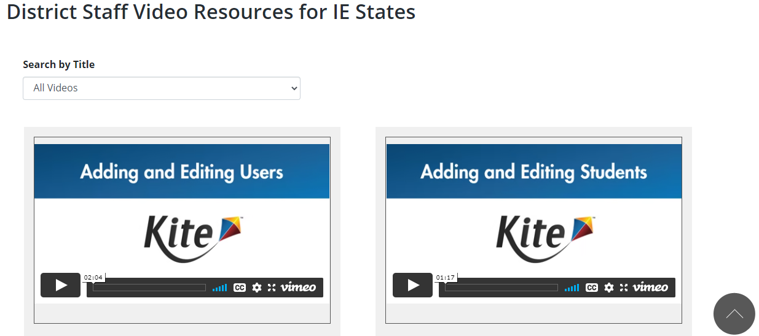
District Staff Video Resources
https://dynamiclearningmaps.org/district-staff-video-resources-ie
Notes:
To Do: Take the participants to the link.

Slide 47
Instructionally Embedded Model
Integrate instruction with assessment
Based on a student’s academic goals
Administered any time during the assessment windows
Not to be administered in a bunch at the end of a window

Slide 48
Teacher Choice and Flexibility
Instructionally embedded assessments allow teachers to choose
Essential Elements for instruction based on blueprint guidelines for the linkage level for each testlet
The Kite® system will recommend a linkage level, but the teacher can select a different level if desired
When to assess each student is based on instruction and assessment window time frames

Slide 49
Instruction and Assessment Planner
Notes:
To Know: Be familiar with the new assessment format for the 2021-22 school year.
To Do: Make sure you have read the Test Administrator's Manual (TAM).
To Say: The Instruction and Assessment Planner is located in the Kite Educator Portal under the manage tests tab beginning on page 56.

Slide 50
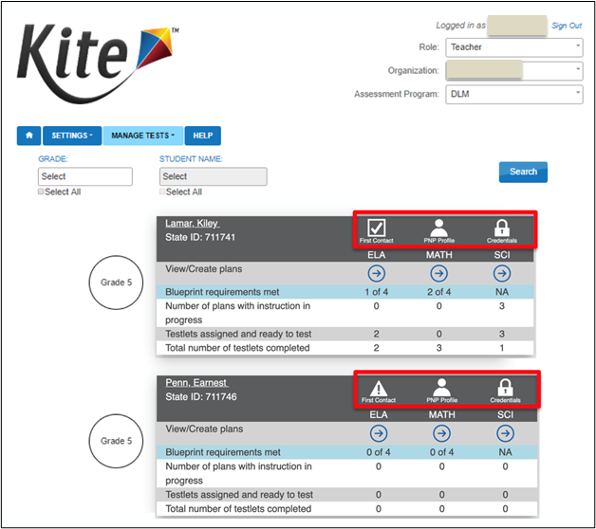
Instruction and Assessment Planner Student Activity Table
Notes:
To Say: Inside the Instruction and Assessment Planner, the first screen is the Student Activity Table, where all students rostered to a teacher will appear. Teachers with students in multiple grades can use filtering.
Earlier, the training showed a student record from the student profiles section of Educator Portal, where the student’s First Contact survey and PNP Profile could be accessed. Notice the student’s First Contact survey and PNP Profile can also be accessed in the Student Activity Table in the Instruction and Assessment Planner, located to the right of the student’s name and state identification number. The student’s login credentials for Student Portal are also accessible here. Select the icons to access the desired feature.
A caution symbol, as shown here, is used to indicate when the student’s First Contact survey has not been completed. Select it to navigate to the First Contact survey for completion. Once the First Contact survey is completed, the caution icon will change to a checkmark. Then, select the arrows under the subject headings to access the blueprints for each subject for the student’s grade.

Slide 51
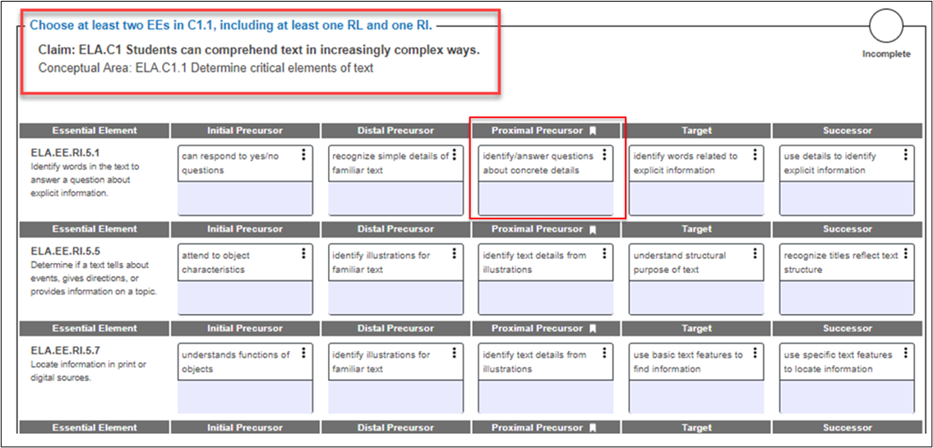
Student View Page The Blueprint
Notes:
To Say: While the blueprints for each subject are provided on the DLM website, they are also conveniently included as part of the Instruction and Assessment Planner.
For example, on the student view screen for ELA, the blueprint requirements display for the subject by conceptual area. Each conceptual area displays its criterion before listing the Essential Elements from which to choose, such as this Grade 5 conceptual area, which states, “Choose at least two Essential Elements in C1.1, including at least one RL and one RI.”
Each Essential Element and each linkage level displays a brief description. A bookmark icon indicates the recommended linkage level. Remember, for ELA and mathematics, during both assessment windows, the teacher can choose a different linkage level for the student, if needed.

Slide 52
To Change or Not to Change
Reason a change might be appropriate
To select a linkage level that better describes the student’s level of skill and understanding after receiving instruction
Reason a change would not be appropriate
To check baseline
To avoid challenging the student
Notes:
To Say: Teachers should use their professional judgment when deciding whether to pick a different linkage level than the one the Kite® System suggests in the Instruction and Assessment Planner. One reason a teacher might want to change the recommended linkage level is if the teacher believes a different level better describes the student’s level of skill and understanding after receiving instruction. On the other hand, changing the recommended linkage level to check the student’s baseline for the skills of the Essential Element or to avoid challenging the student by limiting the student to the lower linkage levels is not appropriate and does not serve the student well.
The DLM alternate assessment is intended to give students opportunities to show what they have learned and can do. Mastering a Target level testlet, for example, likely means the student has also mastered the skills at the lower linkage levels and is reflected as such in a student’s end-of-year score report. However, if a student only takes testlets at the Initial Precursor level, the student never has the opportunity to demonstrate mastery of other skills for the Essential Element. Therefore, changing the linkage level of the testlet to avoid challenging the student is actually not beneficial to the student and does not likely lead to a higher end-of-year performance level.

Slide 53
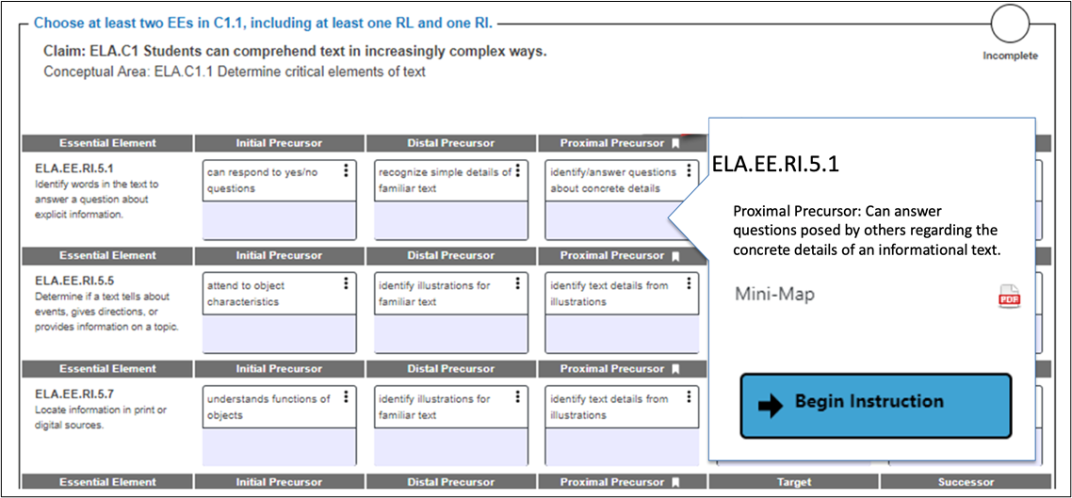
Student View Page Selecting a Card
Notes:
To Say: When a linkage level for an Essential Element is selected in the Instruction and Assessment Planner, a card appears with a longer description of the linkage level and a clickable PDF that contains the Mini-Map for the Essential Element. Remember from earlier in the training that Mini-Maps are used to identify the skills that build to each linkage level so that a teacher can identify the skills a student currently has and the skills a student may need to be taught to progress. While a Mini-Map is not curriculum, it provides important instructional guidance. Select ‘Begin Instruction’ as a signal to the system the Essential Element has been chosen and instruction is, or will soon be, in progress.
Multiple Essential Elements may be selected at a time. Instruction and assessment for one Essential Element does not have to be completed in order to select another Essential Element. The teacher may choose to select all of the Essential Elements planned to cover the blueprint requirements during an assessment window at once or wait and make those selections at later times.

Slide 54
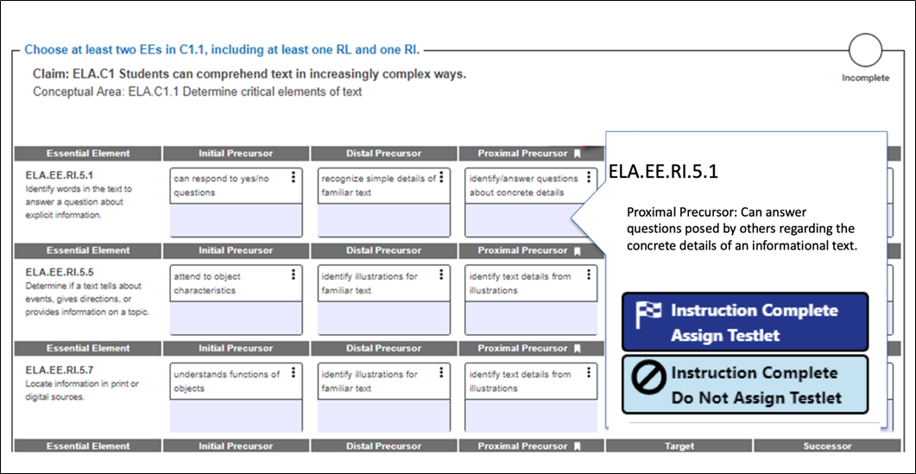
Student View Page Assigning a Testlet
Notes:
To Say: When instruction on an Essential Element is complete, and the student is ready to be assessed, return to the Instruction and Assessment Planner. Select the Essential Element and linkage level card again, then choose the Instruction Complete Assign Testlet button. Selecting this button will deliver a testlet to Student Portal for the student to complete. Assigning a testlet cannot be undone.
If the student will not be assessed on the Essential Element for the planned linkage level, select the ‘Instruction Complete Do Not Assign’ Testlet. Once instruction is complete, if the teacher determines the student has progressed beyond the linkage level chosen, selecting the ‘Instruction Complete Do Not Assign’ Testlet will allow the teacher to select a different linkage level for assessing that particular Essential Element, or another Essential Element.

Slide 55
Locating the Testlet Information Page
Assign testlet
Return to the linkage level card
Access the Testlet Information Page PDF

Slide 56
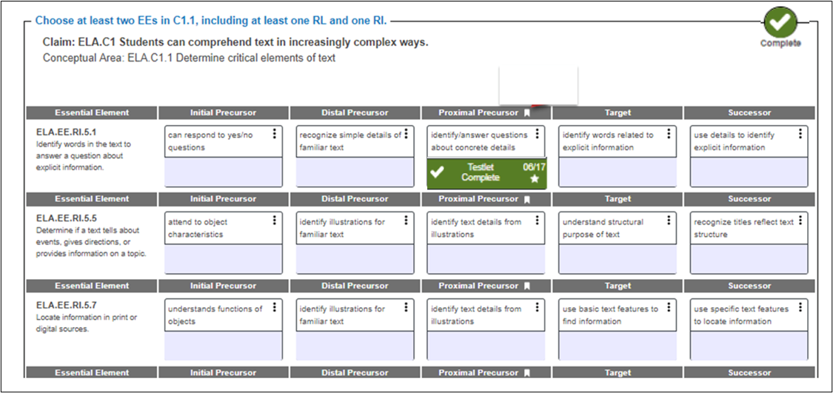
Reminder Meeting Blueprint Requirements

Slide 57
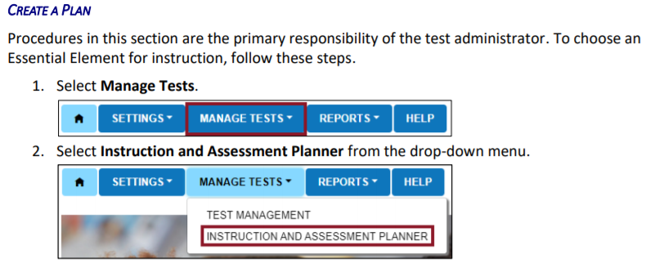
Create a Plan
Notes:
To Say: When you create a plan, you will select ‘Manage Tests’ and ‘Instruction and Assessment Planner’.

Slide 58
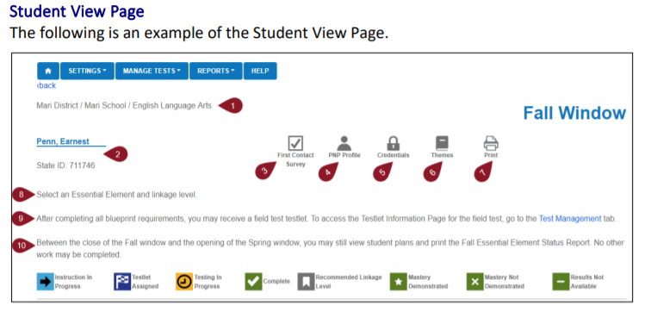
Student View Page
Notes:
To Say: Refer to page 59 of Educator Portal User Guide. The ‘Themes’ icon brings up choices for the teacher. The teacher selects the themes that a student should NOT receive. These themes need only be selected one time for the entire year and will affect each Essential Element during both windows. It will also carry over to the next year. However, a teacher can change the selections at any time.
Fall Window is what you need to be sure you are in and Spring Window will appear when you begin in February.

Slide 59
Instruction and Assessment Planner
Notes:
To Know: Be familiar with the new assessment format for the 2021-22 school year.
To Do: Make sure you have read the TAM.
To Say: Once the teacher selects the “Begin Instruction” button, the card displays “Instruction in Progress” with the date.

Slide 60
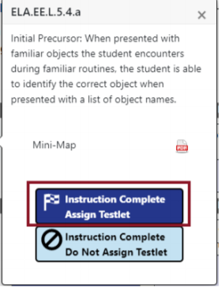
Instruction and Assessment Planner
Notes:
To Know: Be familiar with the new assessment format for the 2021-22 school year.
To Do: Make sure you have read the TAM.
To Say: Once instruction has been provided, the teacher can decide whether to assign the testlet or to not assign the testlet, depending on which button is selected. If the teacher selects “Do not Assign Testlet,” the card reverts back to its original state. It can be chosen again later, if so desired. If the teacher wants to proceed with testing the Essential Element at this linkage level, the teacher selects “Instruction Complete Assign Testlet.”

Slide 61
Instruction and Assessment Planner
Notes:
To Know: Be familiar with the new assessment format for the 2021-22 school year.
To Do: Make sure you have read the TAM.
To Say: When the teacher selects “Assign Testlet”, a warning message appears letting the teacher know that assigning the testlet cannot be reversed. Clicking continues to assign the testlet with the date.

Slide 62
Instruction and Assessment Planner
Notes:
To Know: Be familiar with the new assessment format for the 2021-22 school year.
To Do: Make sure you have read the TAM.
To Say: After administering the testlet to the student through KITE Student Portal, the screen in the Instruction and Assessment Planner within Educator Portal will have a GREEN box that says ‘Testlet Complete’. The teacher has now completed one Essential Element as indicated by the green color and a checkmark will appear in the Essential Element card.

Slide 63
Strategies for Meeting Blueprint Requirements
When looking at the blueprint, decide what Essential Elements are required for ALL grades in your classroom
Fall and spring window
Same set of ELA and/or mathematics Essential Elements may be taught and assessed during both the fall and spring windows
Use professional judgment to decide how to create instructional units with the entire class to meet blueprint requirements
Notes:
To Know: Be familiar with the new assessment format for the 2021-22 school year.
To Do: Make sure you have read the TAM.
To Say: If a teacher has more than one grade level in their classroom, there are ways to utilize instruction time so that it meets the need of all students. Essential Elements meeting the blueprint requirements can be thoughtfully and strategically combined in instructional units at the teacher’s discretion and then assessed at the appropriate time following instruction throughout the fall window.
The same set of ELA and/or mathematics Essential Elements taught and assessed during the fall window can be used for the spring window, or other Essential Elements from the blueprint can be chosen based on the teacher’s professional judgment of the student’s academic needs. The student’s progress report may be used at any time within the cycle to evaluate if additional instruction is needed, or if the student is ready to move on to another linkage level or Essential Element.
How many of you use the same EE in the fall and spring window?

Slide 64
Instruction and Assessment Planner as a Tool
Combine several Essential Elements into an instructional unit and select them at one time
Select all Essential Elements planned for instruction when the assessment window opens so a student meets blueprint requirements
Print the Student View Page after making selections and create a timeline for instruction and assessment throughout the window in order to meet requirements
Notes:
To Know: Be familiar with the new assessment format for the 2021-22 school year.
To Do: Make sure you have read the TAM.
To Say: To utilize the planner as a planning tool for integrating instruction and assessment, as demonstrated on the Student View Page, the entire blueprint for ELA or mathematics is available. This enables the selection of multiple Essential Elements for instruction and assessment at one time.

Slide 65
Creating an Instructional Unit
Notes:
To Know: Be familiar with the new assessment format for the 2021-22 school year.
To Do: Make sure you have read the TAM.
To Say: Several Essential Elements can be combined into one instructional unit. In this example, four Essential Elements are included in the lesson:
EE.RL.3.1
EE.RL.3.2
EE.RI.3.2
EE.RI.3.3

Slide 66
Creating an Instructional Unit
Notes:
To Know: Be familiar with the new assessment format for the 2021-22 school year.
To Do: Make sure you have read the TAM.
To Say: In this mathematics example, telling time is assessed in both grade 3 and grade 4. While grade 4 extends to telling time using an analog clock, a majority of the teacher’s instruction on telling time can be taught to students in both grade levels

Slide 67
Engagement Strategies

Slide 68
Remember the Importance of Engagement
and Instruction
Each testlet begins with an engagement activity
ELA - a shared reading or writing activity
Math - gives the context needed
Science - a short story, experiment, video or sets up a context for doing the testlet *The first portion of every testlet is to ENGAGE the student in the learning
Notes:
To Say: Instructionally embedded assessments look different than other assessments. There is an opportunity for you to engage the student in their learning. Engagement and instruction activities are encouraged before all testlets to get the student in the test mode. For today, we are just going to focus a little on some reading instruction and engagement activities prior to assessing.

Slide 69
Shared Reading/Engagement Strategies
Discuss words – label - point out pictures
Connect words/pictures to the student’s background
Use objects to help students make connections
Encourage engagement and interaction
Use a “think aloud” to engage processing
Ask questions
TAM pg. 71
Notes:
To Say: Here is a list of engagement strategies that are allowed.
Talk about the words:
This is the word ‘dog’.
You have a dog don’t you?
Let’s look at the picture of the dog.
Does your dog look like this dog?
What does your dog look like?
What are some of the things that you do with your dog?
You might use a small stuffed dog and talk about the dog, or have some pictures and have them point to the dog. Model how you would come to the answer of a question.
What sound does a dog make?
Does it meow? No. I have a cat and that is what my cat does.
Does it moo? No. We read a book about cows and they moo.
Oh! Now I remember. Dogs bark. I remember you telling me how your dog barks when someone comes to your door. That is how I remember what dogs do.
Ask questions about the story, words in the story, or the concept of reading
There is also a vignette on the parent’s page that shows one example of what a shared reading could look and sound like. SUGGESTION: (Depending on time, this can be optional). PLACE PARTICIPANTS IN A BREAKOUT ROOM AND DISCUSS WHAT TYPE OF SHARED READING OR ENGAGEMENT STRATEGY THE TEACHER USED TO INTERACT WITH THE STUDENT AND THE TEXT? BE READY TO SHARE OUT. (Depending on time, this might be optional.)
Grade 3 https://www.dropbox.com/s/yve404q8bjuk39n/Shared%20Reading%20Vignette%20%28Grade%203%29.pdf?dl=0
Grade 4 https://www.dropbox.com/s/6sud4s263mqbm38/Shared%20Reading%20Vignette%20%28Grade%204%29.pdf?dl=0
Grade 5 https://www.dropbox.com/s/4dpvwgaehoaxgnm/Shared%20Reading%20Vignette%20%28Grade%205%29.pdf?dl=0
Grade 7 https://www.dropbox.com/s/lu21u4gt9q06cr8/Shared%20Reading%20Vignette%20%28Grade%207%29.pdf?dl=0
Grade 9-10 https://www.dropbox.com/s/2e05jltroro7bfg/Shared%20Reading%20Vignette%20%28Grade%209-10%29.pdf?dl=0
Grade 11-12 https://www.dropbox.com/s/6gc6wl6vrvffpjb/Shared%20Reading%20Vignette%20%28Grade%2011-12%29.pdf?dl=0

Slide 70
Reinforce Sub-skills of Reading
Model concepts of print and phonics
understandings
Reading left to right
One-to-one correspondence between a spoken and written word
Point out rhymes, syllables, and sounds in words
TAM pg. 71
Notes:
To Say: Here are other ideas to connect the student and their skills to the story. These ideas help ensure you connect the student’s learning and needs to the testlet.
Capital letters and sounding words out
Remind them how they read – talk with them about where you start and how the book set it up
You can have them point to the words as you read or you can point to the words as you read them
Point out things within the words and say things like, “Cat starts with C just like your name Cathy.”
In this book, there will be a lot of words that rhyme meaning they end the same – cat and hat.
Can you think of other words that rhyme with cat?
Does bat rhyme with cat? Do they end the same?

Slide 71
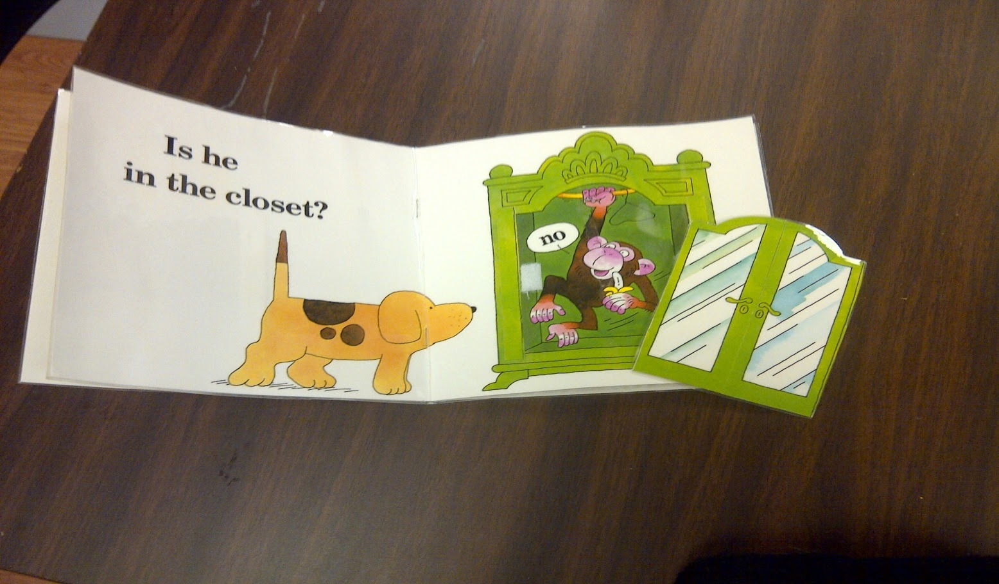
Using The Materials
Notes:
To Say: If it’s easier for the first read, you may print off the book. The TIP tells you where to locate the stories. Read the story with the student.
Maximize your interactions with the student. Point to objects in pictures while you read.
Lead with comments, such as, “Look at the puppy,” while pointing to the picture.
Let them know after you read the storybook and talk about it
Read the story to them a second time and have them answer questions

Slide 72
Shared Reading PD
https://www.dlmpd.com
“The interaction that occurs when a child and adult look at or read a book together.”
Ezell & Justice, 2005
Notes:
To Say: Dynamic Learning Maps (DLM) has some good PD on doing shared reading that can be accessed on the DLMPD website. This is designed to be done individually or in a group, and provides you with the PowerPoint, script, handouts, and the pre- and post-tests. You may also watch the PowerPoint on your own.

Slide 73
Teacher Administered Math
Some materials are required and cannot be substituted, but substitutions are allowed in many cases
Notes:
To Say: Let’s turn to pages 38-40 of TAM. This explains the Testlet Information Pages.

Slide 74
Materials for Test Administration
ELA https://dynamiclearningmaps.org/instructional-resources-ie/english_language_arts/collections
Math https://dynamiclearningmaps.org/instructional-resources-ie/mathematics/collections
Science https://dynamiclearningmaps.org/instructional-resources-ie/science/collections
Notes:
To Say: The links above will take you to the Collections, which is a list of items used when administering the testlet. It also contains a list of substitutions allowed.

Slide 75
Substitutions Using Key Features
Find things that already exist in the classroom
Familiar to the student
Look at the list for each grade and find objects that can meet multiple purposes
Consider materials for Initial Precursor levels and above Initial Precursor level
Notes:
To Say: Make sure that what you substitute is familiar to the student and meets the requirements for what the EE is assessing.

Slide 76
Teacher Administered Science
Most often needs picture-response cards printed ahead of time
https://dynamiclearningmaps.org/instructional-resources-ie/science/instructional-activities
Notes:
To Say: Many times science will need picture cards printed ahead of time.
https://dynamiclearningmaps.org/instructional-resources-ie/science/instructional-activities

Slide 77
Teacher Administered Writing Testlets
Emergent = early symbolic understanding
Conventional = students can use writing tools
Subject of the writing is decided between teacher and student but relevant and familiar
Writing completed outside of DLM system
Notes:
To Say:
Emergent Includes
Initial Precursor
Distal Precursor
Based on First Contact and any testlets completed prior
Conventional

Slide 78
Writing Administration
Evaluate Process
OR
Evaluate the student’s final writing product

Slide 79
Both Writing Assessment Types
Give the student a verbal prompt
Observe the student’s writing process in response to the prompt
Evaluate the student’s behavior according to a set of potential descriptions
Teacher selects the response that matches the highest level of observation that describes what the student did

Slide 80
Writing
A scripted engagement activity
Teacher records observation
Expect 10-20 minutes to complete
All EE for writing will be combined in one testlet
All writing is completed OUTSIDE the system

Slide 81
Emergent or Conventional Writing
Pens or pencils
White boards
Traditional keyboards using word processing
Teacher as a scribe
Any keyboard using word prediction software
Alternate pencils, alphabet flip charts, talking word processors, eye gaze displays of letters, letter dictation of any sort
No word or picture banks
Notes:
To Say: Must have access to the 26 letters of the alphabet. Look at all the things that can be used for writing.

Slide 82
Know the Student
The student is asked to write about something they know or have experienced. They are not given a topic during this portion.
Notes:
To Say: As a teacher, you can direct by making a list of topics that you know the student has experienced recently. These can be a springboard for what you decide to ask the student to write about. Consider things you often visit with the student about each day in your morning greeting or after a weekend.

Slide 83
“Wait and Observe”
Test administrator says
Examples
Write about (topic) using words that describe (topic)
Write about your cat
Tell me about your trip
Notes:
To Say: The teacher allows students to select their own topic, or select a topic with the assistance of the test examiner. ALLOW STUDENTS TO WRITE ABOUT FAMILIAR INFORMATIONAL TOPICS.

Slide 84
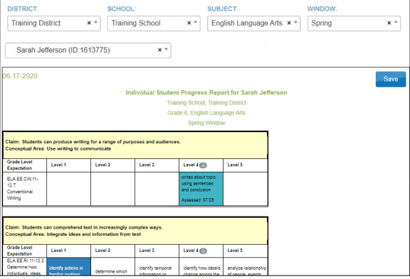
Individual Student Report
Notes:
To Say: Please turn to page 91 of Educator Portal User Guide (or pull up on screen). For this year, the results were NOT for performance but for accountability. You will first need to go to:
Educator Portal
Select Reports
Select Alternate Assessments
Select the Instructionally Embedded tab
Select Student Progress (Complete the filters for the student you want)
View Report
You may find more information regarding Score Reports beginning on page 91 of Educator Portal User Guide.

Slide 85
What To Look For
What are the questions
What are the student’s behavior
If possible, go back and look at the previous year’s results OR look at the IEP goals set forth and check for progress

Slide 86
Embedded Instruction
Pick a grade you will be giving instruction
Look at the Blueprints-ELA, math, and/or science
Unwrap the goals of each Essential Element
What is the common ground
What is the goal of that Essential Element
Why do I need to teach that Essential Element
How might I intertwine the Essential Elements so I can teach both (or all three content areas)
Begin to map out your lesson plan
Begin with the end in mind and work backwards
Notes:
To Do: Spend about 15-20 minutes, if time allows.

Slide 87
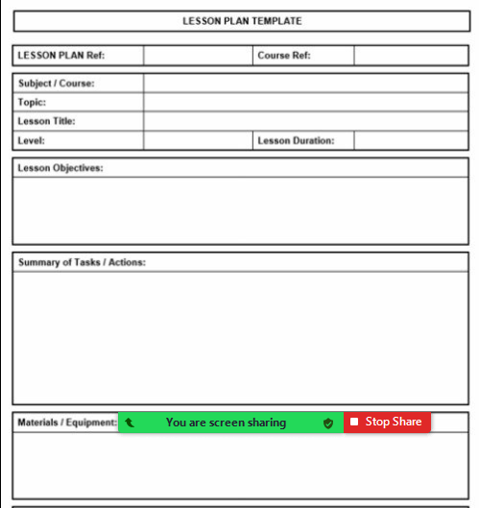
Lesson Plan TIme
Notes:
To Do: If time allows, have participants begin to plan the unit for the EE he/she will instruct. This is just one of many for them to use.
https://www.class-templates.com/printable-lesson-plan-template.html

Slide 88
Utilizing the Individual Student Report (ISR)
Notes:
To Say: On the following slides, your improvement consultant and region are given. Technical Assistance such as Reading Strategies, Specially Designed Instruction, Standards Based -IEPs, Transition Academy, Progress Monitoring, Accommodations/Modifications, and much more are offered after training. Professional Development can be found on each RPDC website or contact your IC.

Slide 89
Individual Student Report (ISR) General Information
ISRs are located in Educator Portal under the Report tab
DLM results are not based on raw or scaled scores
ISRs are in two parts
Performance Profile
Learning Profile
Directors and teachers will need to have access to run the parent report and student report. The parent report should be sent out at approximately the same time as MAP and EOC
Notes:
To Say: The Individual Student Report (ISR) are located in Educator Portal under the Report tab. The Individual Student Report consists of two parts: Performance Profile and Learning Profile. The parent report should be sent out at approximately the same time as MAP and EOC reports.

Slide 90
Individual Student Report (ISR) Performance Profile
DLM Performance Level Descriptors
Emerging
Approaching the Target
At Target
Advanced
Notes:
To Say: DLM is designed so students may be instructed at a linkage level that is an appropriate level of challenge for them. Performance Level Descriptors may help in setting goals and daily instruction at the beginning of the year when looking at the performance at the end of the previous year. As the next slide illustrates, Mastery of Conceptual Areas are also included in the profile.

Slide 91
Individual Student Report (ISR) Performance Profile
Performance Level Descriptors may help in setting goals and daily instruction at the beginning of the year for performance at the end of the previous year
Mastery of Conceptual Areas are also included in the profile as the next slide illustrates

Slide 92
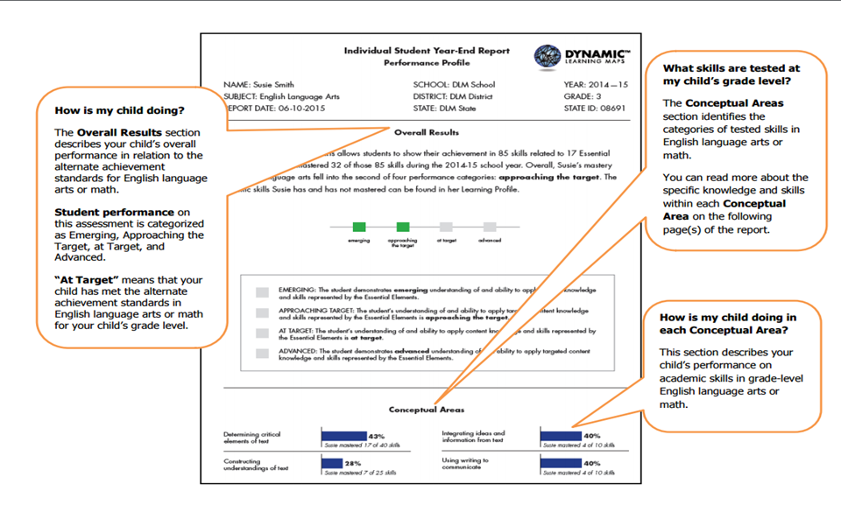
Individual Student Report (ISR) Performance Profile
Notes:
To Say: This is a screenshot of an Individual Student Year-End Report Performance Profile. The Overall Results section describes the student’s overall performance in relation to the alternate achievement standards for English Language Arts or math. The bottom center of the page is labeled Conceptual Areas. This section identifies the categories of tested skills in English Language Arts or math. The colored boxes describe the student’s performance on academic skills in grade-level English Language Arts or math.

Slide 93
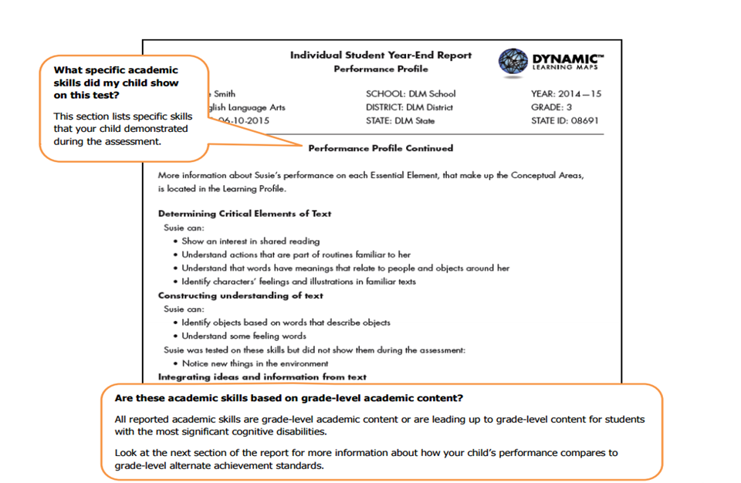
Individual Student Report (ISR) Performance Profile
Notes:
To Say: This slide looks at what specific academic skills the student demonstrated on this test, as well as the academic skills based on grade-level content. The Performance Profile has proven to be one of the most beneficial portions of the ISR. It specifically outlines the skills the student can do according to this assessment. The Performance Profile can also provide statements for the Present Level of Performance and aids in setting IEP goals for the future.

Slide 94
Individual Student Report (ISR) Learning Profile
The Learning Profile describes
EEs tested, including the skills mastered and not mastered
EEs not tested among those available to be tested in the grade and subject
Outlines the number of EEs and Conceptual Areas tested out of the number expected for the grade level
Contains the number of EEs that students were required to be tested on and the number on which the student actually tested
Notes:
To Say: The Learning Profile describes the Essential Elements tested which include:
Skills mastered and not mastered
Skills not tested among those available to be tested in a grade or subject
An outline of the number of Essential Elements and conceptual areas tested out of the number of expected for a grade level
The report will contain the number of essential elements that students were required to be tested on and the number that the student actually was tested.

Slide 95
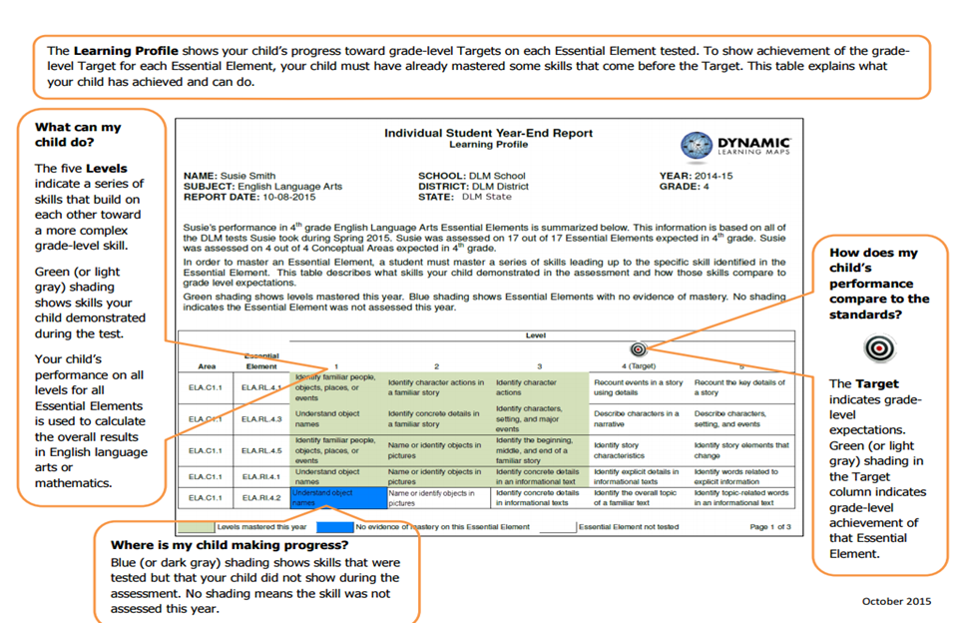
Notes:
To Say: This is an example of the Learning Profile side of the ISR Year-End Report. The graph in the middle of the page explains what the student did. It also explains how the student’s performance compares to the standards that were assessed as well as indicating the student’s progress. What are some other ways you can use the ISR Learning Profile?
Other suggestions include setting instructional goals, connecting previous grade’s EEs to current grade, identifying strengths and weaknesses, and guiding goal development for a standards-based IEP.

Slide 96
Suggestions for Using the Learning Profile
Set Instructional Goals
Connect previous grade’s EEs to current grade
Identify strengths and weaknesses
Guide goal development for a standards based IEP
Notes:
To Say: Here are a few suggestions for using the learning profile:
Instructional goals
Connect previous grades Essential Elements to the current grade
Identify strengths and weaknesses
Guide goal development for a standards-based IEP
You may also use the professional development models found on the DLM website.

Slide 97
Hints to Interpreting the ISR
The amount of white space does not necessarily reflect a lack of instruction. DLM is designed so students may be instructed at a linkage level that is an appropriate level of challenge for them
Students with the most significant cognitive disabilities have a variety of educational goals. Academics are one part of their educational program
Teachers provide instruction beyond what is reflected in the student’s DLM profile, including other academics, functional skills, and other priorities identified in the IEPS
Notes:
To Say: The amount of white space does not necessarily reflect a lack of instruction. DLM is designed so students may be instructed at a linkage level that is an appropriate level of challenge for them. Students with the most significant cognitive disabilities have a variety of educational goals and academics is just one part of their education program. Teachers provide instruction beyond what is reflected in the student’s DLM profile, including other academics, functional skills, and other priorities identified in the IEPs.

Slide 98
Hints to Interpreting the ISR
Remember that judgement of mastery is based on what the student demonstrated on the DLM assessments
A student may have demonstrated a similar skill during instruction but not demonstrated the skill during a DLM assessment
The assessment measures where students are with regard to the grade-level target
Not all students will perform at the target level, and this is to be expected
The number of skills mastered does not mean that a student answered a certain percent of items correctly
Notes:
To Say: It is important to remember that judgement of mastery is based on what the student demonstrated on the DLM assessments. Second, that a student may have demonstrated a similar skill during instruction but not demonstrated the skill during the DLM assessment. DLM assessment measures where students are with regard to the grade-level target. Hence, not all students will perform at the target level and this is to be expected. The number of skills mastered does not mean that a student answered a certain percent of items correctly.

Slide 99
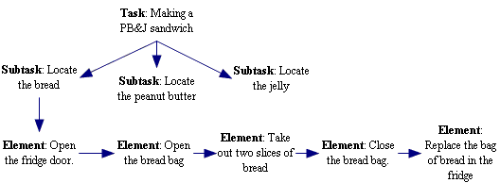
Benchmarks
Are milestones that describe content to be learned or skills to be performed
Can be distinct skills that are often independent of each other, but must be combined to meet the measurable annual goal
Are used when progress is not easily quantified and is based on task analysis
Notes:
To Say: As you know, any student that takes the MAP-A must have benchmarks on their IEPs. Some districts may require all IEPs to have them. The purpose of the benchmark is to specify intermediate progress toward the goal that allows you to determine whether progress is sufficient to meet the goal. It is sequential, progressive, and intermediate progress toward the goal. There are a variety of ways to develop benchmark for a goal and we are going to look at some of them as we develop benchmarks for Susie’s annual goal.

Slide 100
Developing Benchmarks
Individual Student Year End Performance Report Goal Area
ELA EE RI 4.2 - Identify the main idea of a text when it is explicitly stated
Next Grade Level Goal
ELA EE RI 5.1 - Identify Words in the text to answer a question about explicit information
Level I want Susie to achieve – Proximal - Can identify concrete details in an informational text and answer simple questions related to the details
Check Mini Map for linkage levels (9) - Can respond to yes/no questions, ask one or two word personally relevant questions, confirm understanding by answering questions about a familiar text read aloud
Notes:
To Say: One of the ways you can develop benchmarks is to look at the linkage levels that go with Essential Elements that you have chosen. This was the IEP goal that I chose for Susie based on her Individual Student Year End Performance Report. She was tested and did not achieve the ELA EE Reading Information 4.2 - Identify the main idea of a text when it is explicitly stated. So, I find an EE in grade 5 that is similar. In this case, I have chosen EE Reading Information 5.1 - Identify words in the text to answer questions about explicit information.
I then selected a level at which I want her to achieve and she will be assessed. I chose the Proximal Level - Can identify concrete details in an informational text and answer simple questions related to the details.
When I check the mini-maps there are nine individual nodes below this level. Some are untested nodes but they are skills that need to be achieved for her to get to the Proximal Level and I can chose some of those nodes to be the benchmarks I use to determine if she is making sufficient progress to achieve the goal and be assessed in that area.

Slide 101
MAP-A Professional Development
Notes:
To Say: There is a great deal of PD that comes with MAP-A that can help teachers understand not only how to give the MAP-A but how to teach students that are MAP-A eligible.

Slide 102
PD Modules
Notes:
To Say: When you select the PD tab, the first thing that appears are the modules that are organized by claim or domain. These are designed to help teachers understand and develop lessons that will help students do better on the assessments. The modules can be done individually or in small groups. For example, if your teachers are struggling with what shared reading should look like, there is a module that describes that process. If they are not sure how to help students activitate background knowledge, help students taking the MAP-A generate a purpose for reading, and what strategies to help students understand counting and cardinatliy of numbers, it provides research-based approaches on how to do that. There are modules in ELA, math and science. These can be very helpful if you notice trends in your student’s MAP-A data that indicates there are some modules that your students do not do well in, or if you are having a concentrated focus within a specific claim or domain. .

Slide 103
Instructional Resources
https://www.dlmpd.com/instructional-resources/
Notes:
To Say: If you select the Instructional Resources tab, you will find some helpful information.
There is a DLM Essential Elements Unpacking. It is for ELA and math and they essentially give you more information about the EE to help you understand what skills are being taught and tested. It is very helpful for new teachers to better understand what they need to do. In the Exemplar Text Supports section there are some great lesson support activities to help you understand what would be involved in a lesson, suggestions for a good anchor activity, and instructions on how you would explain the purpose to the student and what task they might be asked to do to demonstrate the EE. In Communication Supports you will find the DLM Core Vocabulary which is helpful in determining what type of vocabulary your students will need to take the MAP-A assessments. There are some good writing resources with flipcharts, information about alternate pencils, eye gaze frames, self-reflection sheets, and forms that you can share with your administrators who are observing a lesson with a student that is MAP-A eligible.

Slide 104
Exemplar Text Supports
https://www.dlmpd.com/exemplar-text-supports/
Notes:
To Say: The text support houses accessible, open-source texts that you and your students can read online, on a reader that uses epub files, offline as PowerPoint files, or printed versions of the books. The books come from the collection of books at Tar Heel Reader. Many of the books were written by teachers across the U.S., Canada, and other English speaking countries. Tar Heel Reader (http://tarheelreader.org) is a very large library of open-source, accessible, texts for individuals with disabilities of all ages. Tar Heel Reader was started as a way to address the extreme shortage of easy-to-read books on topics that appeal to older students. You can also get suggestions of books by grade spans.

Slide 105
Blog
https://www.dlmpd.com/new-videos-of-instruction-targeting-the-dlm-essential-elements/
Notes:
To Say: There are various resources in the blog section. One of the more helpful ones is a video collection produced by public television which features strategies for comprehensive literacy instruction for students with significant cognitive disabilities. The purpose of the collection is to support educators and families in understanding how all students can learn and make progress in the ELA Essential Elements. In each video, classroom educators demonstrate research-based instructional strategies in literacy, language, and communication including the use of augmentative and alternative communication systems. The videos feature students in both inclusive general education classrooms and self-contained settings in grades K-12. Again, they can be good PD for your new teachers.

Slide 106
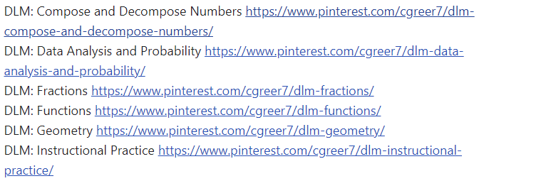
https://www.dlmpd.com/blog-page/
Notes:
To Say:There is also a blog post, it does not have much information in there. But one of the most helpful things is the pinterest boards with ideas and activities for teaching some of the EE skills to students who are MAP-A eligible. It is good source of new ideas for teaching skills.

Slide 107
Notes:
To Say: Do you have any further questions?

Slide 108
Technical Assistance from RPDC
Notes:
To Say: On the following slides, your IC and region are given. Technical Assistance is offered after training such as Reading Strategies, Specially Designed Instruction, Standards Based IEPs, Transition Academy, Progress Monitoring, Accommodations/Modifications, and much more. PD can be found on each RPDC website or contact your IC.

Slide 109
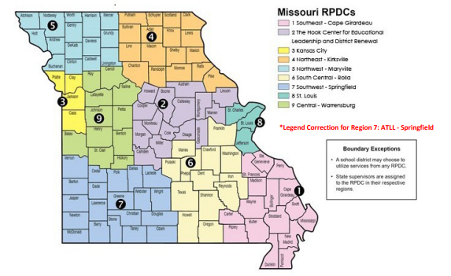
Notes:
To Say: Technical Assistance on Individual Student Reports (ISRs) as well as suggestions for additional content strategies can be obtained through your RPDC consultant.

Slide 110
Improvement Consultant Contact Information
Region 1
Region 6
Susan Hekmat srhekmat@semo.edu
Connie Cromwell cromwellco@mst.edu
Region 2
Region 7
Lisa Rapert rapertl@Missouri.edu
Megan Menton MeganMenton@missouristate.edu
Region 3
Region 8
Mary McConnell mcconnellme@umkc.edu
Patti Stenger pstenger@edplus.org
Carrie Turner cturner@umkc.edu
Region 9
Region 4
Mary Beth Scherer mbscherer@ucmo.edu
Susan See ssee@Truman.edu
Region 5
Jane Jackson Jjackso@nwmissouri.edu
Pam Madison pmadison@nwmissouri.edu
Notes:
To Say: Here is a list of Improvement Consultants around the state. ICs can put their information on the next slide.

Slide 111
Questions? Please contact:
Notes:
To Do: Consultants should enter their contact information prior to training.

