Slide 1
Transition Assessments and Resources
January 2022
Notes:
Good Morning and Happy New Year! Welcome to our presentation on today’s hot topic : Transition Assessments and Resources. My name is Bailey Tennesen and I am the Special Education Compliance Consultant from the KC- Region. My partners in crime today are Lynn Lynch from the Heart of Missouri and Lauren Struthers from the NW Region.

Slide 2
Audience Norms
Be an active listener and participant
Remain on mute
If you have questions drop them into the chat. A FAQ will be created and posted after the training
Notes:
Our audience norms have changed a little bit for this presentation. Please remember to be an active listener/participant and remain on mute. For today’s session there will be NO questions answered live in the chat or during the training. Instead we will be compiling your questions from the chat and placing them into a Transition FAQ document that we can share with everyone at a later date. We do encourage questions being placed into the chat but please do not expect replies at this time.

Slide 3
Learner Intentions
Participants will understand the focus of Transition Assessments:
Why: The Purpose Behind Transition Assessments
What: Definition of Transition Assessments
When: Time frame of Transition Assessments
How: Embedding Transition Assessments within the IEP
Resources
Notes:
To Do: Read the Slide

Slide 4
Mentimeter Interactive Questions
Go to menti.com
Enter code: 29384884
Answer questions
Notes:
Give them 2 minutes to get on website and answer question 1 . Look over the answers and show screen to group. one minute for question 2

Slide 5
Why: Purpose Behind Transition Assessments

Slide 6
Purpose of Transition Assessments (Embedded within the PLAAFP):
Identifies student’s interests, needs, strengths and preferences
Determines post secondary goals
Develops relevant academic and functional skills instruction
Identifies appropriate transition services
Identifies necessary interagency supports and linkages
Evaluates instruction and supports already in place
Notes:
To say: A summary of formal and/or informal age appropriate transition assessments based on the student’s needs, preferences and interests (must be included no later than the first IEP to be in effect when the student turns age 16):

Slide 7
What does the Standards and Indicators Say
•IEP includes the following content:
•200.800 A statement of the transition service needs: The IEP for each student beginning not later than the first IEP to be in effect when the child reaches 16 years of age and updated annually includes coordinated, measurable, annual IEP goals, and transition services that will reasonably enable the child to meet the postsecondary goals.
•200.800.e. The measurable postsecondary goals are based on age-appropriate transition assessment.

Slide 8
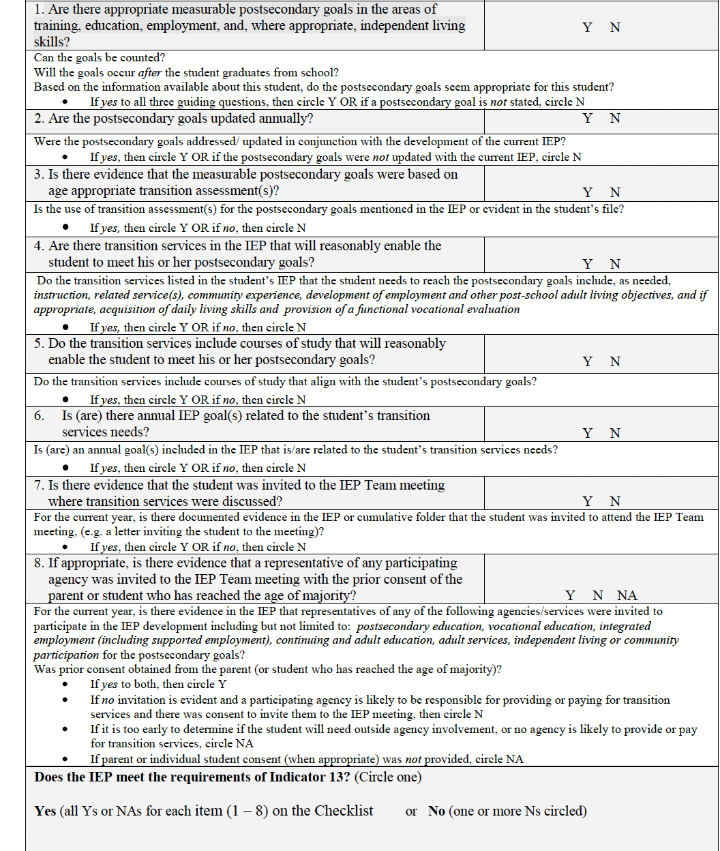
Indicator 13
Is there evidence that the measurable postsecondary goals were based on age-appropriate transition assessment?
Notes:
To Know: Our state regulations (Missouri Compliance Standards and Indicators) are aligned to the federal law.
To Say: Indicator 13 was developed to help states be in compliance when it comes to post-secondary transition. This is one of the 8 items in the Indicator 13 Checklist that measures post-secondary compliance.
Link will be included

Slide 9
Goals of Transition Assessment
Provide information needed to:
Make informed choices
Take charge of the transition process
Understand the skills needed for post-school environments
Notes:
All this information will then be gathered and discussed within the child’s IEP.

Slide 10
Transition Assessments Should Guide You to Answering the Following Questions:
Where is the individual presently?
Where is the individual going?
How do we get the individual there?

Slide 11
Roadblocks for Students with Disabilities
People with disabilities are almost twice as likely to be unemployed as people without disabilities
Persons with Disabilities
Time Period | December 2020
Unemployment Rate | 12.6%
Persons without Disabilities
Time Period | December 2020
Unemployment Rate | 6.7
Notes:
Cite the source of these statistics.
Bureau of Labor Statistics

Slide 12
Explaining the Numbers
Persons who are neither employed or unemployed are considered not in the labor force. A large proportion of persons with a disability—about 8 in 10—were not in the labor force in 2020 compared with about 3 in 10 of those with no disability
Notes:
To Say: The unemployment rate is at 12.6 percent for students with disabilities and has increased 5.3% from the previous year. Unemployed persons are those who do not have a job, those that are actively looking and those available to work on the spot. These statistics once again show the urgency for having good discussions and developing a high quality post secondary plan for our students with disabilities so that they do not become another statistic in unemployment.
To Do: Put in the chat positive jobs that your current and previous students have held. Have conversations surrounding the importance of educators pulling out information on their students interests and preferences. Discuss how educators have to be advocates in driving their post-secondary aspirations.

Slide 13
Remember why we assess!
Without assessment, we cannot plan, set goals, or achieve them. Assessment drives transition!

Slide 14
What: Definition of Transition Assessments

Slide 15
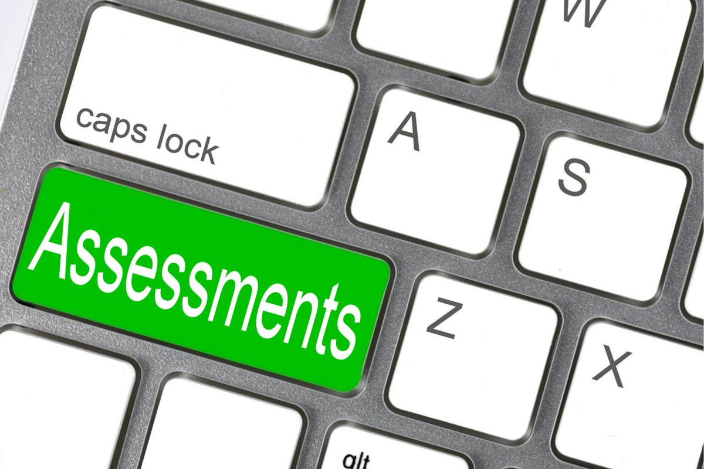
Definition of Assessment
A process of gathering relevant information to plan, evaluate, and make decisions (academic, transition, career, vocational, social).
•It is on-going— NEVER STOPS
•It produces GROWTH and DEVELOPMENT
OSSE Division of Specialized Education Secondary Transition Webinar Series
Notes:
“Transition assessment is an ongoing process of collecting information on the student’s strengths, needs, preferences, and interests as they relate to the demands of current and future living, learning and working environments.” All stakeholders should participate in the process of information gathering and decision-making.

Slide 16
Essential Questions to Ponder
•What are the student’s interests, aptitudes, and capabilities for future education, employment, and community living?
•Where does the student want to live, work, and/or go to school after leaving high school?

Slide 17
Assessment = TEST
Assessment = gathering information
Assessment can be formal, informal or a combination of both.
Notes:
Test and assessment are used interchangeably, but they do mean something different. A test is a “product” that measures a particular behavior or set of objectives. Meanwhile assessment is seen as a process instead of a product. Assessment is used during and after the instruction has taken place. After you’ve received the results of your assessment, you can interpret the results and adjust instruction, if needed. Tests are done after the instruction has taken place, it’s a way to complete the instruction and get the results. The results of the tests, unlike assessment, don’t have to be interpreted.

Slide 18
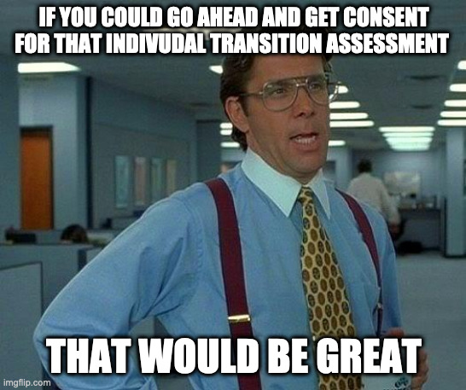
To obtain consent or not, that is the question...
Key Question: Does the IEP team have all the information needed to develop an IEP?
If YES, schedule an IEP team meeting
If NO,
Has the IEP team determined that additional transition information can only be acquired through individual assessment?
If the answer is YES to this question and the Individually given assessment is needed to fulfill IDEA program planning requirements for the student then parental consent is required - conduct RED
Signature should be obtained on the PWN as part of the evaluation process.
Notes:
Consent is needed to conduct any individual assessment. Any time that you need information that you will not be able to get it through classroom discussions, by talking with the student and parents at the IEP meeting, or by using information from tools used by all students in a classroom setting, course, grade or age-level, then you need an individual assessment requiring consent, so must start the evaluation process
(Notes for us: When I scoured LRP for information about when a reevaluation/consent is needed I kept finding that the IDEA connects the purposes of a reevaluation together. The purposes are to determine whether or not the student continues to be a student with a disability and continues to need special education services, and to get information needed to develop an appropriate IEP.

Slide 19
Consent is NOT needed:
When using assessments that are used for all students in a classroom, enrolled in a course, at a grade level, in a building, in a district or at the state level.
For teachers to collect anecdotal information during the course of instruction (Class discussion and group activities or individual assignments that explore employment, education/training or independent living; talking with parents to prepare for IEP meetings; parent questionnaires used to prepare for IEP meetings.)
Notes:
If information is needed for program planning in the IEP, including transition planning, and it can’t be gotten through one of the two ways listed above, then this should trigger a reevaluation.

Slide 20
Types of Transition Assessments

Slide 21
Examples of Transition Assessments
•Transition Planning Inventory (TPI)
•Learning style inventories
•Academic achievement tests
•Adaptive behavior scales
•Aptitude tests
•Interest inventories
•Self-determination assessments
Notes:
Transition Planning Inventories: help identify students goals, awareness, strengths and needs related to various aspects of adult living. This info is used to create an accurate list of transition goals and steps necessary towards attaining a quality of life.
Academic Achievement Tests: measure learning of general or specific academic skills.
Adaptive Behavior Scales: help determine the type and amount of personal assistance a person may need related to home-based support services, special education and vocational training, supported work, special living arrangements, or personal care.
Interest inventories can be considered formal or informal
Self Determination Assessments: help identify student readiness to make decisions about adult life by determining strengths and needs related to decision-making and choice-making and accepting responsibilities.

Slide 22
Cont. Transition Assessment Examples
Structured Interviews
Questionnaires
Direct Observations
Curriculum Based Assessments
Environmental Assessments
Personal future planning activities
Personality Tests
Job or Training Evaluations
Notes:
Interviews and Questionnaires: Can be conducted with a variety of individuals for the purpose of gathering info to be used to determine a students strengths, needs preferences and interest relative to anticipated post-secondary outcomes.
Discuss the difference between an interview and just asking the student “what do you want to be when you grow up”?
It is important to be intentional with the questions that are being asked. To simply throw two or three questions together and call that a sufficient interview would be called out of compliance if there is not be enough information to describe the student’s needs, preferences and strengths related to independent living, education/training and employment or if the information is not consistent with other information in the present levels.
Observations of student performance should be conducted within the natural environment, or school, employment, postsecondary, or community setting. Sometimes called “community-based or situational assessment”, direct observations can be often done by a job coach, co-worker, recreation specialist, general/vocational educator, and/or student. Direct observation data typically includes a list of steps required for completing a task, work behaviors (e.g., on-task, following directions, getting along with coworkers),and affective information (e.g., is student happy, excited, frustrated, or bored?).
Curriculum Based Assessments are typically designed by educators to gather information about a student’s performance in a specific curriculum and to develop instructional plans for a specific student. To gather these data, an educator might use task analyses, work sample analyses, portfolio assessments, and/or criterion-referenced tests
Environmental analysis, sometimes referred to as ecological assessment and/or job analysis, involves carefully examining environments where activities normally occur.A critical part of the analysis should be to identify the necessary academic and social skills, behavioral expectations and types of accommodations that could be provided to help a student perform the necessary functions of a particular job (e.g., job restructuring, modifying equipment, acquiring an adaptive device, re-organizing the workspace, hiring a personal assistant).

Slide 23
Grade-Level Assessments
In advisories or homerooms, transition assessments can be utilized as a pre/post-activity for:
A school-wide activity fair
Course selection for the following school year
Selecting school speakers
As a needs assessment for vocational preparation curricula
Assessments given by the school counselor to a whole class
Assessments conducted in personal finance/ career courses
Pre-ETS activities

Slide 24
When to Conduct Transition Assessments

Slide 25
When to start transition planning?
“Beginning no later than the first IEP in effect where the student turns 16 and annually thereafter…” (section 614)
You can start planning at a younger age if the IEP team determines it is appropriate
Student should be invited to the IEP meeting when transition services are being addressed
Notes:
To say: Read slide

Slide 26
What should I do first with transition planning?
Conduct Transition Assessments
Should address three areas:
Employment
Education and/or Training
Independent Living
Notes:
To say: Transition assessment is the ongoing process of collecting data on the individual’s needs, preferences, and interests as they relate to the demands of current and future working, educational, living, and personal and social environments
data serves as the common thread in the transition process. Transition Assessments forms the basis for defining goals and services to be included on the IEP.
MSIP 6 - Go to your counselors first because transition information is available. It is required for 8th grade and up! It also has to be revisited annually.

Slide 27
How: Embedding Transition Assessments within the IEP

Slide 28
How Should I Write a Transition IEP

Slide 29
How to Plan for Transition Assessments
Collaborate with all team members* – include the student and family in all decisions.
•Plan a sequence of assessment activities with target dates throughout each year—or refine what you do currently
•Begin the sequence in middle school and continue through exit from secondary education
*Include contingency plans: if someone leaves the team, be sure to replace him or her
OSSE Division of Specialized Education Secondary Transition Webinar Series

Slide 30
How to Plan for Transition Assessments
Obtain or develop protocols and procedures needed for transition assessment and planning
•Be creative when assessing (gathering information to make decisions)
•Contact other transition educators—ask them to share what they do
•Initiate new transition assessment activities or processes (e.g., community mapping, scavenger hunts on O*NET, administering support networks)
Assessment is an organized, routine, and ongoing process
Notes:
When choosing the type of transition assessment to be used, determine which assessment(s) will provide sufficient information to write appropriate post-secondary goals and determine appropriate transition services.

Slide 31
Transition Resources

Slide 32
Pre-ETS
Offers no-cost transition services to Missouri public school students with disabilities
Ages 16-21, who are eligible for vocational rehabilitation services.
These services are designed to make an impactful difference for students with disabilities at an earlier age which leads to better coordination, enhanced communication, stronger collaboration, and increased successful post-school outcomes.
Pre-ETS is contracted by the Missouri Department of Elementary & Secondary Education (DESE) division of Vocational Rehabilitation (VR).

Slide 33
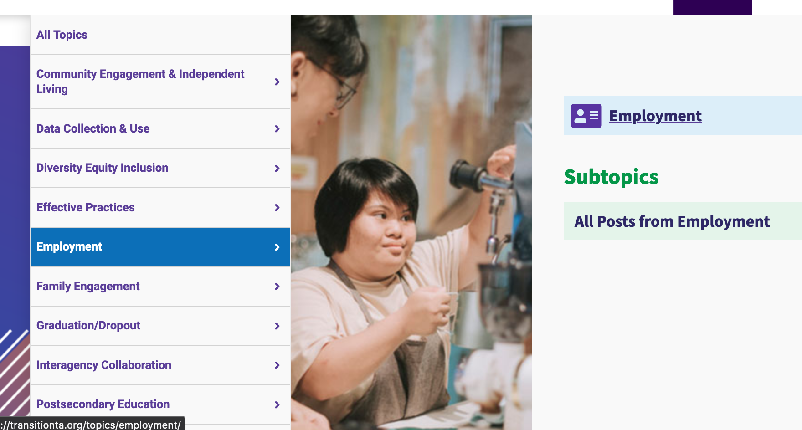
NTACT
National Technical Assistance Center on Transition
Provide information, tools, and supports to assist multiple stakeholders in delivering effective services and instruction for secondary students and out of school youth with disabilities

Slide 34
DESE Transition Newly Created Resource!
What to Know about Post-Secondary Transition for Tiered Monitoring Desk Reviews

Slide 35
Missouri Connections
Notes:
17 minute video!
https://drive.google.com/file/d/1etheJZbwJ3Sp_lsQJiKlsmN0T5agaz4Y/view?usp=sharing

Slide 36
Additional Resources
North Dakota Transition Matrix
Transition Coalition (Kansas)
Northeast Indiana Transition Assessment Matrix
Rhode Island Transition Assessment / Matrix
Quickbook of Transition Assessments
Transition Guide to Post-Secondary Education and Employment for Students with Disabilities- OSEP

Slide 37
RPDC Career Advisors Per Region
Region | Name | Email
1 Southeast | Marisa Bowen | mlbowen@semo.edu
2 Heart of Missouri | Jeffrey Beiswinger | beiswingerj@missouri.edu
3 Kansas City | Dr. Kyle Anderson | Kanderson@umkc.edu
4 Northeast | Polly Matteson | pmatteson@truman.edu
5 Northwest | Charlene Piel | cpiel@nwmissouri.edu
6 South Central | Jackie Marling | marlingj@mst.edu
7 Southwest | Laura Harris | lauraharris@missouristate.edu
8 St. Louis | Michelene Carbol | mcarbol@edplus.org
9 Central | Jay Webster | webster@ucmo.edu

Slide 38
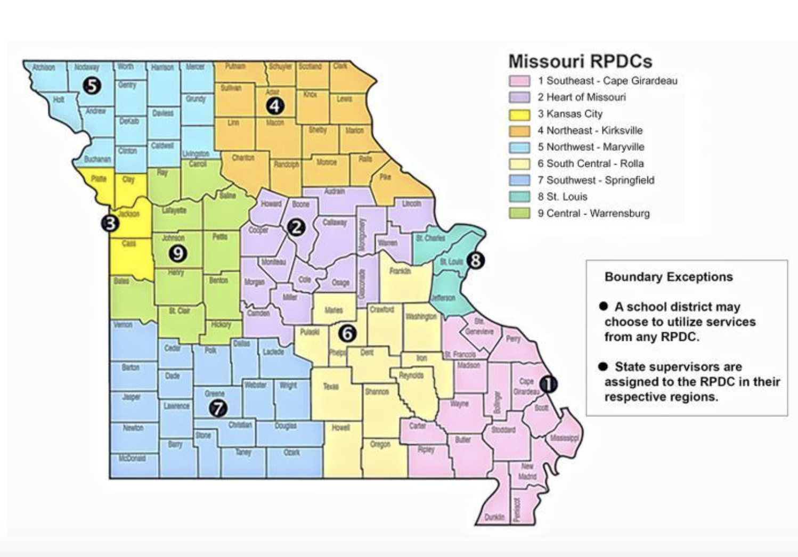
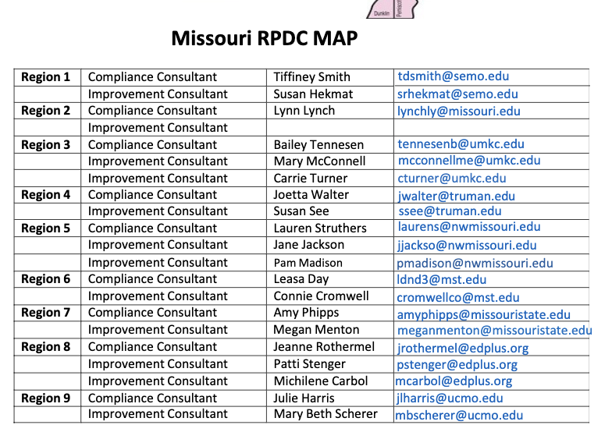
RPDC Contact Information

Slide 39
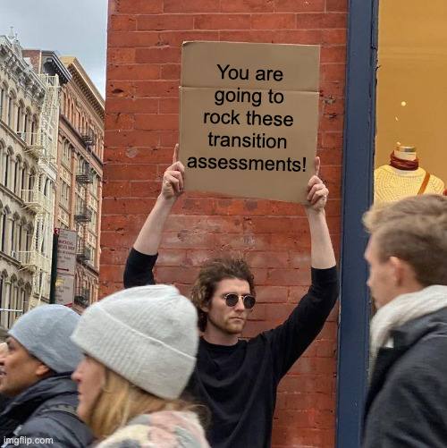
Thank you for participating!
Notes:
Thank you for participating in our session today. We hope the information presented has helped to provide guidance and clarification on DESE Updates for Special Education.
Insert information into slide

Slide 40
Questions from the Field

Slide 41
Exactly how many transition assessments do we need?
Notes:
As many as it takes to describe the needs, preferences, interests and strengths of the child in regards to independent living (when appropriate), education/training and employment.

Slide 42
If I need more information to meet an individual student’s program,
does this open up an evaluation and do I need consent for testing?
Notes:
It is important that IEP teams discuss what transition information they already know about the students needs, strengths and preferences in relation to education/training, employment and independent living (when appropriate). IEP teams need to ask themselves “Has the IEP team determined that additional transition information can only be obtained through individual assessment?”
If the team answers NO, then utilize information gathered through classroom discussions, classroom discussions, by talking with the student and parents at the IEP meeting, or by using information from tools used by all students in a classroom setting, course, grade or age-level. Consent would not be needed because this information has already been gathered.
If the team answers YES to this question then consent is required and triggers the evaluation process. Anytime an individual assessment is given and geared towards the specific student with the purpose is to fulfill a requirement of IDEA (which includes determining continued eligibility and writing an IEP) it requires parental consent. Signature should be obtained on the PWN as part of an Initial or Re-evaluation.

Slide 43
When should I be getting consent for giving transition assessments?
Notes:
Consent is needed to conduct any individual assessment when the purpose is to fulfill a requirement of IDEA (which includes determining continued eligibility and writing an IEP) . Any time that you need information that you will not be able to get it through classroom discussions, by talking with the student and parents at the IEP meeting, or by using information from tools used by all students in a classroom setting, course, grade or age-level, then you need an individual assessment requiring consent, so must start a reevaluation.
Take this out
A district generally doesn't need parental consent before performing post-secondary transition assessments. But if, as part of the transition assessment process, the IEP team decides to reevaluate a student because it needs additional data to address the student's special education or related services needs, then it would have to obtain the parents' consent before conducting the reevaluation. Letter to Olex, 74 IDELR 22

Slide 44
If the student already knows what job and type of education they are interested in, is a transition assessment necessary?
Notes:
Teams should have transition assessment information that describes the needs, strengths, interests and preferences of the student in regards to independent living (when appropriate), education/training and employment. If the transition assessment results do not cover all the areas listed above, additional assessment is needed. Transition assessment results may uncover information that the student does not know about themselves or affirm his/her interests in independent living, education/training and employment. This may assist the educator with discovering multiple jobs in the areas of interest that the student has based off their transition assessment results.

Slide 45
Can we use the same transition assessments for every student on our caseload?
Notes:
Transition assessment should be driven by what is already known and what must be determined in order to help a student write appropriate postsecondary goals. It is important that we look at each student individually and decide what assessment will be best in order to gain the most post-secondary information about each student’s needs, preferences and interests. Preliminary assessments with the whole class tend to be similar (such as an interest inventory). From this information, you may determine the need for more individualized assessment to meet a student’s unique needs. There may be transition assessments that you can utilize for more than one student, but one size does not always fit all, so be mindful of the variety of transition assessment resources out there for use.

Slide 46
Do I need to conduct transition assessments for a student that would be turning 16 within that 3-year evaluation timeline?
Notes:
The Individual with Disabilities Education Act (IDEA) requires that an IEP include a post-secondary transition plan, “beginning not later than the first IEP to be in effect when the child turns 16, or younger if determined appropriate by the IEP Team, and updated annually.” This transition plan facilitates the student’s movement to post-secondary school activities. Missouri’s school counselor curriculum provides tools for school counselors to assist eighth grade students with developing an individual career and academic plan (ICAP) before entering ninth grade. the ICAP includes a place to describe a student’s career path and cluster, additional postsecondary preparation programs, and postsecondary options. It also includes a course of study for high school. (Section 167.903 pertains to SB 638, 2016) So students may have some information you can use for transition planning when it is time to write the IEP that will be in place when the student turns 16. However, student interests may change in the years before the student turns 16 and therefore the student may need additional assessments as the child gets closer to the age of 16.

Slide 47
Is an interview enough?
Notes:
It depends. Discuss the difference between an interview and just asking the student “what do you want to be when you grow up”?
It is important to be intentional with the questions that are being asked. To simply throw two or three questions together and call that a sufficient interview would be called out of compliance if there is not be enough information to describe the student’s needs, preferences and strengths related to independent living, education/training and employment or if the information is not consistent with other information in the present levels. For example, if a student says in an interview he will be a professional basketball player but there is no other information to support that is an appropriate goal (the student didn’t try out for the high school team and hasn’t earned his PE credit yet) then the interview information was insufficient.

