Slide 1
Zoom Support Meeting Norms
Mute unless you are speaking to the group
Use the chat to ask questions
Be professional and helpful
Be mindful when asking questions about specific situations - don't give out any information that could reveal the identity of a person with a disability

Slide 2
Present Level of Academic and Functional Performance
Tips for Creating Compliant Present Level of Academic and Functional Performance Statements
February 2022

Slide 3
Terminology
Present Level of Academic and Functional Performance statement is sometimes referred to as:
  PLAAFP
  Present level
  PL
  PLP
  PLEP
Most common reference: PLAAFP

Slide 4
Before we Begin… A Few Assumptions
A comprehensive evaluation was conducted, eligibility was appropriately determined, and a compliant evaluation report was created
  A compliant PLAAFP can not be written from an evaluation report that does not meet compliance standards
An appropriate IEP team is convened, and each team member is actively engaged in developing the IEP
  Required IEP team members, plus any others who have knowledge of student and could provide input to develop IEP, should create the IEP
  If the parent excuses a team member from attending the IEP meeting, get team member input prior to meeting
  The more team members who contribute to the development of the IEP, the more robust and comprehensive the student’s IEP will become
  Team members should bring data to the IEP meeting to assist in drafting the IEP
Notes:
Be sure to mention

Slide 5
Before We Begin…A Few Assumptions
Begin With The End in Mind….
  The end goal of developing an IEP:
    Ensure provision of FAPE to student
    Enable the student to acquire skills, through the provision of special education and related services designed to meet their unique needs; and prepare them for further education, employment and independent living skills. (34 CFR 300.1)
If you don’t know where you are going, any road will take you there.
  “IEPs are the roadmap to student success.” Pete Wright, Wrightslaw.com

Slide 6
Present Level of Academic and Functional Performance
The “What”

Slide 7
Present Level of Academic and Functional Performance
Sec. 300.320 (a)
Statute/Regs Main » Regulations » Part B » Subpart D » Section 300.320 » a
(a) General. As used in this part, the term individualized education program or IEP means a written statement for each child with a disability that is developed, reviewed, and revised in a meeting in accordance with §§300.320 through 300.324, and that must include—
(1) A statement of the child’s present levels of academic achievement and functional performance, including—
(i) How the child’s disability affects the child’s involvement and progress in the general education curriculum (i.e., the same curriculum as for nondisabled children); or
(ii) For preschool children, as appropriate, how the disability affects the child’s participation in appropriate activities;

Slide 8
Present Level of Academic and Functional Performance
Academic AND functional performance definitions
  Neither defined in IDEA but discussed in OSEP guidance and IDEA commentary
Academic achievement:
  “Academic achievement” generally refers to a child’s performance in academic areas (e.g., reading or language arts, math, science, and history). We believe the definition could vary depending on a child’s circumstance or situation, and therefore, we do not believe a definition of “academic achievement” should be included in these regulations.” (71 Fed. Reg. at 46662)
  “The academic subjects a child studies in school and the skills the student is expected to master in each of the subjects such as reading and language arts, writing, math, science, history, and so on.”
  https://www.parentcenterhub.org/present-levels/

Slide 9
Present Level of Academic and Functional Performance
Sample “snippets”** of academic performance
  “Student has a current independent oral reading grade level of 2.0 and has a reading comprehension grade level of 1.5.”
  “Student can compute single digit addition facts with sums under 20 with 100% accuracy.”
  “Student’s writing skills have improved this year. According to his teacher, he is currently able to consistently construct a 4-sentence paragraph that consists of a topic sentence, 2 detail sentences and a closing sentence, without teacher assistance or prompting. He consistently uses appropriate end punctuation in his independent writings.”
  “Student’s most recent iReady reading assessment indicates he can identify all long and short vowel sounds when they are presented in nonsense words.”
  ** Not complete PLAAFP statements

Slide 10
Present Level of Academic and Functional Performance
Functional Performance:
  With respect to the meaning of “functional performance,” the Department of Education points to how the term is generally understood as referring to “skills or activities that are not considered academic or related to a child’s academic achievement.” This term “is often used in the context of routine activities of everyday living.” The reason that examples of functional skills were not included in IDEA was because “the range of functional skills is as varied as the individual needs of children with disabilities” (71 Fed. Reg. at 46661).
  “Routine activities of everyday living” refers to skills and activities of daily living skills such as:
    dressing, eating, going to the bathroom;
    social skills such as making friends and communicating with others;
    behavior skills, such as knowing how to behave across a range of settings; and
    mobility skills, such as walking, getting around, going up and down stairs.
  https://www.parentcenterhub.org/present-levels/

Slide 11
Present Level of Academic and Functional Performance
DESE IEP model form defines functional performance
  Functional performance refers to general ability and problem solving, attention and organization, communication, social skills, behavior, independent living, self-advocacy, learning style, vocational, employment
Sample “snippets”** that address functional performance
  “Student’s ability to solve problems in everyday life such as determining where to seek help when needed, how to dress appropriately for the weather and how to express wants and needs is limited in comparison to same age peers.”
  “Student learns grade level concepts best when presented with visual aides such as notes, graphic organizers and charts and graphs. He has difficulty retaining information presented auditorily.”
  “Student’s limited attention to task makes it difficult for him to independently complete teacher assigned tasks.”
  “Student is kind, social and compassionate. Student has a large circle of close friends. She often initiates play with her peers during recess and enjoys going to the first-grade classroom to read to younger students.”
  “Student is nonverbal and when frustrated will often bite, scream or kick to express needs.”
  **These are not complete PLAAFP statements

Slide 12
Present Level of Academic and Functional Performance
Must address both academic and functional performance of student
Must list areas of identified need and strengths
Performance must be be described using:
  Language that is clear to all stakeholders
  Data
  Comparisons to grade level standards or to same age/grade peers
Present level= describing the child’s current functioning

Slide 13
Present Level of Academic and Functional Performance
The “Why”

Slide 14
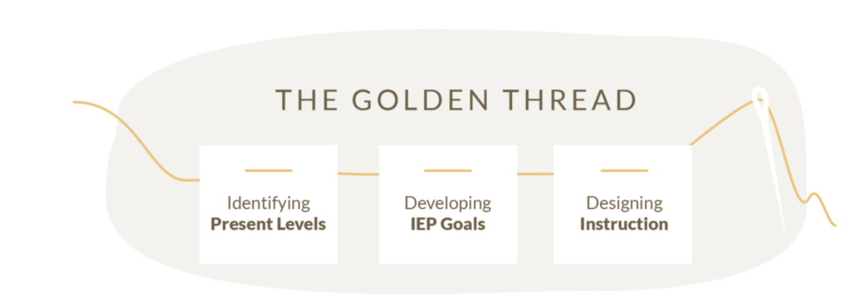
Evaluation Report: Eligibility Determination Data

Slide 15
Present Level of Academic and Functional Performance
Why is it important?
  The PLAAFP is the bridge between information contained in the evaluation report and acts as the foundation for an IEP that provides FAPE to the student.
  The “present levels” statement is intended to comprehensively describe a child’s abilities, performance, strengths, and needs. It is based on, and arises out of, all the information and data previously collected and known about the child, most especially the full and individual evaluation of the child that must be conducted in accordance with IDEA’s evaluation/eligibility provisions of §§300.301 through 300.311. A well-written present level will describe:
    the child’s strengths and weaknesses,
    what helps the child learn,
    what limits or interferes with the child’s learning,
    objective data from current evaluations of the child, and
    how the child’s disability affects his or her ability to be involved and progress in the general curriculum.
  The PLAAFP drives the creation of appropriate IEP goals, services, supports and placement.
  Present Levels (Component of the IEP) | Center for Parent Information and Resources (parentcenterhub.org)

Slide 16
Present Level of Academic and Functional Performance: Caselaw
Statement of Present Levels of Educational Performance
The statement of present levels of academic performance essentially creates a baseline for designing educational programming and measuring future progress. Bakersfield City Sch. Dist., 51 IDELR 142 (SEA CA 2008).
This section of the IEP that includes the child's PLAAFP must be all-encompassing so as to provide a baseline that reflects the entire range of the child's needs, including both academic (reading, math, communication, etc.), and nonacademic (daily life activities, mobility, etc.) areas. This statement should provide relevant background information about the child's areas of need, strengths, interests, and learning style. 34 CFR 300.324 (a).
The statement of PLAAFP should be individualized and reflect the student's unique abilities. See Letter to New, 211 IDELR 464 (OSEP 1987).
A statement of PLAAFP that is unclear or ambiguous could result in a denial of FAPE. In Clovis Unified School District, 109 LRP 69459 (SEA CA 10/19/09), the present levels of academic achievement and functional performance in a transfer student's existing IEP were too vague to be useful.
SpecialEdConnections: SmartStart: IEP- Statement of Present Levels of Educational Performance

Slide 17
Endrew F:
Finally, ED wrote that, so that the Endrew F. standard is met for each individual child with a disability, districts must implement policies, procedures, and practices related to:
  1) identifying present levels of academic achievement and functional performance;
  2) the setting of measurable annual goals, including academic and functional goals; and
  3) how a child's progress toward meeting annual goals will be measured and reported.
In Questions and Answers on Endrew F. v. Douglas County School District. Re-1, 71 IDELR 68 (EDU 2017)

Slide 18
Present Level of Academic and Functional Performance
Cohort 1 file reviews
  PLAAFP indicators made the statewide Top 10 list of indicators called out of compliance
  Regionally, #1 indicator called out of compliance
    39/80 files had one of the 200.740 indicators out of compliance
    17/22 LEAs had one of the 200.740 indicators out of compliance
Result of increased expectations for minimal compliance to ensure districts are meeting Endrew F standard of FAPE
  The Supreme Court determined that, “to meet its substantive obligation under the IDEA, a school must offer an IEP [individualized education program] that is reasonably calculated to enable a child to make progress appropriate in light of the child’s circumstances.”
  The Court additionally emphasized the requirement that “every child should have the chance to meet challenging objectives.”
    https://sites.ed.gov/idea/files/qa-endrewcase-12-07-2017.pdf

Slide 19
2021 Top Ten Indicators Out of Compliance
200.810.b – 92 student records, 64 LEAS: The IEP includes goals that are written in terms that are: Specific to a particular skill or behavior to be achieved, Measurable, Attainable (can reasonably be accomplished within the duration of the IEP), Results oriented, and Time-bound (generally happen within one year).
200.740.f – 85 student records, 56 LEAs: A statement of the present levels of academic achievement and functional performance: Addresses the academic, developmental, and functional needs of the child.
200.810.a – 80 student records, 56 LEAs: The IEP includes goals that demonstrate consistency with the content of the present level of performance.
4.200.180 – 75 student records, 23 LEAs: Eligibility staffing held within required timelines
5. 200.740.a – 73 student records, 49 LEAs: A statement of the present levels of academic achievement and functional performance: Is consistent with evaluation/reevaluation results in the evaluation report.
6. 200.740.c – 61 student records, 40 LEAs: A statement of the present levels of academic achievement and functional performance: Addresses how the child’s disability affects her/his involvement and progress in the general education curriculum.

Slide 20
Present Level of Academic and Functional Performance
A closer look at the PLAAFP related indicators
  200.740 A statement of the present levels of academic achievement and functional performance
    The IEP includes a statement of the child’s present level of academic achievement and functional performance that:
    200.740.a Is consistent with evaluation/reevaluation results in the evaluation report.
    200.740.b.Reflects changes in current functioning of the child since the initial/prior IEP.
    200.740.c. Addresses how the child’s disability affects her/his involvement and progress in the general education curriculum. (For preschool children, how the disability affects the child’s participation in appropriate activities.)
    200.740.d. Considers the results of the initial or most recent evaluation of the child.
    200.740.e Addresses the strengths of the child and the concerns of the parent(s) for enhancing the education of their child.
    200.740.f Addresses the academic, developmental, and functional needs of the child

Slide 21
Present Level of Academic and Functional Performance
200.740.a.Is consistent with evaluation/reevaluation results in the evaluation report**
PLAAFP serves as a link to the evaluation report and eligibility determination
  Golden thread of relevant information should flow from the evaluation report to the PLAAFP
  Disability category stated in most recent evaluation report is same as stated in PLAAFP
  Adverse educational impact statements in evaluation report should align with needs stated in the PLAAFP and lay the foundation for describing how the child’s disability impacts their involvement in the general education curriculum
  The PLAAFP should address all areas of adverse educational impact noted in the most current evaluation report
  Evaluation results summarized in PLAAFP must match the most current evaluation data
  **Your evaluation report could be the RED document if you conducted a reevaluation without assessment and eligibility category did not change

Slide 22
Present Level of Academic and Functional Performance
200.740.b.Reflects changes in current functioning of the child since the initial/prior IEP.
  Changes described using data comparisons from previous IEP cycle
  Include data from a variety of sources
    Progress monitoring data from previous IEP goals
    Classroom assessment data
    Teacher observations
    Parent reports
    State and district assessment data
    Behavioral data ( attendance, discipline data, Counselor reports)
    Health reports (updates from Dr reports, school health records, outside evaluations)
  This information provides baseline data for the formation of appropriate goals, services, and supports

Slide 23
Present Level of Academic and Functional Performance
200.740.c. Addresses how the child’s disability affects her/his involvement and progress in the general education curriculum. (For preschool children, how the disability affects the child’s participation in appropriate activities.)
  This is referred to as the “impact” statement
  Describes how the student’s disability impacts their involvement and progress in general education curriculum
    Describe student skill levels in comparison to grade level standards and/or typical peer development
    Use specific examples to clearly paint the picture of how the student’s disability impacts their involvement and progress in the general education curriculum.
  The information in this section needs to answer the question:
    How is the student’s education being adversely impacted by their disability to the point they need specially designed instruction?
  Avoid just stating the “what” (student’s disability category)

Slide 24
Present Level of Academic and Functional Performance
200.740.d. Considers the results of the initial or most recent evaluation of the child
  PLAAFP form requires a summary of initial or most recent evaluation results
  Summary must capture the highlights of the evaluation data
    No need to copy and paste entire evaluation report in the PLAAFP
    Summarize evaluation data that the IEP team needs to develop an appropriate IEP
  Include evaluation data and description of data’s educational/instructional relevance in PLAAFP
  This data links the evaluation report findings to the PLAAFP and helps to drive the development of subsequent IEP components
  Evaluation data reported in PLAAFP must match data reported in initial or most recent evaluation

Slide 25
Present Level of Academic and Functional Performance
200.740.e .Addresses the strengths of the child and the concerns of the parent(s) for enhancing the education of their child.
  2 Parts to this indicator
    Describe strengths of child
    Describe concerns of the parent for enhancing the education of their child
  Important to note student strengths as these can guide instruction and programming
  Parent input is critical to developing a compliant IEP
    Documentation of parent concerns in PLAAFP is one way to document parent engagement in IEP development process
    Ask open ended questions to acquire parent concerns
    Send home questionnaires or contact parents prior to meeting to gain information

Slide 26
Present Level of Academic and Functional Performance
200.740.f .Addresses the academic, developmental, and functional needs of the child
Academic and functional needs must be addressed for every child
Information in PLAAFP should paint a picture of the “whole child” not just a snapshot of academic performance

Slide 27
Present Level of Academic and Functional Performance
The “How”

Slide 28
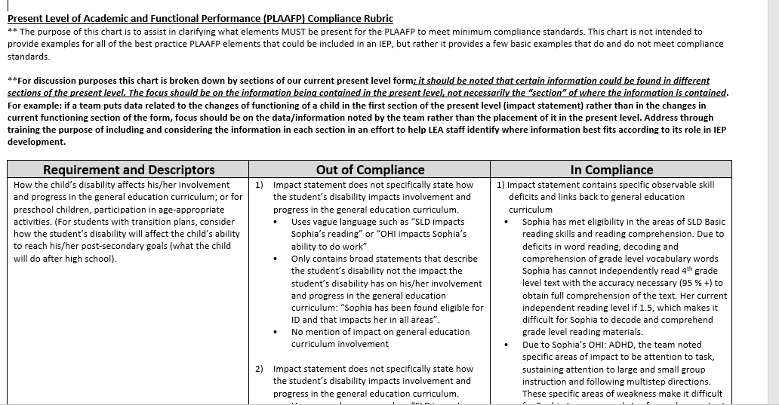
Present Level of Academic and Functional Performance Rubric

Slide 29
Present Level of Academic and Functional Performance Resources
DESE PLAAFP Rubric https://dese.mo.gov/media/pdf/present-level-academic-and-functional-performance-rubric
DESE Myth of the Month – PLAAFP MOM coming soon https://dese.mo.gov/special-education/compliance/general-guidance
IRIS Center PLAAFP Module: https://iris.peabody.vanderbilt.edu/module/iep01/cresource/q3/p06/
Parent Hub PLAAFP Information : https://www.parentcenterhub.org/present-levels/
LRP Special Ed Connection: Smart Start, Articles

