Slide 2
Thoughts for Today’s Meeting
Ask questions in chat at end of today’s session or email questions to
Tiffiney Smith: tdsmith@semo.edu
or
Jeanne Rothermel: jrothermel@edplus.org
Today is just an overview of assessment practices: Read and review supporting resources such as Myth of the Month and resources cited within presentation for deeper understanding of content provided today

Slide 3
Specific Learning Disability Follow Up Questions
1) What is an appropriate threshold to determine excessive absences?
2) I would like a better form for Psychological Processing Deficits that is more in line with what you discussed today.
3) Can you have observations completed before permission given on other areas of disability as well? I’m thinking of the Emotional Disturbance category.
4) Is there anything having a dyslexia diagnosis changes in regard to the process to determine eligibility? Or is this just another piece of the puzzle, and reason to suspect a disability?
Notes:
Before making the determination that a student has met SLD eligibility criteria, the team must consider the special exclusionary factors listed in Standards….Specifically the team has to rule out the lack of instruction in math and reading as being the PRIMARY cause of the student’s lack of achievement. If the student’s attendance records indicate the student has had a pattern of excessive absences then the team should examine what role the absences may be playing in the student’s underachievement. Students have to be in attendance in order to access instruction. If students are not attending school, they are missing out on critical instruction, especially in core content areas such as reading and math. Research has shown that if a student is not in attendance at least 90% of the given school days, their learning is greatly impacted. A key point to keep in mind when determining the impact of a student’s absences on their achievement, is that learning is individual and contextual to the learner. For some students, a few days of absences can greatly impact their achievement levels, whereas other students may miss a few days, and their achievement will not be impacted as much. Individuals are unique in their learning profiles and their regression levels. Each student’s attendance record should be analyzed within the context of the learner and within the context of the pattern of absences (when did the absences occur? Start of year, end of year, all throughout year, over multiple years, just one year, early elementary during rapid growth of early literacy and math skills?)
Teams are advised to align their consideration of attendance rates with the desired attendance rate established with their board policy. If the attendance rate of the student falls below the accepted attendance rate of their board policy, then teams should analyze how the lack of attendance could be impacting the student’s ability to receive benefit from instruction in reading and math.

Slide 4
Specific Learning Disability Follow Up Questions
5) Does auditory processing fall under SLD?
6) How can teachers assist students who are slow learners?
7) What to do with slow learners who may have 22 point discrepancy?
8) What about slow learners and the use of professional judgment?
Specific Learning Disability (SLD) Q & A

Slide 5
Evaluation and Assessment Guidance
April 21, 2022

Slide 6
Evaluation and Assessment Guidance
Common Vocabulary: Defining Assessment, Evaluation, Test
Purpose of Evaluation
Setting the Stage for Appropriate Evaluations
Guiding Principles for Assessment Practices
Action Steps
DESE Assessment Myth of the Month

Slide 7
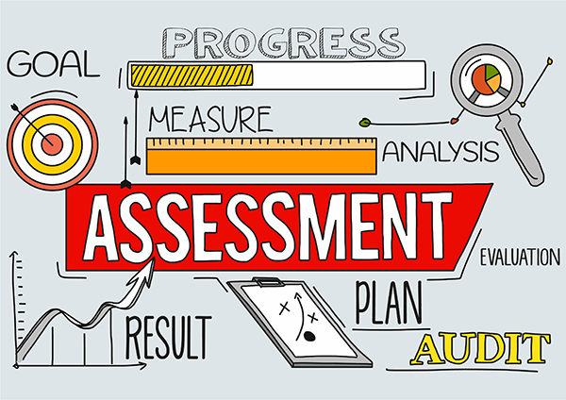
Assessment
Assessment: The processes of systematically observing, gathering, and recording credible information to help answer referral questions and make decisions. Assessment is an inquiry based, problem solving process.

Slide 8
Evaluation
Evaluation: Procedure used to determine whether a student has a disability under IDEA and the nature and extent of the special education and related services that the student needs.

Slide 9
Test
Test: One type of data collection tool. It measures a student’s mastery of a skill or knowledge of content. There are many kinds of tests; norm referenced and criterion referenced are the most common. Tests are also commonly referred to as “measures” or “instruments” or “assessments”.

Slide 10
Purpose of Evaluation
Evaluations under IDEA serve a dual purpose
Remember: Evaluation=D²
Determine eligibility under IDEA
Direct educational decision making for the student

Slide 11
Setting the Stage for Evaluations
Evaluations must be driven by the referral concerns
Referral RED Evaluation

Slide 12
Setting the Stage for Evaluation
What specific concerns prompted the referral?
Have those concerns been adequately described in the Review of Existing data?
Are there other concerns that came up in the RED discussion? Are they adequately described?
What specific tests or other assessment measures would line up with the concerns noted? Have we tailored the assessments to the child?
Are we accustomed to giving all kids the same assessments whether they need them or not?

Slide 13
Clinical (Professional) Judgement in the Evaluation Process
Clinical expertise and professional judgement are woven into the entire evaluation process. Decisions are made based on data at all points.

Slide 14
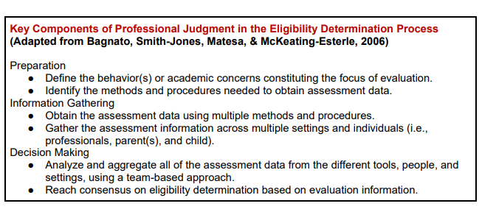

Slide 15
High Cost of Not Getting It Right
Disability “labeling” life long consequences
Lower academic expectations
Lower achievement
Fewer post secondary options

Slide 16
Assessment Practices

Slide 17
IDEA Evaluation Requirements
No single measure or assessment is used as the sole criterion for determining eligibility and educational programming for a student.
Assessment is conducted in all areas related to the suspected disability.
The evaluation is sufficiently comprehensive to identify all of the student’s special education and related services needs.
A variety of assessment tools and strategies are used to gather relevant information to determine educational needs of the student.
Technically sound instruments are used.
Assessments must be conducted by trained and knowledgeable assessment staff.
34 CFR 300.304 and Missouri State Plan for Special Education Regulation III

Slide 18
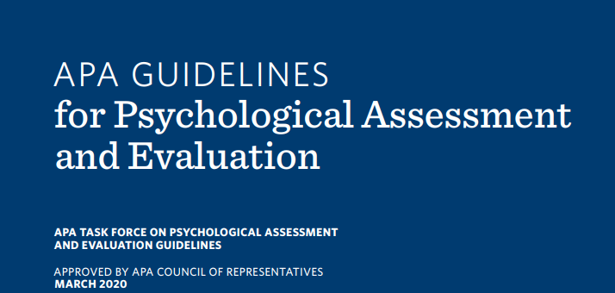
Evaluation and Testing Standards of Practice
Code of Fair Testing Practices in Education
APA Guidelines for Psychological Assessment and Evaluation
Standards for Educational and Psychological Testing

Slide 19
Code of Fair Testing Practices in Education: Guiding Principles
Selecting Appropriate Tests
Qualifications of Assessment Users
Technical Knowledge
Assessment Administration
Assessment Scoring
Interpreting Assessment Results
Communicating Results
(2014) Joint Committee on Test Practices which is a collaborative effort between American Counseling Association (ACA), the American Educational Research Association (AERA), the American Psychological Association (APA), the American Speech-Language-Hearing Association (ASHA), the National Association of School Psychologists (NASP), the National Association of Test Directors (NATD), and the National Council on Measurement (NCME).

Slide 20
Selecting Assessment Tools
Individualized assessment
Norm Referenced tests
Criterion Referenced tests
Observations
Interviews
Assessment selection is thoughtful, intentional and inquiry driven based on the unique needs of the student
What areas of concerns and needs did the team identify during the referral and RED process?
What questions do you want answered?
What specific data do you need?
Does the assessment assist in answering the questions or address concerns brought forward in the referral and RED process?

Slide 21
Selecting Assessment Tools: Comprehensive Evaluation
Comprehensive evaluation does not necessarily mean giving the entire battery of a norm referenced test
Data collected during the RED and referral process should drive the selection of assessment tools
Avoid over testing by clearly identifying the data that needs to be collected to address the individualized student concerns

Slide 22
Idaho Training Clearinghouse: Avoiding Over Assessment
As the team creates an assessment plan, it is important to ensure that team members are only conducting assessments that provide necessary and relevant information.
Watch the Avoiding Over Assessment video for more information.

Slide 23
Qualifications of Assessment Users
Qualified assessment users must demonstrate appropriate education, training, and experience in using tests and measurements
Assessment users should posses a deep understanding of the assessment tool, as well as, a high level of skill administering them
Qualifications for test administrators are set forth by test publishers (not DESE) , based on professional standards
Staff should not administer assessments for which they are not qualified to administer

Slide 24
Qualification Guidelines
Pearson’s Qualifications Policy
The "Qualified User" is the individual who assumes responsibility for all aspects of appropriate test use, including administration, scoring, interpretation, and application of results. Some tests may be administered or scored by individuals with less training, as long as they are under the supervision of a Qualified User. To assist the qualified user, each test manual will provide additional detail on administration, scoring and/or interpretation requirements and options for the particular test.

Slide 25
Qualifications of Assessment Users
Qualification “B”: Masters, formal training on assessment of children
Woodcock Johnson IV Achievement (WJ IV ACH)
Wechsler Individual Achievement Test IV (WIAT 4)
Vineland 3
Qualification “C”: Doctorate, or Licensed Psychologist, Psychological Examiner
Wechsler Intelligence Scale for Children V (WISC V)
Stanford-Binet Test Fifth Edition (SB5)
Woodcock Johnson Cognitive IV (WJ COG IV)

Slide 26
Qualification of Assessment Users
Many assessments require a higher level of training for staff who interpret the assessments.
“Only individuals who have received professional training in educational or psychological assessment should interpret the results of the WIAT III.” -WIAT III User Manual
“Competent interpretation of the WJ IV ACH requires a higher degree of knowledge and experience than is required for administering and scoring the tests. Graduate-level training in standardized assessments and a background in diagnostic decision-making are requisite. The level of formal education necessary to interpret the WJ IV ACH is typically documented by successful completion of an applicable graduate-level program of study that includes, at a minimum, a practicum-type course covering administration and interpretation of standardized test of academic achievement.” WJ IV ACH, Manual

Slide 27
Qualification of Assessment Users
Staff should keep proof of training for each assessment they administer and interpret
Training activities could include manual study groups, publisher provided trainings and online webinars, individual self study trainings, LASE group trainings, RPDC trainings, assessment trainings provided by national organizations such as APA, NASP, etc
Each time a test is updated, additional training is required.

Slide 28
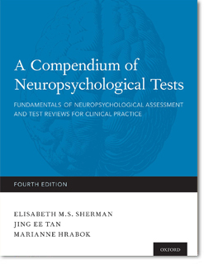
Technical Knowledge
Technical aspects of the test should be reviewed for:
Validity: The degree the tool measure and identify what it’s intended to measure
Reliability: Consistency of the tool to measure same construct over time, between raters, and over multiple administrations of test
Error of Measurement: Estimate in the amount of error of the test.
Normative samples: The population used to norm the test can influence the mean and the reliability of the test.
Technical information can be found:
Test manual
Buros.org Buros Center for Testing online test reviews
Professional Organizations

Slide 29
Technical Knowledge
Users should know the intended purpose and scope of the assessment
Assessments should only be used for the purpose intended (ie screener vs comprehensive test of achievement)
Users should understand the limitations of the assessment
Validity coefficients
Reliability coefficients
How constructs are measured on test
Item density (sufficient floor and ceiling)
Norm stratification method (inclusive of special populations, diverse cultural groups,etc. )
Date assessment was normed and published (Flynn Effect)

Slide 30
Technical Knowledge
When should we update our tests to the newest edition?
In order for tests to retain their validity and reliability it is important for the most current editions of the assessments to be used. While there is no clear rule regarding the time frame required to transition to the newest edition of a test, there is a “community standard” or professional consensus that you should switch to the newer test edition within one year of publication. (Pearson, When to Upgrade to the Newest Revision of a Test)

Slide 31
Technical Knowledge
What do specific tests measure?
Review the test manual for information related to:
Task complexity charts
Task demand charts
Input, Process, and Output demand charts
Constructs assessed and how they are assessed
Adaptive behaviors vs maladaptive behaviors
Reading (cipher knowledge vs reading outcome)
Broad and narrow abilities of intelligence

Slide 32
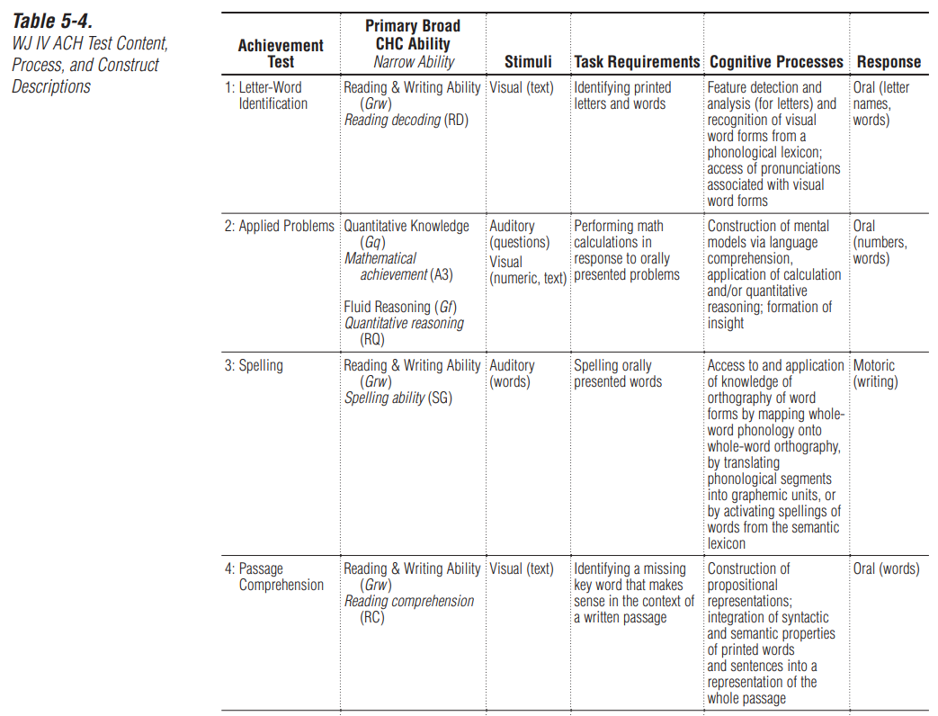
Task Demand Chart Example WJ IV ACH
WJ IV ACH
Technical Manual, pg 127

Slide 33
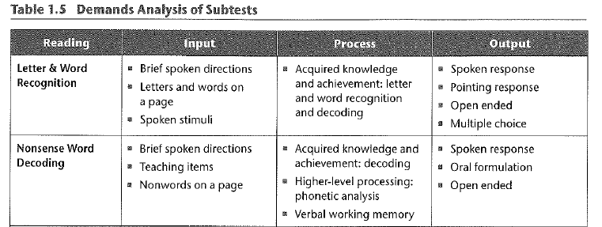
Task Demand Chart Example KTEA 3
KTEA 3 Administration Manual, pg 8-13

Slide 34
Technical Knowledge
Achievement tests measure cognitive processes paired with an academic skill
WIAT and KTEA manuals: “Student engages in the expected cognitive process when responding to the test item (academic skill)”
Norm-referenced tests of achievement are not valid measures of a student’s mastery of curriculum or grade level standards.
They do not measure mastery or progress towards curriculum or state standards
They are not validated for this purpose
Limited scope and breadth of items for each age and grade
Best way to measure mastery or progress toward attainment of curriculum or grade level standards is using curriculum based measures (CBMs)
Intellectual Development and Specific Learning Disability: The Role of Norm-Referenced Tests, Dr. Edward Schultz

Slide 35
Assessment Administration
Follow ALL standardized testing procedures to maintain validity of test results
Starting points, basals, ceilings, practice items
Following directions “with precision”
Queries and prompts
Time limits
Materials
Breaks and number of testing sessions
Order of administration
Use of manipulatives and required technology for administration
Feedback
If any non-standardized assessment procedures are used then they MUST be described in evaluation report.
Know thy manual!!!!

Slide 36
Assessment Administration
Non-standard Administration Guidance:
Any scores obtained from non-standard administration of an assessment should be used primarily for descriptive, informative purposes.
The evaluator must recognize and document that the scores cannot be interpreted because the scores obtained are inaccurate and misleading.
Any scores reported must be clearly identified as estimated scores and should be reviewed with extreme caution.

Slide 37
Assessment Administration
Be sensitive as to when you pull students for testing sessions
Avoid pulling from preferred activities
Build rapport with students
“Establishing a relationship conducive to eliciting the examinee’s best performance is one of the most important preconditions for accurate individual testing.” KTEA 3 Manual
Note behavioral observations during testing session in the evaluation report
Behavior observations during testing can provide valuable insight and data

Slide 38
Assessment Scoring
Follow test manual for basal and ceiling rules
Give credit for all allowable responses, adhere to standardized scoring procedures
Double check calculation of raw scores
If any outlier scores are obtained, recheck scoring or contact test publisher for explanation. You want an answer for this before other stakeholders ask.

Slide 39
Interpreting Assessment Results
Accurate interpretation of assessment results requires an understanding of psychometric statistics and knowledge of assessments
2 Levels of assessment result interpretations
Intra-assessment
Cross assessment
Interpretation of assessment results should ALWAYS follow test manual guidance
Pearson and Riverside Insights offer several free interpretation webinars and resources on their websites

Slide 40
Interpreting Assessment Results
Norm Referenced Tests (NRT) compare an individual child’s performance to that of the norming group
NRT compare the child to similar children on a given set of skills and knowledge
NRT standard scores do not provide information about what the child does and does not know
Scores on NRT indicate the student’s ranking or position relative to the norming group
NRT standard scores fall into a normal distribution or a naturally occurring distribution of scores
Notes:
The WISC-V was normed on 2,200 children while the WJ IV was normed on over 7,000 children

Slide 42
Interpreting Assessment Results
Standard Score (SS): A type of score, in which the student’s raw score is converted to a standard unit of measurement;
Often reported for index scores, composite scores, domain scores
SS distribution has known values for the mean and standard deviation.
Normal distribution: Mean=100, Standard Deviation= 15
Refer to assessment manual for mean and standard deviation of specific assessment.

Slide 43
Interpretation of Assessment Results
Percentile Rank:
Percentile Rank indicates the status or relative standing of an individual within a specified group (e.g., norms group), by indicating the percent of individuals in that group who obtained lower scores.
For example, if a 12 year old student earned a 75th Percentile Rank on the test of Oral Language, this would mean he or she scored better than 75 percent of the 12 year old students in the norm group who were administered that same test of Oral Language.
This also implies that the only 25 percent (100 - 75) of the norm group scored the same or higher than this student.
Glossary of Testing, Measurement and Statistical Terms, Riverside Insights, 2014

Slide 44
Interpreting Assessment Results
How do you select a normative sample to use as a comparison?
Age based norms vs grade based norms
Review updated publisher recommendations
Important to know the difference between the two sets of norms and the appropriate use of each set

Slide 45
Interpreting Assessment Results
Age based norms provide for comparison against other children of the same age
Grade based norms provide for comparison against other children of in the same grade

Slide 46
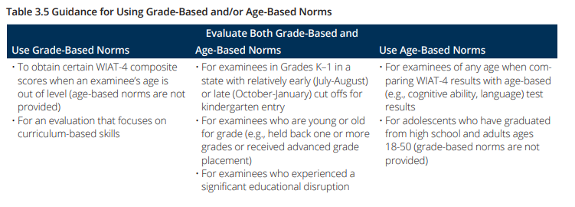
Interpreting Assessment Results
Special Considerations for Score Interpretations, Pearson 2020
What Norms Should I Use? Riverside Insights, 2020

Slide 47
Interpreting Assessment Results
“When comparing WIAT-4 (or any other achievement assessment) results with age-based (e.g., cognitive ability, language) test results as part of a comprehensive evaluation, age-based norms are necessary so that all test results are being compared to a similar reference group.”
Special Considerations for Score Interpretations, Pearson 2020.

Slide 48
Interpreting Assessment Results
Choosing a particular score simply because it is lower, is higher, or meets eligibility criteria is inappropriate, as all scores must be considered within the context of other data sources and other information about the child.
New Mexico Technical Evaluation and Assessment Manual, 2017

Slide 49
Communicating Assessment Results
Report all levels of scores obtained
Include charts and graphs of results in addition to narrative describing constructs assessed on each test and subtest

Slide 50
Communicating Assessment Results
Be familiar with score reports and resources each assessment can provide
Vineland: Item score comparison between raters, intervention suggestions, task complexity
BASC: F Index looks for negative distortion of ratings, C Index looks for consistency within respondent’s rating, intervention suggestions
KTEA: Error pattern analysis and corresponding goal suggestions
WIAT 4: Error analysis and corresponding goal suggestions

Slide 51
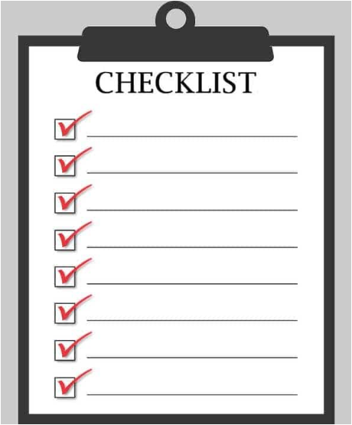
Action Steps
Review process used when determining which assessment tools to use
Check versions of tests you use, see if you need to update
Review training levels of all assessment staff
Plan for training on the various assessments your system uses

Slide 52
RPDC Assessment Specific Training
Virtual: WIAT 4 Administration and Interpretation: June 14 and 15, 2022 9am-12pm
Virtual: KTEA 3 Administration, Scoring, Interpretation and Error Analysis September 13 and 20, 9am-12pm
For additional information contact: Tiffiney Smith tdsmith@semo.edu

Slide 53
RPDC Assessment Specific Training
In person, WJ IV Cognitive Administration and Interpretation, Fall 2022, Southeast RPDC
In person, Battelle-3 Administration and Interpretation, Fall 2022, Southeast RPDC
In person, Assessment Of Learning Academy, Dr. Edward Schultz, 3 sessions throughout the 2022-2023, Southeast RPDC, focusing on intellectual, academic, language and executive functioning development and assessment

Slide 54
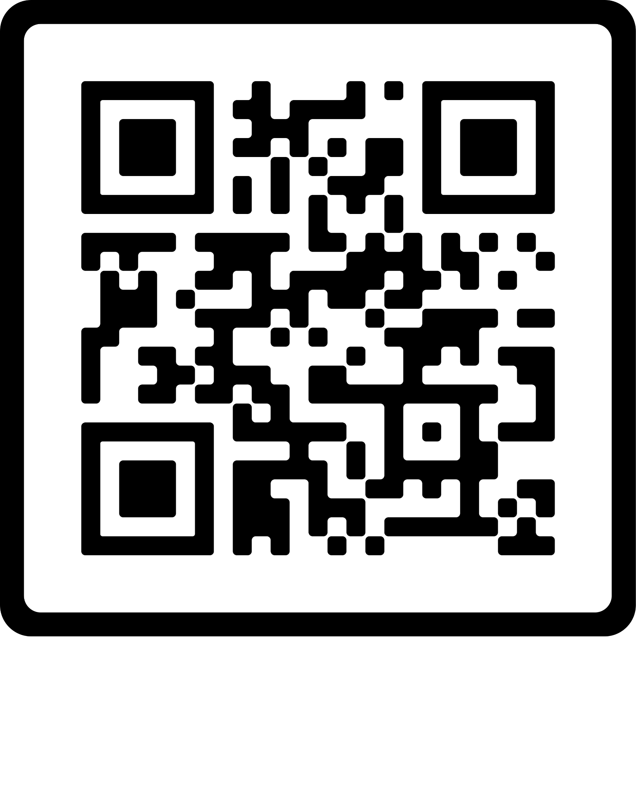
Please Fill Out Our Survey
Survey Link:
https://forms.gle/RJd25C7Q6PXPGeqW8
Scan Me

