Slide 2
Specific Learning Disability
April 7, 2022

Slide 3
Processing Pause
Listen for connections
Extend your learning by applying this information to your current practices
Process the information in entirety beyond this one hour session
Send us your questions
Tiffiney Smith tdsmith@semo.edu
Jeanne Rothermel jrothermel@edplus.org
Join us again on April 21

Slide 4
Virtual Emotional Support Animals

Slide 5
Specific Learning Disability (SLD)
What is a Specific Learning Disability?
SLD By the Numbers
SLD Understanding the Criteria

Slide 6
SLD Defined
34CFR 300.8 (c) (10)
(i) General. Specific learning disability means a disorder in one or more of the basic psychological processes involved in understanding or in using language, spoken or written, that may manifest itself in the imperfect ability to listen, think, speak, read, write, spell, or to do mathematical calculations, including conditions such as perceptual disabilities, brain injury, minimal brain dysfunction, dyslexia, and developmental aphasia.

Slide 7
SLD Defined (cont.)
34CFR 300.8 (c) (10)
(ii) Disorders not included. Specific learning disability does not include learning problems that are primarily the result of visual, hearing, or motor disabilities, of intellectual disability, of emotional disturbance, or of environmental, cultural, or economic disadvantage.
Notes:
Will discuss exclusions later in this presentation.

Slide 8
SLD Defined
Missouri State Plan For Special Education, Regulation III
Specific Learning Disability means a disorder in one or more of the basic psychological processes involved in understanding or in using language, spoken or written, which may manifest itself in an imperfect ability to listen, think, speak, read, write, spell, or to do mathematical calculations. The term includes such conditions as perceptual disabilities, brain injury, minimal brain dysfunction, dyslexia, and developmental aphasia. The term does not include learning problems that are primarily the result of a visual, hearing , or motor disability; intellectual disability; emotional disturbance; cultural factors; environmental or economic disadvantage; or, limited English proficiency.

Slide 9
SLD Defined
Involve difficulties in one or more basic psychological processes:
Input (difficulty processing information through auditory and visual means; receptive language) | may impact reading, spelling, writing; understanding and using language
Integration (sequencing, abstraction, organization) | may impact prioritizing, organizing, doing mathematics and following instructions
Memory (working short term and long term memory) | may impact storing or retrieving information from short or long term memory
Output (expressive language) | may impact using spoken language

Slide 10
SLD Defined
SLD is: | SLD is not:
Neurodevelopmental disorder which impacts functioning of the neurological system and neural pathways in the brain | Lack of appropriate instruction (frequent moves, homeschooling without verification of instruction) Excessive absences Lack of appropriate evidence based interventions, done with intensity and fidelity

Slide 11
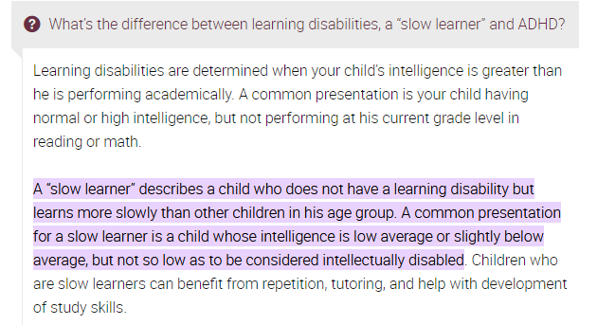
SLD Defined
The learning difficulties are “unexpected” in that other aspects of development seem to be average or above average
Expert Q & A: Specific Learning Disorder, American Psychiatric Association, 2020
Notes:
Understanding the Dual Discrepancy Consistency Model for SLD Identification Dawn P. Flanagan, Ph.D. St. John’s University, New York Yale Child Study Center, School of Medicine
Some Specific learning disability definitions contain cognitive referencing language.

Slide 12
SLD And Young Children
At present, no clear distinction can be made in the early years between the children whose problems may persist from those who will make adequate progress with time. Therefore, young children who demonstrate difficulties in early development may or may not be at risk for LD; nevertheless, screening, evaluation, enhanced learning opportunities, and possibly intervention services should be provided. It is not in the child’s best interest to “wait and see” or hope that the child will “grow out of” his or her problems. Conversely, it is important to guard against the premature identification of a disability, especially if high quality learning opportunities have not been provided…
It is important to recognize that there is a wide range of individual differences, both within and between children, some of which may fall within the “normal” range of expected behaviors
Learning Disabilities and Young Children: Identification and Intervention, National Joint Committee on Learning Disabilities

Slide 13
SLD By The Numbers

Slide 14
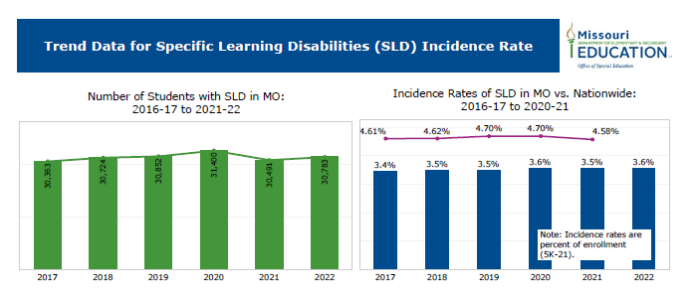

Slide 15
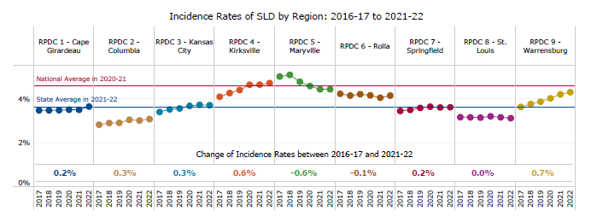

Slide 16
SLD Eligibility Determinations and Criteria

Slide 17
Eligibility Determination Grounding Assumptions
Eligibility determinations are:
Complex and require (clinical expertise) and data analysis beyond the parameters of a mathematical formula
Based upon multiple sources of informal and formal data which is gathered using valid and reliable measures
Reliant on the convergence of multiple data sources (which support eligibility)
Life altering for the student
Notes:
Understanding the Dual Discrepancy Consistency Model for SLD Identification Dawn P. Flanagan, Ph.D. St. John’s University, New York Yale Child Study Center, School of Medicine
The implementation of any eligibility criteria must always be guided by the preponderance of evidence standard:
Valid and accurate data is gathered to address identified areas of concern
Clinical expertise and collaborative data analysis is used at each step of the evaluation process
Convergent data is present to support an eligibility determination
(Use of Preponderance of Evidence in Determining SLD Eligibility, Idaho State Department of Education)

Slide 18
Eligibility Determinations
Driven by 3 factors:
Does the student meet the eligibility criteria for one or more of the 16 eligibility categories as set forth by Missouri Standards and Indicators?
Does data confirm the suspected disability causes adverse educational impact?
Does the suspected disability cause adverse educational impact to the degree that the student needs special education (specially designed instruction)?

Slide 19
SLD Eligibility Determinations
IDEA allows states flexibility when determining how to identify student who may have an SLD under IDEA.
According to the 2006 IDEA regulations (§300.307) concerning SLD, each state must adopt criteria for determining whether a child has a specific learning disability as defined by §300.8 (c)(10), requiring that states
1. Must not require the use of severe discrepancy between intellectual ability and achievement for determining whether a child has a specific learning disability as defined in §300.8 (c)(10);
2. Must permit the use of a process based on the child’s response to scientific, research-based intervention; and
3. May permit the use of other alternative research based procedures for determining whether a child has a specific learning disability as defined in §300.8 (c)(10); (IDEA, 20 U.S.C.§ 1414 (b)(6)(A)
Notes:
States vary on what methods they require for SLD identification. This can create confusion in out of state SLD transfers scenarios.

Slide 20
SLD Eligibility Determinations
Missouri’s SLD Eligibility criteria can be found in the 1400’s section of the Standards and Indicators
No component of the eligibility criteria should be viewed in isolation.
All criteria should be examined together in order to form a complete picture of the student’s functioning.

Slide 21
SLD Eligibility Criteria
1400.10 Areas of Inadequate Achievement
A comprehensive evaluation report is present and documents:
The child does not achieve adequately for the child’s age or to meet State approved grade-level standards in one or more of the following areas, when provided with learning experiences and instruction appropriate for the child’s age or State approved grade-level standards.
1400.10.a Basic Reading Skill
1400.10.b Reading Comprehension
1400.10.c Reading Fluency Skills
1400.10.d Written Expression
1400.10.e Mathematics Calculation
1400.10.f Mathematics Problem Solving
1400.10.g Listening Comprehension
1400.10.h Oral Expression

Slide 22
SLD Eligibility Criteria - RTI
1400.20 Methods of eligibility determination
Response to Scientific Research-Based Intervention Method (RTI)
1400.20.a Documentation is present that agency procedures for identification of a child with Specific Learning Disabilities were followed
1400.20.b Instructional strategies used and the student-centered data collected
1400.20.c Documentation that the child’s parents were notified about:
1400.20.c(1) the State’s policies regarding the amount and nature of student performance data that would be collected and the general education services that would be provided.
1400.20.c(2) Strategies for increasing the child’s rate of learning, and;
1400.20.c(3) The parents’ right to request an evaluation

Slide 23
Response to Intervention Guidance
Missouri RTI documents:
RTI Guidelines
RTI Guidance

Slide 24
Virtual Emotional Support Animals

Slide 25
SLD Eligibility Criteria – Discrepancy Method
1400.20 Methods of eligibility determination
Discrepancy Method
The Child exhibits a pattern of strengths and weaknesses in performance, achievement, or both, relative to age, State approved grade-level standards, or intellectual development
1400.20.d Evidence of a pattern of strengths and weaknesses
AND
1400.20.e Discrepancy of at least 1.5 standard deviations between achievement and intellectual ability
Notes:
IDEA: The child does not make sufficient progress to meet age or State-approved grade-level standards in one or more of the areas identified in 34 CFR 300.309(a)(1) when using a process based on the child’s response to scientific, research-based intervention; or the child exhibits a pattern of strengths and weaknesses in performance, achievement, or both, relative to age, State-approved grade-level standards, or intellectual development, that is determined by the group to be relevant to the identification of a specific learning disability, using appropriate assessments, consistent with 34 CFR 300.304 and 300.305;
the following question may be asked: Do the results of the student’s assessments and evaluations show a pattern of strengths and weaknesses in her academic performance, achievement (or both), or in intellectual development? Patterns of strengths and weaknesses commonly refer to the examination of profiles across or within tests that have typically been used to determine SLD, such as standardized achievement tests and aptitude (IQ) tests. Sometimes referred to as intra-individual differences or variability, these patterns of strengths and weaknesses are particularly relevant to the identification of SLD. Recognition of a discrepancy between ability and achievement, previously required for SLD identification, could also be considered as part of this step.

Slide 26
SLD Eligibility Criteria – Discrepancy Method
A few words about discrepancy data -
Normative achievement data should always be “anchored” to other data pieces such as informal assessments, work samples, observations, classroom assessments, district assessments
Discrepancy criteria is only one piece of the SLD eligibility criteria
Discrepancy data alone will not establish or refute SLD eligibility

Slide 27
SLD Eligibility Criteria – Discrepancy Method
Intellectual Ability
The full scale IQ score should be used to represent the student’s intellectual ability unless there is a clinically compelling reason (as defined by the publisher of the cognitive measure) to use another score for SLD eligibility determinations.
A full, comprehensive standard measure of cognitive ability should be used unless there is a clinically compelling reason to use another type of cognitive measure (ie non-verbal)
The clinically compelling reasons for NOT using the full scale score or a full, comprehensive cognitive measure should be clearly documented in the evaluation report
Notes:
Clinically compelling= statistically significant and unusual discrepancy exists per test publisher

Slide 28
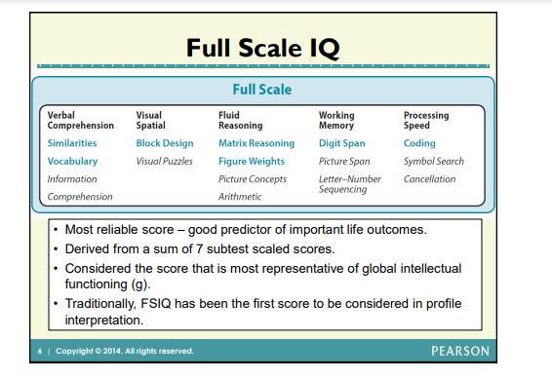
Webinar: Advanced Interpretation of the WISC-V, 2015, Pearson

Slide 29
General Ability Index (GAI)
Webinar: Advanced Interpretation of the WISC-V, 2015, Pearson
Notes:
General Ability Index

Slide 30
SLD Eligibility Criteria – Discrepancy Method
Academic Achievement
The discrepancy method requires a standardized measure of academic achievement that provides a standard score
Discrepancy between intellectual ability and achievement can not be based on one academic achievement subtest score
See Discrepancy Score Chart posted on DESE website for further guidance

Slide 31
Discrepancy alone SLD Eligibility
Must have other pieces of convergent data to substantiate SLD eligibility

Slide 32
SLD Eligibility Criteria – Discrepancy Method
Patterns of strengths and weaknesses
The Child exhibits a pattern of strengths and weaknesses in performance, achievement, or both, relative to age, State approved grade-level standards, or intellectual development
1400.20.d Evidence of pattern of strengths and weaknesses
A pattern of strengths and weaknesses can be defined as data pattern that over time repeats and predicts
Intraindividual differences or variabilities a hallmark trait of SLD
Informal and formal data sources can be used as evidence of a pattern of strengths and weaknesses (benchmark data, progress monitoring data, classroom assessment data, student work samples, standardized achievement data, observation data, cognitive ability profile data, etc.)

Slide 33
SLD Eligibility Criteria – Discrepancy Method
“When you’re trying to meet discrepancy you’ll need to use a calculator but, if you’re trying to understand learning, you’ll need to use the test manual. Looking only for the discrepancy is missing the boat of why we are giving the test. We give tests to understand the student’s level of learning not just to meet a mythical number.”
Dr. Edward Shultz, Riverside Insights Woodcock Johnson IV
Notes:
Each academic achievement measure has a manual. Each manual will describe what the tests measure and how to interpret the cognitive processes involved in each of the tests. It’s important to read the manual to fully understand how to interpret the test results. Error analysis and examine task demands for each test.

Slide 34
SLD Eligibility Criteria – Professional Judgement
1400.20 Methods of eligibility determination
Professional Judgement
1400.20.f A child who exhibits a pattern of strengths and weaknesses as noted above but does not display a discrepancy of at least 1.5 standard deviations as defined above, may be deemed to have a specific learning disability through the use of professional judgment.
AND
1400.20.g Documentation must include evidence that the child is not achieving adequately or making sufficient progress based on a review of formal and informal assessments.

Slide 35
SLD Eligibility Criteria – Professional Judgement
Multiple sources of data (informal and formal assessments) must confirm areas of inadequate achievement and a pattern of strengths and weaknesses
Observation(s) are still required to substantiate lack of achievement in suspected subcategories of SLD
Evaluation report should clearly outline the data based decision making process the team used for determining SLD eligibility based on professional judgement

Slide 36
SLD Eligibility Criteria – Professional Judgement
Districts cannot implement a policy that prohibits the use of professional judgment for SLD eligibility determinations.
A district may violate the IDEA by focusing solely on test results in determining whether a student has SLD. The District Court in V.M. v. Sparta Township Board of Education, 63 IDELR 184 (D.N.J. 2014), criticized the district's failure to consider other evaluative data after its calculations showed less than 1.5 standard deviations between a 10-year-old boy's intelligence and achievement scores. The court held that the district's procedures for SLD eligibility determinations, which required it to focus solely on the statistical formula, violated state and federal law. (Special Ed Connections, LRP)

Slide 37
SLD Eligibility Criteria - Observation
1400.30 Observation
The public agency must ensure that the child is observed in the child’s learning environment (including the regular classroom setting) to document the child’s academic performance and behavior in the areas of difficulty.

Slide 38
SLD Eligibility Criteria - Observation
1400.30 Observation
1400.30.a Information from an observation in routine classroom instruction and monitoring of the child’s performance done before the child was referred for an evaluation
OR
1400.30.b Observation by a qualified professional in the regular classroom after the child has been referred for an evaluation and parental consent is obtained

Slide 39
SLD Eligibility Criteria - Observation
1400.30 Observation
1400.30.c Relevant behavior noted during the observation related to the subcategory of Specific Learning Disability suspected and the relationship of the behavior to the child’s academic functioning.
1400.30.d The observation report must contain the name and title of the qualified professional conducting the observation.

Slide 40
SLD Observation Guidance
Missouri Observation Resources:
SLD Observation Chart
Observation Zoom
Observation Powerpoint
Golden Thread Observation Form

Slide 41
SLD Observation Guidance
A few key reminders…
Observations must contain data to support all areas of suspected SLD
Observations must contain data that supports underachievement in the suspected areas of SLD and adverse educational impact in order to support SLD eligibility determination

Slide 42
Notes:
https://www.pattan.net/getmedia/56d1bb3c-2e53-4cce-bfd4-821ee333871b/RtII-SLD
This chart illustrates how observations help support the eligibility determination and how observations can either rule in or rule out SLD.

Slide 43
SLD Eligibility Criteria – Addition Group Members
1400.40 Additional Group Members
1400.40.a The child’s regular education teacher
OR
1400.40.b If the child does not have a regular teacher, a regular classroom teacher qualified to teach a child of his/her age
OR
1400.40.c For a child of less than school age, an individual qualified to teach a child of his/her age

Slide 44
SLD Eligibility Criteria – Additional Group Members
1400.40 Additional Group Members
1400.40.d At least one person qualified to conduct individual diagnostic examinations of children such as a school psychologist, school psychometric examiner, speech/language pathologist, special education teacher or remedial reading teacher.

Slide 45
SLD Eligibility Criteria-Special Requirements for SLD Evaluation Reports
In interpreting evaluation data for the purpose of determining if a child is child with a specific learning disability:
1400.50.a The public agency must document relevant medical findings
OR
If no relevant medical findings, this must be noted in the evaluation report

Slide 46
SLD Eligibility Criteria-Special Requirements for SLD Evaluation Reports
In interpreting evaluation data for the purpose of determining if a child is child with a specific learning disability:
1400.50.b Each team member must certify in writing whether the report reflects her/his conclusion(s).
If it does not, the group member must submit a separate statement presenting the member's conclusion.
NOTE: This requirement is not applicable to parent(s) of a child
Notes:
Each member participating in the determination must provide written certification that the documentation reflects the member’s conclusion. If any member(s) disagree with the conclusion, a statement of that member(s) conclusion must also be included in the documentation.

Slide 47
SLD Eligibility Criteria-Special Requirements for SLD Evaluation Reports
The report includes a statement that the group considered as part of the evaluation:
1400.50.c Data that demonstrates that prior to or as part of the referral process the child was provided with appropriate instruction in the regular education settings, delivered by qualified personnel and
1400.50.d Data based documentation of repeated assessments of achievement at reasonable intervals, reflecting formal assessment of student progress during instruction, which was provided to the child’s parents.
Report should include what the repeated assessments of academic achievement entail (i.e. benchmark data, progress monitoring data, classroom formative and summative assessments etc.)
Notes:
Commentary to fed regs:The Department believes that good instruction depends on repeated assessments of a child’s progress. This allows teachers to make informed decisions about the need to change their instruction to meet the needs of the child, and also provides parents with information about their child’s progress so that they can support instruction and learning at home. Parents should be informed if there are concerns about their child’s progress and should be aware of the strategies being used to improve and monitor their child’s progress. We understand the commenters’ requests for more specific details on timelines and measures of adequate progress. However, as noted above, these decisions are best left to professionals who have knowledge about the instructional models and strategies used in their States and district

Slide 48
SLD Eligibility Criteria-Specific Exclusionary Factors
The team determines that its findings of a Specific Learning Disability are not primarily the result of :
1400.60.a A visual, hearing or motor disability
1400.60.b Intellectual Disability
1400.60.c Emotional Disturbance
1400.60.d Cultural Factors
1400.60.e Environmental or economic disadvantage
1400.60.f Limited English proficiency
1400.60.g Lack of appropriate instruction in reading, including the essential components of comprehensive literacy instruction
1400.60.h Lack of appropriate instruction in math
Notes:
Students with or without disabilities often have one or more factors that may contribute to academic and learning difficulties. The evaluation team must rule out any of these factors as the primary cause of a student’s academic and learning difficulties to determine/maintain eligibility for special education services.
The fundamental principle underlying this rule is that a child should not be regarded as having a disability if (1) he or she has not been given sufficient and appropriate learning opportunities or (2) the child’s academic struggles are primarily due to other factors.
Students whose lack of achievement can be attributed primarily to one of the following factors should not be determined to have an SLD.

Slide 49
SLD Eligibility Criteria-Specific Exclusionary Factors
National Joint Committee on Learning Disabilities Definition of Learning Disabilities
Learning disabilities are disorders that are intrinsic to the individual.
Problems in self-regulatory behaviors, social perception, and social interaction may exist with learning disabilities but do not by themselves constitute a learning disability.
Although learning disabilities may occur concomitantly with other disabilities (for example, sensory impairment, emotional disturbance), or with extrinsic influences (such as cultural or linguistic differences, insufficient or inappropriate instruction), they are not the result of those conditions or influences.
National Joint Committee on Learning Disabilities, 2016
Notes:
Primary cause of learning difficulties or low achievement vs contributing factor. Teams have to rule out that other factors are the primary cause of the student’s low achievement. Many student’s with SLD have additional factors that may be contributing to their low achievement but team’s need to rule out that they are not the primary cause of the learning difficulties.
Low SES or environmental disadvantage is often times misidentified as SLD
: Book study:Poverty Is NOT a Learning Disability Equalizing Opportunities for Low SES Students
Edited by:Tish Howard - Washington Mill Elementary School
Sandy Grogan Dresser - SGD Consulting
Dennis R. Dunklee - Emeritus, George Mason University, Virginia, USA
Mislabeled as Disabled: The Educational Abuse of Struggling Learners and How WE Can Fight It Paperback – March 14, 2019
by Kalman R. Hettleman (Author)

Slide 50
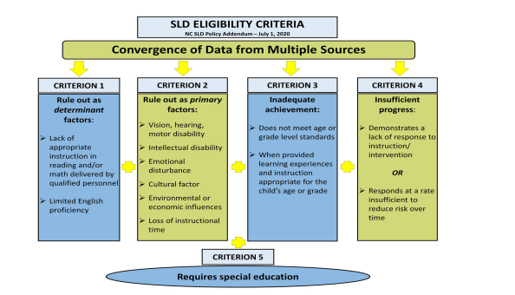
SLD Identification and Pandemic Impact
National Association of School Psychologists: The Pandemic’s Impact on Special Education Evaluations and SLD Identification
Notes:
The Pandemic's Impact on Special Education Evaluations and SLD Identification
Realigning the Order of SLD Identification Criteria to Mitigate the COVID-19 Effect As school psychologists know, the 2006 IDEA Regulations specify that, for a student to be identified with an SLD, four criteria must be fulfilled, and the student must also display a significant degree of need to qualify for special education. The criteria are: (a) the student must fail to meet age- or grade-level standards in one of eight academic areas, (b) the student must either display a lack of progress in response to scientifically based instruction (i.e., RTI) or display a pattern of strengths and weaknesses in performance and/or achievement, (c) other disabilities or situational conditions must be ruled out as the primary cause of the student’s academic difficulties, and (d) the student’s academic difficulties must not be primarily a function of a lack of instruction. Our colleagues in North Carolina recognize the unique circumstances caused by the COVID-19 pandemic (North Carolina Department of Public Instruction, 2020) and have rendered these criteria plus the degree of need in a unique way (see Figure 1). This depiction has particular relevance to how the evaluation for SLD is carried out after the pandemic school closure because it envisions the process as starting with the rule-outs of lack of instruction and other factors, rather than concluding with it. That is, it emphasizes the need to establish (or in this case, reestablish) core instruction and evidence-based interventions as the first and most important task not only for all students but particularly for students who might be considered for SLD identification National Association of School Psychologists: The Pandemic’s Impact on Special Education Evaluations and SLD Identification

Slide 51
Specific Exclusionary Factors Considered
Exclusionary Factor resources:
Idaho Exclusionary Factors Worksheet
Texas Exclusionary Checklist for Eligibility Teams
What a Specific Learning Disability Is Not

Slide 52
SLD Eligibility Action Steps
Understand the definition of a specific learning disability
Understand the ethical assessment practices involved in making eligibility determinations
Fully explore each piece of the criteria for eligibility as a student with a specific learning disability

Slide 53
Jeanne Rothermel: jrothermel@edplus.org
Tiffiney Smith: tdsmith@semo.edu

