Slide 1
What You Will Need
Participants will need a device to access the internet
Each participant will need the following Reading Rope supplies
  Eight pieces of yarn/string - 18 inches long
  Ten address labels* - If presenting virtually, 2 X 2.5 inch sticky notes. (*Masking or painters tape can be used in place of labels.)
  “Script” Instructions for making the Reading Rope
Notes:
To Know: Hide this slide when presenting. This is the list of needed supplies.
This module is the introduction to a series of six other professional development modules for literacy to be anchored in the science of reading.
Participants will need access to the Google slides later in the presentation to share thoughts on the Simple View of Reading. https://docs.google.com/presentation/d/1GFKhOrAYj2ZvNeG9Nx-d6mkwA-oehJu-DZdX9rFRuW0/edit?usp=sharing

Slide 2
What You Will Need
Handouts Required for Training
Handout #1 - Reading Rope (slide #14)
Handout #2 - Your Incredible Brain (slide #19)
Handout #3 - Data Flowchart for Literacy Development Decisions
Google slides for participant sharing https://docs.google.com/presentation/d/1GFKhOrAYj2ZvNeG9Nx-d6mkwA-oehJu-DZdX9rFRuW0/edit?usp=sharing
Notes:
To Know: Hide this slide when presenting. This is the list of needed supplies.

Slide 3
Introduction
Components of Effective Literacy
Module 1
2021
Notes:
To Say: The purpose of this training is to introduce the components of literacy as anchored in the science of reading. There are six additional modules that are designed to address the elements skilled readers possess as well as the instructional components necessary to produce success in reading. Each session is designed to be completed sequentially.

Slide 4
Welcome and Introductions
Notes:
To Know and To Do: Please add introductory information here to introduce yourself to the group.

Slide 5
Learner Intentions
Participants will
Consider the research behind the Simple View of Reading
Understand the interrelated skills needed for developing skilled readers according to the Reading Rope
Explore the science of reading and the Reading Brain
Examine the use of the Flowchart for Literacy Decision Making to determine where to begin instruction for struggling readers
Prepare to gather information to align our instruction for reading with the evidence of what works in reading instruction
Notes:
To Know: This module will be the first in a series of research-based modules that will address phonological and phonemic awareness, phonics/spelling connections, assessment, vocabulary, comprehension, and writing.
To Do: Review the learning intentions for the day.
To Say: These are our learning intentions for this module. By the end of the module, you will understand the importance of the Simple View of Reading in terms of how it impacts reading instruction. You will understand the interrelated skills of the Reading Rope and how it relates to the Simple View of Reading. You will see how our brain processes reading, understand where we need to begin instruction for struggling readers, and find out what the research says is necessary to teach reading.

Slide 6
Missouri Teacher Standards
The following Missouri Teacher Standards will be addressed today
Standard #1: Content knowledge aligned with appropriate instruction
Standard #2: Student Learning, Growth and Development
Standard #3: Curriculum Implementation
Standard #7: Student Assessment and Data Analysis
Notes:
To Know: These are the teacher standards we will address today.
To Do: Direct participants to the slide.
To Say: If you need to document for your professional development reference, here are the Missouri Teacher Standards that we will be addressing today. I will pause a moment while you note these. We will address Standards #1, #2, #3, and #7.

Slide 7
Norms
Be present
Turn cell phone off or silence
Minimize sidebar conversations
Take care of personal needs with minimal distractions
Ask questions
Have open hearts and open minds
Be patient
Notes:
To Know: There are norms for virtual or face-to-face, so please place the norms that fit your group into the slides so that all attending are comfortable and ready to learn the expectations needed for their building or district.
To Do: Use norms and expectations that fit the group and situation.
To Say: Today, we are going to ask that you be present with us by considering how this learning fits into what you already do. It will either confirm some things you are already doing or it might push you to consider what might be different, according to research, on what works in the world of literacy development. We would ask that you have cell phones on silent and minimize sidebar conversations or distractions. We will take formal breaks. So, please take care of personal needs with minimal distraction.
Since our goal is to apply the content to you and your students, we hope you will ask questions to clarify the content and how it relates to you and your students. As you open your mind to confirm your practices or align your practices with research, we know it takes patience and a heart for doing what is best for students. We deeply appreciate your professional passion and drive to share, learn, and apply for student success.

Slide 8
Virtual Norms
Ask questions using chat box or unmute
Engage fully using the clock icon should you need to step away
Integrate new information
Open your mind to diverse views
Utilize what you learn
Adapted from: Mallia, G. (2013). The social classroom: Integrating Social Network Use in Education.
Notes:
To Say: Stay open to what you are hearing. Everything we are sharing with you is research-based on what good reading instruction looks like. Are there additional norms you would like to add for the sake of the group?

Slide 9
Child at kindergarten screening
“ I don’t know how to make books talk to me yet.”
Remember, this is what we do,
“We help make the books talk to the kids.”
Emily Twiehause - Instructional Coach
Notes:
To Know and To Say: We will pause a moment, so that you can read the screen.
This represents what we desire all students to aspire to in literacy. Our goal is to make reading come to life for students of all ages. It also speaks to us today to remind us that it is a skill that can be learned. They do not possess these skills YET. But, there are answers to allow every student the right to read. We want books to speak to students, to call their names, and take them to a world and life beyond where they are at that moment.

Slide 10
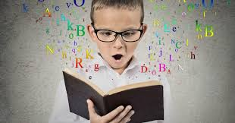
What is Reading?
Stop and Jot
Your definition of reading
Notes:
To Know: Allowing participants to frame their thinking about reading helps to focus what they believe and understand with the end in mind for reading instruction.
To Do: Ask participants to jot down their thoughts. They will return to these later in the presentation.
To Say: Take two minutes to write your definition of reading. We will look at them later in the presentation.

Slide 11
Reading Research
Notes:
To Know: This is the Section Header
To Do:
To Say: Let’s start with the research foundation.

Slide 12
https://docs.google.com/presentation/d/1GFKhOrAYj2ZvNeG9Nx-d6mkwA-oehJu-DZdX9rFRuW0/edit?usp=sharing
Research Simple View
https://www.readingrockets.org/article/
simple-view-reading
What resonated with you from your exploration?
What are questions to post for us to consider as we move forward?
Notes:
To Know: This is an article regarding the Simple View of Reading to begin the discussion of the definition of reading. It is from the Reading Rockets website. You may want to plan for 7-10 minutes for this activity. If this is virtual, you may want to have participants post in the chat box or use the next slide to annotate. Participants will need the reading link: https://www.readingrockets.org/article/simple-view-reading
Participants will also need the link for the Google slides to add their thoughts and questions: https://docs.google.com/presentation/d/1GFKhOrAYj2ZvNeG9Nx-d6mkwA-oehJu-DZdX9rFRuW0/edit?usp=sharing
NOTE: If internet access is difficult, you may want to have printed copies of the article available. You will need to post two links in the chat for participants to access.
To Say and Do: Reading Rockets is a national multimedia project that is a clearinghouse of research-based reading strategies, lessons, and activities designed to help young children grades K-3 learn to read. Much of the this reading module was based on information from the Reading Rockets website. Even though the activities on this site are designed for younger students, the steps in the reading process are steps that need to be followed for students of all ages. This specific article outlines the Simple View of Reading which is a formula for the understanding and teaching of reading. You will not need to watch the video. We will share two links in the chat. The first link will give you access to the article in Reading Rockets. The second link will take you to our shared Google slides where you can post your thoughts. Right now, I am going to show you how to access and navigate the document.
Step 1: Tell participants that you will be providing two links in the chat. One will be a Google Document where they will note their thoughts and questions. The other will be the link to the article to read.
Step 2: Direct attention to your screen as you show them how to use the Google Document.
Step 3: Direct the participants attention to the top left corner of the screen. Each slide will have a number for the participants to claim as their slide. Show them how to find the slide number typed in the upper left corner and click in the box to change the text in the box.
Step 4: Assign each participant a slide. Ask them to note their name or initials in the small box with the number in the top left corner.
Step 5: Place the link in the chat for participants to access. Go to the Google Document. Wait to see that the participants have claimed their slide. Ask if there are any clarifying questions. Place the link for the Reading Rockets site in the chat. The Google Slide will be set up for participants to type on during the presentation. You will be able to access the template for your own use in the module directions. You will need to clear the conversations after each presentation should you want to use the slide again.
If Virtual:
To Do: Number of participants to designate who has which slide to make notes of the learning.
To Say: I am going to assign a slide for you to make notes of your learning. As you read, please take a moment to go to the Google Slides to find the slide with your number to add your thoughts and questions. What can I clarify for you?

Slide 13

Sharing Thoughts
Notes:
To Know: This page can be used if you are presenting virtually, and you want your participants to post answers to the prompts from the questions on the previous slide. Others may chose to type in the chat. If you have a small group, they can unmute and share.
To Say: Based on what you read about the Simple View of Reading, let’s go back and read what others have posted.
We would like to have an open conversation about your celebrations. You can take a moment to add a star in the presenters notes section located under this slide and type your thoughts.
What is one thing you saw that was similar to you?
What was one thing that was vastly different from yours?
You can unmute or share some common thoughts.

Slide 14
Simple View of Reading
D X LC = RC
Decoding
Word recognition
Language Comprehension
Reading Comprehension
Gough and Tunmer (1986)
Notes:
To Know: The Simple View of Reading is a formula demonstrating the widely accepted view that reading has two basic components: word recognition (decoding) and language comprehension.
To Say: Let’s recap on what we read in this article. The Simple View of Reading is a formula demonstrating the widely accepted view that reading has two basic components: word recognition (decoding) and language comprehension. The simple view formula has been supported and validated by a number of research studies. Understanding the formula will help educators with assessing reading weaknesses and providing appropriate instruction.
In this model
D represents Decoding which is defined as, “efficient word recognition."
LC represents Language Comprehension or, “the ability to derive meaning from spoken words."
Multiplied together you have RC or Reading Comprehension. Reading Comprehension is defined as, “the ability to perceive words and derive meaning from print."
Notice the formula is one involving multiplication not addition. That’s important because it means when one is weak you can’t just compensate with a heavier dose of the other. A student needs both to be a successful reader. Reading comprehension scores will NOT be an average of decoding (D) skills and language comprehension (LC).
Intervention for struggling readers is effective only when it addresses the student’s specific weakness, which may be decoding, language comprehension, or both.
Intervention instruction focused on developing content knowledge or comprehension strategies will benefit struggling readers only if they have a weakness in language comprehension.
Struggling readers of all ages can have decoding weaknesses; explicit instruction in decoding will be necessary to improve their reading comprehension.

Slide 15
Simple View of Reading
D X LC = RC
Decoding
Word recognition
Language Comprehension
Reading Comprehension
.50
x
1
.50
=
Notes:
To Say: In the Simple View formula, the values of D and LC must be between 0 and 1 (or 0 percent and 100 percent). A score of ‘0’ means no skill or ability at all, while ‘1’ indicates perfection. A student’s reading comprehension will always be equal to the lowest variable of decoding or language comprehension. An example of this is a student who has poor decoding skills and would score at .50 or greater and scores a 1 in language comprehension skills. When you multiply the .50 by 1, you will get an overall reading comprehension score of .50.
The Simple View formula makes it clear that strong reading comprehension cannot occur unless both decoding skills and language comprehension abilities are strong.
We must teach students to decode expertly as early as possible. When students can decode expertly, their reading comprehension capabilities equal their language comprehension abilities.
We must provide students with strong content knowledge in many domains at all grade levels in order for them to develop adequate language comprehension abilities.

Slide 16
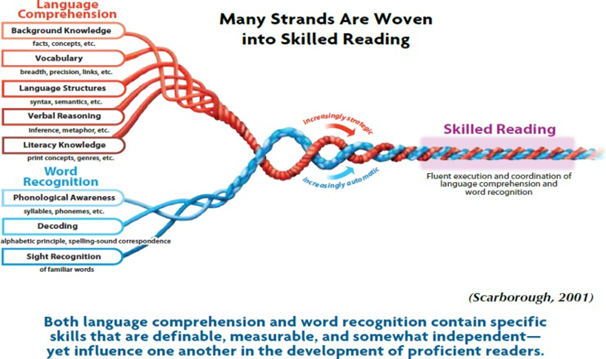
Reading Rope
Handout #1
Notes:
To Know: You will follow the “Script” instructions for the Reading Rope and explain the elements of reading. (Estimated Time: Eight minutes)
To Do: Provide supplies for making the Reading Rope. Follow the “Script” Instructions for making the Reading Rope.
To Say: One of the other anchors that came out of those researching the different elements of reading to target for intervention and instruction was Scarborough’s Reading Rope. At this time, I would like you to build the Reading Rope, and label the elements that are needed for skilled readers. These are the skills good readers fluently combine to comprehend building meaning from print. Take a moment to place your string, yarn, or pipe cleaners, address labels or sticky notes in front of you. If we were face-to-face, we would have the labels printed for you using the elements listed in the boxes on the left side of each strand. Please take a minute to place those terms on your labels or sticky notes.

Slide 17
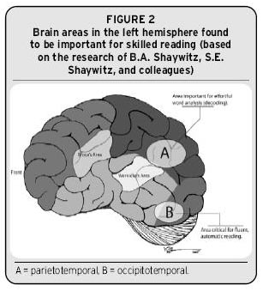
Brain Imaging and Reading
fMRI
Functional Magnetic Reasoning Image
Sally Shaywitz
Brain Activation
Reading Rockets
Notes:
To Know: Current research has begun to reveal where the processing occurs inside the brain (Papanicolaou, Pugh, Simos, and Mencl (2004) and Richards (2001)) have great descriptions.
To Do:
To Say: While some research projects looked to identify the elements we could develop more intentionally through intervention or instruction in literacy, others began to look inside the human body to see how we learn. Brain imaging provides us with the reality of what actually happens inside of a person’s brain as they read. How many of you have ever had an MRI? (Pause to give participants time to respond). So, you know that an MRI will light up to show regions of the brain where blood flow (activity processing) is happening. Advances in MRI have led to what we call Functional Magnetic Reasoning Image or fMRI which map which sections of the brain are active.
Sally Shaywitz was the first to find that you can actually look at the brain to find which areas are linked to reading. The portions of the brain that are activated during reading light up when reading and will appear during an fMRI. Images of the brain taken during reading tasks with strong readers looks different than those who are struggling readers. There was a definite signature of non-activation in people who were struggling readers no matter the age or grade. This led to even more studies looking at brain activity. Sally opened the door for us to start identifying which regions needed to be activated to become a strong, successful reader. Struggling readers had less activation in the left hemisphere but there were instructional activities that would light up that portion.
More information below if needed:
Researchers have used fMRI allowing people to stay alert and perform tasks while under the magnet. The image can reveal which sections of the brain light up due to activity. The fMRI can document the different areas of the brain that are activated with different readers.
Several studies using functional imaging techniques that compared the brain activation patterns of readers with and without dyslexia show potentially important patterns of differences. We might expect that readers with reading disability would show under-activation in areas where they are weaker and over-activation in other areas in order to compensate, and that is exactly what many researchers have found (e.g., Shaywitz et al.,1998). Shaywitz found that the brain uses the same regions while reading/sharing the same patterns. Poor readers do not show those necessary patterns. But those patterns can be formed with good instruction.

Slide 18
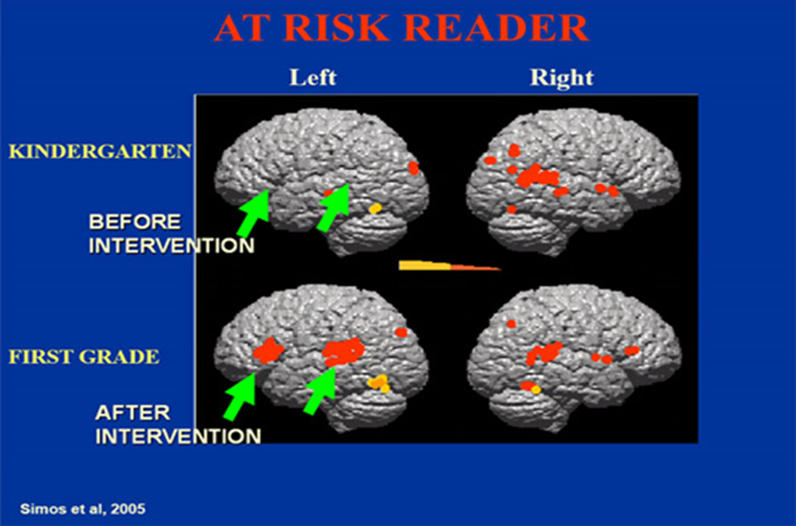
Notes:
To Know: Simos et al, 2005 documents how intervention can rewire the brain.
To Do:
To Say: Others followed in the field of research to determine if, when, and how long it would take for intervention or instruction to change the brain. Was it possible for everyone to become a successful reader? Yes!
In this photo, you can see the difference intervention makes with an at-risk reader. More parts of the brain are firing and in the appropriate areas needed for literacy. Take a moment to notice the difference in the left hemisphere and how it more closely resembles the activity seen in good readers. https://www.commlearn.com/dyslexia-and-the-brain/

Slide 19
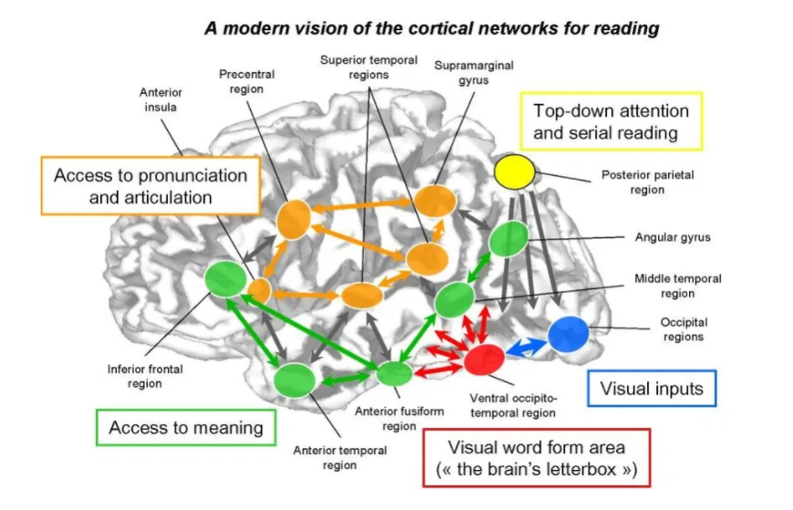
Dr. Stanislas Dehaene “Reading in the Brain”
Handout
#2
Notes:
To Know: Dr. Stanislas Dehaene has completed multiple studies on the brain and published the book, "Reading in the Brain." For more information go to https://www.youtube.com/watch?v=25GI3-kiLdo&t=72s and https://www.youtube.com/watch?v=MSy685vNqYk&t=259s.
To Say: Dr. Stanislas Dehaene has completed multiple studies on the brain, and has found how several areas of the brain are used to read, speak, process letters, sounds, and words. He also found that the pathways needed for reading can be found in all readers of all cultures in the same locations. Poor readers do not have those same activation areas. However, those areas can be rewired to activate with intervention and instruction.
Take a moment and sketch a brain. Place a dot to represent the areas of the brain which are needed for successful reading.
You will want to take note of
Pronunciation and articulation
Access to meaning
Visual input - where we see the letter and words
Visual word form area - when words become automatic sight words
There are many areas which must be activated. So, draw a few lines to represent the highways that must be traveled between those centers to make meaning from speech to print.
Several key findings currently drive the science of reading:
Routines and repetition on those pathways create super highways for automaticity and processing.
Those areas can be opened up to receive and process learning when using multimodal instruction.
Research proved that if these pathways of different sensory processing were not activated a person could remain a struggling reader for life no matter the language or culture.
The younger a child was when the instruction occurred, the less repetitions were needed to change the brain.

Slide 20
What is Reading?
Stop and Jot
Any adjustments to your definition of reading?
Notes:
To Know: Allowing participants to frame their thinking about reading helps to focus what they believe and understand, with the end in mind, for reading instruction.
To Do: Ask participants to return to their previous thoughts, and make adjustments as we achieve closure on this learning session.
To Say: Pull out the definition of reading you wrote several slides ago. Based on what we have shared regarding the Simple View of Reading, the Reading Rope, and the brain research, are there any adjustments that you would like to make to your definition of reading? We will give you a moment to make any adjustments you think are helpful to your definition.

Slide 21
Looking at the Reader
Notes:
To Know: This is the Section Header
To Do:
To Say: We have talked about reading. Now, we are going to switch and begin thinking about the reader.

Slide 22
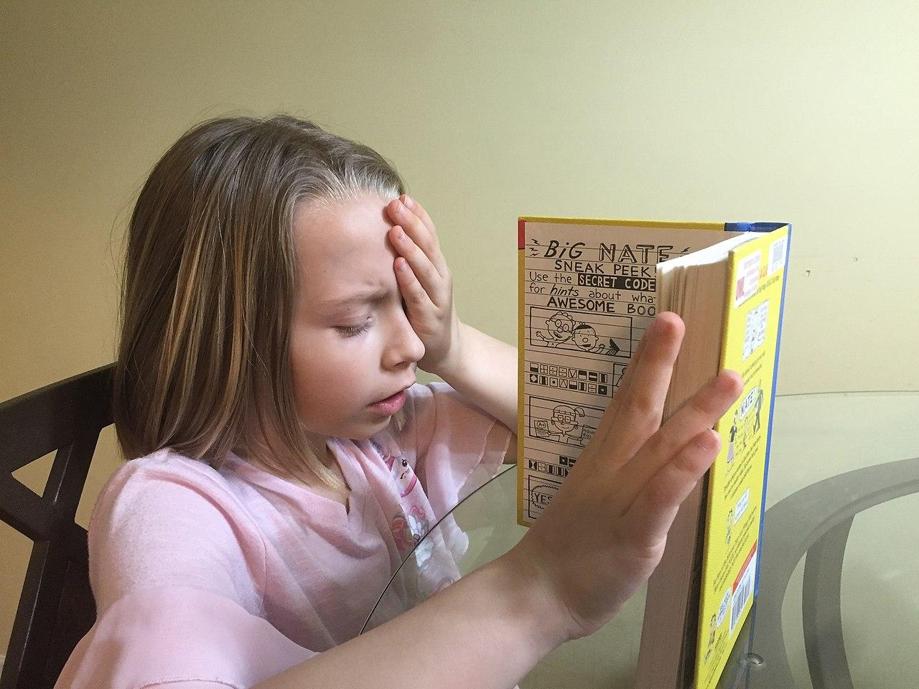
Characteristics of Poor Readers
List a few characteristics of poor readers in your class.
Notes:
To Know: Allowing participants to frame their thinking about reading helps to focus what they believe and understand with the end in mind for reading instruction.
To Do: Ask participants to list three of the most common characteristics of poor readers.
To Say: Think about your class and your students in the context of reading. You have one minute to list at least three characteristics the poor readers in your class demonstrate the most. As you are thinking about these characteristics, here are some questions to consider:
Where do they struggle?
What can they not do?
What do you consistently have to reteach?

Slide 23
Do You Recognize These?
Difficulties with accurate and/or fluent word recognition
Poor spelling and decoding abilities
Can actively be a part of conversations understanding content well when text is read aloud and discussed
Poor reading comprehension
Reduced knowledge of vocabulary and background knowledge
Notes:
To Know: Begin thinking about the student characteristics.
To Do: If virtual, have participants annotate the ones that are true for them or place in the chat how many, out of five characteristics, that they see.
To Say: Do you recognize any of these? Are any of these on your list? They come from both decoding and language comprehension. Do I need to define any of these statements further? On the slide are five characteristics that we see in poor readers. Using your fingers, hold up the number of fingers that corresponds with the number of characteristics that you see with your students that are struggling readers. For instance, if your students demonstrate two of these characteristics, hold up two fingers.
Definitions
Fluent word recognition: The ability to recognize words automatically, accurately, and quickly.
Decoding: Understanding the predictable relationship between the sounds of spoken language, and the letters and spellings that represent those sounds in written language.
Reading Comprehension: The ability to derive meaning from print.
Background knowledge: What a student brings to the reading experience, their personal knowledge and experiences regarding the topic.

Slide 24
Do You Recognize These?
Slow, choppy reading
Guesses words based on shapes (house/horse, breakfast/basket)
Correct letters/incorrect sequence (from/form, stop/spot)
Inserts or omits letters
Skips or misread prepositions (of, at, to)
Struggles to read the same word in multiple places on the page
Confuses vowel sounds (bat, bet, bit)
Notes:
To Know: Consider other common difficulties struggling students exhibit.
To Do:
To Say: Do you recognize any of these? Did any of these make your list? What other characteristics do you observe in struggling readers that were not on the list we provided on this slide and the one before? All of them are characteristics of poor readers, regardless if they have an IEP or a 504 plan or have or have not been identified as dyslexic. However, not all poor readers struggle with all of these characteristics.
But, all of the ones we have shown on this and the previous slide can be remediated with instruction, support, and practice using routines and strategies from the science of reading.

Slide 25
______________________________________________________________________________difficulties with accurate and/or fluent word recognition…poor spelling and decoding abilities. ___________________________________________________________________________________________________________________________________________________________________________________. Secondary consequences may include problems in reading comprehension and reduced reading experience that can impede growth of vocabulary and background knowledge.
Notes:
To Know:
To Do: Allow time for participants to read the slide.
To Say: Now, let’s compare what you marked as characteristics of struggling students to the characteristics on this screen. How many do you see here on our list?
Pause for participants to read. What we see here is the reality that students who struggle with reading carry the same characteristics.

Slide 26
“Dyslexia is a specific learning disability that is neurobiological in origin. It is characterized by difficulties with accurate and/or fluent word recognition and by poor spelling and decoding abilities. These difficulties typically result from a deficit in the phonological component of language that is often unexpected in relation to other cognitive abilities and the provision of effective classroom instruction. Secondary consequences may include problems in reading comprehension and reduced reading experience that can impede growth of vocabulary and background knowledge.” (IDA/NICHD, 2002)
Notes:
To Know: This is the official definition of dyslexia. (International Dyslexia Association, National Institute of Child Health and Human. Development, 2002)
To Do: Be intentional when you pause for understanding and reading of the slide.
To Say: What do you notice? (Wait for reflection of participants)
This is the official definition of dyslexia. (International Dyslexia Association, National Institute of Child Health and Human Development, 2002)
Neurobiological means, “of the brain." The research has proven to us that there is a neurobiological signature for dyslexia that is found in the brain even before a child enters school. The rest of the definition, stating the academic characteristics are inline with the same characteristics, were posted a few slides earlier.
Not all of the students who display these difficulties actually have dyslexia.
There are several factors that could impact these: Lack of connection or attendance in school, limited opportunities to engage in the foundational instruction needed for reading, or lack of direct, explicit instruction. In some cases, the student was not taught with intentional instruction due to lack of training.
Research has proven that good reading instruction, when combined with the use of targeted, direct, explicit instruction, served to rewire portions of the brain so they were being activated for successful reading. This, in turn, reduced and often removed most the characteristics found here in this definition.
These practices changed the progress and reading trajectory of students exponentially.
MORE INFORMATION FOR YOU, if needed.
There are three other indicators that a person might have dyslexia according to clinical considerations:
Others in the family have a history of difficulties learning to read or with literacy
Assessments indicate limited short-term memory
Assessments indicate slower processing speed
The definition and the three factors above are very evident in many of our students with a reading disability. The way we support, instruct, and intervene can change the learning for all these students. Many of our SLD students can show unexpectedly strong abilities in other areas of learning (music, building, painting, oral discussions, hands-on performance, etc.) but struggle to read, write, spell, or retain vocabulary without multimodal instruction.

Slide 27
State Standards
Notes:
To Say: One of the challenges we face with poor readers is how to address grade-level standards?

Slide 28
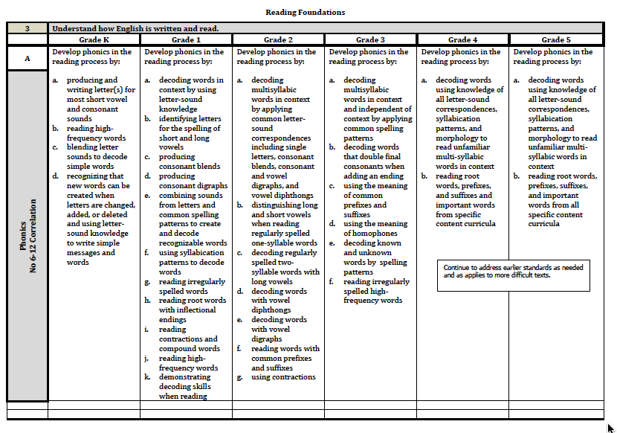

Reading Foundations
Notes:
To Know: This slide represents Reading Foundations in our Missouri Learning Standards.
To Do: Point to the little box.
To Say: Here is a snapshot of our Reading Foundations out of the Missouri Learning Standards. Reading Foundations cover the phonological and phonemic awareness skills, as well as phonics. This comes straight from the DESE website and is what the Missouri Assessment Program (MAP) and End-of-Course (EOC) tests are based on. Have you noticed what that little box says to us? (Click to pull out the box)
Here is what that little box says. (Pause)
We are charged with this notice in the elementary standards. Phonemic awareness does not naturally develop in some readers and all readers need this to become a successful reader. As students move into more difficult text with longer sentences and multi-syllable words, we find students can not decode or apply the skills.
As we see, it is part of our curriculum to go back and teach the skills as it applies to more difficult text. Where are we carving out, devoting, and ensuring this for our students?
We must ask ourselves to reflect on
What do you have in place to do this?
Is it more difficult in upper grades to address?

Slide 29
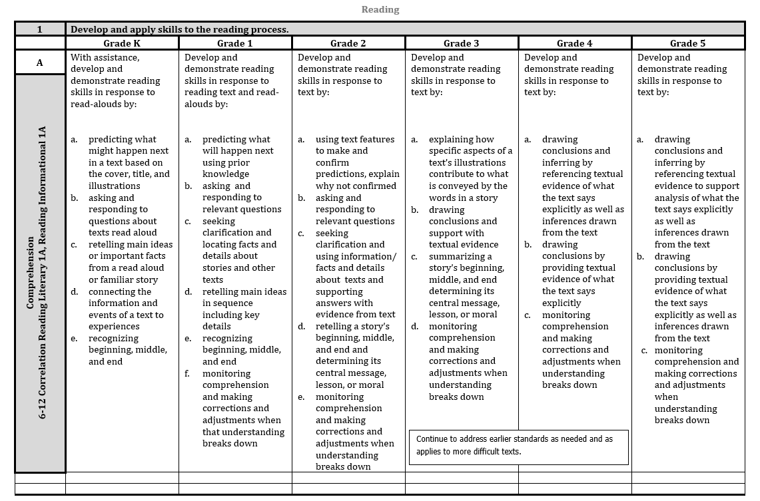

Reading Foundations
Notes:
To Know: This is the first section of the Missouri Learning Standards adopted in 2016.
To Do: Provide time to reflect on the slide.
To Say: Do you notice that same little box on the Reading Standards? (Click to show the box enlarged.)
Yes. This little box reminds us to ensure literacy development across different genre. Informational text can be more difficult for some students to read than literature. Prose can also be a struggle with language becoming less literal with similes, metaphors, and figurative language.
We must remind ourselves to be intentional with the lens of grade-level vocabulary. Students need to be able to access grade-level text using quality grade-level questions. As we provide an instructional-level text, we still must ask questions using grade-level vocabulary even when using a lower level readability.
When we select a text for readability for a student or look to select an instructional-level text, we are frequently accessing a text with questions for that level of readability. We need to be intentional that the questions and vocabulary used in those questions reflect the grade level. For example, a student in 5th grade reading on a 3rd grade level needs to be asked questions using the vocabulary and items from the 5th grade standards skills such as comparing and contrasting the roles and functions of characters or explain the conflict and resolution in a story.
Another caution here is that we must ensure that students can access the language of the standards as they move into different genre.
Skills will need more direct, explicit instruction as the text becomes more complex before the gradual release for independence.

Slide 30
Reading is learned developmentally,
not by grade level.
Notes:
To Do: Pause for participants to read and digest.
To Say: Reading is a developmental process. Students do not learn to read grade-by-grade as standards state. As we learn more, we know better and can go back to fill in the holes of learning. We won’t be able to make progress unless we take time to go back and fill in those holes and recognize what makes the difference for that reader. Every student can learn, but not on the same day and not in the same order.

Slide 31
Research to Practice
Notes:
To Know and to Say: When we know better, we do better. But, only if we are intentional about how we connect our daily practice in meaningful steps for application. Let us look at a Decision Making Tree to help us connect what we discussed today from research and individual student needs to overall practical application.
To Do: Move to the next slide.

Slide 32
Combining Research to Practice
“A large percent of at risk readers and students with severe reading disabilities can develop and maintain average reading skills when provided with the right kind of intervention.”
Torgesen et al., 2001; Lennon & Slesinski, 1999; Shapiro & Solity, 2008; Foorman & Al Otaiba, 2009; Torgesen, Wagner, Rashotte, Herron & Lindamood, 2010; Truck 1994, 2003, 2004; Vellutino et al., 1996
Notes:
To Know: There are many studies to validate the ability to change the reading trajectory of at-risk readers or students who have met eligibility for a reading disorder. This is only a small number of researchers who have proven this to be a true fact.
To Do: Stay current on research.
To Say: Numerous studies, after more than 30 years, has proven we can change students reading ability when we target the skills needed for intervention. A large proportion of students at risk for reading difficulties and students with severe reading disabilities can develop and maintain normalized reading skills. The key is to inform all teachers in what good instruction looks like and which elements to focus in on for intervention.

Slide 33
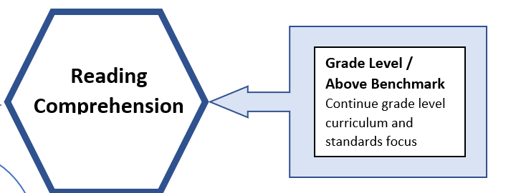
Developing Fluency for Strong Comprehension
Targeted Literacy Decision Making
If low
Handout #3
Notes:
To Know: This is a Targeted Literacy Decision Making Flowchart that can be used per individual student data and in consideration of small groups needs for classroom instruction, intervention, special education, or title.
To Do: Reference Handout #2. Ensure participants have this in hand.
To Say: This is a Targeted Literacy Decision Making Flowchart that helps us to look at student needs and connect data to instruction. This tree helps us to consider the individual student and/or can help guide us in developing small groups for instruction within a classroom or help us to make meaningful groups for intervention whether for increased instructional intensity with title, intervention, or special education. We will be going deeper in this Decision Making Tree as we move through the modules and we learn the different elements needed for effective readers. Today, we will do an overview. You will not have enough information from this overview to use the science of reading along with this tree to make changes for student impact. The modules that follow will provide the information you need.
Let’s start at the top with Reading Comprehension. As we look at universal tools we use for assessing comprehension such as iReady, STAR, NWEA, DIBELS, AIMSweb, etc., we get scores that tell us who is functioning at grade-level and who is not. We prefer standardized tests with national norms to indicate if students have reading comprehension and those assessments have cut-points for determining who is achieving as they should.
We consider benchmark as grade level. If a student scores at or above grade level we continue to work on grade-level skills reaching to move forward in our standards and grade-level curriculum.
When a student or group of students reveals scores below benchmark or grade level, we need to consider the why. What is keeping that student from being able to achieve at grade level? We first check Oral Reading Fluency with a measure that has proven through research using authentic student reading. (DIBELS, Acadience, easyCBM, AIMSweb, etc.) Every curriculum-based measurement takes into account the rate at which a student can process to read orally. We might need to take into consideration that rate means the ability at which a student can read. If they can process information to read at a benchmark level then they can continue to process information at the rate needed to learn our grade-level vocabulary and comprehension. When a student cannot process at the rate needed to hit benchmark, we go further into the why and what is keeping them from being able to process at the needed rate.
We might want to take a moment to address the word “rate”. Good readers can read fluently with intonation and phrasing. Good readers who score well on comprehension assessments have the ability to read automatically. Learning word-level reading to automaticity allows our brains to focus on the thinking needed for comprehension. The student does not have to focus on the word-by-word processing. This is what research proved to us through the use of addressing the rate or automaticity of the learning. I ‘see it’ and I ‘know it’ with no hesitation. Oral Reading Fluency rates have been the greatest predictor of successful readers in estimating reading comprehension for over 30 years and continues to be tested as true.

Slide 34

When Reading Comprehension is Low
Reading
Comprehension
Below Grade Level/Benchmark
Check Oral Reading Fluency
On Grade Level
Focus on
Vocabulary
Comprehension
If low
Notes:
To Know and Say: When reading comprehension is low, we look to see what is the underlying cause. The science of reading tells us that there are different skills that can interrupt the ability to read and understand. The first check is to look at the processing rate of the student’s oral reading. Is the student able to read grade-level material and meet benchmark on oral reading fluency measures? Oral reading is the strongest predictor found in research to predict who will struggle to comprehend.
To Do: Move to the next slide.

Slide 35
Low Oral Reading Rate
Check Word Reading Lists
Vocabulary
Phonics/Decoding
On Grade Level
Focus on Fluency, Spelling,
Vocabulary, Comprehension
If low
Notes:
To Know and Say: When a student is not able to process at the needed rate as they orally read, we move into checking the ability to read word lists. We check the ability of the student to read words that follow phonetically regular phonics patterns and check word lists with irregular pattern. In other words, we begin to see if it is a vocabulary issue or a decoding concern. You can see by the flowchart that great ways to check this is by using word lists from CORE or Curriculum-Based Measures (CBMs) like AIMSweb, Acadience, etc. Also, consider checking the students ability to use phonics when meeting unknown words. The most valuable proven tool is to use nonsense words. When low in these, we move to the next step. Remember the impact that learning had from the Simple View of Reading. Was it a decoding or language issue?
To Do: Move to the next slide

Slide 36
When Phonics is Low
Use Diagnostic Decoding Surveys
Narrow in on phonics skills for instruction in addition to general education instruction
Use direct explicit, instruction through error analysis of patterns
Increase instructional time with making and building words, decoding those patterns in text, and spelling the patterns. Include Latin, Greek roots/affixes as students’ grade-level increases through phonics patterns
In Addition
Notes:
To Know and Say: The next step guides us to look at the diagnostic level of what phonics skills and spelling skills impact the fluency of a student who is addressing the words that should be known words or in research we call them the student’s ‘sight words’. Frequently, we pull in diagnostic surveys starting with nonsense words. Nonsense words help to weed out the known word factors that can mess with authentic scores. Nonsense words prove to us whether a student can read a word correctly even if they do not know what that words should be. Most nonsense word tests are limited to short and long vowel words. But, some newer versions now assess all phonics patterns taught across grade levels. Spelling patterns students use are also closely linked to phonics patterns needed for decoding. So, these two types of information help us connect learning for instruction. The act of writing helps put words into long-term memory.
On the right side of the slide you notice when a student is at grade-level on these skills. We continue to work with students using phonics in spelling, building sight word recognition for fluency and vocabulary, which in turn, also builds comprehension.
All of these skills are addressed as we move forward with the trainings for effective reading. Time will be spent in the assessment section looking at how different assessments can direct, inform, and monitor the growth of students in literacy.

Slide 37
Phonemic Awareness in Addition to Phonics
Check Phonological and Phonemic Awareness
Basic Levels through segmentation and blending. Advanced Levels through addition, deletion and substitution
Use direct, explicit instruction focusing on the skill developmental sequence
Notes:
To Know and Say: If decoding skills are low, we check phonemic awareness. Phonemic awareness is the manipulation of sound. Readers need to be able to attach sounds to letters. In order to spell, we must be able to attach letters to sound. Phonemic Awareness has been found to be a huge predictor of reading success. Students who score low in phonological manipulation in grades K-1 generally are struggling readers in grade 2 and above. Research trials, which included phonemic awareness instruction to the advanced levels, increased the success rates of readers when connecting phonics to print.
As the right side of the slide suggests, when students are at grade-level with phonemic awareness, you will continue to address phonics, spelling, sight word recognition, fluency, vocabulary, and comprehension. These are the components to develop strong readers. But, if phonemic awareness is low after much remediation, we move to the next slide.

Slide 38
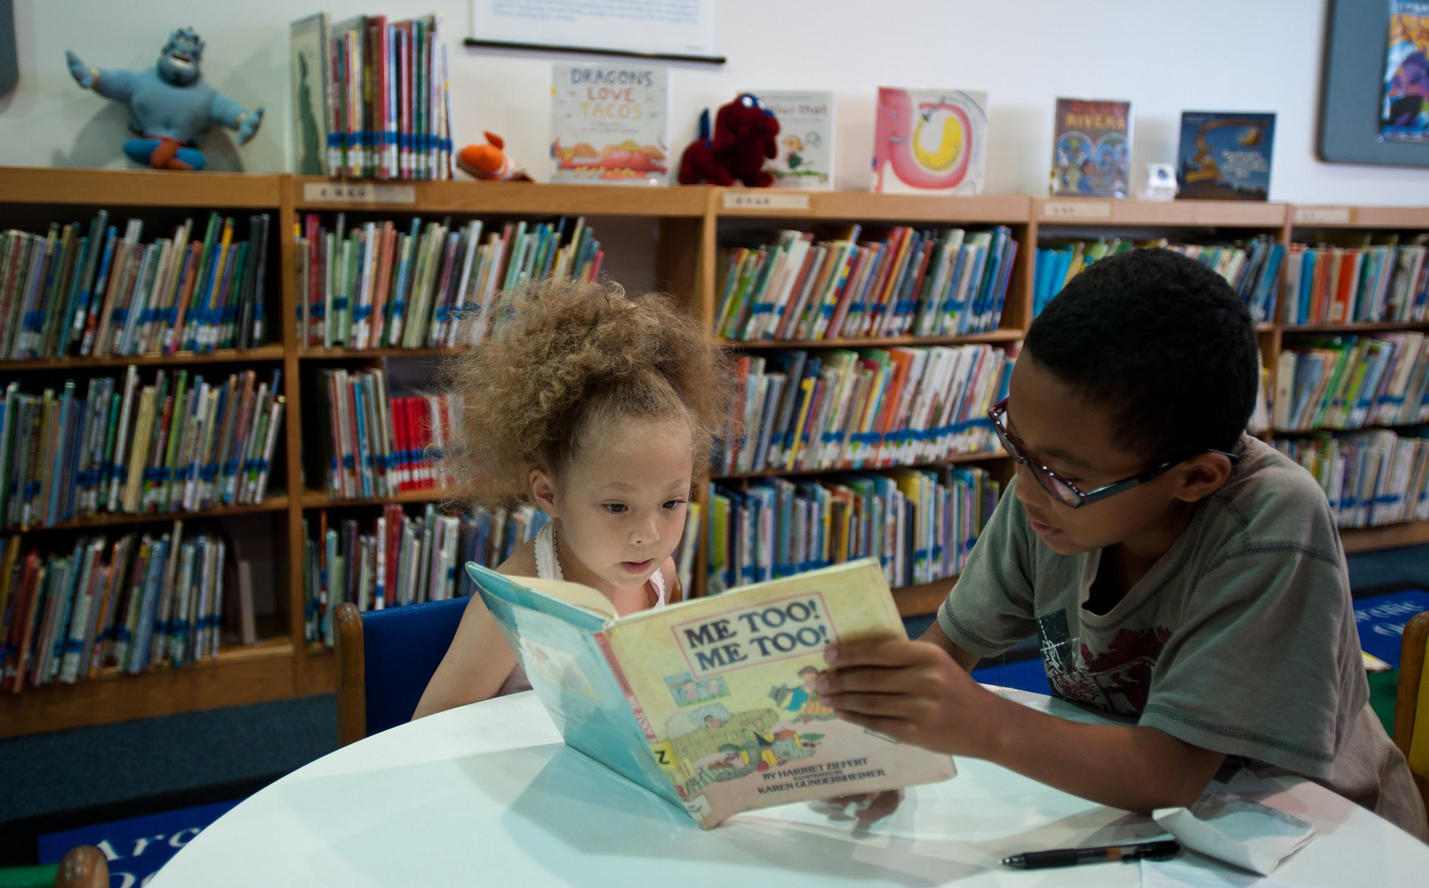
Every human, every student has the right to learn to read. It is a civil right and without this fundamental right, you lose the ability to navigate successfully in this world.
Notes:
To Know and Say: This module alone is not enough to make decisions on referral for special education or for decision-making toward intervention. You will need the depth and breadth of each module to more fully understand the intensity and duration of targeted instruction.
Labeling a student as having a disability impacts the student’s perception of who they are and the perception of others who work with them. Often teachers who have learned the science of reading have found students no longer needed the label. The students needed targeted instruction in specific skills, and with time, the student was reading at grade level. While it is a great reward to release a student from special education, it might be an even greater honor to have never needed the label in the first place.
Students who struggle are sometimes referred for special education. The question then becomes when to test for eligibility or how long to work on interventions? We must always consider three important things
Assess anytime you expect a disability
Ensure the student has received evidence-based, targeted, and explicit instruction in the skill deficit needs
Look deeper in the Guidance Document for Response to Intervention (RTI) on MO DESE
Some learning in these modules will be individual to us as teachers and some learning will step into how we use the resources we have in our curriculum or people resources in our buildings.
Each step and process will provide answers. But, it will take time and commitment that goes beyond the two-hour learning chunks found in these modules. (Move to the next slide to recap).

Slide 39

Poor Comprehension
goes back to fluency
Poor Fluency
goes back to word recognition
Poor Word Recognition
goes back to Phonics and Decoding
Poor Phonics and Decoding
goes back to Phonemic Awareness
Notes:
To Know and to Say: To recap what we just processed through, I would like to ask you to read the bold print and I will read the underlying problem to check in italics.
Poor Comprehension - goes back to fluency
Poor Fluency - goes back to word recognition
Poor Word Recognition - goes back to phonics and decoding
Poor Phonics and Decoding - goes back to phonemic awareness
We just need to know what works, how to identify the student need, and provide the appropriate instruction.

Slide 40
What Works in Reading Instruction
Students were trained in phonological awareness to the advanced levels
Phonics decoding skills were taught in explicit, systematic ways and reinforced within text
Lots of opportunities to read connected text
Kilpatrick, 2016
Notes:
To Know and To Say: It is difficult to overestimate the importance of reading for success in school and in life. Reading is essential for all academic areas and future endeavors in life. It is essential that all teachers understand the science of reading and what constitutes effective reading instruction. Years of research indicates the programs found most effective in reading had all three of the components listed on this slide.
The next module will address phonological awareness to the advanced levels. We will look at the depths of what that instruction might need to look like for students to manipulate sound to the advanced levels.
The following module will address the relationship between letters of the written language and the sounds of spoken language in an organized and logical sequence for phonics and spelling development. It will take a look at how to develop student ability to apply what they learn to decode unknown words while reading and writing. The step for reinforcing within text is frequently left out of some products or practices.
The final bullet addresses the need for lots of opportunities for the student to read connected text. The products and strategies that had the greatest impact on changing students reading included the student reading and not just listening to others read.
Struggling readers might need to listen to some reading to gain access to the content, but they need the opportunity and resources to read at their readability and interest level.
This is what works in reading instruction. We will define, explain, and go through the developmental levels of these foundational skills needed for literacy.
To Do: (Pause for the slide to be read and considered)

Slide 41
What is Reading?
Reading is making meaning from print. It requires
Notes:
To Know: Allowing participants to frame their thinking about reading helps to focus what they believe and understand with the end in mind for reading instruction.
To Do: Ask participants to pull out their definition of reading.
To Say: Pull out the definition of reading you wrote several slides ago. What is reading? (Pause to click in the text). Reading is making meaning from print.
If virtual, unmute or place in the chat the other elements you added to your definition.

Slide 42
“The components of effective reading instruction are the same whether the focus is prevention or intervention…”
Foorman and Torgesen (2001) Learning Disabilities Research & Practice
Notes:
To Know: Foorman, B.R., & Torgesen J.K. (2001) Critical elements of classroom and small group instruction promotes reading success in all children. Learning Disabilities Research & Practice, 16 (4) 201-212.
To Do:
To Say: Take a moment to read this quote. The components of effective reading instruction are the same whether for prevention or for intervention.
There is no better prevention or intervention than having a teacher that recognizes and is trained in the elements needed for effective instruction.

Slide 43

Components of Effective Literacy
Phonological and Phonemic Awareness
Phonics and Spelling
Assessment
Vocabulary
Comprehension
Writing
Notes:
To Know: This series will address the components listed on the slide.
To Do:
To Say: This is the series of modules in our Components of Effective Literacy training.
Each module will address a different element from the science of reading and from the Reading Rope we discussed earlier. For students to be proficient readers they need to possess all these skills. If they have a deficit in one, it will impact their overall reading skills. Sessions will dive into what works and provide hands-on application for preventing reading difficulties and intervening effectively to close the gap for struggling students.
This series must be completed sequentially beginning with Phonological and Phonemic Awareness without skipping or randomly taking sessions apart from the whole. It was designed to be completed as a series to understand what makes effective literacy instruction.

Slide 44
Examples for Practice
Take Some Time to Explore
Go to Reading Rockets
https://www.readingrockets.org/teaching/reading101-course/modules/course-modules
What did you notice?
What did you learn?
What do you still wonder?
Will this change the way you teach reading?
Notes:
To Know: The link to Reading Rockets is meant to be a hot link for you to show participants how to look at the website.
To Do: Take time to go to Reading Rockets and show them all the different activities. https://www.readingrockets.org/teaching/reading101-course/modules/course-modules
To Say: We are going to go to the Reading Rockets website. Reading Rockets is a national public media literacy initiative offering information and resources on how young children learn to read, why so many struggle, and how adults can help. It has the researched-based strategies to help students become proficient readers. Reading 101 is a self-paced professional development course providing K-3 teachers an in-depth knowledge of reading and writing. What is important to realize is that even though the course is for K-3 teachers, if your students are older and struggling with reading, they have most likely missed some of those early skills and you will need to go back and make sure they are covered. So, all teachers can benefit from this training.
The training is arranged in nine modules
Print Awareness
Phonological and Phonemic Awareness
Phonics
Fluency
Vocabulary
Spelling
Comprehension
Writing
Assessment
All the modules will provide
Pre-tests
In-depth understanding through articles and videos
In-practice activities with step-by-step directions
An assignment for you to complete
A post-test
We are going to give you 20 minutes to explore Reading Rockets and see the different types of components, skills, and activities there are for us to learn more about reading and use with our students. As you go through the website, consider the four questions at the bottom of this slide. You will have an opportunity to share some of your insights at the end of the 20 minutes.
If there is time during your presentation, allow participants to navigate. They will only be able to do a surface view and not go deep. The Reading Rockets 101 is used throughout the trainings for teachers to go deeper and connect to other resources. If face-to-face, set up charts around the room for participants to post sticky notes of their learning and questions to reflect on as you move forward.

Slide 45
Thank You for Your Professional Attention

Slide 46
Resources
https://www.readingrockets.org/article/simple-view-reading
Simple View of Reading, Gough & Tunmer, 1986
The Reading Rope, Scarborough, 2001
Reading and the Brain, Deheane, 2010
Reading Rockets https://www.readingrockets.org/teaching/reading101-course/modules/course-modules
Notes:
Jane Jackson, NWRPDC
Karen McDonald, Central RPDC
Mary Beth Scherer, Central RPDC

