Slide 1
What You Will Need
HO #1 - Phonics and Spelling Glossary
HO #2 - Phonics Terms to Match
HO #3 - Elkonin Boxes
HO #4 - Phonics Common Syllable Patterns
HO #4a - Phonics Common Syllable Patterns Answer Key
HO #5 - Essential Elements Phonics Lesson Plan
HO #5a - Script to Practice ‘ai’ Phonics Lesson Plan with Essential Elements
HO #6 - Ticket to Ride Decodable Text for ‘ai’ Words
HO #6a - Ticket to Ride the Rails Highlighted ‘ai’ Words
HO #7 - Effective Phonics Programs
Warm-Up or Engagement Alternate for Phonics Terms to Match
Resource 1 - Find Someone Who, Resource #2 - Answer Key for Find Someone Who
Notes:
To Know: This slide will remain hidden for presentation mode. Please consider whether you will be using the Resource #1 – “Find Someone Who”, as an ice breaker along with the Glossary or exchange Resource #1 with Handout #2 – “Phonics Terms to Match."
The following handouts and resources are included with Module 3:
HO #1 - Phonics and Spelling Glossary
HO #2 - Phonics Terms to Match
HO #3 - Elkonin Boxes
HO #4 - Phonics Common Syllable Patterns
HO #4a - Phonics Common Syllable Patterns Answer Key
HO #5 - Essential Elements Phonics Lesson Plan
HO #5a - Script to Practice ‘ai’ Phonics Lesson Plan with Essential Elements
HO #6 - Ticket to Ride Decodable Text for ‘ai’ Words
HO #6a - Ticket to Ride the Rails Highlighted ‘ai’ Words
HO #7 - Effective Phonics Programs
Warm-Up or Engagement Alternate for Phonics Terms to Match
Resource 1 – Find Someone Who, Resource #2 – Answer Key for Find Someone Who

Slide 2

Please take out the two handouts from your folder called, “Find Someone Who” and “Glossary (Phonics & Spelling).”
Follow the directions at the top of “Find Someone Who.”
Notes:
To Know: This module may be very difficult for people who have had limited phonics in their background. There are a few ways to engage participants with vocabulary. You might want to send the glossary ahead of time or build in time to play with some vocabulary as you move forward within the training.

Slide 3
Fluency in Phonics and Spelling Development
Components of Effective Literacy
Module 3
2021
Notes:
To Say: Welcome to Fluency in Phonics and Spelling Development. This is the third in a series of modules to strengthen literacy development for successful readers. Our training today will focus on the development of phonics and its connection to spelling. This learning module is strongly tied to the module for Phonemic Awareness. When a student is weak in phonics or decoding skills, usually that student will also have a deficit in phonemic awareness. If you did not participate in the phonemic awareness training, you are missing a link to why some students have difficulty retaining phonics learning to memory for use in decoding words.

Slide 4
Learning Intentions
Participants Will
Understand the difference between decoding for reading and spelling
Identify phonics skills from simplest to more complex
Recognize the important language connections of phonics and spelling
Practice activities that can be used in the classroom
Plan explicit steps for integration in the classroom
Notes:
To Know: These are the learning intentions of this module. They are supported and linked to the Science of Reading and Reading Rockets.
https://www.readingrockets.org/teaching/reading101-course/modules/phonics-introduction
To Do: Ensure participants have access to a computer for explorations on Reading Rockets and Handouts #1 plus Affirmations for Action Planning. Provide time for participants to read the slide.
To Say: Please take time to familiarize yourself with our learning intentions for today. We hope to confirm some instructional practices you currently have in place and to anchor those instructional practices and decisions to the Science of Reading. We plan for you to leave this training assured in research-based knowledge of what works in building successful readers in this area.

Slide 5
Missouri Teacher Standards
The following Missouri Teacher Standards will be addressed today
Standard #1: Content knowledge aligned with appropriate instruction
Standard #2: Student Learning, Growth and Development
Standard #3: Curriculum Implementation
Standard #7: Student Assessment and Data Analysis
Notes:
To Know: These are the teacher standards we will address today.
To Do: Direct participants to the slide.
To Say: If you need to document for your professional development reference, here are the Missouri Teacher Standards that we will be addressing today. I will pause a moment while you note these. We will address Standards #1, #2, #3, and #7.

Slide 6
Norms
Be present
Turn cell phone off or silence
Minimize sidebar conversations
Ask questions
Take care of personal needs with minimal distractions
Have open hearts and open minds
Be patient
Notes:
To Know: Change norms to fit your audience and needs.
To Do: Change norms to fit your audience needs or usual norms. Explain break times and where to take care of personal needs, if not in their normal learning space.
To Say: Here are what we can expect as norms for our session today. We expect you to listen and interact with understanding. Questions are welcome! We would ask that you have cell phones on silent and minimize sidebar conversations or distractions. We will take formal breaks. So, please take care of personal needs with minimal distraction. When we provide opportunities for you to learn, we do it with intention and believe that your engagement and thoughtful reflection for application is what will make this day productive for all. Is there anything you might want or need for this to be a good day?

Slide 7
Virtual Norms
Ask questions (chat box, raise hand, unmute)
Engage fully (clock icon when you step away)
Integrate new information
Open your mind to diverse views
Utilize what you learn
Adapted from: Mallia, G. (2013). The social classroom: Integrating Social Network Use in Education.
Notes:
To Say: Are there additional norms you would like to add for the sake of the group?

Slide 8
Unpacking Terms
Glossary of Terms - Handout #1
Handout #1
Notes:
To Say: You may access your Handout #1 Glossary of Terms for reference during the following slides.

Slide 9

Alphabetic Principle
The understanding that written language involves a code, with clear, logical, and predictable relationships between written letters and spoken sounds.
Notes:
To Know: Written language is a code. It is not something we were born to do or know. It is something we developed to be able to put what we say onto paper providing us with the ability to communicate without talking. This code was developed less than 5,000 years ago.
To Do: Use the slide
To Say: Take a moment to find the Glossary for this module. (Handout #1)
The alphabetic principle is the understanding that written language has a code. That code represents the relationship between written letters and spoken sounds in a clear, logical, and predictable way. Everything we say can be put into that code for others to read or write. This is not a process or a strategy for instruction, rather, it is the ‘insight’ that the sound in oral language can be represented by letters in written words.
To apply phonics skills successfully, students need to grasp this understanding of the alphabetic principle.

Slide 10
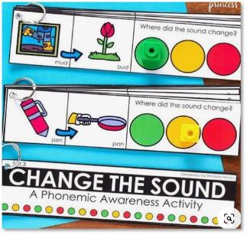
Phonemic Awareness
Refers to the awareness of the individual phonemes — the smallest units of sound — in spoken words, and the ability to manipulate those sounds.
Notes:
To Know: Phonemic awareness is the individual sounds/phonemes.
To Do: Read the slide or allow time for participants to read the slide.
To Say: Phonemic awareness is the ability to recognize the individual sounds/phonemes in words and be able to manipulate those sounds. We find that many programs and curriculums include this in the early instruction for reading yet, we often do not have access to or take the time to access this with older students. We will also refer to phonemic awareness as PA.
There are some people who use the word phonemic awareness and phonological awareness interchangeably. In the Science of Reading they are not the same. Phonological awareness is most commonly thought of as the manipulation of the words and syllables in chunks of words.
Many people say we can do phonemic awareness in the ‘dark’ since we do not need to see letters. But, we have found that some students need to see our mouths and even have a conversation about how to make the phonemes inside our mouths with tongue, teeth, lips, and air or vocal cords. Not all students will need this for good phonemic awareness but it might be necessary for some. That type of training is for another day, but today we will need to understand the difference in phonemic awareness and specifically phonics.

Slide 11
Starts with Sound
Children who lack the development of phonemic awareness have a very difficult time making sense out of phonics instruction and they certainly have little chance to notice the phonemic patterns in written words on their own.
Torgesen
Notes:
To Know: Research continues to prove that we spell words by what sounds we hear in them. It is essential to link all phonics instruction to sound so we can map/spell/decode words from sound to letters.
To Do: Understand the relationship between phonemic awareness and phonics and be ready to respond to differences when participants ask or are confused.
To Say: Everything begins with sound. We learned that in our session on Phonemic and Phonological Awareness. Students who lack the development of the ability to hear, produce, and manipulate sound have difficulty making sense of phonics. They will not be able to connect letter/graphemes to a sound or sounds. They will also not be able to hear the different sounds or syllables within words to spell or decode them.
You see evidence of a need for phonemic awareness in your students when they
Spell words using letters that do not represent the correct sounds
Leave out complete syllables when trying to spell words
Students are not be able to retain the phonics patterns
I am going to pause for a moment to allow you to read and digest this idea from research.

Slide 12
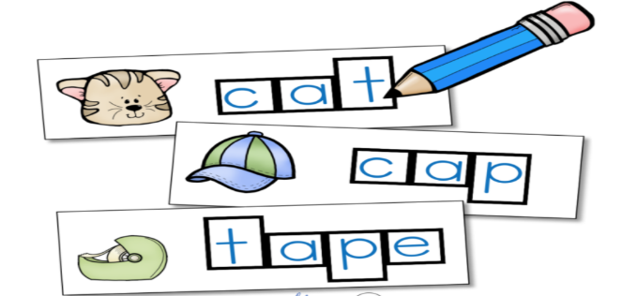
Phonics
Refers to knowledge of attaching letters to sounds and the ability to apply that knowledge in decoding unfamiliar printed words.
Notes:
To Know: Phonics is usually our most common understanding of the ‘ph’ words. The two prior slides represent vocabulary that we normally do not include in upper elementary curriculum. As soon as we attach letters to sound it becomes phonics.
To Do: Note the difference when phonemic awareness becomes phonics.
To Say: Phonics is the most common “ph” word we know. Phonics refers to letter knowledge and the ability to apply the letters and letter patterns in decoding unfamiliar printed words. As soon as we attach letters to sounds/phonemes in our lessons or curriculum we have moved into phonics.
There are some that want to argue that there is much about phonics that is irregular but, in fact, most English words are quite decodable when we teach students to pay attention to the letter patterns in words. Phonics instruction is most effective when it begins in kindergarten and first grade. But, it is also a necessary component of reading instruction at any level where a student is not fluent because he/she cannot decode the words.
Although mastering these complex letter-sound relationships can be challenging for some students, the alternative, memorizing “by sight” the many thousands of words needed to read proficiently in English, is simply not possible. No one can become a good reader in English by just memorizing all the words necessary to read at advanced levels of literacy.
Our focus today will be to look at the patterns and understanding needed to use phonics effectively and efficiently for successful reading. Students who become good at decoding words develop automaticity and are then able to focus on comprehending what they read instead of focusing their efforts on sounding out the words. We are going to be looking at teaching phonics as ‘patterns’. The brain learns by connecting patterns.

Slide 13

Graphemes
The letters that correspond to sounds (phonemes) are called graphemes.
Each sound is represented by graphemes.
/a/
/t/
/tch/
Notes:
To Know: We will use letters (graphemes) interchangeably. Each sound is represented by graphemes. If there are two people presenting, one person might be writing important terms or concepts on a wall chart as those are introduced.
To Do: Direct attention to the slide.
To Say: In the English language there are 26 letters in our alphabet represented by 44 different graphemes. The letters that correspond to sounds (phonemes) are called graphemes. On this slide there are three examples of graphemes with two of the sounds represented by one letter. The letter or grapheme ‘a’ makes either the short /a/ sound or the long /a/ sound. The ‘t’ letter or grapheme makes the /t/ sound. However, in the third example, the three letters ‘tch’ is one grapheme making the /tch/ sound.
Each sound in a word is represented by graphemes. Some sounds may use one grapheme while others will be represented by patterns of graphemes. We begin teaching the letter/sound relationships that are represented by one grapheme before we move into the more complex patterns like the /tch/ which is the sound we hear at the end of ‘catch’ but spelled with three letters.
The reason we want you to understand the term ‘grapheme’ is that there will be resources that you can find by searching under terms for phoneme/grapheme mapping. These activities will allow students practice connecting sounds to letters in structured activities. When a student can connect phonemes to graphemes, they begin to visually ‘map’ phonemes to letters that will go into long-term memory which results in the development of sight words. Any word known by sight is a sight word. In short, the development of automaticity through phonics with the connections of sounds to letter patterns in turn increases reading ability and fluency.

Slide 14
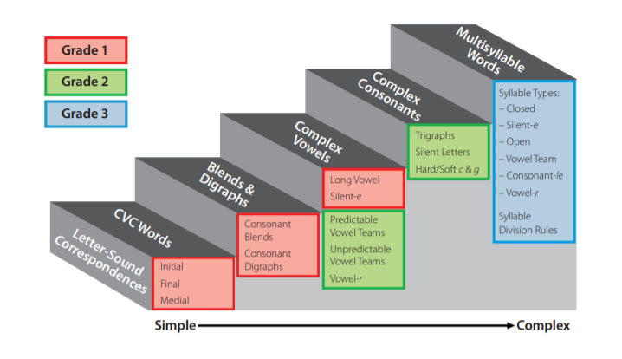
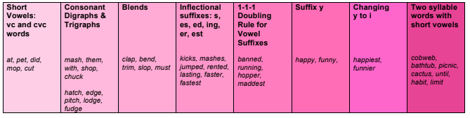

Levels of Development
Phonics Sequence
graphemes short vowels, consonants, vc and cvc words, digraphs, trigraphs, blends, vowel teams, rime families
inflectional endings, diphthongs, vowel -r, syllables, consonant -le, dropping and doubling with affixes
morphemes - Latin and Greek roots, affixes, etymology
95% Group and Reading Universe
Notes:
To Know: Knowing the sequence a program addresses through the different levels of development will be important for fidelity of implementation of any program or the fidelity of change which reflects the learning of this module.
To Do: Point out the importance of the development of skills.
To Say: Phonics can be dissected to show a progression of development from simple to more complex teaching graphemes as patterns. Phonics letter patterns then move into activities that include more morphological instruction of ‘units’ of meaning. Instruction will begin to practice prefixes, suffixes, and common Latin and Greek roots. The three types of sequences represented on the screen are from the 95% Group (online resource company) and many common sequences used.
Exact order of letters or patterns of letters may vary between researchers or programs, but the one anchor that stays firm is that skills move from easier to more complex practicing the most common sounds before moving to letter patterns that some call irregular but are actually regular enough that we need to teach and practice them. Effective phonics instruction increases decoding skills, spelling skills, and word recognition.

Slide 15

Do You Know These Terms?
phoneme morpheme
grapheme diphthong
onset digraph
rime schwa
Handout #2
Notes:
To Know: This slide is to be used as an engagement with the participants through common vocabulary. There is a handout to use with this slide.
To Do: Provide three to five minutes for participants to understand common phonics terms in teams or with partners.
To Say: Let’s take three to five minutes to prep our brains for phonics terms. Find Handout #2. Turn to your tablemates or partners and match the terms to the definitions. There is a glossary, if needed.
Depending on the people you have in your training you might want to have some people have the term and some have the definition and allow them to move to find their match. Or you can use the, “Find Someone Who”, sheet as an ice breaker before you start the phonics module.

Slide 16
Considering Sequence
Kindergarten
automatic letter naming
single grapheme-letter sounds
short vowels
may include digraphs (ch, sh, th, wh, and ck)
Continue kindergarten skills to automaticity in First Grade
First Grade
consonant blends
trigraphs (tch, dge)
long vowel silent ‘e’
two-syllable words with short vowels
inflectional ending (ing, er, s)
vowel-r (er, ur, or, ar, ir)
diphthongs (oi, aw, oo, ou, ow, oy)
vc pattern as a syllable
Notes:
To Know: Teaching most common sounds first in sequential, direct, explicit, and systematic ways is among the most regarded “Settled Science” aspects of reading. See “Settle Science” in reading.
To Say: Phonics instruction is most effective when we start in kindergarten or first grade. Kindergarten instruction for phonics is to attach sounds to letter names with automaticity. Instruction will begin with single-grapheme-letter sounds, short vowels and may include digraphs shown here (ch, sh, th, wh, ck). You will notice the slide says to become automatic, which means a student can quickly name these letters and sounds from memory, as soon as the letters are seen.
We learned in our last module that phonemic awareness is the core causal underlying factor of students not being a successful reader. A student must be able to manipulate the basic levels of phonological and phonemic awareness to be able to adequately attach letters to these sounds. It has been very common for programs or teachers to be misled and stop the work of phonemic awareness as they begin teaching letters and simple words. As we move into lessons for phonics we will notice the necessary link between sound and letters.
First Grade phonics mastery works towards automaticity in all of the earlier simpler skills from kindergarten and then deepens phonics instruction with trigraphs (a three letter combination that represents one phoneme like dodge-itch) and consonant blends (a two letter combination that represents a phoneme like ‘bl, st). Diphthongs are the patterns of vowels whose sounds glide together in the same syllable like ou and oi.
Ask different table groups to come up with letters that represent the following (you may choose not to do this if you did the Phonics Terms for matching).
digraphs
trigraphs
blends
Diphthongs
It is important to remember that we should not move into vowel-r patterns (some call this r-controlled) until mastery has been attained with short vowels. Teachers may include instruction in two-syllable words with short vowels due to the utility of short vowel patterns in multi-syllable words (examples: basket, fantastic, transcontinental).

Slide 17
Phoneme/Grapheme Mapping (I Do)
Handout #3
Today we will build words with the sound of /u/.
This is a short vowel sound. We name that sound ‘u’.
Say that sound with me. /u/
Teacher says a word with the target sound /u/.
Tap out the sounds (up).
How many chips will we use?
u
1
2
Notes:
To Know: Your audience might already be familiar with how to use Elkonin boxes. But what will be most important is to ensure they understand the need to do this in a structured, explicit routine. That is what will develop the pathways in the brain to automaticity.
To Do: If your audience already uses and understand Elkonin boxes, you might need to alter what you say below to focus on the instructional routine. Handout #3 - Elkonin Boxes.
To Say: The most important aspect of every instructional routine that is involved in making memory pathways is to do it in the same way each day. Teachers will need to model this process first before doing it with students.
This is a replication of the most common routine used in research that involves multimodal engagement. First, you say the word and have the student repeat the word (keep in mind that sometimes, in larger groups, struggling students do not repeat the words). Some students will listen and just process or stay quiet especially if they process at a slower rate than other students. If we want to change student progress, we need to ensure they do each step with us.
In the lesson you see on the screen, students are given colored chips to use and manipulate for letters in words. You notice that the only chips with a letter on it is the chip that focuses on the letter the lesson will focus on. Strong readers can often move right from using the chips for sound to writing the letters or building the words with letter tiles. This lesson shows the most effective progression needed for struggling readers to connect the letters with sounds allowing them to focus on the new letter sound before manipulating all the letters to spell words.
So, here is our lesson
Today we are going to build words with the sound of /u/
This is a short vowel sound (say /u/). The teacher waits and watches for students to make that sound
We write/name the sound of /u/ with the letter ‘u’. (Teacher points to the chip with the letter ‘u’ on it)
The first word we will build is the word ‘up’
Say ‘up’
Tap out the sounds in ‘up’ (click for dots to appear in two boxes on the screen)
How many sounds do we hear in ‘up’? Yes, two

Slide 18
Phoneme / Grapheme Mapping cont.
Where do you hear the sound /u/?
Say the word again. /up/
We will need one more chip in this word to represent the other sound we hear.
u
Notes:
To Know: This is the continuation of the phonics lesson.
To Say: Where do you hear the sound of /u/? Yes, /u/ is the first sound we hear. We will put the chip with the letter ‘u’ in the first box. There were two sounds. Say the word again - ‘up’. Where will we put our next chip? Yes, in the next box to represent the /p/ sound.
For students who struggle or who are just beginning to map the sounds to letters you might need to extend practice with this on three to five words before moving to students building the words with letter tiles.
Will the color of the chips matter?
Yes. As we begin to teach consonants and vowels we will begin to use one color for consonants and a different color for vowels.
Phonics lessons will move from sound to letter spelling as you make and build words. The most effective programs also include the move to writing the words as they build after using letter tiles to build words.
Research has also shown us that when we include some meaning cues as we build words, we are building comprehension and vocabulary as well. Examples of meaning cues are pictures to be used as anchors to represent the sound. “Up” might be a great multimodal cue with a picture of a hand pointing up and students making a motion by pointing up as they say the sound /u/.
After making and building words with the short vowel sound /u/, it will be important to use, write, and read decodable text with that sound for application to spelling and reading.

Slide 19
Your Turn
h | u | t
n
u
t
Notes:
To Know: This is the continuation of the prior slide to complete the phonics progression from sounds to symbols.
To Do: Provide Elkonin boxes for participants to practice building the word using Handout #3.
To Say: Let’s build some more words with the short ‘u’ sound in them.
Say the word “nut." (Wait for participants to say the word.)
Do you hear the short ‘u’ sound? (Yes)
Tap out the sounds in nut as you put a chip in each box for each sound you hear.
Yes. We will use three sound chips. Touch where you heard the /u/ sound. (Yes, in the second box)
Let’s write the letters to spell ‘nut’. Say the sound then tell the letter that names that sound.
nut =
/n/ = ‘n’ (Click to advance the letter into the box)
/u/ = ‘u’ (Click to advance the letter into the box)
/t/ = ‘t’ (Click to advance the letter into the box)

Slide 20
Building Words
Today we will build one syllable words with the short vowel sound /o/. What sound? /o/
Let’s make the word ‘hop’. A rabbit can hop.
Say ‘hop’. Tap the sounds in ‘hop’. How many sounds do we hear?
Three sounds - How will we spell hop?
Notes:
To Know: This is a clip out of a phonics lesson.
To Say: Take a moment to examine this lesson.
In the progression of phonological awareness, we played with syllables early on because they are the larger chunks of sound and easier to manipulate than individual phonemes.
As we begin to attach letters to sound in this lesson, we tell students in our directions that we are building one ‘syllable’ words. Students begin to use the process of listening for syllables and then the different sounds inside of the syllables.
What elements of literacy do you see inside this small segment of phonics instruction?
Used the vocabulary - one syllable and short vowel sound
Asking students to say the sound - phonemic awareness
Asking students to repeat the word and tap out the sounds - phonemic awareness up to three phonemes
Providing a sentence connects meaning to the words we are building = comprehension/vocabulary
Spelling the word from sound = connecting sound to the letters - connecting phonemes to graphemes
This lesson increases literacy by tapping into three of the five components of effective literacy instruction; phonemic awareness, phonics, and comprehension.

Slide 21
Did You Know?
Every syllable has a vowel sound in it
Which means that
every vowel pattern helps students to recognize where a new syllable is found
Notes:
To Know: When decoding multi-syllable words, you can find how many syllables there are by finding the vowels.
To Do: Refer to slide
To Say: Here is one important fact to remember about phonics. Teaching phonics not only teaches a system for how to remember words, it also teaches a system for decoding unknown words and how to spell words to communicate in writing.
In order to read an unknown word, students needs to be able to look at the graphemes (letter or letter pattern) and connect each one to its phoneme (sound). In order to break a larger word into chunks or syllables, students can start by finding the vowels. This will give them an organized process, if used as a routine, each time they come across an unknown word. We will practice this in a few minutes. One more important point must become real for your instruction.
Instruction for teaching syllable types should focus on the student’s ability to classify words correctly according to finding the patterns; not in memorizing rules.

Slide 22
What Do You Notice?
hut
fun
bug
hot
got
stop
Notes:
To Know: The power of phonics is the power of recognizing patterns in words and applying sounds to those patterns. The power of phonics is not in learning a rule that is common, but in the application of that pattern to words through sounds.
To Do: Take time for participants to tell you answers and notice the patterns of letter and sounds.
To Say: Take a moment to look at the words in the blue box. What do you notice? (Affirm these answers - they all have a vowel ‘u’ in them. The ‘u’ is followed by a consonant. The ‘u’ will be a short vowel sound.)
What do you notice about the words in the green box? (Affirm these answers - they all have one vowel and that vowel is an ‘o’. The ‘o’ is followed by a consonant. The vowel ‘o’ will be a short vowel sound.)
The other fact that is true about each of these words is that they are all closed syllables. One vowel followed by a consonant is usually always short and considered a closed syllable. This pattern is one of the most common patterns and syllable types found in words. You can begin teaching students to find this pattern in the second half of kindergarten and up.

Slide 23
Kindergarten/First Grade Syllable Focus
Syllable Type | Vowel Sound | Definition | Example | Comments
Closed VC | Short | Only one vowel and ends in a consonant | land top stump less splash fantastic | Prerequisite: vowels vs. consonants ~short vowels ~consonant and patterns (blends, digraphs and trigraphs)
Handout # 4
Notes:
To Know: Many of us were never taught that every syllable has a vowel in it. Participants will complete the comment section as a note catcher after they explore past the First Grade Syllable Focus section. Provide participants with Handout #4 for Common Phonics Syllable Patterns.
To Do: Highlight the chart. Provide participants with Handout #4 - Phonics and Spelling Phonics Syllable Patterns
To Say: In kindergarten and first grade we begin teaching students the most common way to decode a word is by looking at each individual letter for sound and spotting that vowel.
Every syllable has one vowel sound.
The most common and identifiable syllable is the closed syllable. A vowel followed by a consonant makes the vowel say a short sound. Vowels are taught as short sounds when we begin phonics instruction in kindergarten.
Vowels can make different sounds as they can be influenced by other letters to change their sound; either by other vowels or by consonants. We call this a Vowel/Consonant pattern or VC. Vowel/Consonant patterns are a short vowel pattern. Read the examples and consider how this is true. If this is the first syllable we teach students, they can read lots of multi-syllable words by locating the vowel and, if followed by a consonant (except an r), the vowel will be short.
There is a word I have been repeating over and over as we began to look at phonics. It is the word pattern.
Some programs teach phonics as a set of rules. Other programs teach phonics using the term patterns. The word ‘pattern’ implies a connection while the word, ‘rule’, is sometimes thought to have a negative connotation. The truth is, whether called a ‘rule’ or a ‘pattern’, there are patterns of letters that commonly represent specific sounds. Students who read effortlessly, use those patterns with automaticity. Our instruction needs to practice patterns to automaticity.
Let’s complete the “comment” portion of our organizer.
To begin working on closed syllables students will need to have the following skills
Know the difference in vowels and consonants - meaning they must understand
short vowel sounds, and
the different sounds of consonants within blends, digraphs, and trigraphs.
Evidence of whether a student truly understands short vowel sounds is to have students decode nonsense words. When we assess students and have them read real words, it is hard to discern whether the student can sound out the syllable type, to decode unknown words, or they knew the word they were reading.
As students are breaking words into syllables the individual syllables sound like nonsense until the student is able to blend those syllables together. Trans/con/tin/ent/al is nonsense until you read it as ‘transcontinental’. There are millions of real words and 50 percent of all words have closed syllables in them. As teachers, we do not need to spend time practicing nonsense words. Our time is best spent teaching how to identify the patterns that guide us in decoding real words and use nonsense words to test students ability to decode unknown words applying that skill.

Slide 24
Closed Patterns
Syllable Pattern | Single Syllable | Multi-syllabic Word
VC | it | in - tend
CVC | cat | cat - nap
CCVC | stop | plen - ty
CVCC | champ | rest - less
CCVCC | stomp | grand - pa
CCCVCC | splint | ab - stract
Notes:
To Know: In 1992 Standbeck found the closed syllable accounts for 43 percent of the syllables in running text. The closed syllable is the most common spelling unit in English. (V = Vowel sound and C = consonant)
To Do: Explain what a closed syllable is for those who have not learned to look at syllables as patterns.
To Say: As you look at the chart representing different patterns you will find it moves from simple to complex. The more complex patterns are found on the lower portion of the chart. To read this chart accurately, you will notice that
The ‘V’ represents a vowel sound, not simply a vowel letter
The ‘C’ represents a consonant sound not simply the consonant letter
Blends have two letters and represent their own sound, so they are seen here as a CC
A digraph is shown as one sound, so it is represented as one ‘C’ even though it takes two letters to make that sound
The trigraph ‘tch’ would be represented by one ‘C’
Closed syllables have one vowel followed by one or more consonants when we connect the sound to the symbol. Students as young as kindergarten can decode and spell many words that are multiple syllable and have the VC pattern which results in a short vowel sound (fantastic, grandpa, catnap, intend).

Slide 25
What Do You Notice?
Silent e (magic e) | Long | Has a –VCE pattern (one vowel, followed by one consonant, followed by a silent e that ends the syllable) | plane tide use chime theme ape stroke hope | Words like noise, prince, and dance are not silent e, even though they end in a silent e, because they do not have the -VCE pattern; noise has a –VCE pattern and prince and dance have a -VCE pattern.
Notes:
To Know: The chart on Reading Rockets. https://www.readingrockets.org/teaching/reading101-course/modules/phonics/phonics-practice shows letter patterns as syllables to teach.
To Do: Prepare breakout rooms for teachers to go to the Reading Rockets website and notice the patterns. Place the link in the chat box or allow participants time to go to the link to follow directions and explore.
To Say: Take a moment to read through this slide. What do you notice? (pause for participants to read). The word ‘pattern’ is highlighted to remind us that the Science of Reading confirms, even through brain scans, that the brain learns by patterns and connections to meaning, teaching phonics is teaching students to notice letter patterns that are consistent in our language code. We teach a pattern connected to a sound and then, as students are learning the patterns, we also tell them why and how we know to use that sound with the pattern with the understanding that a vowel says a long vowel sound most of the time, if it is in a one-syllable word that ends in a letter ‘e’. The pattern is a -VCE pattern.
The letters that follow the vowel can influence the sound the vowel makes. When you see the -VCE pattern in a word, the vowel will say it’s name and there is only one syllable. Teaching students the patterns related to a speech sound then asking them to use those patterns as they read provides a tool to decode small and large words.
We will now place you in a break out room to explore the most common letter patterns that help students decode words into parts or syllables. Please follow the link to go to the chart on Reading Rockets.

Slide 26
readingrockets.org
Which patterns do you teach?
How do you have students map the sounds to letters?
Do you know these patterns and teach them?
After you teach these patterns, what steps do your curriculum or program have you take to practice using these patterns in their reading and spelling?
Do you have a routine for instruction?
Notes:
To Know: Take participants to the Readingrockets.org site helping them find the phonics pattern chart.
To Do and Say: Here is one way to get participants on the Reading Rockets site if you have not sent the hot link and are in face-to-face training
Go to Google
Type in “Reading Rockets”
When Reading Rockets information on Google comes on the screen, select “Reading 101”
As participants are on the Reading Rockets front page of Reading 101, direct their attention to the left side of the screen noting the modules
Click on the section called, ”In Practice”
Scroll down the page to show the chart listing the common syllable patterns for participants to read over and discuss the questions listed on the slide
With your partner (or table teams) read through the chart, “Teaching Syllable Types in First Grade”
Discuss the questions listed on the slide

Slide 27
Moving Forward
Grade 2
Continue explicit phonics instruction with increasingly complex spelling patterns.
Multi-syllable Decoding
How many vowels do you see?
Are the vowels together or apart?
How many syllables will we have?
Notes:
To Know: Students are presented with multi-syllable words starting in first grade. Foundational skills will need to be taught to mastery with repetition and practice over time. Learning to read has developmental stages that can be sequenced.
To Do: Practice decoding some words or discuss the slide and show the video on the next slide.
To Say: For second grade, continue explicit phonics instruction with increasingly complex spelling patterns. During this grade and developmental level, students gain automaticity with many patterns and more time can be devoted to decoding multi-syllable words. We will begin to routinely ask students to look at the word first by following this questioning pattern.
How many vowels do you see?
Are they together or apart?
How many syllables will the word have?

Slide 28

Reading Multisyllabic Words with Xavier A Reading Rockets Video (12:32)
https://www.youtube.com/watch?app=desktop&v=5xXEWm-6bnE
Notes:
To Know: Reading Multisyllabic Words with Xavier is a Reading Rockets intervention video. (12:32 - watch for a little over ten minutes)
To Do: Go to https://www.readingrockets.org/shows/reading-interventions/reading-multisyllable-words-with-xavier-third-grade or use YouTube address for this video: https://www.youtube.com/watch?app=desktop&v=5xXEWm-6bnE
To Say: What does teaching multi-syllable words look like? Let’s take a look at this video. We will watch about ten minutes of authentic instruction.

Slide 29
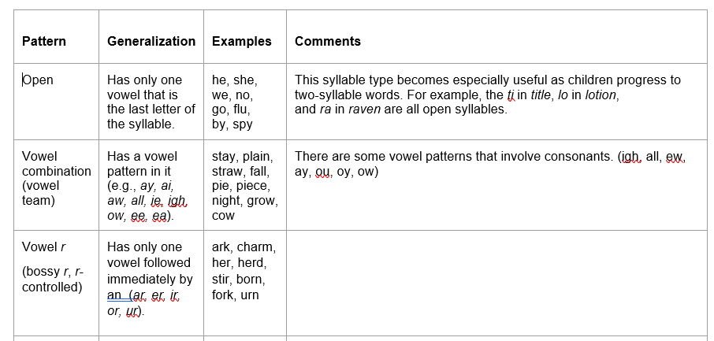
Notes:
To Know: Continue using Handout #4
To Do: Ensure participants return attention to Handout #4
Read through the slide with participants providing time for them to add the information from the “Comments Column”.

Slide 30
Other Common Syllable Patterns
Pattern | Generalization | Examples | Comments
Compound | Divide between the two words in a compound word | back/pack lamp/shade bed/room work/book | To be a true compound word, each of the smaller words must carry meaning.
VCCV | VC/CV Divide between the two consonants | or/bit ig/loo tun/nel lan/tern | Exception: -consonant digraphs (sh, th, ph, ch) are never separated. Treat these as VCV words.
Notes:
To Know: Students will not learn to decode multi-syllable words by learning syllable types. Students learn to decode unknown words by finding the patterns and practicing the sounds to decode unknown words as they read. (Chart adapted from Reading Rockets)
To Do: Ensure participants are using Handout #4 to write in the comments column as you go through the next slides.
To Say: You may want to mark on your chart on Handout #4 that these patterns are more common in second grade reading development. To decode words of more than one syllable, students need a strategy for dividing longer words into manageable parts. Compound words are one of the first patterns to help students. To be a true compound word, each of the smaller words must carry meaning. This changes decoding skills and comprehension.
Another very common pattern is the VCCV (Vowel-Consonant-Consonant-Vowel). The only exception to this is to ensure students know their consonant digraphs ‘sh’,’th’, ‘ph’, ‘ch’. Remember those are two letters that make one sound. You never break those apart.
Students learn to decode unknown words by finding the patterns and practicing the sounds to decode unknown words as they read the word in isolation or in text. Time spent practicing and noticing the patterns is essential.

Slide 31
Common Syllables cont.
Patterns | Generalization | Examples | Comments
-CLE | Word ends in consonant-le syllable, always divide right before the -CLE | ma/ple stum/ble i/dle nee/dle gig/gle | Some programs call this a final stable syllable
-VCV (Vowel- consonant - vowel) | First divide before the consonant and sounding out. If it does not result in a recognizable word, try dividing after | hu/mid mu/sic go/pher plan/et com/et meth/od | To recognize which choice is correct, a child must have the word in his/her oral vocabulary.
Notes:
To Know: Participants will continue to fill in the comments portion of the slides.
To Do: Ensure participants are engaging by completing Handout #4.
To Say: As we look at the other patterns students can generalize to help them break larger words into syllables for decoding, we find one of the most stable patterns is the -CLE (Consonant -le). Some programs often call this the ‘final stable syllable’ pattern. You always divide right before the consonant –le. Then you decode the word based on what you know about the other letters that come before the consonant -le to read or identify the word correctly.
VCV is the Vowel-Consonant-Vowel pattern. This pattern is one that begins to teach students that you might try two different sounds for the vowel to decide which is the correct alternative. In many words you divide before the consonant making the vowel a long vowel sound. Some programs call this an ‘open syllable’. The vowel always says it’s name. If that word does not sound like a word the student recognizes, you encourage the student to try dividing after the consonant in sounding out the word. For a student to recognize which is the correct way to decode the word, the child needs to have the word in his/her oral vocabulary/phonological memory. The teacher must have the student practice words both ways to decide. If the student cannot decide, then it will be necessary for the teacher to tell the child the correct pronunciation of the word with a brief explanation of its meaning.

Slide 32
Common Syllables cont.
Patterns | Generalization | Examples | Comments
Prefix | Divide immediately after the prefix | pre/view mis/trust un/wise re/mind | Sometimes a base word is a new word and not recognized by the student.
Suffix | Divide the word immediately before the suffix | glad/ly sad/ness care/less hope/ful state/ment na/ture frac/ture | Same as above. Informational text has lots of words with Latin and Greek roots.
Notes:
To Know: Teaching prefixes and suffixes are critical for decoding, vocabulary and comprehension.
To Do: Continue to direct note-taking comments for Handout #4.
To Say: Instruction in affixes is critical for decoding unknown words but also provides much deeper vocabulary understanding to aid in comprehension. This component of phonics moves the learner to begin to understand morphology at a different level. Affixes are meaningful units of sound. They hold a meaning of their own and can change the meaning of any base word. As early as first grade, students will find some words have more than one affix on it.

Slide 33

Essential Elements Phonics Lesson
Materials needed
Handouts #3 and #6
Dry erase marker
Eraser
Chips
Notes:
To Know: This slide is to prepare participants for the Phonics Lesson. Make sure you have chart paper, marker, and sticky notes to use as chips to demonstrate the lesson. You will also need to print off the Handout #5a to use as a script.
To Do: Ensure participants are ready with the correct materials.
To Say: Let us take a moment to work through the Essential Elements of a research-based phonics lesson.
(Follow directions on the script for Handout #5a to complete the lesson.)

Slide 34

Phonics Lesson Continued
Notes:
To Know and Do: Continue to move through Handout #5a with the script clicking forward to display each picture described in the lesson.

Slide 35

Phonics Lesson Continued
Notes:
To Know and Do: Continue to move through Handout #5a with the script clicking forward to display each picture described in the lesson.

Slide 36
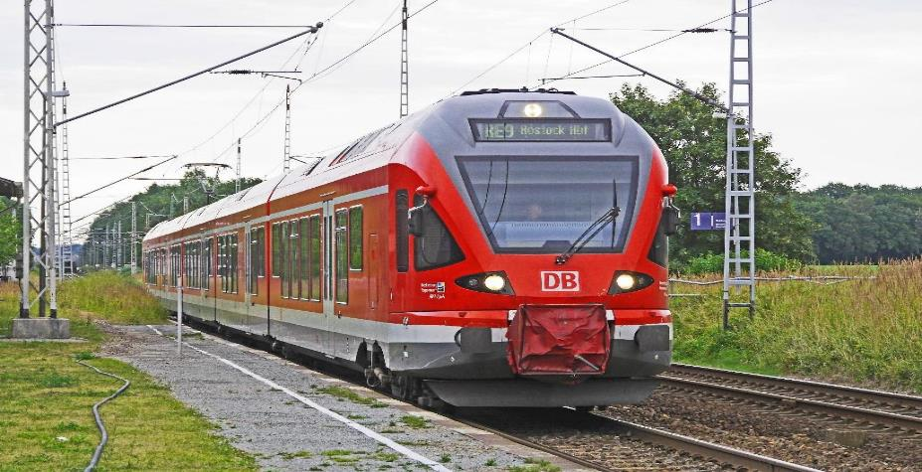
Phonics Lesson Continued
Notes:
To Know and Do: Continue to move through Handout #5a with the script clicking forward to display each picture described in the lesson.

Slide 37




Phonics Lesson Continued
Connect to word meaning | Using meaning clues with pictures Use meaning clues with phrases Use words in sentences.
Writing | Diction of words with patterns Then dictation of sentence with word(s) containing the patterns. (Finally, as students ability improves move to student generating a sentence using a word with the pattern learned.)
Apply to Text | Find words in text that have the patterns taught and read text decoding words which contain the patterns.
Notes:
To Know and Do: Continue to move through Handout #5a with the script. Use the back of Handout #3 to complete the writing portion of the lesson.

Slide 38
Ticket to Ride the Rails
Riding the train can be fun. But, you can’t get on a train until you have paid for your seat. The train master will take your ticket as you get on the train. There are other people who aid you on the train, too. They can feed you or tell when you can see the main sites outside. Did you know that some trains have a bed for you to sleep in at night?
My dad said the train was a pain. I loved the train. He said the train was slow like a snail. I say it goes just my speed. I loved going into the woods on the rail. The animals stopped eating to look at us as we went past. I guess they like the railroad tracks making a trail of faces pass by. I also saw a sailboat on a lake where a family was fishing.
Sometimes other trains drove by us. We saw trains that had mail, grain, and coal on them. We even saw a train that had cars and trucks on them. Some trains looked like boxes so we did not know what was on them.
But, our train was the best. It took me to my grandma and grandpa. Then on the way home we talked about all the fun we had riding the rails and seeing family!
Notes:
To Know: This is the decodable text for the phonics lesson.
To Do: Continue to follow the script for the phonics lesson. This is Handout #6 for participants to read and highlight the ‘ai’ words.
To Say: Take a few minutes to highlight all the words you see that have the ‘ai’ pattern in them.

Slide 39
Ticket to Ride the Rails
Riding the train can be fun. But, you can’t get on a train until you have paid for your seat. The train master will take your ticket as you get on the train. There are other people who aid you on the train, too. They can feed you or tell when you can see the main sites outside. Did you know that some trains have a bed for you to sleep in at night?
My dad said the train was a pain. I loved the train. He said the train was slow like a snail. I say it goes just my speed. I loved going into the woods on the rail. The animals stopped eating to look at us as we went past. I guess they like the railroad tracks making a trail of faces pass by. I also saw a sailboat on a lake where a family was fishing.
Sometimes other trains drove by us. We saw trains that had mail, grain, and coal on them. We even saw a train that had cars and trucks on them. Some trains looked like boxes so we did not know what was on them.
But, our train was the best. It took me to my grandma and grandpa. Then on the way home we talked about all the fun we had riding the rails and seeing family!
Notes:
To Know: This is the decodable text for the phonics lesson. (The word ‘said’ does not follow the long ‘a’ pattern. It is a high frequency word that can be learned as a ‘Heart Word’.)
To Do: Continue to follow the script for the phonics lesson. This is Handout #6 for participants to read and highlight the ‘ai’ words.
To Say: Read the words that you can decode that have the ‘ai’ in them. Now let’s read the passage together.
You have now completed a phonics lesson that progresses through the essential elements. The one thing we did not do today was a review of a previous lesson. The components can be in a different order and the time spent may vary dependent on the skills of students. You could also do part of the lesson one day and finish the next.

Slide 40

Notes:
To Know: Participants will need time to process the lesson that was completed making notes on Handout #5.
To Do: Allow time for participants to make notes on what they just did in the lesson.
To Say: We are going to pause a moment for you to use Handout #5 and reflect on what we did in our research-based lesson. Consider the steps that were followed for intentional application from sound, to decoding, to spelling, for vocabulary and comprehension with the final application to decoding in text.

Slide 41
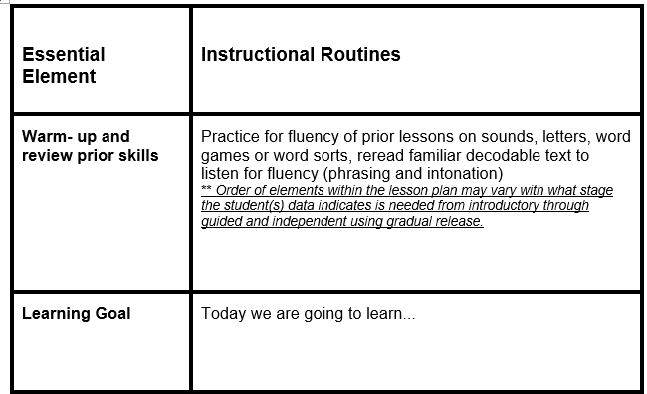
Essential Elements of Phonics Lessons
Handouts # 3, 5, & 6
Notes:
To Know: The next slides will allow participants to share their reflections.
To Do and Say: Share out how this portion of the lesson is similar or different than your routine.

Slide 42
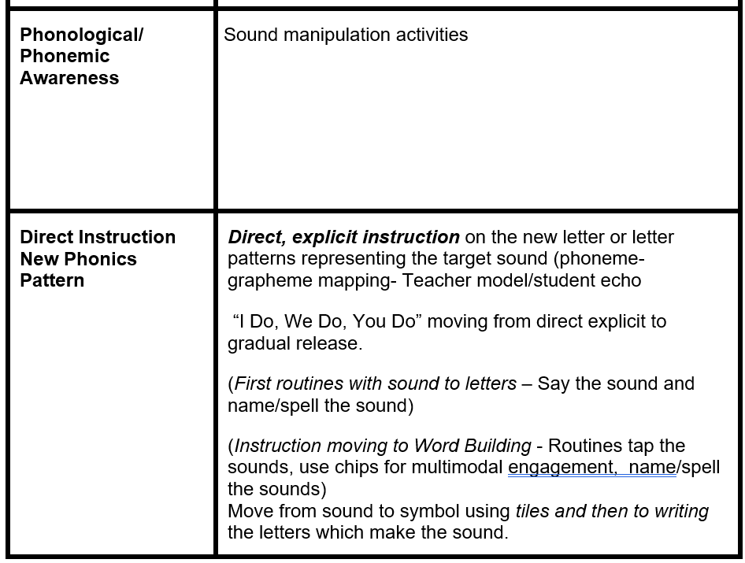
Essential Elements of Phonics Lessons
Notes:
To Say: Share out your reflections.

Slide 43
Essential Elements of Phonics Lessons
Connect to word meaning | Using meaning clues with pictures Use meaning clues with phrases Use words in sentences.
Writing | Diction of words with patterns Then dictation of sentence with word(s) containing the patterns. (Finally, as students ability improves move to student generating a sentence using a word with the pattern learned.)
Apply to Text | Find words in text that have the patterns taught and read text decoding words which contain the patterns.
Notes:
To Say: Share out your reflections. What do you intend to do with your learning?

Slide 44

Meaning Trumps Letters
Grade 3 +
Explicit morphology instruction.
Prefixes, suffixes
Roots, base words
Meaning in multi-syllable words
Notes:
To Know: Students will begin to learn about morphemes and use them in first and second grade. Instruction in grade three will ramp up vocabulary connections and meaning for use in many informational texts, as well as content subjects that demand students read more independently.
To Do:
To Say: Normally, developing readers have mastered many of the phonics patterns by third grade as they move to the ‘reading to learn’ stages. By third grade, teachers may be able to shift explicit phonics instruction mostly to explicit morphology instruction. Meaning now trumps letters. Students are taught to recognize and build words using base words. Morphemes are meaningful units of speech that hold meaning. When students learn those morphemes attached to meaning, they are able to understand, decode, and produce many other words that hold those bases.
This is the grade that frequently is a struggle for students who have not mastered the earlier patterns we discussed. This grade is often a grade where we see instruction shift to more of a standards focus on comprehension and there is no phonics instruction taking place. Yet research has proven we need to teach decoding to mastery therefore, we will need to continue to teach earlier skills for strugglers and begin to focus more on morphology (Latin and Greek roots) for those at grade level.
Vocabulary and spelling can be integrated with instruction in reading words. For example, as students learn to read the root geo, they learn that it means earth and that it will have a stable spelling across related words such as geology, geologist, geological, geography, geographic, etc. Consider how many words you can make with the morpheme matrix on the next slide.

Slide 45
Word Matrix
er
ly
est
s
able
un
friend
ship
ness
be
ed
ing
Notes:
To Know: Participants enjoy competing as teams or tables to figure out how many words they can produce.
To Do: Allow three to four minutes for participants to make a list of words from this matrix.
To Say: One powerful tool that increases decoding, vocabulary, and comprehension is to use a Word Matrix. Form a list of all the words you can make by knowing these affixes as you introduce a new word. After three or four minutes, have them share.
Who had more than ten words?
What was our top?
Have one group read theirs and we add more if we found them.
As a teacher, you can build the matrix dependent on the affixes you have taught. Students quickly find that if they know the word friend with all the other affixes on this matrix, they know MANY other words. It is a great reminder of how affixes change word meaning.

Slide 46

Effective Phonics Programs
Handout # 7
Systematic
Explicit
Opportunities to practice
Reading Rockets: https://www.readingrockets.org/teaching/reading101-course/modules/phonics-introduction
Put Reading First: The Research Building Blocks for Teaching Children to Read Kindergarten Through Grade 3, a publication of The Partnership for Reading.
Notes:
To Know: Effective programs will include these. Handout #7
Teaching the code of written language in a systematic and explicit manner has been empirically shown to have superior results compared to methods that do not. (Brady reviews, 2011, NICHD, 2000; Ehri,Nunes, Stahl, & Willows, 2001; NELP, 2008; Share, 1995)
To Do: Explain and provide the research validation when needed for groups uncertain of reliability of systematic instruction in phonics. Handout #7.
To Say: Programs which are the most effective for phonics instruction should include three defining factors:
The program teaches letter-sound relationships in organized logical sequence. Students first manipulate sounds then are taught that letters are what we use to name those sounds. The letters are arranged in a logical sequence so letters that are very similar are not taught at the same time. The letters are always taught with a strong relationship between the sound and a picture cue. The picture cue will always be used to represent the connection between that sound and letter being displayed and referenced with practice as an anchor.
The program will also have explicit instructions for the teacher to follow in a consistent way with precise directions. These directions can seem very repetitive but will make pathways in a student’s brain that will allow quick connections between sound, letter, and meaning. These paths will become the ‘roads’ of automaticity.
Systematic: the letter-sound relationship is taught in an organized and logical sequence
Explicit: the instruction provides teachers with precise directions for teaching letter-sound relationships
Lessons within the program will include opportunities to practice using the phonics for decoding in words, sentences and text. The programs yielding the most effective transfer and maintenance of phonics instruction move directly into decodable text. These programs also include time devoted to making and building words linking between the decoding and spelling needed for strong literacy development. Classroom instruction will link phonics within reading, spelling and expect those patterns to be used in writing.
You may want to provide Handout #7 and not take the time to detail the information below.
Research has revealed that systematic and explicit phonics instruction
Teaches the major sound/spelling relationships of both consonants and vowels
Gives students substantial practice in applying knowledge of letter-sound relationships as they learn to read and write
Uses text (books or stories) that contain a large number of words that students can decode by using the letter-sound relationships they have learned and are learning
Provides students with opportunities to spell words and to write their own stories with the letter-sound relationships they are learning
Produces the greatest impact on student’s reading achievement when it begins in kindergarten or first grade (However, phonics should be included in the instruction of any student who has not yet mastered phonics skills, no matter the age)
Results in kindergarten and first-grade students being better readers and spellers than their peers who are not taught phonics in a way that is systematic and explicit
Significantly improves student’s reading comprehension
Is beneficial to students regardless of their socioeconomic status. It helps students from various backgrounds make greater gains in reading than non-systematic instruction or no phonics instruction.
Helps to prevent reading difficulties among at-risk students
Helps struggling readers overcome reading difficulties

Slide 47
Reading Programs and What Worked?
Students were trained in phonological awareness to the advanced levels
Phonics decoding skills were taught in explicit, systematic ways and reinforced within text
Lots of opportunities to read connected text
Kilpatrick, 2016
Notes:
To Know: All the trainings presented in the literacy modules will anchor to the framework of the “Five Components of Literacy”, which are phonemic awareness, phonics, fluency, vocabulary, and comprehension and are linked to the connections of research about effective reading instruction through programs. The programs found most effective in reading had all three of the components listed on this slide. Teachers need to know how to use the five components in an effective program to develop strong readers and reduce the number of at-risk readers.
To Do: Pause for participants to digest this slide.
To Say: In each of our sessions we will ensure you take time to look at your reading curriculum, practices, and programs to determine if they contain the necessary components for the most successful reading development.
Based on 30 years of research, these components are found in reading programs with the highest student growth in increased literacy development and reduction of at-risk students.
We defined and practiced the phonological awareness levels in the previous module. If you missed that opportunity, you will need to ensure you understand the difference between basic and advanced levels of phonemic awareness or students will not master and retain phonics instruction.
Another component identified by research was phonics decoding skills were explicitly taught in systematic ways and reinforced within text. We examined this component today.
Finally, as struggling readers get older they rely on others to read the text for them becoming a listener not a reader. Therefore it is crucial we ensure students have age appropriate texts they can read independently. Students need to READ connected text often, not just listen.

Slide 48

How is This the Same or Different as Your Series or Practice?
Notes:
To Know: Networking is a benefit and much is to be gained from sharing what they have and noticing what is effective in their products or how to use their products with greater effectiveness.
To Do: Use this as a Header Division slide.
To Say: It is time to reflect on our own practice. We have experienced a lesson with essential components. We have looked at what research says is important for student growth. Let us take a few minutes to consider the questions on the next slide.

Slide 49
What About Your Reading Program?
Does our reading program produce students who can decode easily or do our students struggle to ‘sound out’ words?
Is our phonics instruction systematic, explicit and begins in kindergarten supporting students mastery regardless of the grade level?
Do we look at our system of instruction for phonics as levels of development or as a program assigned per grade?
Do we teach phonics through mastery of skills or only in the lower grade levels?
Notes:
To Know: This slide is intentional for participants to share how phonics is addressed in their buildings.
To Do: Provide about three to five minutes for teams or partners to discuss.
To Say: Take about three to five minutes with your team or table mates to consider your reading program or reading instruction.
Does our reading program produce students who can decode easily or do our students struggle to ‘sound out’ words?
Is our phonics instruction systematic, explicit, and begins in kindergarten supporting students mastery regardless of the grade level?
Do we look at our system of instruction for phonics as levels of development or as a program assigned per grade?
Do we teach phonics through mastery of skills or only in the lower grade levels?
As you gather the minds of participants back after discussion provide the following thoughts.
As you move forward from today’s learning, keep these questions in your mind to help you plan your next action steps:
Did you find any practices in your program or curriculum that mirror some of these activities?
What is the same or different?
What are your next steps?
What might you need to provide the type of lesson you experienced today?

Slide 50
Examples for Practice
University of Florida Intervention
https://education.ufl.edu/ufli/virtual-teaching/main/
Reading Resource
https://www.readingresource.net/readingactivities.html
Florida Center on Reading Research
https://fcrr.org/student-center-activities/kindergarten-and-first-grade
Reading Rockets
https://www.readingrockets.org/teaching/reading101-course/modules/phonics/phonics-practice
Notes:
To Know: Here are other places to get phonics practice if they do not have a program.
To Do: Provide these in the resources.
To Say: The websites provide you with other resources to improve decoding in students. You will also find the West Virginia Phonics has direct explicit instructional routines and free lessons for you to download and use.
You will find the West Virginia Phonics at Tools for Reading located at https://www.tools4reading.com/tools-4-teachers.
You will need to complete a free registration to access the WVP materials.

Slide 51
Thank You for Your Professional Attention
2021

Slide 52
Resources and Acknowledgements

