Slide 1
What You Will Need
Handout #1 – Glossary
Handout #2, 2a – Product/Process Phrase Strips or Matching
Handout #3 – It Says, I Say & So
Handout #4 – Text Structures
Handout #5, 5a, 5b, 5c – Storyboards/maps (3 pages)
Handout #6, 6a – Visualization (2 forms)
Handout #7 – Paragraph Shrinking
Handout #8 – Story Wheel (2 pages)
Handout #9 – Summarization (Deep & Quick)
Handout #10 – Something Old, Something New
Post-It Notes
Notes:
To Know and To Do: Hide this slide when presenting. This is the list of needed supplies.
Here are the different handouts which might be accessed for this presentation. You will refer to the Decision Making Flowchart as you have in each module before, but it will not be provided as a handout in this module.
Handout #1 – Glossary
Handout #2, 2a – Product/Process Phrase Strips or Matching
Handout #3 – It Says, I Say & So
Handout #4 – Text Structures
Handout #5, 5a, 5b, 5c – Storyboards/maps (3 pages)
Handout #6, 6a – Visualization (2 forms)
Handout #7 – Paragraph Shrinking
Handout #8 – Story Wheel (2 pages)
Handout #9 – Summarization (Deep & Quick)
Handout #10 – Something Old, Something New
Post-It Notes
There is a folder with five possible stories which may be used with this module to practice comprehension. Select one or provide a choice during this training for slides 28-29 and Handout #3. Consider using any graphic organizer with a story to model the I Do, We Do, You Do for intentional teaching of PROCESS THINKING for trainings that will expand in a longer session. Or, you may want to have participants bring their different organizers to compare with this presentation or prepare lessons in how to scaffold intentional instruction and application for comprehension.
There are more resources added as slides after the end of the presentation with accompanying documents as resources listed below.
Resource Handouts
Resource #1 – Directed Reading and Thinking Activity (4 pages)
Resource #2 – Question/Answer Relationship (3 pages)
Resource #3 – Concept Map – Reading Thought Web

Slide 2
Reading Comprehension
Components of Effective Literacy
Module 6
2021
Notes:
To Know: This module will be the sixth in a series of the research-based modules that will address phonological and phonemic awareness, phonics/spelling connections, vocabulary, comprehension, writing and assessment.
To Do: Ensure you read the background information needed and accessed the learning from Reading Rockets before beginning this training. Have ready the handouts for this training for attendees to download or have paper copies available.
To Say: Welcome to Module 6, Reading Comprehension. This module is the sixth in a series of the research-based modules that will address phonological and phonemic awareness, phonics/spelling connections, vocabulary, comprehension, writing and assessment. We are pleased you can join us today. This training is meant to confirm some of your practices and understanding in literacy. Our focus will be anchored in the Science of Reading and information that research has proven to be most effective for successful reading instruction.

Slide 3
Welcome and Introductions
Notes:
To Know and To Do: Please add introductory information here to introduce yourself to the group. You may remove this slide if you do not need to introduce yourself to the group.

Slide 4
Learner Intentions
Participants will Examine
Comprehension – Process vs. Product
Comprehension from sentence – Paragraph-Story
Linking Listening Comprehension and Reading Comprehension
Text Structure and the Impact on Comprehension
The Application of Graphic Organizers for Processing
The Power of Intentional Strategy Instruction
Notes:
To Know: These are the intentions for the day.
To Do: Allow time for the participants to consider the learning ahead for them.
To Say: Here are our intentions for the day. We will examine how our instruction for comprehension impacts student growth and application of learning as we read.
Sometimes we get caught up in the product, the fun games, and activities when it should be the process. Teaching process thinking is the way to increase comprehension.
Comprehension starts at the sentence level.
The intent is to connect listening and reading comprehension.
Text structure impacts comprehension through the application of graphic organizers for processing.
You should walk away today with many examples of intentional strategy instruction which research proves will increase comprehension.
I will now pause for you to wrap your mind around what is ahead for you in this session.

Slide 5
Missouri Teacher Standards
The following Missouri Teacher Standards will be addressed today
Standard #1: Content knowledge aligned with appropriate instruction
Standard #2: Student Learning, Growth and Development
Standard #3: Curriculum Implementation
Standard #7: Student Assessment and Data Analysis
Notes:
To Know: These are the teacher standards we will address today.
To Do: Direct participants to the slide.
To Say: If you need to document for your professional development reference, here are the Missouri Teacher Standards that we will be addressing today. I will pause a moment while you note these. We will address Standards #1, #2, #3, and #7.

Slide 6
Norms
Be present
Turn cell phone off or silence
Minimize sidebar conversations
Take care of personal needs with minimal distractions
Ask questions
Have open hearts and open minds
Be patient
Notes:
To Know: There are norms for virtual or face-to-face, so please place the norms that fit your group into the slides so that all attending are comfortable and ready to learn the expectations needed for their building or district.
To Do: Use norms and expectations that fit the group and situation.
To Say: Today, we are going to ask that you be present with us by considering how this learning fits into what you already do. It will either confirm some things you are already doing or it might push you to consider what might be different, according to research, on what works in the world of literacy development. We would ask that you have cell phones on silent and minimize sidebar conversations or distractions. We will take formal breaks. So, please take care of personal needs with minimal distraction.
Since our goal is to apply the content to you and your students, we hope you will ask questions to clarify the content and how it relates to you and your students. As you open your mind to confirm your practices or align your practices with research, we know it takes patience and a heart for doing what is best for students. We deeply appreciate your professional passion and drive to share, learn, and apply for student success. Is there anything else you might want or need for this to be a good day?

Slide 7
Virtual Norms
Ask questions using chat box, unmute, raising your hand
Engage fully using the clock icon should you need to step away
Integrate new information
Open your mind to diverse views
Utilize what you learn
Adapted from: Mallia, G. (2013). The social classroom: Integrating Social Network Use in Education.
Notes:
To Say: Are there additional norms you would like to add for the sake of the group?

Slide 8

Expectations Between Us
Here to learn
Eager to share
Respectfully gathered
Enjoy professional friends
Notes:
To Know: Please use the norms that fit you and the group you are training.
To Say: These are the expectations set for our time together.
“Here to learn” means you are looking at whether this makes sense to you. We love questions. They ensure we are clear and it helps us to better apply the content to your classroom or district.
“Eager to share” means we will ask you to discuss some learning with a partner or two. We want you prepared to open yourself up to that opportunity.
“Respectfully gathered” means we do not know your situation. We like to see and hear you taking part with us and making the best of our time. If your situation causes an unexpected distraction, we know you will mute or make sure it does not interfere with others learning.
As we gather in person, consider your needs along with others in respect to the bathroom or needing to leave the room for phone calls. Enjoy this time with professional friends and share a laugh or two!

Slide 9








Introduction Activity
Notes:
To Know: Please use what you know about your audience to build a connection between them and the content you are introducing for this module.
To Say: Select an emoji that resonates with you when you hear the term “Reading Comprehension”.
Turn to a shoulder partner and share which emoji you selected and why you selected that emoji.

Slide 10
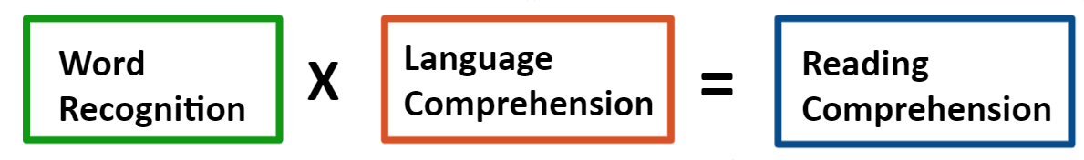
Simple View of Reading
Notes:
To Know: We have anchored all our work in the Simple View of Reading. Take time to connect to the overall reason we are focusing on the end product of reading called comprehension.
To Do: Take a moment to allow participants to respond in writing before asking them to share.
To Say: By now this should look very familiar to you. We started off the training series with the simple view of reading. When you work on word recognition or decoding skills, language comprehension and vocabulary skills then a student develops reading comprehension skills. But, what exactly is reading comprehension? On a piece of paper, write your own definition of reading comprehension. I will give you a minute or two to write and then ask a few of you to share your definitions.

Slide 11

What is Reading Comprehension
The act of understanding and interpreting what we read.
Notes:
To Say: Comprehension, simply stated, is the act of understanding and interpreting what we read. What happens in our students’ brains as they read is anything but simple!
Skilled reading depends on a wide range of abilities — everything from concrete, masterable skills like decoding to complex, hard-to-pin-down thinking skills like making inferences. In order to change reading comprehension we need to explicitly ‘teach’ students how to think as they read. This begins at the sentence level.

Slide 12

Reading Comprehension
Notes:
To Know: Read this with intention and allow participants time to absorb each bullet below.
To Say: Reading comprehension is an ongoing process. The skills students need to be able to master for good comprehension include
The ability to make sense of what they read
Being able to think about and actively engage with a text
Talking about their reading with others to help promote comprehension through questioning; connecting ideas or challenging themselves through what they believe the author means
Think of the strategies and skills as we go over the recipe for reading comprehension. When our students have successfully combined all the skills/ingredients together in their minds, they are able to understand and interpret what they read; which is comprehension.

Slide 13
Process or Product?
HO #2
Match vocabulary words with student-friendly definitions
Write a summary after reading
Make a mental model of the story in your mind as you read
Have students tell what they already know about a topic
Answer true/false questions while reading
Reread what was not making sense during reading
Predict the end of the story
Notes:
To Know: To understand comprehension we must know the difference in what we are teaching as a product of comprehension or a process to increase comprehension. You may want to allow participants to sort the actual stems, then you will use the optional handout to cut apart and physically sort or use the handout for teachers to note which is a process or product.
To Do: Provide the phrase strips for teachers to sort the different comprehension tasks. Handout Process Strips (HO #2) or Process vs. Product Matching (HO #2a). The Answer Key is on the next slide or use Handout #2b as the Answer Key for this processing activity.
To Say: To understand comprehension we must know the difference in what we are teaching as a product of comprehension or a process to increase comprehension. The product is what we assess, but the process is what is going on in their head as they understand and interpret what they are reading. Know how to teach comprehension and know how to test comprehension. There is a difference!
Read through the different comprehension activities and sort the different phrases into which are a product of comprehension and which are a process of thinking.

Slide 14
Product
Match vocabulary words with student-friendly definitions
Write a summary after reading
Answer true/false questions while reading
Process
Make a mental model of the story in your mind as you read
Have students tell what they already know about a topic
Reread what was not making sense during reading
Predict the end of the story
Teach the Process
Notes:
To Know: These are the answers for the Process and Product sort. Each of these activities are used by teachers working on comprehension.
To Do: Show the answers and have the participants check their answers.
To Say: We don’t teach reading comprehension in and of itself. We teach students specific skills and when they are able to master these skills, they are able to comprehend what they read. The product is what we assess, but the process is what is going on as they understand and interpret what they are reading. Know how to teach comprehension and know how to test comprehension. There is a difference!

Slide 15

Constructing Meaning From Text
1. Interactive
2. Strategic
3. Adaptable
Notes:
To Know: It is our goal for our students to become strategic readers. In doing so, they are able to construct meaning from text.
To Say: Comprehension starts as soon as students begin to understand and use language. Reading comprehension instruction begins with teachers using predictable books that are read aloud to students. As students begin reading a book on their own, the book has a simple text structure highly connected to a visual picture. As students get older, the language structure becomes more complex, and students need to be able to continue to construct meaning from various types of texts, including narrative text and expository text. These text structures are very different and are not as simple directly connected to a visual or even written as we normally speak. Across the years of school, their awareness of text structures must increase as they progressively shift from reading a story line or casual text to reading for information (Lorch & Lorch,1996). By the third grade, and obviously by the fourth, there is a noticeable shift to reading texts for information, information that is often dense and written in long passages (Gillet, Temple, & Crawford, 2004; RAND Reading Study Group, 2002).
The act of constructing meaning is
Interactive — it involves not just the reader but also the text and the context in which reading takes place
Strategic — readers have purposes for their reading and use a variety of strategies and skills as they construct meaning
Adaptable — readers change the strategies they use as they read different kinds of text or as they read for different purposes

Slide 16
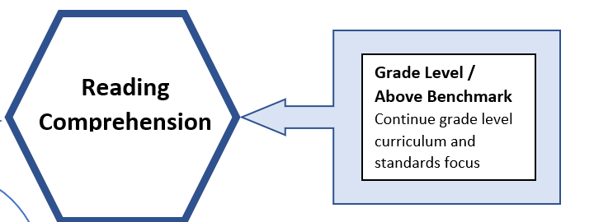
Developing Fluency for Strong Comprehension
Targeted Literacy Decision Making
If low
Notes:
To Know: This is a Targeted Literacy Decision Making Flowchart referred to in every module.
To Do: Let’s remember where we are for comprehension. Weak comprehension is often a first trigger for teachers that something might not be fully developed for the reader. No matter what a district uses to show that a student has low comprehension, remember the first drill down data we recommended in the assessment module was to give an Oral Reading Fluency Assessment.
Our task in the other modules was to drill down to the most foundational parts of reading to find the missing link in development.
To Say: Today we are going to revisit where we are in the process of reading. For strong literacy, students must be able to comprehend or understand and apply what they read silently. Comprehension is the ‘end’ goal of instruction. Some students can read or say the words on the page well and without hesitation, but are at different levels of understanding. Today we will look at how our instruction impacts the depth of comprehension and confirm what you know or use for comprehension to develop deeper thinking.

Slide 17

When Reading Comprehension is Low
Check Oral Reading Fluency
On Grade Level
Focus on
Vocabulary
Comprehension
If ORF is not low
If low
Notes:
To Know: This Data Flowchart for Effective Literacy was introduced in Module 1. Participants are asked to bring this back to each training to connect the new learning to where we are in the reading process.
To Do: Link participants to the Data Flowchart for Effective Literacy.
To Say: The strategies discussed will increase comprehension for any reader however, if a reader is low in comprehension the first decision is to follow the arrows downward to match the instruction to the underlying skill need.
When a student is not at grade level and we have determined that fluency (not rate or phrasing and intonation), vocabulary, phonics, and phonemic awareness are not the issue; then, we truly know the student just needs more targeted instruction in specific strategies to increase the thinking processes needed for comprehension. Today, we will intentionally focus on the strategies to increase thinking for strong comprehension. As we move forward, we will ask that you consider the ‘how’ in using these strategic thinking processes. We hope it will confirm some understandings you have with the tools you use, but we definitely ask that you consider ‘how’ you use these tools and intentionally scaffold their use bringing higher scores on product comprehension assignments or assessments.
If a student has no difficulties with oral reading fluency, continue to focus on vocabulary and use the strategies within this module scaffolded to mastery with feedback on silent reading before focusing heavily on activities that are not process focused in thinking.

Slide 18

Poor comprehension
goes back to fluency
Poor fluency
goes back to word recognition
Poor word recognition
goes back to Phonics and Decoding
Poor Phonics & Decoding
goes back to Phonemic Awareness
Notes:
To Know and to Say: To recap in short form what our modules have taught us, we have to consider the complete process. With each student we will need to consider where the problem actually lies and many times it is not in comprehension but in the other skills needed for a skilled reader.
I would like to ask you to read the bold print and I will read the underlying problem to check in italics.
Poor Comprehension - goes back to fluency
Poor Fluency - goes back to word recognition
Poor Word Recognition - goes back to phonics and decoding
Poor Phonics & Decoding - goes back to phonemic awareness

Slide 19
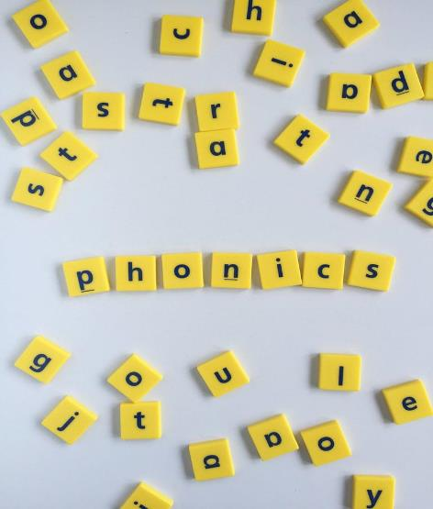
What Do Skilled Readers Do?
Have a clear purpose
Utilize word attack skills
Use knowledge to derive meaning
Bring in background knowledge
Make inferences
Construct and revise meaning
Motivation to read and apply what they learn
Notes:
To Know: Click to have each bullet to appear.
To Do: Take time for participants to share their thinking about the skills a good reader uses as they read which results in strong comprehension.
To Say: Let’s think for a minute about what good or skilled readers do to ensure they comprehend what is being read.
(Allow time for participants to share out a few of their ideas (click to make words fly in)
Reading Researchers have described various skills that most skilled readers seem to have in common:
A clear purpose for reading and an ability to monitor and adjust their reading to serve that purpose
Word attack skills that allow them to accurately, automatically decode words
Vocabulary knowledge and oral language skills that help them understand the meaning of words and sentences
Background knowledge, including content knowledge and literacy knowledge
Thinking and verbal reasoning skills such as drawing inferences
Strategies for constructing and revising meaning as they read, such as making predictions and asking questions about the text
The motivation to read and to apply what they learn
Provide a thumbs up for each time your thoughts aligned with what research says skilled readers do.
Research: (Duke, Pearson, Strachan & Billman, 2009; Sedita, 2006; National Reading Panel, 2000)

Slide 20
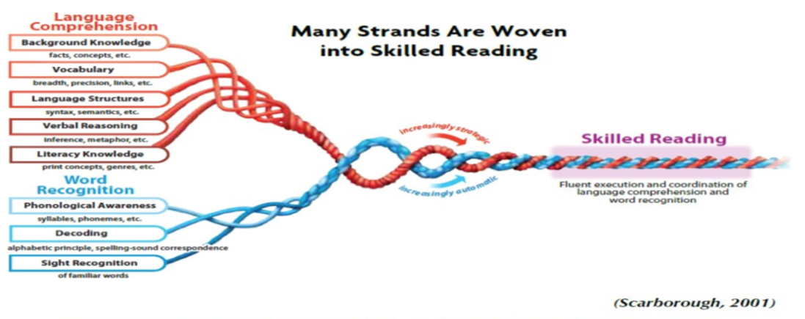
Reading Rope
Notes:
To Know and To Say: The skills we see in a skilled reader are found woven in the Reading Rope. Scarborough stated, “Reading comprehension is skilled reading; fluent coordination of word reading and comprehension process.” The skills we focus on today will be in the Language Comprehension portion of the rope.

Slide 21
Intentional Instruction to Develop
Student Thinking
Notes:
To Know: We are moving from research into practice. This is a transitional slide.

Slide 22
Comprehension Starts at Sentence Level
Who? Subject | Did What? Predicate
The boys ran.
Mom saw the boys.
Rain started falling.
Notes:
To Know: Another way to increase comprehension starts at sentence level
To Do: Use the sentences on the slide to answer both questions (Who? Did What?).
To Say: Comprehension starts at the sentence level. Begin with simple sentences and use the terminology per grade level. Pre-K will begin with ‘who? - did what?”. Use the sentences on the slide to answer both questions (Who? Did What?). Pause for participants to respond.
Upper grades will begin to use the grammar terms for the role words play inside of the sentence. ‘Who’ is the subject or noun.
‘Did what’ is the predicate or do you wish to find the action verb?

Slide 23
Sentence Level Expansion
Who? | Did What? | When? | Where? | How? Why?
Notes:
To Do: Have participants locate some sentences in the text you provided to identify the ‘role’ each word plays in the sentence.
To Know and To Say: As students begin to move to more complex text in first grade, sentences begin to contain words that answer more of the ‘who-what-where-when-how-why’. Sentence Level comprehension can be done as early as kindergarten but still has great value no matter the age or grade.
All MAP assessments or standards assessments use sentences from passages the students have read to answer/ask grammar type questions. Placing this intentional instruction in your literacy groups will develop more skilled readers and writers. Students begin to identify the role words play in sentences for our language structures, but also increase their writing and comprehension as the text becomes more complex.
Locate some sentences in the text provided and label the ‘role’ each word plays in the sentence. Pause for participants to complete the task.
More to Know: Note that the order of who, did what, when, where, how, and why are not always in the order of the words in the sentence frame above. Some sentences do not answer all questions. However, the higher readability texts do contain sentences with far more than seven to ten words per sentence. These sentences require us to have students understand what each portion of those sentences are telling us. Several sentences in rich text can exceed 15 words.

Slide 24

Developing Strategic Readers
Activate Prior Knowledge
Draw Inferences
Text Structures
Visualization/ Form Mental Images
Retell
Summarize
Notes:
To Know and To Say: Comprehension “strategies” are behaviors that researchers have consistently observed in skilled readers. We explicitly teach these behaviors so that all of our students can benefit from them. Strategic readers understand what they read, but their comprehension doesn’t stop there. They also notice and reflect on their own reading. By teaching comprehension strategies, we help our students to be aware of their own thinking — to be metacognitive — as they read.
We will talk about each of these strategies. (Read the strategies)

Slide 25

Activating Prior Knowledge
Image Brainstorm
KWL Chart
ABC Brainstorming
Class Brainstorm Web
Notes:
To Know: Image Brainstorming is when an image is displayed and students are asked to tell you everything they can about the picture. Learning is activated best when teachers select images which can form connections to the new content and/or concepts students will be learning.
To Say and Do: Let’s Brainstorm! Tell me what this image brings to your mind. (Pause for participants to shout out their thoughts.)
We’ve just completed an Image Brainstorm. There are many ways we activate prior knowledge before beginning any type of reading.
Now, with a small group, brainstorm ways you activate students’ prior knowledge. Use Post-It notes for this activity.
We will use “Cover the Table” as our form of brainstorming following these steps:
Turn to your table partners to collaborate and brainstorm.
Have multiple Post-It notes in your hand.
Consider ways you activate prior knowledge before beginning any new learning.
Write one idea on a sticky note and place in the center of the table.
Repeat this process until you are asked to stop.
Cover the table with all your team ideas.
(Provide four minutes for participants to write or call “stop” when the teams seem to have exhausted most of their ideas.)
Now we will organize our notes by stacking the ideas that are the same on top of each other and sort different ideas separately. (Allow the teams time to sort)
Activating prior knowledge impacts the following
confidence booster for students that tend to give up before even trying
motivates student connections to the content
opens up a stronger base for students with limited background knowledge or experience
helps you identify what your students already know about the topic
More to know
Image Brainstorming is described above.
KWL – Know, Want to Know, Learned
ABC Brainstorming is provided at the end of the vocabulary module #4
Class Brainstorm Web – Teacher creates a web based on student responses

Slide 26

Intentional Activation of Prior Knowledge
Gauge and Engage
Ask and Anchor
Map out and Check In
Sequence and Scaffold
Notes:
To Say: Students learn and remember more from a text when they have some familiarity with the content. When we connect what students already know with new content to be introduced, we spark their interest and curiosity and give them a sense of purpose for learning and reading.
Intentional activation of prior knowledge helps us
Gauge where students are prior to instruction so we can engage students in different ways according to their range of knowledge
Ask questions which will enable us to anchor the new learning based on the terminology or concepts the students reveal
As students map out their knowledge, we effectively can check-in on which learning gaps we might need to address on the journey forward
We can then sequence the instruction to scaffold students from their prior understanding to a new deeper learning or concept building from one lesson to the next
Intentional activation of prior knowledge means to gauge, anchor, check in, and scaffold.

Slide 27

2. Drawing Inferences
Inferences are not directly stated, but are what we figure out based on an experience.
What evidence in the text supports my thinking?
Notes:
To Know: You will need to click forward to reveal the thought bubble.
To Say: Many of us did not know that when we work on inferences, we are teaching and engaging students in activities which will increase comprehension. Research has proven when we have students make inferences and validate their inference using evidence from a text to support their thinking, we are increasing comprehension.
Inferences are what we figure out based on an experience. Helping your child understand when information is implied (or not directly stated) will improve the skill in drawing conclusions and making inferences. Inferential thinking is a complex skill that will develop over time and with experience.
More to Know: Marzano (2010) suggests teachers pose four questions to students to facilitate a discussion about inferences.
What is my inference?
This question helps students become aware that they may have just made an inference by filling in information that wasn't directly presented.
What information did I use to make this inference? (specifically stating the evidence from the text)
It's important for students to understand the various types of information they use to make inferences. This may include information presented in the text, or it may be background knowledge that a student brings to the learning setting. This is the greatest gift and anchor in the thinking process for comprehension which is repeatedly found in many of our assessments. Remember how impactful the ‘process’ instruction is within intentional instruction, but the result of this thinking is found in our ‘products/ assessments’.
How good was my thinking?
According to Marzano, once students have identified the premises on which they've based their inferences, they can engage in the most powerful part of the process - examining the validity of their thinking.
Do I need to change my thinking?
The final step in the process is for students to consider possible changes in their thinking. The point here is not to invalidate students' original inferences, but rather to help them develop the habit of continually updating their thinking as they gather new information.
Resource: https://www.readingrockets.org/strategies/inference The Art and Science of Teaching: Robert Marzano

Slide 28
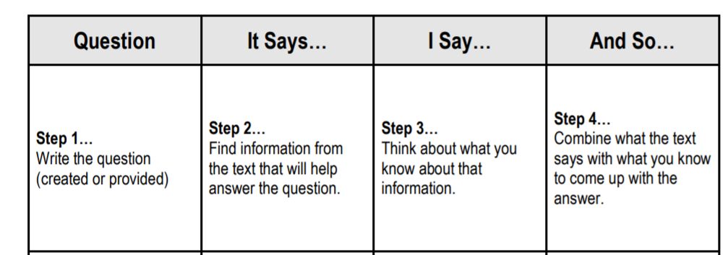
Drawing Inferences: It Says, I Say and So
HO#3
Notes:
To Do: Access Handout #3 - It Says, I Say, and So
To Know and To Say: It Says, I Say and So is a model that helps students understand how to make inferences. We will practice this example for deepening comprehension through text evidence by completing a listening activity using an excerpt from the Goldilocks and the 3 Bears. You will need the It Says, I Say and So Handout #3.
Ready listeners?
“Once upon a time, there was a little girl named Goldilocks. She went for a walk in the forest. Pretty soon, she came upon a house. She knocked, and when no one answered, she walked right in.
“After she'd eaten the three bears' breakfasts, she decided she was feeling a little tired. So, she walked into the living room where she saw three chairs. Goldilocks sat in the first chair to rest.
"This chair is too big!" she exclaimed. So she sat in the second chair.
"This chair is too big, too!" she whined. So she tried the last and smallest chair.
"Ah, this chair is just right," she sighed. But just as she settled down into the chair to rest, it broke into pieces!
Follow along with me as we go through the handout.
Step 1 is the question. This is the question we will be doing this activity with. “Why did Goldilocks break the baby bear’s chair?”
Looking at Step 2, “It Says”. Find the information from the text that answers the question. ”What information do we know from the text about what happened?” (Goldilocks sat in the baby bear’s chair and broke it.) “What do we know about Goldilocks?” (Goldilocks was a little girl; not a baby.)
Step 3, “I Say” asks, “What information do we know about the chairs and about Goldilocks?” Baby stuff is small and is not made for really heavy things. Girls weigh more and are bigger than babies and do not fit well into baby sized furniture.)
And “So”, what is our “why” question? Why did Goldilocks break baby bear’s chair? (Because the furniture was small and because it was not made for the weight and size of an older child, it broke.)
We worked through the process of drawing inferences from the text through listening. This strategy also provides an opportunity to synthesize information with prior knowledge.

Slide 29
Independent Practice
HO#3
Notes:
To Do: There are five different classic children’s stories in the resources for this activity. You can use all five or every group can have the same story. Please select one that you will use for this activity and have it ready for participants to share.
To Say: Let’s use another familiar children’s story. Read through the story and come up with a question to address and complete the organizer, “It Says, I Say, And So.”

Slide 30

Share Out to Learn Application
Notes:
To Know: There are many teachers in the room with a variety of strategies in their toolbox. This opportunity allows voice in the room to confirm their strategies and consider how the strategies they are using are aligned to a research-based process. If participants used different stories, you have the opportunity to process their ideas as well.
To Do: Allow time for participants to share their work product and discuss.
To Say: What did you learn? Share your answers from ‘It Says, I Say, And So’ independent practice. (Pause for sharing)
Now, let’s reflect on how this research-based practice is the same or different than what you use. (Allow time to share, confirm, and question.)

Slide 31
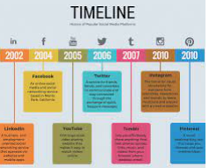
3. Text Structures
Sequence
Problem and Solution
Comparison
Cause and Effect
Description
Notes:
To Know and To Say: Text structures refer to the way authors organize information in text. Recognizing the underlying structure of texts can help students focus attention on key concepts and relationships, anticipate what is to come, and monitor their comprehension as they read. Narrative text (stories) and expository or informational text follow predictable patterns and include common elements. No two books are exactly the same, of course, but having a sense of what to expect in a text based on its genre gives our students a framework for comprehension. The structure of texts fit into one or a combination of two or more of the five most common text structures:
Sequence
Problem and Solution
Comparison
Cause and effect
Description

Slide 32
Text Structures per Common Genre
Sequence | Expository History, Narrative stories, Science
Problem and Solution | Narrative text, Science
Cause and Effect | Science/ Social Studies text
Comparison | Inside narrative with characters, text to text
Description | Narrative, textbook passages and short readings
Notes:
To Say: Did you know or realize the power in helping students to identify text structures that are found in the different genre we read? Teaching these structures and having students practice with common organizers will increase the students’ ability to outline what they remember while reading.
In expository texts such as history, events can be studied using a cause and effect structure nested within a sequence of events.
When reading a narrative text, students are often asked about the moral of the story or the actions of the main characters. These ideas can be studied using a problem and solution and/or a cause and effect lens.
Most novels, textbook passages, and short reading pieces may contain descriptions of events and sequences nested within the causes and effects of the event.
These text structures are used to organize every text regardless of genre (e.g., expository, narrative) or content (e.g., science, social studies, current events, sports).

Slide 33
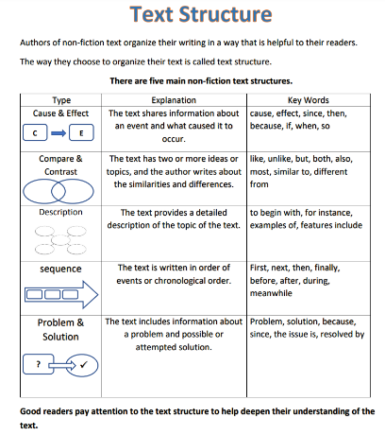

Teach
Use
Apply
HO #4
to Reading and Writing
Notes:
To Know and Say: Graphic organizers that follow text structures must be taught as a ‘thinking process’. As students begin to recognize and use these aligned to text structures, practice will become automatic and independently applied to any text structure.
The strongest results in research on using text structures and graphic organizers was found in student application using the same processes (click to bring in the final four words) for reading text and to organize ideas for writing.
To Do: Ensure access to Handout #4

Slide 34
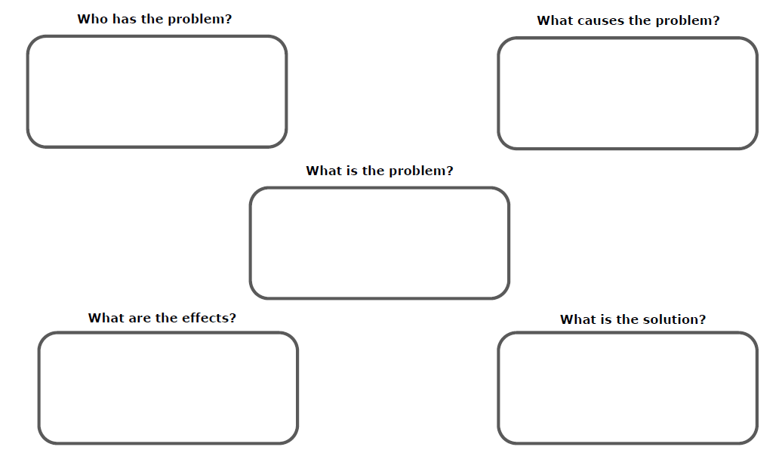
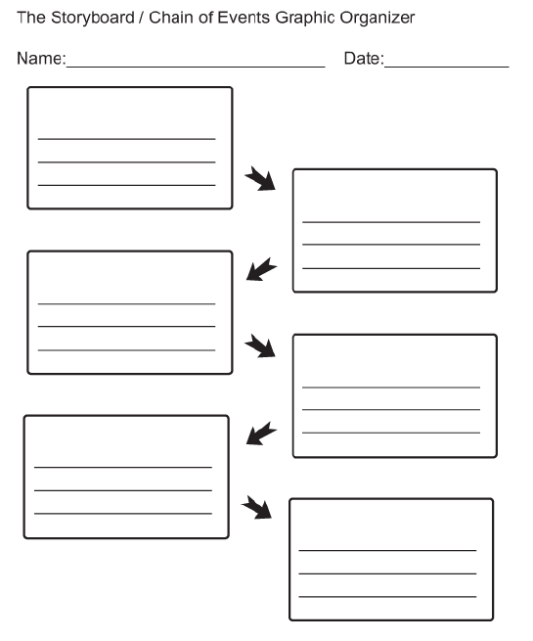
Organizers for Text Structures
HO #5a,b,c
Notes:
To Do: Provide a few organizers for participants to consider.
To Know and To Say: As we click through the next slides, consider what you use for taking notes or to outline a story after reading. Do you connect students to the most efficient organizers for comprehending and remembering importance ideas?
Some students need explicit instruction to recognize and use these structures for reading and writing. Continue to model and scaffold until students are able to identify and use the most effective structure for their comprehension.
More to know: First organizer is a detailed reasoning of the Problem & Solution for an individual character. The second organizer is a chain of events story board.

Slide 35
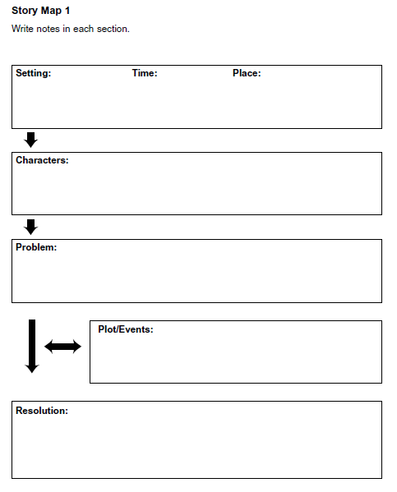
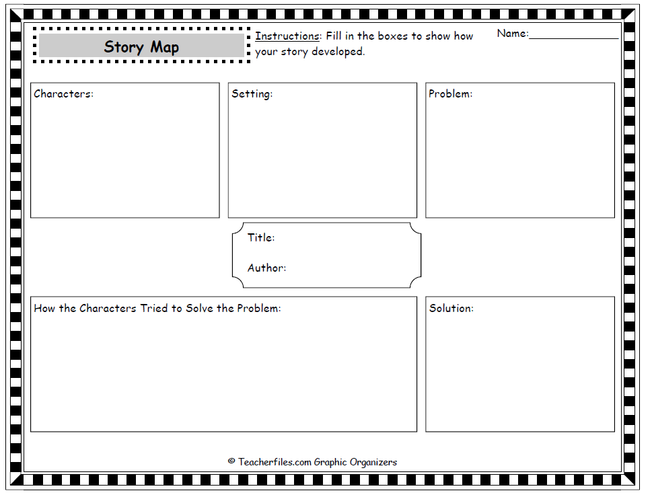
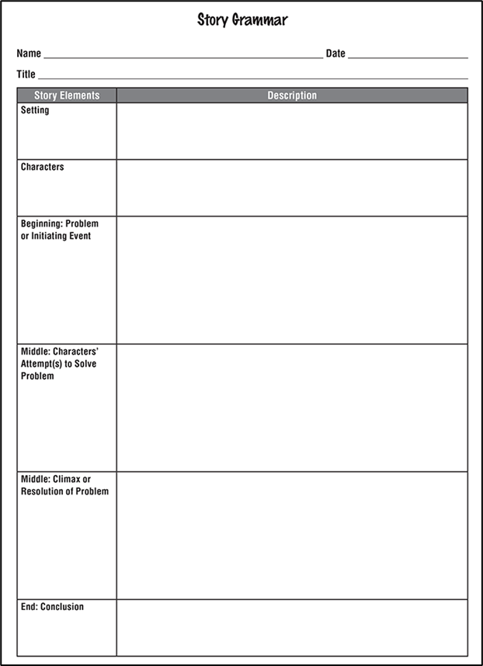
Notes:
To Do: Continue to pause for participants to consider the type of structure/organizer on the screen. Then click forward to the next screen.
To Say: These are story maps. The difference is the vocabulary used. (Plot, events, climax, resolution, solution).
The organizer on the right allows for multiple ways of solving the problem with a final solution. It could be used to allow students the opportunity to apply the process to their own book or text independently. (Click forward for a third story map) When selecting a story map ensure the vocabulary matches grade level terminology.

Slide 36
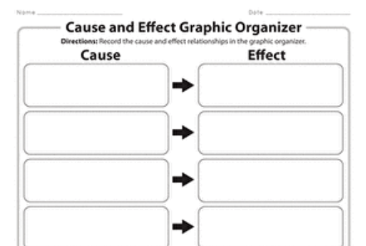
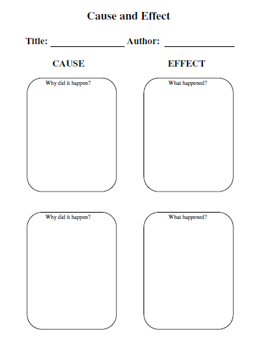
Across Grade Levels
Notes:
To Do: Continue to pause for participants to consider the type of structure/ organizers on the screen. Ensure participants also have a text you selected from the resources provided.
To Say: Graphic organizers are to develop ‘process thinking’ for students to be able to summarize key details from a text. Please take a few minutes to review these organizers and select one to orally retell or summarize the text provided. (Pause and encourage participants to orally summarize the text you provided. Ask if any participants wish to share their work.)
More to Know: Skill levels of students scaffold from “why did something happen” to the word “cause” and the “what happened” is now the “effect”. Teachers can increase comprehension by carefully selecting the way questioning words are linked to the vocabulary.

Slide 37
Text Structure Signal Words
Cause- Effect | Comparison | Description | Problem/ Solution | Sequence
because consequently if so, then since therefore so that thus as a result not only, but | however but on the other hand instead of as well as similar to different from compared to | for example for instance specifically in addition described as to illustrate another | because since consequently so that nevertheless a solution however therefore in addition as a result | for example therefore first, second, third before after then finally in conclusion
Notes:
To Say: Student comprehend text structures more easily when teachers take time to teach students signal or cue words. This is especially useful in comprehending expository text. Expository text uses clear, focused language which moves from facts that are general to specific and abstract to concrete.

Slide 38
Text Features
Titles
Table of Content
Index
Diagrams
Captions
Charts
Graphs
Teaching the text structures when using graphic organizers is just as important to comprehension as instruction on text features.
Notes:
To Do: Click forward to reveal the speech bubble.
To Know and To Say: It is common in many grade levels to teach text features as seen on the left side of the screen. From our presentation today, we hope to help you realize teaching the text structures when using graphic organizers is just as important to comprehension as instruction on text features.

Slide 39


4. Visualization - Forming Mental Images
Notes:
To Know: You will use the story to model, support and scaffold the participants learning with visualization.
To Do: Clicking to the next slide will display the words from E.B. White’s Charlotte's Web.
To Say: One way to help a child comprehend what he is reading is to encourage him to visualize parts of the story in his mind. These "mind movies" help clarify information and increase understanding. The images can include any of the five senses. Which are? (Pause for participants to respond: see, hear, smell, taste, and feel.)
To teach visualization, select a passage with good descriptive words.
Begin reading. Pause after a few sentences.
Share the image you've created in your mind, and talk about which words from the book helped you "draw" your picture. Your picture can relate to the setting, the characters, or the actions.
Remember to target what you see, feel, hear, smell or taste. By doing this, you are modeling the kind of picture making/visualization you want your students to do.
Let’s try this with a passage from Charlotte’s Web from E. B. White. It is one that students in grades K-2 could not read on their own, but could comprehend if it was read aloud to them.

Slide 40
“The barn was very large. It was very old. It smelled of hay and it smelled of manure. It smelled of the perspiration of tired horses and the wonderful sweet breath of patient cows. There was always hay in the great loft up overhead. And there was always hay being pitched down to the cows and the horses and the sheep.”
Words from the Text
large barn
old
hay
horses
loft
cows
Notes:
To Say: “The barn was very large. It was very old. It smelled of hay and it smelled of manure. It smelled of the perspiration of tired horses and the wonderful sweet breath of patient cows. There was always hay in the great loft up overhead. And there was always hay being pitched down to the cows and the horses and the sheep.”
As I was reading, here are a few words that stood out to help me form a picture in my head. (Click forward to reveal the “Words from the Text”). I visualized a large, old barn, horses, cows, hay and a loft. I might draw a picture to show you what I see.

Slide 41
HO #6
“.. it was pleasantly cool in summer when the big doors stood wide open to the breeze. The barn had stalls on the main floor for the work horses, tie ups on the main floor for the cows, a sheepfold down below for the sheep, a pigpen down below for Wilbur, and it was full of all sorts of things that you find in barns…”
Notes:
To Do: Provide Handout #6 for Visualization. You may want to pause after every one or two sentences for participants to write the words which ‘draw’ a picture in their mind.
To Say: The next step would be to continue reading. Please read the text along with me on the screen.
Use the handout to write the words which create your mental image/emotions. As I reread this passage, I will pause after a few sentences to allow you time to place your thoughts on paper. Then draw what you visualized. Allow time for participants to write words from the text and illustrate their mental picture.
Place your work on your table for others to see. Did everyone visualize the same? Probably not! This is a great time to talk about why the images might be different. As students are better able to visualize, you can read a longer portion of text and continue the sharing process. Once students have mastered this skill, encourage the use of mental imagery when they are reading independently. Visualization/mental images help students understand the story in a clearer way.

Slide 42
5. Retelling
Simple to Complex
Notes:
To Know and To Say: Retelling involves having students orally reconstruct a story that they have read.
Retelling requires students to activate their knowledge of how stories work and apply it to the new reading. As part of retelling, students engage in ordering and summarizing information and in making inferences. The teacher can use retelling as a way to assess how well students comprehend a story, then use this information to help students develop a deeper understanding of what they have read. Students' retellings should become more detailed as they become better readers. The power of teachers using common graphic organizers for retelling is in guiding/leading students to retell the most important portions of the text based on the type of text genre.

Slide 43
Simple Retelling
The Student Can
Identify and retell the beginning, middle, and end of the story in order
describe the setting
identify the problem and the resolution of the problem
Notes:
To Say: With Simple Retelling, we will start with the listening comprehension and our modeling before students are able to do these skills on their own when reading silently. Teacher selection of graphic organizers for simple retelling should help structure student thinking around the following ideas:
Identify to retell the beginning, middle, and end of the story in order
Describe the setting
Identify the problem and the resolution of a problem
Teachers will model the use of the organizer and scaffold with ‘We Do’ until students can perform the “You Do” independently. Some students will need more practice in small groups before they can apply to their own silent reading of a text.

Slide 44
More Complete Retelling
The Student Can
Identify and retell events and facts in a sequence
Make inferences to fill in missing information
Identify and retell causes of actions or events and their effects
Notes:
To Say: For more complete retelling we begin to select more complex metacognitive organizers. Teachers who are intentional with instruction, selection, and application of graphic organizers will develop students who can comprehend text more deeply. I probably do not need to remind you that a student must be able to read the text they are reading with more than 94 percent accuracy to focus on the ‘thinking’ involved with this level of comprehension when reading silently.
To reiterate, comprehension develops across a continuum of skills. This progression begins with the teacher orally reading and student listening before being asked to retell from their independent silent reading.
In addition to all the simple retelling activities, the student needs be able to
Identify and retell events and facts in a sequence
Make inferences to fill in missing information
Identify and retell causes of actions or events and their effects

Slide 45
Complex Retelling
The Student Can
Identify and retell a sequence of actions or events
Make inferences to account for events or actions
Offer an evaluation of the story
Notes:
To Say: For the most complete or complex retelling
The student can
Identify and retell a sequence of actions or events
Make inferences to account for events or actions
Offer an evaluation of the story
What does the last bullet mean to you? Allow participants to share their thoughts.
Example Answers might include
Offer opinion
Connect text to self
Evaluate character actions
Provide plausible outcomes
Evaluate factual evidence

Slide 46
Which level?
Student silently reads a text and makes inferences about the setting
Teacher reads aloud and asks student to help her jot down the beginning, middle and end of the story
Notes:
To Do: Allow wait time for discussion.
To Know and Say: Using what we have discussed about the different complexity levels of comprehension and retelling, what would be the level of comprehension if a student silently reads a text and makes inferences about the setting? Is that a simple, more complete, or complex level of comprehension? (It is more complete) What makes this example more complete?
Which level is the second option? When a teacher reads aloud and asks student to help her jot down the beginning, middle, and end of the story? (Simple)

Slide 47
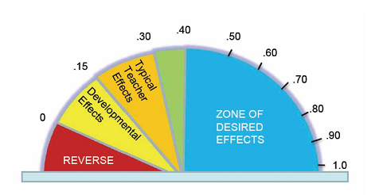
6. Summarization
Effect Size
.79
Notes:
To Say: The National Reading Panel (NICHD, 2000) reviewed more than 200 studies on comprehension strategies and that analysis attributed the largest learning effects to summarizing. Summarizing teaches students how to
Discern the most important ideas in a text
How to ignore irrelevant information
How to integrate the central ideas in a meaningful way
We have talked about Dr. John Hattie’s research before in the Phonological and Phonemic Awareness module. John Hattie is an educational researcher who conducted meta-analysis of over 300 million students around the world. Hattie has determined the .4 effect size = one year growth.
The skill of being able to summarize has an effect size of .79, which means nearly two years of academic growth in one year.

Slide 48
Benefits of Summarization
Determine essential ideas and consolidate important details
Focus on key words and phrases that are worth noting and remembering
Reduce texts to the main points for understanding
Notes:
To Know and To Say: There are many benefits to teaching strategies which result in strong comprehension:
It helps students learn to determine essential ideas and consolidate important details that support them.
It enables students to focus on key words and phrases of an assigned text that are worth noting and remembering.
It teaches students how to take a large section of text and reduce it to the main points for more concise understanding.

Slide 49
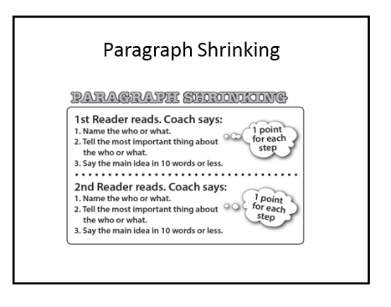
Paragraph Shrinking
HO #7
https://www.readingrockets.org/strategies/paragraph_shrinking
Notes:
To Do: Provide Handout #7: Paragraph Shrinking
To Say: Paragraph shrinking was developed at Vanderbilt University as one of the Peer Assisted Learning Strategies known as PALS. Paragraph shrinking allows each student to take turns reading, pausing, and summarizing the main points of each paragraph. Students provide each other with feedback as a way to monitor comprehension.
There are two roles needed for paragraph shrinking: a coach and a reader. Both roles read the paragraph. The coach will then ask the reader the following:
Who or what is the paragraph about?
Can you determine the most important thing about the who or the what?
What is the main idea in ten words or less?
If a reader is not sure of the who, what, or the most important thing, they can ask the coach. Coaches are encouraged to not tell the partner the answer, but to try and help them find the answer. Responses that a coach could include are:
“That is too many who’s. Chose the most important who or what.”
“That is not quite right. Let’s try again. Let’s go back to the previous step and see if that will help.”
If the main idea is more than ten words, the coach can tell the reader to “shrink it.”
If neither the reader nor coach knows the answer, the coach should raise their hand and keep working until the teacher can help the reader.

Slide 50
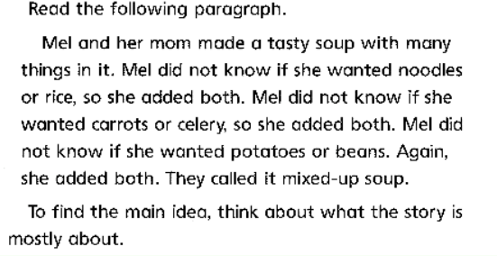
Practice: Paragraph Shrinking
I Do
HO#7
https://www.readingrockets.org/sites/default/files/paragraph-shrinking.pdf
Notes:
To Do: Access the handout for Paragraph Shrinking
To Say: Teachers should use the I Do, We Do, You Do model before putting students in groups to work on this skill.
I will model the thinking process for this paragraph:
First, I read the paragraph. (Read the paragraph above to model the process)
Next, I identify the who or the what of the paragraph. (Mel and her mom)
Then, I identify the most important thing about the who or the what. (made soup)
Finally, I state the main idea in ten words or less. (Mel and her mom made soup with many ingredients, or Mel and her mom made a mixed up soup).
More to Know:
How to use paragraph shrinking
Choose the assigned reading and introduce the text to the students.
Create pairs within the classroom by identifying which children require help on specific skills and who the most appropriate children are to help other children learn those skills.
Model the procedure to ensure that students understand how to use the strategy.
Have each member of the teacher-assigned pair take turns being "Coach" and "Player."
Ask each student to read aloud for five minutes without rereading a text. After each paragraph, students should stop to summarize the main points of the reading. Ask students to then summarize the following information:
The who or the what of the paragraph
The most important thing about the who or the what
The main idea
Note: If a "Player" gives a wrong answer, the "Coach" asks the "Player" to
Skim the paragraph again and answer the questions a second time
State the main idea in ten words or less, which will encourage them to monitor comprehension while taking turns reading
Award each pair points when the above goals of the strategy are met

Slide 51
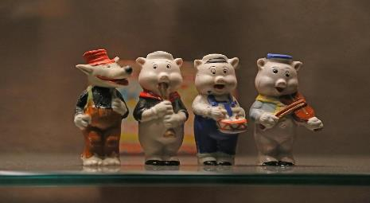
We Do
The wolf chased them down the lane and he almost caught them. But they made it to the brick house and slammed the door closed before the wolf could catch them. The three little pigs they were very frightened, they knew the wolf wanted to eat them.
Notes:
To Say: Let us try one together in teams of two. Decide who is the coach and who is the reader. You will both need to read the paragraph. Now the reader will identify
The who or what the paragraph is about? (the hungry wolf)
The most important thing about the who or what? (He chased the frightened pigs into a house.)
Say the main idea in ten words or less. (The hungry wolf chased frightened pigs into a brick house.)
If the reader at any step answers incorrectly, go back to the previous step and reinforce the correct answer.

Slide 52
You Do
Well! He huffed and he puffed. He puffed and he huffed. And he huffed, huffed, and he puffed, puffed; but he could not blow the house down. At last, he was so out of breath that he couldn't huff and he couldn't puff anymore. So he stopped to rest and thought a bit. This was too much. The wolf danced about with rage and swore he would come down the chimney and eat up the little pig for his supper.
Notes:
To Say: Now we will move to a ‘You Do’ with a partner. Partners have three minutes to read through this paragraph and shrink it down to the ten words that summarize the most important detail in the paragraph.
To Do: Give three minutes for participants to work through the process in partners. Then, ask a group or groups to share out.
Answers:
Who or what is the story about? (The wolf)
Most important thing? (The wolf was mad he could not blow the house down)
Example: The wolf was mad he couldn’t blow down the house.
More to Know:
Vanderbilt PALS uses this strategy with partners to strengthen the ability to independently summarize and increase comprehension.

Slide 53
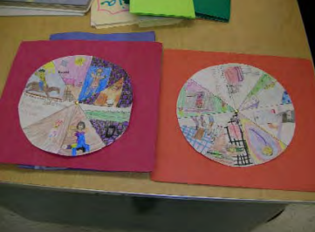
Story Wheel
HO #8
Notes:
To Know: Handout #8 is a template for a story wheel.
To Do: Provide Handout #8
To Say: A story wheel is another way students can summarize and retell a story. In addition to summarizing the story, it helps students practice sequencing skills, visualize story elements, and recognize story structure. Follow these steps to create a story wheel:
Ask students to list the important events in the story. Emphasize that the events should be from the beginning, the middle, and the end of the selection.
Next, have the students narrow the list of events to the most important depending on the age of the student and the complexity of the story.
Provide students with a blank story wheel.
Students are to write the story title and author’s name in a wedge on the story wheel.
Students should then illustrate a story event in each of the story wheel wedges so that when the story wheel is completed, they have a summary of the story. Students can also include the written event in each of the story wheel wedges.
Have students share their story wheels with their classmates.

Slide 54

What’s the Difference?
HO #9
Notes:
To Do: Pass out Handout #9 and allow participants the necessary time to review individually and have a robust discussion at their table. Provide at least five to seven minutes for them to discuss.
To Know and To Say: Let’s think about what we just talked about with paragraph shrinking and story wheels. One of those was a PROCESS for developing reading comprehension and one of them was a PRODUCT demonstrating their ability to comprehend what they read.
Which one was the process? (Paragraph Shrinking) Why? (It outlines a process that a student goes through to learn how to summarize. It can be replicated in other content areas)
This means that the story wheel is considered a what? (Product). What makes it a product? (It is a way that students can demonstrate that they comprehend what they are reading.)
I am going to share Handout #9, ‘Summarization for Deeper Comprehension’. Take a moment to review Handout #9. (Pause for participants to read.)
Do you see the reference to Graphic Organizers? (Yes) What do you notice?
The graphic organizers listed on that sheet will produce greater comprehension when taught using direct, explicit instruction through a teacher ‘Think Aloud’ then scaffolded to independence using the ‘I Do, We Do, You Do’ process.
These can teach PROCESS thinking and will result in connecting a text structure to a ‘way of thinking’ thus greater ability to summarize producing significant growth in comprehension. Some teachers use these as assignments or activities, INSTEAD be intentional in your instruction and application of these organizers. Modeling and practicing their use with the appropriate type of text.
Do you see other ideas on here that you use or have used that can produce summarization ability? (Pause for them to review and discuss.)
These are a great ‘quick check’ to see if the students have the comprehension needed or you need to continue to spend instructional time on the strategies for ‘process thinking’. Remember, different genre of reading may need more time on ‘process strategies’. They are also fun engagement activities to help keep students engaged in the learning process, but they do not teach comprehension on their own.

Slide 55
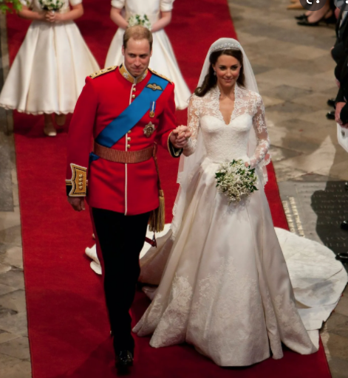
Something Old/Something New
HO #10
Notes:
To Do: Provide Handout #10 for participants to share their learning.
To Say: Who does not love a wedding, a royal one at that. We are going to summarize the comprehension module with a wedding tradition of something old, something new, something borrowed, something blue.
Here is what I want you to do. (Pause after making each statement below for participants to respond on their handout.)
On the handout for something old, list something that you already knew about reading comprehension before we started this module.
For something new, list something that you learned today.
For something borrowed, note something that you learned from someone here today.
For something blue, think about something colorful and interesting that you are going to try to help your students gain reading comprehension skills.

Slide 56
Comprehension Resources
Into the Book: https://reading.ecb.org/index.html
Inference Riddles: http://www.philtulga.com/Riddles.html
PBS Kids Reading Games: https://pbskids.org/games/reading
Scholastic Reading Activities:
https://www.scholastic.com/teachers/student-activities/

Slide 57
Questions? Please contact:
Consultant Information

Slide 58
The following slides are an extra resource for your use if desired. Handouts for these slides are also found in the Resource Section of the handouts.

Slide 59

Generate and Ask Questions
Question the Author (QtA)
Directed Reading and Thinking Activities (DRTA)
Question Answer Relationships (QAR)
Notes:
To Say: This strategy involves readers asking themselves questions throughout the reading of a text. The ability of readers to ask themselves relevant questions as they read is especially valuable in helping them to integrate information, identify main ideas, and summarize information. Asking the right questions allows good readers to focus on the most important information in a text.
Questions can be effective because they
Give students a purpose for reading
Focus students' attention on what they are to learn
Help students to think actively as they read
Encourage students to monitor their comprehension
Help students to review content and relate what they have learned to what they already know
We will review the three questioning strategies on the next few slides.

Slide 60
Question the Author (QtA)
What do you think the author is trying to say?
Why do you think the author used the following phrase?
Does this make sense to you?
Notes:
To Say: Question the Author (QtA) is a strategy that engages students actively with a text. Rather than reading and taking information from a text, the QtA strategy encourages students to ask questions of the author and the text. Through forming their own questions, students learn more about the text.
Students learn to ask questions such as: What is the author's message? Does the author explain this clearly? How does this connect to what the author said earlier? This strategy is best suited for nonfiction.
The steps you should follow during a Question the Author lesson include
Selecting a passage that is both interesting and can spur a good conversation
Deciding appropriate stopping points where you think your students need to obtain a greater understanding
Creating queries or questions for each stopping point
What is the author trying to say?
Why do you think the author used the following phrase?
Does this make sense to you?
Display a short passage to your students along with one or two queries you have designed ahead of time.
Model for your students how to think through the queries.
Ask students to read and work through the queries you have prepared for their readings.

Slide 61
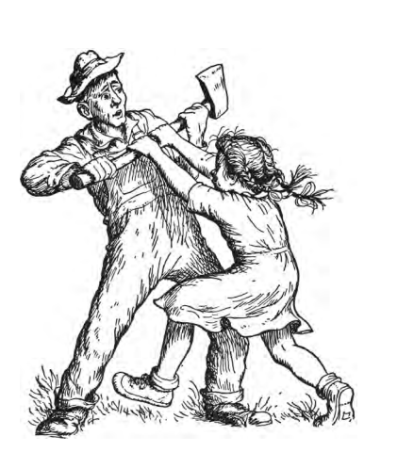
Practice QtA
Notes:
To Say: We are going to practice a QtA using a passage from Charlotte’s web. Some students with a farming background may make an instant connection with the passage. You may have to help other students understand, but, it can lead to rich comprehension discussions.
'Where’s Papa going with that axe?’ said Fern to her mother as they were setting the table for breakfast. ‘Out to the hoghouse,’ replied Mrs. Arable. ‘Some pigs were born last night.’ ‘I don’t see why he needs an axe,’ continued Fern, who was only eight. ‘Well,’ said her mother, ‘one of the pigs is a runt. It’s very small and weak, and it will never amount to anything. So your father has decided to do away with it.’ ‘Do away with it?’ shrieked Fern. ‘You mean kill it? Just because it’s smaller than the others?’ Mrs. Arable put a pitcher of cream on the table. ‘Don’t yell, Fern!’ she said. ‘Your father is right. The pig would probably die anyway.’ Fern pushed a chair out of the way and ran outdoors. The grass was wet and the earth smelled of springtime. Fern’s sneakers were sopping by the time she caught up with her father. ‘Please don’t kill it!’ she sobbed. ‘It’s unfair.’ Mr. Arable stopped walking. ‘Fern,’ he said gently, ‘you will have to learn to control yourself.’ ‘Control myself?’ yelled Fern. ‘This is a matter of life and death, and you talk about controlling myself.’ Tears ran down her cheeks and she took hold of the axe and tried to pull it out of her father’s hand. ‘Fern,’ said Mr. Arable, ‘I know more about raising a litter of pigs than you do. A weakling makes trouble. Now run along!’
What do you think the author is trying to say?
Why do you think used the following phrase “Fern,” said Mr Arable, ‘I know more about raising a litter of pigs than you do. A weakling makes trouble. Now run along!”
Does this make sense to you?

Slide 62

Directed Reading and Thinking Activities (DRTA)
What do you think of your predictions now?
What did you find in the text that proved your predictions?
What did you read in the text that made you change your predictions?
Resource #1
Notes:
To Say: The Directed Reading Thinking Activity (DRTA) is a comprehension strategy that guides students in asking questions about a text, making predictions, and then reading to confirm or refute their predictions. The DRTA process encourages students to be active and thoughtful readers, enhancing their comprehension.
Directed reading and thinking activities
Encourage students to be active and thoughtful readers
Activates their previous knowledge
Teaches students to monitor their understanding of the text as they’re reading
Helps strengthen reading and critical thinking skills
Teachers should follow the steps below when creating a DRTA.
Determine the text to be used and pre-select points for students to pause during the reading process.
Introduce the text, the purpose of the DRTA, and provide examples of how to make predictions.
Note: Be aware of the reading levels of each student, and be prepared to provide appropriate questions, prompts, and support as needed.
Use the following outline to guide the procedure
D = DIRECT - Teachers direct and activate students' thinking prior to reading a passage by scanning the title, chapter headings, illustrations, and other materials. Teachers should use open-ended questions to direct students as they make predictions about the content or perspective of the text (e.g., "Given this title, what do you think the passage will be about?").
R = READING - Students read up to the first pre-selected stopping point. The teacher then prompts the students with questions about specific information and asks them to evaluate their predictions and refine them if necessary. This process should be continued until students have read each section of the passage.
T = THINKING - At the end of each section, students go back through the text and think about their predictions. Students should verify or modify their predictions by finding supporting statements in the text.
The teacher asks questions such as
What do you think about your predictions now?
What did you find in the text to prove your predictions?
What did you read in the text that made you change your predictions?

Slide 63

Question Answer Relationships (QAR)
Right There Questions
Think and Search Questions
Author and You Questions
On My Own Questions
Resource #2
Notes:
To Say: The question–answer relationship (QAR) strategy helps students understand the different types of questions. By learning that the answers to some questions are "Right There" in the text, that some answers require a reader to "Think and Search," and that some answers can only be answered "On My Own," students recognize that they must first consider the question before developing an answer.
The QAR Strategy can
Improve students' reading comprehension
Teach students how to ask questions about their reading and where to find the answers to them
Help students to think about the text they are reading and beyond it, too
Inspire them to think creatively and work cooperatively while challenging them to use higher-level thinking skills
Explain to students that there are four types of questions they will encounter. Define each type of question and give an example.
Four types of questions are examined in the QAR:
Right There Questions: Literal questions whose answers can be found in the text. Often the words used in the question are the same words found in the text.
Think and Search Questions: Answers are gathered from several parts of the text and put together to make meaning.
Author and You: These questions are based on information provided in the text but the student is required to relate it to their own experience. Although the answer does not lie directly in the text, the student must have read it in order to answer the question.
On My Own: These questions do not require the student to have read the passage, but he/she must use their background or prior knowledge to answer the question.
Read a short passage aloud to your students.
Have predetermined questions you will ask after you stop reading. When you have finished reading, read the questions aloud to students and model how you decide which type of question you have been asked to answer.
Show students how to find information to answer the question (i.e., in the text, from your own experiences, etc.).
QAR Strategy Page

Slide 64
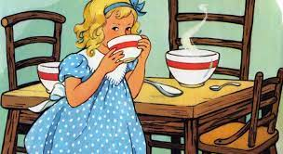
Goldilocks and the Three Bears
Notes:
To Say: Using the Goldilocks story let’s practice.
‘Once upon a time, there was a little girl named Goldilocks. She went for a walk in the forest. Pretty soon, she came upon a house. She knocked and, when no one answered, she walked right in.
At the table in the kitchen, there were three bowls of porridge. Goldilocks was hungry. She tasted the porridge from the first bowl.
"This porridge is too hot!" she exclaimed.
So, she tasted the porridge from the second bowl.
"This porridge is too cold," she said.
So, she tasted the last bowl of porridge.
"Ah, this porridge is just right," she said happily and she ate it all up.’
Right There Question: What was the girls name? (Goldilocks)
Think & Search Question: How many people/bears lived in the house? (Three)
Author and You Question: What do you think porridge might be? - What were your clues? (Hot/cold in a bowl (could say, soup, oatmeal or hot cereal))
My Own Question: Is it ok to just walk into a house if no one answered the door, but it was unlocked?

Slide 65
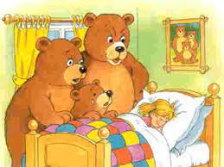
Practice: QAR

Slide 66
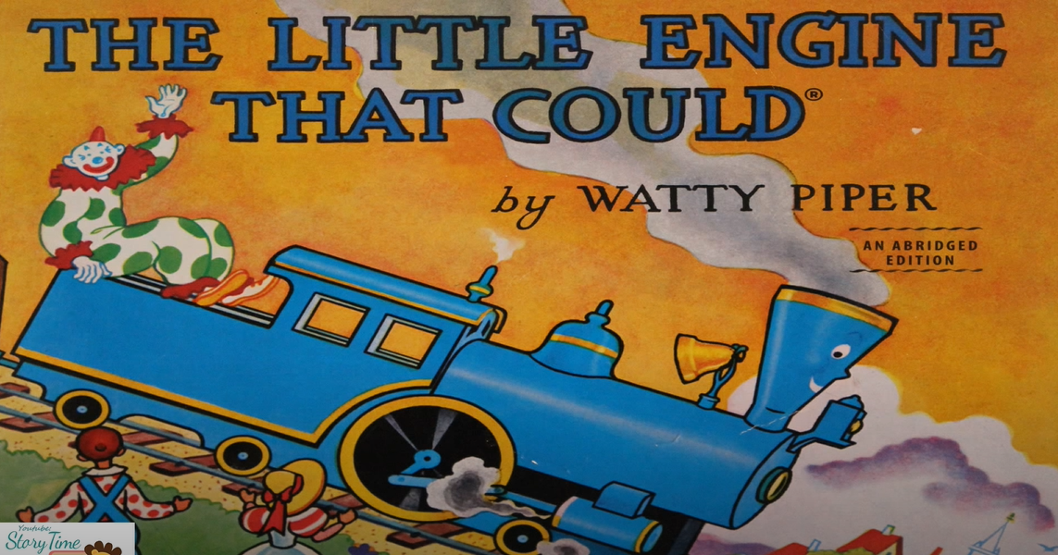
Practice: Story Map
https://youtu.be/JdFm7eekQZY
Notes:
To Say: We are going to listen to the story of The Little Engine that Could by Watty Piper being read on a YouTube video (3.54 minutes). As you hear the story being read fill out the story map.
Review the story map as a group when you are finished.

Slide 67
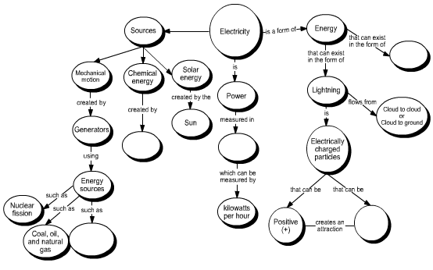
Concept Map
Resource #3
Notes:
To Know: This is an optional slide. You may use this if participants have not had an understanding of a Concept Map. You will know if participants understand a concept map by listening to their brainstorm lists completed in the previous slide. Participants will need post-it notes and/or large chart paper for the activity.
To Do: You can watch Example video: https://www.youtube.com/watch?v=8XGQGhli0I0
Watch this eight minute video to understand how to take the teachers through how to develop a concept map. You may want to model the steps for them to start out.
To Say: Let’s do a Map Out and Check In activity. We are going to create a concept map about the solar system. A concept map is a visual way to organize your thoughts and make connections between ideas. They improve our ability to understand and remember concepts because our brains process faster visually. Concept maps have three basic elements: shapes, arrows, and text. The shapes represent concepts or ideas, arrows show the relationships between those concepts, and text is used to identify and describe the concepts and relationships.
Concept maps start from the top with the broad concept and work their way down to more specific ones. Our concept is the solar system. We will put that at the top. So, write it in a shape at the top of your chart. Sometimes topics are very broad so we can use focus questions to help specify the issue the concept map will address. Our focus question will be, “What is in the solar system?”
Using your sticky notes let’s start creating a list of related concepts. Think about our focus question, “What are the things found in the solar system?” I will give your team about 90 seconds to come up with related concepts of things found in the solar system. What are some of the things that you came up with? (Planets, names or planets, sun, moons, stars, asteroids)
They will eventually fall under our main concept and form the concept map, but we are not putting them on the map yet. Try to keep each concept to one or two words. Now that you have your key concept and related words, we can start putting them on the concept map and organizing them.
(Let’s start in pencil first in case we need to erase and move concepts)
Remember, this is in a hierarchical format with your main topic at the top and then getting more and more specific. To show relationships between the concepts, draw an arrow between them. You will define the relationship between the two concepts by a linking the concepts together with a word or two, typically a verb to form a simple phrase as you move down the map. You might use words on this concept map like: includes or orbits. Then, you will read it down the map. This is called a proposition. A proposition is two concepts linked together with a simple phrase. (Example; solar system includes planets)
Not all arrows have to go down. You can link them to each other. Read in the direction of the arrow. Go ahead and get all your related concepts on the map and link with an arrow and the simple phrases.
Give the partners or groups up to five minutes to complete their concept map and you can have some groups share out their concept map.
After you read the selection, you can refine your concept map and use different words or look for a better position for a certain concept or add more related concepts.

