Slide 1
Zoom Support Meeting Norms
•Mute unless you are speaking to the group
•Use the chat to ask questions
•Be professional and helpful
•Be mindful when asking questions about specific situations - don't give out any information that could reveal the identity of a person with a disability

Slide 2
IEP Meeting Facilitators
The Department of Elementary and Secondary Education (DESE) values being committed to excellence, focusing on the future, and being dedicated to serving others. Our mission is providing access to opportunity and improving lives through education. The Office of Special Education is adding State IEP Meeting Facilitators for the 2022-23 school year.
If you are interested in joining DESE and the Office of Special Education in fulfilling our mission and would like to become a facilitator, visit our website for more information: https://dese.mo.gov/media/pdf/facilitator-recruitment-2022

Slide 3
Educational Surrogate Critical Shortage
The Department of Elementary and Secondary Education is looking for caring individuals who want to make a difference in the life of a student in need. Educational surrogates make educational decisions for students who receive special education and do not have someone to fill that role. Please share the following links with those willing to give a little time to improve the life of a student.
https://www.youtube.com/watch?v=H_u8u5M28RI
https://dese.mo.gov/special-education/compliance/educational-surrogate

Slide 4
Educational Benefit Review: Why, What, When, and How to Prepare
DESE May 19th Zoom
May 19, 2022

Slide 5
Objectives for Today
Understand Educational Benefit Review (EBR)
Understand why DESE is changing from the traditional onsite to the EBR onsite
Understand how specific districts are chosen for this compliance and improvement effort
Discuss how to prepare for the EBR

Slide 6
What Is an Educational Benefit Review?

Slide 7
What is it?
“An educational benefit review process is a systematic way for school systems, families, and SEAs to review a student’s IEPs across multiple years and determine whether the IEPs were reasonably calculated to provide educational benefit, based on the student’s unique circumstances. This evaluation is typically done by comparing a student’s current IEP with IEPs from the two prior years.”
Resource: Fast fives | Five Questions Answered about Educational Benefit Review | NCSI 2021

Slide 8
What does an EBR onsite entail?
Four common processes across CA, CT, and PA; MO has adopted these processes for the 2022 and 2022-23 selected pilot onsite visits.
Step 1: Review three consecutive years of a student’s IEPs and document key pieces of information, including present level of performance, annual goals and modifications, needs or concerns, services and placement, growth/progress, and any adjustments or changes to the IEP across years.
Step 2: Consider the relationship between these components of the IEPs.
Step 3: Analyze the student’s growth and progress over time in relationship to the IEP components.
Step 4: Look for patterns and assess the overall educational benefit to the student.

Slide 9
Who will be involved during the onsite visit if your district has been selected?
District and Building Leaders – General Education and Special Education
Special Education Staff
General Education Staff
Some of the states involve parents
The student files selected for the EBR visit will determine what staff are involved in the process.

Slide 10
When Will the Educational Benefit Review Occur for the Districts Selected from Cohort 1?

Slide 11
Cohort 1 Educational Benefit Review Visits for 22-23
During the Spring of 2022, the EBR process was piloted with some Cohort 3 districts.
Cohort 1 districts will be the first to go through the process as part of the Tiered Monitoring Onsite process during 2022-23.
Six districts have been selected for onsites in 22-23 and they were notified in September 2021.
EBR visits will occur between November 2022 and Spring 2023.

Slide 12
Why Is DESE Using Educational Benefit Review for the Onsite Process?

Slide 13
The Law
Notes:
To Know: Transition Slide
To Say: There are legal mandates that dictate the reason progress monitoring/data collection is required and important. During the next few slides we will look at the law and the most recent case law in which the U. S. Supreme Court issued a unanimous opinion in Endrew F. v Douglas County School District Re-1.

Slide 14
The Law
The Individuals with Disability Act (IDEA) states that each child’s IEP must contain:
(3) A description of—
(i) How the child’s progress toward meeting the annual goals described in paragraph (2) of this section will be measured; and
(ii) When periodic reports on the progress the child is making toward meeting the annual goals (such as through the use of quarterly or other periodic reports, concurrent with the issuance of report cards) will be provided…[300.320(a)(3)]
Federal Regulation, IDEA; 34 CFR 300.320 (a) (2)
Notes:
To Know: This is information from Federal Regulation, IDEA; 34 CFR 300.320 (a) (2)
https://sites.ed.gov/idea/regs/b/d/300.320/b1.
To Say: The special education regulations require that progress toward a student’s IEP annual goals be monitored, measured, and reported to parents as frequently as general education is reported to parents. Take a look at the exact wording from the Federal regulations. We in Missouri are required to follow the federal regulations.

Slide 15
The Law
Required by IDEA:
Monitor and provide parents with documentation of progress towards mastery for annual IEP goals and objectives.
Provide documentation of participation in statewide assessments for students with disabilities.
Notes:
To Know: Federal Regulation, IDEA; 34 CFR 300.320 (a) (2)
https://sites.ed.gov/idea/regs/b/d/300.320/b1.
To Say: As providers of special education supports and services, we are mandated to provide parents/guardians with data that documents progress toward meeting IEP goals. The present level of academic achievement and functional performance along with goals provide documentation for IEP teams to determine participation in statewide assessments.

Slide 16
Endrew Case
The case revolved around a central question:
Must schools provide a meaningful education in which children show significant progress and are given substantially equal opportunities as typical children, or can they provide an education that results in just some improvement?
Notes:
To Know: The Endrew case Q and A document: For more information refer to https://www2.ed.gov/policy/speced/guid/idea/memosdcltrs/qa-endrewcase-12-07-2017.pdf
To Say: On March 22, 2017 the US Supreme Court issued a unanimous opinion in Endrew F. v Douglas County School District re-1 137 S. Ct. 988. The Endrew F. decision is important because it informs our efforts to improve academic outcomes for children with disabilities. On December 7, 2017, the United States Department of Education issued a Q & A document on the Endrew F v. Douglas County School District Re-1. This document provides school districts, state departments of education, parents and all interested parties information about the lower court case, decisions and the Supreme Court decision. The Table of Contents of this document includes an overview of the facts surrounding the case, clarification of IDEA’s FAPE requirement and considerations for implementation.

Slide 17
Endrew Case Supreme Court Decision
When all is said and done, a student offered an educational program providing “merely more than de minimis” progress from year to year can hardly be said to have been offered an education at all.
For children with disabilities, receiving instruction that aims so low would be tantamount to “sitting idly... awaiting the time when they were old enough to ‘drop out.’”
“Questions & Answers on U.S. Supreme Court Case Decision Endrew F. v. Douglas Co. School District Re-1, US Depart. of Ed. Washington, DC, Dec. 7, 2017
Notes:
To Know: “de minimis” means too trivial or minor to consider. This was used by the hearing officer and lower courts to determine if FAPE was met. Each one determined that FAPE met and parents continued to appeal through the court system to determine that “de minimus” was not acceptable for Endrew’s educational benefit. It was the Supreme court that rejected the low standard for education benefit for a child with an IEP, therefore reversing all lower court decisions.
To Say: Look over the information on this page (read slide). Notice the words “de minimis”. It means “more than trivial or minor education benefit”. While the lower courts used that phrase to determine if FAPE was met, the Supreme Court rejected that thinking and determined that minimal progress is not acceptable for a student with a disability. How do you feel about “de minimus” progress?
To Do: Take 30 seconds and reflect on that phrase. Now in your own terms/thinking talk at you table about what “de minimis” means.
Share with the large group a couple of points/comments regarding “de minimus” progress.

Slide 18
Summary of Supreme Court Decision for Endrew
The court’s decision increases the education expectations for children with disabilities.
We must be able to show more than minimal progress for students with disabilities.
IEPs must not look substantially similar year after year.
Notes:
To Know: The Endrew case Q and A document: For more information refer to https://www2.ed.gov/policy/speced/guid/idea/memosdcltrs/qa-endrewcase-12-07-2017.pdf
To Say: In layman terms this a summary of US Supreme court decision. There are 2 major takeaways from the summary decision:
1. IEP teams must ensure that every student with an IEP have the chance to meet challenging goals/objectives and progress monitoring will prove the progress made on goals/objectives.
2. IEPs must address yearly high expectations and not look the same from year to year.
You can find more information at www.ed.gov
Questions and Answers on U.S. Supreme Court Case Decision Endrew F. v. Douglas County School District Re-1.

Slide 19
“Is there anything IEP teams
should do differently?”
“Identifying present levels of academic achievement and functional performance;
The setting of measurable annual goals, including academic and functional performance; and
How a child’s progress toward meeting annual goals will be measured and reported.”
“Questions & Answers on U.S. Supreme Court Case Decision Endrew F. v. Douglas Co. School District Re-1, US Depart. of Ed. Washington, DC, Dec. 7, 2017
Notes:
To Know: This is the answer to question 18 from the article “Questions and Answers on U.S. Supreme Court Case Decision Endrew F. v. Douglas County School District Re-1. This slide is animated and the question appears and followed by the statements.
TO SAY: Look at the question on the slide--we need to look and listen closely to the information shared in the Q and A document. When asked what the IEP is to do differently, the US Supreme Court decision makes our mission clear. Before we look more closely at their information in the Q & A document, talk at your table and identify three things that IEP teams should do differently.
To Do: Ask the group to discuss in small groups, “Is there anything IEP teams should do differently?” Set a timer for 3-4 minutes. Ask each table to share 1 thing that was discussed. After each group has discussed and shared out. On each mouse click the 3 points appear. Then discuss the 3 points as a large group.

Slide 20
Moving from a Compliance Focus to a Comprehensive EBR Process
DESE wants the onsite process to be beneficial to districts and to help improve outcomes for students.
The ultimate goal would be for all districts to use the EBR process as an internal process for self-improvement to ensure IEPs are reasonably calculated to increase student achievement and progress toward goals.
DESE will not be determining educational benefit but rather evaluating to see if the components are present to reasonably calculate educational benefit.

Slide 21
Why Is a District Selected for an Onsite Educational Benefit Review?

Slide 22
The Why Starts with Your Data:
The Special Education Performance Profile (Known as the SPP)

Slide 23
Missouri Department of Elementary and Secondary Education
Special Education District Profile
Redacted SPP for Training
As required by the Individuals with Disabilities Education Improvement Act of 2004, the Missouri State Performance Plan (SPP) is a plan that includes targets for student performance indicators and improvement activities designed to enable districts (regular districts, charter schools and state operated programs) and the state to meet those targets. Missouri is also required to publicly report on the performance of each local education agency (LEA) in relation to the targets established in the SPP. The State Performance Plan can be found online at:
http://dese.mo.gov/special-education/state-performance-plan
The purpose of this profile is to:
1. Provide information to the public about the performance of districts on the SPP Indicators
2. Address other outcome measures for students receiving special education services.
Page 1 of this profile summarizes whether the district met or did not meet the target for each indicator. The remaining pages provide additional data for the SPP indicators (noted as "SPP #").
Students with disabilities are those students who qualify for special education services and who have an Individualized Education Program (IEP). Data sources are provided for each table included in this profile, however most of the data are reported by the district directly to the Department.
* - Indicates the number or percent has been suppressed due to cell size.
Page 1 of 23
Printed: 2/15/2022 6:18:21 PM

Slide 24
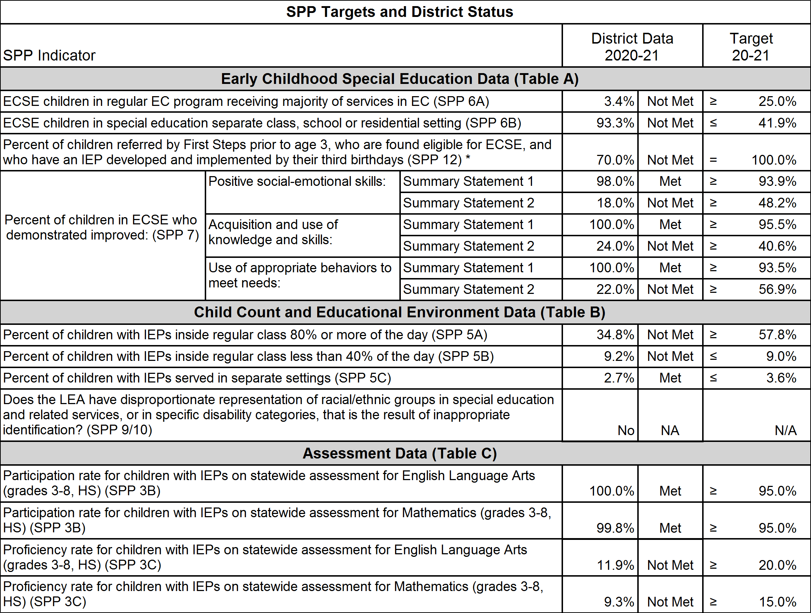
Missouri Department of Elementary and Secondary Education
Special Education District Profile
LEBANON R-III (053-113)
* - Indicates the number or percent has been suppressed due to cell size.
Page 3 of 23
Printed: 2/15/2022 6:18:21 PM

Slide 25
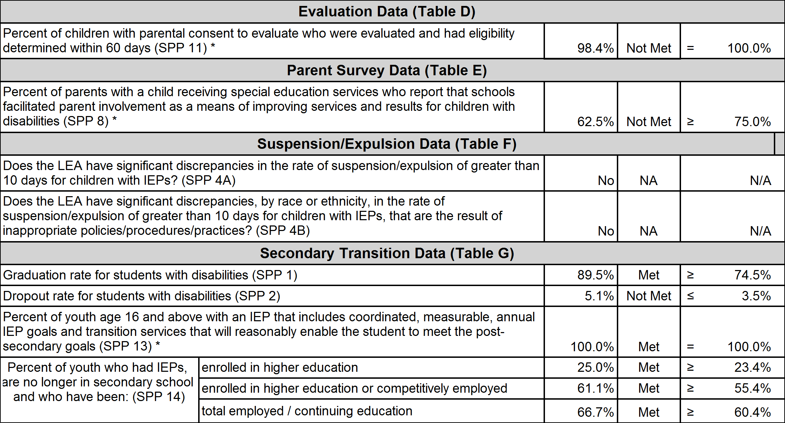
Missouri Department of Elementary and Secondary Education
Special Education District Profile
* Data are collected from districts in conjunction with their Monitoring review, so data is not available for all districts every year.
* - Indicates the number or percent has been suppressed due to cell size.
Page 4 of 23
Printed: 2/15/2022 6:18:21 PM

Slide 26
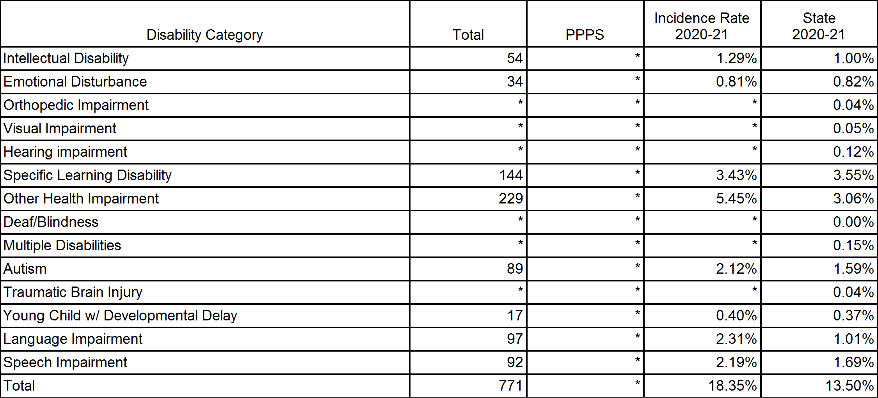
Missouri Department of Elementary and Secondary Education
Special Education District Profile
Child Count and Educational Environment Data - (Table B)
Child Count (5K-21) and Parentally-Placed Private School Students (PPPS) (B1)
The following table indicates the number and incidence rate of students with disabilities by disability category.
* - Indicates the number or percent has been suppressed due to cell size.
Page 9 of 23
Printed: 2/15/2022 6:18:21 PM

Slide 27
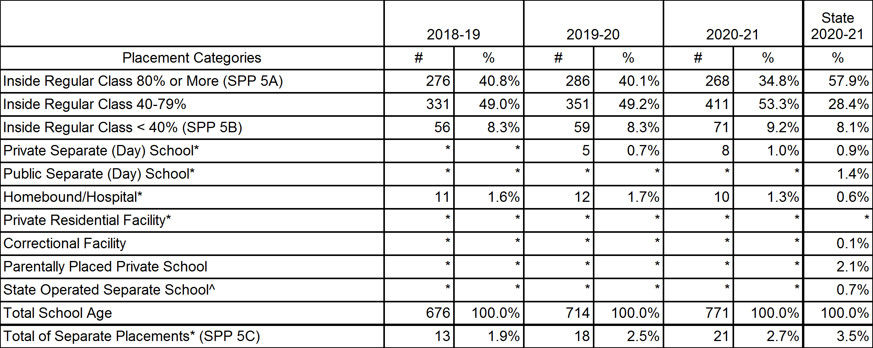
Missouri Department of Elementary and Secondary Education
Special Education District Profile
Child Count and Educational Environment Data - (Table B)
School-age Educational Environments (SPP 5) (B3)
The following table indicates the amount of time students with disabilities are included in the general education classroom.
* - Indicates the number or percent has been suppressed due to cell size.
Page 11 of 23
Printed: 2/15/2022 6:18:21 PM

Slide 28
How Do the Selected Cohort 1 Districts Prepare for the EBR Onsite

Slide 29
2021-22
Completion of the Individual Corrective Action Plans (CAPS) from Tiered Monitoring
Completion of the Corrective Action Plan (CAP) from Tiered Monitoring
Professional Development around Compliance
Improving compliance and ensure IEPs are based on data to allow the student to make progress
2022-2023
Professional Development around Compliance
Improving compliance and ensure IEPs are based on data to allow the student to make progress
Working with DESE staff to provide documents/files and plan for the schedule during the visit
Internally complete Educational Benefit Review Worksheets on selected student files prior to the onsite visit
During the visit, there will be an entry conference, interviews with school teams around the selected student files, and an exit conference; there may also be classroom observations – that has been a process in previous onsite visits, and we are still working on this component for EBR.

Slide 30
Criteria for Student File Selection
DESE pre-selected criteria may apply based on district SPP data
3-5 students will be reviewed
Students will need to have three consecutive IEPs written by the district - no transfer IEPs that were accepted should be used
Some of the students will need to have transitioned from at least one building to another during the three IEPs (Elem to MS or MS to HS)
At least one student file should have post-secondary transition planning
Evaluation Report or RED must exist for the cycle - no three year waiver files should be chosen for review
Compliance Review in IMACS 2.0 for CAPs and ICAPS will be done on the RED, Evaluation Report, and third (current) IEP

Slide 31
What do the team EBR conversations entail?
Typically, the district staff involved in the student’s IEP will be present for the EBR conversation with DESE staff and Compliance Consultants (typically this will be one DESE staff member and one compliance consultant).
Staff who wrote a previous IEP may also participate on the team.
The intent of these conversations is to discuss the documentation of educational benefit; this process is not designed to be punitive but rather a collaborative approach around both procedural compliance and instructional practices to enable the student to attain IEP goals.
The next slides help guide these collaborative conversations.

Slide 32
Educational Benefit Review Worksheet
EBR Worksheet

Slide 33
Sample IEP Comparison Chart Years 1-3
Sample Student EBR Worksheet Years 1-3

Slide 34
Final EBR Worksheet
Final EBR Worksheet

Slide 35
How Can Districts Start Using EBR Internally for Improvement Efforts?
Work with your local compliance consultant to set up internal support for you staff in the EBR process

Slide 36
How Can District Staff Work Together to Prepare for the EBR and Overall Compliance?

Slide 37
Preparation
The District will work closely with:
District Special Education Administration/PCs/Teachers
The RPDC Special Education Consultants
DESE Compliance Staff

Slide 38
“Is there anything IEP teams
should do differently?”
“Identifying present levels of academic achievement and functional performance;
The setting of measurable annual goals, including academic and functional performance; and
How a child’s progress toward meeting annual goals will be measured and reported.”
“Questions & Answers on U.S. Supreme Court Case Decision Endrew F. v. Douglas Co. School District Re-1, US Depart. of Ed. Washington, DC, Dec. 7, 2017
Notes:
To Know: This is the answer to question 18 from the article “Questions and Answers on U.S. Supreme Court Case Decision Endrew F. v. Douglas County School District Re-1. This slide is animated and the question appears and followed by the statements.
TO SAY: Look at the question on the slide--we need to look and listen closely to the information shared in the Q and A document. When asked what the IEP is to do differently, the US Supreme Court decision makes our mission clear. Before we look more closely at their information in the Q & A document, talk at your table and identify three things that IEP teams should do differently.
To Do: Ask the group to discuss in small groups, “Is there anything IEP teams should do differently?” Set a timer for 3-4 minutes. Ask each table to share 1 thing that was discussed. After each group has discussed and shared out. On each mouse click the 3 points appear. Then discuss the 3 points as a large group.

Slide 39
District Collaboration - IEP Development
General Education Participation
Grade Level Standards
Functional Performance
Changes in Current Functioning
Accommodations and Modifications

Slide 40
Professional Development
The RPDC Compliance Consultant and Improvement Consultant can be of assistance in this area as well as preparing for the EBR onsite
PD topics: Quality Eligibility Determinations, Quality IEP, SMART Goals or Standards Based Goals, Post-Secondary Transition, MAP-A, Standards Based IEPs, Accommodations and Modifications, Literacy Modules, etc.

Slide 41
What Questions Do You Have about the EBR Onsite Process?

