Slide 1
Zoom Support Meeting Norms
Mute unless you are speaking to the group
Use the chat to ask questions
Be professional and helpful
Be mindful when asking questions about specific situations - don't give out any information that could reveal the identity of a person with a disability

Slide 2
Progress Monitoring for IEP Goals
Jeanne Rothermel, STL Special Education Compliance Consultant
Aug. 3, 2022
Notes:
All slides should have:
To Know:
To Say:
To Do:
If one of the above is not applicable, leave it off. To Know: Any background information the presenter needs prior to presenting. To Say: Script for the slide. To Do: Any explanation of activity, handouts, etc.
Purpose: Provide opportunity for learners to engage in the content prior to the formal training
Content: Learning objectives; Expectations for the training; Preparatory reading Reflection exercise
THIS SLIDE SHOULD BE HIDDEN PRIOR TO PRESENTATION

Slide 3
Disclaimer
Today’s presentation is an overview of Progress Monitoring. It is not intended to be a comprehensive training on this topic. Please reach out to your RPDC Special Education Consultants for more in-depth training.

Slide 4
Progress Monitoring
=
Data Collection

Slide 5
Progress Monitoring vs. Progress Reporting
Progress monitoring and progress reporting are distinctly different, but related, activities.

Slide 6
Progress Monitoring vs. Progress Reporting
Progress monitoring means gathering data about a particular skill often enough to determine whether the instruction being delivered is working to ensure the student is making meaningful progress toward attaining that skill.
Progress reporting means sharing student progress with parents/guardians/caregivers and others on a schedule as determined by the IEP team.

Slide 7
Why should we progress monitor?

Slide 8
Why should we progress monitor?
It provides a strategic, on-going way to document real progress (or lack thereof) on IEP goals.
The data we get from progress monitoring should be used to plan, implement and/or change our instruction in response to student need.
For this reason, it should be FREQUENT

Slide 9
Why should we progress monitor?
IDEA requires that we provide a free, appropriate public education (FAPE) to students with disabilities who are enrolled in our public schools.
One component of FAPE is ensuring the student is receiving a meaningful educational benefit from the services provided.
The best way to determine whether FAPE has been provided is to have data to support the progress the student is making or data to support the instructional changes made to work toward that receipt of meaningful educational benefit (Endrew F. Supreme Court case)
Reflected in our Present Level of Academic Achievement and Functional Performance and in our development of meaningful goals

Slide 10
Why should we progress monitor?
Ultimately, the progress the student makes toward her annual goals is the barometer of whether the student has received educational benefit and whether the student’s IEP provided FAPE. Therefore, the development of reasonable data-based annual goals and the reporting of progress toward them is of extreme importance.” -- Dr. Derek Ihori and Dr. Alexia Melara; Your Big Picture, Real-Life Guide to the Entire IEP Process; 2018 LRP Publications

Slide 11
What is involved in progress monitoring?

Slide 12
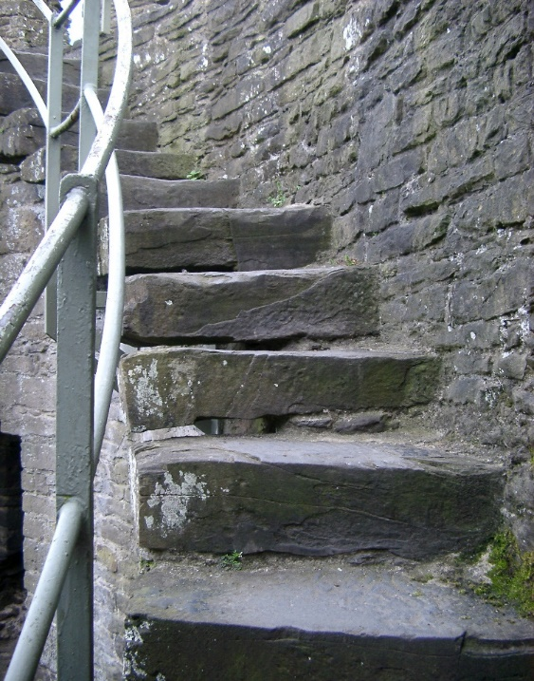
Steps in Data Collection ( aka Progress Monitoring)
Writing measurable goals and objectives
Making data collection decisions
Determining data collection tools & schedule
Evaluating the data
Making instructional adjustments
Communicating progress
Pennsylvania Department of Education; Southwest Ohio Special Education Resource Center
Notes:
These are the steps we should be going through, at least mentally, when planning for how we’re going to collect data on our goals. We are not going to go into depth with most of these today, but I wanted you to at least visually see that data collection really has to be more than an afterthought.

Slide 13
Writing measurable goals
Goals should target specific, measurable skills, not vague generalized areas of need.
Goals should contain baseline information so the level of attainment makes sense.
At the very least, the baseline information should be noted in the PLAAFP
Contact your RPDC Consultants for training on writing measurable goals for progress monitoring.

Slide 14
A word about baseline data
Baseline Data is ACTUAL Data
Not service provider’s best guess
Baseline data must be collected in the same manner as the annual goal data will be collected for an apples to apples comparison

Slide 15
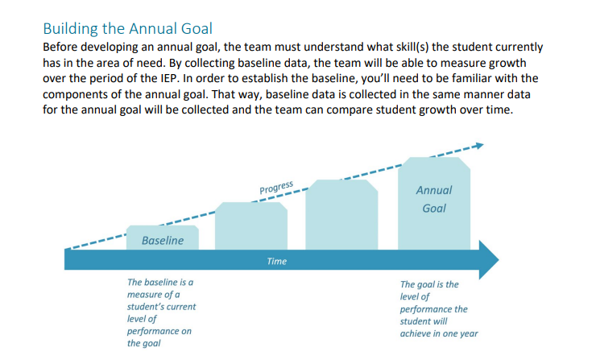
Idaho IEP Guidance Handbook pg 28

Slide 16
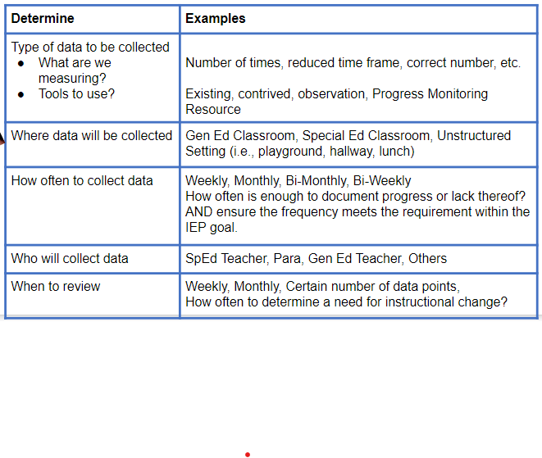
Making data collection decisions

Slide 17
Determine data collection tools and schedule
Make sure the tools chosen match the skill/behavior within the goal.
Communicate with others who may be helping with this data gathering regarding the tools and schedule chosen.
Stick to the plan.

Slide 18
Data tool resources
Free Data Collection sheets and data analysis graphs
Sped Track Free Progress Monitoring Data Collection Resources
Idaho IEP Guidance Handbook (pg 49-51)
Behavior Progress Monitoring: Part 2 - Develop Objective, Measurable Goals - Procedure & Schedule (idahotc.com)
Progress Monitoring: Mathematics & Reading | Progress Center (promotingprogress.org)
Measuring Progress IEP (promotingprogress.org)
Chart Dog: Free data chart graph maker

Slide 19
Evaluate (analyze) the data
Collected data should be reviewed regularly on a predetermined basis.
The data must be analyzed to determine if the student is making progress toward goals, and how the child is responding to the intervention/specially designed instruction being implemented.
Decision rules should be applied when analyzing data. Do you have these? What are they?

Slide 20
Analyzing the data (display visually)
100
100
90
90
80
80
trend
trend
-
-
line
line
70
70
X
X
X
X
60
60
WIF: Correctly Read Words Per Minute
WIF: Correctly Read Words Per Minute
50
X
50
X
40
40
goal
goal
-
-
line
30
line
30
20
20
10
10
0
0
1
1
2
2
3
3
4
4
5
5
6
6
7
7
8
8
9
9
10
10
11
11
12
12
13
13
14
14
Weeks of Instruction
Weeks of Instruction

Slide 21
Making instructional adjustments
Data collection provides information used to drive instruction.
Student progress is considered in relationship to each goal or expected outcome.
Instruction should either change or stay the same based on the data.

Slide 22
Making decisions about goals
What if the student is not making progress over time?
When a team notes that minimal to no progress has been made on a goal during the IEP cycle, teams must address the root cause or reasoning for the child not meeting the goal rather than repeating the same goal over multiple IEP cycles.
Before changing the goal, first consider the type and amount of instruction that has been provided to the student. Changes can and should be made at any point during the IEP cycle rather than waiting until the next IEP to repeat the same goal or the same instruction.
If the team does determine it is appropriate to include the same goal in a subsequent IEP, there should be a clear explanation, supported by data, in the present level of the IEP as to why the team felt this was an appropriate determination.

Slide 23
Making decisions about goals
What if the student has mastered the goal in the middle of the IEP cycle?
Depending on the situation, it may be appropriate to amend the current goal to add additional skills or increase the level of attainment required.
It may also be appropriate to add a different goal to work on, perhaps within the same eligibility area.
Endrew F. set an expectation that all students would have challenging IEP goals as part of receiving FAPE. Therefore, changing or adding goals within the IEP cycle may be necessary if students master the goals written more quickly than anticipated.

Slide 24
Communicating Progress
What do our Missouri Standards & Indicators require for Progress Reporting?

Slide 25
200.940: Reporting progress on annual goals
200.940.a. The IEP includes a description of how progress toward meeting the annual goal(s) will be measured.
200.940.b. The IEP includes a statement of when periodic reports on the progress the child is making toward meeting the annual goals will be provided to the parent(s)
200.940.c. The content of the progress report includes the progress toward the annual goal(s).

Slide 26
And one more thing…
NOTE: Due to the relationship between the annual goals of a transition-aged student and the student’s post-secondary goals, the public agency should include content about progress toward the post-secondary goals and transition services in the periodic report.

Slide 27
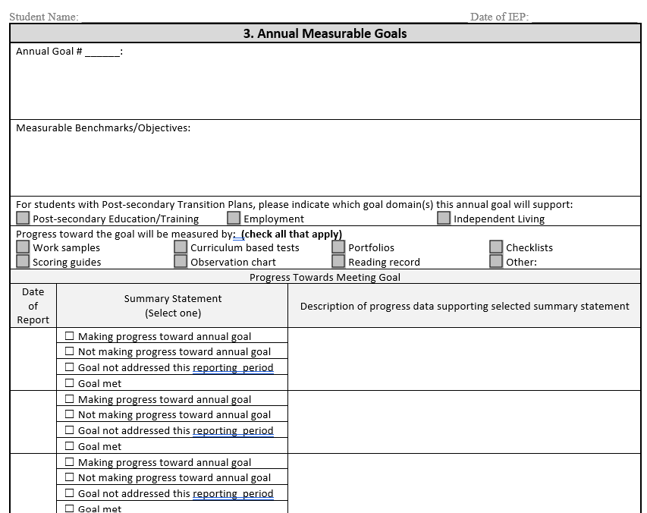
Updated model goal form

Slide 28
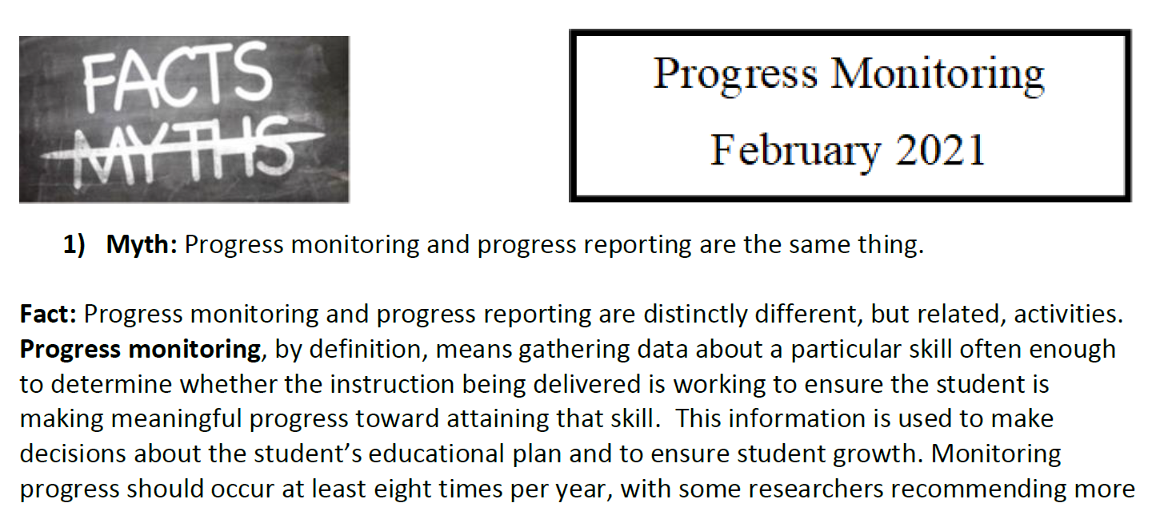
Resources available
https://dese.mo.gov/media/pdf/progress-monitoring-february-2021

Slide 29
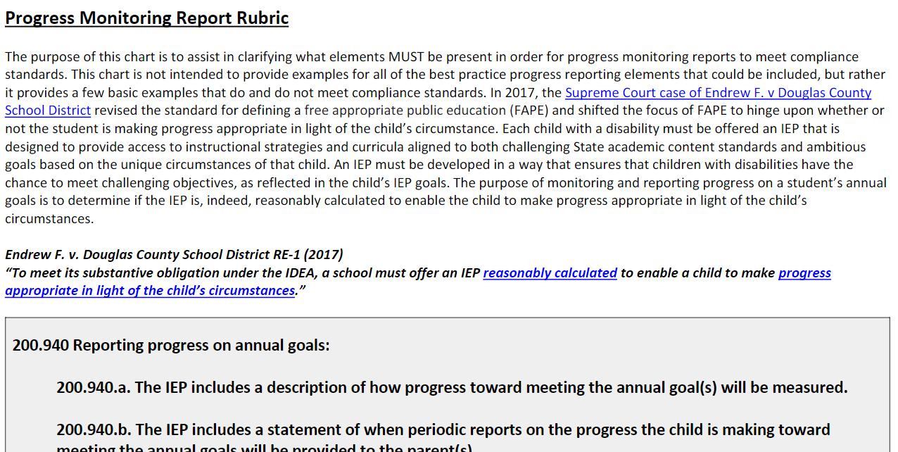
Resources available
https://dese.mo.gov/media/pdf/progress-monitoring-report-rubric-pdf-version-2022-23

Slide 30
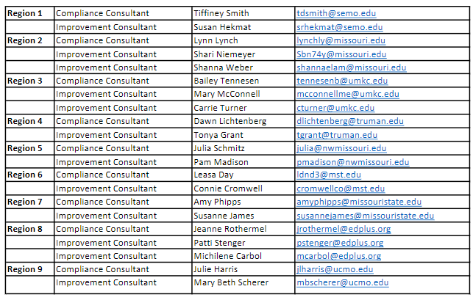
Resources available-RPDC Consultants

Slide 31
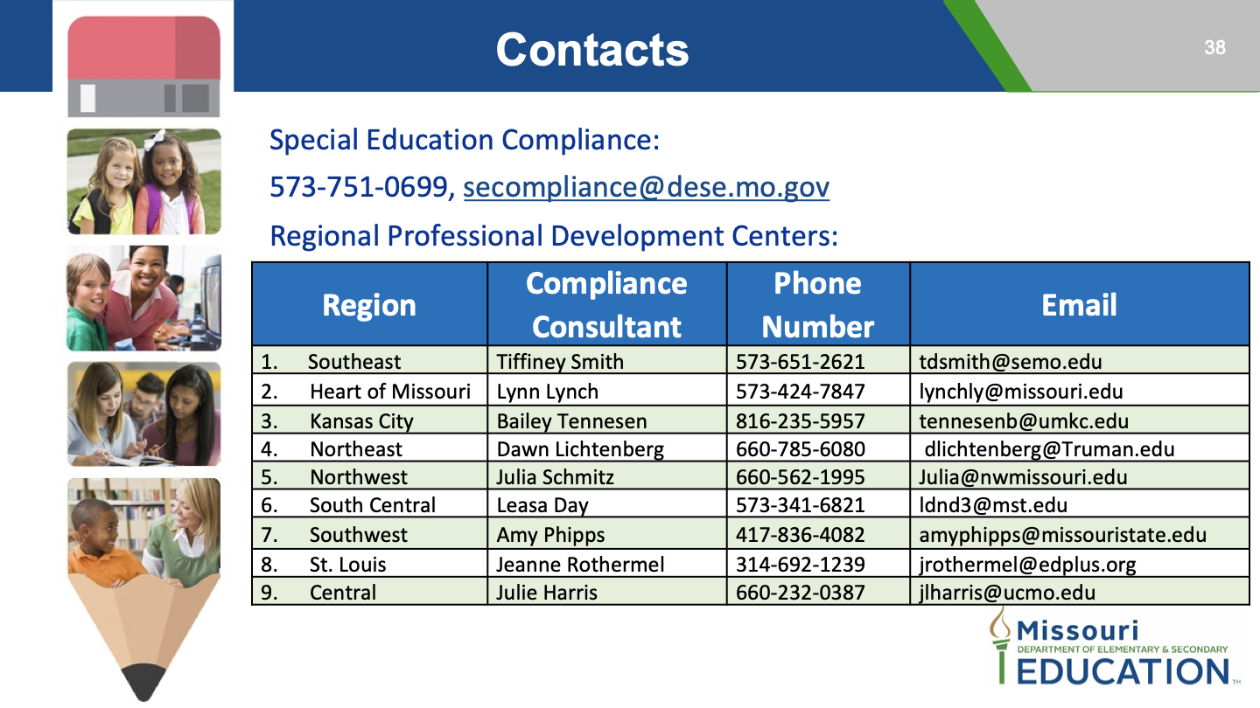

Slide 32

Progress monitoring reminders
DO IT!!
Gut checks are no longer accepted.
Once a quarter is not frequent enough. We report progress to parents once a quarter, we should be progress monitoring much more frequently
Progress monitoring MUST match the goal.
That data drives your next PLAAFP!!

Slide 33


Slide 34
Office of Special Education - Compliance
Phone: 573-751-5739
Fax: 573-526-4404
specialeducation@dese.mo.gov

