Slide 1
Progress Monitoring:
Student Growth on Goals
Include Presenter Names Here
2022-2023
Notes:
What is needed for this presentation
Note Catcher
Post-It Notes
Half-sheet of paper for Human Bar Graph/Snowball Fight Activity
Article - Progress Monitoring
Text Rendering Document - you can print these and have participant write on them; or laminate them and use wipe-off markers
Example goals (listed on slides near the end of the presentation)
Chart paper (two per group)
IEP goal sheet (DESE Model)
Can these be used to monitor Individualed Education Program (IEP) progress (handout)?
Note cards
Ask attendees to bring copies of their IEP goals.
How to collect data; analyze data; and interpret it to show growth
Include resources such as the spedtrack option to take data.
Focus on both academic and behavior - including how to collect data for an Applied Behavior Analysis (FBA).
Example - If you have ______________ information about a student, what is the goal and measurement?
Curriculum-Based Measurements - samples, and how to obtain the data.
Show a diagnostic.
Use facts - not opinions.
If the audience requires more work on actual goal writing, have them contact their CC.
Slide 38 (old version) The Data Collection Decision - we should make into a handout.
Classroom grades is NOT what should be taken as data for IEP goals (nor should it be an IEP goal).
Remove performance assessments from the old version.
Have participants bring IEP goals to practice with and set up data collection systems.
Set Goal Line and Trend Line
Frequency of Monitoring Progress - at least every two weeks

Slide 2
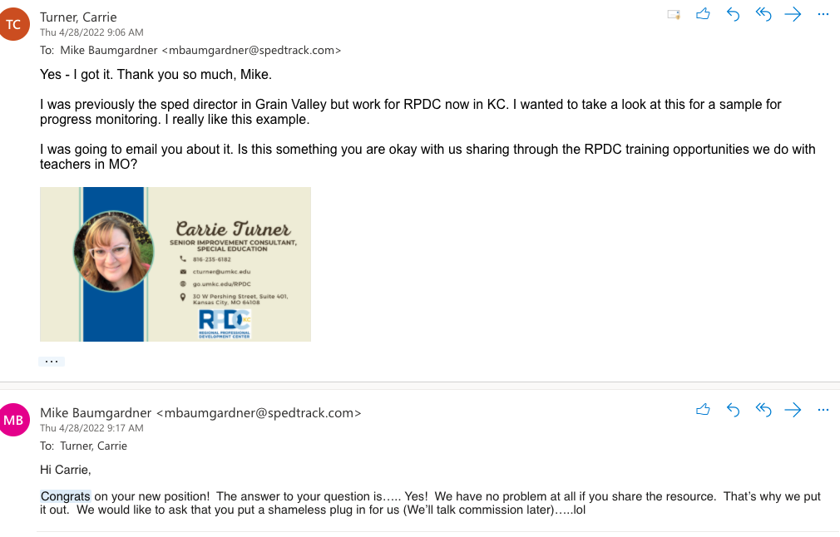
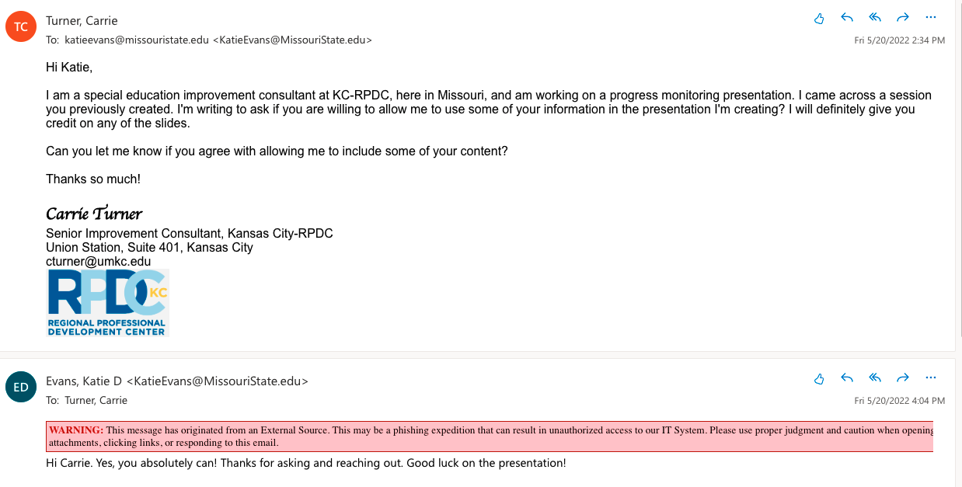
Notes:
This is email communication with the approval to use content from these sources.

Slide 3
Welcome and Introductions
Name
Email
Phone
Twitter
Etc.
Notes:
Add introduction information for the presenter. Replace the image with a picture of yourself or something you want to share and complete the personal information.

Slide 4
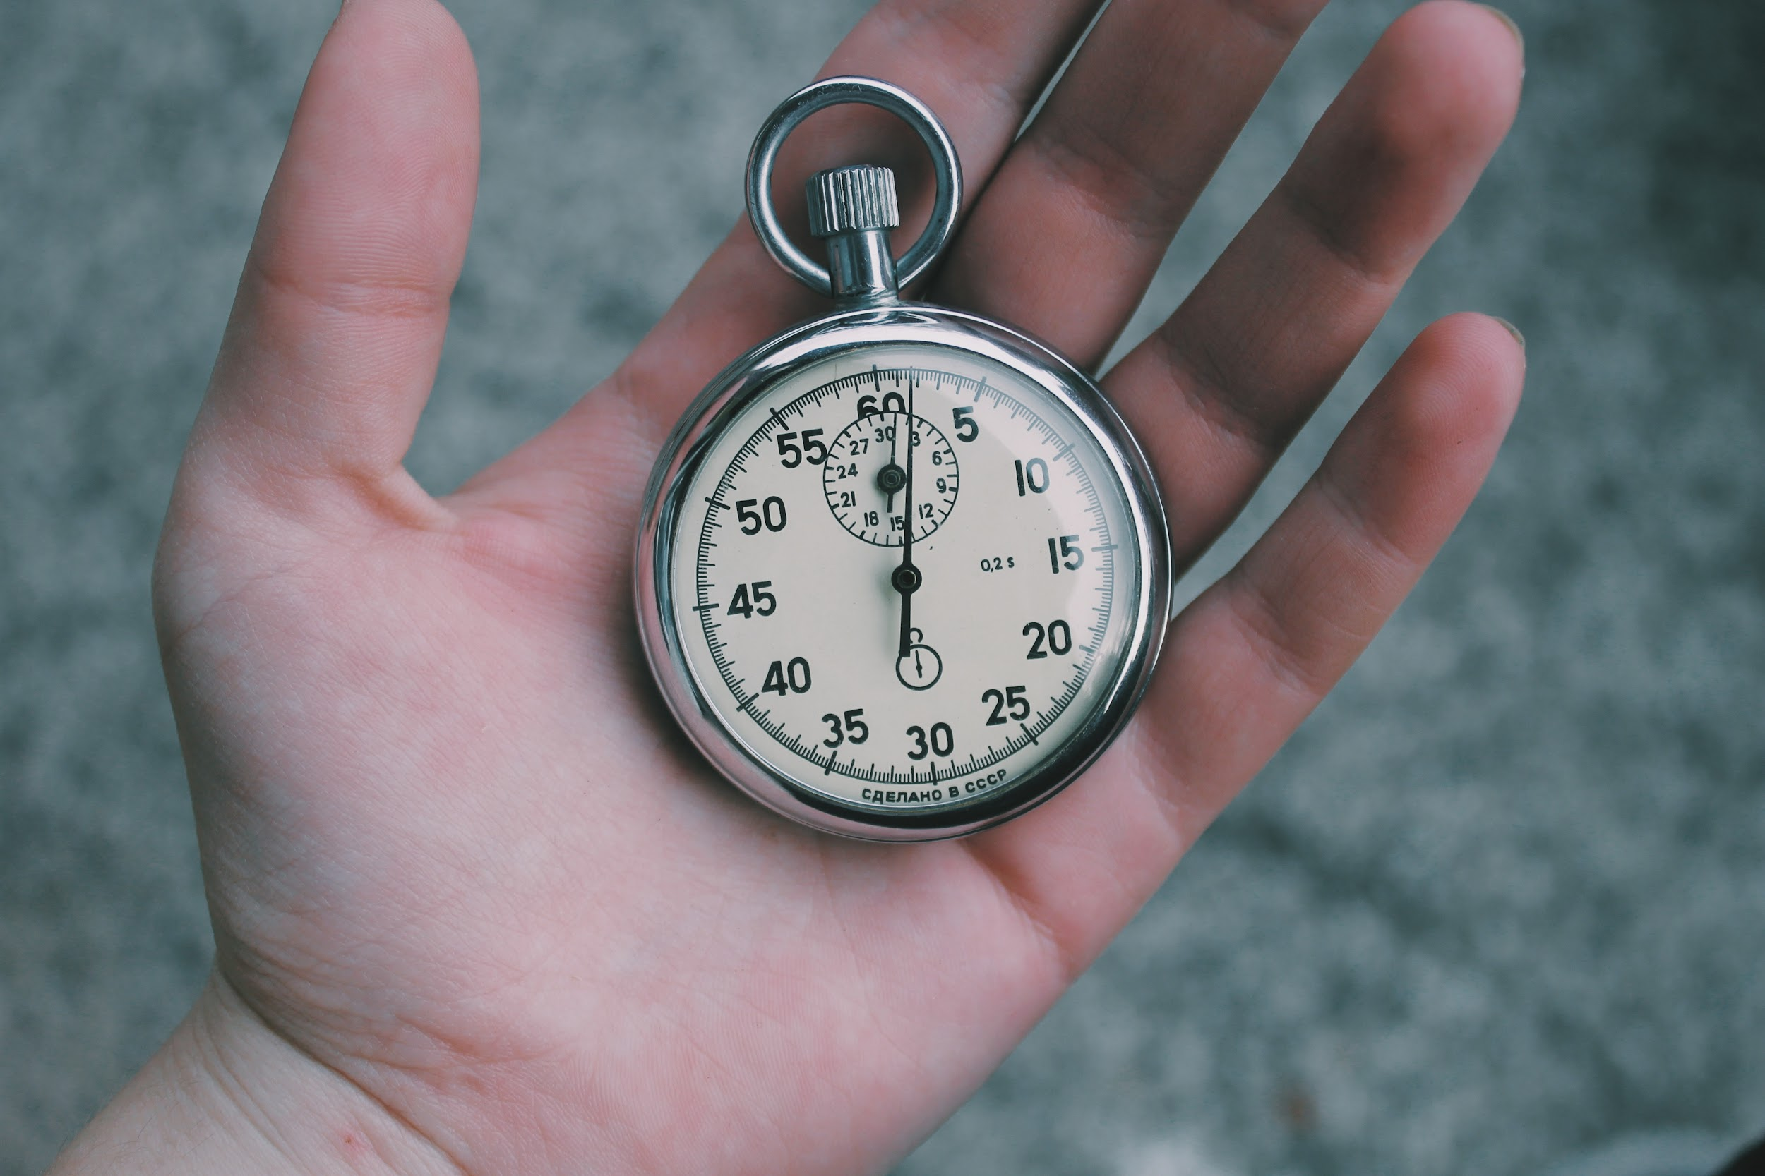

Introduction Activity
FIND YOUR SOLEMATE
Name, Position, and Where you Work
Something you would like to learn today
What is a positive experience you have had this school year
Notes:
(Five minutes)
Find someone in the room with similar shoes, and share the answers to the questions on the slides with this person/group. Be prepared to share with the group.

Slide 5

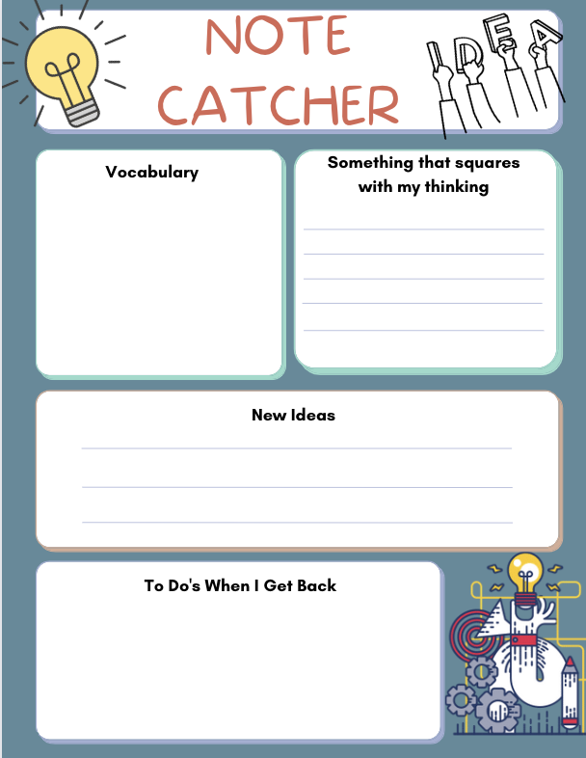
Important to Note
HO #1
Use this Note Catcher throughout the day!
Notes:
Share this note catcher and information with the attendees for their use throughout the training. HO#1 Note Catcher

Slide 6
Norms
Be present, enjoy yourself
Be engaged
Address personal needs
Set a goal for your self-learning today
Notes:
Review norms with the attendees
Feel free to change these norms as you see fit and appropriate for your group.

Slide 7
Learning Objectives
Participants will gain an understanding of progress monitoring, including
The importance of data collection
How to select data collection
Methods of data collection
How to analyze data and make data-driven instruction decisions
Notes:
Share the learning objectives with the group.

Slide 8

Questions
Using the post-it notes on your tables to indicate any questions/learning needs you have specifically for today’s session.
Notes:
Using the post-it notes, write a question you have about data collection or progress monitoring.
Ask for volunteers to share their question(s).
Be sure to work to address the questions with the content provided throughout the day.

Slide 9
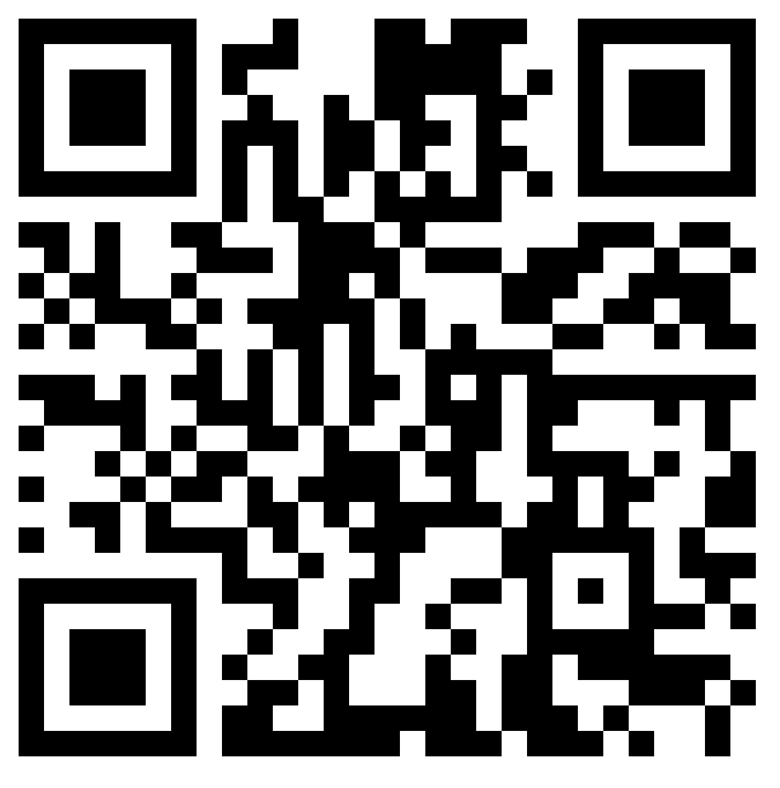

Padlet Link
https://tinyurl.com/rpdcprogress
Notes:
Share this padlet link with your attendees. They can either use the QR Code or they can type in the URL into the address bar. You cannot open the link from this slide.
This padlet will stay active so they can continue to use it as a resource in the future. You should also share with them that as we find additional resources, we will continue to add information to the Padlet.

Slide 10
Rate Yourself Activity
How successful do you believe your current data gathering methods are for measuring IEP goals?
5 | My current data gathering methods are exemplary at measuring IEP goals.
4 | My current data gathering methods are successful at measuring my IEP goals.
3 | My current data gathering methods are somewhat successful at measuring my IEP goals.
2 | I’m not sure if my current data gathering methods truly measure my IEP goals.
1 | I have no idea how to take data on IEP goals, so therefore, don’t know if I am successful.
Notes:
High Leverage Practice Explanation
This is a good example of an activity you can do with your students to figure out what they already know about a topic.
For this training, the Human Bar Graph will give an ‘analysis’ of where the group seems to be in regard to their confidence with taking data on IEP goals.
It is also a quick way to check for understanding,
AND, it allows the participants to move.
Step 1: Self Rating Using the Scale on the Slide
Ask participants how successful they believe their current data gathering methods are for measuring IEP goal progress?
Using a half sheet of paper, they will write the number from the options on the slide that best represents where they are with data collection and progress monitoring.
Ask them to immediately wad up the piece of paper.
Step 2: Snowball Fight
If there is space in the room, ask the participants to form a circle. Otherwise, you can have participants go into a hallway.
After they have formed a circle, ask them to throw their wadded up piece of paper at someone across the room…”having a snowball fight”. Continue picking up a ‘snowball’ from the floor and throwing them around the room. After 30-45 seconds of snowball fighting, ask everyone to get a ‘snowball’ and open it. (No participant should end up with their original paper)
Step 3: Human Bar Graph
Ask participants to open the piece of paper they have at the end of the snowball fight. Line up (like a bar graph) for the number written on the paper. There should be a line for each of the five rating options.
You can opt to place numbers 1-5 on the wall for each of the five bar graph lines (optional).
Discuss results.

Slide 11
Agenda
Why Data?
Law
Best Practice
Steps to Progress Monitoring
IEP Goals
Data collection decisions
Data tools and schedules
Analyzing the data
Making instructional decisions
Communication progress
Notes:
Review the Agenda with the group.

Slide 12
Why Data?

Slide 13
The Law
IDEA states that each child’s IEP must contain
(3) A description of—
(i) How the child’s progress toward meeting the annual goals will be measured; and
(ii) When periodic reports on the progress the child is making toward meeting the annual goals (such as through the use of quarterly or other periodic reports, concurrent with the issuance of report cards) will be provided…[300.320(a)(3)]
Federal Regulation, IDEA; 34 CFR 300.320 (a) (2)
Notes:
This is information from Federal Regulation, IDEA; 34 CFR 300.320 (a) (2)
https://sites.ed.gov/idea/regs/b/d/300.320
The Federal IDEA special education regulations require that progress toward a student’s IEP annual goals be monitored, measured, and reported to parents as frequently as general education progress is reported to parents. Take a look at the exact wording from the Federal regulations.
In Missouri we are required to follow the federal regulations.
On each IEP there is a place to document the frequency for progress reporting. Remember, this has to be at least as often as reports cards are issued. ESY students also receive a progress update.

Slide 14
Why It Matters
Districts must provide Free Appropriate Public Education (FAPE) to students with disabilities
One component of FAPE is whether the student is receiving a meaningful educational benefit from the services provided
Need data to be able to determine FAPE is provided and appropriate
  Present levels of performance
  Progress data that aligns with goals
Notes:
In special education, we are required to provide FAPE to students.
FAPE means that special education students are entitled to a Free Appropriate Public Education.
Based on case law, we know that our students with disabilities must receive meaningful educational benefit from the services they are provided.
We are able to provide that students are receiving FAPE based on the data we collect, analyze, and use to determine student progress on IEP goals. This data also helps us develop an appropriate present level of performance and updated goals for each new IEP.

Slide 15
And More Reasons
IEP Meetings
Parents expect to hear the progress of their student
  We should have the data available for review
Due Process Complaint for failure to provide FAPE can be filed
Districts can demonstrate that FAPE has been provided by
    Providing available data to demonstrate progress on IEP goals
    Charted data is even better
Notes:
We are required to do this based on the federal regulations.
If needed, you can use the link provided to show the actual Federal Regulation, IDEA; 34 CFR 300.320 (a) (2) https://sites.ed.gov/idea/regs/b/d/300.320/a
As providers of special education supports and services, we are mandated to provide parents/guardians with data that documents progress toward meeting IEP goals. Also, the present level of academic achievement and functional performance along with goals provide documentation for IEP teams to determine participation in statewide assessments.
This topic is one that gets districts into due process because parents want the evidence or proof that their child is progressing.

Slide 16
U. S. Supreme Court Case
HO #2
Endrew F. v. Douglas County School District Re-1
The Central Question
Must schools provide a meaningful education where children show significant progress and are given substantially equal opportunities as typical children, or can they provide an education that results in just some improvement?
Notes:
Refer to the Endrew F. v. Douglas County School District Re-1 Case Decision Q and A Document (HO#2)
The Endrew F. v. Douglas County School District Re-1 case is a U. S. Supreme Court Case decision that was passed in 2017. This case informs our efforts to improve academic outcomes for children with disabilities, as it defines the FAPE standard. The United States Department of Education issued a Q & A document on the Endrew F. v. Douglas County School District case. This document provides information about the lower court case, decisions and the Supreme Court decision. The table of contents of this document includes an overview of the facts surrounding the case, clarification of IDEA’s FAPE requirement, and considerations for implementation.
This document is in the Padlet for your review.

Slide 17
Supreme Court Decision
Court said
A student offered an educational program providing “merely more than de minimis” progress from year to year can hardly be said to have been offered an education at all.
For children with disabilities
Receiving instruction that aims so low would be tantamount to “sitting idly…awaiting the time when they were old enough to ‘drop out.’”
“Questions & Answers on U.S. Supreme Court Case Decision Endrew F. v. Douglas Co. School District Re-1, US Depart. of Ed. Washington, DC, Dec. 7, 2017
Notes:
The Endrew F case originated in Colorado which is the 10th circuit. In Missouri, we are part of the 8th circuit. This is important as the previous FAPE standard in the 10th circuit was a very low standard. This case redefined the FAPE standard across the country.
“De minimis” means too trivial or minor to consider. This was used by the hearing officer and lower courts to determine if FAPE was met. The lower courts determined that FAPE was met and parents continued to appeal through the court system to determine that “de minimis” was not acceptable for Endrew’s educational benefit. It was the Supreme court that rejected the low standard for education benefit for a child with an IEP, therefore reversing all lower court decisions.

Slide 18

Our Takeaways
The court’s decision increases the education expectations for students with disabilities
We must be able to show more than minimal progress for our students
IEPs must NOT look substantially similar year after year
Notes:
This is the basis of the summary of the US Supreme court decision.
Every student with an IEP has the chance to meet challenging goals
Data collection with progress monitoring will prove the progress made for each student on his/her IEP goals
IEPs must have high expectations annually and not look the same from year to year.
We will talk more specifically about goals in upcoming slides.

Slide 19
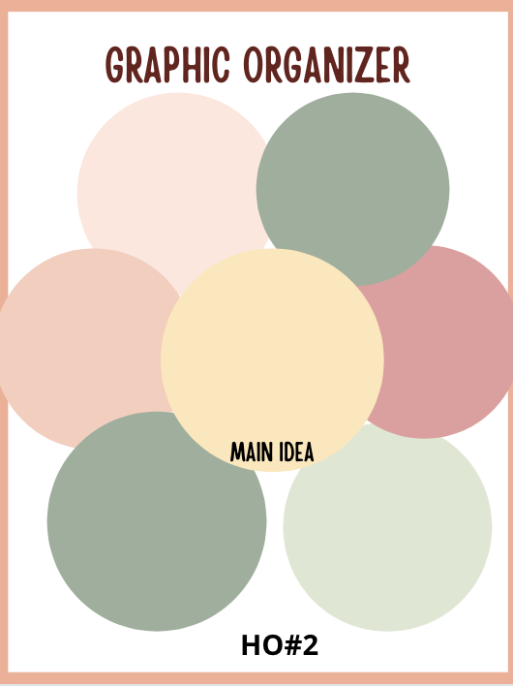
Let’s Brainstorm
HO #3
Write “Why is data collection important” in the center circle
Provide six reasons why data matters in the rest of the circles
Be ready to stand
and share
Notes:
Four Minutes (or give a little longer if needed) for this activity. HO#3 Graphic Organizer
Ask participants to think about why data collection is important. This is a brainstorm activity.
Have individuals complete their graphic organizer.
Once the individual brainstorm is complete, use the Stand and Share activity.
All participants stand up with their own list.
Call on one participant to share each item from their list.
Participants add the shared item to their list, if they don’t have it, or check it off if they do have it.
Participants sit down when all of their items are checked off, but do continue to add new items to their list.
When all participants are seated, the Stand and Share activity is complete.

Slide 20
Why Do We Need Data?
DATA Answers Questions/Make Informed Decisions
Is my intervention working?
What is the function of this behavior?
DATA Provides Evidence
Brings to light the true frequency or duration of a behavior
Proves or disproves a hypothesis
DATA Measures Progress
Indicates if a student is or is not making progress
It’s Required
Federal mandate (FAPE standard) related to measuring progress on IEP goals
Katie Evans, Missouri State University
Notes:
These are some reasons we need data. Many of you probably thought of these reasons when you created your graphic organizer. Feel free to note these on your organizer, if needed.
Even if taking data and progress monitoring our students was not required (it is required), we need data in order to effectively provide specially designed instruction with our students!
Data allows us to make informed instructional decisions
Whether the level of the content needs adjusted
If the student needs more advanced skills
If re-teaching is necessary
Data proves the learning and progress occurring with our students
Data helps us monitor the appropriateness of our IEP or if it needs to be adjusted
Data is important to help the student know his/her progress as they learn and grow

Slide 21
Why is Data Collection Important?
Provides a strategic (on-going) way to document REAL progress (or lack thereof) on IEP goals
Should also be used to plan, implement, or change instruction in response to student need
For this reason, it should be FREQUENT
FREQUENT
Notes:
There are many reasons why data collection is important. We just talked about a few of these reasons during our brainstorm activity.
Data is used to track student progress.
Data is used to make informed instructional decisions.
Data is used to determine baseline information for students when developing a new IEP.
Data is used within the Present Level of Performance in the IEP.
Data is used to change instruction; move a student to a more advanced level; or reduce the level to ensure the student is truly understanding the concept.
Data is used to inform parents about their student’s progress.

Slide 22

Implications
Small Group Activity
Discussion Question:
Is there anything IEP teams should be doing differently?
Notes:
Three Minutes (or give a little longer if needed) for this activity.
Discuss in small groups, “Is there anything IEP teams should be doing differently?”
Ask each table to share one thing that was discussed.
More to share on this topic on the next slide

Slide 23
Implications Cont.
Be clear, accurate and factual with present level development
Develop appropriate annual goals
Ensure each goal is measurable
AND ensure the progress toward meeting each goal is noted and applicable to the goal
Share student progress with parents in understandable terms
Notes:
After each group has discussed and shared out regarding what IEP teams should or could be doing differently, show the five points on this slide.
Then discuss the four points as a large group.
Remember to describe or include the facts of what you can see and hear when preparing the present level and given specific progress updates. Do not give your opinion, but rather include facts.
Everyone comes to the IEP table with some knowledge about the child. Know where the child is performing in relation to his/her general education peers.

Slide 24
Challenges
Other professional responsibilities and demands
Selecting optimal target skills that align with Missouri Learning Standards
Having reliable and the right type of data
Finding efficient, effective means of data collection
Making ongoing progress monitoring a habit
Notes:
There are some challenges for teachers when it comes to data collection and progress monitoring. However, time spent to set up the process is well worth it. Once the process is in place, taking data, reviewing data, and analyzing data can be part of the normal routine each week.
Hopefully, throughout this session, you will gain some methods and/or tools to help with these challenges.

Slide 25

Progress Monitoring
Progress monitoring means gathering data about a particular skill, using systematic and planned methods, often enough to determine whether instruction is working so the student is making meaningful progress toward attaining that skill.
Notes:
Plan for the data collection. Ensure the data collection system is set up, and readily available so data can be collected on a regular schedule. Having this system in place is imperative so you can be consistent with progress monitoring for your students. This process is all part of ensuring each student is making meaningful progress toward his or her goals.
Progress monitoring is a means to an end. In special education it is required by law. However, even general education teachers should be progress monitoring with their students. This is how all educators have concrete data to demonstrate the progress their students are making. Progress monitoring is something special educators can share with their general education peers.

Slide 26
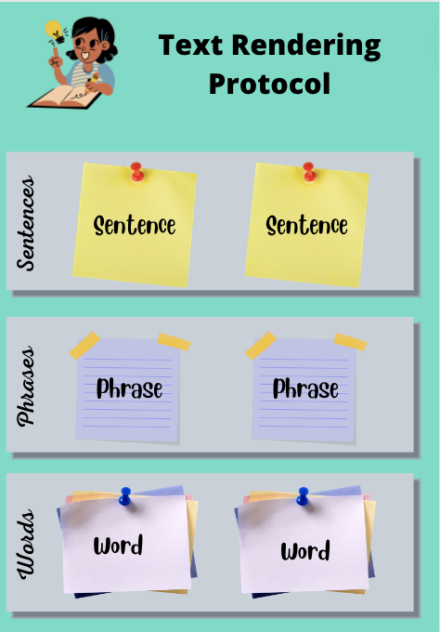
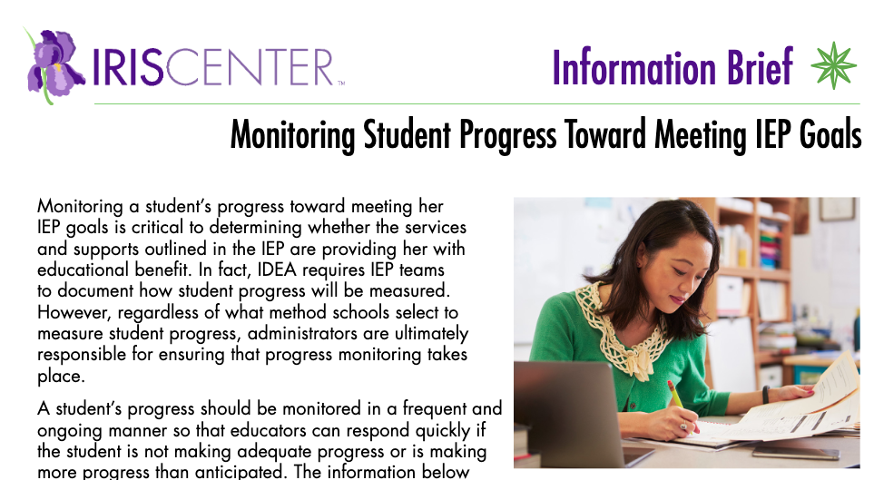
Text Rendering Activity
HO #4 and #5
Notes:
Link to the article https://iris.peabody.vanderbilt.edu/wp-content/uploads/pdf_info_briefs/Monitoring_Student_Progress_Toward_Meeting_IEP_Goals.pdf
Be sure to read these articles prior to training.
HO#4 Text Rendering Protocol
HO#5 Information Brief – Monitoring Student Progress Toward Meeting IEP Goals
Use the Text Rendering Protocol document for this activity.
Each individual will read the article (or the parts of the article assigned)
Each individual will use sticky notes to write two words, two phrases, and two sentences that are the most meaningful for them.
Small groups (assigned to the same portion of the article) will share their individual words, phrases, and sentences, and explain why these were the most meaningful.
Small groups will determine two words, two phrases, and two sentences that the group agrees are the most meaningful.
Each group will share out.

Slide 27
Six Steps to Progress Monitoring

Slide 28

Six Steps: Data Collection (to Progress Monitor)
1. Appropriate IEP goals with defined target skill or behavior
6. Reporting Progress
Progress Monitoring
5. Make data driven decisions
4. Graph & Analyze
2. Making Data Collection Decisions
3. Select appropriate data collection tools and schedule
Notes:
Use these steps when planning for how to collect data on our goals. We are going to review each of these today. It’s important that you visually see that data collection really has to be more than an afterthought.

Slide 29
Step 1: Appropriate IEP Goals with Defined Target

Slide 30
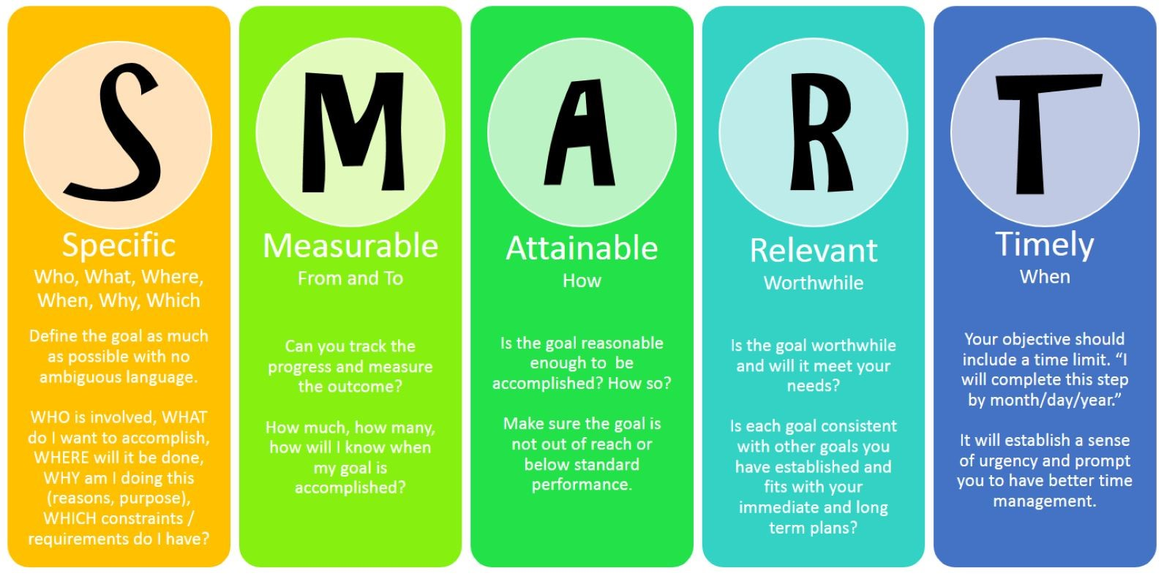
Write Measurable IEP Goals
HO #6
Not the focus today, but very important!
Notes:
HO#6 Annual IEP Goal Compliance Rubric
Ultimately, good data collection starts with good goal writing. But, that is a professional development session all by itself, so we won’t be going in-depth on goal writing today!
Talk through this visual.
The Annual IEP Goal Compliance Rubric is in the Padlet as a resource.

Slide 31
Measurable Annual Goals
Report progress to family
Baseline
Target Skill
Procedures for Measuring Progress
Mastery Level Outcome
Notes:
The target skill must be very specific. If it isn’t specific, then you can’t report out data correctly as you really don’t know what or how to measure what is happening.
This process is always a cyclical process and ongoing.
Target skill can be a focus on academic skills or behavioral skills.
Baseline data is important as we need to know where students are at (starting point) in order to measure their progress.

Slide 32

Monitoring Progress of IEP Goals
The IEP goal statement must include a measurable target skill
AND
The skill targeted by the goal must address student-specific disability related need

Slide 33
Goal Writing Matters
Sometimes we see this
But - This is what is needed
Corey will increase his positive social interactions using age- appropriate behavior with 100 percent accuracy.
When an adult or a peer greets Corey, he will respond in an
even tone of voice, using positive language such as
‘Fine, thank you’ or ‘I feel ______ today’ on three out of four opportunities on four out of five data collection days.
IEP Goal Partner Activity
Notes:
Partner Work
Have the groups work with a partner to write a better goal from the first version (good example will transition on the slide after the activity). Have them share out.
Share that this goal does not have a specific behavior included or the types of social interactions to measure. This goal would not allow the teacher to take appropriate data to measure progress.
NEXT
transition to the “What is needed”

Slide 34
Scenario
Given a direction to complete a task, Jack will begin the task with no more than two teacher prompts, six or more consecutive times, on four out of five data gathering days by the end of the IEP cycle. Jack’s current baseline is beginning assignments one out of five times after five or more prompts.
What is the target skill(s) on which we will need to collect data?
Notes:
There are a few scenario slides. These can be reviewed as a full group or ask your participants to talk with a shoulder partner and then share out answers to the prompt.
Discussion Question: “What is the target we are trying to measure here?”
Answer: The target is “beginning a requested task”.
The data to be collected for this goal must be latency recording. The time the teacher makes the request to the time the student begins the task.

Slide 35

Scenario
Susie will read a fiction story written at the second grade level and identify the main character(s), setting, and problem in the story on four out of five consecutive data gathering days.
NOTE: Susie can currently identify the main character two out of five times, the setting one out of five times and is not identifying the problem at all with second grade level material.
What is the target skill(s) on which we will need to collect data?
Notes:
Discussion Question: “What is the target we are trying to measure here?”
Answer: The target is identifying the main character, setting, and problem in the story. This actually measures three skills (main idea, setting, and problem).
The data to be collected for this goal will be based on the correct responses for each of the target areas. This is an example where benchmarks for each of these skills might be helpful.

Slide 36
Scenario
Max will increase his functional skills by using calming techniques when he is upset on eight out of ten opportunities.
What is the target skill(s) on which we will need to collect data?
Notes:
Allow time for discussion amongst attendees.
This is a “non” example - the goal is not written accurately to be able to determine how to correctly take data.
This goal needs specific calming techniques included in order to accurately take data.

Slide 37
Step 2: Data Collection Decisions

Slide 38
Plan for Data Collection
Determine | Examples
Type of data to be collected What are we measuring? Tools to use? | Number of times, reduced time frame, correct number, etc. Existing, contrived, observation, Progress Monitoring Resource
Where data will be collected | Gen Ed Classroom, Special Ed Classroom, Unstructured Setting (i.e., playground, hallway, lunch)
How often to collect data | Weekly, Monthly, Bi-Monthly, Bi-Weekly How often is enough to document progress or lack thereof? AND ensure the frequency meets the requirement within the IEP goal.
Who will collect data | SpEd Teacher, Para, Gen Ed Teacher, Others
When to review | Weekly, Monthly, Certain number of data points, How often to determine a need for instructional change?
HO #7
Notes:
This handout is included on the Padlet. HO#7 Plan for Data Collection
When prepping for data collection, having the answers to each of these questions first, will guide your decisions about the tools to use when collecting data.

Slide 39

Data Collection Methods Versus Tools
Methods Defined
Describes the type of data to be collected
Frequency or rate
Percentage or accuracy
Duration
Latency
Quality
Level of assistance
Number
Tools Defined
Describes the materials you have available to assist in the data collection process

Slide 40

Current Data Collection Methods
What methods do you currently use to collect data for IEP goals and/or student progress?
Notes:
Write three different data collection methods on the card you have (given out ahead of time). Get up and find someone you haven’t communicated with yet today and share one thing you wrote (allow one or two minutes). Then find another person in the room to share another item on your list. (allow another one or two minutes).
Fluency or Rate
Percentage or accuracy
Duration
Latency
Quality
Level of assistance
Number

Slide 41
Classroom Friendly Methods of Data Collection
HO #8
Data Collection Method | Definition | Best For… | Example
Frequency | How many times a behavior occurs | Behaviors that do not last very long and are easy to count | How many times did Sally make an off topic remark during the 30 minute reading block?
Latency | The Amount of time between the signal for a behavior to occur and the behavior starting. | Behaviors that have a clear signal to begin and there is a delay to when the behavior actually occurs that you want to shorten. | It took 2.5 minutes from the time the teacher blew the whistle (signal) to when Sally lined up (behavior).
Duration | The period of time that a student engages in the behavior. | Behaviors that have a clear stop and start that you want to increase or decrease the amount of time that the student engages in them. | Robby cried for 16 minutes out of a 30 minute math block.
Permanent Product | A work sample or physical change in the environment as a result of a behavior that lasts long enough for you to take data on. | Academic behaviors, life skills behaviors, or other behaviors where you can physically see the environment change as a result of the behavior. | Robby completed a writing assignment with 20 questions. He got 10/20 correct. Henry completed ⅘ of his chores for today.
Notes:
There is a handout with this chart in the Padlet. HO#8 Classroom Friendly Methods of Data Collection
Review the contents of this information with the group.

Slide 42
Type of Data Collected
Contrived data: Purposely set up situations in which we collect the data.
Existing: Data that can be gathered from current formative assessments, behavior checklists from the classroom, bell ringer assignments, journal writing, etc.
Progress monitoring tools: Benchmark-type assessments that are given to all or specific students periodically.
Observation: Specific behaviors or skills are watched for and charted.
Notes:
There are several types of data that can be collected.
Contrived data can be specifically set up during resource time, during a self-contained type of class or even in the general education classroom.
What might be a danger of using all contrived data to measure IEP goals?
The danger is it’s possible it could look like a student can perform a skill because when it’s done in the ‘sterile’, well controlled, contrived situation, he or she CAN do it. But when that same skill has to be used out in the general environment, the student does not demonstrate the ability to do it. Settings and situations matter. We have to keep that in mind.
Existing data can be gathered from formative assessments, behavior checklists from the classroom, bell ringer assignments, etc.
Progress monitoring tools are great (the purchased ones) if you have them. But, if you don’t, it doesn’t mean you can’t ‘progress monitor’. You can use things you already have that may be occurring with some frequency.
If you are using common formative assessments, you might be able to use that information in a progress monitoring way depending on the goals that you have.
Progress monitoring means keeping track of whether or not your students are making progress on their goals. When writing these goals, you have to be thinking about how you’re going to do that BEFORE you finish writing the goal!
Observations are generally the ‘go to’ way to document behavior related goals.
These observations can be done by anyone as long as they are very much aware of what they are supposed to be observing.
We need to clearly define the behavior or skill we are tracking so that everyone gathering data on a particular student is gathering it based on the same criteria.
For example, if the goal is written for the student to respond to adult directives, we need to make sure everyone tracking that goal knows what we’re calling a ‘directive’.
If we’re making that directive in the form of a question, does the student have to respond?
“Peter, will you move over here, please?”, sounds like the student has a choice in the matter versus, “Peter move over here please” where no choice appears to be given.
When using observation as the data gathering method, you also have to make sure that there is some type of tangible data that goes along with the observation
checklist
tally sheet
anecdotal notes
We need to point out that we are working smarter, not harder. When writing present levels, which is where our goals should be coming from, we need to focus on the things that SHOULD be happening which are the skills the students SHOULD be learning at each particular level for a variety of reasons.
It tells us just how far behind the student is from their peers.
It makes it much easier to decide what goals to write.
And ultimately, gives us various opportunities for collecting data to evaluate progress on goals that already exists.

Slide 43
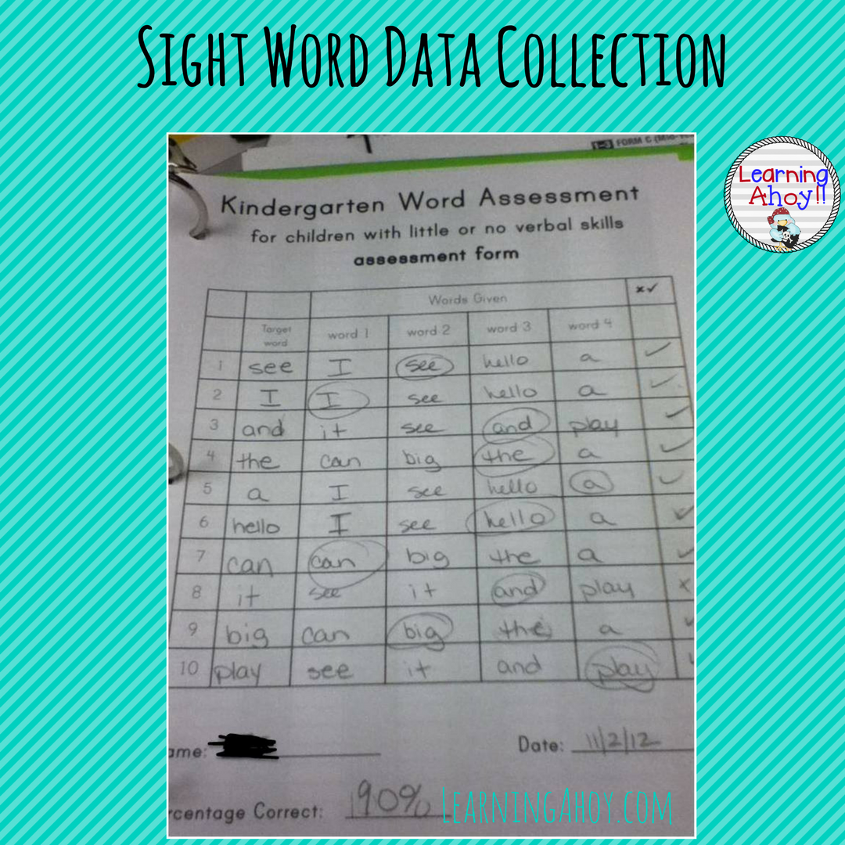
Common Methods of Data Collection
Method must match target skill in the goal.
Notes:
The method used to collect data for a specific goal, must be consistent over time. We will talk through several methods on the next several slides.

Slide 44
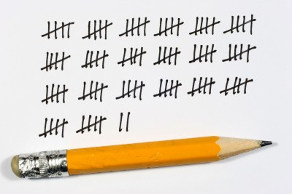
Frequency or Rate Recording
Frequency or rate recording accurately reflects the number of times a behavior occurs.
Suitable for behaviors that have a beginning and a end
Recording tools include
  tally marks
  checkmarks
  handheld frequency counters
  smiley faces
  tokens

Slide 45
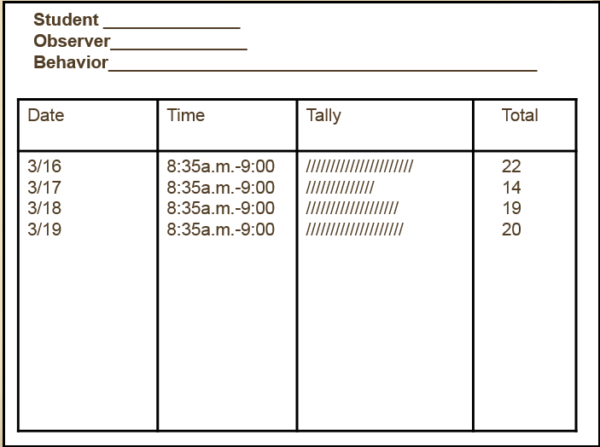
Example - Frequency or Rate Recording

Slide 46
Partial Interval Recording
Record if a behavior/action happens within a set amount of time. If I see it, they get a plus (or some specified mark).
This might be a one hour observation and the data is marked every five minutes or every 15 minutes noting if the behavior/action occurred at all during that segment of time.
Notes:
Partial Interval recording is data recorded on a specific behavior or action if it happens within a set amount of time.
Whole interval recording could be used but the behavior or action is only recorded if the action lasted throughout the entire interval.
If collecting this method of data, ensure the total reported is based on the number of intervals rather than the total amount of time. Remember, this is data noted if it occurred at all within the specified interval so it is not based on the amount of time.

Slide 47
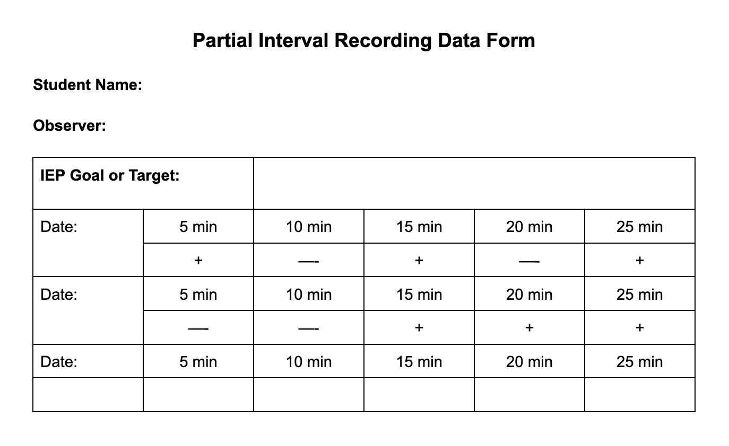
Notes:
Example of Partial Interval Recording
When using this option, you may want to have a separate form to take the same data for a typical peer. This allows you to have a comparison student when looking for typical vs atypical actions. This might be helpful if looking for on task/off task behavior.

Slide 48
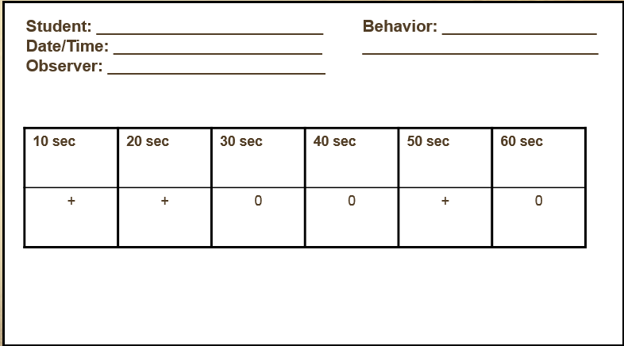
Notes:
Another example of interval recording

Slide 49

Partial Interval Recording Video
Notes:
Partial Interval Recording Video 1:27 – Click on screen and push the play button.

Slide 50
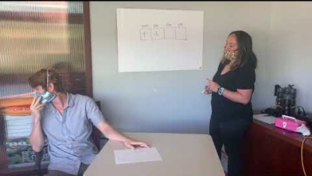
Whole Interval Data Recording Sample
Notes:
23 second video – Click on screen and push the play button.
This is an example of whole interval data recording.
In this example, the data is recorded at the end of every five seconds. If the student was complying with the request during that five seconds, a plus sign (+) is recorded. If the student is not complying a minus sign (-) is recorded. This data is based on the target behavior lasting through the entire interval.
What did you notice happening within this interval data recording sample? Did you notice her hand? (She was counting each interval of five seconds with her fingers).

Slide 51
Duration Recording
Good option for behaviors with a clear beginning and end (i.e., talking, screaming, interacting with peers, length of restroom break)
Use of a timer is recommended.
Used to measure the length of time a student engages in a particular behavior.

Slide 52
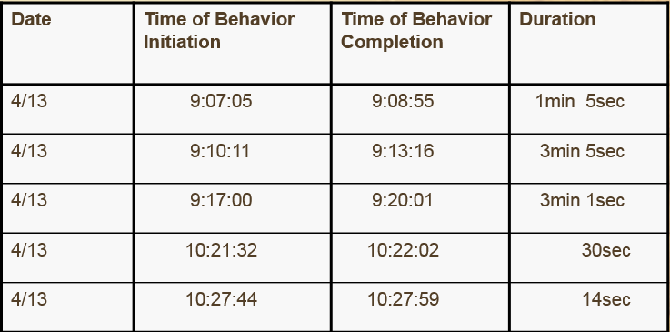
Notes:
Example of duration recording
This method of data collection is typically used for student behavior that tends to last for an extended period. For example, time on/off task, a tantrum, or physical aggression. A timer needs to be readily available to accurately record the duration of the target behavior.
This is NOT the method to use if the target behavior is blurting out in class. When a student blurts out, this is a very quick behavior and not something that lasts for more than about a second or two.

Slide 53
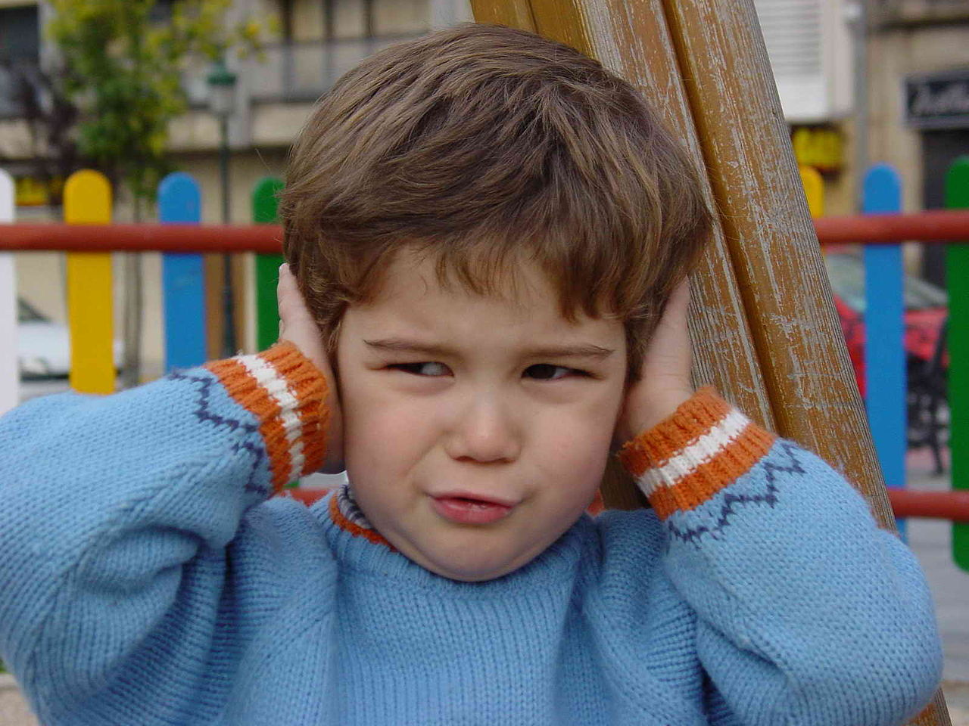
Latency Recording
Used to measure the length of time that elapses between the time the student is cued to the time the behavior begins.
Notes:
Latency recording is used to measure the length of time that elapses between the time the student is cued to the time the behavior begins.
Examples for when to use latency recording
Lining up at the end of recess - when the whistle blows, it is the cue for students to line up. At this time, start the timer and stop the timer once the student complies with the expectation.
Any transition period is a time when latency recording could be used.
Ask for other ideas from the group on when latency recording could be used?

Slide 54
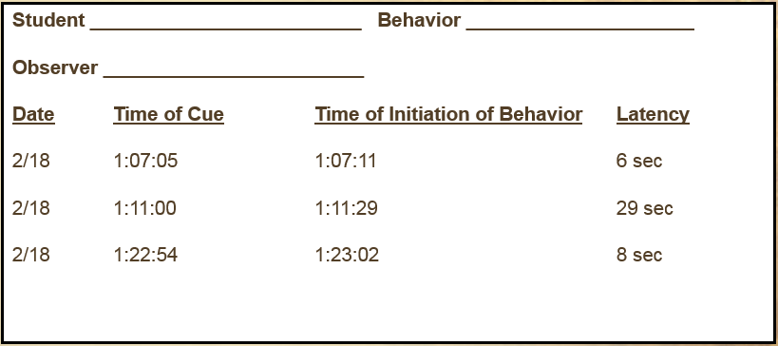
Latency Data Collection Example
Notes:
Example of latency data
On any data form you utilize, you can also add a note column for the location or other important information based on your specific situation with the student.

Slide 55
Does the Method Match the Purpose?
During class time, Fred will reduce the time it takes him to respond to an adult directive from more than ten minutes with multiple prompts to less than three minutes with no additional prompts 90 percent of the time on three out of four data collection periods.
Notes:
Here’s an example of someone using the wrong data collection method for a goal. The special education teacher asks the general education teacher to track data on the amount of time it takes Fred to respond. The special education teacher does not give her a data collection tool that outlines what to do, so the general education teacher uses tally marks to record the number of times Fred does not respond to the directive. What’s wrong with that?
This goal is not about the number of times Fred does not respond, but the amount of time it takes him to respond. Tally marks will not provide useful information for measuring this goal.

Slide 56
Which Method to Target
PLAAFP indicated Alex has the following weaknesses
Receptive language
Understanding content vocabulary
Determining the connection between relevant facts from a passage, especially when determining how to solve math word problems
IEP goal states: “When given a math word problem, Alex will correctly state what operation is necessary to complete the word problem….”
Progress monitoring data provided
Alex was able to accurately compute nine out of ten word problems that required him to use single digit by single digit multiplication facts. He has mastered his 2’s, 5’s,10’s and 3’s multiplication facts this quarter.
During the three data collection trials this quarter, Alex was able to correctly state what operation he needed to use to accurately solve a given math word problem with the following accuracy (probe contained five problems), data collections: 1: 3 /5, 2: 4/5, 3: 4/5
Notes:
This slide is about identifying the purpose of the data collection and consistently collecting the correct data.
Which of the data collection examples should be used for this goal?

Slide 57
Let’s Take Data!
Use sticky notes or a piece of paper and be ready to take data based on the prompt on the next slide.

Slide 58
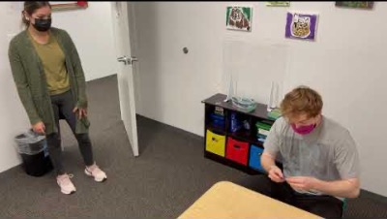
Let’s Take Data!
Track the time it takes for this student to return the greeting from the teacher.
What method of data collection is needed?
Notes:
Video 0:00 - 0:52 seconds – Click on the screen and press the play button.
Review the prompt on the slide with attendees. Discuss what type of data recording this task will require (latency data collection).
Ask the attendees to use their phone as a timer and record the amount of time it takes for the student to respond to the greeting.
Explain that with this type of data collection, we are looking for a decrease in time for the reaction, to see improved behavior or progress toward and IEP goal.

Slide 59
Step 3: Tools and Schedule

Slide 60
Tools - Defined
Tools may need to reflect different locations, different types of assessments, etc. to show real progress across settings. It depends on the way the goal is written.
  The what and the where for the data collection, for example
Notes:
Tools are used to help guide the specific type of data to be collected, the location, and the type of assessment to be used with the student.

Slide 61
Characteristics of Effective Progress Monitoring Procedures and Tools
Accurate (valid + reliable): Consistently measures target outlined in the goal
Sensitive: Tools used are sensitive to growth; small changes in performance
Frequent: Regular and frequent data collection
Simple: Easy to implement, quick to administer, easy to “score”
Brief: Takes only a short amount of time or embedded in instruction
Notes:
Review the content on the slide.
Explain that these are hints to look for when planning for data collection. You want your data collection system to meet all of the items on this checklist.
We want our data collection to be
Accurate and consistent
Sensitive to student growth and small changes in performance
Allow for frequent data collection
Be easy to implement and use
Take only a short time to utilize while embedded in instruction

Slide 62
Can These be Used to Monitor IEP Goal Progress?
Yes, No, Maybe
HO #9
Daily behavior checklist
Annual statewide achievement exam
Unit quizzes from grade level curriculum
Grade level screener administered one to three times per year
Published Curriculum-Based Measures (CBM) probes administered weekly
Familiar or unfamiliar read
Notes:
Refer to HO#9 to identify if the item is a good option to use for IEP goal progress.
Have participants work with a partner to determine if these options are appropriate tools to use to monitor progress. Allow a few minutes to complete the answers to these questions and then ask the participants to respond to the questions in a discussion format.

Slide 63
Sample Tools
Structured Interview
Observation Logs
Teacher-made Tests/Tasks
Rating Scales
Checklists of Skills
Rubrics
Task Analysis Records
Portfolio Assessments
Curriculum-Based Measures
Anecdotal Records
Incident Records
Classroom Assignments
Notes:
Highlight a couple of things to discuss more in depth: CBM, classroom assignments (or whatever you’d like).
You can also ask participants to share out on a couple of these choices after discussion with partners or in small groups.
Allow individuals to review this list and discuss examples they have available to use as tools for data collection for their students. They can do this is small groups, with a shoulder partner, etc. and then share out.

Slide 64
Format Options for Data Collection
Paper Pencil | Apps | Google Forms/Digital Options
There are many sheets you can print and use to track data. Remember - It still needs to be uploaded, entered electronically, graphed, and analyzed. | There are many apps that make data collection very easy! | Google Forms is a great way to easily track data and it also organizes the data for you. You can also use other digital options with the iPad/Computer
Katie Evans, Missouri State
Notes:
Review the content of these options with the group.

Slide 65
Curriculum-Based Measures
What is CBM?
A tool used to determine if students are progressing in academic areas (reading, math, writing).
  These probes are generally very quick and can help with instructional needs immediately.
Notes:
Here is an example of a CBM Probe Generator. There are links for creating probes on the Padlet as well.
https://www.interventioncentral.org/teacher-resources/curriculum-based-measurement-probes-writing
DIBELS is an example of a CBM product. Do any of your districts use CBMs to assess and/or progress monitor students? There are many of these tools from various vendors. FastBridge is another example. Aimsweb is one as well.
These options do have good flexibility, can be administered quickly, and meet the sensitivity requirement.

Slide 66
CBM Probe Examples
Reading Fluency
One minute cold read on three separate passages to find the rate and accuracy (use the median score from the three)
Math Probes
Complete as many problems as possible in two minutes
  Focus on a given skill
Writing
Use a story starter on lined writing paper. The student thinks for one minute about a possible story using the story starter, then spends three minutes writing the story.
  Score by counting the number of correct words.
Notes:
Make a handout of CBM probes to provide and perhaps an activity to complete with the probes.
When looking at reading fluency for a student, he/she needs to be fluent (read a passage within a specific amount of time) and also accurate. The accuracy rate for mastery should be 94 percent. We have to remember even the best readers stumble over words at times, but generally anyone reading with an accuracy rate of 94 percent or higher is able to comprehend the content.

Slide 67
Example of Tools
Using two different non-fiction sources about a particular topic, written at a fourth grade level, Paula will independently read each passage and use a T-chart to compare and contrast the two sources by listing at least two correct facts under each heading on four out of five data gathering opportunities.
What method could you use to collect data for this goal?
Notes:
Let’s look at this example. What tools could you use to collect data for this goal?
Rubric with specific score target
Frequency - tallying the correct and incorrect responses per opportunity

Slide 68
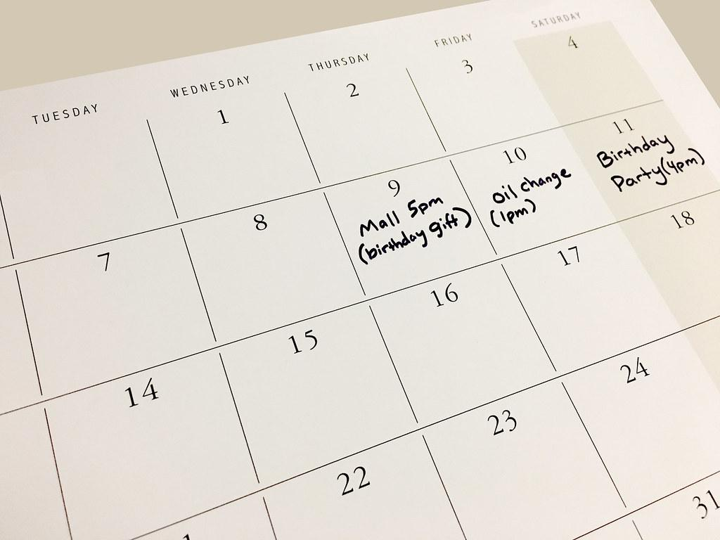
Schedule Depends on Numerous Things
Who is collecting the data?
How often do you need the information?
How often is the skill being addressed?
Where is the data being collected?
What is best practice?
Why do we need to actually make a schedule for data collection?
Should we keep track of this somehow? Why?
Notes:
Data collection must be scheduled prior to instruction. This makes the data collection a part of the daily or weekly process within the instructional plan. There also has to be an opportunity for instruction on the skill between data collection times.
When planning, know that taking data once per week is ideal, but sometimes there are goals that the data collection would need to be less often.
It takes at least six data points to establish a good trend line.

Slide 69
Schedule When to Collect Data
Set up Specific Times
How will you have time for this?
  Build it into your schedule
  Schedule “data time” for both you and the support staff
Have a Plan
How many data points are required to determine progress (or lack thereof)?
Train support staff on the data collection process.

Slide 70
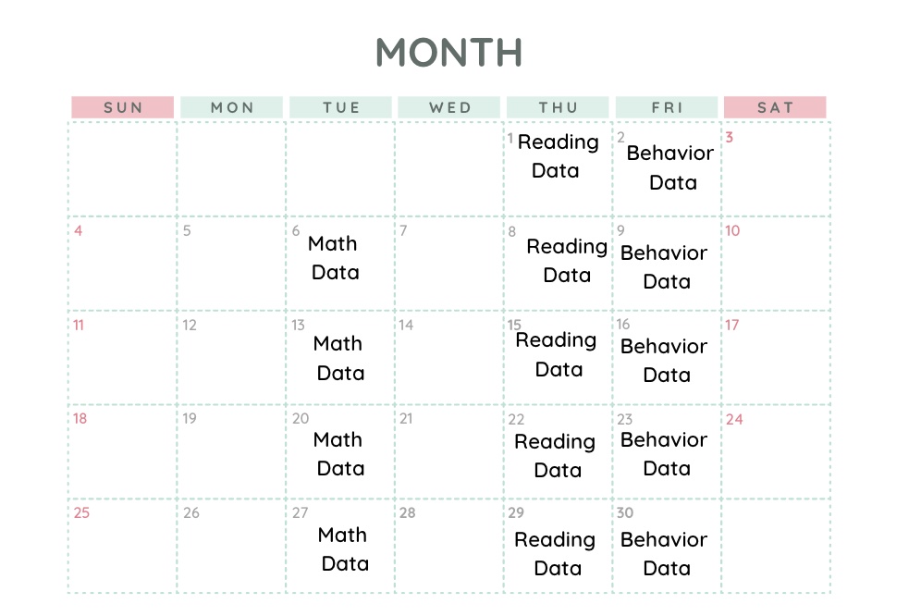
Data Schedule Example
Notes:
One way to build a schedule is to collect a specific type of data on a given day of the week.
Another option is to focus on data collection with specific students on a given day.

Slide 71
Schedule
By the end of the IEP cycle, Claire will increase her oral reading fluency rate of an on grade level passage from 60 words per minute to 110 words per minute on three consecutive oral reading probes.
What type of schedule could you set up for collection data on this goal?
Notes:
What type of schedule could you set up for collecting data on this goal?
Remember to allow instructional opportunities between data collection periods.
It is suggested that you have practice on reading fluency every day. This is a skill with practices that doesn’t take a lot of time. Instruction should include both hot and cold reads. Then data could likely be collected every two weeks on the same day of the week (i.e., every Thursday).

Slide 72

Tools and Schedule – What to Use
When asked to write about a specific topic, Sally will write an introductory sentence; four sentences with details about the topic and a concluding sentence with no more than one organizational error on three out of four opportunities.
What tools could you use to collect data for this goal?
What type of schedule could you set up to collect data for this goal?
Notes:
Tools: Writing rubric, actual paper student wrote and a score of number correct out of six. The score would directly relate to any organizational errors within the writing.
Schedule: When do classes write essays? Can you contrive this data? Could you give teachers a folder for this student and ask them to provide you with a copy (or could they scan to you) of any essay writing the student does? How else might you gather the data?

Slide 73
Tools and Schedule – What to Use
Within the classroom, Joey will reduce the amount of time it takes him to initiate a requested task from more than five minutes to less than one minute with one verbal prompt on six out of eight consecutive data gathering opportunities.
What tools could you use to collect data for this goal?
What type of schedule could you set up to collect data for this goal?
Notes:
Using a latency data collection tool is the best option for this goal. The target is to reduce the amount of time it takes Joey to initiate a requested task.
What schedule would you set up to collect data on this goal?

Slide 74
Data Organization Isn’t One-Size-Fits-All
There are many ways individuals can organize their data. This is not a one-size-fits-all requirement. Build a system that works for you.
X
Notes:
It is important to have an organization system for collecting data and storing data. Talk with your shoulder partner about options related to organization.

Slide 75
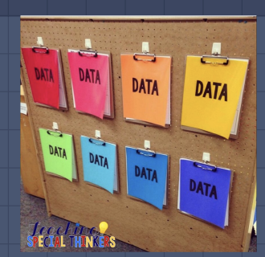
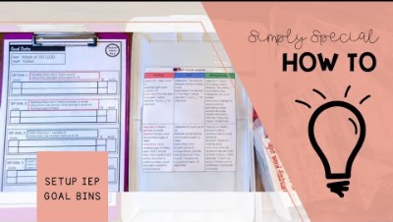

Data Organization Options
Notes:
How to apply to high school? Check to make sure it will apply.
Color Coding Bins and/or Clipboards
YouTube Video - How to create bins for organization - 3:25 minutes https://www.youtube.com/watch?v=GzCo4I42iuo&t=16s
Pros: Easy for support staff, generally easy access to materials, color coding can go past just data (schedules, class materials, etc).
Cons: You have to keep track of paper copies, you will have to still transfer the. paper copies to digital.

Slide 76
Step 4: Analyzing the Data

Slide 77
What Does the Data Tell You?
Data analysis helps determine if the student is making progress, and/or responding to the intervention
Decision rules should be applied when analyzing data (e.g., four consecutive or four out of six below the aimline).
  Do you have these? What are they?
Notes:
Discuss each of these bullets.
Why collect the data if we’re not going to use it? This is the first step in the ‘use’ of the data.

Slide 78
Example of Decision Protocol
Based on three most recent consecutive scores
If scores are above the goal-line, continue with instruction as currently doing
If scores are below the goal-line, student instructional program needs to be revised
Trend lines are also important
  Is progress closing the gap?
Notes:
Make sure your team all agree on this process and the decision protocol you use.

Slide 79
Data Analysis Terms
Goal or Aimline: Expected rate for growth
Trendline: A straight line drawn on a graph from the baseline data point to the ending data point within a phase based on the Rate of Improvement (ROI).
NOTE: Most programs will calculate the trendline for you!
Intervention Central/Chart Dog
Intervention Central/Chart Dog
Notes:
Review the content on this slide to define and explain terms.
Chart Dog on Intervention Central is a free option to help track data and include both the Aimline and the Trendline/Rate of Improvement for the student.

Slide 80
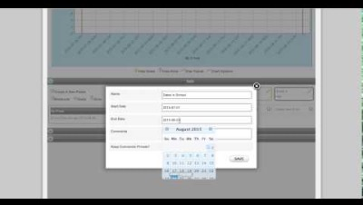
Chart Dog Tutorial
Notes:
Video 8:50 – Click on the screen and hit the play button.
This is worth the time in order to really explain how data should be taken and how to use the tool.
This is a tutorial on how to use Chart Dog, a free online data collection tool.
This can be found on the Padlet and is part of the Intervention Central website.
It does require you to create an account but there is no cost for the account.
This option is free and will also include a trendline for you.

Slide 81
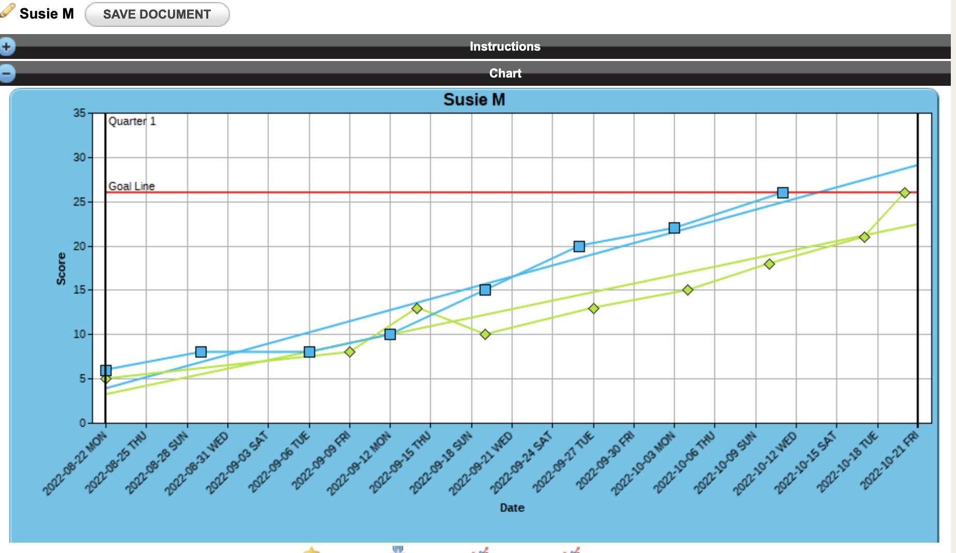
Chart Dog Example (Intervention Central)
Notes:
The title on this slide is a link to Chart Dog. You might want to go to this website to demonstrate how to create the chart and add the trendline.

Slide 82
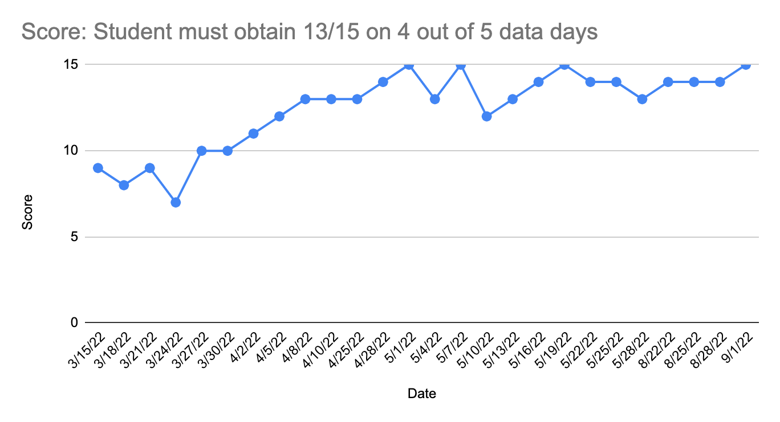
Example Data
Goal Line
Trendline
Baseline
Notes:
This example is drawn in Google Sheets which is another option to track data.
The black line shows when the goal was met.
Define baseline, trendline, change line. etc. Maybe use Loom to create a video of this information.
What if you get a goal that you don’t have baseline data (a transfer student)?
We need more examples of the data graphed, etc.

Slide 83
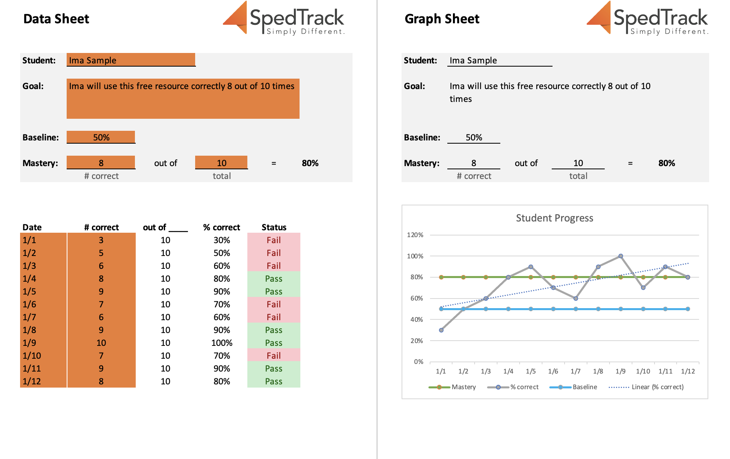
IEP Goal Process
Intervention Central/Chart Dog
Notes:
If you happen to have SpedTrack and use the progress monitoring module in the program, it will look like this. You enter the data points and the system will create the graphs.
Goalbook is another example of a program that can help with this process.
Does anyone have another program they use to help support their data collection and analysis for progress monitoring?

Slide 84
Step 5: Instructional Decisions

Slide 85
Making Instructional Decisions
Data collection provides information used to drive instruction.
Student progress is considered in relationship to each goal or expected outcome.
Instruction should either change or stay the same based on the data.
Iris Center - Progress Monitoring
Notes:
This is where the rubber meets the road and is the most important part of data collection!

Slide 86
Using Data to Make Decisions
Are your students involved in looking at the data about their own progress?
Planned
Systematic
Multiple sources
Routinely
used
On-going
Notes:
This is the continuous cycle to be completed over and over.
Data collection should be planned and systematic
Data collection processes should be routinely used
Data collection must be on-going
Data collection can include multiple sources of data
Students will work to progress at a faster rate when they are directly involved in tracking their own data or at least monitoring the progress they make.

Slide 87
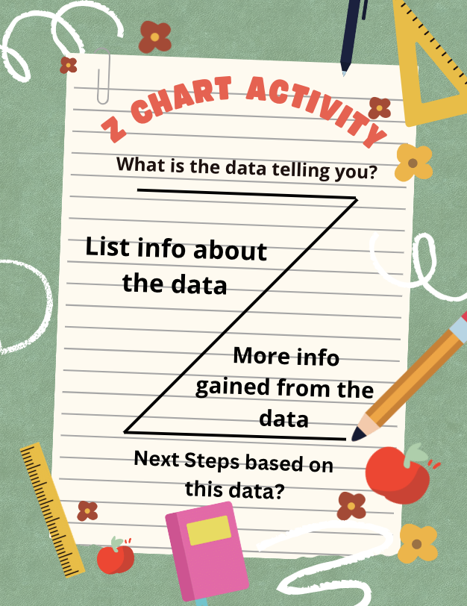
Analyze Data Activity
Trendline
Baseline
Notes:
Activity
Use chart paper for each group to create a Z chart
This activity should allow attendees to process the information noted in this data
What is the data telling you
What are the next steps for the student

Slide 88
Step 6: Reporting IEP Progress

Slide 89

Progress Monitoring vs. Progress Reporting
Progress monitoring and progress reporting are distinctly different, but related activities.
Notes:
Progress monitoring - taking consistent data over time to monitor student growth (or lack thereof).
Progress reporting is sharing student progress with parents/guardians/caregivers and others on a schedule as determined by the IEP team and at least as frequent as general education grades are reported.

Slide 90
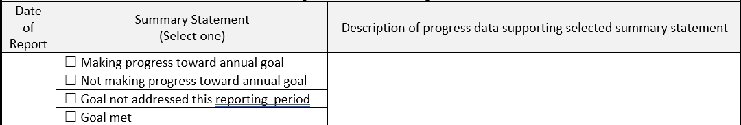
Progress Reporting Requirements in Missouri
How progress on goals will be measured
When progress on goals will be reported to parents
The content of the progress report includes the progress toward the annual goal
  Best practice is to include a description of that progress
Notes:
The Standards and Indicators give us the requirements for Progress Reporting within IEP’s. This progress reporting is based on our progress monitoring data. We are required to report how progress will be measured, when progress will be reported to parents, and a description of the progress toward the annual goal. Putting a checkmark in a box is not generally sufficient to adequately describe the amount of progress students are making.
Adequate descriptions of this progress help us make the decisions we need to make at each annual IEP meeting.

Slide 91
Making Decisions at IEP Time
Four aspects should be considered
  Progress
    Did the student make the progress expected by the IEP team? (criteria)
  Comparison to Peers or Standards
    How does the student’s performance compare with the performance of general education students?
  Independence
    Is the student more independent in the goal area?
  Goal Status
    Will work in the goal be continued?
    Will student be dismissed from this goal area?
Iris Center
Notes:
In reporting progress for our students, we have to consider these aspects:
Did the student make the progress expected by the IEP team? What is the students criteria on each goal?
How does the student’s data outcomes compare to her same age peers?
What are your recommendations regarding this goal? Should he/she continue work on this goal? Should the criteria be increased or is the student ready to advance to a higher level skill?
How close is the student to working on grade level standards?
When these decisions are considered, are they discussed among team members? What is your current method of looking at data for your special education students?

Slide 92
Let’s Practice

Slide 93
“We Do” Practice Item
Within the classroom, Joey will reduce the amount of time it takes him to initiate a requested task from more than five minutes to less than one minute with one verbal prompt.
  Type of data—observational data
  Where collected—within the classroom (special education or general education)
  How often collected—three times per week, three times per day for 40 minutes. four weeks; what would you recommend for the frequency of collection?
  Who will collect– one of those days will be done in the special education setting, other two days will be done in general education setting. The special education teacher is to provide data sheet to the general education teacher
  When reviewed– end of each week to determine if strategies being taught are working
Notes:
A gradual release of instructional responsibility is a model used for teaching that can be used with your students. Follow the model.
I do
We do
You do
This is the “we do” part of this model. I have included some suggestions, would you add other options for this process in setting up the progress monitoring for Joey?

Slide 94
IEP Goal Example – Group Activity
HO #10
In your groups, use the goal examples provided to answer the following questions. Be prepared to share out.
What type of data will be collected?
Where will the data be collected?
How often will it be collected and why would you choose that schedule?
Who will collect the data?
How often will the collected data be reviewed?
If the student is not making the expected progress, what will need to happen?
Notes:
HO #10 – IEP Goal Example - Activity
Provide the copies of the goals to each group and assign each group one or two of them to work on.
Also, provide HO #7, Plan for Data Collection Handout for use during this activity.
Refer to the goals on the following slides as each group shares out.

Slide 95
Example #1
Given math problems involving fractions with like and unlike denominators, Peter will correctly solve at least half of the problems on six out of seven data
gathering opportunities.
Notes:
Goal written this way = data collection via math assignments that cycle back to previously taught skills. This could also facilitate contriving this type of math problem to purposely measure this goal.

Slide 96
Example #2
Given between five to ten vocabulary words from a content class and a Frayer Model template that he has completed for each word, Fred will use those words correctly when answering questions about the topic orally with an adult on six out of eight data gathering opportunities.

Slide 97
Example #3
When faced with an assignment or a situation in which Jeremy is unsure what is required or what he is to do, he will ask for help from an adult or a peer who can give him directions on at least half of the opportunities presented on five consecutive data gathering opportunities.

Slide 98
Example #4
When asked to write an explantory paragraph about a topic, Sarah will use textual evidence to support her ideas as measured at a three or better on a scoring rubric on at least 75 percent of the opportunities provided.

Slide 99
Example #5
When presented with ten addition and subtraction problems with mixed numbers, Joe will change the mixed numbers to an improper fraction and solve the problems with 90 percent accuracy on four out of five consecutive data collection opportunities.

Slide 100
Setting It Up
IEP Goal Activity
Notes:
This will allow those in attendance to use their own goals and start setting up a system to use.
Pull out your IEP Goals.
Review the goal and make sure it is measuring one specific skill.
Determine the progress monitoring method to use.
Be ready to set up the system for your student.

Slide 101

Notes:
Make sure all questions they turned in have been answered here.
1. Type of data to collect for math calculation goals…calculator question
2. How do you collect data for a baseline when district doesn’t have a universal screener tool?
3. What should go into a math present level? If in resource class, how do you tie in general education curriculum into present level. Examples…(I will create this…)
4. When you say four out of five data days is that five days a week, an IEP period, a month, a quarter?
5. When you are taking data for a large amount of students that are all task related behaviors, what would be a good example of how to do that?

