Slide 1
FAM
SEPTEMBER 2023
MONTHLY FINE ARTS MEETINGS with DR FRANKS
Kendra Franks, Ph.D.
Director of Fine Arts
Department of Elementary & Secondary Education
Kendra.franks@dese.mo.gov
573-751-9610

Slide 2
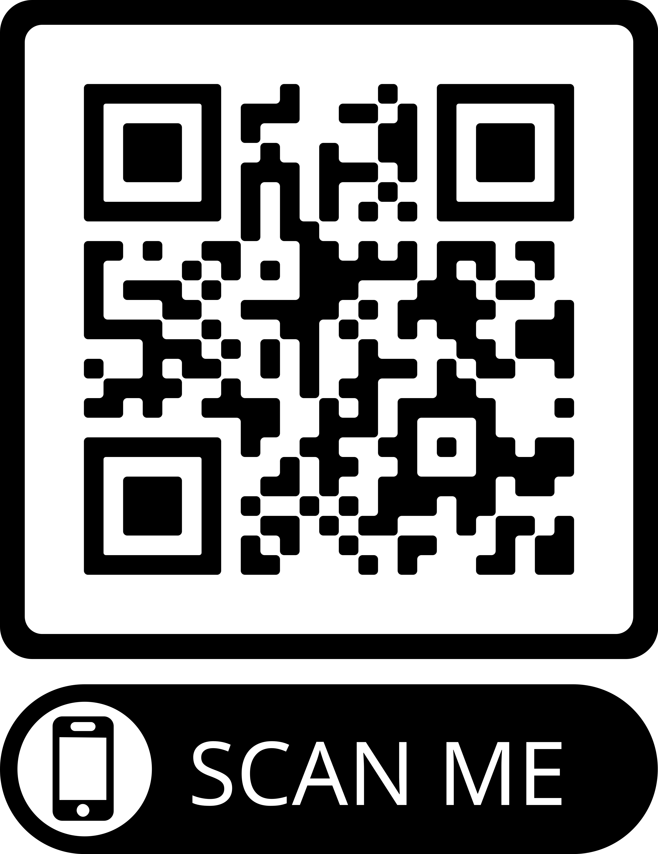
Dates of fam meetings
Sept. 27th
Oct. 25th
Nov. 29th
Jan.31st, 2024
Feb. 28th
Mar. 27th
Apr.24th
FAM files in google drive with art and music
Standards and scope pages
https://drive.google.com/drive/folders/1jGBJlrpXlN5Z0FsqqL7Of1CkkwLM7J7W?usp=drive_link

Slide 3
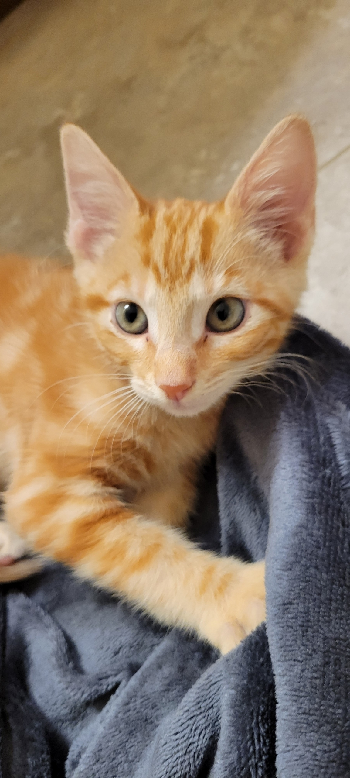
Newest member of the Franks FAM:
“TONY”

Slide 4
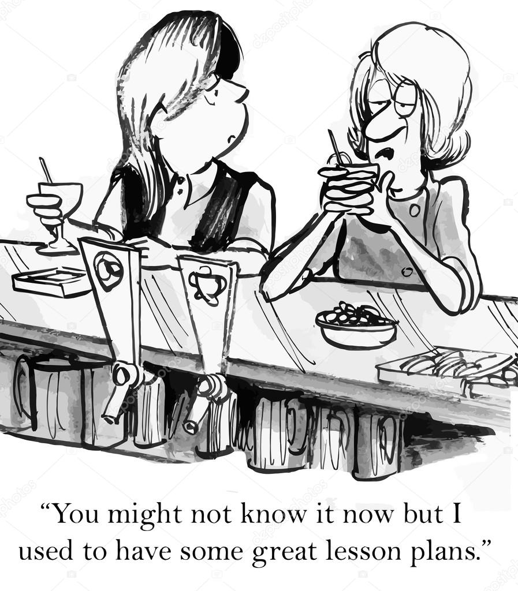
LESSON PLANS
Guided by standards
Framed by curriculum
Influenced by setting

Slide 5
STANDARDS
How to think about the Fine Arts Standards…
The standards…are a guideline…not a checklist…to ensure that our teaching and student learning is not one dimensional.
Our students should experience learning AND demonstrate learning through and by the 4 Strands of…
CREATE – PERFORM/PRODUCE/PRESENT – RESPOND – CONNECT

Slide 6
Sometimes we’re always making sure
students produce something but forget
to include opportunities for them to
Create something; or connect what they
made with history or culture; or reflect
about what they made and respond about
how it makes them feel.
Sometimes we may get to December and realize that our students have done a lot in the purple and blue Strands of Produce and Create, but they haven’t done much in the orange and yellow Strands of Respond and Connect.
The Fine Art standards remind us that students should receive instruction in different
Ways and demonstrate their understanding of learning in different ways.
What students learn is determined by you—the expert. The standards do not outline
The key concepts and skills or the units & projects.
You, the expert, decide that. Hopefully, you AND your colleagues collaborate together
To align units, concepts, and skills across grade levels.

Slide 7

JOURNAL…
Take a moment to journal a question or thought. We will circle back here in a moment…

Slide 8
CURRICULUM
Curriculum describes the totality of experiences a student will have in learning.
It communicates clear expectations for what ought to be achieved by an end-point.
A good curriculum will also connect teachers across the school, so they can plan together, which allows them to think long-term and foster student development across the key stages and across the subject disciplines.
“I can do things you cannot,
you can do things I cannot;
together we can do great things.”
Mother Theresa
Taken from Kelly, A.V. (2009). The Curriculum: theory and practice (6th ed.) p. 13. & Wiles, Jon (2008). Leading Curriculum Development. p. 2.

Slide 9
STANDARDS & CURRICULUM
STANDARDS
CURRICULUM
Established at the state level to provide a foundation for school districts to develop their own curriculum for their setting.
Links the school’s beliefs and expectations for learning
So we have a cyclical process going on here where each inform the other.

Slide 10
CURRICULUM…CONT…
Key concepts & skills - (lean on your own training and sharing with colleagues)
Circular & spiraling
Coordinated & Collaborative
K - 12
“Repetition is your friend…”
By K. Franks
Students should be experiencing art at all grade levels.

Slide 11

QUESTIONS…
What are your school’s curricular goals?
What are your Art/Music classes’ curricular goals?
What are key concepts for your grade level classes?
What are key skills for your grade level classes?
How do the 4 Strands shape your curriculum?
How do the 4 Strands inform your lesson plans?

Slide 12
Lesson plans
Every school has a different format and expectations.
Some want to see details while others want highlights.
We will focus another PD session on LP specifics.
But…there is a template that can be used to get LP’s, or Units, or curriculum goals aligned with the Standards.
Maybe it can be a starter to get you going, or maybe it can be a way to describe to parents or admin. more easily.

Slide 13
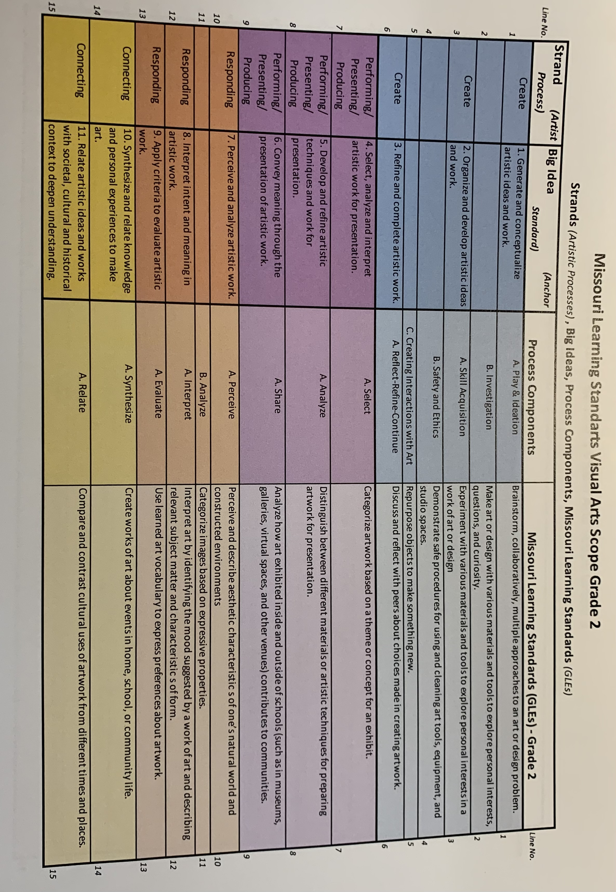

Slide 14
ALL K – 12 ART STUDENTS IN EVERY CLASS EACH SCHOOL YEAR SHOULD…
Play and imaginatively think of multiple ideas for a creative endeavor.
Investigate different ways to convey an art idea.
Create and develop their own artwork.
Collaborate with others in making art.
Gain skills in making different kinds of art.
Know safety with art materials.
Synthesize how to develop their ideas to produce art.
Connect art with society and culture.
Relate their perception of art with human experience.
Interpret art they observe in comparison with other art.
Evaluate art they observe based upon a criteria.
Select artworks for presentation.
Share reasons why an art exhibition is presented in the way it is.
Explain how art influences their audience.
Share the meaning of their personal view of art with others.

Slide 15
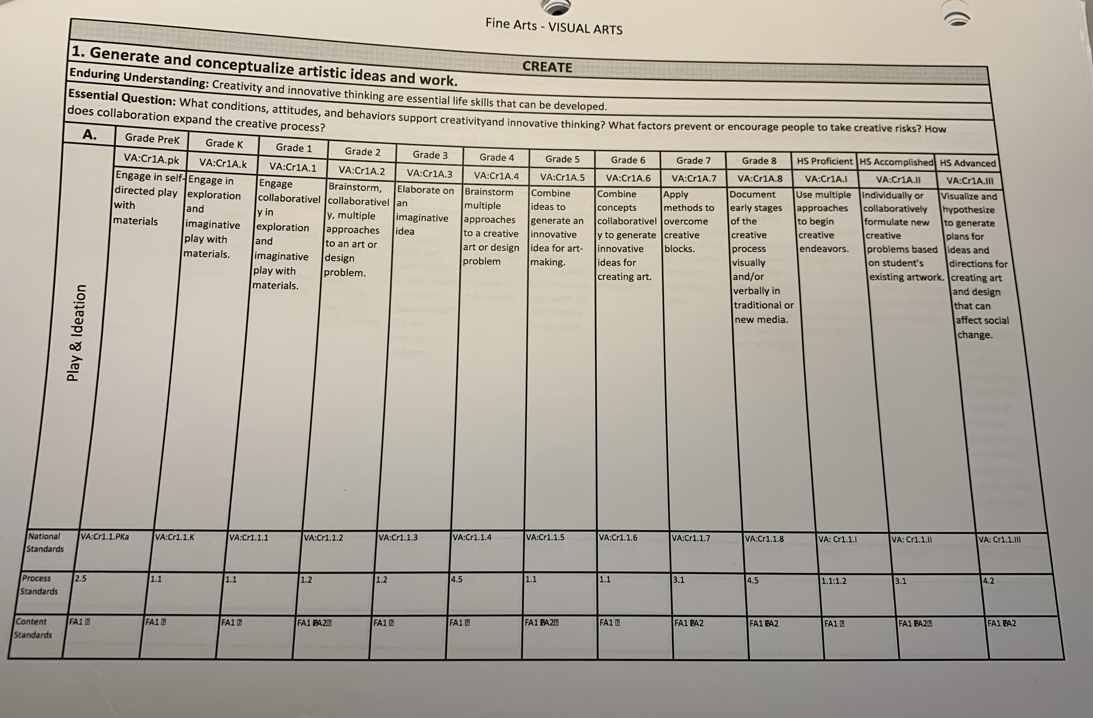
BIG IDEA
STRAND
PHILOSOPHY
GLE’S
Grade Level Expectations
Process Component

Slide 16
(Grade) (Subject)
(GLE)
(GLE cont…)
(Process Component)
(Big Idea)
(Big Idea cont…)
(Strand)

Slide 17
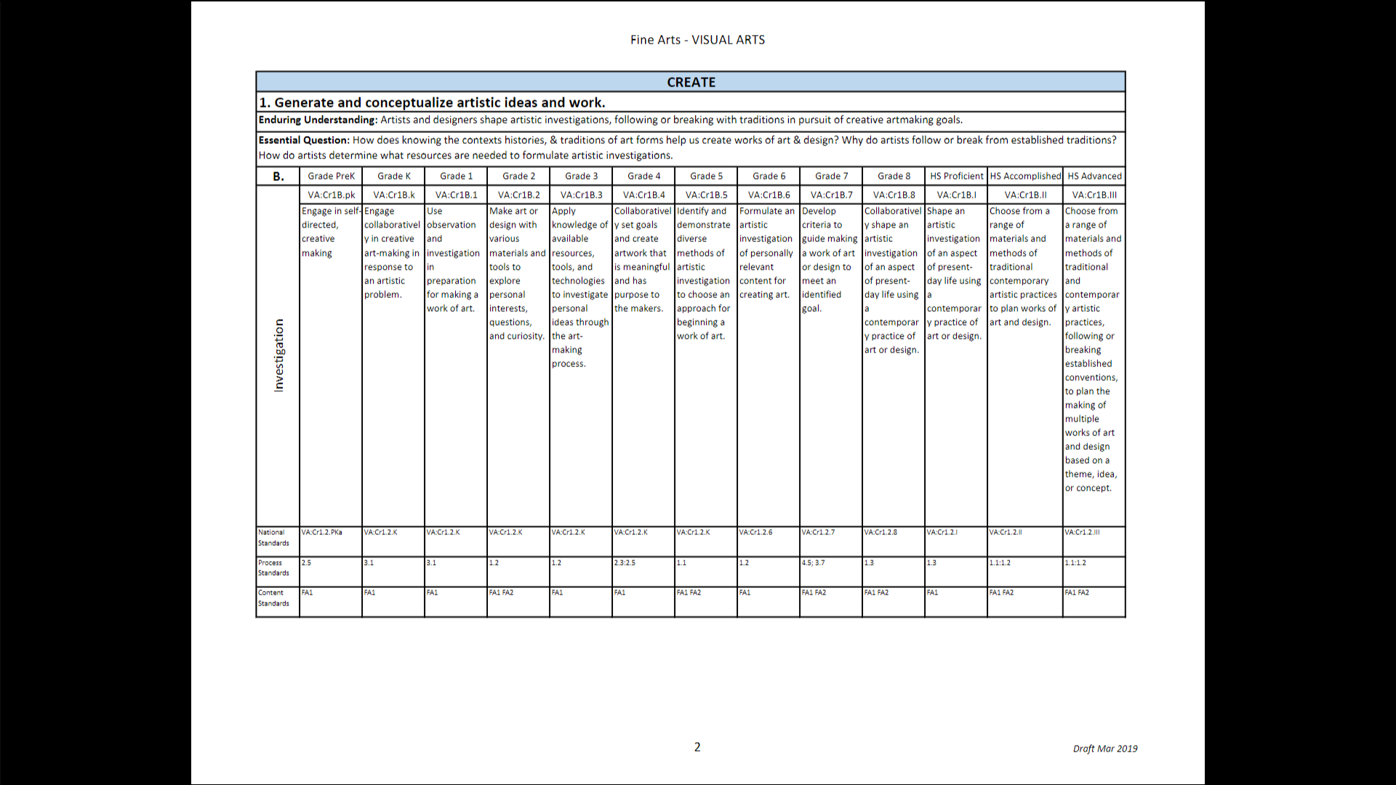

Slide 18
VA:Cr1B.2
2nd Grade Art
Make art with various materials
And tools to explore personal interest
Investigation
Generate artistic ideas - through the flower project in the
Unit on Colors*
Create
*Students will demonstrate their understanding of warm and cool colors as they create
their flowers; S W experiment with sculpture’s clay, markers, art sticks, and thin paper petals.

Slide 19
It may be that your school’s art curriculum has particular Units or Key skills they want covered for certain grades.
It may be that your school wants you to indicate SEL standards that occur in this lesson.
Or, indicate how this fits within the Standards-based learning objectives, etc.
This would be a good place to reference those.

Slide 20
HELPFUL HINTS…
Big picture
Longer time frame
Some lesson plans or projects might connect with multiple GLE’s and Strands – but they may not.
Larger, overall Units or curriculum might connect with multiple GLE’s and Strands – but they may not.
But…over the time frame of the school year…all 4 Strands should be included in your teaching plans.
Over the course of the year, can students also demonstrate their comprehension by creating? By responding? By connecting? And by presenting/producing?

Slide 21
HELPFUL HINTS…cont…
Every GLE does not have to be used for every grade level and class.
But…over the course of a K – 5 art curriculum…all 4 Strands should be connected to…and the “intention” of every GLE should be covered.
A coordinated and collaborative curriculum across grade levels is beneficial.
The beauty of the Art standards are that the teachers may vary in their lesson plans and units they use but still achieve a common curricular goal.

Slide 22
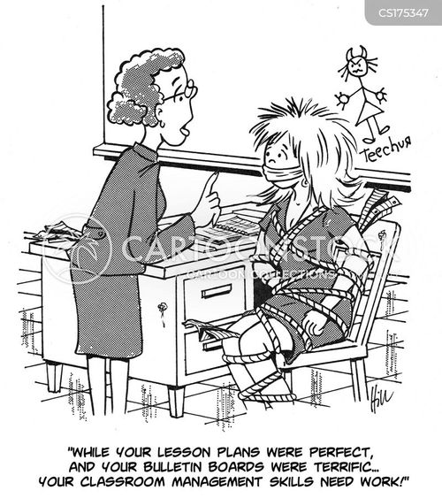
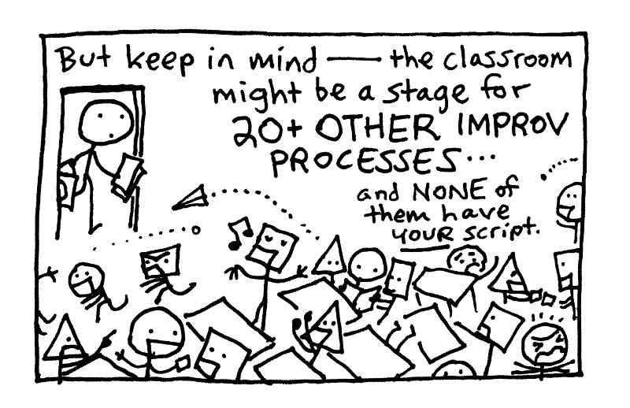
FUTURE TOPICS…

Slide 23
FAM
SEPTEMBER 2023
SEE YOU AT THE NEXT FAM MTG ON OCTOBER 25TH AT 3:30PM!
MONTHLY FINE ARTS MEETINGS with DR FRANKS
Kendra Franks, Ph.D.
Director of Fine Arts
Department of Elementary & Secondary Education
Kendra.franks@dese.mo.gov
573-751-9610

