Slide 1
Evaluations and Assessments
Tiffiney Smith
Amy Phipps
October 5, 2023

Slide 2
Connecting The Dots
Current Reality
Defining a Comprehensive Evaluation
Golden Thread
Setting the Stage for Comprehensive Evaluations
Guiding Principles for Assessment Practices
Making Appropriate Eligibility Determinations
Evaluation Report Writing: Helpful Hints
DESE Assessment Myth of the Month

Slide 3
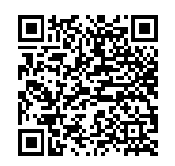
Scan for Resource Folder

Slide 4
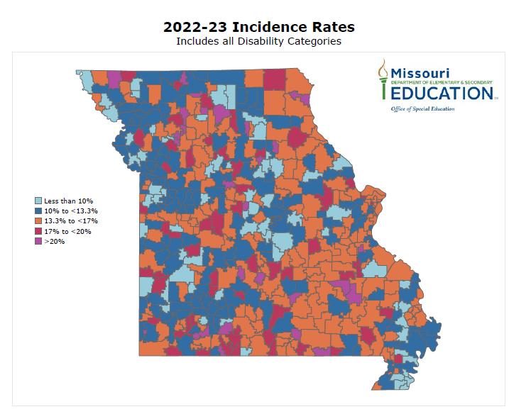

Slide 5
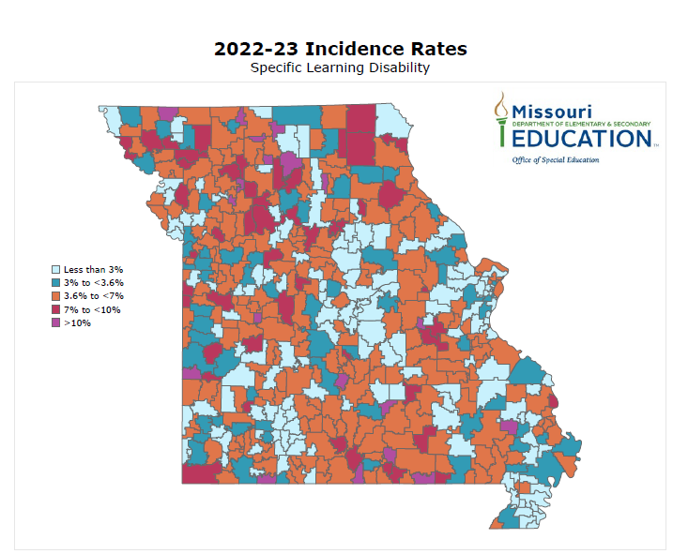

Slide 6
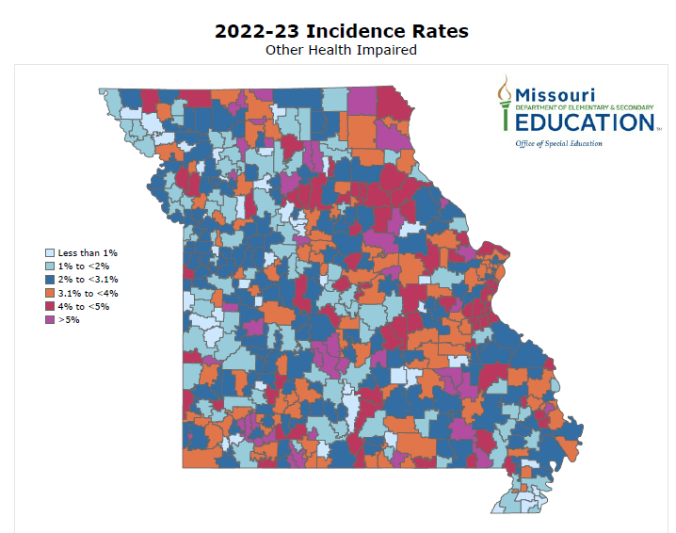

Slide 7
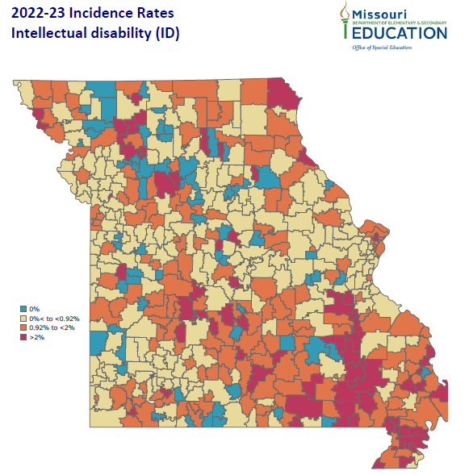

Slide 8
Current Reality
Where do you currently stand with your incidence rates?
Can you identify any patterns or trends?

Slide 9
What is a Comprehensive Evaluation?
Comprehensive Evaluation: The Individuals with Disabilities Education Act (IDEA) requires that special education evaluations be sufficiently comprehensive to identify all of the student’s disability-related educational needs, whether or not commonly linked to the disability category in which the student has been classified. (34 CFR 300.304).

Slide 10
C
Comprehensive Evaluations

Slide 11
Purpose of A Comprehensive Evaluation
Comprehensive evaluations under IDEA serve a dual purpose
Remember: Evaluation=D²
Determine eligibility under IDEA
Describe (in detail) the educational needs of the student which is necessary to direct educational decision making

Slide 12
Changing Mindsets About Evaluations
By focusing the evaluation process on exploring individual student “needs” rather than primarily on “labeling” the IEP team is better able to make the ultimate evaluation decision as to whether the student needs special education services as a result of a disability.
Disability category labels fail to capture an individual’s unique strengths, assets, and abilities, nor do they adequately describe the extent of a student's needs.
When teams use a “needs” (vs. label) focus throughout the evaluation process it leads to the collection of valid and reliable (i.e. accurate) information about the student and their specific needs related to instruction, services, accommodations and supports.
Comprehensive Special Education Evaluations, Wisconsin Department of Education

Slide 13
Changing Mindsets: Balanced Questioning
Comprehensive Evaluations (Need Based) | Disability Category Evaluation (Label Focused
Initial: What concerns are noted in the referral? What IEP team members should be assigned to learn more about this student? What expertise is likely to be needed? | Initial: What disability category fits the referral concerns? What individuals generally serve on the IEP team for this category of disability?

Slide 14
Changing Mindsets: Balanced Questioning
Comprehensive Evaluations (Need Based) | Disability Category Evaluation (Label Focused
Reevaluation: Is there information the IEP team needs to help us better understand the student’s disability related needs or changing needs since the student was last evaluated? Does the IEP team need to conduct a reevaluation because additional information other than IEP progress monitoring data, general education assessments, etc. is needed to determine the student’s needs? What IEP team members should be assigned to the reevaluation to collect data to identify student specific needs? | Reevaluation: Should the IEP team waiver the reevaluation because they know the student will continue to qualify in their disability category? Should the IEP team conduct a reevaluation without assessment to make sure the student continues to qualify for the student’s disability category? Does the IEP team need a reevaluation because they need to add another disability category or change disability categories?

Slide 15
Changing Mindsets: Balanced Approach
Teams should aim for a balance of determining eligibility and determining student specific needs
When the evaluation process is driven by the need to “find a magic number or test score” for eligibility purposes, teams often fail to identify student specific needs necessary for developing appropriate educational programming.
Comprehensive Special Education Evaluations, Wisconsin Department of Education

Slide 16
Setting the Stage for Evaluations
Evaluations must be driven by the referral concerns
Referral RED Evaluation

Slide 17
Golden Thread
Referral Concerns
Review of Existing Data
Evaluation
Eligibility Determination
IEP

Slide 18
High Cost of Not Getting It Right
Disability “labeling” life long consequences
Lower academic expectations
Lower achievement
Fewer post secondary options
“Blessing their Heart” with an inaccurate disability determination may seem like a win but, more often than not, it does more harm than good

Slide 19
Assessment Practices

Slide 20
Identity Crisis
Sophia
12 year old female
85 FSIQ
SS 75 Letter Word Identification
What does this really tell us about Sophia?

Slide 21
Caution
All tests have limitations
All tests contain bias
All tests contain measurement error
Test scores alone do not tell us all we need to know about a student

Slide 22
IDEA Evaluation Requirements
No single measure or assessment is used as the sole criterion for determining eligibility and educational programming for a student.
Assessment is conducted in all areas related to the suspected disability.
The evaluation is sufficiently comprehensive to identify all the student’s special education and related services needs.
A variety of assessment tools and strategies are used to gather relevant information to determine educational needs of the student.
Technically sound instruments are used.
Assessments must be conducted by trained and knowledgeable assessment staff.
34 CFR 300.304 and Missouri State Plan for Special Education Regulation III

Slide 23
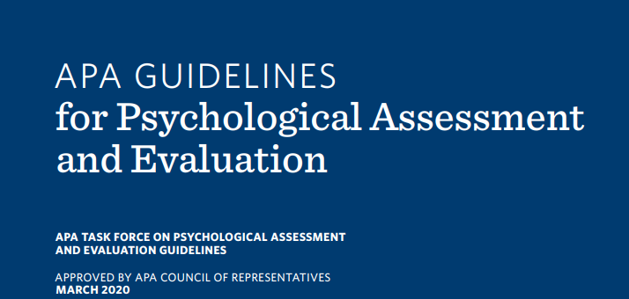
Evaluation and Testing Standards of Practice
Code of Fair Testing Practices in Education
APA Guidelines for Psychological Assessment and Evaluation
Standards for Educational and Psychological Testing

Slide 24
Selecting Assessment Tools
Individualized assessment tools
Norm Referenced tests
Criterion Referenced tests
Observations
Interviews
Medical record review and analysis
Assessment selection is thoughtful, intentional and inquiry driven based on the unique needs of the student
What areas of concerns and needs did the team identify during the referral and RED process?
What questions do you want answered? (3 types of questions: disability, solution, present level)
What specific data do you need to answer those questions?
Does the assessment assist in answering the questions or address concerns brought forward in the referral and RED process?

Slide 25
Selecting Assessment Tools: Selective Evaluation Process
Comprehensive evaluation does not necessarily mean giving the entire battery of a norm referenced test
Data collected during the RED and referral process should drive the selection of assessment tools
Avoid over testing by clearly identifying the necessary and relevant data that needs to be collected to address the individualized student concerns and to provide actionable guidance for instruction

Slide 26
Qualifications of Assessment Users
Qualified assessment users must demonstrate appropriate education, training, and experience in using tests and measurements
Assessment users should posses a deep understanding of the assessment tool, as well as, a high level of skill administering them
Qualifications for test administrators are set forth by test publishers (not DESE), based on professional standards
Staff should not administer assessments for which they are not qualified to administer

Slide 27
Qualification Guidelines
Pearson’s Qualifications Policy
The "Qualified User" is the individual who assumes responsibility for all aspects of appropriate test use, including administration, scoring, interpretation, and application of results. Some tests may be administered or scored by individuals with less training, as long as they are under the supervision of a Qualified User. To assist the qualified user, each test manual will provide additional detail on administration, scoring and/or interpretation requirements and options for the particular test.

Slide 28
Qualifications of Assessment Users
Qualification “B”: Masters, formal training on assessment of children
Woodcock Johnson IV Achievement (WJ IV ACH)
Wechsler Individual Achievement Test IV (WIAT 4)
Vineland 3
Qualification “C”: Doctorate, or Licensed Psychologist, Psychological Examiner
Wechsler Intelligence Scale for Children V (WISC V)
Stanford-Binet Test Fifth Edition (SB5)
Woodcock Johnson Cognitive IV (WJ COG IV)

Slide 29
Technical Knowledge
When should we update our tests to the newest edition?
In order for tests to retain their validity and reliability it is important for the most current editions of the assessments to be used. While there is no clear rule regarding the time frame required to transition to the newest edition of a test, there is a “community standard” or professional consensus that you should switch to the newer test edition within one year of publication. (Pearson, When to Upgrade to the Newest Revision of a Test)

Slide 30
Technical Knowledge
*** New DESE Update***
When should we update our tests to the newest edition?
DESE guidance: Districts should switch to the newer edition of an assessment within 2 years of publication
This will be monitored during future desk reviews

Slide 31
Technical Knowledge
Do our examiners know what specific tests measure and how to use resources available to inform and explain the results?
Review the test manual for information related to:
Task complexity charts
Task demand charts
Input, Process, and Output demand charts
Constructs assessed and how they are assessed
Adaptive behaviors vs maladaptive behaviors
Reading (cipher knowledge vs reading outcome)
Broad and narrow abilities of intelligence (CHC)
Reading comprehension

Slide 32
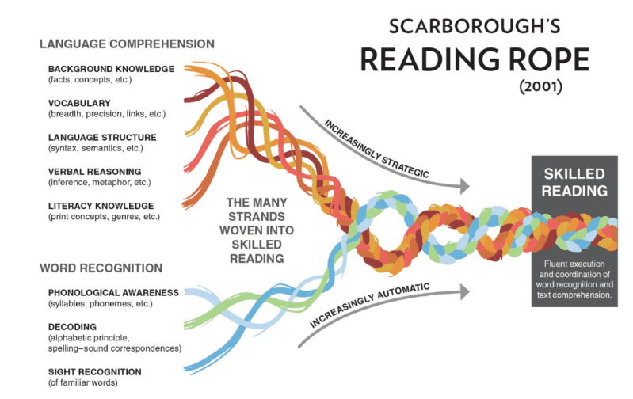
A Word About Reading Comprehension Tests

Slide 33
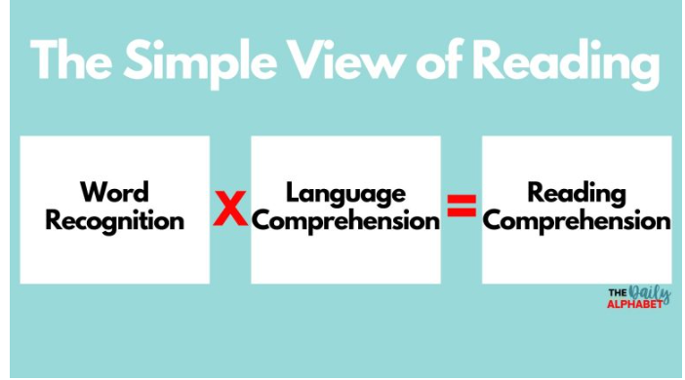
A Word About Reading Comprehension Tests

Slide 34
A Word About Reading Comprehension Tests

Slide 35
A Word About Reading Comprehension Tests
Reading Comprehension is an “end product” or a result of the execution of multiple operations and skills
Language skills
Vocabulary
Syntactical (grammar) knowledge
Background knowledge
Decoding skills
Cognitive skills
Attention
Working memory
Visual perceptual skills

Slide 36
A Word About Reading Comprehension Tests
Assessments of reading comprehension have limitations
Cloze vs answering questions
Sentences vs paragraph
Different reading comprehension test formats do not measure the same construct in the same way.
Best practice in reading comprehension assessment involves multiple subtests and the assessment of key skills that underlie reading comprehension and general language comprehension
“Any score from a standardized reading comprehension test can not possibly provide the information needed to understand “why” a student struggles in understanding what is read.”
David Kilpatrick, Assessing, Preventing and Overcoming Reading Difficulties,2015

Slide 37
Assessment Administration
Follow ALL standardized testing procedures to maintain validity of test results
Starting points, basals, ceilings, practice items
Following directions “with precision”
Queries and prompts
Time limits
Materials
Breaks and number of testing sessions
Order of administration
Use of manipulatives and required technology for administration
Feedback
If any non-standardized assessment procedures are used then they MUST be described in evaluation report.
Know thy manual!!!!

Slide 38
Assessment Administration
Non-standard Administration Guidance:
Any scores obtained from non-standard administration of an assessment should be used primarily for descriptive, informative purposes.
The evaluator must recognize and document that the scores cannot be interpreted because the scores obtained are inaccurate and misleading.
Any scores reported must be clearly identified as estimated scores and should be reviewed with extreme caution.

Slide 39
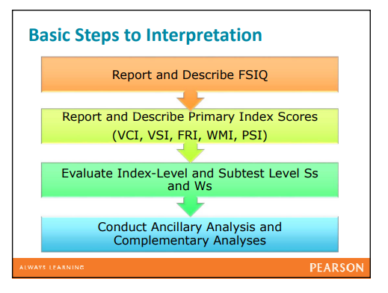
Interpreting Assessment Results
Important to interpret all levels of assessment scores
Look for patterns, trends and discrepancies between scores
WISC V, Interpretation Guidance, Pearson

Slide 40
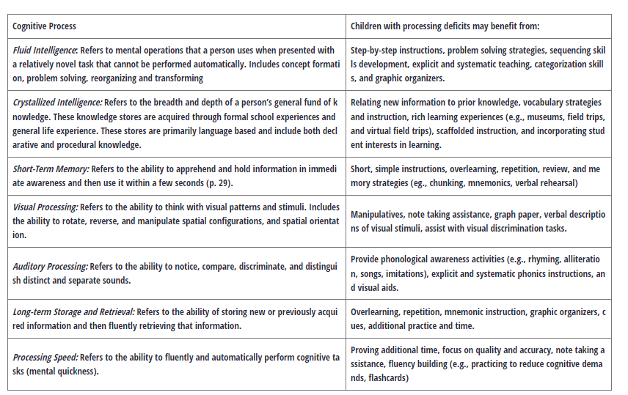
Interpreting Assessment Results
Connecting Cognitive Process to Instruction

Slide 41
Connecting Cognitive Processes to Instruction
Cognitive Functioning and Psychological Processing Impact On Instruction (Georgia Department of Education)
Cognitive Functioning and Psychological Processing Guidance Document (Idaho)
WJ IV Interpretation and Instructional Interventions Program™
Pearson Dyslexia Toolkit Whitepaper

Slide 42
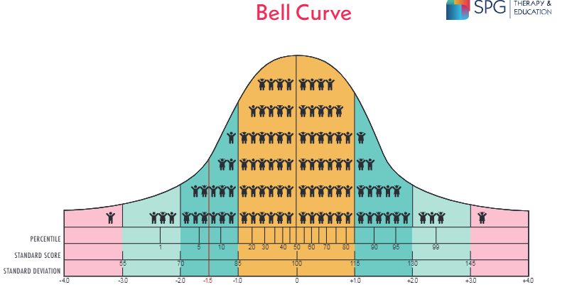
Interpreting Assessment Results
Norm-referenced tests compare one student’s performance to the performance of others in the norm group. The most common types of scores included in evaluation reports:
Standard Scores
Scaled Scores
T Scores
Percentile Ranks
Standard Error of Measurement
Glossary of Testing, Measurement and Statistical Terms

Slide 43
Interpreting Assessment Results
Norm Referenced Tests (NRT) compare an individual child’s performance to that of the norming group
NRT compare the child to similar children on a given set of skills and knowledge
NRT standard scores do not provide information about what the child does and does not know (Proceed with Caution: Grade Equivalency and Age Equivalency score interpretation)
Scores on NRT indicate the student’s ranking or position relative to the norming group
NRT standard scores fall into a normal distribution or a naturally occurring distribution of scores
Notes:
The WISC-V was normed on 2,200 children while the WJ IV was normed on over 7,000 children

Slide 44
Pop Quiz
True or False: Sophia earned a grade equivalent score of 2.6 on the WJ IV Passage Comprehension test. This means that Sophia’s current reading comprehension level is at mid second grade.

Slide 45
WJIV Beyond the Score Webinar, 11/30/22

Slide 46
Grade Equivalent Scores
Grade Equivalent (GE) Scores
The grade equivalent is a number that describes a student’s location on an achievement continuum.
Grade Equivalents are expressed in terms of grade and months into grade, assuming a 10-month
school year (e.g., 8.4 means after 4 months of instruction in the 8th grade).
The Grade Equivalent corresponding to a given score on any test indicates the grade level at which the typical student in the norming group obtained the same score as the student who took the test.
It does NOT indicate the child’s current grade level functioning!
For example: A student obtains a score of GE 7.4 on a reading assessment. This means the raw score that the specific student obtained on the reading assessment was the mean raw score of all 7th grade 4th month students who were in the normed test population. This does not mean the student can read 7th grade reading materials, or that the student’s reading skills are at the 7th grade level.

Slide 47
Age Equivalent Scores
Age-equivalency is derived from the median raw score that children of a certain age in the normative sample achieved.
If the median score for 3-year-olds was a raw score of 68, this score would be used as the age-equivalency for 3-year-olds. If a 4-year-old receives a raw score of 68, his age equivalency would be 3 years old

Slide 48
WJIV Beyond the Score Webinar, 11/30/22

Slide 49
Pearson Guidance
Interpretation problems of age and grade equivalents
Because of the inherent psychometric problems associated with age and grade equivalents that seriously limit their reliability and validity, these scores should not be used for making diagnostic or placement decisions (Bracken, 1988; Reynolds, 1981).

Slide 50
AE and GE Cautions
•Age Equivalents (AE)
•Grade Equivalents (GE)
•Abundance of caution should be used if you are reporting these scores. Recommended not to report due to confusion and misinterpretation.
•They can not be used for eligibility purposes and have limited utility for educational programming decisions.

Slide 51
Interpreting Assessment Results
Notes:
The WISC-V was normed on 2,200 children while the WJ IV was normed on over 7,000 children

Slide 52
Interpreting Assessment Results
Shifting Gears….. Score Calculations

Slide 53
Interpreting Assessment Results
How do you select a normative sample to use as a comparison?
Age based norms vs grade based norms
Review updated publisher recommendations
Important to know the difference between the two sets of norms and the appropriate use of each set
These recommendations are set by test publishers, not DESE

Slide 54
Interpreting Assessment Results
Age based norms provide for comparison against other children of the same age
Required when comparing to other age-based assessments (e.g.cognitive ability, language) for SLD eligibility using discrepancy
Grade based norms provide for comparison against other children in the same grade
More widely suggested when the purpose of the assessment is to focus on curriculum based skills

Slide 56
Interpreting Assessment Results
Choosing a particular score simply because it is lower, is higher, or meets eligibility criteria is inappropriate, as all scores must be considered within the context of other data sources and other information about the child.
The primary purpose for testing should be to find out more about the problem, not to just get a score
New Mexico Technical Evaluation and Assessment Manual, 2017

Slide 57
Interpreting Assessment Results
Observation data should be analyzed along with assessment results
Observations required for SLD, OHI, ED, AU, ID; all other categories highly recommended
Observation data (qualitative) holds equal weight to assessment scores (quantitative) when making eligibility determinations
SLD Observations (SLD Observation Guidance)
Observations should be conducted in every subcategory of suspected SLD
Observations must contain data related to SKILLS in suspected subcategory(ies) of SLD
If observation data does not indicate weaknesses of skills related to specific SLD subcategory or subcategories, then SLD eligibility does not exist

Slide 58
Interpreting Assessment Results
Rating scales are observation data quantified
Rating scale respondents must be familiar with student before results are considered valid and reliable
Most rating scales require a person to have worked with student at least 30-60 days before rating scale results are deemed valid.
Check your manual or reach out to publishing company for guidelines on who can fill out rating scales
Know what type of behaviors your scales are measuring
Adaptive behavior and social behavior are NOT the same constructs!!!
Vineland measures a different type of behavior than BASC
Use the information collection method specified in manual to gather rating scale data
Interview vs independent respondent completion
Fully explain the scale and comparison group to the respondent

Slide 59
Communicating Assessment Results
Report and describe all levels of scores obtained
Full Scale IQ
Composite scores
Index Scores
Subtest scores
Ancillary and complementary subtest scores
Include charts and graphs of results in addition to narrative describing constructs assessed on each test and subtest
Also include observational data related to behavior of student during testing situation
Attention to task, perseverance level
Following prompts or directions
Problem solving behaviors
Attitude, self confidence level

Slide 60
Communicating Assessment Results
Be familiar with score reports and resources each assessment can provide
Vineland: Item score comparison between raters, intervention suggestions, task complexity
BASC: F Index looks for negative distortion of ratings, C Index looks for consistency within respondent’s rating, intervention suggestions
KTEA: Error pattern analysis and corresponding goal suggestions
WIAT 4: Error analysis and corresponding goal suggestions

Slide 61
Eligibility Determinations
Refer to current Standards and Indicators for eligibility criteria
Remember 3 prongs for eligibility
Eligibility criteria met
Are all criteria listed in Standards and Indicators met? Refer to Standards and Indicators manual
Adverse education impact
Is it significant, present, specific and consistent?
Need for special education and related services
Is there a need for adaptation of instruction, methodology and/or delivery of instruction?

Slide 62
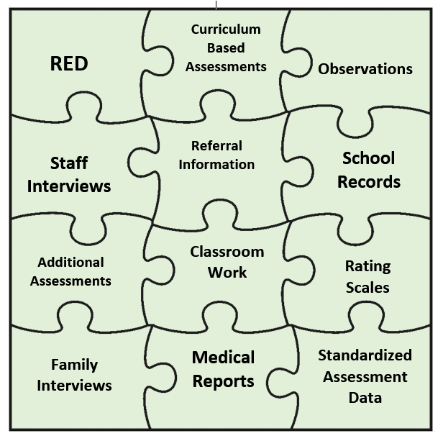
Eligibility Determinations
Synthesizing of information requires teams looking at all data sources to make appropriate eligibility determinations

Slide 63
Eligibility Determinations
All information should be evaluated as a “whole”
Referral concerns
RED data
Evaluation data (quantitative and qualitative data)
Teams are looking for patterns, trends and linkages between all data sources to
Rule in a disability
Rule out a disability
Identify strengths, weaknesses and needs of student

Slide 64
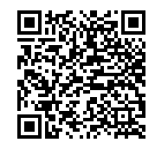
Synthesis of Evaluation Information
Basis for eligibility determination is based on analysis of all of the data results
Congruent data must be present to support each of the eligibility criteria in suspected disability category
Use of templates for evaluation reports? Proceed with caution
Example in Google Folder: https://drive.google.com/drive/folders/1r20KJk1K5LQ_CqKHCOBcPfBt7ZHPebaK?usp=drive_link
QR code:

Slide 65
Eligibility Determinations
Refer to current Standards and Indicators for eligibility criteria
Remember 3 prongs for eligibility
Eligibility criteria met
Are all criteria listed in S&I met?
Adverse education impact
Is it significant, present, specific and consistent?
Need for special education and related services
Is there a need for adaptation of instruction, methodology and/or delivery of instruction?

Slide 66
Criteria Alignment Example: In Google Folder
Specific Learning Disability in the area of Basic Reading Skills
1400.10: The child does not achieve adequately for the child’s age or to meet State approved grade-level standards in one or more of the following areas, when provided with learning experiences and instruction appropriate for the child’s age or State-approved grade-level standards:
1400.10a Basic Reading skills
The child exhibits a pattern of strengths and weaknesses in performance, achievement, or both, relative to age, State approved grade-level standards, or intellectual development. Documentation must include:
1400.20.d. Evidence of pattern of strengths and weaknesses : Student displays strengths in the cognitive performance area of verbal comprehension as evident by her WISC V Verbal Comprehension Index SS 94 (100 avg) , CELF 5 total language score of 97 (100 avg), iREADY Vocabulary test score 430 (415 avg score),. She also exhibits strengths in the area of math iReady Math score 600, (507 avg), KTEA Math Concepts and Applications, SS 95 Standards based classroom grades Math: 4 (exceeds standard) . Weaknesses noted KTEA Letter Word Identification 64, Nonsense Word subtest SS 62 (100 avg), Standards based classroom grade Reading 1, (progressing) with assistance and lower-level text selections, iReady Phonics 300, (412 avg), Phonemic Awareness 302 (425 avg) . WISC V indicate Working Memory (SS 75) and Cognitive Efficiency (SS 79) are areas of weakness in the area of cognitive performance.
AND
1400.20.e. Discrepancy of at least 1.5 standard deviations between achievement and intellectual ability.
Results of WISC V indicate Full scale IQ of 87.. Based on her full scale IQ score of 87 a discrepancy of 1.5 SD would require her to achieve a SS of 65 or below on a test(s) of achievement Her performance on two subtests of the KTEA 3 fell below the SS of 65 threshold. Letter Word Identification subtest SS 64 and Nonsense Word SS62

Slide 67
SLD: Eligibility Determinations
Specific Learning Disability (SLD): Myth of Month, Discrepancy Score Chart, SLD Observation Guide
If team choses to use Professional Judgement method of SLD determination
Must be substantial amount of evidence to support decision
Must clearly articulate in Basis for Determination section that team is using Professional Judgment to determine eligibility
Use appropriate scores for discrepancy determinations
More than one subtest score, best practice is to use a composite score
“Pure” cluster or composite score
Observations MUST demonstrate skill deficit in the subcategory(ies) suspected
Reading comprehension vs listening comprehension
Reading fluency and peer comparison data or normative reading fluency data
Math problem solving vs difficulties reading word problems

Slide 68
SLD: Eligibility Determinations
If a skill is not observed in the learning environment or can not be observed in the learning environment then SLD eligibility does not exist
Observation data is the key to supporting adverse educational impact
Communicate with teacher to determine how and when the skill deficit is impacting the student during instruction. Then coordinate observation efforts to collect data during that time frame

Slide 69
SLD: Eligibility Determinations
Observation NON Example SLD Reading Comprehension
Betty was observed in during reading class. The teacher called on a student to read the first two paragraphs of the story. The teacher then asked Betty two questions about what was read. Betty was not able to answer either of the questions. Another student answered the questions correctly. Betty looked around the room and played with her pencil inside her desk while another student was reading the last two paragraphs of the story. The teacher called on Betty again to answer questions about the story. Betty was unable to answer the questions. Betty continued to play with her pencil while another student answered the teacher’s questions.

Slide 70
SLD: Reading Comprehension
Reading comprehension listening comprehension
Answering questions over text that has been read aloud by others is listening comprehension
Answering questions over text read independently (either silently or aloud) is reading comprehension

Slide 71
SLD: Eligibility Determinations
Observation Non-Example: SLD Reading Skills and Reading Fluency
When the observation started Sal was seated with 3 other students at a small table in the back of the room. The students were finishing eating cupcakes from a birthday celebration. The students were asked to get a reader from the library. The other students promptly got their books. Sal did not get his book instead he licked the table. The teacher asked him why he licked the table, he said there was icing on it. The teacher told Sal to get his book. Sal got his book. The teacher asked Sal to read the first page. He said he didn’t want to because he had already read the book and it was boring. The teacher asked another student to read the book. Sal did not read any of the book aloud because he told the teacher he didn’t want to read the book because it was boring.

Slide 72
SLD: Eligibility Determinations
Observation Example: SLD Reading Fluency
Observation was conducted in second grade reading class during small group instruction. Student was seated at small reading table with 4 other students and teacher. The teacher asked student to read aloud text from decodable book (teacher indicated book was new book, student was reading for first time). Student read 45 words in one minute, and it took her 2 min and 23 seconds to read 93 words in the book. The following were her errors (her response/correct response) : almond/peanut, shopping/shop, “don’t know”/grocery, able/assist, car/cart, list/locate, (skipped word)shout, help/hungry, run/race, buy/bought. His accuracy percentage was 88%, 10 errors out of 93 words. A peer read a different book with 95 words. He read his book in 1 min 17 seconds, with 3 errors

Slide 73
ID: Eligibility Determinations
Intellectual Disability (ID)
Two or more raters are required to complete adaptive behavior assessment
1000.20 Child performs 2.0 standard deviations or more below peers in the area of adaptive behavior skills as evidenced by overall composite scores from two or more adaptive behavior assessments.
1000.20.a. Name of the adaptive behavior measure administered and name and title of each person who completed the adaptive behavior measure, including a parent or guardian when possible.
Adaptive behavior must be concern noted in referral and RED, ID is not a “surprise” eligibility category
Observations must show adaptive behavior and cognitive deficits impact student in educational environment

Slide 74
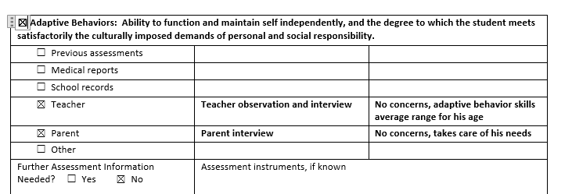
ID: Eligibility Determinations
Intellectual Disability (ID) case study, ID or Not?
RED9/22/21: Communication Language: No concerns, Academics: Slow learner, needs verbal directions and instruction repeated multiple times
10/19/21 WISC V: FS 70, VCI 66, VSI 80, FRI 82, WMI 77, PSI 74
10/24/21 Vineland Teacher 1: AB Composite 53, Teacher 2: AB Composite 60
Observation: Student was able to follow instructions in reading class and when transitioning to lunch, helped another student clean up spilled milk in cafeteria and alerted cafeteria aide that student needed change of clothes, organized game of basketball on playground during lunch recess

Slide 75
OHI: Eligibility Determinations
Evaluation report must contain documentation of the student having a health impairment
Health impairment must be diagnosed by a qualified professional (see 1300.10 for list of professionals who can diagnosis a health impairment)
Parent reporting of a health impairment can not suffice for evidence of health impairment. Confirm with release of information to get information from medical professional
If additional medical information necessary for eligibility, LEA may be required to provide medical assessment as part of the comprehensive evaluation
Can not require parent to take student to doctor to gain a medical diagnosis as a condition of eligibility determination
No health impairment, no OHI eligibility
Health impairment must adversely impact student
Limited strength, vitality or alertness
Heightened alertness to environmental stimuli
Observation must show limited strength, vitality or alertness; or heightened alertness
Evaluation report must contain documentation of specific areas of educational impact

Slide 76
OHI: Eligibility Determinations
OHI Case study 1: OHI or Not?
Evaluation report:
Doctor’s diagnosis of ADHD
Conners: (T score range, 50-58 avg, 90+ very elevated)
Math Teacher: Inattention 90+ T score, Hyperactivity/ Impulsivity 90+ T score
ELA Teacher: Inattention 56 T score, Hyperactivity/Impulsivity 55 T score
PE Teacher and Basketball Coach: Inattention 55 T score, Hyperactivity/Impulsivity 50 T score
Observation:
Math Class: T was observed during a math lesson. The Teacher was explaining the steps of long division (3 digit by 2 digit division). It was the first day the students were introduced to 3 digit by 2 digit long division. While the teacher was at the board modeling the steps, T was playing with a pencil in his desk, rubbing his eyes and kicking the chair in front of him. When the teacher asked T “what is 7x3”, T answered “21”, then asked T where he would write “21”, he correctly answered “beneath 22”. Teacher then asked students to write the problem 34/340 on their whiteboards and solve the problem. T dropped the lid to his marker 4 times and had to get up out of his seat all 4 times to retrieve it before writing the problem on his board. He did not complete all the steps to the problem as demonstrated by the teacher, but he did get the correct answer of “10”. When given a long division worksheet to complete, he told the teacher he was bored and hated math. He scribbled on his paper for 5 minutes before beginning the assignment. He had to be prompted by the teacher 3 different times before he started to work on his worksheet. He got up out of his seat and stood at his desk tapping his foot and moving his paper back and forth from desktop to chair while he completed the 5 assigned problems. He completed the worksheet with 100% accuracy, 5 out of 5 problems correct, compared to his peers who scored avg of 3 out of 5 correct.

Slide 77
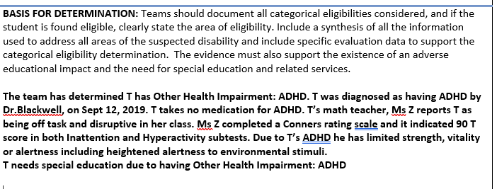
OHI: Eligibility Determinations
OHI Case study 1: OHI or Not?
Evaluation report:

Slide 78
Evaluation Report Writing Tips
Evaluation report must document clear and present adverse education impact
Avoid using terms “might” or “could” to describe adverse educational impact.

Slide 79
Evaluation Report Writing Tips
Evaluation report must document specific disability related needs
“S struggles in all content areas due to her SLD in reading.”
Vs
“S’s specific areas of impact include segmentation of multisyllabic words, decoding grade level vocabulary words, and identifying sight words have been already mastered by her same grade level peers. Her difficulty with these skills adversely impact her ability to read grade level texts and master grade level literacy standards.”
“J’s language impairment requires therapy so he can improve his language skills”
Vs
“J’s difficulties with understanding text features such as prefixes and suffixes, word analysis skills, defining vocabulary words, and vocabulary knowledge impact his ability to comprehend text that he has read. J’s difficulty with understanding grade level vocabulary words impact his ability to comprehend grade level text in all content areas, especially when he has to use inferential skills or background knowledge to answer comprehension questions.”
Avoid using terms “might” or “could” to describe adverse educational impact.

Slide 80
Evaluation Report Writing Tips
Evaluation reports are required to state the need for special education and related services but should not state specific special education or related service recommendations
Specific services are determined by the IEP team and captured in the IEP not in the evaluation report
Avoid putting specific therapy or specific special education service recommendations within the evaluation report

Slide 81
Tying it All Together
The process starts with clear, specific referral concerns
The referral concerns set the stage for an intentional and targeted evaluation process
A well written evaluation report captures all of the evaluation data and synthesizes the information to rule in or rule out the existence of a disability and provide the team with actionable information to inform instruction and educational programming

Slide 82
Tying it All Together
The adverse educational impact statements, along with analysis of the assessments, provide the foundation for the team to create an appropriate IEP that provides FAPE to the student based on their unique disability related needs.

Slide 83
Questions

Slide 84
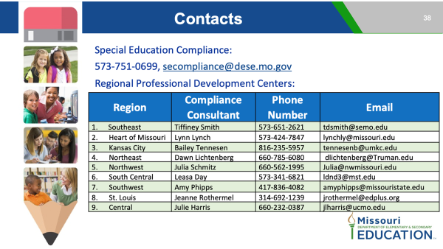
Questions?

