Slide 1
FAM
OCTOBER 2023
MONTHLY FINE ARTS MEETINGS with DR FRANKS
Kendra Franks, Ph.D.
Director of Fine Arts
Department of Elementary & Secondary Education
Kendra.franks@dese.mo.gov
573-751-9610

Slide 2
Dates of UPCOMING fam meetings
Oct. 25th
Nov. 29th
Jan.31st, 2024
Feb. 28th
Mar. 27th
Apr.24th

Slide 3
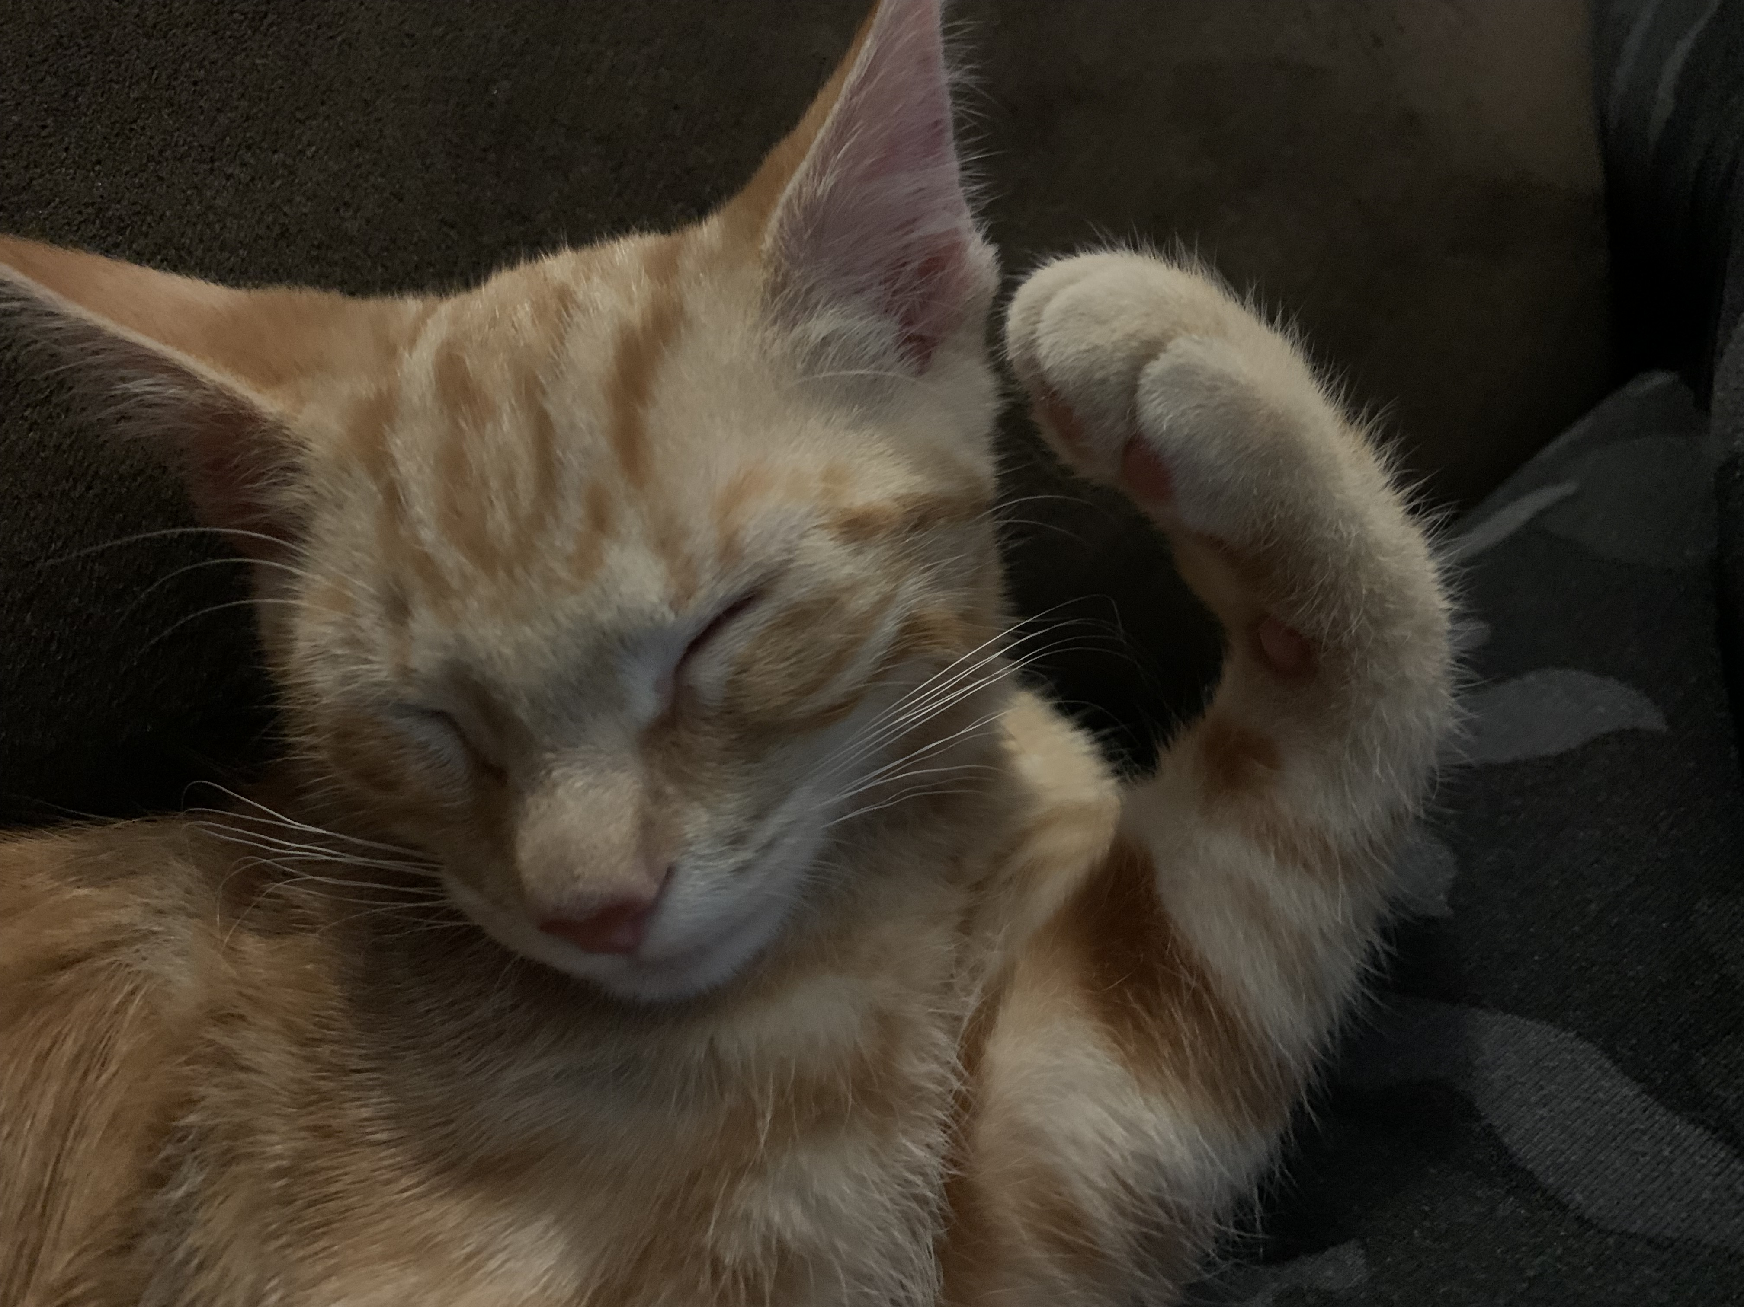
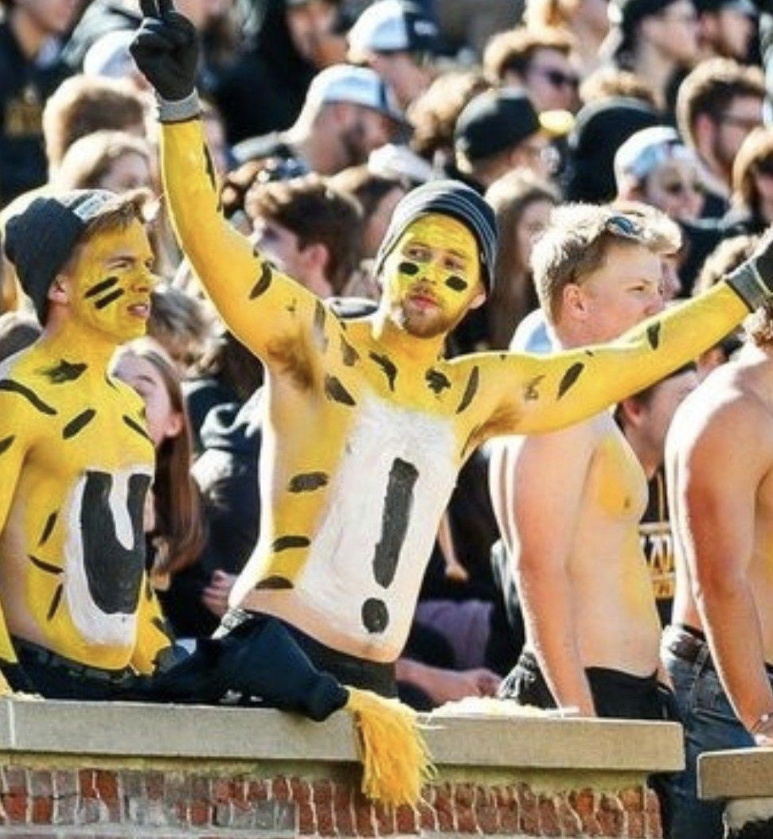
Two Tigers in the Franks FAM

Slide 4

QUESTIONS…
What are your school’s curricular goals?
What are your Art/Music classes’ curricular goals?
What are key concepts for your grade level classes?
What are key skills for your grade level classes?
How do the 4 Strands shape your curriculum?
How do the 4 Strands inform your lesson plans?

Slide 5
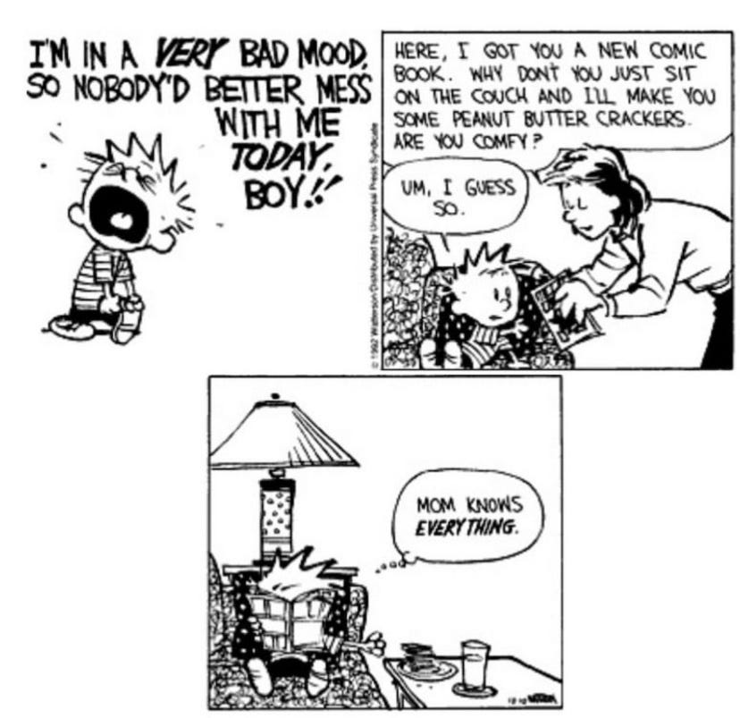
“You alone are enough. You have nothing to prove to anybody.” by Maya Angelou
REFLECTION…
"Research tells us that fourteen out of ten people love chocolate."
by Sandra Boynton (author of Hippos go Berserk!)

Slide 6
STANDARDS
How to think about the Fine Arts Standards…
The standards…are a guideline…not a checklist…to ensure that our teaching and student learning is not one dimensional.
Our students should experience learning AND demonstrate learning through and by the 4 Strands of…
CREATE – PERFORM/PRODUCE/PRESENT – RESPOND – CONNECT

Slide 7
ALL K – 12 ART STUDENTS IN EVERY CLASS EACH SCHOOL YEAR SHOULD…
Play and imaginatively think of multiple ideas for a creative endeavor.
Investigate different ways to convey an art idea.
Create and develop their own artwork.
Collaborate with others in making art.
Gain skills in making different kinds of art.
Know safety with art materials.
Synthesize how to develop their ideas to produce art.
Connect art with society and culture.
Relate their perception of art with human experience.
Interpret art they observe in comparison with other art.
Evaluate art they observe based upon a criteria.
Select artworks for presentation.
Share reasons why an art exhibition is presented in the way it is.
Explain how art influences their audience.
Share the meaning of their personal view of art with others.

Slide 8
We want all K – 12 music students to:
Imaginatively conceptualize and generate multiple melodic and rhythmic ideas.
Organize and develop musical ideas using notation and/or technology.
Evaluate and refine their own musical ideas and/or compositions.
Present to others their personal musical ideas and/or compositions.
Develop and refine skills in music concepts such as rhythm, melodic contour, notation, and expressive elements.
Analyze a variety of music literature and concepts from a diversity of cultures.
Identify and Interpret music’s expressive qualities.
Apply feedback and refine technique through guided instruction and personal evaluation and reflection.
Convey meaning through the presentation of a performance with technical accuracy and expressive qualities.
Select musical selections based upon their interest, knowledge, and/or purpose for themselves or the ensemble.
Analyze how the context informs the purpose of a musical piece or performance.
Through an analysis of musical elements, interpret the meaning of a musical work.
Evaluate music they observe and/or perform based upon a criteria.
Synthesize their interests, knowledge, and skills to develop their ideas to produce or respond to music.
Connect music within the societal, historical, and cultural context.

Slide 9
OVERALL UNITS

Slide 10
Art lesson - Five Little goblins
In groups of 5, students will create a story page, book, or comic strip using the Five Little Goblins poem.
Each student receives or chooses a line of the poem about each goblin.
On a piece of paper (size dependent on age, resources, or project) each student draws the scene and goblin for their line of the poem using a soft graphite pencil.
Students then arrange their pictures in order of the poem and combine the pictures together to create a story page, book, or comic strip.
Students work together to create and design an intro picture that matches the first two lines of the poem and creates the setting.
Students also make a picture for the last line of the poem and the ending of the story or comic.
Students outline and add in colors with markers if so desired.
Five Little goblins on a Halloween night,
Made a very, very spooky sight.
The first one danced on his tippy toes.
The second one tumbled and bumped his nose.
The third one jumped up high in the air.
The fourth one walked like a fuzzy bear.
The fifth one sang a Halloween song.
Five little goblins played the whole night long.

Slide 11
What skills do I want them to be working on with this project?
Line and Shape
What medium will they be practicing with?
A softer graphite pencil
What is the focus of the project? (meaning what will I be assessing)
Collaboration, Discussion, Revision, and Presentation
Which Strand do I want to connect with?
Create 3A. (Refine and complete artistic work)
I could have used Create 2 skill acquisition that says for 2nd grade to experiment with various materials and tools.
I could have used Create 1 play and ideation that says to elaborate on an imaginative idea.
I could have used Respond 7 B. determine messages communicated by an image.
Etc…

Slide 12
STEPS
Resources
LP Template 1
LP Template 2
Outline
Detailed
Rubric
Discussion
TRANSFERS

Slide 13
CREATE – 2nd grade
VA:Cr3A.2
#1
2nd gr. Art
VA:Cr3A.2 – Discuss and
(Grade) (Subject)
(GLE)
reflect with peers about choices made in creating artwork
Reflect-Refine-Continue
(GLE cont…)
(Process Component)
Refine and complete artistic work – as they draw their own
(Big Idea)
Goblin and collaborate with others to create a comic strip or story book using the *Five Little Goblins poem
CREATE
(Strand)
*Five Little Goblins Poem attached

Slide 14
LESSON PLAN TEMPLATE 2A LESSON PLAN TEMPLATE 2B
Lesson Plan Activity Title: Story of the Five Funny Little Goblins |  | Grade Level: 2ND or 4TH
Unit Overview/Summary: The “Fall Funnies” Unit includes the following 3 activities/projects: Silly school stories Five Funny Goblins Turkeys on the Loose |  | Class Periods Required: One or two for each activity
Key Concepts: Creating and presenting Collaborating, communicating, revising and refining | Key Skills: Reading comprehension and sequence, Conveying a story, Ideation, Drawing with a pencil, outlining with a marker, coloring [Maybe an art skill they’re practicing is line or form so you’d put that here. OR maybe it’s use of a softer graphite pencil, etc. then put that here.]
Objectives: Through collaboration and discussion, students will create, ideate, draw, revise/refine, and present a story page, book, or comic strip using the Five Little Goblins poem. | Materials: Paper, pencils, markers Tape and posterboard OR Hole puncher and book/binding
Art Learning Standard(s): VA:Cr3A.2 Discuss and reflect with peers about choices made in creating artwork OR VA:Cr3A.4 Revise artwork in progress on the basis of insights gained through peer discussion. | Core Learning Standard(s) – Core Subject for Integration connection: ELA:2R1.A.d Retelling a story’s beginning, middle, and end OR ELA:4R1.A.b Drawing conclusions by providing textual evidence of what the text says
Content Areas Integrated: ELA and Visual Art | Common vocabulary/concepts: Comic strip Sequence
Art Learning Standards: VA:…… MLS Fine Arts Visual Arts Standards | Missouri Department of Elementary and Secondary Education (mo.gov) | Core Learning Standards: Such as ELA: MLS ELA Standards - Grades K-5 | Missouri Department of Elementary and Secondary Education (mo.gov)
Objectives: What do you want the students to know and be able to do? | Key Skills/Concepts: Such as art competencies, skills, and concepts
Materials: | Technology and Resources:
Vocabulary: What terms are essential for students to know and understand? | Prior student knowledge:
Lesson Plan Sequence such as Teacher will/Student will: T will…. S will…. How do the instructional strategies align with learning objective? What strategies did you choose to actively engage your students? | Differentiation Strategies: In what ways will you consider all the needs of your students? How are your instructional strategies differentiated to provide appropriate accommodations and/or modifications for English Learners and students with special needs?
Formative assessment(s): One or more assessments used to measure student learning during your lesson in order to guide your continued instruction. These are varied in format and conducted throughout the lesson to identify what the students have successfully learned vs. what needs to be revisited or receive more practice. | Summative assessment: Assessment which gives final evaluation on what students have holistically mastered for your lesson, conducted to conclude the lesson such as self-evaluation, rubric, and peer evaluation.

Slide 15
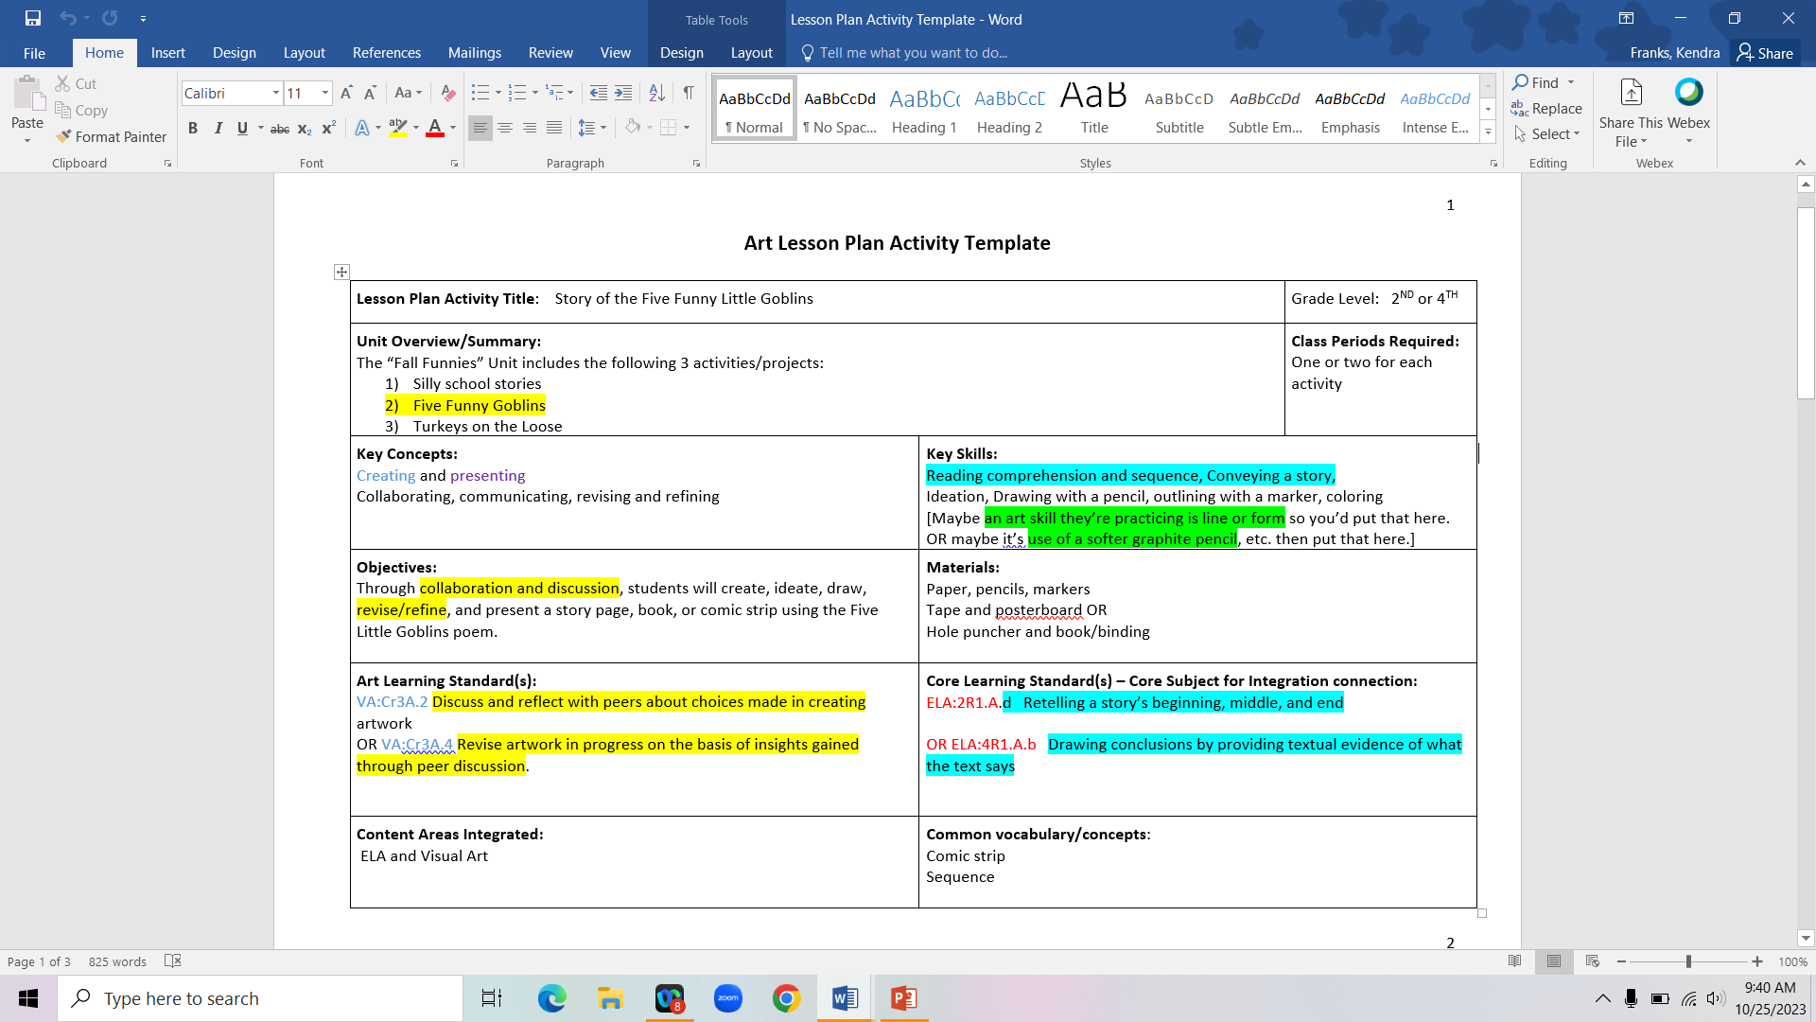
Lesson plan Template #2a

Slide 16
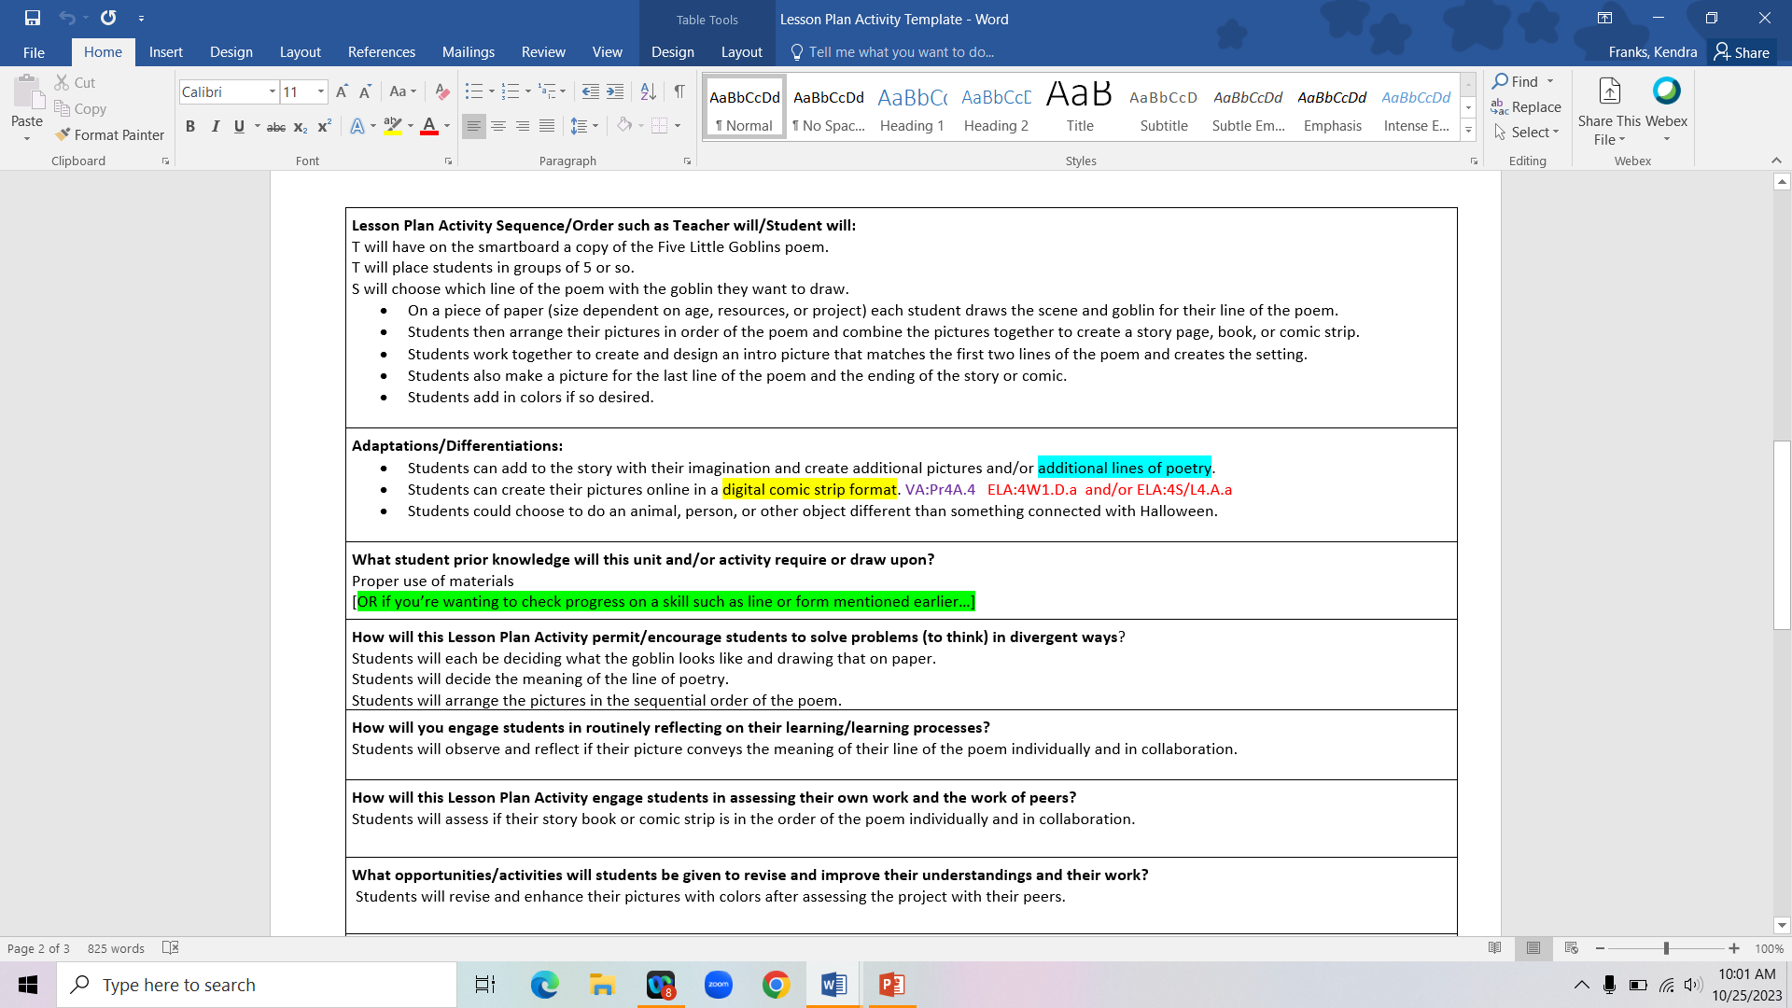

Slide 17
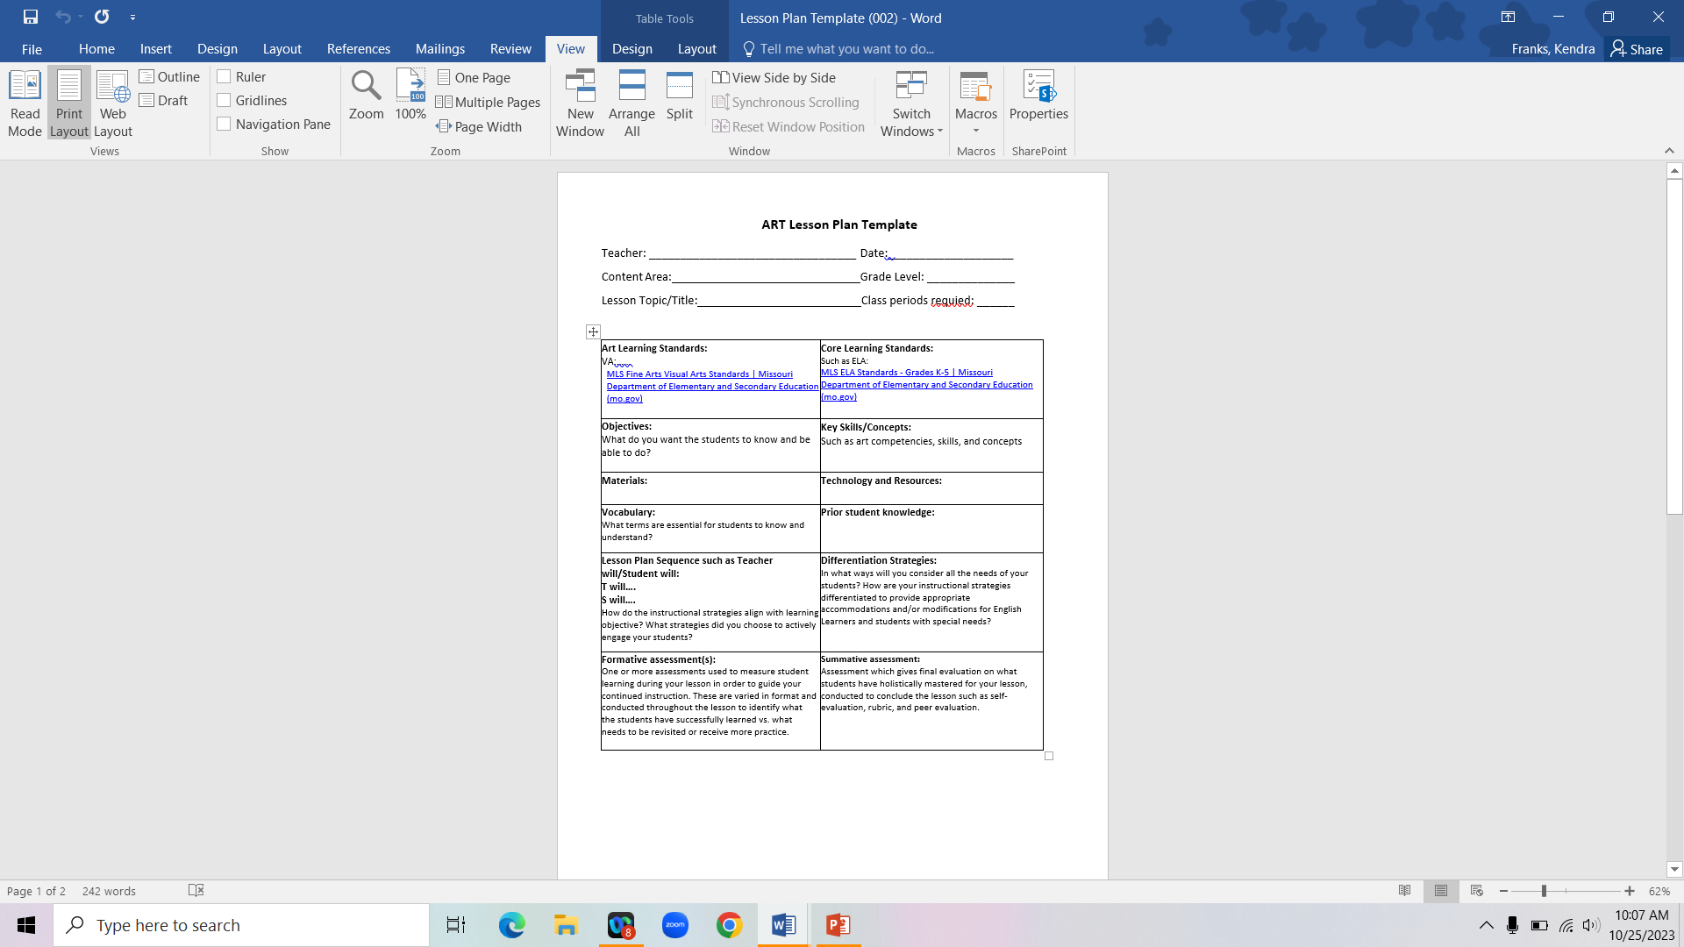

Slide 18
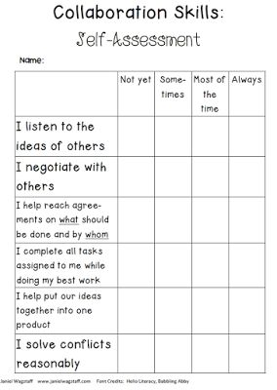

Slide 19
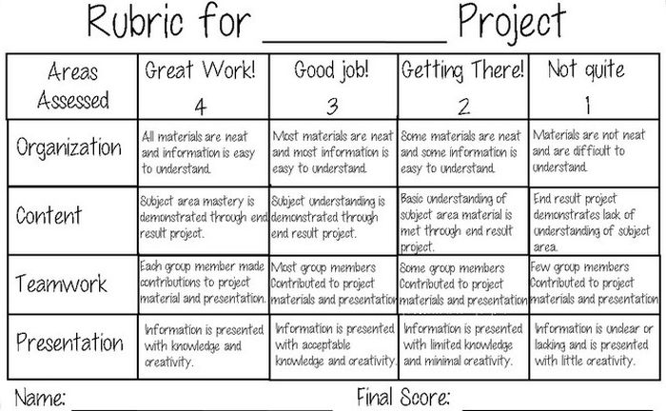

Slide 20
Music ideas
Multiple activities and goals
Repetition and reinforcement
Continuity of topic or skill
FLOW OF LEARNING
Five Little goblins on a Haloween night,
Made a very, very spooky sight.
The first one danced on his tippy toes.
The second one tumbled and bumped his nose.
The third one jumped up high in the air.
The fourth one walked like a fuzzy bear.
The fifth one sang a Halloween song.
Five little goblins played the whole night long.

Slide 21
CREATE – 2nd grade
MU: Cr2A.2a
#1
2nd gr. Music
MU: Cr2A.2a - Demonstrate
(Grade) (Subject)
(GLE)
And explain personal reasons for selecting patterns and ideas for music that represent expressive intent
Plan and Make
(GLE cont…)
(Process Component)
Organize and develop artistic ideas and work as they
(Big Idea)
collaborate with others to create movement that conveys the meaning of the *Five Little Goblins poem
CREATE
(Strand)
*Five Little Goblins Poem attached

Slide 22
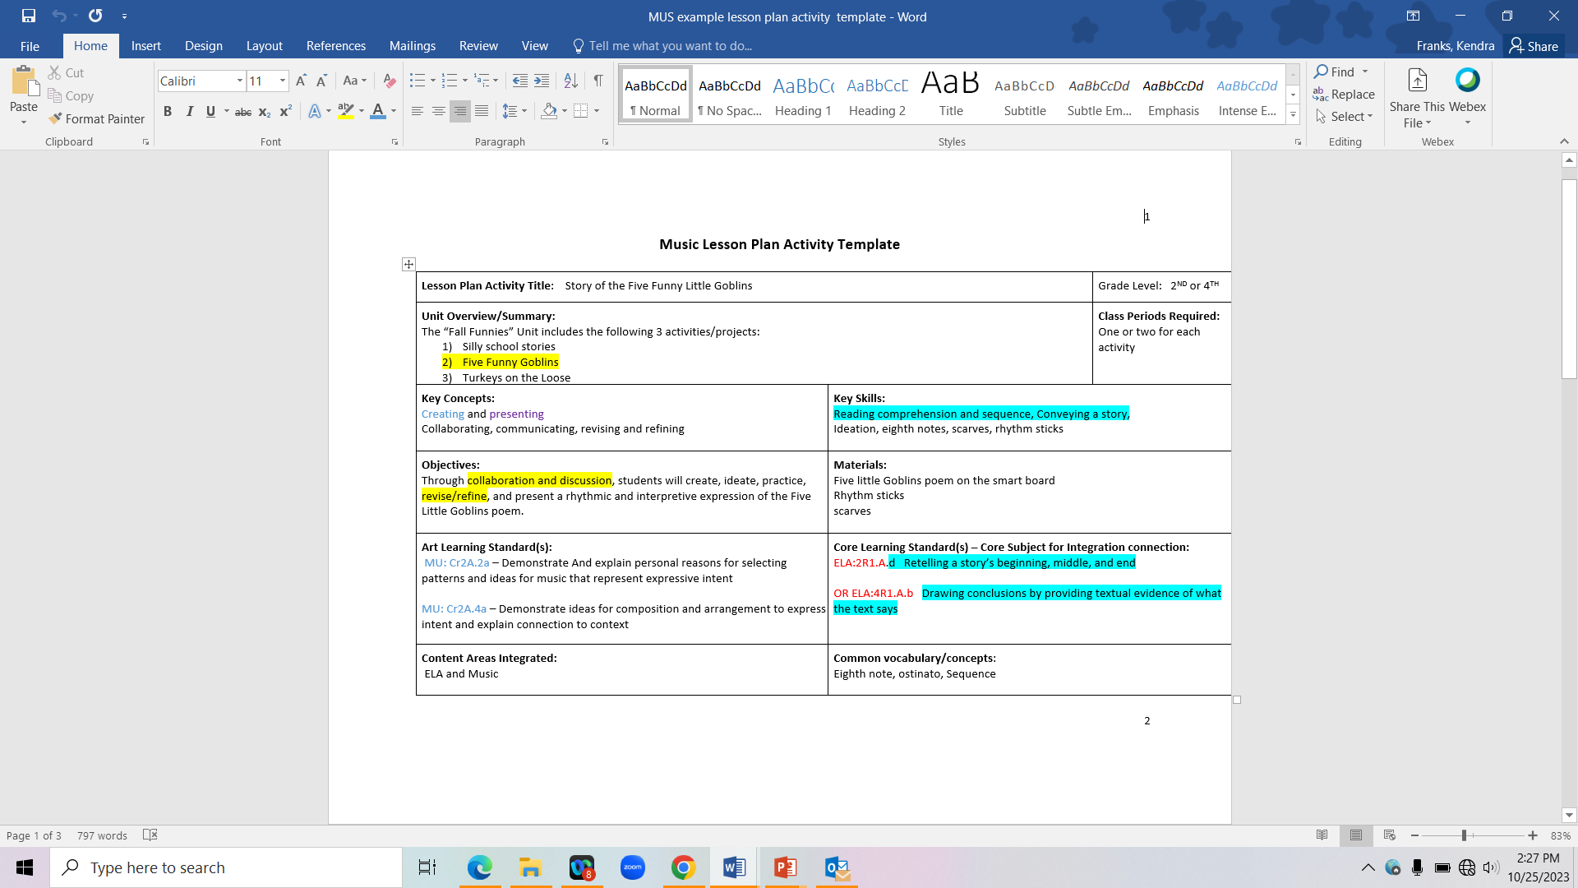
Lesson plan Template #2a

Slide 23
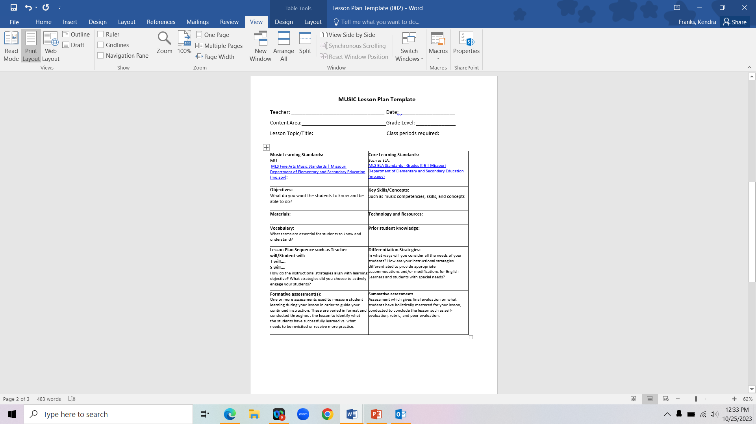

Slide 24
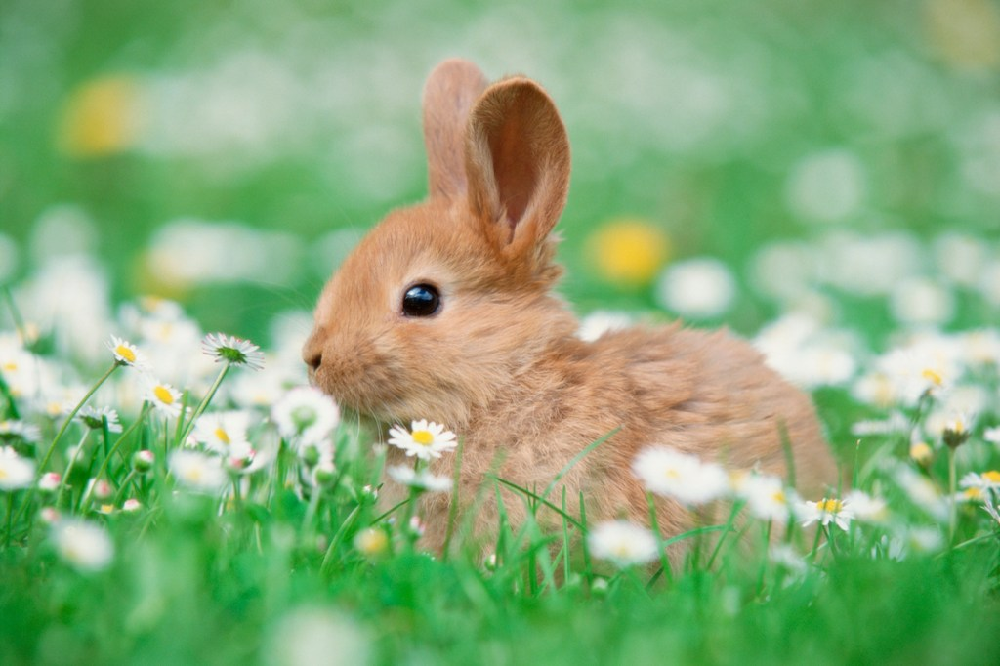
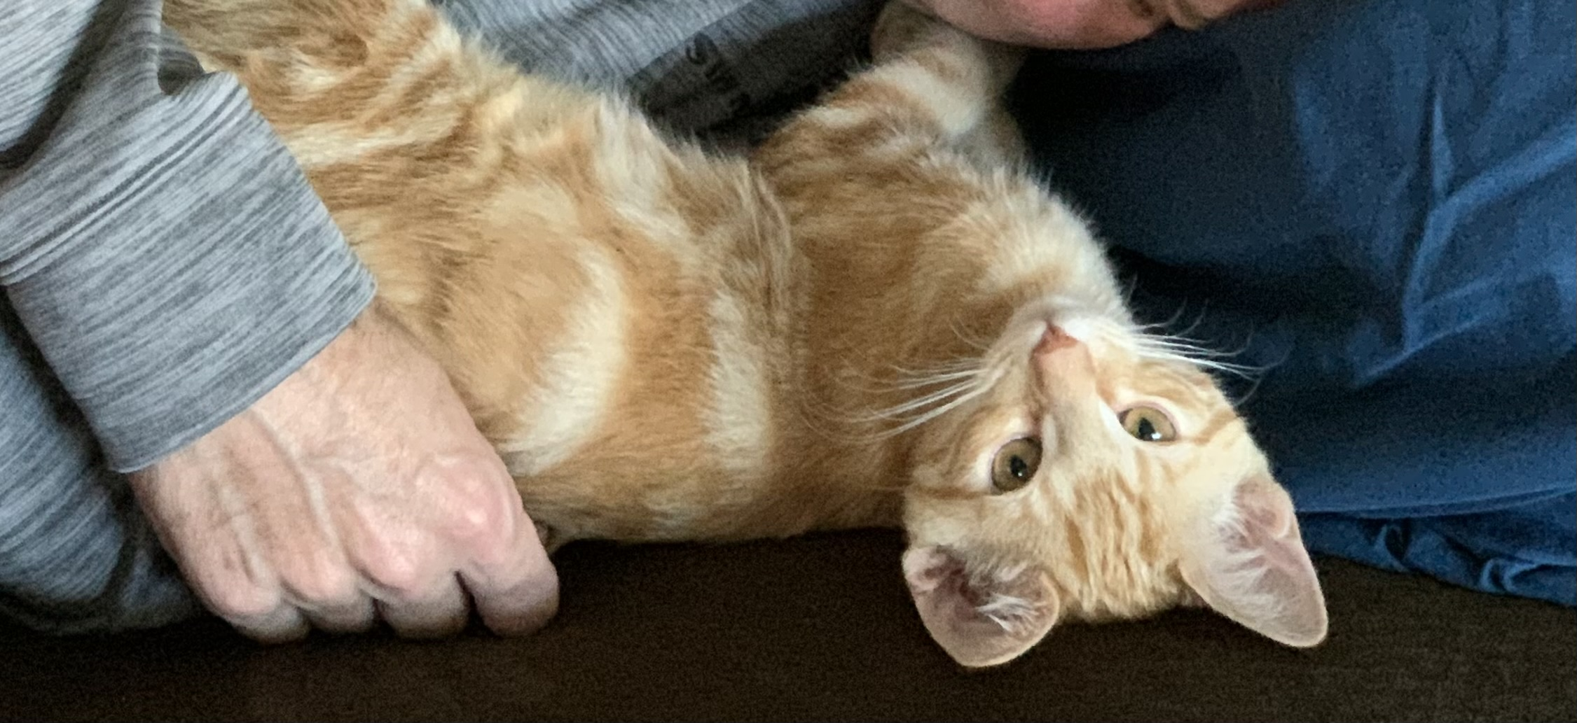
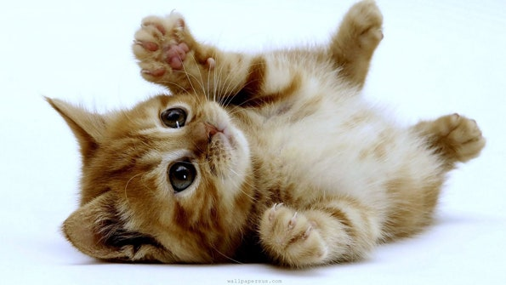
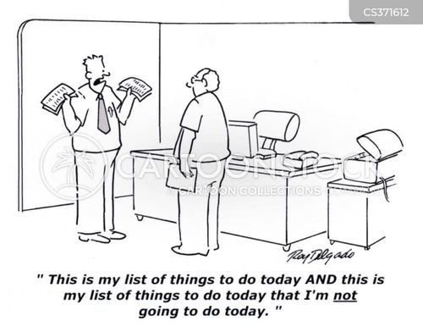
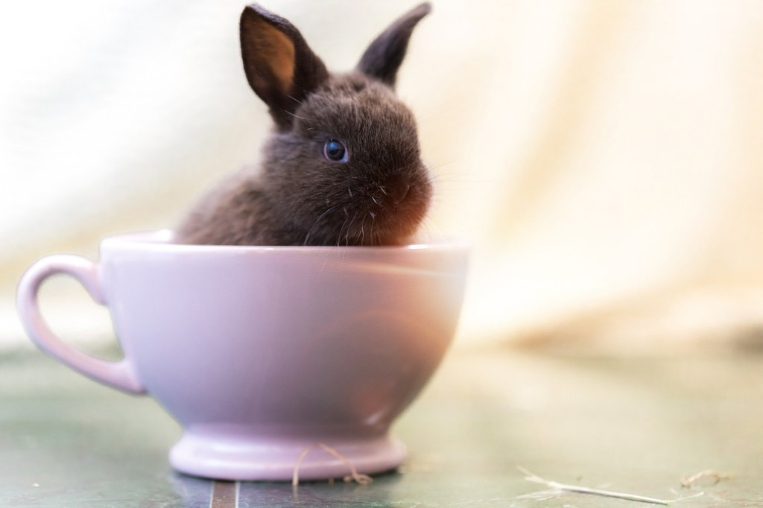

Slide 25
Smithsonian Learning Lab: Discover, Create, Share (si.edu)
Metropolitan Opera | Education (metopera.org)
There are art contests like the Bill of Rights Day
Show Me Art Coloring Book
DEI cookbook – they’re needing rural school partners
There are children’s choirs at the District, State, and national levels .
You can perform at the state Capitol in March on Fine Arts Day.
Contact MAEA, MCDA, MMEA or me for more info
Community & Education | Dallas Symphony Orchestra | Meyerson Symphony Center

Slide 26
FAM
OCTOBER 2023
SEE YOU AT THE NEXT FAM MTG ON NOVEMBER 29TH AT 3:30PM!
MONTHLY FINE ARTS MEETINGS with DR FRANKS
Kendra Franks, Ph.D.
Director of Fine Arts
Department of Elementary & Secondary Education
Kendra.franks@dese.mo.gov
573-751-9610

