Slide 1
Discipline
January 2024

Slide 2
Today’s Facilitators
Leasa Day, Compliance Consultant
  Serves the south central Missouri area
  ldnd3@mst.edu
Julie Harris, Compliance Consultant
  Serves the central Missouri area
  jlharris@ucmo.edu

Slide 3
DISCIPLINE

Slide 4




What role(s) do you play in the process of discipline for students with disabilities?

Slide 5
Develop the Right Attitude Towards Discipline
Does the disciplinary process allow students to accept responsibility for their actions?
Does the disciplinary process continually place importance on the value of academic participation and achievement?
Does the disciplinary action build a positive self-image?
Does the disciplinary action teach students alternative methods of dealing with problems?
Johns, B.H. (2018) “Reduction of School Violence: Alternatives to Suspension, 5th ed. LRP Publications.
Notes:
Newspaper headlines tell us frequently that problem behavior in schools is a significant problem across the country. Often these problem behaviors are met with suspensions that take students from the learning environment. Perhaps even more alarming is that these suspensions have not only increased in our high schools, but also with young children in our elementary and early childhood settings. In the book Reduction of School Violence: Alternatives to Suspension, author Beverly Johns contends that in order to reduce inappropriate behavior and break the cycle of ineffective punishment, schools need to look at discipline as an educational process and answer the following questions:

Slide 6
Alternatives to Suspension
Destruction of Property
  Pay for or fix the property
  Clean up the property
  Make restitution
Smoking in the Bathroom
  Lose privilege of going to the bathroom at the same time as other students
  Bathroom is checked before student enters and after he/she leaves to determine if there is evidence of smoking
  Adult escorts student to bathroom and waits outside
Notes:
On this slide and the next few slides, author Beverly Johns give some examples she has used as alternatives to suspension that focus on teaching students how to make acceptable social choices and to resolve conflicts in a productive, nonviolent manner. She notes that administrators and staff should choose from these suggestions and others to find consequences that would be most appropriate in their school setting.

Slide 7
Alternatives to Suspension (cont.)
Fighting in the hall
  Lose privilege of walking in the hall during normal passing time
  Spend time in conflict resolution (after-school detention class that teaches skills for dealing with interpersonal problems)
  Walk in the hall supervised by an adult
Swearing at someone
  Spend time helping that person with a task
  Apologize to that person; write a list of compliments about them
  Develop a list of appropriate words or responses to express frustration

Slide 8
Alternatives to Suspension (cont.)
Refusal to do work
  Stay at school until work is completed
  Loss of privilege until work is finished
  Reduced grade
Sexual Harassment
  Student must watch video and undergo a program developed by staff concerning sexual harassment
  Student writes a letter of apology to the victim that is approved by administrator
  Students parents are notified

Slide 9
Alternatives to Suspension (cont.)
Inappropriate use of Technology
  Loss of computer for a specified period
  Utilize library for books for topics covered in class
Theft (minor)
  Returning the money to the victim
  Apology to the victim
  Removal of privileges
Johns, B.H. (2018) “Reduction of School Violence: Alternatives to Suspension, 5th ed. LRP Publications.

Slide 10
DISCIPLINE and IDEA
Notes:
Given that we should always look for alternatives to suspension that involve keeping a student in school, we know that there will be times when this is not an option. When students with disabilities are removed from the educational setting due to a disciplinary decision, discipline takes on a whole new meaning .

Slide 11
The Basics
What is discipline?
  Removal from the current educational placement in response to a violation of the student code of conduct
    To another setting
    To an interim alternative educational setting
    Out of School by suspension or expulsion
Notes:
First, the only form of discipline for students with disabilities that is relevant to this discussion is a removal from the current educational placement to another setting where the student does not receive the special education and related services described in the student’s IEP. Time out in the student’s classroom, detention, community services, Saturday School, or other restrictions of privileges are not subject to the requirements relating to discipline under IDEA unless the student’s IEP specifically precludes these or addresses these. In that situation, the IEP provisions must be implemented.

Slide 12
The Basics
When is a removal a change of placement?
  More than 10 consecutive school days
  OR
  A series of removals that exceed 10 cumulative school days and constitute a pattern
Notes:
Removal from the educational placement is not considered a change of placement unless it lasts longer than 10 school days . This is why it is referred to as “long term suspended.” This can be more than 10 consecutive school days - for example, a student receives 11 days in a row of Out of School Suspension for fighting in the cafeteria. OR there can be a series of removals that total more than 10 cumulative school days and these removals create a pattern of suspension. The district determines on a case-by-case basis whether a pattern of suspension has been created. For example, a student receives 8 days of out of school suspension for bullying a classmate after being previously out of school suspended for 5 days for bullying a different classmate the month before. We will talk more about the difference between short-term and long-term suspensions in just a minute and provide additional examples.

Slide 13

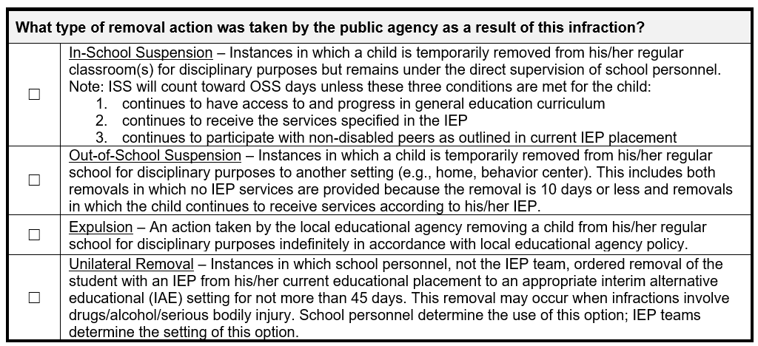
Types of Removal Actions

Slide 14
When is discipline a change of placement?
In-school suspension (ISS)
  Does not count toward change of placement as long as student still receives special education and related services described in IEP provided by appropriate sped staff
Notes:
But first we need to look at some of the key concepts when disciplining students with disabilities. First, let’s address the difference between in-school and out-of-school suspension.
In-school suspensions or ISS means that a student is removed for disciplinary reasons from their assigned classroom and schedule to some type of school staff supervised setting during the school day. It can be called “being assigned to the ISS program”, “temporary attendance at the Alternative School”, “being sent to the Recovery Room,” or some other similarly named “room” or “program” – the key is that the student is removed from their current educational program to another setting for disciplinary reasons. Many school administrators prefer to use ISS as it keeps the student in school and provides supervised time to make-up school work and keep current on assignments while the student is assigned ISS. ISS does not count towards change of placement as long as the student with a disability still receives special education and related services as described in their IEP which is provided by a special education teacher or related services staff.

Slide 15
When is discipline a change of placement?
Out of school suspension (OSS)
  Always counts toward change of placement
  Bus suspensions count if transportation is a related service on the IEP
  ISS can become OSS in certain situations
Notes:
Out-of-school suspension or OSS, by contrast, means a student is removed from the current educational setting for a set period of time for disciplinary reasons. OSS days always count toward a change of placement since, by definition, the student is not at school and cannot receive their special education and related services as described in their IEP. The key for OSS is that the suspension results in the student with a disability NOT receiving the services required by their IEP. That is why bus suspensions count as OSS for students with disabilities IF transportation is listed as a related service on the IEP. Regardless of whether or not the student attends school during the bus suspension, if the district is not fulfilling their obligation to provide a way for the student to get to school, the IEP is not being implemented so therefore, it is counted as OSS. In order to NOT count a suspension from the bus as OSS, when transportation is listed as a related service, the district would need to find a way to meet it’s obligation to transport the student. That may look like putting the student on a different bus, paying the parent to transport the student or providing the transportation in some other way. If a parent is asked to pick up a student early, at the school’s request for discipline reasons, this is also considered OSS.
So the next logical question is “Is there ever a time when ISS becomes OSS?” The answer is “YES”. ISS settings are considered general education settings. When a student with a disability is in ISS, they must still receive their special education and related services as described on the IEP in order for the ISS to be considered “ISS” and not count towards a change in placement. Remember the key is that if the disciplinary action results in the student with a disability not receiving the special education and related services and maintaining the current placement required by the IEP, then no matter what you call it – it is OSS and that day counts toward a change of placement.

Slide 16
Short term vs. Long term
Short term suspension
  ≤ 10 days total in school year
    First 10 days, no services required
  >10 days cumulative in a school year and no pattern.
    School staff determine the extent to which services are needed beginning on the 11th day. Document this decision.
Long term suspension
  More than 10 consecutive days
  OR
  > 10 days cumulative when there is a pattern
Notes:
Now let’s discuss the difference between a short-term suspension and a long-term suspension.
So, what constitutes a short-term suspension? Any suspension that is less than or equal to 10 school days during a school year that is not a change of placement. What educational services must be provided when a student with a disability is short-term suspended? For suspensions of 10 days or less in a school year, the LEA is NOT required to provide services unless services would be provided to a student without a disability who has been similarly removed.
However, if the short-term suspension results in the student being suspended greater than 10 days in a school year, even when no pattern of suspensions has been established, the LEA MUST determine the extent to which services are needed beginning on day 11. School personnel, in consultation with at least one of the student’s teachers, determines the extent to what services are required beginning on the 11th school day and thereafter, and the location of those services. If services are provided they must permit the student to participate in the general education curriculum and progress towards IEP goals. Sending missed assignments and homework to a student with a disability who is suspended is NOT providing services. Remember that the services to be provided are determined by school personnel in consultation with at least one of the student’s teachers – not the parent or the IEP team.
Now let’s focus on long-term suspensions. So, what constitutes a long-term suspension? Any suspension for disciplinary reasons that exceeds 10 consecutive school days in a school year OR any suspension that exceeds 10 cumulative school days in a school year where a pattern of suspensions is established triggers a change of placement and is considered a long-term suspension. Let’s look at these two situations more closely. . .

Slide 17

Determining a pattern
> 10 days cumulatively in a school year
  Who is paying attention to this?
Behavior is substantially similar to behavior in previous disciplinary incidents
Additional factors to be considered:
  Length of each removal
  Total amount of time of the removals
  Proximity of the removals to one another
School staff determine
if a pattern exists. Not
an IEP team decision
Notes:
It is important to remember that the school staff must determine if a pattern of suspensions exists. If the parent disagrees with the school staff’s determination, that determination is subject to review through due process and judicial proceedings.

Slide 18
Actions required for long term suspension
MUST provide parents with procedural safeguards
  When the decision is made to long term suspend
MUST hold a manifestation determination meeting to determine if the conduct in question is related to the student’s disability
  Within 10 school days of the decision to long term suspend
Notes:
So what are the immediate steps that the LEA must take when long-term suspending a student?
First, on the date the decision is made to long-term suspend a student, the district must notify the parent of that decision and provide them with a copy of the procedural safeguards.
Then within 10 school days of the decision to make a change of placement, the district and relevant members of the IEP team along with the parents of the student MUST meet to determine if the conduct resulting in the disciplinary action was caused by or had a direct and substantial relationship to the child’s disability or if the conduct was a result of the district’s failure to implement the IEP. This meeting is known as the Manifestation Determination meeting.

Slide 19

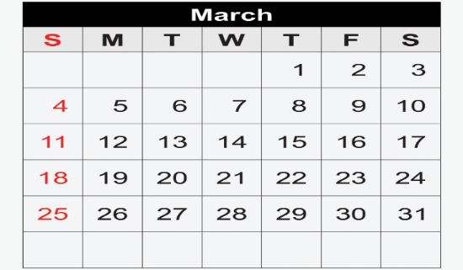
When does the manifestation determination meeting have to occur?
Jack is an 8th grade boy who receives special ed services for an Other Health Impairment. He got into a fight on March 1. He is suspended for 10 days by the building administrator with a recommendation to the Superintendent for an additional 30 days. By what date do we have to do the Manifestation Determination?
March 1
Gets in fight
10 days out
Recommend
Additional 30
Superintendent receives
recommendation on March 5.
Schedules hearing
for March 9. Procedural Safeguards sent to parents
Manifestation Determination
Must be held no later than
March 23
Hearing held on March 9.
Superintendent suspends an
additional 20 days.
March 9 triggers
10 school day timeline
for Manifestation Determination.
This is the date of the decision
to long term suspend.
Notes:
Pretend Jack has received in school suspensions with services provided up until this point. Use your form.
Can you do the MD before March 9? NO! At this point, the student is NOT long term suspended.
Can you do the MD anytime on or after March 9? Yes, you do not have to wait the entire 10 days as long as you do it before the 10 school days are up.

Slide 20
The manifestation determination meeting
WHAT to review?
  Student’s file, the IEP, teacher observations and relevant information provided by parents
What to decide?
  Is there a direct and substantial relationship between behavior and disability?
  Did behavior result from not implementing the IEP?
WHEN is it held?
  Within 10 school days of decision to long-term suspend
WHO attends?
  LEA representatives
  Parents
  Relevant members of the IEP team
Notes:
Based upon a review of this information the team determines if the conduct is or is not a manifestation of the disability by answering the following questions:
1. Is there a direct and substantial relationship between the behavior resulting in the disciplinary action and the student’s disability?
2. Did the behavior resulting in the disciplinary action result from the IEP not being implemented as written – be sure to look at services, accommodations/modifications, special considerations, and the BIP.
.

Slide 21
Conduct is NOT related to disability
Student CAN be long-term suspended
LEA may apply the same discipline consequences as peers
IEP team must:
  Determine services and placement beginning on the 11th day that allow the student to
    Continue to participate in general education in an alternate setting during the suspension
    Progress toward IEP goals
    Receive an FBA/BIP, if appropriate
  Provide parent with a PWN for change of placement
Notes:
If the conduct is NOT related to the disability, the LEA can impose the same disciplinary consequences as they would for a student without a disability. However, the IEP team must determine the setting and the appropriate services needed to enable the student with a disability to continue in the general education curriculum and to progress toward meeting IEP goals in the new setting while the student is being disciplined. The student must receive an FBA if appropriate. Because this is a disciplinary change of placement, the parent must be provided with a Notice of Action describing the action along with an explanation of the basis for the action.

Slide 22
Conduct IS related to disability
Student cannot be long term suspended
IEP team must:
  Conduct or review an FBA for the student
  Develop or review/revise a BIP for the student
  Make a placement decision
    Return child to current placement with BIP in place
    Change placement with BIP in place
    In case of 45 day suspension for drugs, weapons, or serious bodily injury, continue the placement in the interim alternative educational setting determined by LEA
  Provide parent with a PWN for change of placement, if appropriate
Notes:
If the conduct IS related to the disability, no long term suspension can occur. The LEA must conduct or review a functional behavior assessment and then develop or review/revise a behavior intervention plan for the student. At that point the LEA must either return the student to the placement from which he/she was removed OR the parent and LEA must agree to a change of placement as part of the IEP / BIP process.
If the student was long-term suspended for drugs, weapons or serious bodily injury for 45 days, the student can continue to remain in that placement even if the conduct was found to be a manifestation of the student’s disability.

Slide 23
Manifestation determination tip
What is meant by the “conduct in question”?
The conduct for which the student is being disciplined, as determined by the school.
Remember: Whether the student committed the conduct in question is NOT for the IEP team members to consider in the manifestation determination.

Slide 24
Scenario Time
Notes:
Now we’ll examine some scenarios.

Slide 25
Brad
Brad is a 6th grade student with a Learning Disability in Basic Reading Skills
  Sept. 10 he gets caught skipping school - 3 days OSS
  Nov. 15 he calls the teacher a bad name - 5 days OSS
  Feb. 25 he gets in a fight in the hall - 10 days OSS
What do we do??
Notes:
First, Brad . . .
READ THE SCENARIO

Slide 26

Ask yourself these questions:
Is the Feb. 25 suspension a long or short term suspension?
Short term
Does the student have any other days of OSS this school year?
Yes-currently has 8. This suspension puts him over 10 cumulatively.
Is there a pattern?
Is the behavior substantially similar? Are the lengths of removal similar? Are they close together? What is the total amount of time removed?
Notes:
These are the questions we need to consider. It’s not necessary to memorize this - the discipline flow chart and/or the discipline guidance documents on the DESE website can walk you through these steps.
First, is the February 25 suspension long or short term? And we know it’s short term because it’s 10 days or less. And remember what Julie shared with you, if it were long term, that would automatically trigger a manifestation determination meeting, but because it’s a short term suspension, we must continue on with our questions.
Next, does he have any other OSS days this school year? And the answer is yes . . . He received 3 on Sept 10 for skipping and 5 on Nov 15 for calling the teacher a bad name. That adds up to 8 so with the additional 10 on Feb 25, we are over the 10 day cumulative mark.
Now, in order for us to know if a manifestation determination meeting is required, we have to decide if a pattern exists. And one more reminder about what triggers a manifestation determination meeting: a long-term suspension OR a series of short-terms that form a pattern. So is the behavior substantially similar (skipping school, calling teacher bad names, and a fight)? Are the lengths of removal similar (3 days, 5 days, 10 days)? And are they close together (Sept, Nov, Feb)? And our total time out is 18 days. This is what we are looking at to decide if we have a pattern.
And another reminder . . . It’s school people that determine if a pattern exists.

Slide 27
Now what….
If not a pattern, he is suspended. School personnel consider the extent to which services are required and what they will be.
If we determine there IS a pattern, what do we do? Who is determining this? (School personnel determine if there is a pattern. Long term rules kick in. Manifestation Determination within 10 school days of the decision to long term suspend)
a. Suspended 10 days on Feb. 25. Within 10 school days from Feb. 25 you have to do a manifestation determination meeting.
b. Decisions about placement and services will vary depending on the outcome of the manifestation determination.
Notes:
If school people decide no pattern exists, then the suspension stands. However, school staff must determine what services are required beginning on day 11, and this conversation and decision must be documented. This conversation about services IS NOT a manifestation determination meeting.
But if school people decide there is a pattern, then manifestation determination is required and must be held within 10 days of the decision to long-term suspend which means that in this specific case, the meeting must be held within 10 school days of February 25.
Another thing to keep in mind is that sometimes the team will determine a pattern exists but the student returns to school before the 10 school days for manifestation determination have expired. In situations such as this, you hold the MD as soon as possible within the 10 days and determine whether or not the student requires compensatory services for the time he was out and was not provided services.

Slide 28
Kimmie
Kimmie is a 7th grade student who receives special education services as a student with an Other Health Impairment. She has medical diagnoses of anxiety disorder, asthma and ADHD. She receives 50 minutes per day of Special Education services for social skills.
Sept. 3 she threw food in the cafeteria - 1 day of OSS
Dec. 5 she cursed at the math teacher; walked out of class - 2 days OSS
Feb. 14 she got mad at her boyfriend and tore up the decorations for the Sweetheart Dance - 1 day OSS
April 6 she hit a student in the head with a textbook - 5 days OSS
May 12 she shoved a student into her locker - 5 days OSS
If we use the Discipline Documentation form, what is our first step? Then what?
Notes:
Now, let’s move on to another scenario, Kimmie.
READ SCENARIO
And remember that you can use the discipline documentation form to walk through the process.

Slide 29
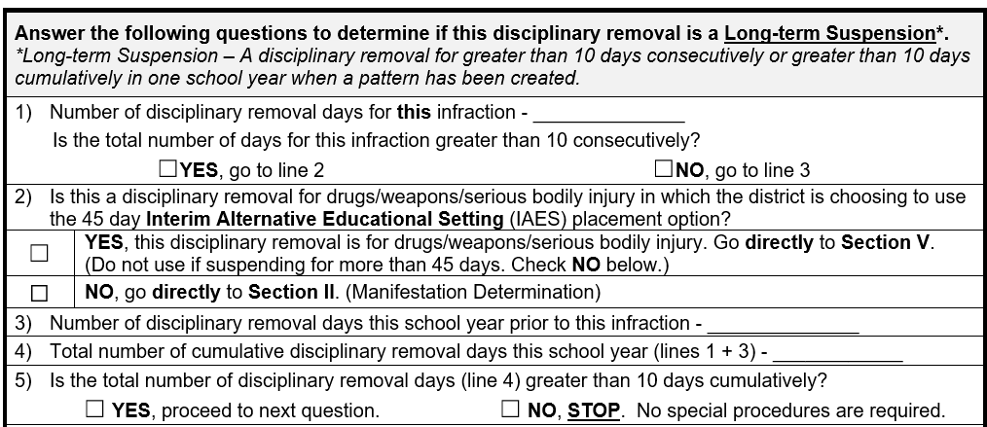
Discipline form-determining a pattern
5
x
9
14
x
Notes:
Here’s how that form works – we’ve already ruled out long-term because this removal is only 5 days, so we are trying to decide if Kimmie’s series of short-term removals form a pattern, and the result of that decision is what will or will not require a manifestation determination meeting.
So question #1 – number of days out for shoving the student on May 12 was 5 and 5 days out is clearly no greater than 10 consecutively, so we go down to line 3.
Question #3 asks how many days out this school year prior to this infraction, and we come up with 9 based on
1 day for throwing food on 9/3
2 days for cursing at teacher and walking out of class on 12/5
1 day for tearing up dance decorations on 2/14
5 days for hitting a student in the head with book on 4/6
Now question #4 asks you how many total days this school year and 5 days on May 12 + 9 days prior is how we come up with 14 days.
And the answer to question #5 is yes - we have 14 days cumulative, so we must keep going to decide if a pattern exists.

Slide 30
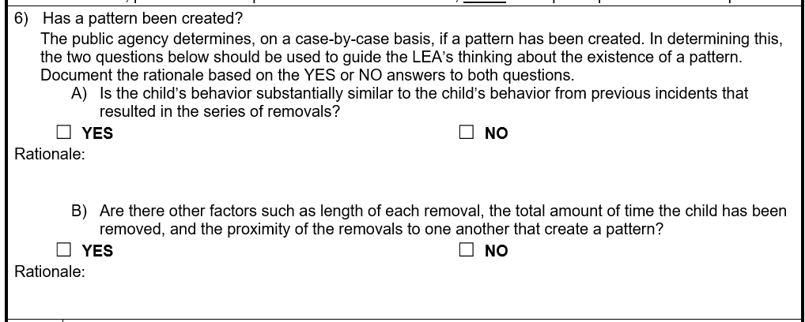
Pattern: YES or NO
x
x
Notes:
Another reminder, it’s school people that determine if a pattern exists, and we are thinking about the same questions as before:
Is the behavior substantially similar? (threw food, cursed at the teacher, tore up decorations, hit a student with textbook, shoved a student into her locker)
For the purpose of this scenario, we’re going to say that school people decided the behavior is similar.
Are the lengths of removal similar? (1 day, 2 days, 1 day, 5 days, 5 days)
Are the removals close together? (Sept, Dec, Feb, April, May)
However, the lengths of removal are not that similar and they span over the entire school year, so we decided the answer to this question was no.
Another thing I want to point out is that there is space to document the rationale for each part of this decision. No essay is required here, but jotting down the reasons for the decisions made is extremely important, especially if you’re called upon for justification. It’s not likely that you’re going to remember why the decision was made once a few days or weeks pass.

Slide 31
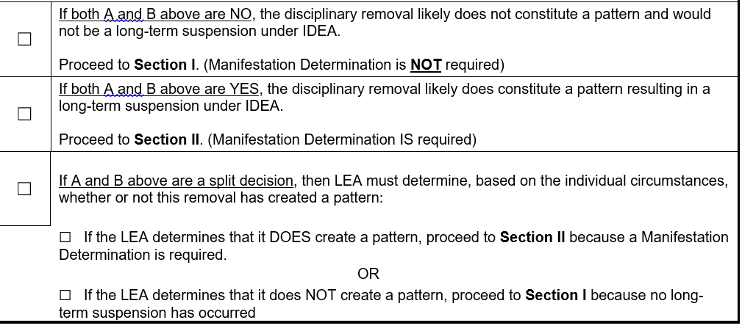
Decision documentation
x
x
Notes:
Thinking back to Kimmie, if both of our answers had been “no,” there would be no pattern (no long-term suspension) and no manifestation determination. However, we would still be obligated to determine what services are required beginning on day 11 of OSS. And remember this is not a MD meeting; it’s just a consultation between school people to make this decision. The decision about services resulting from this consultation is documented in Section 1 of the Discipline Documentation Form.
If both of our answers had been “yes,” then that would have automatically meant we were required to hold a manifestation meeting.
But we had a split decision. We decided that the behavior was substantially similar so that could possibly constitute a pattern, but the length and proximity of the removals did not create a pattern. That split decision is what landed us at the 3rd option on this page, and now we must decide one way or another. Is there a pattern or not?
At this point, it is still school people making the decision, and if the district decides there is a pattern, then the LEA moves forward with a manifestation determination meeting that includes the parent. Everything we’ve talked about up to this point IS NOT a manifestation determination meeting. Keep in mind that the determination of whether or not a pattern exists is what triggers a MD meeting, it’s not part of what is decided in the MD meeting.
Now back to Kimmie, we decided there was a pattern (which constitutes a long-term suspension under IDEA) so a MD meeting is required. Section 2 of the Discipline Documentation Form will walk us through the next steps.

Slide 32
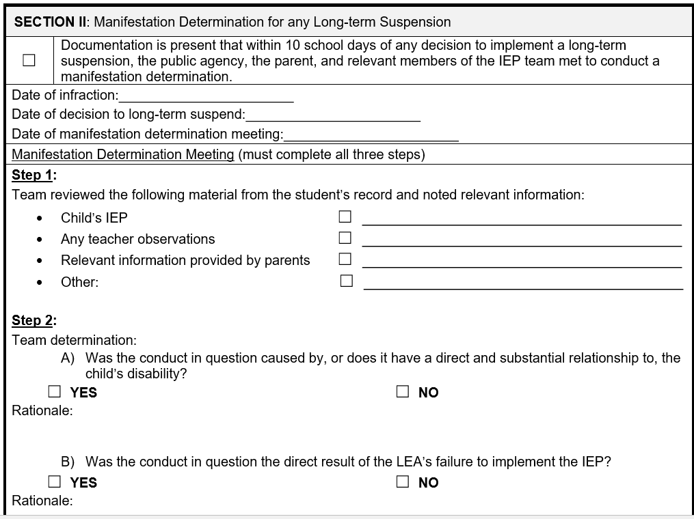
If there was a pattern, manifestation determination is required
x
x
Notes:
Keeping on with the Kimmie scenario, our team decided there was a pattern, so we need to hold a manifestation determination. At that meeting, our first step is to review:
Student records
IEP (including the behavior plan, if one exists)
Relevant information provided by teachers and other persons with knowledge of the incident
Relevant information shared by the parent
Any other information that might be relevant to our decision
I would strongly encourage you to keep copies of the information reviewed at this meeting and absolutely appoint someone to take meeting notes. You’ll want to keep this information along with the discipline documentation form.
Once we have reviewed the materials from step 1, a decision must be made as to whether the conduct in question has a direct and substantial relationship to the student’s disability and if the conduct was a direct result of failing to implement the student’s IEP. Based on our review of the step 1 data, we decided the answer to both of those questions was “no.”

Slide 33
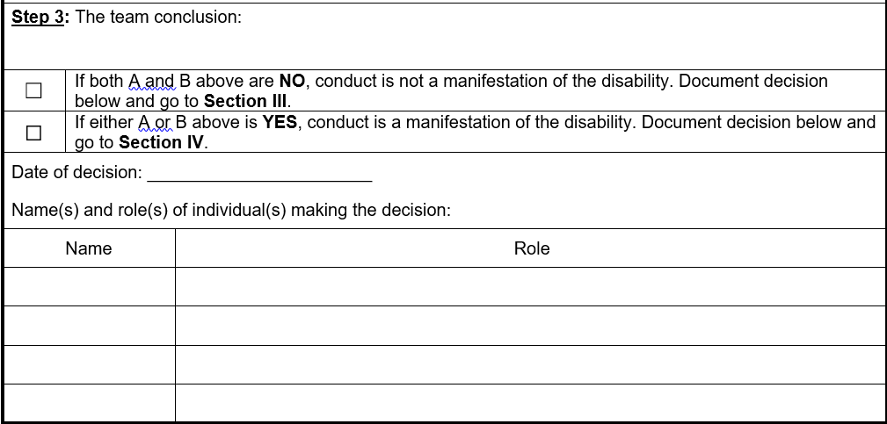
Manifestation, yes or no?
x
Notes:
Since we decided her behavior of shoving a student into her locker was not a manifestation of her disability, we are now ready to move on to Section 3, but remember to document dates and names in this part of the form.

Slide 34
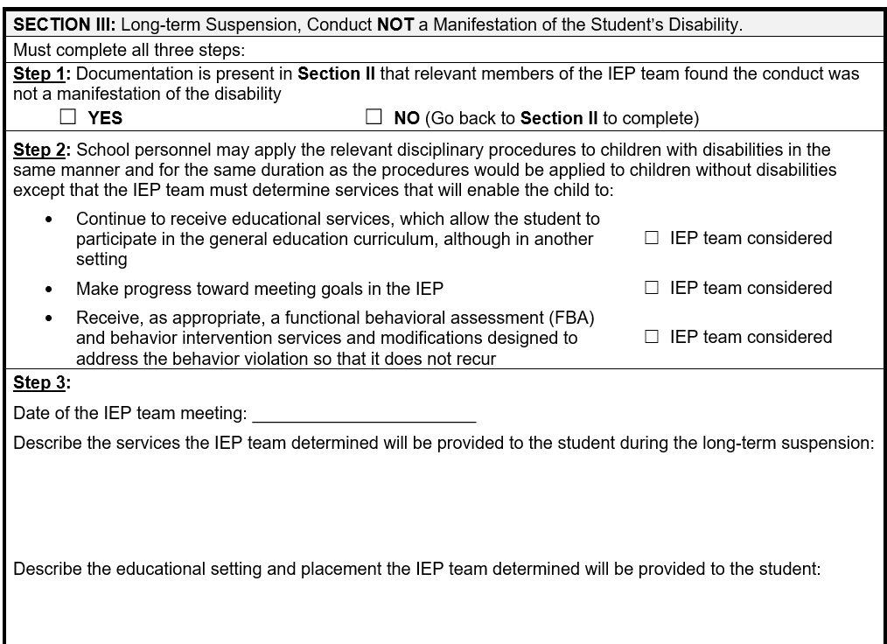
Not a manifestation for Kimmie
x
April 17, 2023
Kimmie received 20 minutes a day of virtual special education services for
Social skills while she was out of school these 5 days. No further services required.
Kimmie’s placement was not changed. A PWN was provided to her parents explaining that these
services will be provided virtually while she is at home on suspension (5 days). The services on her
current IEP will begin again when she returns to school.
Notes:
And it’s also in Section 3 where we document how we are going to provide services to Kimmie during her OSS.
You can see that the team decided to provide 20 minutes of virtual services per day in social schools during the 5 days of OSS, and the parents were provided with a prior written notice.

Slide 35
Lori
Lori is an 11th grade student. She was identified as a student with an intellectual disability in 3rd grade. She receives 250 minutes of specialized instruction per day for reading, math, written expression and social skills. She has a history of emotional and behavioral difficulties dating back to 1st grade. Her IEP includes a BIP based on a FBA done last school year after an incident of inappropriate comments and touching another student.
Sept. 1 Refused to work in science class and directed profanity at teacher - 2 days OSS
Oct. 5 Inappropriate sexual remarks to a peer - 3 days OSS
Oct. 11 Told a sexual joke directed at the PE teacher. BIP not being implemented - 3 days OSS
Nov. 1 Knocked books from another student’s hands and made inappropriate sexual comments to the student - 10 days OSS
Notes:
Now let’s take a quick look at Lori.
READ SCENARIO
When we look at the behavior in question, we notice it all includes profanity or sexual comments, and notice how close these incidents occurred. These are all the kinds of things school people would want to consider when making a decision about whether or not a pattern exists. And remember, a conversation about services beginning on day 11 happens no matter what is decided about a pattern.

Slide 36
Here’s what we decided…
Yes, there’s a pattern so the 10 days would fall into a long term suspension so must do a manifestation determination meeting
Determined it was a manifestation of the disability. What do we do now?
Notes:
Fast forwarding, the team decided there was a pattern, so that triggered the manifestation determination meeting. We used the Discipline Documentation Form and decided the conduct in question was a manifestation of Lori’s disability, so that meant we move on to Section 4 of the Discipline Documentation Form. Remember, the behavior in question all included profanity or sexual comments. A further study of Lori’s situation revealed that she has a history of these kinds of difficulties and behaviors. In fact, this type of behavior is what her behavior improvement plan addresses.

Slide 37
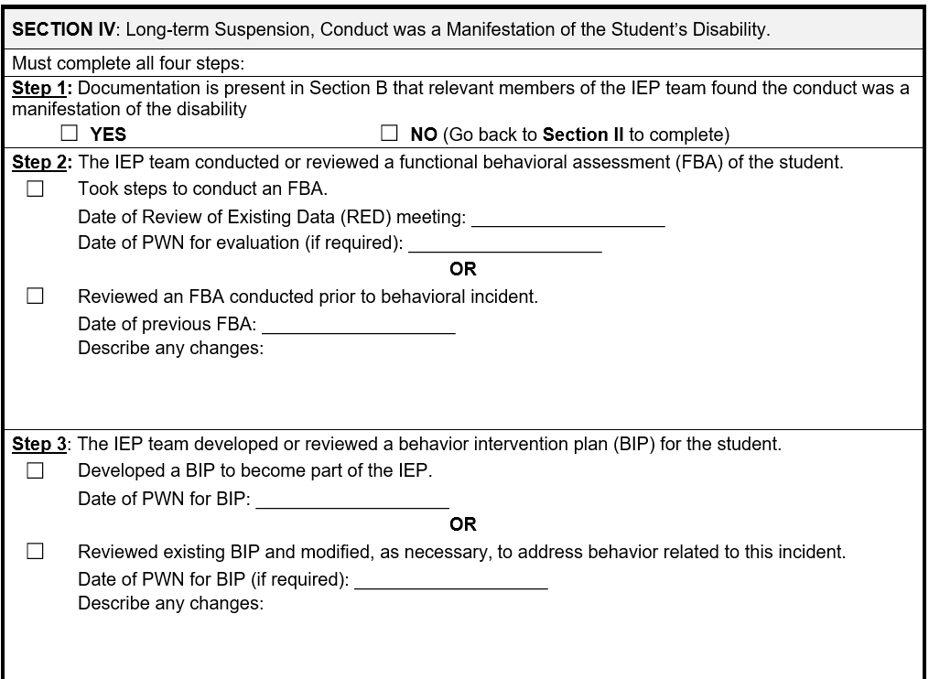
Incident was a manifestation for Lori
x
x
March 3, 2022
Changes included the increase in aggression Lori is displaying, especially when
Paired with the sexual comments. Parents will speak to her doctor about this.
x
None required. No changes made.
Notes:
Section 4 guides us through Lori’s process. Note, that if Lori had not already had a functional behavior assessment, one would be required. However, since an FBA has already been conducted, the team reviewed and noted changes in Step 2. Step 3 of this section reminds us that we need to make decisions about a behavior improvement plan and document those decisions.
It’s important that we document in this section the steps we are taking to prevent future occurrences of the behavior that got Lori jammed up.

Slide 38
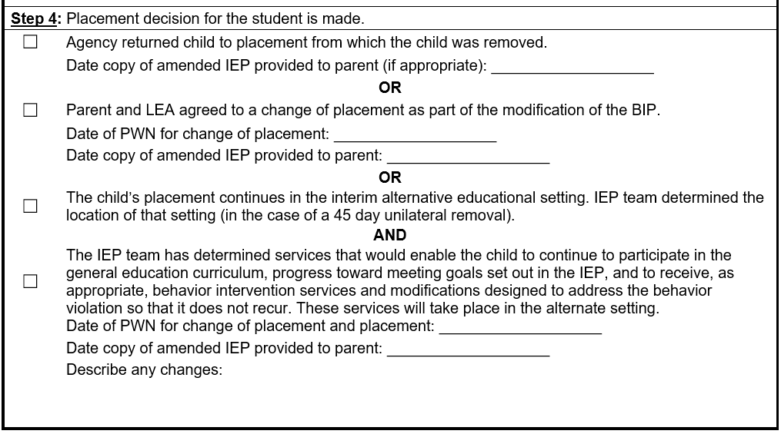
Placement decision
x
No need to amend IEP.
Notes:
Finally, we must document the decision about placement. For Lori, we decided to return her to the placement from which she was removed.
However, if we had made a different decision about placement, we would select the appropriate box and follow the guidance associated with that selection.

Slide 39
John
John has an IEP. The IEP provides for bus transportation as a related service. John threw chocolate raisins at the bus driver’s head while she was driving. The bus company wants John suspended from the bus for 10 days.
Is a manifestation determination required?
Does it matter if John’s parents volunteer to drive him to school during those 10 days?
Notes:
My guess is that you have several questions about this scenario. Remember back at the beginning of the hour that Julie told you bus suspensions count towards OSS days if transportation is a related service in the IEP.
In order for us to know if a MD is required, we would need to know if John had any other OSS during the school year. If no, then no MD required. If yes, then work through the Discipline Documentation Form to decide if there is a pattern and proceed accordingly.
And the second question of whether or not it matters if the parents volunteer to drive John to school during the 10 days – the important thing to remember is that if the team determined transportation was required as a related service, then it’s the district’s responsibility to make that happen. The parent volunteering could be the way that is accomplished, but the district cannot require the parent to drive the student. The bottom line is that if the student cannot access his services due to lack of transportation, then those 10 days off the bus count as 10 days OSS.

Slide 40
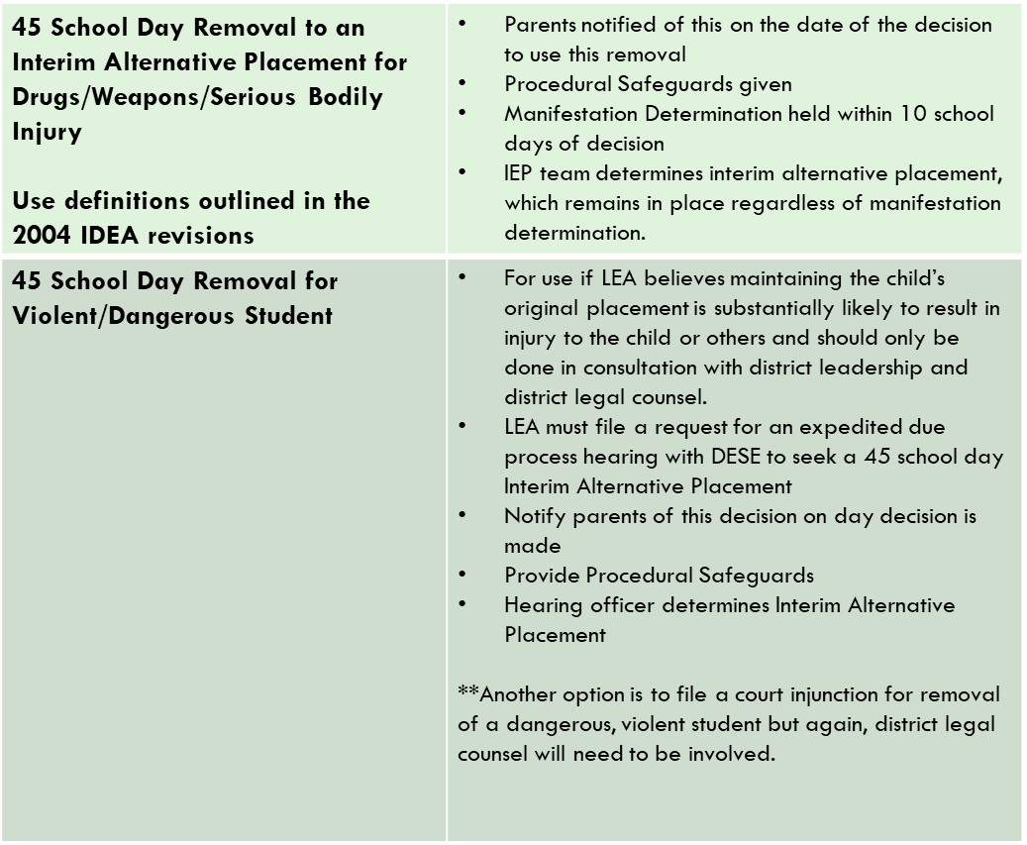
Other discipline options under IDEA
Notes:
Occasionally, students are subject to a 45 day removal from their current placement as a result of more serious behaviors such as drugs, weapons, or serious bodily injury. In these situations, a manifestation determination meeting is still required with 10 school days of the decision to long-term suspend. However, even if the conduct in question is a manifestation, the student can still remain in the interim alternative placement for the 45 school days.

Slide 41
Other discipline options under IDEA
Notes:
The 45-day removal is also an option for a violent and/or dangerous student, but now we are moving into an area that requires consultation with district legal counsel.

Slide 42
Stay Put
Occurs when parents or LEA request a due process hearing regarding the disciplinary action to challenge the manifestation determination or a placement decision.
If parents challenge the manifestation determination, stay put is out of school suspended.
If parents challenge the placement when the behavior is a manifestation, stay put is the placement determined by the IEP team.
If parents challenge the placement and or setting of a 45 day IAES, stay put is the IAES which was determined by the IEP team.
If the LEA challenges a decision to maintain the current placement, stay put is the IAES determined by the IEP team
Notes:
This is complicated and is probably best to work with your school district attorney in these situations. Parents and LEA’s have the right to due process in the discipline process. Parents can file for due process if they disagree with the manifestation determination or the placement decision made as a result of the manifestation determination or in an interim alternative educational setting determination. If the parent is challenging the manifestation determination (and that generally happens if the decision was that the behavior was NOT a manifestation of the disability), stay put is out of school suspended. If the parent is challenging the placement determination when the behavior WAS a manifestation of the disability, since 2004 stay put is the placement determined by the IEP team and NOT returning the student to the original placement from which he was removed. If the parent is challenging the placement determination in the case of an interim alternative education setting decision, stay put is the interim alternative educational setting determined by the IEP team. That same thing is true if the LEA challenges a due process decision to return the child to their original placement. Stay put is in the placement setting determined by the IEP team.

Slide 43
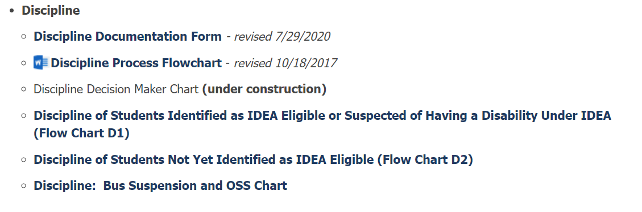
Resources for discipline decisions
These resources can be found on the DESE website at the link below.
https://dese.mo.gov/special-education/compliance/special-education-forms
Notes:
Here is a list of discipline resources and the links to find them. We are also updating Discipline Myths and those will also be available on the DESE website.

Slide 44
Discipline Data Reporting
Notes:
Now, we’ll turn the presentation over to Mary Corey to discuss discipline data.

Slide 45
Reporting discipline removals
Data reporting often does not align with the special education discipline process!
  Report all removals from the student’s “usual” place, regardless of pattern, manifestation determination, provision of service, etc.
Discipline incidents:
  Report ALL incidents resulting in ½ day or more of in-school suspension, out-of-school suspension, unilateral removal, or expulsion
  Report ALL students, grades PK-12; including students with disabilities
  MOSIS June Discipline Incidents file populates Core Data Screen 09
  Due in June cycle
Notes:
Please note that the MOSIS discipline data reporting does not always align with the special education discipline process. All in-school and out-of-school suspensions that are a half day or longer, unilateral removals, and expulsions are to be reported to DESE in the June MOSIS Discipline submission. Removals are reported for all students, grades PK-12, including students with disabilities. Basically, you need to report all disciplinary removals from the student’s “usual” class or school, regardless of pattern, manifestation determination, or provision of special education services.

Slide 46
Discipline removal type definitions
In-School Suspension: Removal of student from regular classroom setting (within a school building) for a fixed amount of time with student automatically returning to regular classroom setting after the suspension is completed
Out-of-School Suspension: Removal of student from regular school for a fixed amount of time with student automatically returning to school after the suspension is completed
Unilateral Removal: School personnel (not IEP team) ordered removal of student with disabilities from current educational placement to an appropriate interim educational setting for same amount of time that a child without disabilities would be subject to discipline, but for not more than 45 days
Expulsion: Removal of student from school and by local board action for an indefinite period of time until student is reinstated by local board of education
Notes:
Shown here are the discipline removal type definitions. An in-school suspension is the removal of a student from their regular classroom. This could be to an In-School Suspension room, but it could also be for an extended visit to the principal’s office or other area that is not the regular classroom. An out-of-school suspension is the removal of a student from their regular school. This could include an alternative setting or school. In general, if a student is not where they would normally be as a result of a disciplinary offense for a half day or more, it needs to be reported.

Slide 47
Discipline data elements
Data elements include:
  MOSIS ID
  Offense date
  Offense type
    Weapon type
  Discipline removal type
  Length removed
  And others
Notes:
These are the main data elements reported for each removal. They include the student’s MOSIS ID, the offense date and type, the removal type, and the length of the removal.

Slide 48
Brad’s data reporting in MOSIS
First Name | Offense Date | Offense Type | Discipline Removal | Length Removed | IEP Disability
Brad | 9/10/22 | Other | OSS | 3 | 09-SLD
Brad | 11/15/22 | Other | OSS | 5 | 09-SLD
Brad | 2/25/23 | Other? Violent Act? | OSS | 10 | 09-SLD
Notes:
In reference to the scenarios above, the MOSIS Discipline reports for Brad are shown here. The three OSS removals that Brad received must all be reported, regardless of whether a pattern exists.

Slide 49
Kimmie’s data reporting in MOSIS
First Name | Offense Date | Offense Type | Discipline Removal | Length Removed | IEP Disability
Kimmie | 9/3/22 | Other | OSS | 1 | 10-OHI
Kimmie | 12/5/22 | Other | OSS | 2 | 10-OHI
Kimmie | 2/14/23 | Other | OSS | 1 | 10-OHI
Kimmie | 4/6/23 | Other? Violent Act? | OSS | 5 | 10-OHI
Kimmie | 5/12/23 | Other? | OSS | 5 | 10-OHI
Notes:
Reporting for Kimmie is similar to Brad’s. Each removal is reported separately indicating the offense type, discipline removal type, and length of removal.

Slide 50

Questions?

Slide 51
Contact Information
Compliance
573-751-0699
secompliance@dese.mo.gov
Data
573-751-7848
speddata@dese.mo.gov
Effective Practices
573-751-0187
seep@dese.mo.gov

Slide 52


