Slide 1
Zoom Support Meeting Norms
Mute unless you are speaking to the group
Use the chat to ask questions
Be professional and helpful
Be mindful when asking questions about specific situations - don't give out any information that could reveal the identity of a person with a disability

Slide 2
School Year Wrap-Up
Bailey Tennesen
Dawn Lichtenberg
Notes:
Dawn:

Slide 4
Today’s Hot Topics
Policy & Procedure Reminders
PWN for Initial Eligibility/Provision of Initial Services
Summer School Access for IDEA Students
Retention of Students with IEPs
Retention of Records
Transfer Students
Initial Timeline Extensions- Summer
C-B Summer Birthday Options and 3rd Birthday
OSEP Assistive Technology Guidance Documents
Upcoming DESE Sponsored Events

Slide 5
Policy & Procedure Reminders

Slide 6
Prior Written Notice (PWN) for Initial Eligibility/Provision of Initial Services
DESE revised initial evaluation flow charts for parent and agency referrals
LEAs are required provide PWN requesting parent written consent for provision of initial special education and related services but are not required to convene the IEP team until the parent has provided written consent.
C.F.R 300.300.b
Notes:
When researching federal law 34 CFR 300.300 (b), DESE Compliance found that if a student is eligible for special education, they are eligible for the initial provision of special education and related services, and this should be determined at the eligibility determination meeting. During eligibility determination meeting, the team would not predetermine the amount, frequency or location of services being provided (that would be discussed at the IEP meeting) . We are simply stating that they require special education services (and potentially related services depending on the needs of the student).An analogy that was shared with me is the doctor office analogy. When you check in at doctors office, you’re required to consent to doctor providing services prior to even being seen by the doctor. When you see the doctor, they you fine tune treatment plan…similar to IEP team and IEP development.
*During the IEP meeting, the IEP team will determine the amount, location and frequency of services required. Parental consent is not required for this determination . This would be considered the details of the initial placement on your PWN.
LEAs are encouraged to set a tentative IEP meeting date in anticipation of receiving parent consent for provision of initial services. LEAs should expedite the IEP meeting process as much as possible after receiving consent when a parent has delayed providing consent. In no case should the IEP meeting be held more than 30 days after the date the parent provided consent for provision of services.
A recap: The provision of initial special education and related services is determined at time of eligibility, that’s what the initial services PWN is focused on, “the general need” not the specific details of services.

Slide 7
Two Ways to Fill Out PWN for Initial Eligibility and Provision of Initial Special Education and Related Services
1st Way: 2 Separate PWNs Describing Each Action:
PWN 1 : Initial Eligibility ( box for initial eligibility would be checked, but parental consent is not required)
PWN 2: Initial Services (box for initial service would be checked and consent required)
DESE Example showcases provision of services on March 2024 To-Do List (PWN 2 above)
2nd Way: One PWN Describing Both Actions:
PWN1: Initial eligibility & initial service box would be checked and discussed. Parental consent would be required for initial services
*Suggestion: Separate out each action by including one paragraph for initial eligibility and a second paragraph for provision of initial special education and related services on each section of PWN.
Notes:
There are two ways you can complete Prior Written Notices (PWN) for initial eligibility and provision of initial special education and related services during the Eligibility Determination Meeting
1st way: The PWN example that was provided in DESE sample was to show how you could describe the provision of initial special education and related services at the eligibility determination meeting (PWN 2). In the example, the team chose to have two separate PWN documents describing each action that was agreed at the eligibility determination meeting (initial eligibility – PWN 1 and PWN 2 for the provision of initial special education and related services).
2nd way: Districts could choose to put both actions on one PWN. If you do this, I would suggest writing one paragraph on initial eligibility and a second paragraph on provision of initial special education and related services for each section of the PWN. In this situation both boxes would be checked, initial eligibility and initial services. Parental consent would be required for this PWN because you combined initial services and initial eligibility.

Slide 8
ESY VS. Summer School

Slide 9
Reminder: Summer School Access to IDEA Students
If Summer school is offered to all students, then students in special education are allowed to participate as well.
SPED- Accessibility is key
Review summer school policies for potentially discriminatory practices
Field trips (students without a disability can attend without parent, but students with a disability must have parent attend with them)
Students who have a behavior intervention plan (BIP) or student’s who meet eligibility of ID are not allowed to attend summer school
IEP accommodations, modifications, supplemental aids and services, and/or
May need to write a 504 Plan for just Summer school
Notes:
Summer school is designed for enrichment, remediation, and credit recovery. If summer school is offered to all students, then students with disabilities will be allowed to participate as well.
Many times, the accommodations, modifications, and supplemental aids and services will suffice for access to the summer programs.
504 Plan can be written to address just the summer school session.
Accommodations: Be sure to mention: If a student requires a para during the school year, the same applies to summer school; nursing services; and transportation and extra supervision are needed for field trips during the school year, the same applies to summer school.

Slide 10
Retention of Students w/ Disabilities
Missouri State Plan does not have guidance on this and leaves it up to the district to make the decision on how a student will be promoted.
Check district policy on retention for all students.
The IEP team could, based on the needs of the child, recommend an exception to the policy
In an LRP article Expectations Matter When Contemplating Grade Retention for Students with Disabilities it discusses how districts should proceed with caution. The IEP Team should review/consider:
why retention is necessary
the most recent evaluation & IEP to understand the students academic, behavioral and other needs
whether or not retention is appropriate given the student’s needs
whether or not retention would be effective.
how retention would be addressed within the IEP
Nissman, Cara. “Expectations Matter When Contemplating Grade Retention for Students with Disabilities.” Special Ed Connection , LRP, 26 Mar. 2026, www.specialedconnection.com/LrpSecStoryTool/index.jsp?contentId=22751058&query=%28%28%7BRETENTION%7D%29%29&listnum=0&offset=5&topic=Main&chunknum=1.
Notes:
Based on the child's needs, The IEP team could recommend an exception to the policy. It seems more complex than the IEP decision. I recommend digging out the district policy first and then talking about what the IEP does and when an exception to the policy should be made for a child with a disability. There is a policy that applies to all children, but the IEP team can document in the IEP why the policy doesn’t apply based on the child’s disability and resulting needs

Slide 11
Retention of Records:
DEFINITIONS
Destruction means physical destruction or removal of personal identifiers from information so that the information is no longer personally identifiable.
Educational records means records maintained by a public agency responsible for the provision of general education or special education and related services that pertain to the special education and related services provided to a student with a disability. The term includes medical, psychological, and educational reports but does not include records of instructional, educational, ancillary, supervisory, and administrative personnel which are the sole possession of the maker and which are not accessible or revealed to any other personnel, except another person who performs on a temporary basis the duties of the individual who made the record. The term includes test instruments or protocols/score sheets and a record of the test results. Copies of test protocols will only be provided if the failure to do so would effectively prevent the parent or student from exercising the right to inspect and review the educational records. The term does not include certain records maintained by a law enforcement unit of a public agency or records maintained about a student with a disability as an employee of the public agency.
Participating agency means any agency or institution that collects, maintains, or uses personally identifiable information or from which information is obtained under Part B of IDEA.

Slide 12
Retention of Records:
Student Special Education Record
Also Called: Chapter Programs; Individuals with Disabilities Education Act Data; Title Programs
Content: Record of Access Form; Documentation of Screening; Program Modifications; Evaluations Plans; Notice and/or Consent forms for Evaluation; Diagnostic Summaries; Individualized Education Programs (IEPs); Notice and/or Consent Forms Placement and Documentation of the Provisions of Appropriate Procedural Safeguards.
Minimum Retention: Permanent*
Disposition: Archive Note: *Per RSMo 167.027, beginning with the 2023-2024 school year, all special education records must be maintained permanently; For older special education records (previously scheduled with a minimum retention of 3 Years from date of last service), the last, most recent, record must be retained permanently.
Approval Date: Revised August 19, 2014; Revised August 24, 2016; Revised November 16, 2023
https://www.sos.mo.gov/CMSImages/LocalRecords/PublicSchool.pdf
DESE will not be issuing any guidance contrary to the Secretary of State’s instructions
Notes:
The Secretary of State Revised SCH097 Student Special Education Record, published November 2023 reads-

Slide 13
Transfer Students
Summer break is the time when the largest number of students transfer between school districts.
To ensure a smooth transition you need to train front office staff to LOOK, LISTEN and ASK….and then NOTIFY special education staff.
Train staff who process new enrollees to the district to listen for “trigger” words.
Check enrollment forms for common SPED language.
Have the office staff ask clarifying questions.
Notes:
Because this is one of the first activities that will occur at the start of the new school year, we will go through the transfer process compliance requirements a little bit more in-depth to ensure a timely and seamless transfer from one school district to another for students with disabilities.
When receiving a new student in your district, school staff will need to look and listen for any indications that the enrolling student may have been identified as a student with a disability.
The first place to begin determining if a new student is a student with a disability is with the initial contact with the school district and through the enrollment paperwork. It is important to know who in your district is responsible for this initial contact. In some districts, this can be the school building secretary or the school counselor. In other districts, it could be the principal or the registrar. No matter who it is, these staff should be trained to “look” and “listen” for indications that the new enrollee is a student with a disability since not all new students arrive at their new school with their IEP and Evaluation in hand. These staff must ensure that enrollment forms are thoroughly completed. Don’t be afraid to ask questions to clarify information the parent provides on the enrollment form!

Slide 14
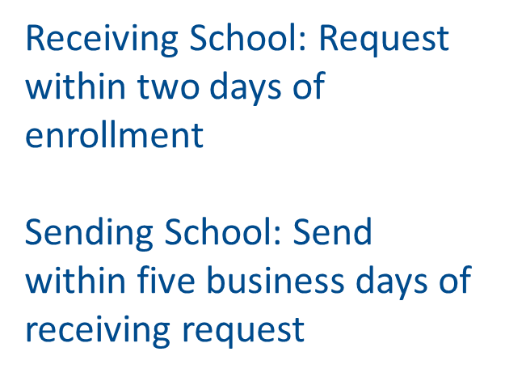
Notes:
In Missouri, the Safe Schools Act requires that receiving school districts request student records within two (2) days of enrollment. Sending Missouri school districts are required to send records within five (5) business days of receiving a request for records. Remember that FERPA allows for student records to be exchanged between LEAs when students transfer.
*Very important the receiving school cannot keep a student out of school pending the receipt of school records. In other words, districts cannot refuse to allow a student to begin attending school on the basis of waiting for the receipt of the special education records for a student.
Another way to gain information is the interview process. Interviews will provide valuable information. Interviews can be in person or over the phone. Interviews can be conducted with the student’s parents and with previous school staff, such as the special education teacher, the school counselor, the building principal, the special education process coordinator, etc. Interviewing will provide a better picture of the types and amounts of services that a student received at their previous school than enrollment documents alone.

Slide 15
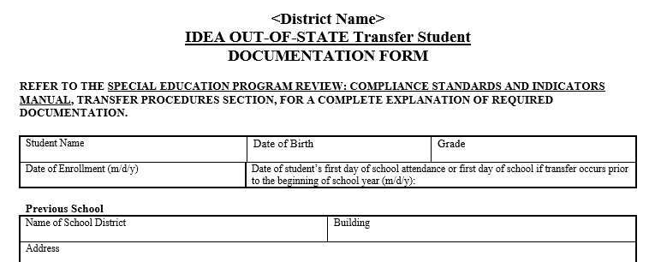
The 500s cover the In-State Transfer Process
The 550s cover the Out-of-State Transfer Process.
A LEA can accept a transfer evaluation report if they believe it is compliant and includes all information necessary to determine eligibility in the State of Missouri. If a LEA does NOT accept a transfer evaluation report because it is not compliant then:
An in-state transfer goes through the reevaluation process.
An out-of state transfer goes through the initial evaluation process.
Other key elements about transfer students with IEPs are:
IDEA requires that their Free Appropriate Public Education (FAPE) be provided during the transfer process. If paperwork is delayed from the sending school or the receiving school rejects the IEP, the public agency in consultation with the parent must provide FAPE to the child including services comparable to those in the previous IEP.
A transfer IEP can not be amended. Either it is accepted as written or a new one is written.
Notes:
In-state transfer requirements are found in the 500’s while compliance requirements for out-of-state transfers are found in the 550s. There are model Transfer Documentation forms to assist LEA staff in documenting and following all of the steps in the process. These can be found in the Form section of Compliance’s website.
In some cases, students arrive at their new school with complete copies of evaluation reports and IEPs; in other instances, students enroll with little or no paperwork and incorrect information from parents regarding past special education services. The model forms are designed specifically to address the required considerations for various transfer scenarios. In addition, the Standards and Indicators Manual clearly describes the process steps for both options.
Key elements during the transfer process are:
Incoming Evaluation Report - One of the biggest differences between an in-state transfer and an out-of-state transfer is how the evaluation report is handled. A LEA can accept a transfer evaluation report if they believe it is compliant and includes all information necessary to determine eligibility in the State of Missouri. If a LEA does NOT accept a transfer evaluation report because it is not compliant, then:
An in-state transfer goes through the reevaluation process.
An out-of-state transfer goes through the initial evaluation process.
IEP – If there is an IEP, the IDEA clarifies that FAPE must be provided. There should be NO DELAY in providing special education and related services to students with disabilities who transfer between schools. Those services can be guided by accepting the previous school’s IEP, the receiving school developing a new annual IEP, OR the receiving school providing comparable services to the previous IEP until a new annual IEP can be developed.
Another point is that if your district decides to ACCEPT the IEP from the previous school, that means that the IEP from the previous school has to be implemented EXACTLY as written. That means you cannot amend a transfer IEP since it has to be implemented as written. If (or when) the team determines that the previous IEP is no longer appropriate, the previous IEP is REJECTED, and a new annual IEP must be developed. Remember that there is no longer the need to develop an Interim IEP – the IEP Team will be developing the annual IEP at this point, and the annual IEP can be amended or re-written as the IEP Team determines is necessary for the individual student.

Slide 16
Tips for Transfer Success
The person reviewing transfer evaluations must be familiar with MO Standards and Indicators and MO eligibility criteria.
DESE Model Transfer Forms guide the transfer process, step-by-step.
Conduct thorough interviews with parent, sending school, and student (if 18+).
Keep good documentation of consultation regarding comparable services provided until a new IEP is developed.

Slide 17
The Model Transfer Forms and Flow Charts are Found Here:
In State Transfer Model Form: https://dese.mo.gov/media/file/transfer-state-documentation-form-0
In State Transfer Flow Chart: https://dese.mo.gov/media/pdf/state-transfer-flowchart
Out of State Transfer Model Form: https://dese.mo.gov/media/file/transfer-out-state-documentation
Out of State Transfer Flow Chart: https://dese.mo.gov/media/pdf/out-state-transfer-flowchart

Slide 18
COMMON TRANSFER FACTS AND MYTHS
MYTH: Students transferring from out of state do not need to meet Missouri eligibility requirements.
FACT: The transfer report must comply with Missouri’s Standards and Indicators and meet ALL the compliance requirements for evaluation and eligibility.
MYTH: All evaluation reports and IEPs from Missouri LEAs should be accepted and implemented.
FACT: The receiving LEA must ensure that the report and IEP are compliant with Missouri Standards and Indicators and that the IEP can be implemented as written before accepting the documents.

Slide 19
COMMON TRANSFER FACTS AND MYTHS
MYTH: Transfer IEPs can be amended.
FACT: IDEA does not provide a process for transfer IEPs to be amended.
MYTH: If a transfer student requires an evaluation, an interim IEP is written.
FACT: There is no such thing as an interim IEP. Comparable services should be provided while the evaluation is conducted.

Slide 20
COMMON TRANSFER FACTS AND MYTHS
MYTH: Once the LEA receives the evaluation report and IEP, there is no need to write a new IEP until the student’s annual review.
FACT: If the LEA cannot implement the IEP as written, a new IEP must be developed (usually within 30 days of enrollment). If the IEP can be implemented EXACTLY as written, there is no need to develop a new IEP until the annual review.
MYTH: Comparable services are decided solely by the LEA.
FACT: The LEA, in consultation with the parents, must determine what services are comparable to those described in the transfer IEP.

Slide 21
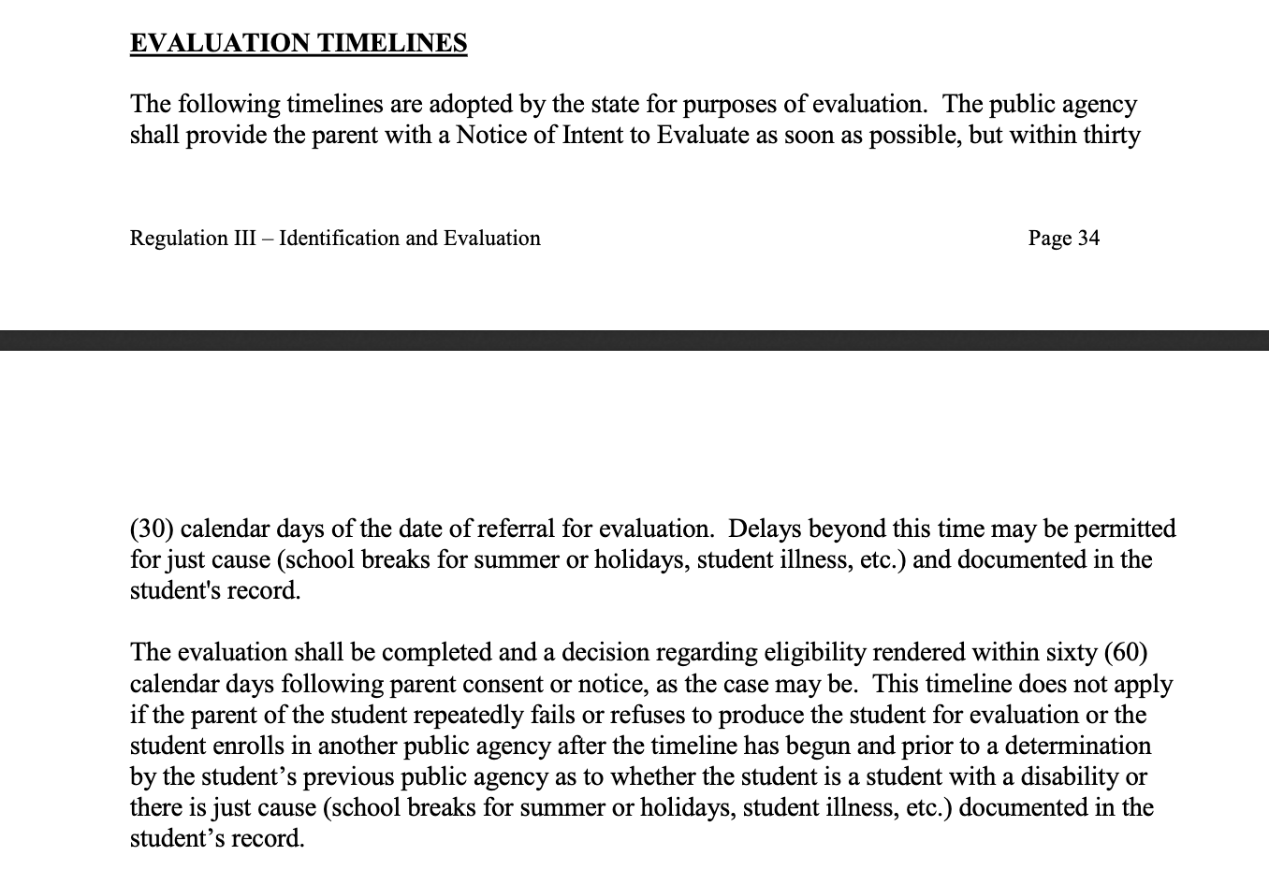
Special Education Evaluations and Summer
Districts should have procedures and practices in place to process requests from agency personnel and parents throughout the school year.
Public agencies cannot have an arbitrary cut-off date for accepting requests for initial evaluations, however it is important to keep in mind that there are acceptable extensions for the first 30 and 60 days of evaluation timeline listed in the Missouri State Plan, Regulation III (p.34).**** However, there are no extensions to the 30-day timeline for developing the IEP.
Notes:
Bailey:
We want to remind you all that requests for evaluations in special education increase during 3rd and 4th quarter. Districts must have procedures and practices in place to process requests from agency personnel and parents throughout the school year. There are no cut-off dates for accepting requests for initial evaluations. Remember it is important to know that there are acceptable extensions for the first 30 and 60 days of evaluation (includes summer break). There is no extension for the 30-day timeline for developing the IEP.

Slide 22
First Steps Summer Third Birthdays: Overview of Programs
First Steps (Part C): Provides early intervention services to eligible children through an Individualized Family Service Plan (IFSP)
Early Childhood Special Education/ECSE (Part B): Provides a Free Appropriate Public Education (FAPE) to eligible children at age three-21 through an Individualized Education Program (IEP)
Notes:
Speaking of summer, we also wanted to remind you all about First Steps summer 3rd birthdays. Please remember there is a difference between First Steps and early childhood special education.

Slide 23
C to B Summer Third Birthday Options
Summer third birthdays fall between April 1st -August 15th
Remember:
Eligibility must be determined and an IEP in place prior to child’s third birthday. However, parents have options on when IEP services begin:
Option 1: Parents may determine whether they stay in First Steps until school starts in August
Option 2: Parents may determine to transition to Early Childhood Special Education (ECSE) to receive ESY services
Option 3: Parents may wait to start ECSE services in August
Notes:
Children transitioning from First Steps who have summer third birthdays falling between April 1st -August 15th have several choices for obtaining services starting on their third birthday. Option 1: Parents may determine whether they stay in First Steps until school starts in August
Option 2: Parents may determine to transition to Early Childhood Special Education (ECSE) to receive ESY services
Option 3: Parents may wait to start ECSE services in August

Slide 24
Additional Information on Summer Third Birthday Guidance From First Steps to ECSE
Summer Third Birthday Guidance
Summer Third Birthdays (recording)
Summer Third Birthdays (1 slide per page)
Summer Third Birthdays (3 slides per page)
Frequently Asked Questions (Updated March 2018)
Handouts
Parent Options for Summer Third Birthdays
Notice of Action/Consent to Continue First Steps for Summer Third Birthday Children
Notes:
For additional information on this topic, please visit the Early Childhood of Special Education website on DESE. On this website there are tons of resources including a presentation over this topic, FAQ, and handouts for parents!

Slide 25
OSEP Assistive Technology Guidance Documents
Notes:
We also wanted to let you know that in January 2024, OSEP created new Assistive Technology Guidance Documents!

Slide 26
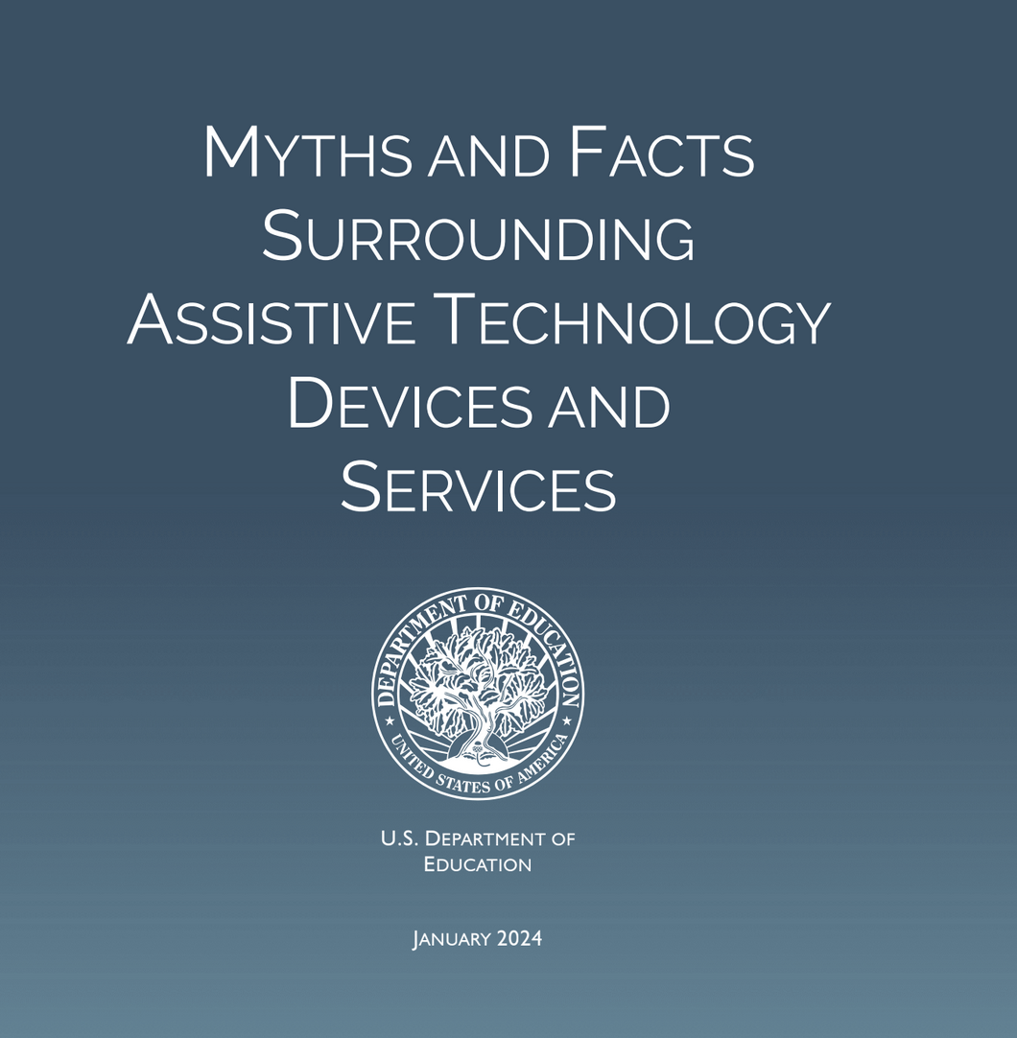
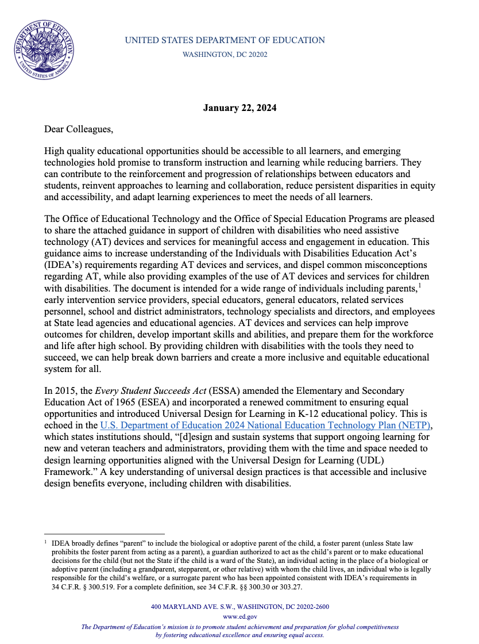
New Guidance on Assistive Technology Devices and Services by OSEP
Myths and Facts Surrounding AT
Dear Colleague
Notes:
The United States Department of Education published Myths and Facts Surrounding Assistive Technology Devices and Services and a Dear Colleague Letter surrounding this topic. Myths and Facts Surrounding Assistive Technology Devices and Services (PDF) is designed to increase understanding of the IDEA’s AT requirements, dispel common misconceptions regarding AT, provide examples of the use of AT devices and services for children with disabilities, and highlight the different requirements under Part C and Part B of IDEA.
The Dear Colleague Letter discusses the provision of assistive technology devices and services for children with disabilities under the Individuals with Disabilities Education Act (IDEA).
I highly recommend that these apart of your tool box when teams are considering assistive technology for a student with a disability.

Slide 27
DESE Sponsored Upcoming Events
Notes:
Before the end of the school year, we also wanted to make sure you were aware of two upcoming DESE Special Education sponsored events happening this summer!

Slide 28
Register Today: https://tinyurl.com/TTI2425
Notes:
The Transition Training Institute will be held June 26-28th in Columbia MO

Slide 29
TTI Information
Where: Holiday Inn Executive Center, Columbia MO
Cost: Registration Fee $150.00 per person until June 10th
Keynote Speaker: Sam Glenn
Training Tracks: Career Development, Healthy Living, Safety and Security, Community Living,Transition Training, Engagement/Advocacy and Compliance!
Notes:
Registration is only 150.00 per person.
Our keynote speaker is Sam Glenn: he has been giving inspirational and artistic speeches that have impacted audiences of all
sizes (some as large as 75,000 at stadium events) for nearly three decades. He believes that attitude
is the driver of everything and knows exactly how to recharge and rekindle that positive spark that
empowers leaders to give, do, and be their best. Today, his award-winning speeches set a positive
and energetic tone that engages with audiences and gets them ready to learn, grow, and have fun! Throughout this training there will be several different training tracks that participants can receive training in! This is something that not only would be great for special education directors, but also process coordinators and even sped high school teachers!

Slide 30
Special Education Directors Academy
Notes:
The second DESE sponsored event is the Special Education Directors Academy. This will be held July 24-26th in Columbia MO! This conference is geared towards 1st and 2nd-year directors but will also have an advanced track!

Slide 31
SEDA Information
Where: Stoney Creek Hotel, Columbia, MO
When: July 24-26th
Topics: Leadership, Early Childhood Special Education, Dispute Resolution, Discipline, Postsecondary Transition, Data Reporting and Special Education Program Requirements
Register today: https://tinyurl.com/mrxc9huz

Slide 32
Notes:
DESE would like to hear from you in regards to our Special Education Virtual Support Meetings. This will assist us with our planning for the 24-25 school year.
This link will stay open until June 4th
If you have not filled out the survey, please go ahead and do so now! Simply,
1. Open the camera app on your phone
2. Focus the camera on the QR code by gently tapping the code
3. Fill out the 1 question survey!
If this is difficult I will also put the link in the chat- https://forms.gle/mGS5kjumfL5uVh3t7 .
So far we have had over 100 directors respond

Slide 33
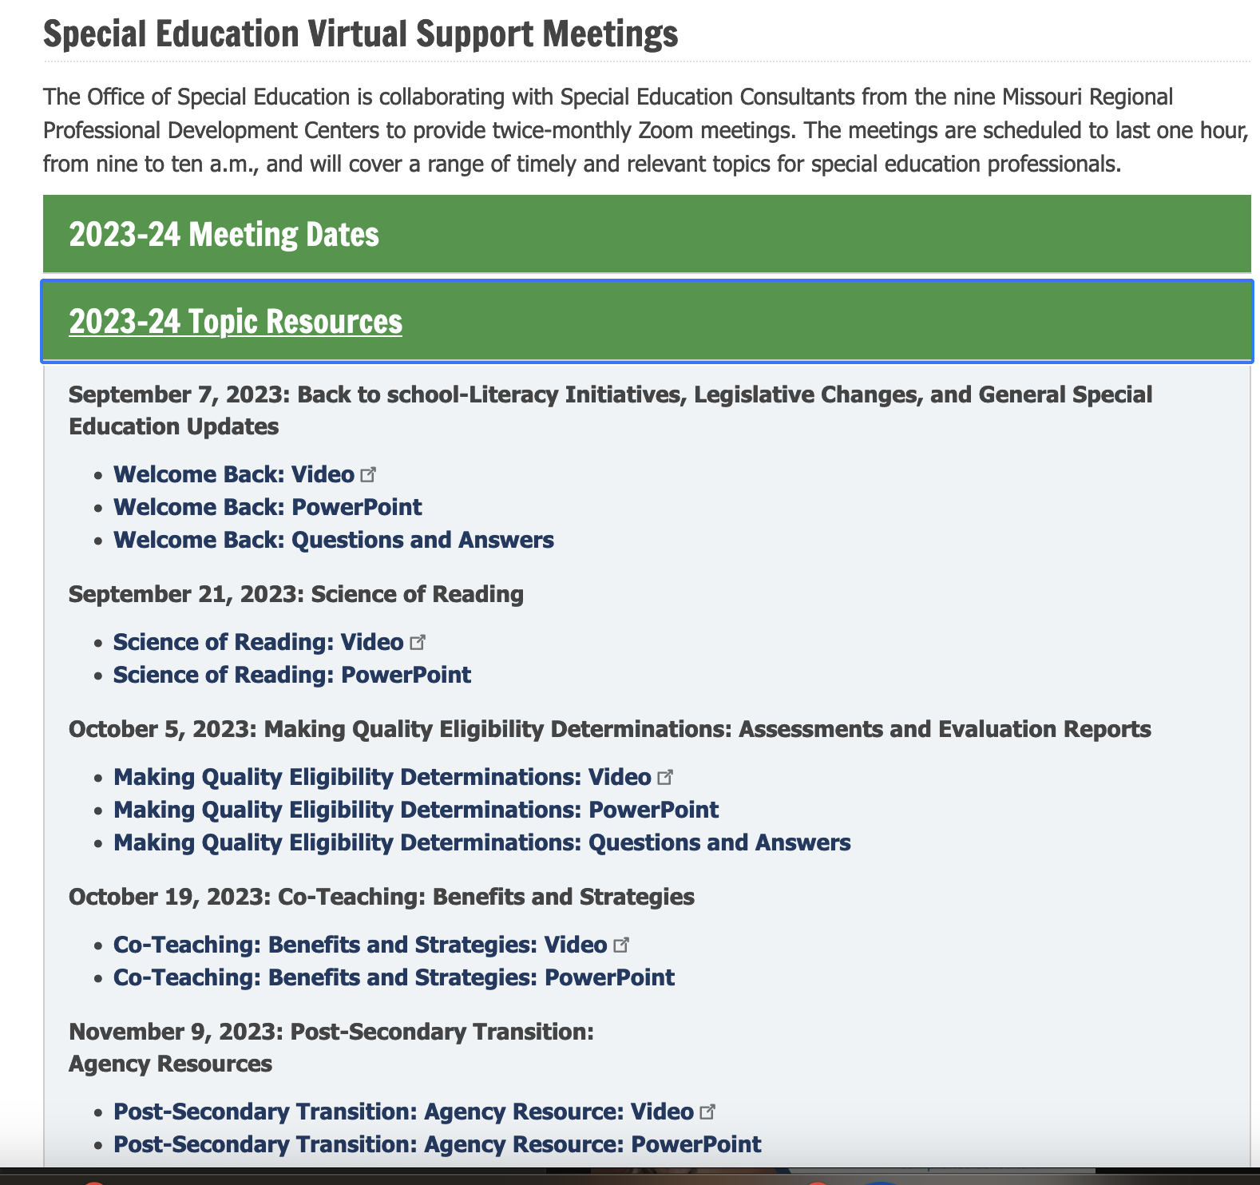
Don’t Forget!
Check out our DESE Special Education Virtual Support Meeting webpage for additional training resources on special education hot topics!
Notes:
After getting over 100 responses, we noticed that many people are requesting topics that we actually had already covered and are located on our virtual support meeting webpage. We can’t stress how amazing this webpage is for new special education directors and process coordinators! On this webpage, we have presentations that cover topics like eligibility determinations, present levels, IEP SMART goals, transition assessments, specific eligibility categories, manifestation determinations, etc... go to the tab that says 2023-2024 Topic Resources or 2022-2023 Topic Resources,etc.. and search for the topic you would like to see additional information on.
These resources are for you to utilize for your own professional development or even for upcoming training with your district educators and administrators. Each presentation has a PowerPoint, recording, and even a Q&A document and sometimes additional resources. If I were to lead a PD on the topic “Eligibility Determinations”, I personally would watch the training conducted by the DESE, RPDC consultant, or outside agency, then utilize the PowerPoint presentation and make it my own within the district. I would also suggest looking at the Q&A document or other resources before presenting so that you have an idea of what questions may arise and have the DESE guidance to back up your answers.

Slide 34
Confidentiality Training 24-25
Reminder to train staff on Confidentiality at the beginning of the 2024-2025 school year link:
https://studentprivacy.ed.gov/content/online-training-modules
Standards and Indicators: 100.220
Notes:
Another item that has been brought to our attention from the survey, is that many of you request FERPA training be a bi-monthly topic. We wanted to point out that the U.S. Department of Education has wonderful online training modules that cover FERPA. These are FREE and have all already been created. This is just one option for confidentiality training. There are other options that your district may use.

Slide 35
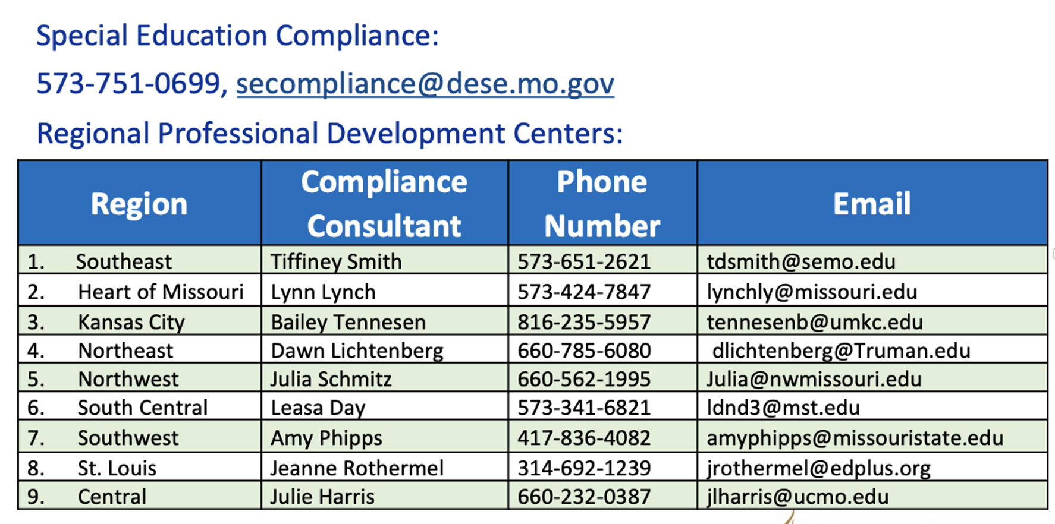
Who You Gonna Call?
Notes:
Here at the RPDC and DESE, we are 12-month employees. Please know that we are here and happy to assist you in any way possible throughout the summer.

Slide 36
"And suddenly you know... It's time to start something new and trust the magic of beginnings."
Notes:
As the 2023-2024 year slowly ends, if you are changing positions, retiring, or moving onto something entirely new, we ask that you please notify your RPDC Compliance Consultant so that we can update our contact list. This will give us the ability to be prepared for the changes to come in the 2024-2025 school year. If you have decided to leave your position, we wish you only the best in what is to come and hope our paths cross again.

Slide 37
THANK YOU!!!

