Slide 1
Multi-Tiered Systems of Support (MTSS): Planning Effective Systems of Support with Interventions, Accommodations, and Modifications
Tiffiney Smith, SE RPDC
Jeanne Rothermel STL RPDC
Special Education Compliance Consultants
April 25, 2024

Slide 2
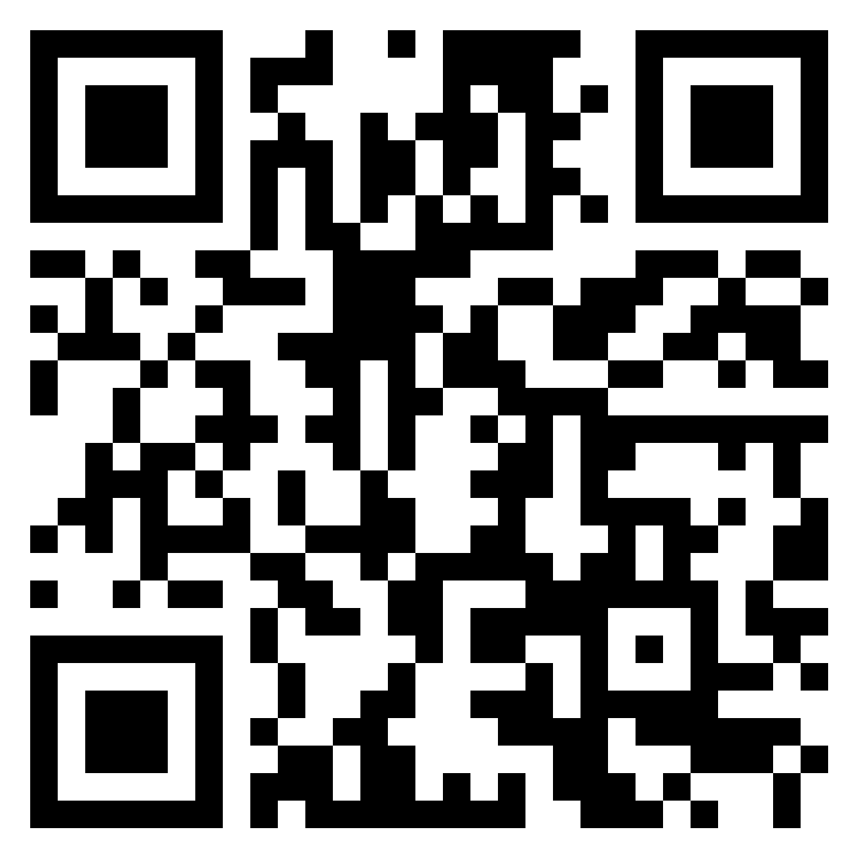
Padlet
Interventions, Accommodations, Modifications

Slide 3
Learning Objectives
Define and differentiate between an accommodation, modification and intervention
Understand the purpose of pre-referral interventions
Recognize how accommodations and modifications impact the determination of a student’s Least Restrictive Environment (LRE)
Identify ways to appropriately identify accommodations and modifications necessary for FAPE

Slide 4
Interventions, Accommodations, Modifications,
Oh My!

Slide 5
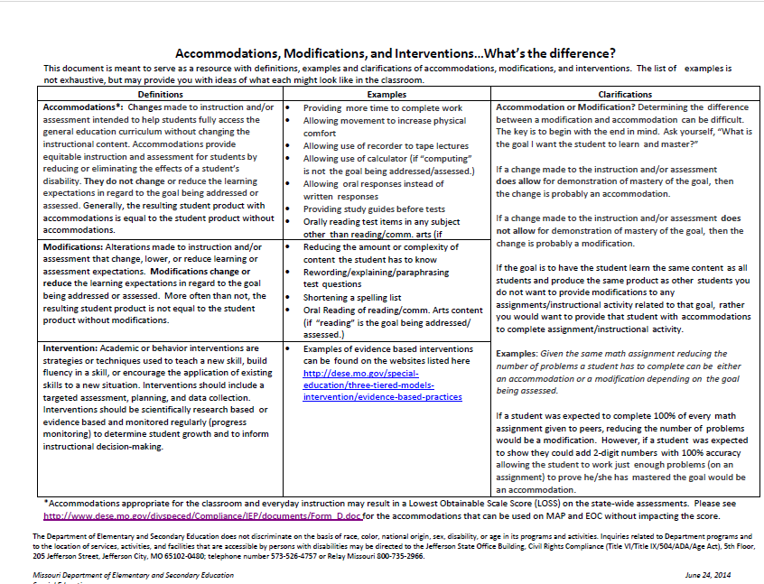
DESE Accommodation, Modification and Intervention Chart
https://dese.mo.gov/media/pdf/accommodations-modifications-and-interventionswhats-difference

Slide 6
Pre-referral Interventions

Slide 7
Multi Tiered Systems of Support = Interventions
Effective implementation of a comprehensive, inclusive multi-tiered system of support (MTSS) framework gives schools and districts data and infrastructure to meet the needs of students in both general and special education.
CASE MTSS Policy Statement

Slide 8
Interventions through MTSS
Academic or behavior interventions are strategies or techniques used to teach a new skill, build fluency in a skill, or encourage the application of existing skills to a new situation.
Interventions should include a targeted assessment, planning, and data collection.
Interventions should be scientifically research based or evidence based and monitored regularly (progress monitoring) to determine student growth and to inform instructional decision‐making.

Slide 9
MTSS Intervention Model
80%
Core
instruction
Very little progress
Core instruction + intervention
15%
Core instruction + intensive intervention
5%
special education referral
Notes:
To Do: Bring audience’s attention to intervention model graphic on slide.
To Say: Read each section of the graphic. Looking at the model you can see the first step for all students should be research based “core instruction”. This is the instruction that every child at a particular grade level receives. When little progress is made in the core instruction, students are then provided interventions. “interventions” are discreet and skill specific instructional activities provided to the child in his/her area of weakness. If the student is still demonstrating little progress in skill acquisition then the interventions are intensified. If after receiving, skill based intensive interventions over a period of time and the student fails to demonstrate progress, this may be the appropriate time to consider a special education referral. This is just another graphic representation of a model many districts are using in their intervention process. There is no right or wrong model or way to represent what is happening. The important thing is that prevention and early intervention are part of the conversation in your district. Remember, special education should be the LAST resort, not the first.

Slide 10
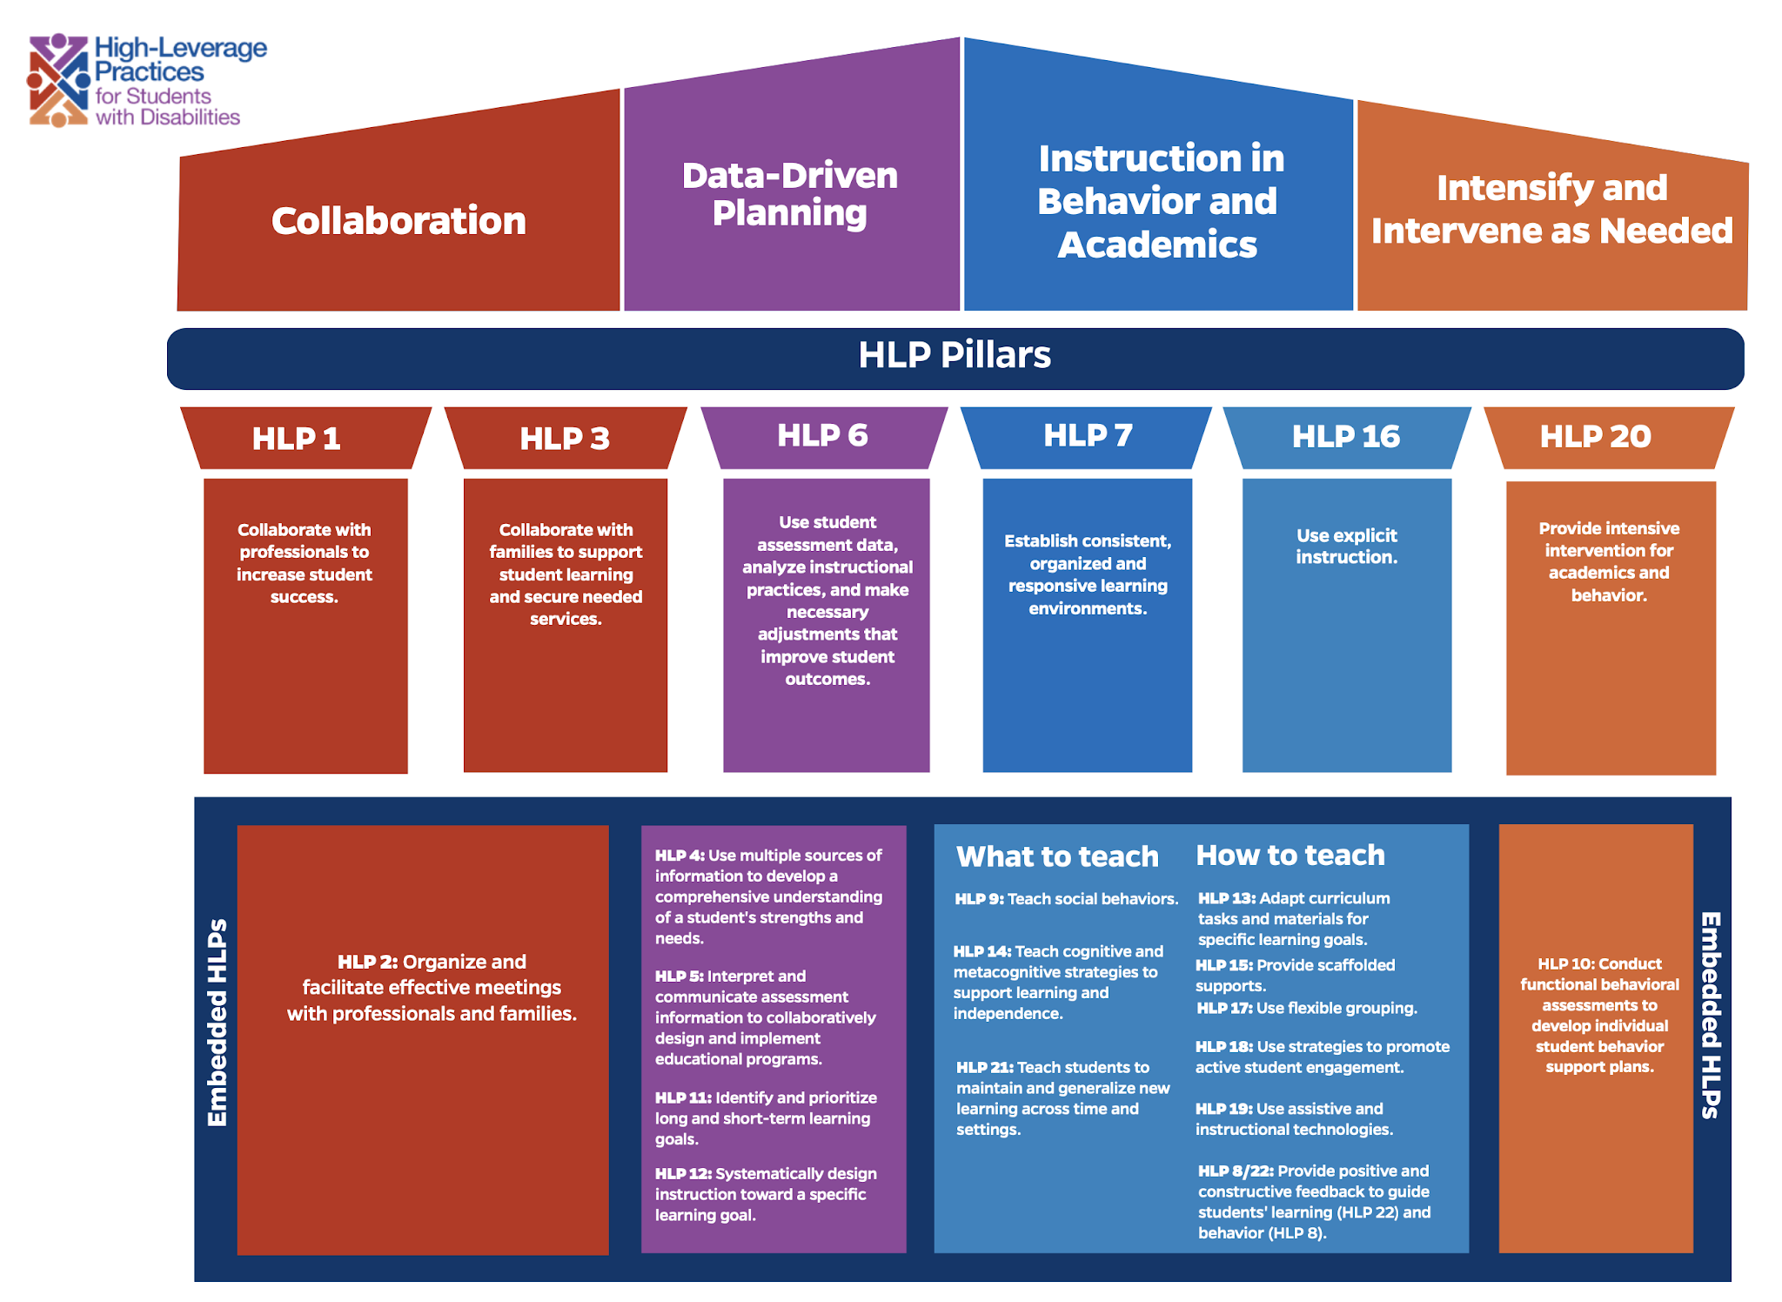
Notes:
As with everything else, the HLPs got a makeover on their structuring. Here are the High Leverage Practices Restructured.
The top level holds the Four Areas of Practice, note we now have new titles following Collaboration, Data Driven Planning, Instruction in Behavior and Academics, Intensify and Intervene as Needed.
Underneath this layer we have the HLP Pillars. These pillars are the HLPs that create the foundation for and encompass other HLPs.
The 3rd level holds the Embedded HLPs- those that are encompassed within the Pillars.
Today for our purposes and time limit we are going to provide a brief overview of the Pillars of High Leverage Practices and the embedded practices. If you would like to learn more in depth about the HLPs, please contact your local IC or behavior specialist.

Slide 11

Start Early
Prevention
Early Intervention
Prevention and early intervention are more effective than treatment of academic or social/behavioral problems after they have existed for several years.
Notes:
To Say: What we do know for sure is that prevention and early intervention can make all the difference in future learning for students. And we also know that the earlier we intervene, the better. It is much harder to make gains with older students than it is with younger students. We know from brain research that there are ‘windows’ of development where certain skills develop at a more rapid pace and it is in these windows that learning is critical. We also know from brain research that people CAN learn those skills outside of those windows, but….it is much harder and will take much more time with the task than it would have if it had been learned within the window. (Example: language skills….the window of opportunity for students to effectively learn ‘language’ is from birth up until about 8-10 years old. After that, in order to really make a big difference in language development, it would take many hours of therapy. We can certainly provide accommodations and modifications both through the use of technology and just as a matter of how we do business, but…is it likely that we have the staff and the available time to provide hours and hours of therapy within the week? Likely not. Again, early intervention is the key for most of the academic and social/behavioral problems students exhibit.)

Slide 12

Prevention
and Early Intervention
  The response to individualized intervention data in general education is critical to determining special education need and to measuring adverse educational impact.
Notes:
To Do: Ask the large group audience the following questions and acknowledge any share outs participants may give.
How many of you have some sort of intervention system in place in your districts? What is the purpose? Are they done with intensity, duration and fidelity? Do you notice fewer referrals?
To Say: We need documented data from general education based on district screeners, authentic classroom work, results of interventions, etc. in order to make high quality decisions about whether children have been given a real opportunity to learn these skills and what that rate of learning looks like.
The data is the evidence needed to make these decisions. Think for a minute about the kind of data you’re getting when you receive referrals in your district. We will talk about that in a minute.

Slide 13
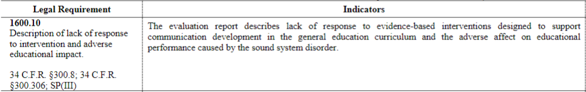
Sound System Disorder Eligibility Criteria
Intervention data is a requirement to determining eligibility under SSD
Intervention data should be included in the evaluation report along with a description of the student’s response to the interventions

Slide 14
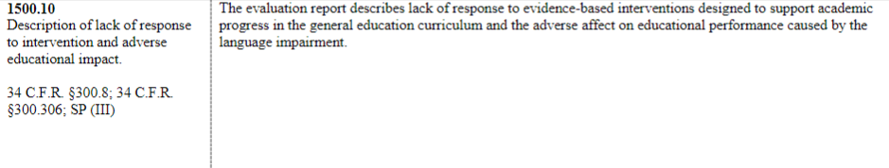
Language Impairment Eligibility Criteria
Intervention data is a requirement to determining eligibility under SSD
Intervention data should be included in the evaluation report along with a description of the student’s response to the interventions

Slide 15
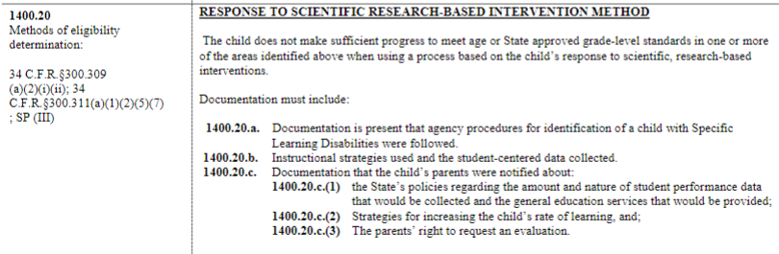
Specific Learning Disabilities(SLD) Eligibility Criteria
Response to Intervention (RTI) is one method of SLD eligibility determination
Must have board approved policy regarding the use of RTI for SLD eligibility
Fidelity to instruction and intervention is critical when using RTI for SLD eligibility
DESE RTI Guidelines

Slide 16
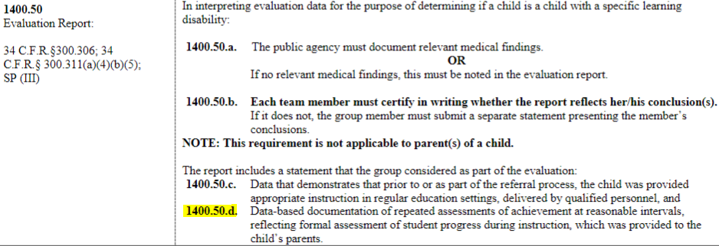
Specific Learning Disabilities(SLD) Eligibility Criteria
1400.50d applies to ALL SLD eligibility determinations
This criteria refers to intervention data

Slide 17
Remember: MTSS Cannot Delay An Evaluation
Return to School Roadmap — Child Find Under Part B of the Individuals with Disabilities Education Act (OSERS Aug. 24, 2021):
Question B-3: Can an LEA require that all students participate in general education multi-tiered systems of support (MTSS) or other general education interventions prior to referring a child for special education?
Answer: No.The implementation of MTSS strategies cannot be used to delay or deny the provision of a full and individual initial evaluation, pursuant to 34 C.F.R. §§ 300.304 through 300.311, to a child suspected of having a disability under 34 C.F.R. § 300.8.10 It would be inconsistent with the evaluation provisions at 34 C.F.R. §§ 300.301 through 300.111 for an LEA to reject a referral and delay provision of an initial evaluation on the basis that a child has not participated in an MTSS framework.

Slide 18
In addition, MTSS is NOT just for general education students.
Having an IEP should not preclude students with disabilities from receiving continued universal evidence-based core programming, ongoing supplemental supports, and individualized intensive interventions at all tiers.
CASE MTSS Policy Statement

Slide 19
Universal Design For Learning (UDL)

Slide 20

What is UDL?
Universal Design for Learning is a framework to improve and optimize teaching and learning for ALL people based on scientific insights into how humans learn.
it is a tool for pre-planning so that lessons and instruction are meaningful and appropriate for all children in the room. It prevents making needed accommodations/modifications on the fly or at the last minute.
https://www.cast.org/

Slide 21
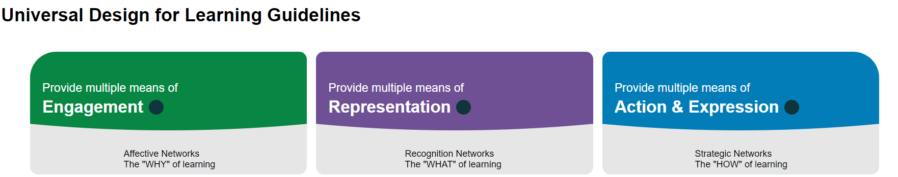
The Premise of UDL

Slide 22
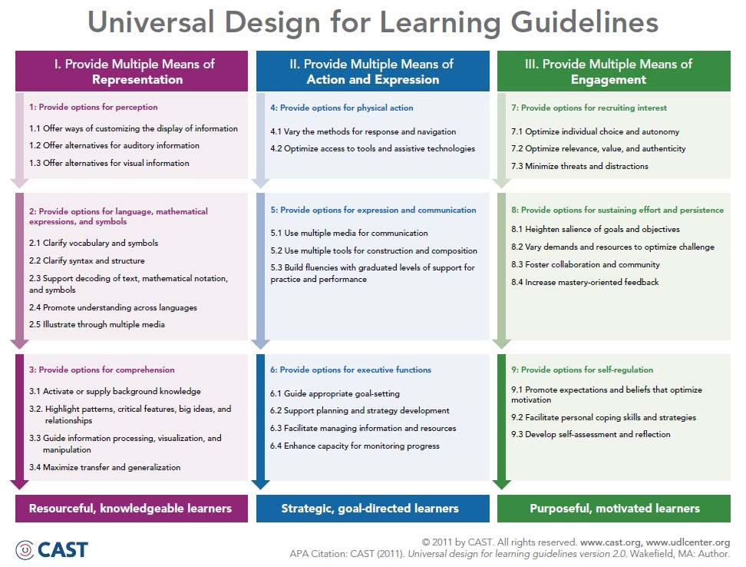
Universal Design for Learning

Slide 23
LRE, Accommodations & Modifications: The “Why” Behind The “What”

Slide 24
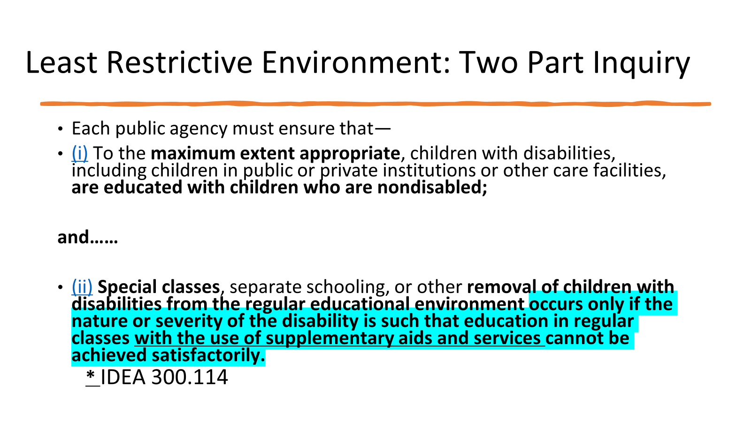

Slide 25
“Use of Supplementary Aids and Services”
Supplementary aids and services means aids, services, and other supports that are provided in regular education classes, other education-related settings, and in extracurricular and nonacademic settings, to enable children with disabilities to be educated with nondisabled children to the maximum extent appropriate in accordance with Sec. 300.114 through 300.116.” 34 C.F.R. 300.42

Slide 26
What Are Supplementary Aids and Services?
Supplementary aids and services means aids, services, and other supports provided in regular education classes, other education-related settings, and extracurricular and nonacademic settings, to enable children with disabilities to be educated with nondisabled children to the maximum extent appropriate …
Accommodations
Modifications
Assistive technology
Behavioral supports
Staff training
Paraprofessional support

Slide 27
Removal from General Education and LRE
A child with a disability is not removed from education in age-appropriate regular classrooms solely because of needed modifications in the general education curriculum.
Missouri State Plan for Special Education LRE

Slide 28
LRE and General Education Teacher’s Role
IDEA: 34 CFR 300.324 (a)(3)
•Requirement with respect to the regular education teacher. A regular education teacher of a child with a disability, as a member of the IEP team must, participate in the development of the IEP of the child, including the determination of –
• Appropriate positive behavioral interventions and supports
• Supplementary aids and services, program modifications and supports for school personnel.

Slide 29
Accommodations and Modifications
The ‘What’ and a few Best Practices

Slide 30
Did you know??
There are no laws, no policies, no regulations and no rules that say we cannot accommodate for EVERY child who needs such things to truly learn.

Slide 31
Accommodations
Changes made to instruction and/or assessment intended to help students fully access the general education curriculum without changing the instructional content. Address the ‘how’ of access to the curriculum.
Accommodations provide equitable instruction and assessment for students by reducing or eliminating the effects of a student’s disability.
They do not change or reduce the learning expectations in regard to the goal being addressed or assessed.
Generally, the resulting student product with accommodations is equal to the student product without accommodations.

Slide 32
Modifications
Alterations made to instruction and/or assessment that change, lower, or reduce learning or assessment expectations. Address the ‘what’ of access to the curriculum.
Modifications change or reduce the learning expectations in regard to the goal being addressed or assessed.
More often than not, the resulting student product is not equal to the student product without modifications.

Slide 33
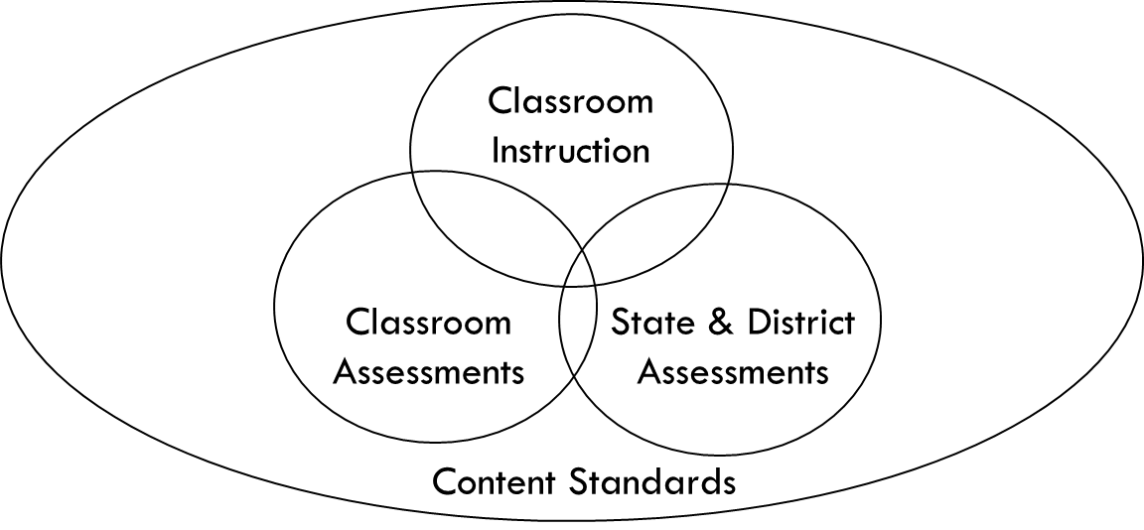
Connecting Accommodations
The use of accommodations should be linked through all of these areas

Slide 34
A few Tips
Do's and Don'ts Chart
Do | Don’t
DO…Involve the entire IEP team in decisions about accommodations and modifications by gathering information ahead of time for discussion at the meeting | DON’T…make accommodation/modification decisions based on what is easiest to do.
DO…make accommodation/modification decisions based on individual needs and data to support that need documented in the PLAAFP | DON’T…indicate ‘as needed’ unless you specify the situation when that applies. In other words, WHEN could it be needed!!!
DO…evaluate the continued need for accommodations/modifications yearly at the IEP meeting based on whether they are necessary for FAPE | DON’T…check all kinds of accommodations/modifications ‘just in case’. There needs to be evidence of the need routinely.
DO…be specific about the “Where, When, Who, and How” of providing the needed accommodations within the IEP. | DON’T…keep accommodations/modifications on the IEP that the student does not use or need. Amend the IEP if necessary.

Slide 35
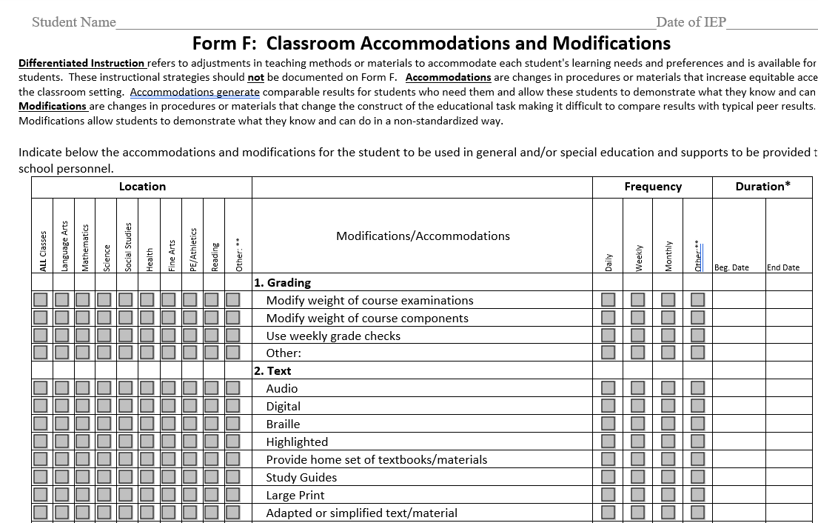
Documenting in the IEP

Slide 36
Case Study

Slide 37
Case Study: Fifth Grade Student
SLD Basic Reading
Present Level of Academic Achievement and Functional Performance (PLAAFP) statements: Student tends to read at a high rate of speed and makes careless errors due to decoding deficits. She needs direct instruction in blending and segmenting of multisyllabic words and decoding grade level vocabulary words. She’s reading at the 4.0 grade level. Student is a very conscientious with her work habits, attentive in class, and is highly organized. Review of teacher records indicates she has not had a missing assignment and she is one of the first students in the class to complete any assignment. She has good study habits and is skilled at taking notes. She prefers to attempt all assignments on her own and receives minimal assistance with grade level work. She is well versed in using the speech to text feature on her Chromebook and uses this app when she feels like she needs the text read aloud to her. She has a high degree of accuracy completing tasks when using this app on assignments that may be written above her independent reading level. Per parent report early elementary (2nd-3rd grade) she used to dislike writing but she now loves writing. Creative writing is an area of academic strength for her. She has a 100% in Writing class.

Slide 38
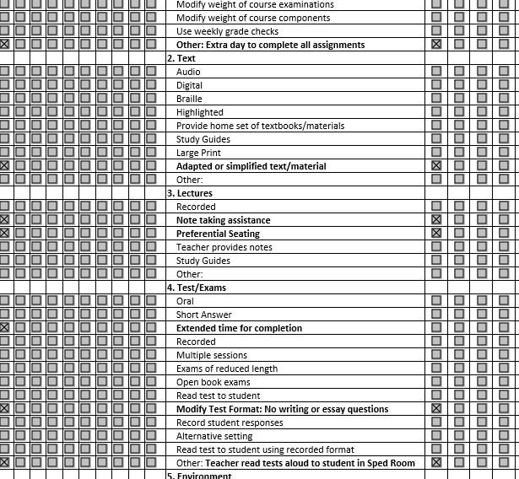
Case Study
Form F
Does this align with
student needs
identified
in the PLAAFP?

Slide 39
Case Study Take-Aways
Info in PLAAFP does NOT support what is on Form F
If those items on Form F are truly needed, where is the evidence?
Homework: Ask your case-managers to review Form F with the current PLAAFP. If they don’t match or support one another, changes need to happen!!

Slide 40

Thank you! Have a terrific end of the school year!

Slide 41
For additional training on Interventions, Accommodations and Modifications
Contact your RPDC Special Education Improvement or Compliance Consultant

