Slide 1

SPECIAL EDUCATION COMPLIANCE TIERED MONITORING
CORRECTIVE ACTION PLAN YEAR TRAINING & GUIDANCE
Missouri Department
of Elementary and Secondary Education
Fall 2024

Slide 2
Learning Objectives
Participants will learn
how to do corrective action steps in the special education monitoring process cycle for federal tiered monitoring.
how to read and understand the Special Education Program Review Report for the self-assessment and desk review.
how to complete required activities for clearing any identified noncompliance.
how to follow timelines for showing evidence of correction of noncompliance.
how to enter information into IMACS.
how to find resources for questions and assistance.

Slide 3


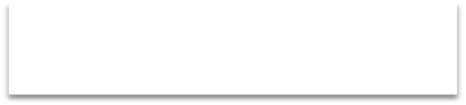

Corrective Action Plan (CAP) Year
Read CAP Year Guidance/Receive Special Education Performance Report – September
Create Plan for Correction in IMACS using Rubric – October 31 or sooner
Submit Documentation to Clear I-CAPs - December 31 or sooner
Submit sample of correction documents in IMACS to clear CAPs - March 1 or sooner
Submit Follow-up Timelines – February 20
Yes
ALL noncompliance cleared within one year
of Special Education Program Review Report
No
Monitoring Complete for the Cycle
Sanctions Determined
Notes:
The “Corrective Action Plan Year” is when a Local Education Agency (LEA) who have indicators that were found to be out of compliance develop corrective action plans to address the root cause of the noncompliance.
Note that any LEA with 100% compliance as a result of the self-assessment, desk review, and timeline review will not have corrective action plans and will not participate in the tiered monitoring activities during the corrective action plan year.
Those LEAs with less than 100% compliance will first submit their plans for correction. Then they will submit documentation as evidence that shows individual noncompliance has been corrected. Finally, the LEA must upload five samples of documentation for each indicator that was out of compliance. Note: While all noncompliance must be cleared no later than one calendar year from the Special Education Program Review Report, there are intermediate deadlines to ensure the correction is being implemented.

Slide 4
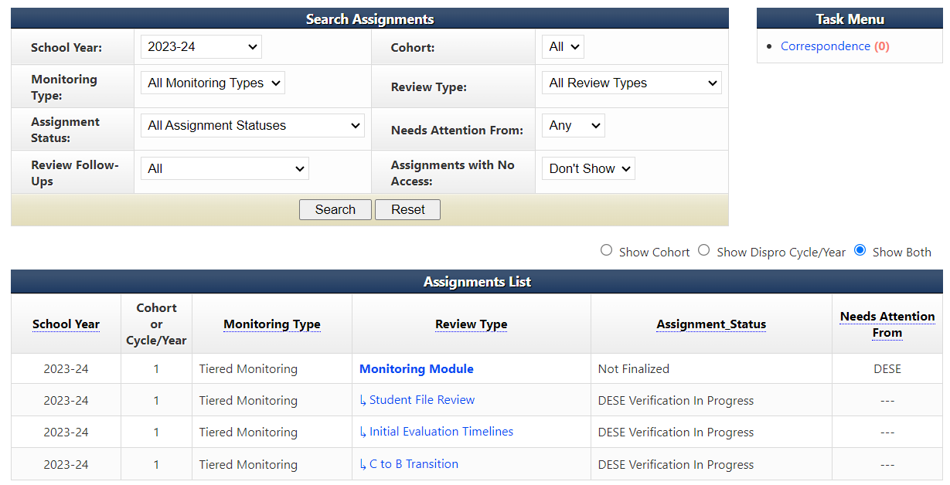
Digging into the information
Make sure that the school year is set to the school year in which the self-assessment was completed. Then select the Monitoring Module.
Notes:
When IMACS 2.0 opens to the districts after the Self-Assessments have been finalized, one of the first things to do is review the reports to see the results.
First, make sure that the school year is set to 2023-2024 (the school year in which the self-assessment was completed) on the district’s home page, and then click on search. When the Assignment List populates, click on Monitoring Module.

Slide 5
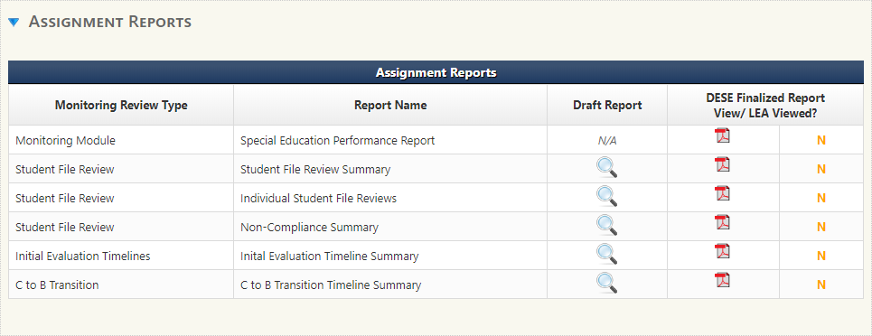
IMACS 2.0 Reports
Select the blue arrow next to Assignment Reports.
Notes:
Once you reach the Monitoring Module page, scroll down until you see Assignment Reports. Click on the blue triangle (circled in red) to the left of Assignment Reports to open the reports list. The Special Education Performance Report contains many parts including the letter to the district Superintendent explaining the outcome of the Self Assessment, Corrective Action Plan information, and the Special Education Monitoring Report which lists whether an indicator reviewed was found to be in or out of compliance.
The Student File Review Summary breaks down all the answers – yes, no, and NA – and gives the LEA the compliance percentage for each indicator included in the review.
The Individual Student File Reviews report gives the yes, no, and NA for the indicators reviewed for each student.
The Non-Compliance Summary report only includes the indicators out of compliance and the note that describes why it does not meet compliance.
The Initial Evaluation Timeline Summary and C to B Transition Timeline Summary reports display the results of the timeline reviews and notes that the Supervisors wrote regarding any timeline that was determined to be out of compliance.

Slide 6
Next Steps
If no noncompliance is identified, then you are finished with the desk review process!
If any indicator is out of compliance, then you must
  complete the Plan for Correction.
  correct individual noncompliance (I-CAP).
  document systemic compliance for each indicator (CAP).
If selected for an onsite review
  watch for correspondence with specific details.
Notes:
After reviewing the Special Education Performance Report, each LEA will need to analyze the information and determine the next steps. If any noncompliance was identified, the LEA will be required to participate in the Corrective Action Plan year steps. The first step is the Plan for Correction due by October 31.

Slide 7
The Two Prongs of Correction
Noncompliance must be corrected for
individual students.
systemic noncompliance.
Notes:
Clearing noncompliance involves two types of correction and evidence. The first is individual correction, or in our process called an ICAP. During this step, all identified individual student noncompliance must be corrected. The second is systemic correction, or CAP. During this portion, the LEA must show systemic correction of all identified noncompliance.
This method allows each LEA to correct the student's noncompliance. It also further demonstrates that the noncompliance issue has been corrected district-wide.

Slide 8
Corrective Action Plan (CAP) Steps
Three steps to completing a CAP
write and submit activities of correction.
implement activities of correction once approved.
provide samples of documentation that demonstrate compliance requirements are being met.
Notes:
The Corrective Action Plan address systemic noncompliance and is the first activity started and the last one completed in the year following the self-assessment. Also know as the LEA plan of correction.

Slide 9
Corrective Action Plan
The Corrective Action Plan is due October 31
  districts must develop an action plan for correcting any noncompliance identified through the self-assessment and desk review verification.
  corrective action plan must identify a root cause and describe strategies and timelines for achieving compliance.
  the Corrective Action Plan rubric can be found on the Tiered Monitoring web page of the DESE Special Education Compliance website.
Notes:
The first step is to develop the Plan for Correction. For every indicator shown as out of compliance, the LEA must first develop a corrective action plan that describes the steps that are needed for the district to be in compliance with specific indicators. Each Plan for Correction should be compared to the rubric provided. The plan must give clear statements of the root cause and strategies to be implemented.

Slide 10
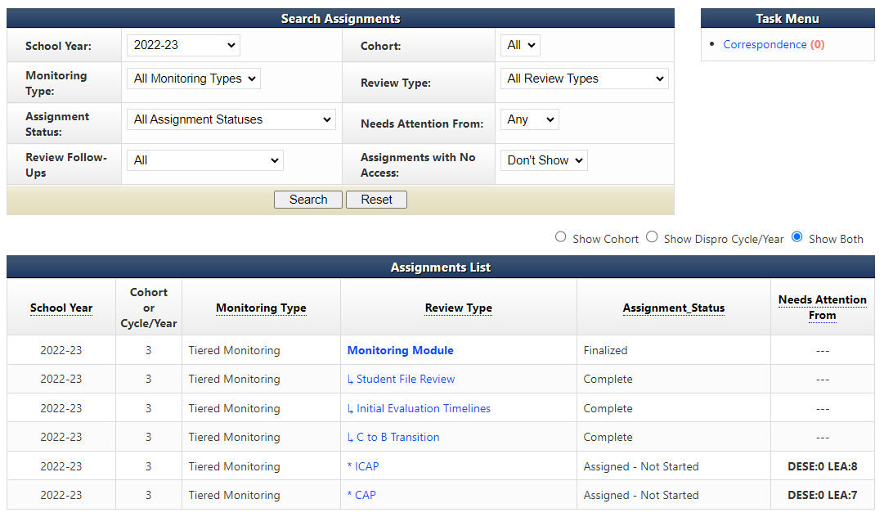
Beginning work on CAP Strategies for Correction
Notes:
Go to your LEA’s home page in IMACS 2.0. Make sure the School Year drop box (found near the top left of the page) is set to the 2023-2024 school year. Proceed to the correct area to begin this process by clicking on the blue CAP found in the Review Type column.
Note: You will be able to quickly see how many CAPs or ICAPs your LEA has as well as which side of the process they are on by noting the number found under the Needs Attention From column. The example on the screen shows DESE 0 LEA 8 and DESE 0 LEA 7. This means the LEA has eight ICAPs, and seven CAPS that should be completed and submitted to DESE.

Slide 11
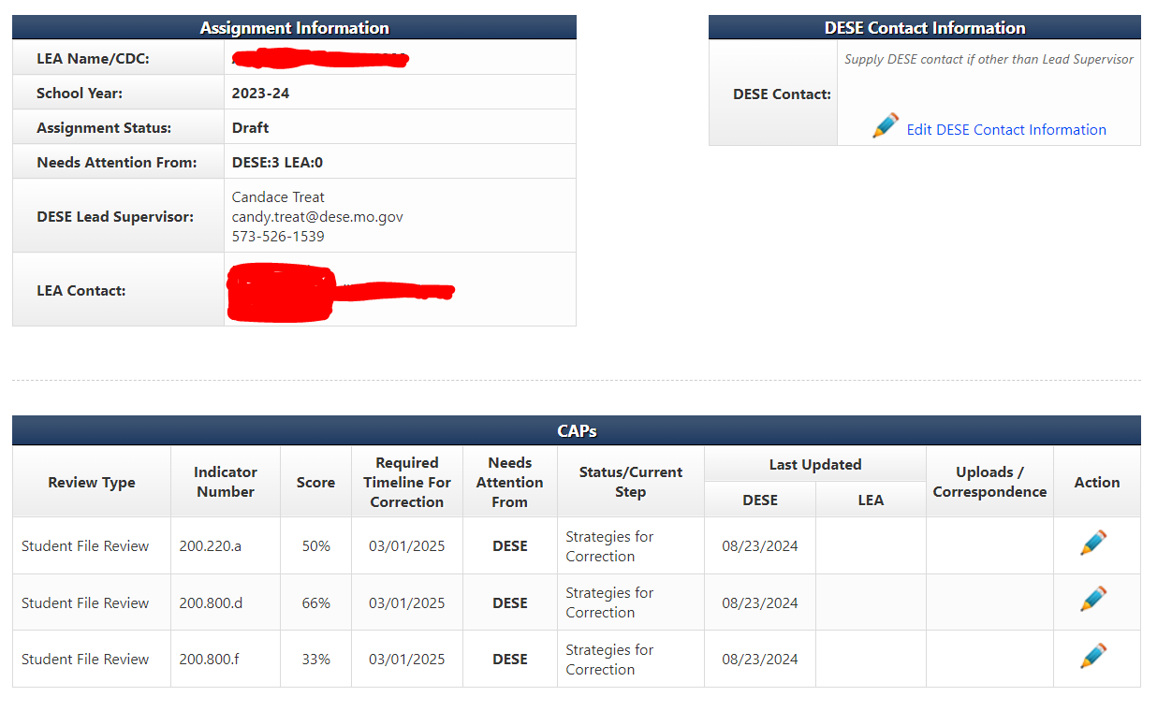
Indicators to address on Your Plan of Correction
Notes:
Click the blue “CAP” under the Review Type column on the LEA’s Monitoring Module page to load the Cap Summary screen, which displays the indicators that were found out of compliance during the desk review verification.
The Indicator Number column shows which indicators were found out of compliance. The Last Updated column will show who last worked on each indicator and when. The action column at the end will either have a magnifying glass (view only) or a pencil (able to take action). Click on the pencil at the end of the row for the indicator on which you wish to work.

Slide 12
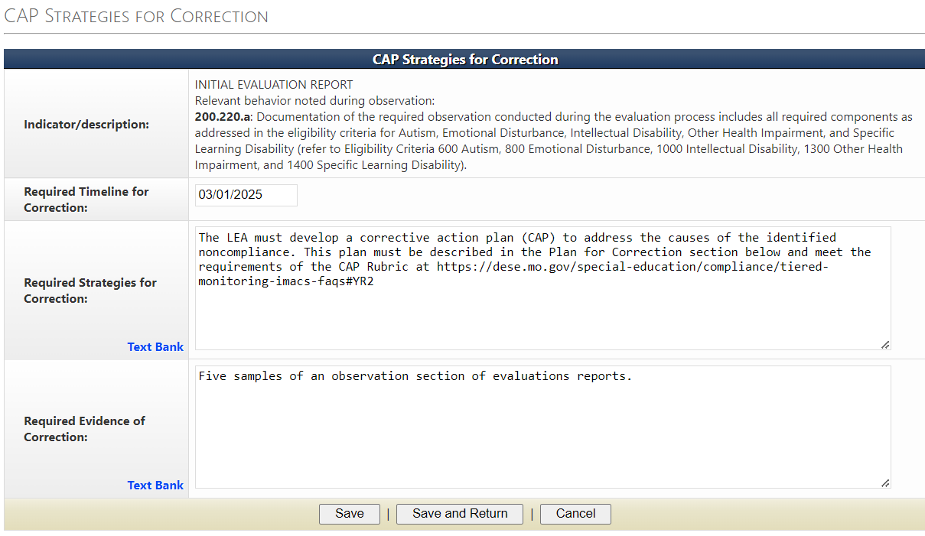
CAP Strategies for Correction Due Date
The Plan for Correction is due no later than October 31, 2024. The date the evidence of correction is due is in the Required Timeline for Correction box.
Notes:
After navigating to the CAP page for each indicator that requires correction, the first box is the CAP Strategies for Correction. This page describes the indicator out of compliance, when the evidence is due, required strategies for correction, and required evidence of correction to submit to your Supervisor.
Note: The deadline for the LEA Plans of Correction is October 31. The required timeline for correction shown on this page is the deadline for submitting the Evidence of Correction, the LEA’s sample of documents that demonstrates compliance.

Slide 13
Plan of Correction Rubric and Resources
The Required Strategies for Correction box contains the web address for the Corrective Action Year Guidance and Resources.
Notes:
The Required Strategies for Correction box contains the web address for the Corrective Action Year Guidance and Resources.

Slide 14
Required Evidence of Correction
The Required Evidence of Correction box gives the type of documentation the Supervisor needs from the LEA as evidence of correction of systemic noncompliance that is due by the Required Timeline for Correction date.

Slide 15
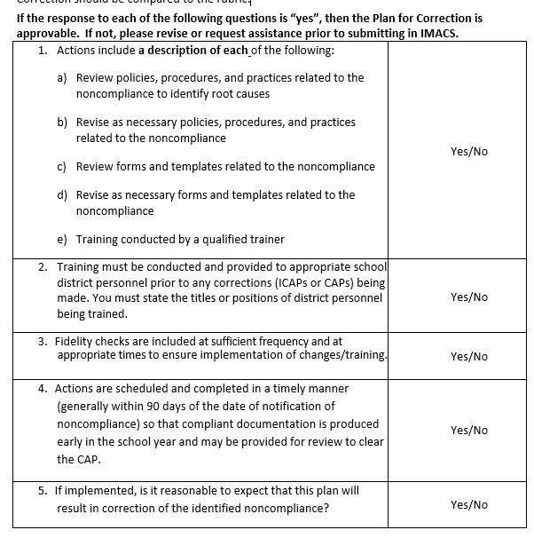
Corrective Action Plan Rubric
Notes:
*Updated 2024*
An approvable corrective action plan describes the steps needed to achieve compliance with specific indicators. The first and most important step is to review the IMACS reports to determine the root cause of the noncompliance. The Corrective Action Plan also identifies school district personnel responsible for implementing the plan and personnel who have a role in reaching and maintaining compliance. Each Plan for Correction should be compared to the rubric created by DESE to assist LEAs in developing an approvable Plan for Correction. This rubric is posted with the other CAP Year Tiered Monitoring Guidance.

Slide 16
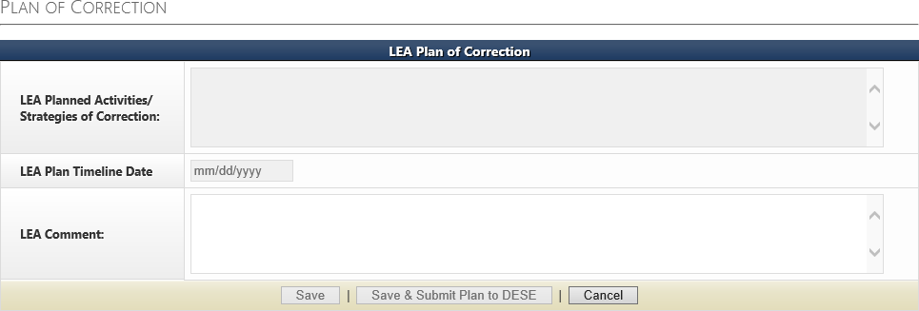
Where to Write the Plan of Correction
Write the Plan of Correction in this box.
Do not proceed to the next box on this page until Your DESE compliance supervisor has approved or discussed revisions to your Plan of Correction.
STOP
Notes:
Type your plan to correct the noncompliance in the text box for LEA Planned Activities/Strategies of Correction. The LEA Plan Timeline Date describes the date Activities/Strategies of Correction will be completed. The quicker your strategies of correction are done in the fall the more time your staff has to use those strategies to produce compliance special education documentation for the sample provided to DESE in March.
Each indicator found out of compliance has its own page and box for the LEA Plan of Correction. Once each indicator has been addressed, the district will save and submit the Plan for Correction for approval. Your special education compliance supervisor will approve and/or discuss revisions to your Plan for Correction in the next section.

Slide 17
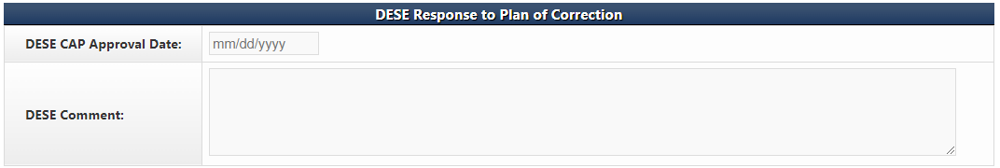
DES Approval of the Plan of Correction
This section will be filled out when a DESE Supervisor has approved the plan. Once a DESE Supervisor has approved all the LEA’s Plans of Correction, you can begin the ICAP Process.
Notes:
This is where your special education compliance supervisor will approve and/or discuss revisions to your Plan for Correction.

Slide 18
Individual Corrective Action Plan (ICAP)
During the ICAP phase of the Corrective Action Plan Year
Districts correct all individual student noncompliance and submit documentation of correction no later than December 31 .
Documentation showing correction for each individual student must be uploaded in IMACS under the ICAP.
DESE Compliance Supervisors will review the documentation in order to clear the ICAP.
Notes:
The next activity is to correct individual noncompliance.
The I-CAP satisfies the Individual Prong for correcting noncompliance. The Student Non-Compliance Report in IMACS will provide a list of all individual student noncompliance identified.
Please note that there are some circumstances require different correction strategies for individual students. When a student is no longer enrolled, the I-CAP can be cleared by uploading documentation from the student information system showing the withdrawal date. Contact your supervisor to discuss each situation.
Correction of all individual noncompliance is expected no later than December 31.

Slide 19
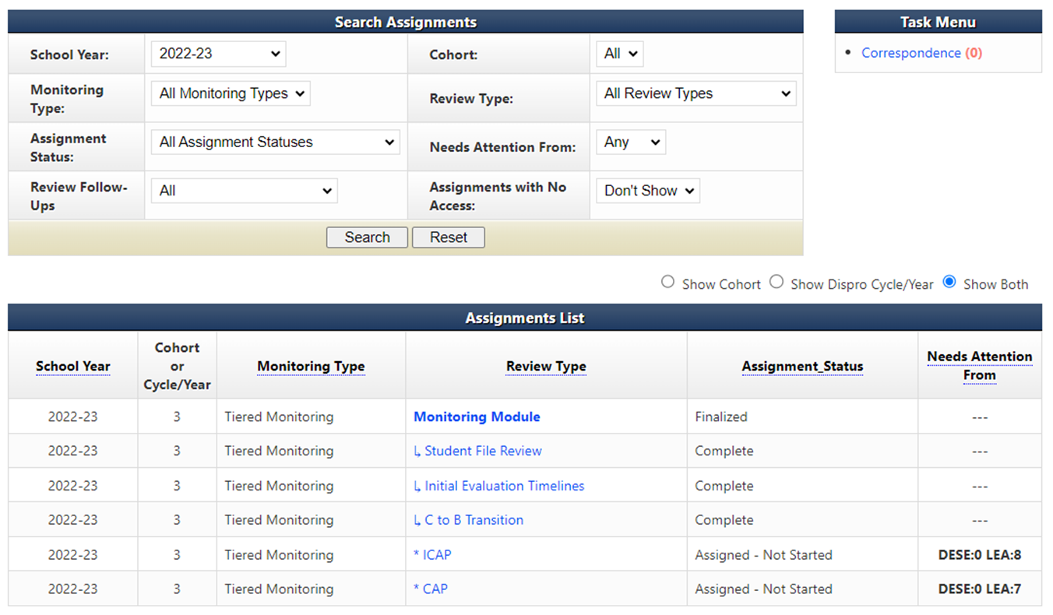
Beginning to work on the Individual Plan of Correction
Notes:
Go to your LEA’s home page in IMACS 2.0. Make sure the School Year drop box (found near the top left of the page) is set to the 2023-24 school year. Proceed to the correct area to begin this process by clicking on the blue ICAP found in the Review Type column. Note: You will be able to quickly see how many CAPs or ICAPs your LEA might have as well as which side of the process they are on by noting the number found under the Needs Attention From column.

Slide 20
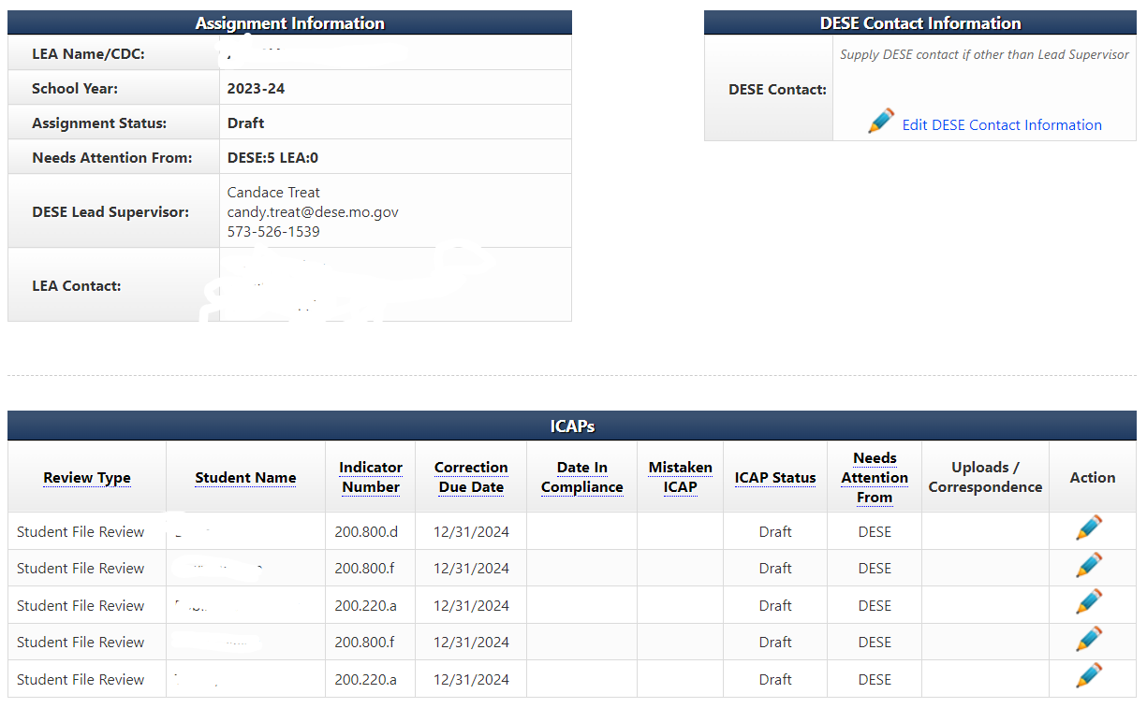
Working on the Individual Plan of Correction
Notes:
After you have clicked the blue ICAP under the Review Type column on the LEA’s Monitoring Module page you will see the ICAP Summary screen which displays the names of individual students and the indicators that were found out of compliance during the review process.
The Student Name column will tell you which student you are working with. The Indicator Number column will tell you which indicators were found out of compliance. The Required Timeline For Correction column will have the final date that all the evidence is due. The Last Updated column will show who last worked on each indicator. Action is the final column. It will either have a magnifying glass (view only), or a pencil (able to take action). Click on the pencil at the end of the row for the indicator you wish to work on.

Slide 21
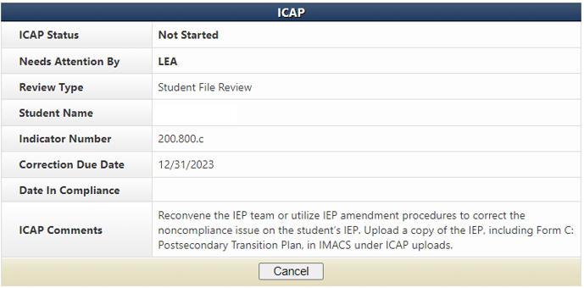
How to correct the Individual Plan of Correction
If the student left the district or graduated,the I-CAP can be cleared by uploading documentation from the student information system showing the withdrawal date.
If there has already been a new IEP or reevaluation done since the self-assessment, that documentation might be used to clear an I-CAP, if it meets compliance requirements.
If the I-CAP cannot be cleared with one of these ways, then proceed with the corrections found in the ICAP Comments box.
Notes:
The top half of the ICAPs page is a dashboard that displays the name of the student, the indicator that was found out, and 2 important dates – the date it is due and the date it is found in compliance. The evidence needed to correct the individual mistake is in the ICAPs Comments box.

Slide 22
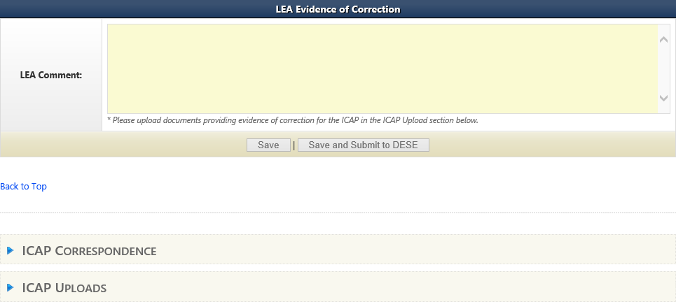
Submitting Evidence for the Individual Plan of Correction
Do not click save and submit until you have uploaded your evidence.
Upload evidence of INDIVIDUAL correction under the student’s name and correct indicator number (see slide 17 if unsure about getting to the correct location).
Notes:
The bottom half of the ICAPs page has a space for the LEA to comment and a space to upload the evidence to clear that student’s individual indicator errors. Click on the blue triangle (in the red circle) to the right of the ICAP Uploads. It will open the uploads section.
Save, but do not click on Save and Submit to DESE until you have completed uploading evidence of correction for each student with an ICAP.

Slide 23
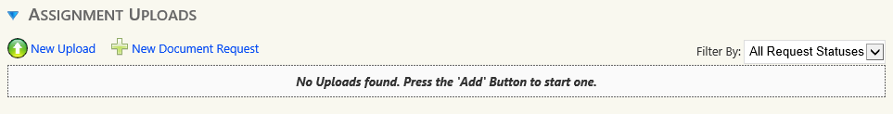
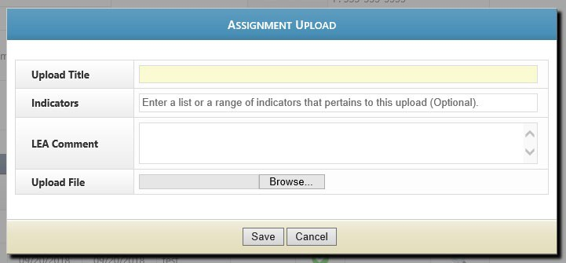
Uploading ICAP Evidence
Click on New Upload to open the Assignment Upload box.
Fill in the name of the document here
This section is optional but always welcomed
Browse for the file you wish to upload
Notes:
Under Assignment Uploads use the New Upload option to add evidence of correction.
Make sure to fill in the name of the document to make easily recognizable. Use a title such as the student's name and the name of the form (Welch RED). Click on browse and find the file on your computer to upload.

Slide 24
Initial Evaluation & C to B Transition Timeline I-CAPs
Individual student noncompliance because of exceeding a timeline MUST be corrected by showing:
The parent was informed that the evaluation exceeded the allowed timeline.
The IEP team convened to determine if the provision of FAPE was impacted by the delay in providing special education and related services due to exceeding the timeline.
The IEP was amended to include compensatory services, if any are owed. Submit a copy of the prior written notice (PWN) describing the outcome of the IEP team meeting or meeting summary if PWN is not needed.
Timeline I-CAPs must be corrected by December 31.
Notes:
Note: IEP teams could address the need for compensatory services at the initial IEP team meeting. If they have documentation that they did these things before we identified noncompliance, we will accept that documentation to clear the I-CAP.

Slide 25
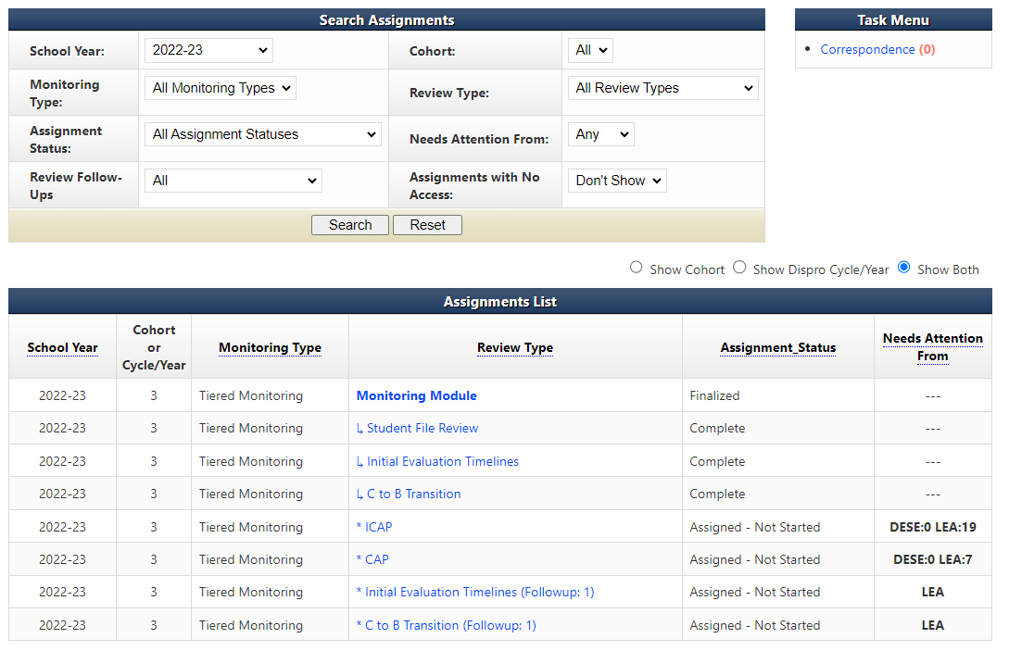
Follow-Up Timelines for Initial Evaluations & C to B Transition
If the Initial Evaluation or C to B Transition timelines were found out-of- compliance then click on the follow-up timeline link under Review Type on the LEA’s home page.
Notes:
If one or more of the timelines are found to be “OUT” of compliance, a link for a follow-up timeline collection will appear on the LEA home page of IMACS 2.0. The next several slides will demonstrate the “Initial Evaluation Follow-up Timeline” submission.

Slide 26
Beginning Follow-Up Timelines
The data collection period for follow-up timeline is from the date you receive the final report (September 16, 2024) through February 1, 2025. They are due by February 20, 2025.
Include the following information dependent on non-compliance:
Initial Evaluations – include all students for whom consent for an initial evaluation was received and eligibility determined within the data collection period.
C to B Transition Evaluations – include all students referred from Part C whose referral date, 3rd birthday and IEP date fall within the data collection period.

Slide 27
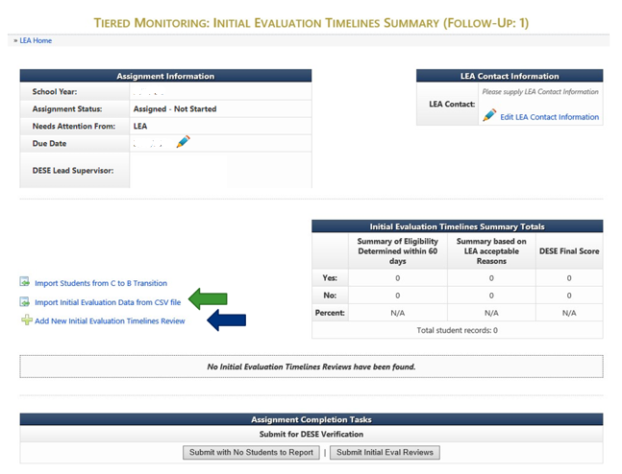
Follow-Up Timelines
Notes:
There are two options for entering the Follow-Up timeline information now in IMACS 2.0.
You can either compile your data collection on a spreadsheet and import that by clicking on Import Initial Evaluation Data from CSV file (green arrow) or you can enter each student individually by clicking on Add New Initial Evaluation Timelines Review (blue arrow).

Slide 28
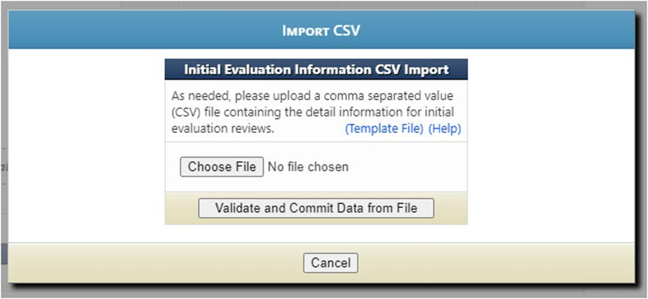
Importing Data from CSV file
Template File allows you to use the blank Excel template that DESE created.
Help gives directions for preparing the CSV/TXT upload.
Choose File locates the CSV/TXT document to upload from your computer.
Click on Validate and Commit Data from File once when the name of the selected
file is showing.

Slide 29
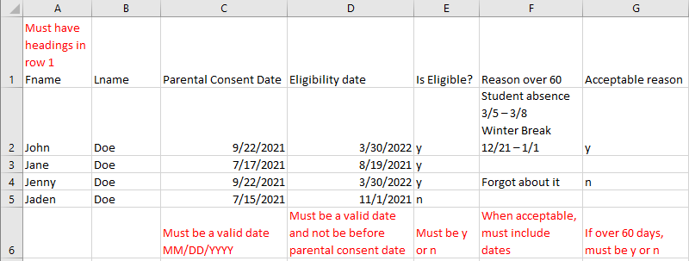

Importing Student Data for Initial Timeline Follow-Up
The file can have an extension of .csv or .txt.
Upon submitting a file, the website will first validate and, if valid, will then prompt the user to commit the data.
Data rows should contain only information intended for Initial Evaluation Reviews.
If 'Is Eligible' is 'N' the remaining fields are not required
'Reason 60 Days' column is only required if student eligibility was not determined within 60 days.
      When you list an acceptable reason in the ‘Reason 60 Days’ column, you also need to list the applicable dates.
Notes:
CSV stands for comma separated values. This type of record uses commas to separate data. If commas are used within a column (for example in the “reason over 60” column) the file will be corrupted.
As you enter students you do have the option to edit (pencil icon) or delete (red cross) your entry on the right hand side of the main Follow-Up timeline page. The system will allow as many CSV/TXT imports as needed. It will take the file and add the data to the existing with no overwriting of previous information.

Slide 30
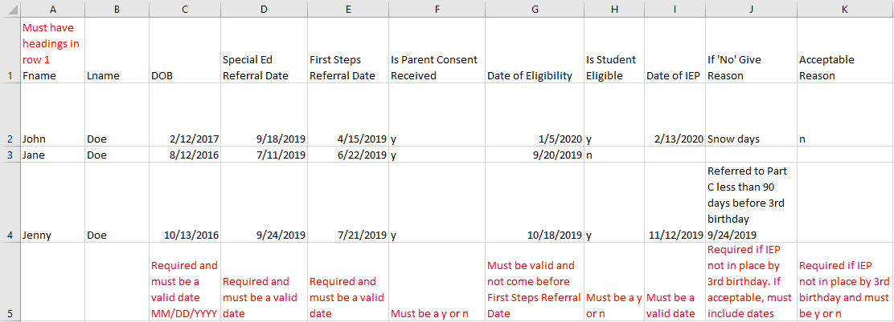
Importing Student Data for C to B Transition Follow-Up Timelines
The file can have an extension of .csv or .txt.
Upon submitting a file, website will first validate and if valid will then prompt the user to commit the data.
Data rows should contain only information intended for C to B Reviews.
If 'Is Parental Consent Received' is 'N' the remaining fields are not required.
If 'Is Student Eligible' is 'N' the remaining fields are not required.
Notes:
As you enter students you do have the option to edit (pencil icon) or delete (red cross) your entry on the right hand side of the main Follow-Up timeline page. The system will allow as many CSV/TXT imports as needed. It will take the file and add the data to the existing with no overwriting of previous information.

Slide 31
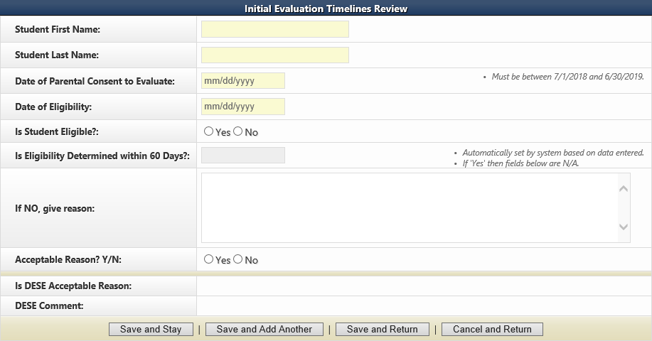
Adding New Student Timeline Data Individually
If you decide to enter your timeline data one student at a time in IMACS 2.0 by clicking on Add New Initial Evaluation Timelines Review then you will see the familiar student demographic screen below. When you list acceptable reasons in the “If NO, give reason,” box list specific dates. For example: Student absence 3/5,6,7,8 or Winter Break 12/21 – 1/1.
Notes:
There are reminders on the student demographic screen reminding you of important dates.
At the bottom of the screen there are many save options. Save and Stay will keep you on the same page after saving the material. Save and Add Another will save the student you just finished working on and give you a new student demographic screen to begin the next student. Save and Return will save the student you just finished working on and then take you back out to the main timeline page. As you enter students you do have the option to edit (pencil icon) or delete (red cross) your entry on the right hand side of the main Follow-Up timeline page.

Slide 32
Submitting Follow-up Timeline Data
The data collection period for follow-up timelines is from the date you receive the final report (September 16, 2024) through February 1, 2025.
The Follow-Up timelines are due by February 20, 2025.
When you are done collecting the data you will need to submit the timelines to DESE for verification. You will either click to submit the timeline data or you will click on Submit with No Students to Report, if no initial evaluations were completed.
Notes:
If you have entered ANY students in the timeline data collection section, then you will not have the option to select the Submit with No Students to Report button.

Slide 33
Corrective Action Plan (CAP) Steps
After completing the first two steps of the CAP, you will provide samples of documentation that demonstrate compliance requirements are being met.
Notes:
The Corrective Action Plan address systemic noncompliance and is the first activity started and the last one completed in the year following the self-assessment. Also know as the LEA plan of correction.

Slide 34
Evidence of Correction
After completing the Plan for Corrective Action (training, change in policy or procedure, etc.), the District should begin collecting samples demonstrating evidence of correction.
The district must submit up to five samples of compliant documentation completed after the district implemented an approved corrective action plan to demonstrate correction of noncompliance no later than March 1, 2025.
Documentation showing examples of compliance for each indicator identified must be uploaded into IMACS 2.0 on the CAP page
Notes:
The final activity of the Corrective Action Year process is clearing the systemic noncompliance by providing evidence of correction. This is accomplished by providing up to five samples of documentation that address each indicator that was identified as noncompliant. The five samples of documentation cannot include the students identified as non-compliant during the student file review process. This documentation should establish that the district followed its Plan of Correction and must demonstrate that the LEA is currently “IN” compliance with the indicator. The evidence of correction should be uploaded into IMACS and submitted no later than March 1.

Slide 35
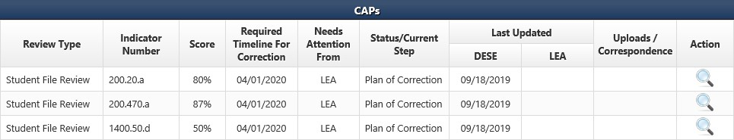

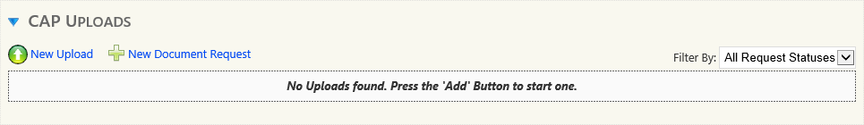
Submitting Evidence of Correction
CAP Summary page
Notes:
To begin submitting the district’s evidence of correction, you will need to go to the Tiered Monitoring: CAP Summary page. Before the CAP Strategies for Correction boxes, you will see CAP Uploads. Click on the blue arrow next to the words CAP Uploads. Next you will use the New Upload button. This will pop up a window.

Slide 36
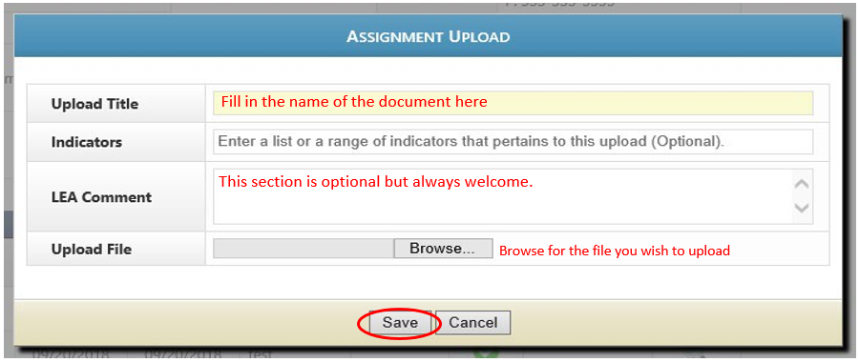
How to upload Evidence of Correction
CAP Uploads, New Upload and this Window will open a Popup Window
Notes:
Fill in the document's name on the Upload Title line, and then use the browse feature to find the file on your computer. The LEA Comment box is optional but may be used to provide the supervisor with more information about your upload. Click on the Save button after you are done.
You can choose to upload your samples of correction for a particular indicator separately by clicking a new upload each time and putting one file into the Upload File location. You can also combine your PDF documents into one upload and browse for that file. After you hit save it would be a great idea to test the upload by trying to open the file uploaded.

Slide 37
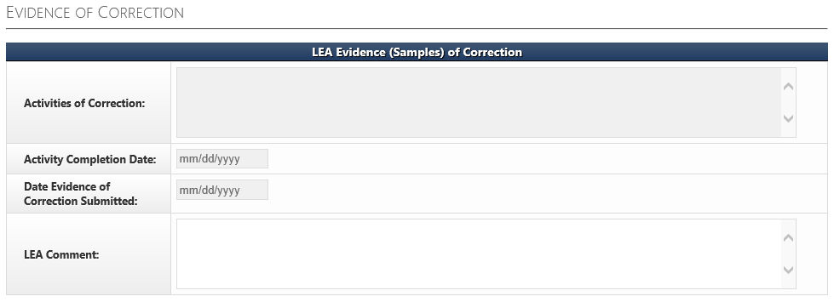
LEA Evidence (Samples) of Correction
The FINAL STEP of the CAP process for each indicator is completing the LEA Evidence (Samples) of Correction section on the CAP page. The Activities of Correction box should be completed using the Evidence of Correction rubric.
Notes:
Once the documentation showing evidence of correction has been uploaded into IMACS, the LEA must complete the FINAL STEPS to clear the identified noncompliance. The LEA completes the final steps in IMACS to document the dates and outcomes of the planned activities to correct noncompliance.
Complete the Activities of Correction box using the Activities of Correction rubric at https://dese.mo.gov/media/pdf/evidence-correction-rubric
The Activity Completion Date is the date that the LEA Planned Activities/ Strategies of Correction were completed.
The Date Evidence of Correction Submitted is the date you submit uploads of evidence to DESE. LEA Comment is optional.

Slide 38
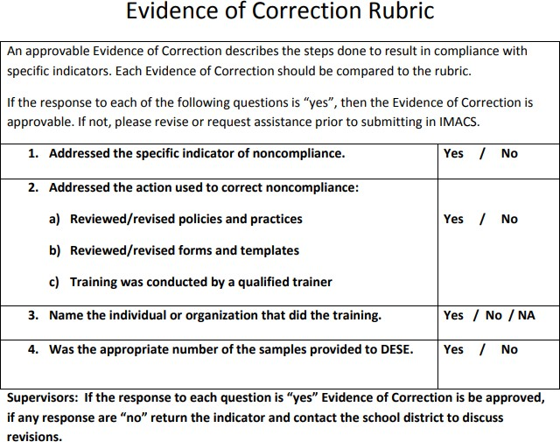
Evidence of Correction Rubric
Notes:
An approvable LEA Evidence of Correction describes the Activities of Correction that were followed to become in compliance with specific indicators. It is the conclusion of the Corrective Action Plan and should touch upon the training or changes that the district put in place to stop the noncompliance from occurring again. It identifies the personnel responsible for implementing the plan as well as the personnel who have had a role in reaching and maintaining compliance. This rubric is posted with the other CAP Year Tiered Monitoring Guidance on the DESE SPED Compliance pages at https://dese.mo.gov/media/pdf/evidence-correction-rubric

Slide 39
Final Thoughts
Statewide, all LEA level noncompliance must be corrected within 12 months of the date of the final report, so the SEA sets up intermediate deadlines.
Sanctions may be imposed for any non-compliance not corrected within 12 months of the date of the Program Review Report.
The deadline for clearing all identified noncompliance for Cohort 1 LEAs is September 16, 2025.
Notes:
Please note the compliance supervisors and compliance consultants are ready, willing, and able to assist LEAs in correcting identified noncompliance. However, if an LEA is unwilling or unable to correct the identified noncompliance, sanctions may be required.

Slide 40
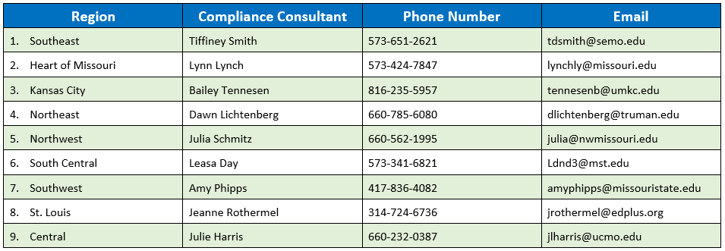
Compliance Consultants
Notes:
The RPDC is your first line of defense in regards to issues of compliance. You should have these numbers on speed dial. When you have a question or need an extra set of eyes to help you in this process call your RPDC Compliance Consultant.

Slide 41
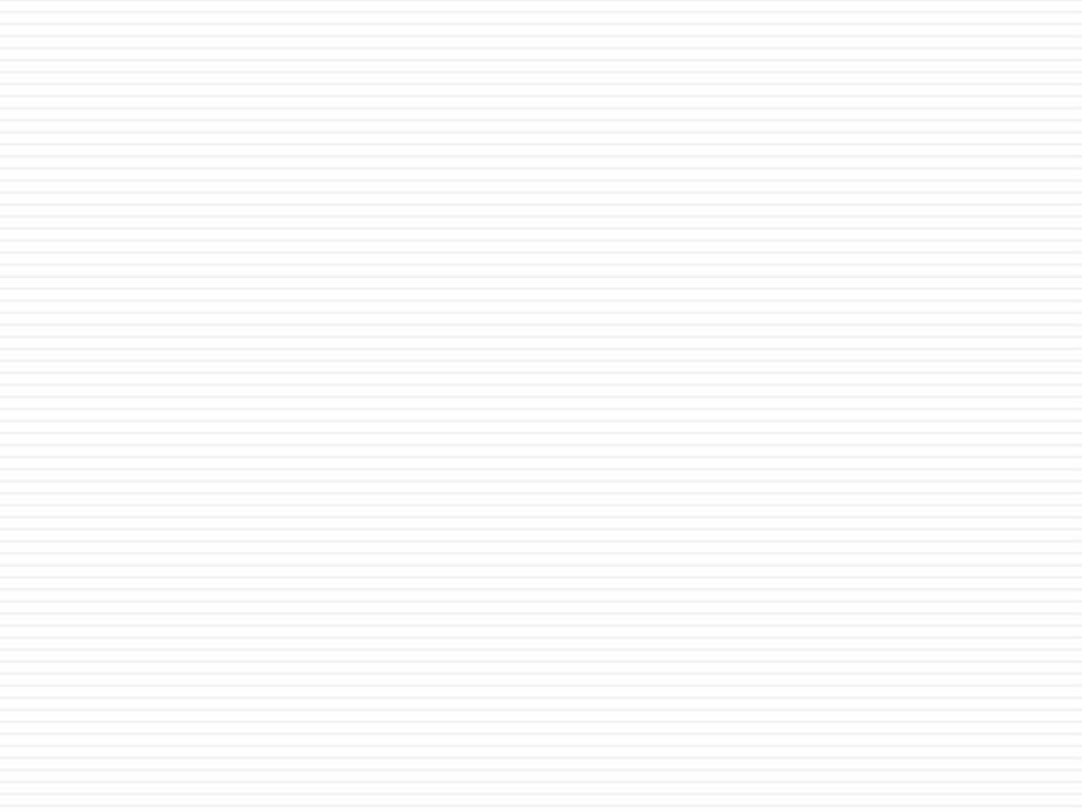

Resources
Office of Special Education
Special Education Compliance (Part B)
P.O. Box 480, Jefferson City, MO 65102-0480 Phone: 573-751-0699
Email: secompliance@dese.mo.gov
Notes:
This slide shows one of your best resources – the Compliance staff at the Office of Special Education. We encourage you to call or email if you have questions or need assistance.

Slide 42
Last Page of Presentation
The Department of Elementary and Secondary Education does not discriminate on the basis of race, color, religion, gender, national origin, age, or disability in its programs and activities. Inquiries related to department programs and to the location of services, activities, and facilities that are accessible by persons with disabilities may be directed to the Jefferson State Office Building, Director of Civil Rights Compliance and MOA Coordinator (Title VI/Title IX/504/ADA/ADAAA/Age Act/GINA/USDA Title VI), 5th Floor, 205 Jefferson Street, P.O. Box 480, Jefferson City, MO 65102-0480; telephone number 573- 526-4757 or TTY 800-735-2966; email civilrights@dese.mo.gov.

