Slide 1
Zoom Support Meeting Norms
Mute unless you are speaking to the group
Use the chat to ask questions
Be professional and helpful
Be mindful when asking questions about specific situations - don't give out any information that could reveal the identity of a person with a disability

Slide 2
Using SMART Goals for Educational Benefit
Amy Phipps, Compliance Consultant
Agency for Teaching, Leading, and Learning
and
Leasa Day, Compliance Consultant
South Central RPDC
October 10, 2024

Slide 3
Agenda Outline
Free Appropriate Public Education (FAPE)
What Part Do SMART Goals Play in Educational Benefit?
  Ensuring Compliant SMART Goals
  Noncompliance Related to SMART Goals Cohort 1
  Progress Monitoring and FAPE
Using the Educational Benefit Review (EBR) Process for Professional Development and Evaluating Files

Slide 4
What Is FAPE?

Slide 5
Rowley (1982)
Standard for FAPE
The Rowley “Two-Prong Test”
  Has the school complied with the procedural requirements of IDEA? (Procedural Prong), AND
  Is the IEP, developed through IDEA’s procedures, reasonably calculated to enable the child to receive educational benefit? (Substantive Prong)
Board of Educ. v. Rowley, 458 U.S. 176 (1982)

Slide 6
Endrew F. (2017)
Standard for FAPE
The standard established by the Endrew F. case built on the Rowley substantive prong, setting a single standard for educational benefit:
  “progress appropriate in light of a child’s unique circumstances.”
Endrew F. v. Douglas County School District Re-1, 137 S. Ct. 988

Slide 7
Endrew F. (2017) continued
Key Holdings
“every child should have the chance to meet challenging objectives”
“adequacy of a given IEP turns on the unique circumstances of the child for whom it was created”
Endrew F. (2017) Endrew F. v. Douglas County School District Re-1, 137 S. Ct. 988

Slide 8
Summary of Supreme Court Decision for Endrew F.
The court’s decision increases the education expectations for children with disabilities.
We must be able to show more than minimal progress for students with disabilities.
IEPs must NOT look substantially similar year after year.

Slide 9
Endrew F. Standard (Cont.)
ED wrote that, so that the Endrew F. standard is met for each individual child with a disability, districts must implement policies, procedures, and practices related to:
  1) identifying present levels of academic achievement and functional performance;
  2) the setting of measurable annual goals, including academic and functional goals; and
  3) how a child's progress toward meeting annual goals will be measured and reported.
In Questions and Answers on Endrew F. v. Douglas County School District. Re-1, 71 IDELR 68 (EDU 2017)

Slide 10
More about FAPE
An appropriate education will include:
  education services designed to meet the individual education needs of students with disabilities as adequately as the needs of nondisabled students are met;

Slide 11
More about FAPE
An appropriate education will include:
  the education of each student with a disability with nondisabled students, to the maximum extent appropriate to the needs of the student with a disability;

Slide 12
More about FAPE
An appropriate education will include:
  evaluation and placement procedures established to guard against misclassification or inappropriate placement of students, and a periodic reevaluation of students who have been provided special education or related services; and

Slide 13
More about FAPE
An appropriate education will include:
  establishment of due process procedures that enable parents and guardians to:
    receive required notices;
    review their child’s records; and
    challenge identification, evaluation and placement decisions.

Slide 14
What Does the Law Say About Appropriate?
To be appropriate, education programs for students with disabilities must be designed to meet their individual needs to the same extent that the needs of nondisabled students are met. An appropriate education may include regular or special education and related aids and services to accommodate the unique needs of individuals with disabilities.

Slide 15
What Does the Law Say About Appropriate?
One way to ensure that programs meet individual needs is through the development of an individualized education program (IEP) for each student with a disability.
IEPs are required for students participating in the special education programs of recipients of funding under the IDEA.

Slide 16
What Else Does the Law Say About Appropriate?
The quality of education services provided to students with disabilities must equal the quality of services provided to nondisabled students.
Teachers of students with disabilities must be trained in the instruction of individuals with disabilities.
Facilities must be comparable, and appropriate materials and equipment must be available.

Slide 17
Standards Based IEPs to Help Ensure FAPE and Educational Benefit
They All Go Together

Slide 18

Before We Begin…A Few Assumptions
Begin With The End in Mind….
  The end goal of developing an IEP:
    Ensure provision of FAPE to student
    Enable the student to acquire skills, through the provision of special education and related services designed to meet their unique needs; and prepare them for further education, employment and independent living skills. (34 CFR 300.1)
If you don’t know where you are going, any road will take you there.
  “IEPs are the roadmap to student success.” Pete Wright, Wrightslaw.com
ThePhoto by PhotoAuthor is licensed under CCYYSA.

Slide 19
Connecting to the Standards
A Standards-based IEP describes an IEP in which the IEP team has incorporated state content standards in its development.
Taken from the OSEP Guidance Letter on FAPE, November 16, 2015 https://sites.ed.gov/idea/files/idea/policy/speced/guid/idea/memosdcltrs/guidance-on-fape-11-17-2015.pdf

Slide 20
What is a Standards-Based IEP?
Includes a Present Level with clear academic statements of student performance towards Missouri Learning Standards (MLS)
Includes SMART goals based on the student’s functional, academic and/or behavioral needs grounded in the Missouri Learning Standards
Identifies accommodations or modifications necessary for the student to access grade level instruction and assessment

Slide 21
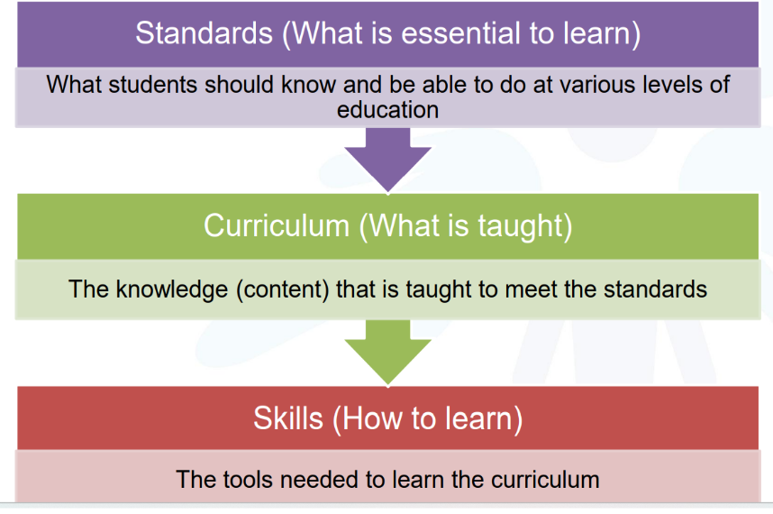
Graphic of Standards Based Goals

Slide 22
SMART Standards Based Goals to Help Ensure Educational Benefit and FAPE

Slide 23
IEP Goals Must Be
Related to the PLAAFP and Evaluation Report.
Written in terms parents and educators can understand.
Instructionally relevant.
Support participation and progress in the general education curriculum.

Slide 24
200.810.b Defines a SMART Goal
  200.810.b.Are written in terms that are:
    200.810.b.(1) Specific to a particular skill or behavior to be achieved,
    200.810.b.(2) Measurable
    200.810.b.(3) Attainable (can reasonably be accomplished within the duration of the IEP)
    200.810.b.(4) Results oriented, and
    200.810.b.(5) Time-bound (generally happen within one(1)year)

Slide 25
An Easy Method to Create SMART Goals
Remember “BCCT” to “B” Compliant
Behavior
Condition
Criteria
Time-bound
Behavior: | Criteria:
Condition: | Time-bound:

Slide 26
BCCT Goal Formula
Who
Student
Behavior
Will do What
Time Frame
In what length of time
Conditions
Under What Conditions
Criteria
To what level or degree

Slide 27
Behavior – What Will the Student Do?
Sally will read
Scott will initiate a conversation
Mary will solve
Matt will verbally answer

Slide 28
Condition – When Will They Do It?
Using what materials – when presented with a 2nd grade non-fiction text
In what setting – on the playground, during unstructured time, during transition time, during instructional time

Slide 29
Condition continued
Under what circumstances
  when given a story prompt
  when given a 10th grade writing stem
With how much support or assistance
  with physical prompt
  with verbal cues
  independently

Slide 30
Criteria – What Level of Skill Proficiency the Student Must Achieve to Meet the Goal?
Be challenging but realistic.
Use baseline data.
Ask yourself why you are setting the criteria where you are.
Can be %, X number of times out of Y, increase/decrease by a certain number.
To close the gap, must make more than a year's gain in a year's time.

Slide 31
Criteria Examples
Trial based: on 9 out of 10 trials
Production: at least 9 exchanges
Percentage: with at least 75% accuracy
Change from baseline: improve by at least 10 %
Behavior change: no more than 3 times per day
Across sessions: on 9 consecutive attempts
Time based: for at least 15 minutes at a time
Grade level: at the 1st grade level

Slide 32
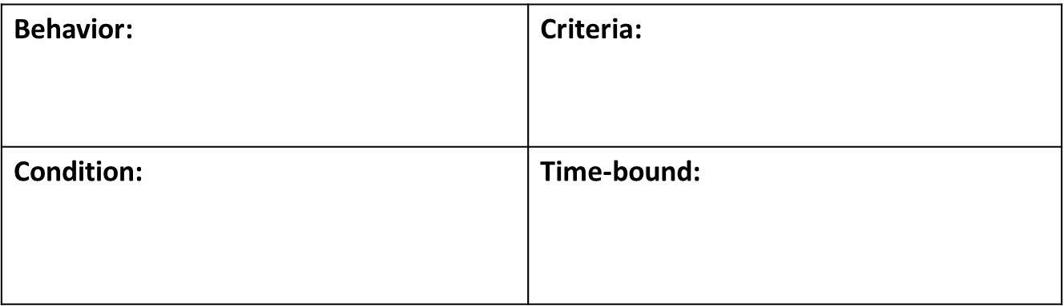
BCCT SMART Goal Example
Draw conclusion using textual evidence
From a baseline of 40% accuracy to 70% accuracy 3 out of 4 trials
When given a 3rd grade level text
During course of IEP

Slide 33
BCCT SMART Goal Example
From a baseline of 40% accuracy to 70% accuracy 3 out of 4 trials
Draw conclusion using textual evidence
When given a 3rd grade level text
During course of IEP
SMART Goal: During the course of this IEP, Amy will increase reading comprehension by drawing conclusions using textual evidence when reading 3rd grade level text from a baseline of 40% accuracy to 70% accuracy on 3 of 4 trials.

Slide 34
Another BCCT Example
Within 1 minute of teacher prompt, on 4/5 data collection days
Start working on task
When given a nonpreferred task (independent math assignment or journal writing)
During the course of this IEP

Slide 35
BCCT with Goal Example
Within 1 minute of teacher prompt, on 4/5 data collection days
Start working on task
When given a nonpreferred task (independent math assignment or journal writing)
During the course of this IEP
SMART GOAL: During the course of this IEP, when given a nonpreferred task (independent math assignment or journal writing assignment), Student will start working on task within 1 minute of teacher prompt as measured by teacher observation 4/5 data collection days per month. Current baseline: student starts work on tasks greater than 3 min after teacher prompting

Slide 36
Let's Talk About Baseline Data
For your goal to be measurable, it MUST have baseline data.
The baseline is the starting point to measure progress on the annual goal.
Baseline data is ACTUAL data, not service provider's best guess and usually not 0%.
Baseline data must be collected in EXACTLY the same manner as the annual goal data will be collected for an apples-to-apples comparison.

Slide 37
A Little More about 0% Baseline
When a goal’s baseline is set at zero, how are you determining if the goal was reasonably calculated to confer meaningful benefit? How can you set a realistic goal?
Team has a duty to develop a goal at the initial team meeting based upon the information it has at the time.
This information comes from the evaluation AND most definitely from the intervention data collected prior to referral.
Tell the story in the PLAAFP.

Slide 38
How Does Goal Progress Connect to FAPE?
“Ultimately, the progress the student makes toward her annual goals is the barometer of whether the student has received educational benefit and whether the student’s IEP provided FAPE. Therefore, the development of reasonable data-based annual goals and the reporting of progress toward them is of extreme importance.”
Dr. Derek Ihori and Dr. Alexia Melara; Your Big Picture, Real-Life Guide to the Entire IEP Process; 2018 LRP Productions

Slide 39
As You Write Goals, Think About
What type of data will be collected for this goal?
Where will the data be collected?
How often will it be collected?
Who will collect the data?
When will the data be reviewed?
If there is a lack of progress, what will be the next step?

Slide 40
Think about how often you are collecting data…
Daily, as part of instruction effectiveness may be determined within 2 weeks.
Twice a week effectiveness determined within a month.
Weekly effectiveness within a quarter.
If you collect data only once per quarter for goal progress, you won’t ever know if your instruction is effective before a new IEP will need to be written and you will have only measured progress 3-4 times…. Your students cannot afford for you to not take data at least every two weeks because students with disabilities don’t have a month, quarter, or year to waste!

Slide 41
Data collection should be:
Systematic
Routinely
used
On-going
Multiple sources
Planned
Are your students involved in looking at the data about their own progress?

Slide 42
Areas of Non-Compliance Related to Goals Which May Decrease Receiving FAPE and Educational Benefit

Slide 43
#1 200.810.b
The IEP includes goals that are written in terms that are SMART.
79 LEAs

Slide 44
200.810.b (1)
  200.810.b.(1) Specific to a particular skill or behavior to be achieved,
  Answers the questions
    “What do we want the student to do?”
    “What specific skills will the student need to do to accomplish the goal?”
  Key word “specific”
  Describes the precise skill or behavior we want the student to do
  Uses an action verb
    Avoid using vague open-ended verbs such as know, understand, appreciate, learn, remember or comprehend
  Skill or behavior must be able to be observed and measured
Reference: ModelTeaching.com

Slide 45
Specific Examples
Specific: Non-examples**
“Increase his Aimsweb reading score to a 334”
“Decrease inappropriate behavior”
“Make and maintain passing grades”
“complete grade level writing assignments”
Specific: Examples**
“Increase his ability to decode words containing long vowel patterns”
“ Decrease incidents of biting when she is asked to transition to a nonpreferred activity (writing)”
“Increase the accuracy of his note taking skills when using a 3 column note taking graphic organizer”
“Increase her sentence composition skills by constructing grammatically correct sentences over given topic”
** These are not complete goals

Slide 46
#2 200.940.c
The content of the progress report includes the progress toward the annual goal(s).
59 LEAs

Slide 47
#7 200.810.a
The IEP includes goals that demonstrate consistency with the content of the present level of performance.
38 LEAs

Slide 48
#12 200.810.e
The IEP includes goals that are present for each special education and related service (n/a for transportation as a related service).
26 LEAs

Slide 49
How Can We Use the Goal Data to Determine Educational Benefit?

Slide 50
What is Educational Benefit?
Educational benefit refers to the extent to which children benefit from their educational experience.

Slide 51
And Remember What We Said Earlier
“Ultimately, the progress the student makes toward her annual goals is the barometer of whether the student has received educational benefit and whether the student’s IEP provided FAPE."
Dr. Derek Ihori and Dr. Alexia Melara; Your Big Picture, Real-Life Guide to the Entire IEP Process; 2018 LRP Productions

Slide 52
Data Collected Drives Decision Making
Data provides information used to drive instruction.
Student progress is considered in relationship to each goal or expected outcome.
Instruction should either change or stay the same based on the data.

Slide 53
Consider These Four Aspects at IEP Time
Progress: Did the student make the progress expected by the IEP team?
Comparison to Peers or Standards: How does the student’s performance compare with the performance of general education students?
Independence: Is the student more independent in the goal area?
Goal Status: Will work on the goal continue or will student be dismissed from this goal?

Slide 54
The EBR Process Requires Teams to Look at Data Across Three Annual IEPs
During these conversations, teams analyze annual goals and progress.
Are the goals becoming more complex as a reflection of student growth?

Slide 55
Think Back to Endrew F.
Has the LEA offered "a cogent and responsive explanation for their decisions that shows the IEP is reasonable calculated to enable the child to make progress in light of his circumstances..." Endrew F vs Hendrick Hudson Central (2017)
The IEP goals are central in answering this question.

Slide 56
Uses for an EBR
Assist LEAs to collect data regarding the impact and quality of the IEP service being offered and implemented
Prepare individual IEP team for an annual IEP review.
Aid the team when a parent shares a concern about their child not making progress or progress has been limited for a student.
Impact and build capacity as a professional development activity to improve the quality of IEP development.

Slide 57
If you are interested in EBR at your district:
Focus is on professional development – not compliance.
Outcomes are student focused as well as system focused.
When we know better, we do better!
Contact your RPDC Consultant to schedule.

Slide 58
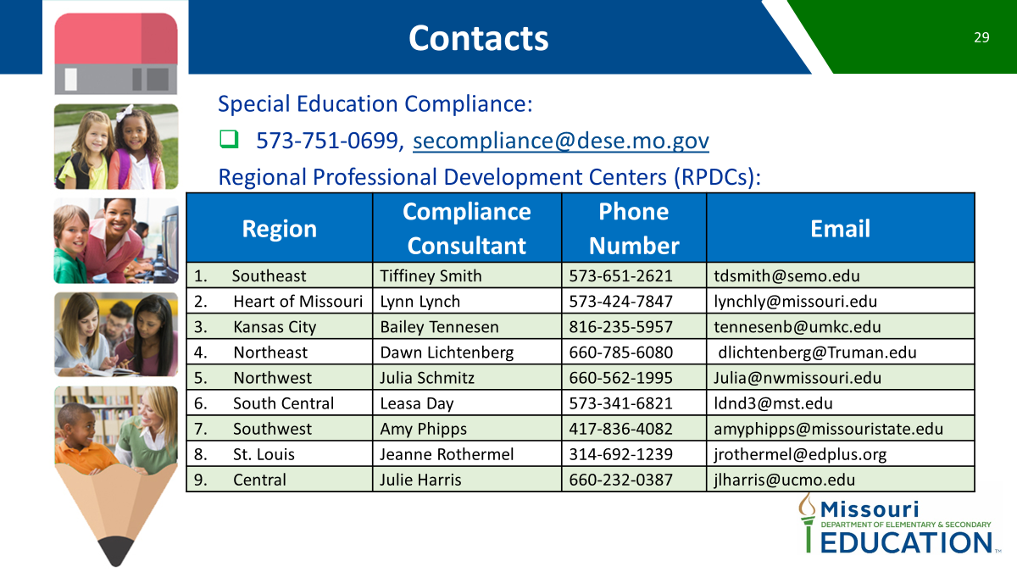
Contacts
Assisting teams in collecting data regarding the impact and quality of the IEP services being offered and implemented.
Preparing an individual IEP team for an annual IEP review.
Aiding teams when a parent shares a concern about their child not making progress or progress has been limited for a student.

