Slide 1
TIERED MONITORING Cohort 3
SELF-ASSESSMENT YEAR
SPECIAL EDUCATION COMPLIANCE
IMACS 2.0 TRAINING & GUIDANCE
2025

Slide 2
Learning Objectives
Participants will learn:
the steps in the special education monitoring process for local agency self-assessment,
the required activities for the self-assessment and their due dates, and
how to find resources for assistance with questions.
Notes:
C

Slide 3
Questions to Be Answered
3
Why do I have to use IMACS2.0?
What is the Parent Special Education Survey?
Where did the Correspondence go?
Where do I go in IMACS2.0 for each step?
Which students do I pick for the Self Assessment Student/File Review?
Why is it not uploading my file?
When do I turn in Timelines? What is the collection period?
Notes:
D
I am going to talk about
1. the steps in the special education monitoring process for local agency self-assessment,
2. the required activities for the self-assessment and their due dates, and
3. how to find resources for assistance with questions.

Slide 4
IDEA SPP/APR Impacts
IDEA SPP/APR identifies certain areas as requiring 100% compliance. These scores are obtained through the Tiered Monitoring Cycle and impact the districts risk factor. During the Self-Assessment File Review, there are FIVE areas identified as “In Compliance or Out of Compliance”
#8 Parent Involvement- The percent of parents who report that the school facilitated parent involvement. This indicator is impacted by the number of Parent Surveys returned.
Notes:
D

Slide 5
IDEA SPP/APR continued
#11 Child Find: The percent of children evaluated within 60 days of parental consent for initial evaluation.
#12 Early Childhood Transition: The percent of children found Part B eligible with IEP implementation by the 3rd birthday.
#13 Secondary Transition: The percent of youth ages 16+ with measurable, annually updated IEP goals and appropriate transition assessment, services, and courses.
#18 General Supervision. % of findings of noncompliance corrected within one year of identification.
Notes:
D

Slide 6
Parent Special Education Survey
We have partnered with the University of Missouri’s Institute of Public Policy (IPP) to conduct the 2025-2026 Parent Special Education Survey.
The survey is mandatory for federal reporting purposes and part of the self-assessment process.
We appreciate your cooperation in administering this important survey to parents in your district.
Notes:
D
The Missouri Department of Elementary and Secondary Education (DESE) has partnered with the University of Missouri’s Institute of Public Policy (IPP) to conduct the 2025-2026 Parent Special Education Survey. This survey is mandatory for federal reporting purposes. We appreciate your cooperation in administering this important survey to parents in your district. The survey is sent out in the fall of the self-assessment year. Surveys are due March 31, 2026.

Slide 7
Parent Surveys
Purpose is to increase parent engagement and provide data for State Performance Plan (SPP) Indicator 8 which states:
Percent of parents with a child receiving special education services, who report school facilitated parent involvement as a means of improving services and results for children with disabilities.
Local Education Agencies (LEA) provide parents with the survey or a survey link, and the parents complete the survey and mail it back to the MU/IPP or submit it electronically.
Local Education Agencies (LEA) will receive the results of surveys to use in planning for increasing parent involvement.
Notes:
C
The purpose of the Parent Surveys is to improve parent engagement in the special education process and to provide data for SPP Indicator 8 which addresses parent involvement and is included in the district’s special education profile.
During fall the University of Missouri will send an email containing the survey information to each director. This email is copied to the superintendent, as well. It will contain instructions, timelines, and district specific surveys. The surveys are available online, but since some parents do not have access to the internet, paper copies are also distributed. The paper copies should be mailed by the parent, not the district, to IPP. It is important to note that each Local Education Agency will receive a copy of their Parent Survey results to assist the Local Education Agency to increase parent engagement and involvement. The results are not parent specific.

Slide 8
Parent Survey Helpful Hints
Some helpful hints and ways to increase response rates:
Provide a translated survey.
Complete the district name and district code sections when providing paper copies.
Provide a pre-addressed stamped envelope when providing a paper copy of the survey. Be sure to provide a survey for EACH child with an Individualized Education Program.
Use school-wide communication systems and specifically communicate with parents of students with an IEP.
Ask parents to complete the survey during conferences and meetings.
Notes:
D
Please read through the helpful hints and implement these to increase response rates.
Paper copy with an envelope to parents at conferences. Parents can return the survey in the sealed envelope to the building office or to the special education department. You can drop the self addressed/stamped envelope at the office for the district to drop in the mail.

Slide 9
Special Education Survey Questions
If you have any problems accessing the site, receiving your response rate information, or have any other questions or concerns, please contact the University of Missouri’s Institute of Public Policy (IPP).
Contact: Rachel Dicke
racheldicke@missouri.edu
Notes:
D

Slide 10
Program Monitoring of Districts
Missouri uses a 3-year cyclical monitoring process. Cohort 3 is beginning their self-assessment year.
The cyclical monitoring process includes:
Self-Assessment (Year 1) (Cohort 3- you are here)
Corrective Action (Year 2)
Maintain & Retrain (Year 3)
Notes:
C
Missouri uses a 3-year cyclical monitoring process. Cohort 3 is beginning their self-assessment year. The cyclical monitoring process includes Self-Assessment (Year 1), Corrective Action (Year 2), and Maintain & Retrain (Year 3). Today we will explain processes for monitoring in Year 1, the Self-Assessment year with file reviews.

Slide 11
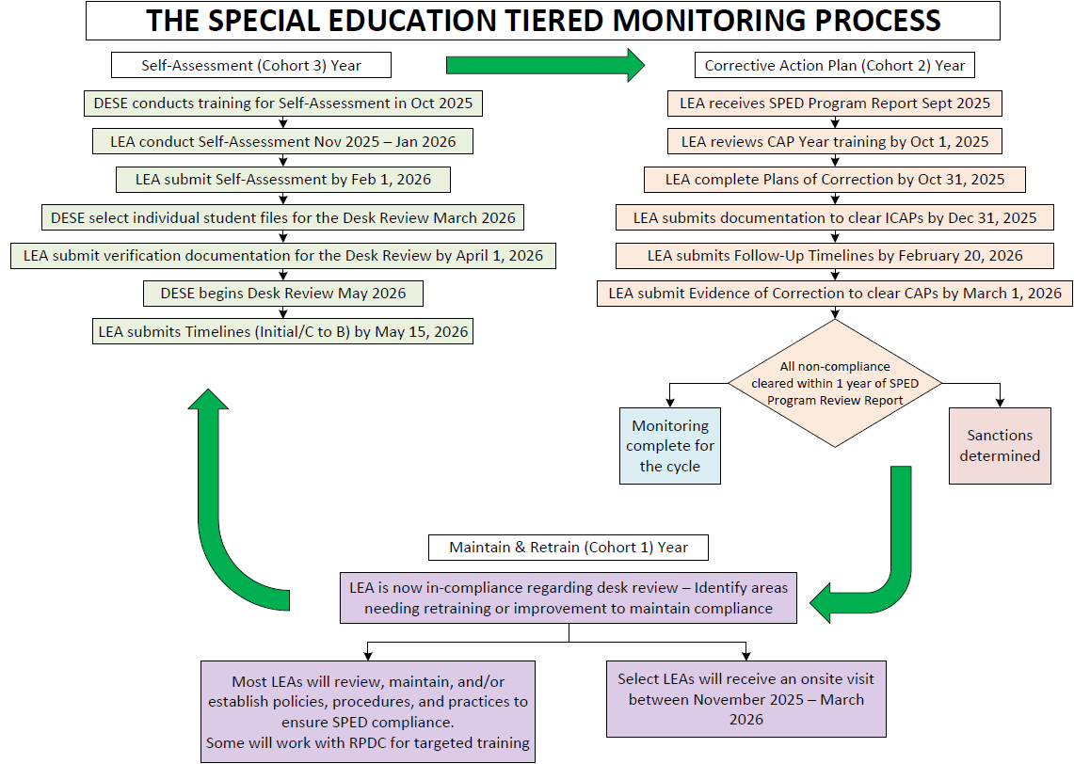
Special Education Tiered Monitoring
Notes:
D

Slide 12
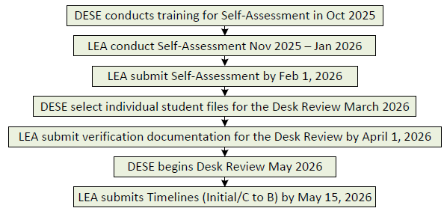
Self-Assessment Year 1
Notes:
D
Here you can see the steps in the Self-Assessment process and the due dates. Today we are conducting the training for self-assessment and will cover each of the other steps in detail. From November to January, you will conduct self-assessments. In February, you will use IMACS 2.0 to submit the Self-Assessment. Districts will be notified when student files have been selected. Districts will be provided with a list of required documents to be submitted in the initial document upload. In April compliance supervisors conduct a review of the documentation districts have uploaded into IMACS 2.0 to determine whether each district has uploaded all of the required information. In May, the compliance supervisors will begin the Student File Review, reviewing student files to determine if indicators are in or out of compliance. On May 15, you will submit Initial Timelines and C to B Transition through IMACS2.0.

Slide 13
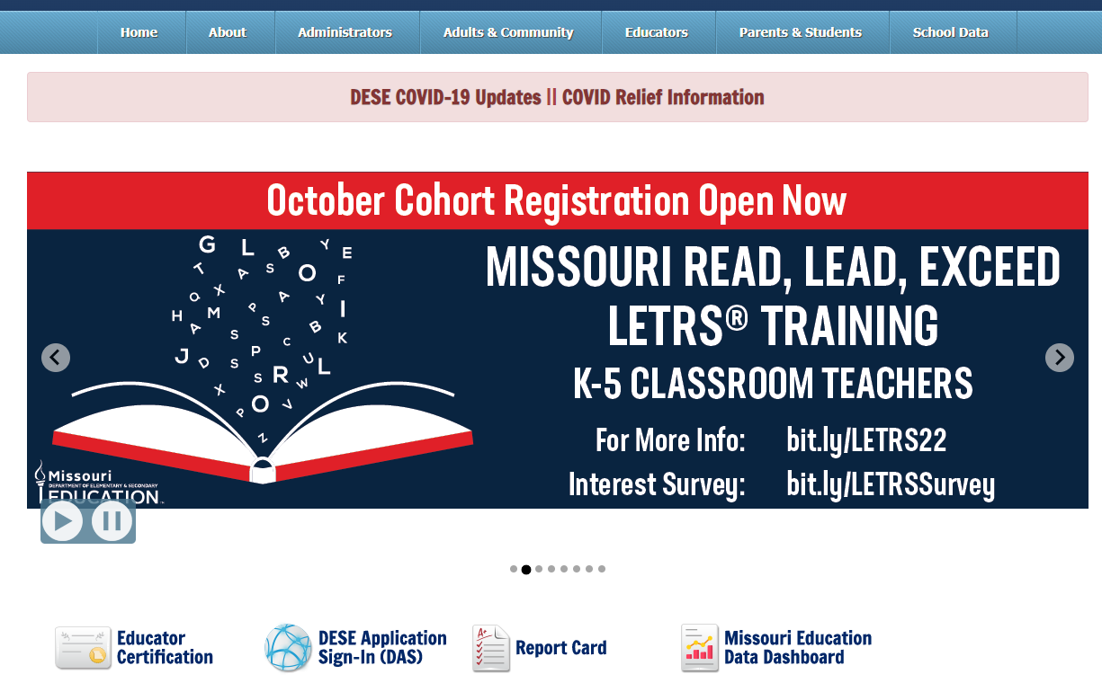
How to Find IMACS 2.0
Notes:
C

Slide 14
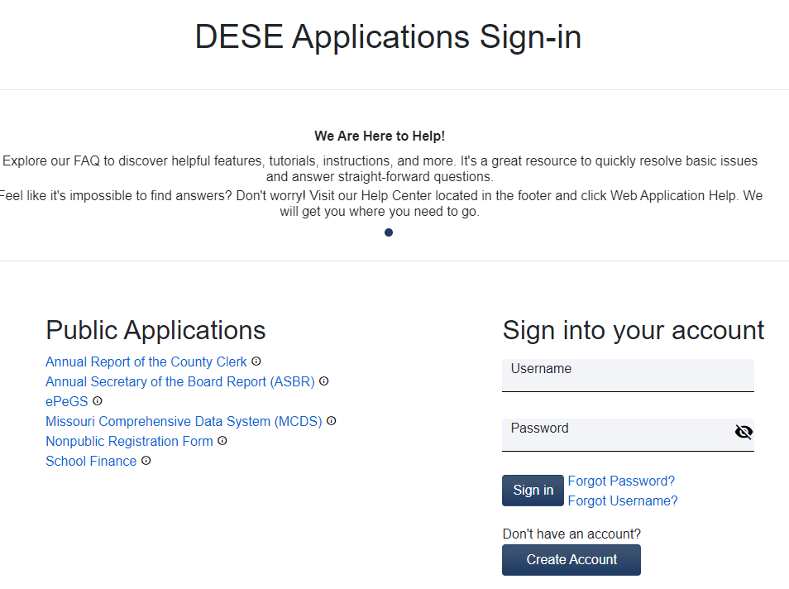
Gaining DESE Applications Access
If you have not had previous access to DESE Applications, you will need to request access before you can use IMACS 2.0. You will need to create an account.
Notes:
Create Account
C

Slide 15
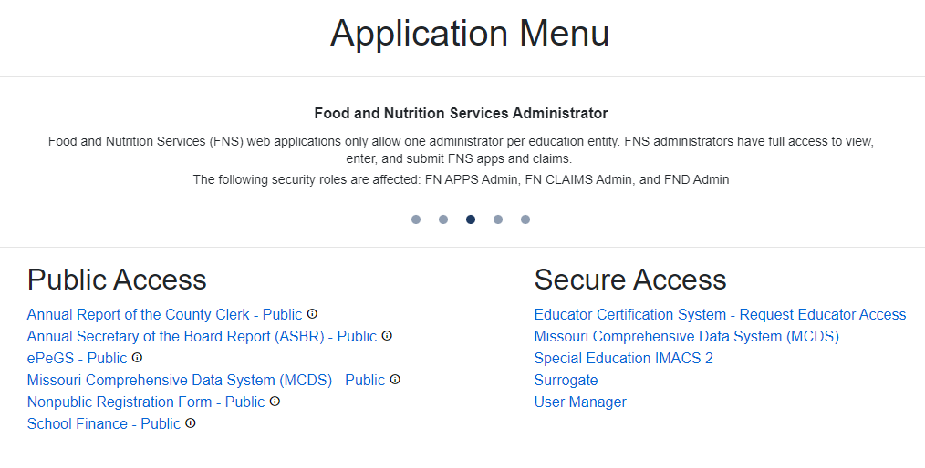
IMACS2.0 Secure Access
Once you have created your account and been granted access: Click on the Special Education IMACS2
Notes:
D
The list of applications is dependent upon what User Access level you have been granted. Contact your User Manager if you do not see Special Education IMACS 2.0 on your screen.

Slide 16
Access in IMACS 2.0
There are two access levels in IMACS 2.0:
User Manager access includes permissions to all functionality in IMACS 2.0, including the ability to grant access to users at the district
User access includes permission to view only or update specific modules in IMACS 2.0
Notes:
C
Your superintendent will assign you the level appropriate for your position and needs.
Notes - Your district will assign the level appropriate... (fyi it is not always the superintendent in each district.)

Slide 17
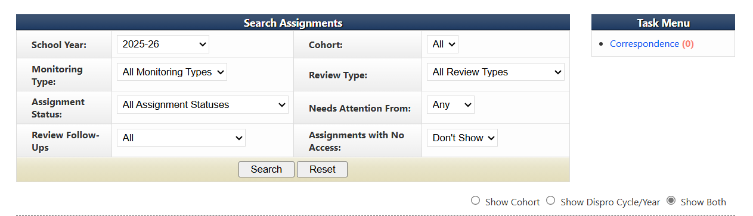
IMACS 2.0 Monitoring School Year
Check the year
Notes:
C
Update the year

Slide 18
Features in IMACS 2.0
All communication between DESE and LEAs regarding compliance monitoring or containing student Personally Identifiable Information (PII) will be housed in IMACS 2.0.
Districts will receive email notifications from IMACS 2.0 when information from DESE is available in IMACS 2.0 (and vice versa).
IMACS 2.0 automatically saves each answer in the file review as it is entered.
Notes:
D
Please use IMACS 2.0 for all correspondence regarding any issue so that we have a collection of all communications in one safe, secure place. Check to see if you are the contact person in IMACS2.0, if not, update the information to ensure you are receiving correspondence.
You will receive notifications via the email address entered by the Local Education Agency in IMACS 2.0. Pay attention to the notification messages so that you are looking in the right place when you open IMACS 2.0. You will get notifications when uploads are requested as well as when there is a communication from DESE to read. If multiple people work within IMACS 2.0 at the district level, the first person who opens new communication needs to make sure the intended receiver knows about it because it will be marked as Read after it has been opened on the district side.
Now IMACS 2.0 automatically saves the information. A box on the indicators page indicates when an auto-save has occurred.
Talk about where you submit correspondence and where to find correspondence, and how the different modules DO NOT communicate.

Slide 19
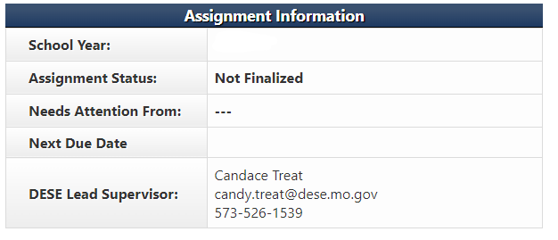
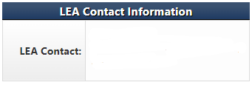
Local Education Agency Contact Information
Notes:
D
When you are the person responsible for self-assessment monitoring, make sure you are listed as the Local Education Agency contact in IMACS 2.0 so you receive email notifications when correspondence is waiting for your review. Be sure to enter Local Education Agency contact information on the Monitoring Module page. Contact information should be copied to the other assignments in IMACS 2.0 (student file review, initial evaluations, C to B Transition, CAP, and ICAP). You can also find the contact information for your DESE Lead Supervisor at the top of each assignment.

Slide 20
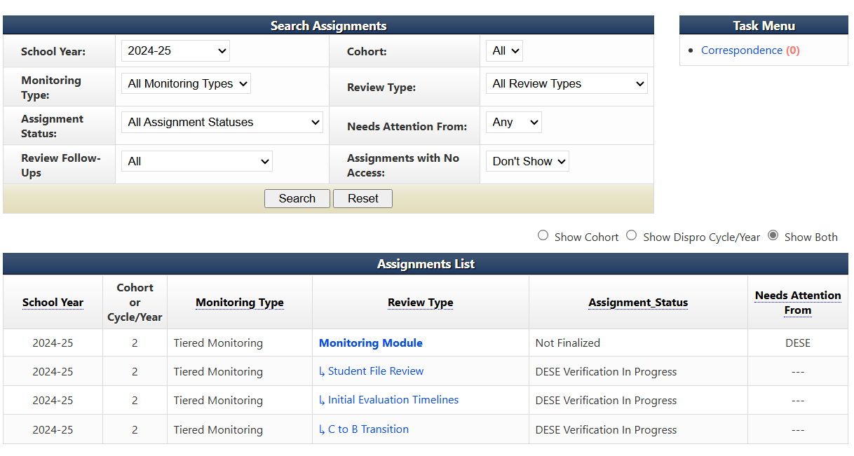
Locating Correspondence
To locate correspondence, from the LEA home page click on Correspondence under Task Menu.
Notes:
D

Slide 21
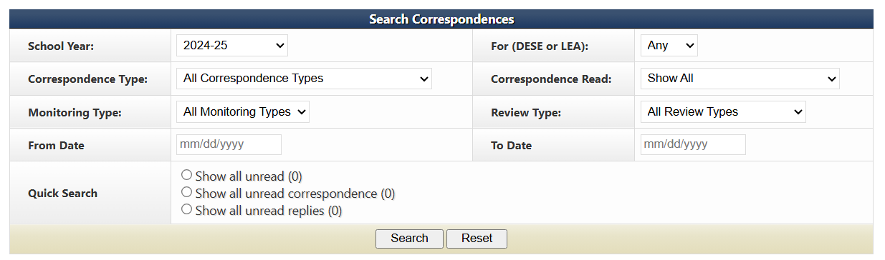
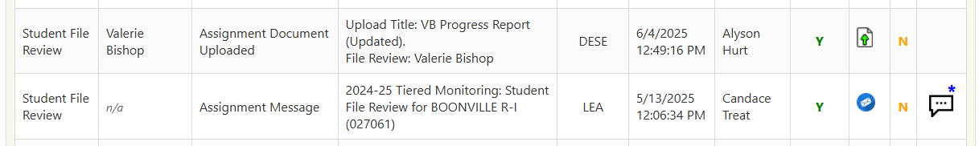
Correspondence Screen
Notes:
D

Slide 22
Monitoring Process

Slide 23


Monitoring Process Umbrella
Monitoring Module
Student File Review
Initial Evaluation Timelines
C to B Transition Timelines
Notes:
C
The Monitoring Module:
The Assignments List gives links to each part of the process. Monitoring Module: The over-arching layer of the tiered monitoring process that encompasses the Student File Review, Initial Evaluation Timelines, and the C to B Transition Timelines. All communication and uploads can be viewed here.
Student File Review: Contains student files selected for self assessment review by the Local Education Agency. Once DESE selects the student file to review documentation is uploaded by the district. Any communication and uploads regarding student files can be viewed here. ONLY once requested you will upload documentation related to student files here.
Initial Evaluation Timelines: Contains student demographics and important dates for all initial evaluations completed between July 1, 2025, and April 30, 2026. Any communication and uploads regarding initial evaluation timelines files can be viewed here.
C to B Transition Timelines: Contains student demographics and important dates for all C to B Transition Timelines completed between July 1, 2025, and April 30, 2026. Any communication and uploads regarding C to B transitions timelines files can be viewed here.

Slide 24
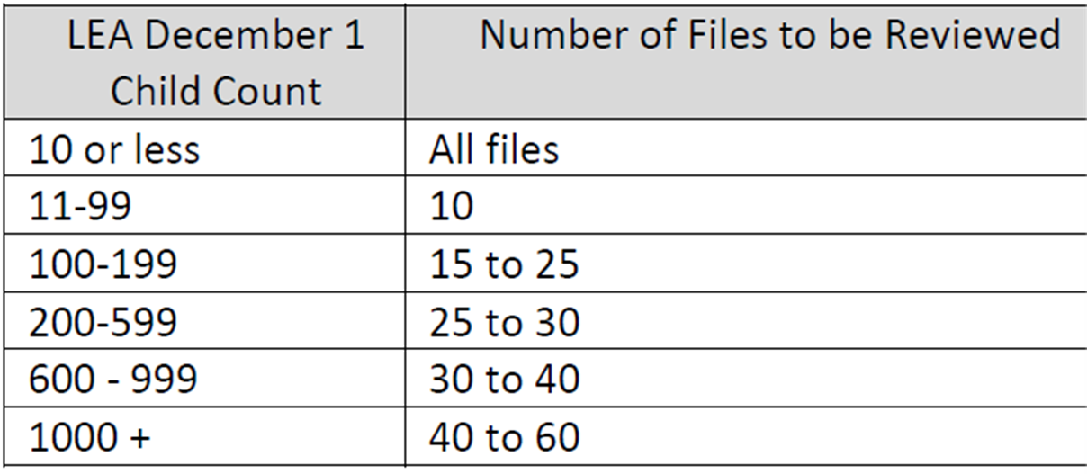
Self Assessment: Number of Student Files Included
Based on the December 1, 2024, Child Count for the agency, the following number of files should be used as a guideline for determining the total number of files included in the self-assessment:
Notes:
D
This slide lists the number of files you will review based on the number of students with IEP’s reported in your most recent December 1 Child Count. This is the number of student files the LEA will use conduct self-assessment. In March, your DESE Lead Supervisor will select from the self assessment files for files to complete the desk review verification. DESE Lead Supervisors will generally select files which serve multiple purposes for review. For example, files for a high-school student would be used to review reevaluation indicators, Individual Education Program indicators, and postsecondary transition indicators. This chart is posted on our website.

Slide 25
Selecting Student Files
Student files should represent a cross section of:
Initial evaluation
Reevaluation
Ages
Grade levels
Buildings within the district
ECSE students
Postsecondary transition
Notes:
C

Slide 26
Selecting Student Files Continued
Provide a variety of disabilities and placements.
Some districts will be asked for specific conditional areas.
Select files for students who were evaluated or reevaluated between January 1, 2025, and completed with an IEP in place before February 1, 2026.
Notes:
C
Files chosen for Self Assessment MUST BE :
For INITIAL EVALUATIONS, completed with a current IEP in place and the student currently enrolled.
For Reevaluations- the evaluation must be complete and the student must have an IEP in place, and the student currently enrolled.
For Transition ONLY files, the IEP must be in place, and the student actively enrolled.
If you don’t have files-CALL your DESE Supervisor. DO NOT conduct the self assessment on files that do not meet the criteria until you talk to your DESE supervisor.

Slide 27
Students In an APA or MOCAP
Districts that have full-time students placed in a DESE Approved Private Agency (APA) must include one or more of those students
Resident districts that have full time students enrolled in virtual learning through a Memorandum of Understanding (MOU) or enrolled with a non-hosted Missouri Course Access and virtual school program (MOCAP) provider must include one or more of those students
Host districts that have full time students enrolled with their hosted MOCAP provider must include one or more of those students
Notes:
D
Districts that have full-time students placed in a DESE Approved Private Agency (APA) must include one or more of those students in their self-assessment file review.
Resident districts who have full-time students enrolled in virtual learning through a Memorandum of Understanding (MOU) or enrolled with a non-hosted MOCAP provider must include one or more of those students in their self-assessment file review. A resident district is the public school district or charter school the student would attend if receiving classes in person, and that would receive state aid for the student. These are students who are still ENROLLED in your district, just not in seat.
Host districts that have full-time students enrolled with their hosted MOCAP provider must include one or more of those students in their self-assessment file review. A Host District is the public school district, charter school, or higher education institution that enrolls the student in the online provider’s program.

Slide 28
Students Attending APA or Enrolled in Virtual Learning
Number of students placed in an APA, enrolled in virtual Learning through their resident district, or enrolled in virtual Learning with a host district | Number of files to include in their self-assessment selection
Up to 5 students | 1 or 2 student files
6 to 10 students | 3 or 4 student files
11 to 19 students | 5 or 6 student files
20 or more students | 7 student files
The APA or virtual learning files selected must be an initial evaluation, a reevaluation, or have a postsecondary transition Individual Education Program completed, as described in the selection criteria on slide 22.
Notes:
D
The chart shows you the number of files you should include for your review.
APA or virtual learning files selected must meet the selection criteria outlined on slide 8, such as an initial evaluation, a reevaluation, or having a postsecondary transition IEP completed. There will be an expectation In the documentation for Year 2 that CAP statements will include how virtual providers will be trained and how needed corrections for them would be monitored.

Slide 29
Triennial Waivers and Transfer Students
Triennial waivers are not reevaluations and should not be used for self-assessment.
Transfer students, if they must be used to meet required number of files, contact your DESE supervisor, before conducting the self-assessment.
Notes:
D
DO NOT use files that used triennial waivers. Triennial waivers are not reevaluations.
Do NOT use transfer students, but if they must be used, contact your DESE supervisor.

Slide 30
Required/Conditional Indicators
Required Indicators
Referral (initial only)
Evaluation
Reevaluation
IEP
Present Level of Academic and Functional Performance
Annual Goals and Goal Progress Reports
Postsecondary Transition
Conditional Indicators
MAP-A
Specific IDEA Disability Areas
Long Term Suspensions
(more than 10 days
with a pattern)
Notes:
D
Required indicators are those that every public agency must address through student file reviews.
For the required indicators, the district and the compliance supervisor will review the referral form (initial evaluations only), the evaluation, and the Individualized Education Program, including the postsecondary transition planning and goal progress reports.
Conditional Indicators are those included in the file review only when the district special education performance data reflects the need. Conditional indicators are included when districts do not meet performance targets such as: MAP-Alternate (MAP-A) participation, identification of students in a specific eligibility, or long-term suspensions of students with disabilities.
For a review of students who have been long-term suspended, including records for the student meeting the description in the Special Education Program Review Indicators 300.30 through 300.80 in the self-assessment file review.

Slide 31
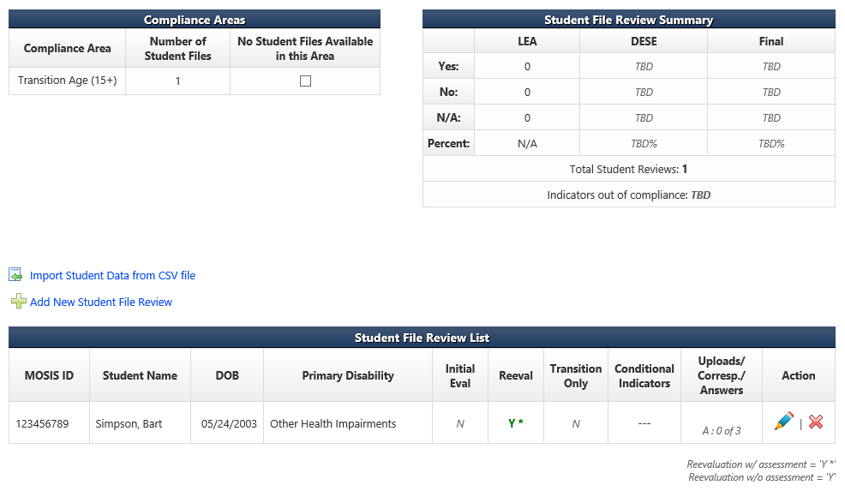
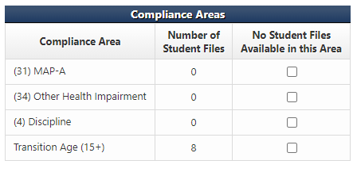
Conditional Indicators Student File Review Page
The Student File Review Summary page is where LEAs add student names and demographic information.
Notes:
D
Conditional areas data codes are listed on the main monitoring page in IMACS 2.0 are generated by the district’s data. The eligibility areas listed are there because the district is over the state incident rate in those particular areas. The DESE reviews initial evaluations as part of the conditional areas to review the district’s eligibility determination process.
In this district’s sample we were looking for Other Health Impairment. The district must go through their files and see if there are any students who have been determined initially eligible as Other Health Impairment since Fall (August) 2024. If there are NO students who meet this criteria and the district has not determined anyone eligible in that category since Fall (August) 2024 then they need to mark the check box on their side of IMACS 2.0 attesting to that fact, that there are NO INITIAL EVALUATIONS conducted where the student was found eligible for OHI.

Slide 32
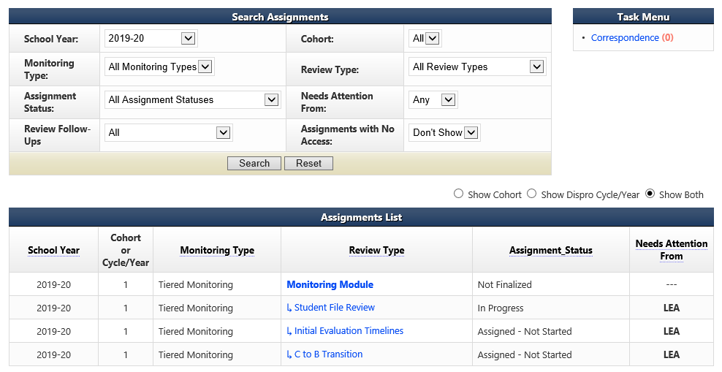
Student File Review Home Page
Add the names of students whose files are being selected by the LEA for self-assessment/file review by going to the LEA home page and clicking on Student File Review.
Notes:
C
Add the names of students whose files are being selected by the Local Education Agency for review by going to the Local Education Agency home page and clicking on Student File Review.

Slide 33


Student File Review Summary Page
The Student File Review Summary page is where LEAs add student names and demographic information.
Notes:
C
There are two ways to enter students on the Student File Review Summary page.
Students are entered by Method 1 or Method 2.
Method 1: Students are added to the system individually: Add New Student File Review (Blue Arrow) or
Method 2: Students are uploaded in the system as a group: Import Student Data form CSV file. (Orange Arrow)
The Local Education Agency can also see their Compliance Areas dashboard on this page. The dashboard has information such as how many of the students they are entering are included in compliance areas such as Postsecondary Transition, MAP-A, Discipline, or various areas of eligibility. If the Local Education Agency is required to include students to meet certain conditional areas it will show up on this dashboard.

Slide 34
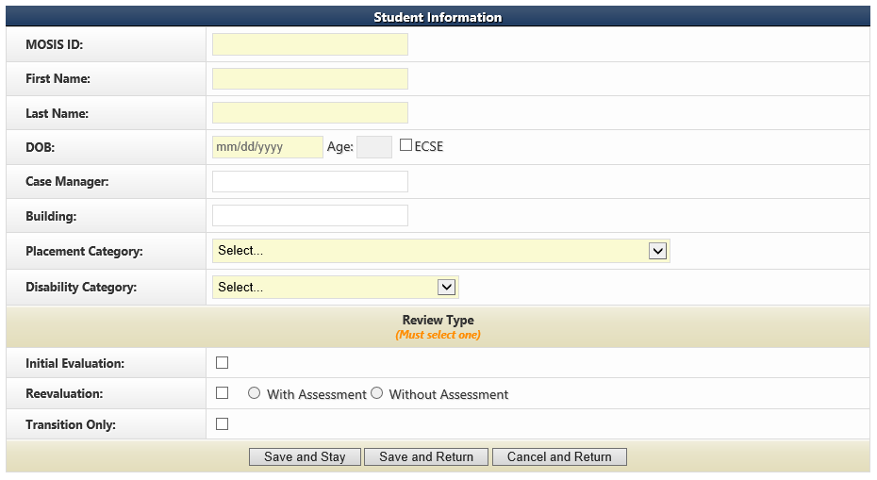
Adding New Students: Method 1
If you decide to enter your student demographics one student at a time in IMACS 2.0, you will do so by clicking on Add New Student File Review. It will bring up the familiar student demographic screen below.
After the LEA has completed filling in the boxes, they need to select either the “Save and Stay” or “Save and Return” button. The “Cancel and Return” button does not save.
Notes:
D
Save and Stay will keep you on this page, Save and Return will return you to the Student File Review Summary, and Cancel and Return will erase what you have typed and return you to the Student File Summary.
Make sure you are reporting your files correctly and ask if you are unsure.
Initial files: The student has never had special education services prior to this IEP, Initial files are NOT students who were identified as YCDD eligible and are changing eligibility NOR are they students changing specific eligibility areas.
Re-evaluation with Assessments: Any re-evaluation in which the district conducted any new assessments. (Including observations)
Re-evaluation without Assessment: Any re-evaluation in which the district determined no new additional data or information is needed and no new assessments were given. This includes when parents bring in new data to consider.
Please ensure that you are indicating the review type correctly. This will impact indicators assigned to the review.

Slide 35
Adding a New Student: Method 2
Notes:
C

Slide 36
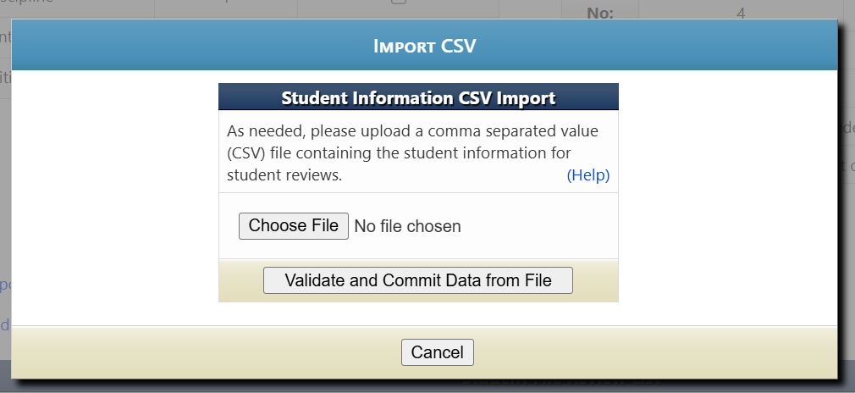
Adding a New Student CSV: Method 2
When importing data for the Self-Assessment File Review through a CSV file, click the “Help” button. This provides the instructions to develop the CSV template for Student Information.
Notes:
D

Slide 37
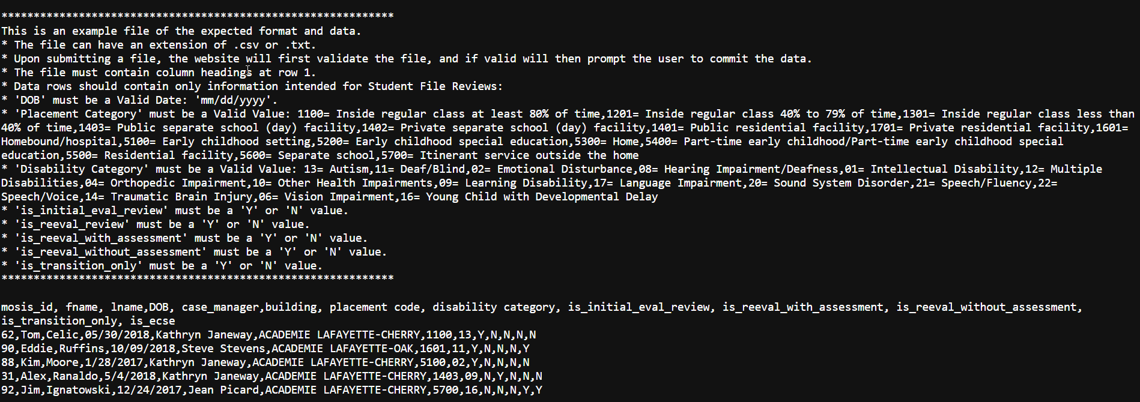
CSV Template Help: Method 2
The Help button will open this screen, providing the steps necessary to create the CSV file.
Notes:
D
If using the CSV file to upload student demographics. Be sure to double check your entries for identifying Initial and Reevaluations, as this is an area that must be accurately marked to ensure the correct indicators are applied.

Slide 38
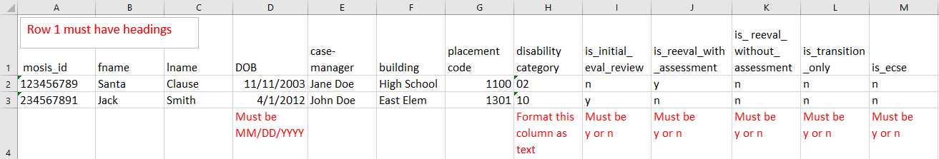
Sample of CSV file: Method 2
The file can have an extension of .csv or .txt.
Upon submitting a file, the website will first validate the file, and if valid will then prompt the user to commit the data.
The spreadsheet should look like this:
Use the codes listed on the next slide for columns G and H.
Notes:
D
Method 2: Students are uploaded in the system as a group: Import Student Data form CSV file.
CSV stands for comma separated values. This type of record uses commas to separate data. If commas are used within a column (for example in the “reason over 60” column) the file will be corrupted.

Slide 39
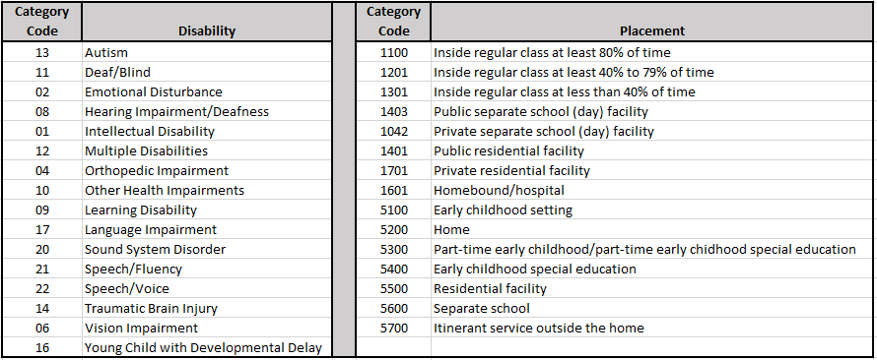
Disability and Placement Codes: Method 2
Notes:
D

Slide 40
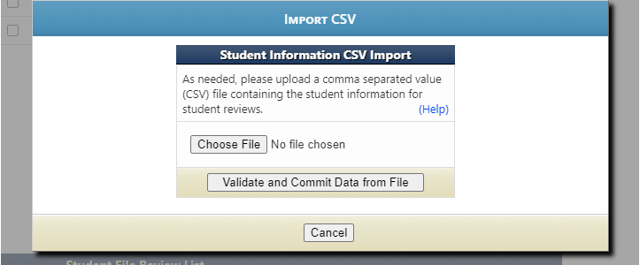
Importing Data from CSV file: Method 2
Click on Choose File to locate the CSV/TXT document and to upload from your computer.
Click on Validate and Commit Data from File once you are finished.
Notes:
D
Click on Choose File to locate the CSV/TXT document and to upload from your computer.
Click on Validate and Commit Data from File once you are finished

Slide 41
File Review: Conducting Self-Assessment
Read the entire indicator.
Refer often to the Special Education Compliance Program Standards and Indicators manual for guidance and clarification. Do not rely only on the IMACS 2.0 checklist language.
Determinations are
  Yes = documentation is present/correct
  No = documentation does not meet compliance
  N/A = indicator doesn’t apply
Notes:
C
When Conducting self-assessment for the file review. Read the entire indicator.
Use the Special Education Program Review Standards and Indicators manual as you review files and are entering responses into IMACS. Do not rely only on the IMACS 2.0 checklist language.
As you review, you will select
Yes = YES means the documentation is present and meets the compliance requirement.
No = NO means the documentation does not meet compliance requirements.
N/A = NA means the indicator doesn’t apply to the special education process for this student.
Give examples of common mistakes by marking “NO” SLD:WE and marking Reading Comprehension NO instead of N/A.

Slide 42
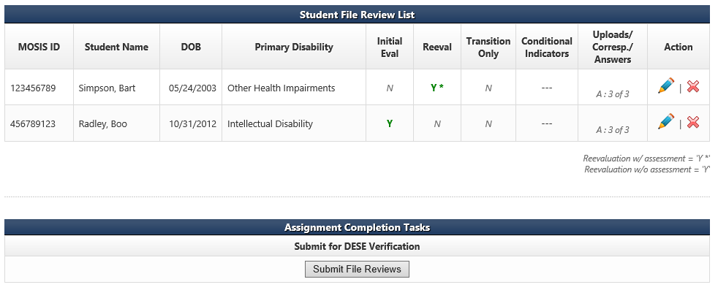
Student File Review Screen, continued
After the district has answered the individual indicators under each individual student on the Student File Review List, the district will need to submit the self-assessment. Complete the review and submit no later than February 1, 2026.
Notes:
C
The Uploads/Correspondence/Answers column shows if all the indicator questions have been answered. (yellow circle)
Once the LEA is sure that it has entered all the required students and answered all the indicator questions, it needs to click on the Submit File Reviews (red circle) button.
It is important to remember that only the Student File Review (Self-Assessment) Assignment is completed and submitted by February 1, 2026. Do not upload any student records. DESE compliance supervisors will request specific student records after March 1, 2026.
Do NOT complete the self-assessment on any file that has not been completed. If the IEP is not in place, don’t use the file for self-assessment.

Slide 43
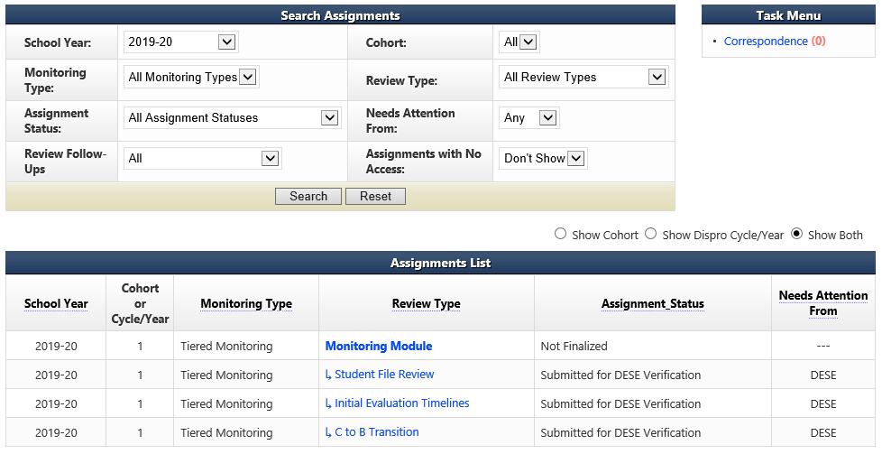
Self-Assessment Completed
Notes:
C
Do NOT worry about this- it is just the next step in the process.
The CAP Year Training & Guidance can be found at https://dese.mo.gov/special-education/compliance/tiered-monitoring-imacs-faqs and is updated for each cohort. You will receive a notification when it is ready, or you can view the date posted next to the documents to ensure it has been updated.

Slide 44
Uploading Requested Student Files

Slide 45
Documentation Request for Selected Students
Upon request by the DESE compliance supervisor, upload, under the student's name, the required documentation specific to the student chosen for the desk file review.
Upload to IMACS 2.0 no later than April 1, 2026.
Notes:
C
Your Department of Elementary and Secondary Education compliance supervisor will request documents used to verify the self-assessment results through the IMACS 2.0 system. Upload documents described in the request for selected students. Make sure all documentation is included, which determines the decision for a particular indicator. For example, be sure to include all the supporting documents for each part of the process being reviewed. For an initial evaluation, you will need the referral form, any other documents such as a contact log that includes the date Procedural Safeguards were provided to the parent, Prior Written Notice for consent to evaluate, Notification of Meeting for the eligibility determination, and the evaluation report.
Upon request by the compliance supervisor, upload documentation into IMACS 2.0 by April 1, from the files of students chosen for the desk review.

Slide 46
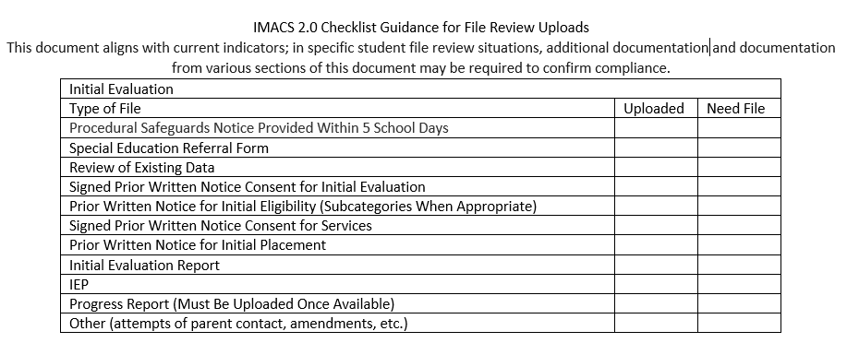
IMACS 2.0 Checklist Guidance for File Review Uploads
Required documentation needed for an Initial Evaluation. The checklist includes the types of files and documentation.
Notes:
C
This checklist will be posted with other self-assessment guidance and training documents. It includes a general list for initial evaluations, re-evaluation with testing, re-evaluations without testing, files containing postsecondary transition, and disciplinary files. Please provide/include the front page of the previous IEP if the date of the previous IEP is not on the front page of the current IEP.
FYI Be sure your PWNs are signed. Remember to provide emails for documentation of electronic signatures, if not indicated on the form.

Slide 47
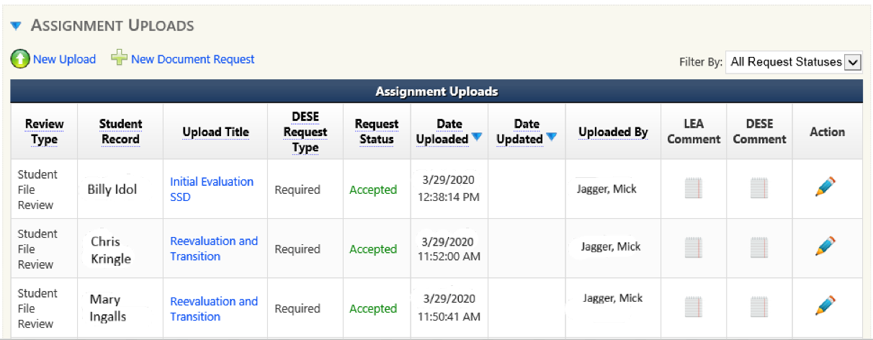
Uploading Documentation for the Desk Review
During late February/early March 2026, districts will be notified via IMACS 2.0 correspondence of the student files chosen for desk review verification. Including required documents to be uploaded.
Student documents should be uploaded under the student file review summary page.
This documentation is due in IMACS 2.0 no later than April 1, 2026.
Notes:
D
MAKE SURE TO SEND ALL DOCUMENTS USED TO MARK INDICATORS!!
At the bottom of the Student File Review Summary page is the Assignment Uploads area. When you click on the blue arrow next to the words Assignment Uploads the document requests from Department of Elementary and Secondary Education will be listed.
Most IEP systems allow users to “print to PDF” rather than print/scan documents.
To open each individual request click on the pencil at the end of the row (green arrow). This will open the Assignment Upload window for that student.
ONLY UPLOAD REQUIRED RECORDS IN THE STUDENT FILE REVIEW,

Slide 48
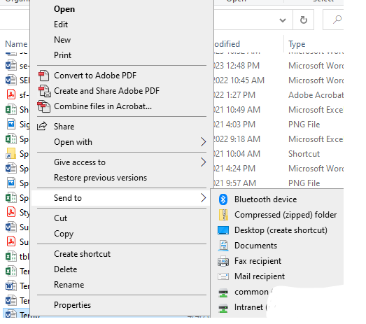
Creating a zip file
Right click on the file or folder. (To select multiple files, hold down the Ctrl key on your keyboard and click on each file you wish to zip. Then right click.)
Select Send to
Select Compressed (zipped) folder
To rename the file, right click on the file and select Rename
You can now drag and drop additional files into the folder
Notes:
D
Right click on the file or folder. (To select multiple files, hold down the Ctrl key on your keyboard and click on each file you wish to zip. Then right click.)
Select Send to
Select Compressed (zipped) folder
To rename the file, right click on the file and select Rename
You can now drag and drop additional files into the folder
Do not use a TIF file. This uses Windows Photo Viewer, and files will be returned.

Slide 49
Upload Quality
Check the quality of your upload. If you can’t read it, neither can we.
Make sure no part of the page is cut off.
Make sure both sides of double-sided copies are scanned.
Make sure there are no missing pages.
Notes:
D
Check the quality of your upload. If you can’t read it, neither can we.

Slide 50
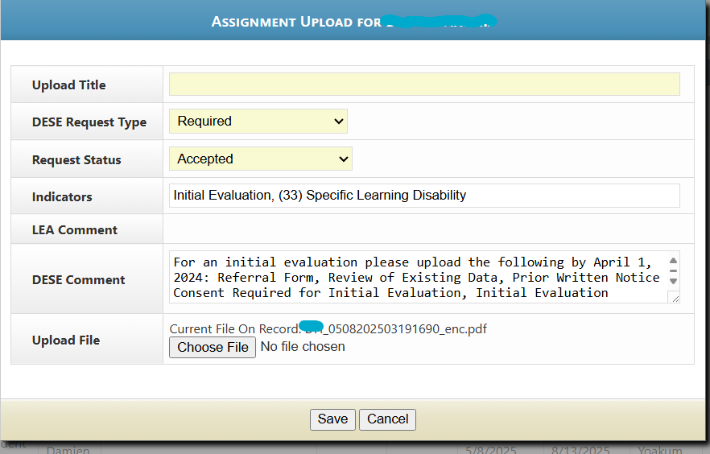
Uploading Documentation
Once the Assignment Upload window has opened, the LEA may upload the required student documents. You will receive one document request per student. It is preferred that all documents needed for verification are merged and uploaded as one file.
Notes:
D
Once the Assignment Upload window has opened, the Local Education Agency may upload the requested student documents. You will receive one document request per student. It is preferred that all documents needed for verification are merged and uploaded as one file, in the order of the special education process, for each requested student. An automated email will be generated to the Supervisor overseeing your district to let them know it is uploaded.
Consider using a ZIP file to upload all required documents in a single upload.
The DESE comment, as seen in this window, includes a list of things that need to be uploaded for that file.
Use the checklist to ensure all documents have been uploaded.

Slide 51
Helpful Hints for Uploading of Documents
Merge all documents into one file for that student’s Document Request.
Send all documents that were used to mark indicators in IMACS 2.0.
Provide meeting notices only if used to answer an indicator
Place documents in the order of the special education process.
Check to make sure each student’s file is 20 MB or less in size. Merging options impact file size.
Make sure each file’s path name is less than fifty characters.
Only upload files under the individual student and NOT the monitoring module or student file review summary page.
Notes:
D
Merge all documents for a specific student into one file for that student’s Document Request.
BE SURE to send all documents that were used to mark indicators in IMACS 2.0.
We only need meeting notices if you use it to answer an indicator. Usually only needed for transition-aged students.
Before merging all of one student’s files together, place them in the order of the special education process.
Check to make sure each student’s file is 20 MB or less in size. Merging options impact file size.
Make sure each file’s path name is less than fifty characters. The location for saving your file prior to upload can lengthen the path name.
Only upload files under the individual student and NOT the monitoring module or student file review summary page.
You might need to speak to your district’s IT manager or administrative staff to find out which program with merge capability is available. Documents may be uploaded as WORD, PDF, or zip files.

Slide 52
Documentation for the Desk Review Verification
DESE supervisors will review and verify each district’s self-assessment in IMACS 2.0 during desk monitoring conducted from April through August 2026.
Provide your DESE supervisor with your summer contact information (Phone #, email address)
Keep an electronic copy of the documents, including those with signatures, in a central, easy-to-access location.
Notes:
C
Compliance supervisors will review and verify each district’s self-assessment in IMACS 2.0 during desk monitoring conducted from April through August 2026.
It is important to provide your compliance supervisor with summer contact info such as your cell phone number or an email address you use in the summer, in case additional documentation is needed to complete the verification or questions arise.
Keep an electronic copy of the documents, including those that have signatures, in an easy-to-access, central location preferably one that can be accessed remotely.

Slide 53
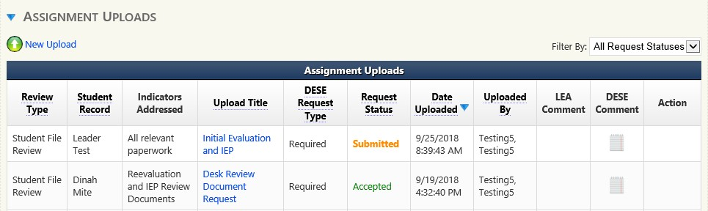
Documentation Request Status
The document status can be found in the Request Status box.
Submitted - Uploaded, but not yet accepted by DESE
Accepted – DESE has reviewed submitted documents
Rejected – DESE has not reviewed the file and returned to the district..
If your file is rejected and you need to upload new information, be aware that you will need to:
1) merge new information into your file and re-upload the entire thing, or
2) upload the missing information under the student’s record or call DESE
Notes:
D
The document status can be found in the Request Status box.
Submitted - Uploaded, but not yet looked at by the Department of Elementary and Secondary Education
Accepted – DESE has reviewed the file, and it seems that everything needed is there.
Rejected – DESE has not reviewed the document and returned to the district.
When a file is rejected, the assigned Department of Elementary and Secondary Education Supervisor will contact you by phone or email to help you understand what to do next.
If additional documents are needed, you will get an email/phone call from your DESE supervisor and a message will be sent through IMACS2.0 as well.

Slide 54
Features in IMACS 2.0
Districts will be able to upload required or requested documentation at any time in IMACS 2.0.
DESE tailors file reviews according to each LEA’s Special Education Performance Data. Districts meeting performance targets have fewer indicators in their self-assessment file reviews.
Notes:
C
If a Supervisor is missing something, they can request a document upload at any time. Use the links provided to upload the requested documents.
DESE tailors file reviews according to each LEA’s Special Education Performance Data. Districts meeting performance targets have fewer indicators in their self-assessment file reviews.

Slide 55
Timelines: Initial Evaluation

Slide 56
Initial Evaluation Timeline Submission
Timeline submissions are due May 15, 2026.
Initial evaluations that began after July 1, 2025, and are finished before April 30, 2026.
Include all students with initial evaluations (ineligible and eligible).
C to B transition students who were evaluated between these dates should be included in the initial evaluation timelines.
Notes:
C
C to B transition student information will be uploaded into the Initial Evaluation Timeline submission once the C to B Transition Timelines are completed.

Slide 57
BE AWARE
Timelines cannot be extended for:
Virtual Schooling- Students attending school virtually are counted as in attendance for reporting and funding purposes. So, it is inconsistent to say a child is attending school but is unavailable for testing.
4-day School Week- the 60 calendar day timeline always includes 5 weekdays even if you are in seat 4 days of the week.
Alternative Methods of Instruction (AMI)- are days when students are receiving instruction and counted in attendance.
Notes:
D
Explain that, district who chose to use the 4 day school week, must count by calendar days- not the days in seat.

Slide 58
Timeline Exceptions
Timelines may be extended for just cause:
school breaks for summer or winter break,
student absences due to illness, and
repeated failure by the parent to make the child available for testing
Districts must document good faith efforts to work with parents to complete assessments. Consider alternative settings or virtual assessments, if necessary, to access the student.
Notes:
C
This does not include teacher illness

Slide 59
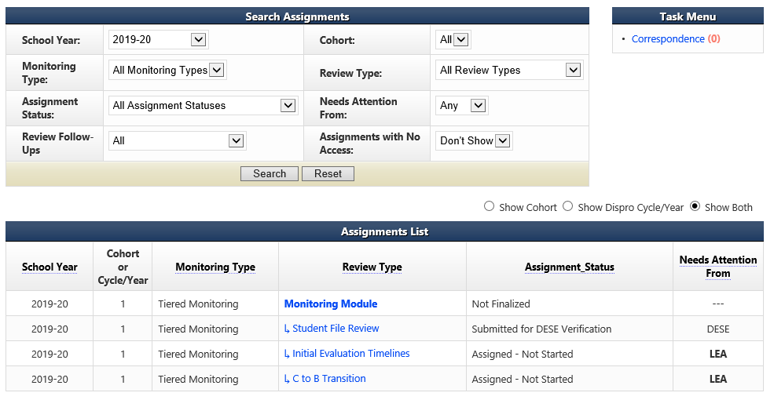
Initial Evaluation Timelines Summary Page
Add Initial Evaluation Timelines information by going to the LEA home page and clicking on the Initial Evaluation Timelines review type.
Notes:
C
Add the Initial Evaluation Timelines information by going to the Local Education Agency home page and clicking on the Initial Evaluation Timelines review type.

Slide 60
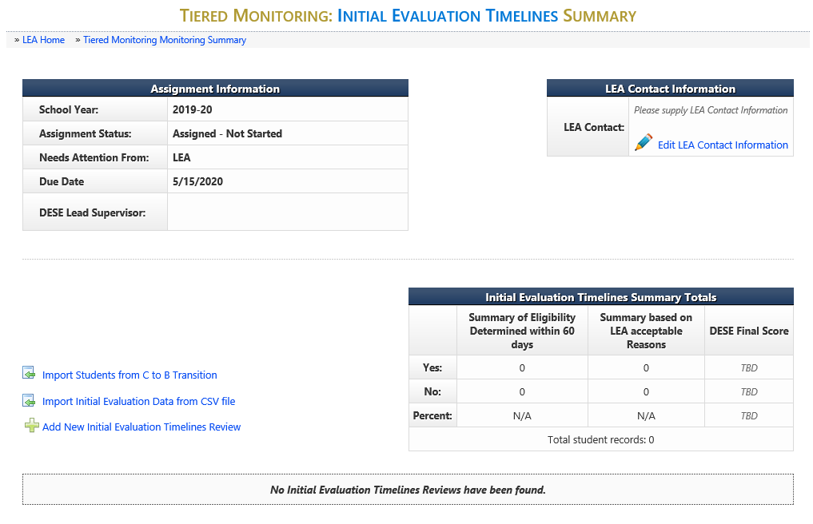
Initial Evaluation Timelines Summary
Notes:
C
There are two options for entering the Initial Evaluation Timeline information now in IMACS 2.0.
Option 1: Add New Initial Evaluation Timelines Review (blue arrow) OR
Option 2: Import Initial Evaluation Data from CSV File (red arrow)

Slide 61
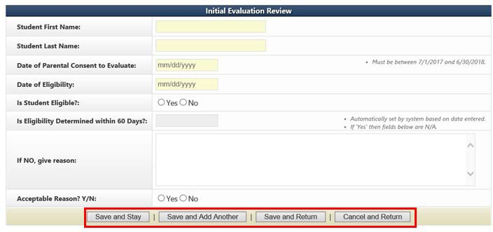
Option 1: Adding New Initial Evaluation Timelines
If you decide to enter your timeline data one student at a time in IMACS 2.0 by clicking on Add New Initial Evaluation Timelines Review then you will see the familiar student demographic screen below.
BAD EXAMPLE 21 vacation days
GOOD EXAMPLE 12/19/24-01/02/25: Christmas Break, 01/16/25: No School, 01/25/25: Snow Day, 01/31/25-02/03/25: student absence, 02/17/25: Professional Development Day, 02/20/25: President's Day
**BE SPECIFIC!
Notes:
D
When the timeline is not met (exceeded 60 calendar days) the Local Education Agency will need to make sure that specific dates that the student was absent or school was not in session are put into the “If NO, give reasons:” box. The compliance supervisor is NOT responsible for reviewing school calendars. Be specific by identifying the days as snow/weather related, student absence, district scheduled out (holiday/PD)
At the bottom of the screen there are many save options. Save and Stay will keep you on the same page after saving. Save and Add Another will save the student you just finished working on and give you a new student demographic screen to begin the next student. Save and Return will save the student you just finished working on and then take you back out to the main timeline page.
As you enter students you do have the option to edit (pencil icon) or delete (red cross) your entry on the right hand side of the main Initial Evaluation Timeline Summary page.
Remember the only weekends that are counted as an exception are the weekends included in the scheduled winter break.

Slide 62
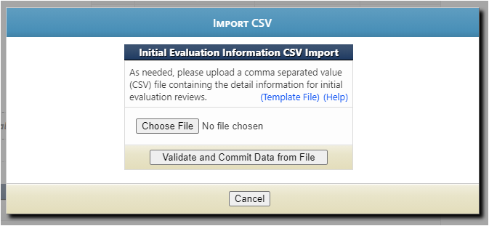
Option 2: Importing Data from CSV file
Click on the Template File (yellow arrow) to use the blank Excel template.
Click on the Help (green arrow) to read the directions for preparing the CSV/TXT upload.
Click on Choose File (blue arrow) to locate the CSV/TXT file to upload from your computer.
Click on Validate and Commit Data from File (orange arrow) once you have uploaded your file.
Notes:
D

Slide 63
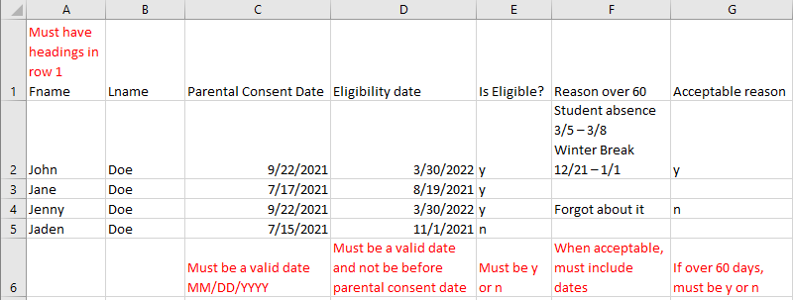
CSV/TXT File Template for Initial Evaluation Timelines
The file can have an extension of .csv or .txt.
Upon submitting a file, the website will first validate and, if valid, will then prompt the user to commit the data.
Data rows should contain only information intended for Initial Evaluation Reviews.
If 'Is Eligible' is 'N' the remaining fields are not required
'Reason 60 Days' column is only required if student eligibility was not determined within 60 days.
When you list an acceptable reason in the ‘Reason 60 Days’ column, you also need to list the applicable dates. Be sure there are NO COMMAS or SPACES at the end of each data field.
Notes:
D
CSV stands for comma separated values. This type of record uses commas to separate data. If commas or spaces are used within a column (for example in the “reason over 60” column) the file will be corrupted.
When the timeline is not met (exceeded 60 days) the Local Education Agency will need to make sure that specific dates that the student was absent or dates school was not in session are put into the “If NO, give reasons:” field. Do NOT use any commas within dates. Do not use any commas or hard returns within the description of the reason why the evaluation exceeded 60 days. Using commas and hard returns will result in data corruption in your upload because the system uses commas to separate the data being reported.
The system will allow as many CSV/TXT imports as needed. It will take the file and add the data to the existing records with no overwriting of previous information. Please review records in IMACS2.0 to make sure that there are no duplicates before submitting the Timelines for review.
After student timelines have been uploaded, you do have the option to edit (pencil icon) or delete (red cross) your entry on the right hand side of the main Initial Evaluation Timeline page.

Slide 64
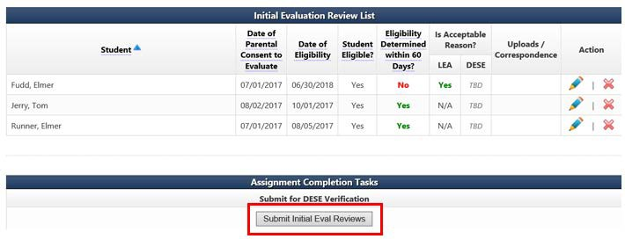
Submitting Initial Evaluation Reviews
After the district has entered the individual student information, the district will submit the Initial Evaluation Review.
Notes:
D
After the district has entered the individual student information, the district will submit the initial evaluation review.

Slide 65
Timelines: C to B Transition

Slide 66
Part C to Part B Timelines Submission
Timeline submissions due May 15, 2026.
    Include all students referred from Part C whose referral date falls within the data collection period and whose 3rd birthday is prior to April 30, 2026.
    For C to B transition students who were evaluated between these dates they should be included in the initial evaluation timelines.
Data collection for timelines will cover the period beginning July 1, 2025 and ending April 30, 2026.
Notes:
C

Slide 67
C to B Transition Summary Page
Add the C to B Transition Timelines information by going to the Local Education Agency home page and clicking on the C to B Transition review type.
Notes:
C
Add the C to B Transition Timelines information by going to the Local Education Agency home page and clicking on the C to B Transition review type.

Slide 68
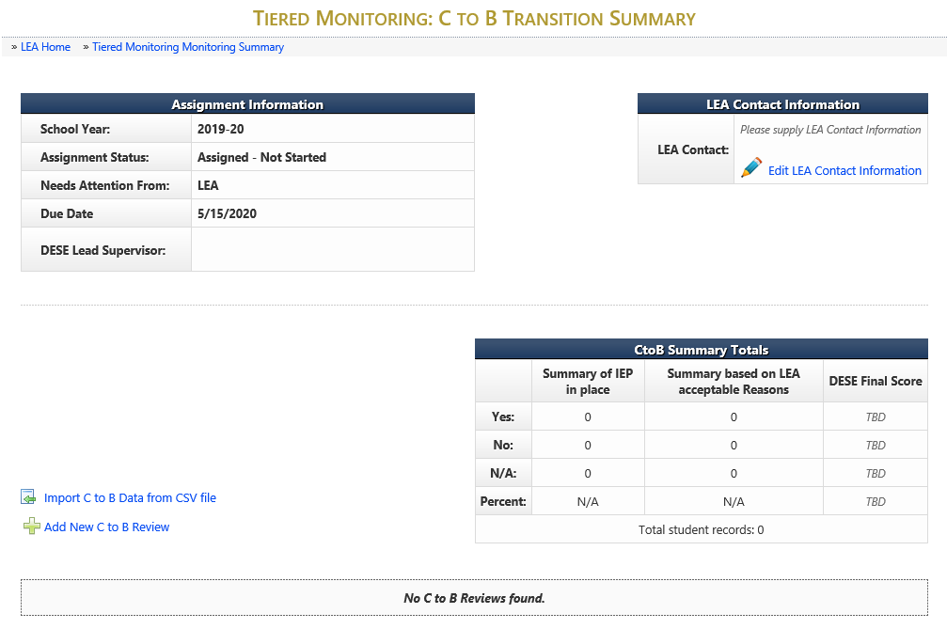
C to B Transition Summary
Notes:
C
There are two options for entering the C to B Transition information now in IMACS 2.0.
Option 1: Add New C to B Review (blue arrow).
Option 2: Import C to B Data from CSV file (red arrow)

Slide 69
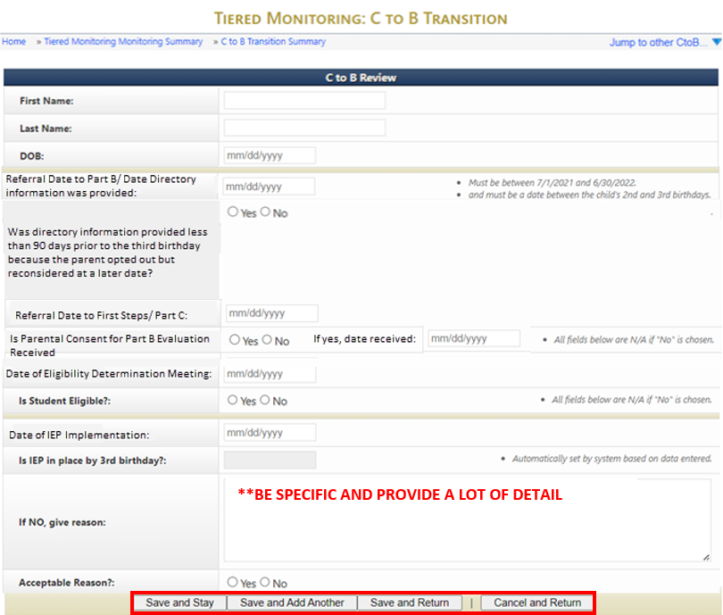
C to B Transition Review
Once completed, select the “Save and Stay,” “Save and Add Another,” or “Save and Return” button.
Notes:
D
Special Ed Referral Date and First Steps Referral Date are two different dates!
Special Ed Referral Date is the date the Local Education Agency received the directory information from First Step.
First Steps Referral Date is the date that the child was first referred for First Steps services.
When the IEP is not in place by the 3rd birthday, the Local Education Agency must provide specific, detailed reasoning in the “If NO, give reason” box.
If the student’s birthday is on a weekend and the IEP is held on the Friday before, you can use that Friday as the implementation date or implement the IEP on the next school day. Be give a specific reason for the IEP not being in place prior to the third birthday, if it is not in place.
Give specific reasons for NO, to justify the reasoning.

Slide 70
When IEP is not in place by 3rd Birthday
Must provide specific, detailed reasoning in the “If NO, give reason” box.
Reasons may include:
Child referral to Part C less than 90 days before the third birthday
The parents opted out of providing directory information to part B and then changed their minds less than 90 days before the third birthday
Delay in providing consent or parents refusing to provide consent
Children with summer birthdays whose parents chose to continue early intervention services
Notes:
D

Slide 71
Other Helpful Hints for C to B
When the C to B Referral is LESS than 90 days, and the 30-60-30 timeline is followed, the C to B student is still entered as a C to B Transition.
If the student is NOT a First Steps transition and are 3, they are included in the Initial Evaluation Timeline.
Reason for NOT meeting timelines, should include specific dates and information supporting the reason.
Notes:
D

Slide 72
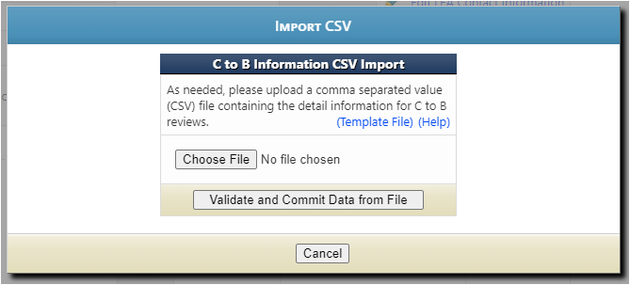
Importing Data from CSV File
Click on the Template File (yellow arrow) to use the blank Excel template.
Click on the Help (green arrow) to read the directions for preparing the CSV/TXT upload.
Click on Choose File (blue arrow) to locate the CSV/TXT file to upload from your computer.
Click on Validate and Commit Data from File (orange arrow) once you have uploaded your file.
Notes:
D
Click on the blue Template File to use the blank Excel template that Department of Elementary and Secondary Education created.
Click on the blue Help to read the directions for preparing the CSV/TXT upload.
Click on Choose File to locate the CSV/TXT document and to upload from your computer.
Click on Validate and Commit Data from File once you are done with everything.

Slide 73
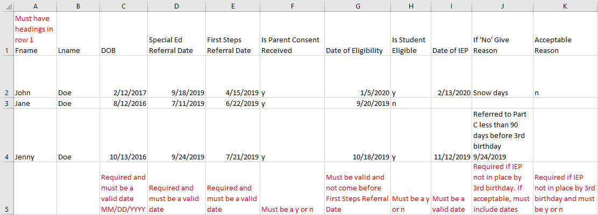
CSV/TXT File Template for C to B Transition Timelines
The file can have an extension of .csv or .txt.
Upon submitting a file, website will first validate and if valid will then prompt the user to commit the data.
Data rows should contain only information intended for C to B Reviews.
If 'Is Parental Consent Received' is 'N' the remaining fields are not required.
If 'Is Student Eligible' is 'N' the remaining fields are not required.
Notes:
D
CSV stands for comma separated values. This type of record uses commas to separate data. If commas are used within a column the file will be corrupted.
When the IEP is not in place by the 3rd birthday, the LEA will need to make sure that specific dates that the student was absent or school was not in session are put into the “If NO, give reasons:” box. Do NOT use any commas within dates or when describing reasons. Do not use hard returns.
Please review records in IMACS 2.0 to make sure that there are no duplicate records before submitting the Timelines for review.
After student C to B Transition Timelines have been uploaded, you do have the option to edit (pencil icon) or delete (red cross) your entry on the right hand side of the main C to B Transition Timeline page.

Slide 74
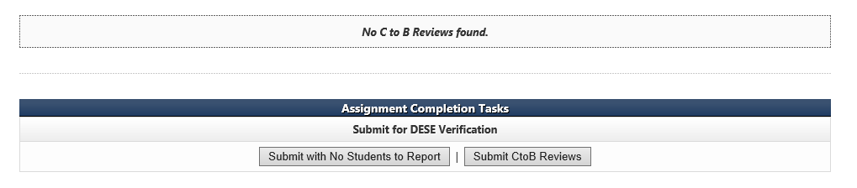
Submitting the C to B Transition Review
After the district has entered the individual student information, the district will need to submit the C to B Transition reviews.
If there are no C to B students, then the LEA will select the Submit with No Students to Report button.
Notes:
C
Do not submit district C to B Transition Timelines early. Timelines are submitted May 15th.

Slide 75
Import C to B Transition into Initial Timelines
Notes:
D
All C to B Transition Timelines are uploaded into the Initial Evaluation Timelines.
Click the Import Students from C to B Transition (orange arrow)

Slide 76
Reminders, Helpful Hints and Guidance

Slide 77
Reminders
All communication between the DESE and the LEA regarding compliance monitoring or containing Personally Identifiable Information (PII) will be housed in IMACS 2.0.
The system will send an email notification to the Special Education contact and DESE supervisor each time information has been submitted or returned.
Districts will be able to upload required/requested documentation to the individual student record at any time in IMACS 2.0. using the provided request link.
Notes:
C

Slide 78
Common Issues
When submitting prior written notices, if the signature line is blank because they were sent electronically, you must also submit a copy of the email in which they were received.
Be sure to submit progress reporting for EVERY IEP, even if it is submitted after the initial file upload.
Make sure that the correct contact information for the LEA is included on every page in IMACS 2.0.
Fill out ALL demographic information for student files.
Be sure to submit a document that states the previous IEP date.
Notes:
D
Read the Slide
Remember to review your files before entering the student demographics. Documentation submitted and opened by Department of Elementary and Secondary Education may be reviewed for compliance.

Slide 79
Helpful Links for Tiered Monitoring
Self-Assessment (Year 1) Guidance and Resources
Self-Assessment Tiered Monitoring with IMACS2.0 Training
Top Indicators Out of Compliance
Top Indicators Out of Compliance PowerPoint
List of Things to Remember for Self-Assessment
Self-Assessment Procedures for Monitoring
Local Education Agency Special Education Compliance Monitoring Checklist
Tiered Monitoring Flowchart
Notes:
C

Slide 80
Resources
Office of Special Education
Special Education Compliance (Part B)
P.O. Box 480, Jefferson City, MO 65102-0480
Phone: 573-751-0699
Email: secompliance@DESE.mo.gov
Notes:
C

Slide 81
RPDC Compliance Consultants
Region | Compliance Consultant | Phone Number | Email
1. Southeast | Tiffiney Smith | 573-651-2621 | tdsmith@semo.edu
2. Heart of Missouri | Lynn Lynch | 573-424-7847 | lynchly@missouri.edu
3. Kansas City | Bailey Tennesen | 816-235-5957 | tennesenb@umkc.edu
4. Northeast | Dawn Lichtenberg | 660-785-6080 | dlichtenberg@truman.edu
5. Northwest | Julia Schmitz | 660-562-1995 | julia@nwmissouri.edu
6. South Central | Leasa Day | 573-341-6821 | ldnd3@mst.edu
7. Southwest | Melynda VanNote | 417-836-4082 | melyndavannote@missouristate.edu
8. St. Louis | Cheryl Garbs | 314-724-6736 | cgarbs@edplus.org
9. Central | Julie Harris | 660-232-0387 | jlharris@ucmo.edu

Slide 82
82
Missouri Department of Elementary and Secondary Education
The Department of Elementary and Secondary Education does not discriminate on the basis of race, color, religion, sex, sexual orientation, national origin, age, veteran status, mental or physical disability, or any other basis prohibited by statute in its programs and activities. Inquiries related to department programs and to the location of services, activities, and facilities that are accessible by persons with disabilities may be directed to the Jefferson State Office Building, Director of Civil Rights Compliance and MOA Coordinator (Title VI/Title VII/Title IX/504/ADA/ADAAA/Age Act/GINA/USDA Title VI), 7th Floor, 205 Jefferson Street, P.O. Box 480, Jefferson City, MO 65102-0480; telephone number 573-522-1775 or TTY 800-735-2966; fax number 573-522-4883; email civilrights@dese.mo.gov.

